Slide 1
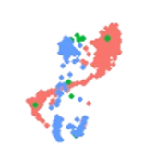
Getting Started with Conda Environments
ReloGene Bioinformatics Pvt. Ltd.

Slide 2
Why Should I Care About Conda?
🧠 Imagine working on two different science projects.
One needs Python 3.10 and Package A
The other needs Python 3.8 and Package B
Running both on the same system can cause conflicts.
#~~~~~~~~~~~~~~~~~~~~~~~~~#
# Conda helps you avoid that. #
#~~~~~~~~~~~~~~~~~~~~~~~~~#
🎒 Conda is like a backpack for each project.
You pack only what you need
Keep it separate from other projects
You can “activate” or “switch” between backpacks anytime
ReloGene Bioinformatics Pvt. Ltd.

Slide 3
What is Conda?
Conda is a tool that helps install software and manage environments
It’s like an organizer for your digital workspace (especially when you working on local device or workstations).
It avoids the headache of software crashes due to mismatched versions.
🔑 Benefits:
No coding errors due to conflicting setups.
Easy to try out new tools without “breaking” your computer (local device/ workstation/HPCs).
ReloGene Bioinformatics Pvt. Ltd.

Slide 4
Think of a House…
🏠 Imagine a house with two separate rooms.
In Room A, the person is very neat – everything is clean and organized.
In Room B, the person is very messy – clothes on the floor, food everywhere.
Even though both people live under the same roof (your system), they don’t bother each other because they are in separate rooms (environments).
🧹 The tidy person keeps their space clean.
🗑️ The messy person does what they want in their space.
Result: No clashes, the rest of the house remains peaceful.
ReloGene Bioinformatics Pvt. Ltd.

Slide 5
Imagine There Are No Rooms…
🏠 What if both people had to live in one big shared space – no walls, no doors?
One keeps cleaning.
The other keeps making a mess.
Soon, they start fighting, arguing, and messing up each other’s things.
💥 This is exactly what happens when you don’t use environments in programming:
Conflicts, errors, broken tools.
ReloGene Bioinformatics Pvt. Ltd.

Slide 6
Conda Environments Keep Things Separate and Safe
Just like rooms in the house, conda isolates each project into its own clean, separate space:
You can install specific tools in each room
Different room can have different versions of Python
What you do in one room never affects the other.
🧳 It’s like giving each person their own backpack, space, and freedom — and your house (computer) stays healthy and sane!
ReloGene Bioinformatics Pvt. Ltd.

Slide 7
Installing Conda (Windows)
*We’ll use Miniconda: a lightweight version of Anaconda
For Windows:
Open your Command Prompt (Search cmd)
Type the following commands:
There are three separate commands:
First command, downloads the miniconda software installer from the internet.
Second command, starts the installation using the downloaded installer.
Third command, deletes the installer since the miniconda is already installed
curl https://repo.anaconda.com/miniconda/Miniconda3-latest-Windows-x86_64.exe -o .\miniconda.exe
start /wait "" .\miniconda.exe /S
del .\miniconda.exe
ReloGene Bioinformatics Pvt. Ltd.

Slide 8
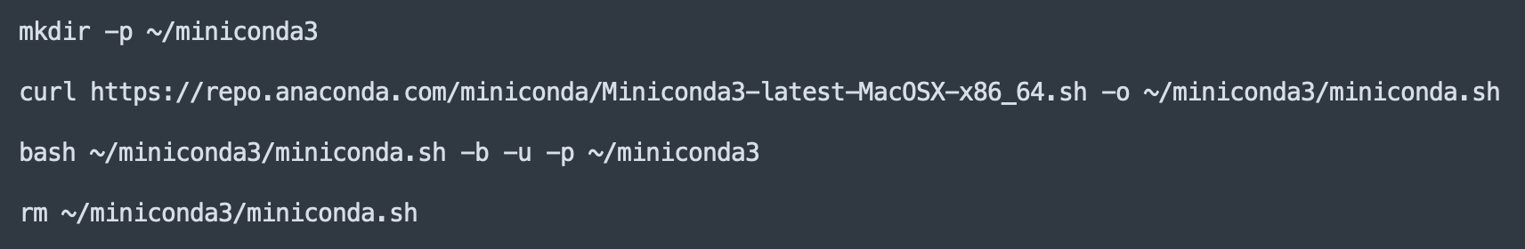
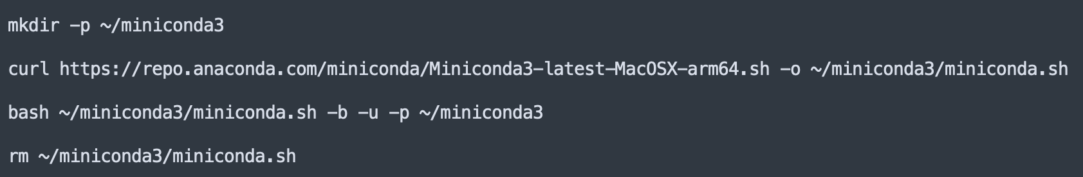
Installing Conda (MacOS)
Same as windows we will be downloading and installing miniconda using the mac terminal.
Since the mac comes in two different kind of chipset (Intel and Apple Silicon) the installation is a bit different.
You can check if your mac has intel chip or Apple silicon chip (M1, M2 or M3) and use the commands accordingly.
For Intel based mac
For Apple Silicon mac
ReloGene Bioinformatics Pvt. Ltd.

Slide 9
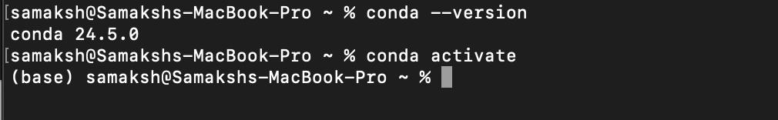
Installing Conda (MacOS)
Once installation is complete:
Restart your command prompt (if Windows) or terminal (if Mac)
Check if the conda is correctly installed by typing the following command:
conda --version
This will print the version of conda installed in your device. Once confirmed run:
conda activate
This command will start the conda base environment(This is your House!)
Once you see the (base); It means that now you are in the House!
This environment is also called the Global environment.
ReloGene Bioinformatics Pvt. Ltd.

Slide 10
Creating New Room
If you remember from our story; we need to have rooms (local environments)in the house(global environment) to prevent clashes between the housemates(Python/Softwares/Tools).
Now to create a local environment we use the following command
conda create --name myenv python=3.11
At some point of creating the conda environment you will be asked to press [y]/[n], Just type ‘y’ and press enter.
ReloGene Bioinformatics Pvt. Ltd.

Slide 11
Creating New Room
Once the installation is complete type the following command:
conda activate myenv
Now you can see that we see myenv instead of base!
Congratulations! Now in our house base, we have successfully created a room myenv !!!
To exit the local environment, type the following command:
conda deactivate myenv
This will bring you out from your local environment (myenv) back to the global environment (base)
ReloGene Bioinformatics Pvt. Ltd.

Slide 12

Congratulations!!!
What we have learned so far:
Installation of miniconda.
Setting up conda base environment (Our house)
Creating new local environment (Our rooms)
Activating and deactivating local environments.
ReloGene Bioinformatics Pvt. Ltd.

