Slide 1
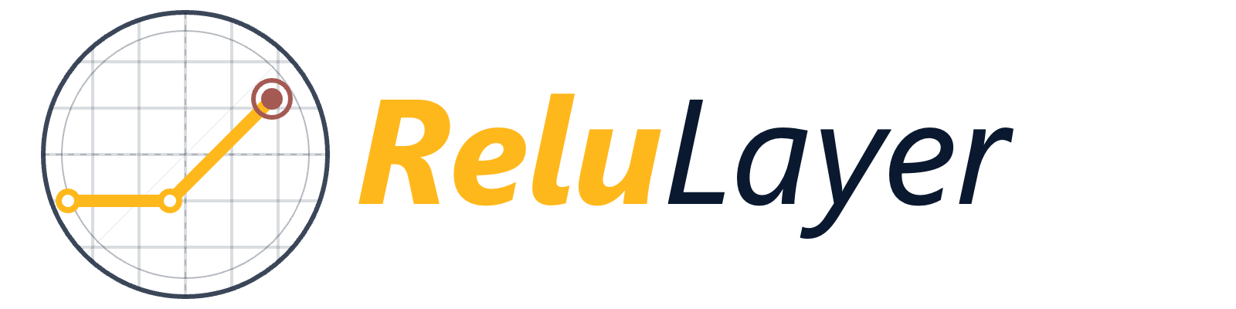
CONFIDENTIAL INVESTOR PRESENTATION
Intelligent Compliance
Automation
for Modern Enterprises
Series A | Q1 2026
For discussion purposes only. Not for distribution.
relulayer.ai

Slide 2
01
SECTION ONE
Your Section
Headline Here
A brief description of what this section covers and why it matters to the audience.
relulayer.ai
2

Slide 3
AGENDA
WHAT WE'LL COVER TODAY
01
The Problem
02
Our Solution
Current challenges in enterprise compliance workflows
How ReluLayer.ai transforms the end-to-end process
03
Market Opportunity
04
Traction & Growth
$14B TAM and competitive landscape overview
ARR, net retention, and enterprise proof points
relulayer.ai
3

Slide 4
THE PROBLEM
CHALLENGES
BUSINESS IMPACT
Manual compliance workflows consume 40% of legal ops time
Regulatory updates arrive faster than teams can track
Cross-jurisdictional complexity creates serious audit exposure
Legacy tools require expensive consultant customization
No single source of truth across regulatory frameworks
$4.5B
Annual compliance cost for mid-market firms
67%
Of legal teams cite lack of automation as top pain
3.2×
Higher audit failure rate: manual vs. automated firms
relulayer.ai
4

Slide 5
TRACTION & METRICS
Numbers That Tell Our Story
ARR
NRR
Customers
$2.4M
94%
48
Annual recurring revenue
grown 3× year-over-year
Net revenue retention
across enterprise portfolio
Enterprise clients across
6 regulated verticals
relulayer.ai
5

Slide 6
“
“
ReluLayer.ai cut our compliance review time by 70% in the first quarter. It's the most impactful workflow tool we've deployed in five years.
Sarah Chen
Chief Legal Officer | Meridian Financial Group
relulayer.ai
6

Slide 7
OUR TEAM
THE PEOPLE BEHIND RELULAYER.AI
JD
MR
PN
TW
Jane Doe
Mark Rivera
Priya Nair
Tom Walsh
CEO & Co-Founder
CTO & Co-Founder
Chief Product Officer
VP Sales & Partnerships
15+ years enterprise SaaS.
Previously [Company Name].
15+ years enterprise SaaS.
Previously [Company Name].
15+ years enterprise SaaS.
Previously [Company Name].
15+ years enterprise SaaS.
Previously [Company Name].
relulayer.ai
7

Slide 8
Let's Build the Future of
Compliance.
hello@relulayer.ai · www.relulayer.ai · Schedule a Demo →
Confidential. For discussion purposes only. Not for distribution.
relulayer.ai

