Slide 1

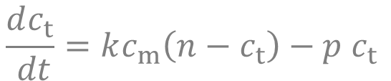




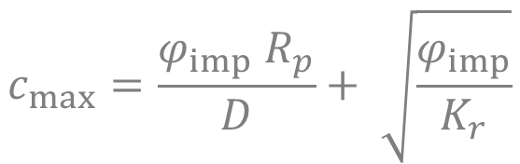

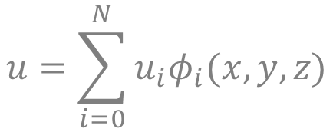
$$\frac{dc_{m}}{ dt}=∇⋅\left(D\left(T\right)∇c_{m}\right)+Γ −∑\frac{dc_{t}}{dt}$$
$$−D\left(T\right)∇c_{m}⋅n=K_{r}c_{m}^{2}$$
$$ρC_{p}\frac{dT}{ dt}=∇⋅\left(λ ∇T\right)+Q$$
$$\frac{dc_{t}}{ dt}=kc_{m}\left(n−c_{t}\right)−p c_{t}$$
$$\frac{c_{m}^{−}}{S^{−}}=\frac{c_{m^{+}}}{S^{+}}$$
$$c_{m}=S\left(T\right)√P$$
$$−λ∇T⋅n=h(T−T_{ext})$$
$$u=\sum_{i=0}^{N}{u_{i}φ_{i}(x,y,z)}$$
$$c_{max}=\frac{φ_{imp} R_{p}}{D}+ \sqrt{\frac{φ_{imp}}{K_{r}}}$$

