Slide 1
Helium bubble density sample 21BT
Aix en Provence 26.02.2021
Mykola Ialovega
CEA Cadarache, IRFM
Université d’Aix Marseille, PIIM laboratory
Supervisors: E. Bernard¹, R. Bisson², C. Grisolia¹
Thesis Director: T. Angot²
IRFM, SI2P, CEA/Cadarache
Université d’Aix Marseille, PIIM

Slide 2
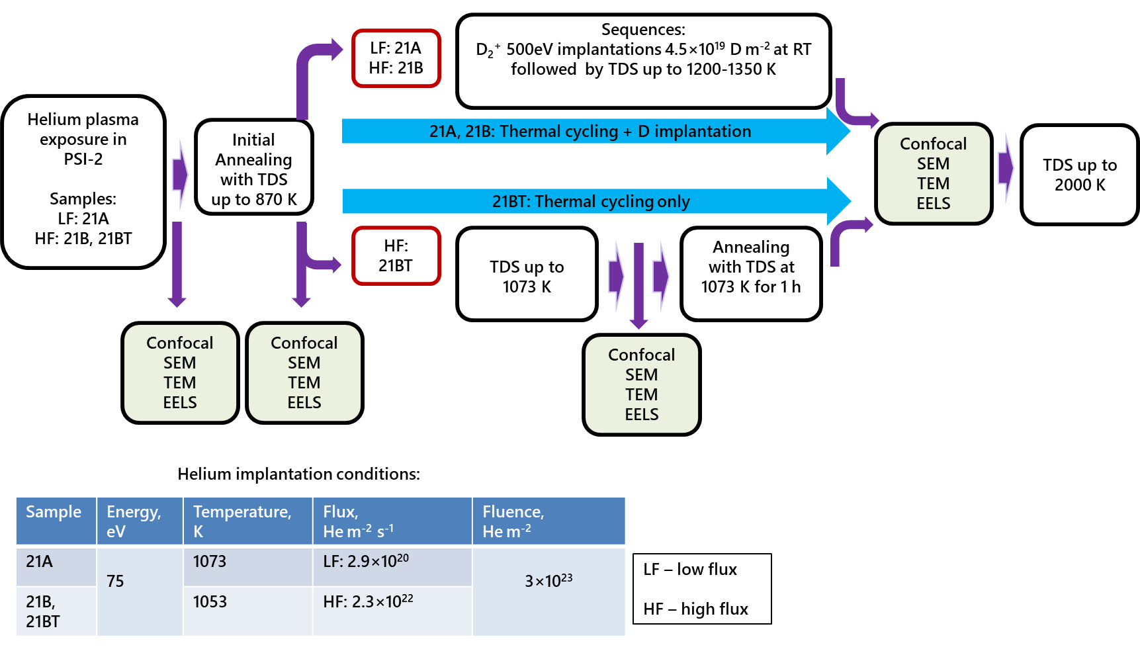
Experimental protocol

Slide 3
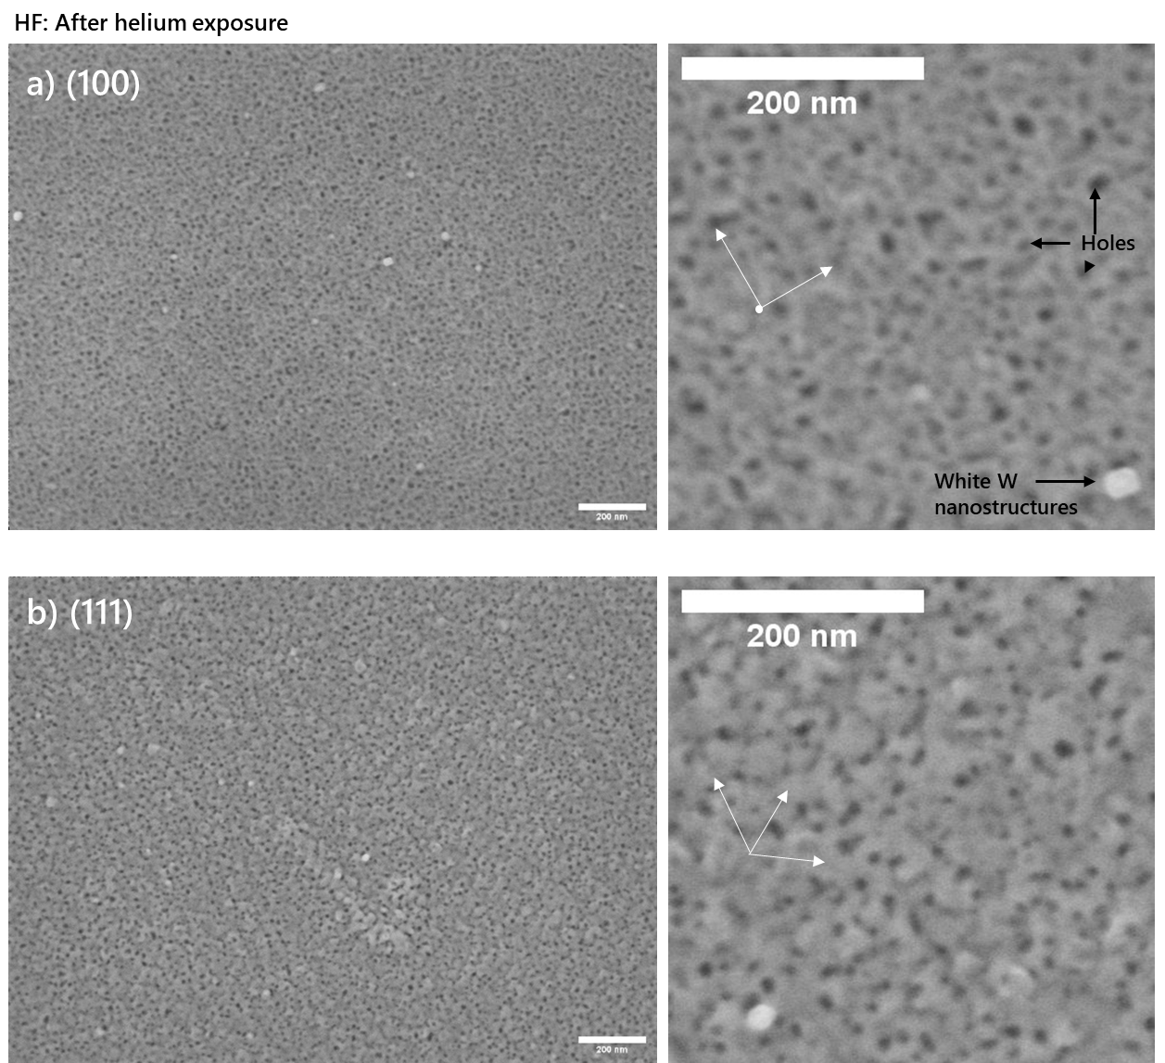
HF after Helium irradiation
HF:
SURFACE (SEM):
Oval-shaped holes
white W particles
undulating surface structure on (111) that is aligned with <100> direction

Slide 4
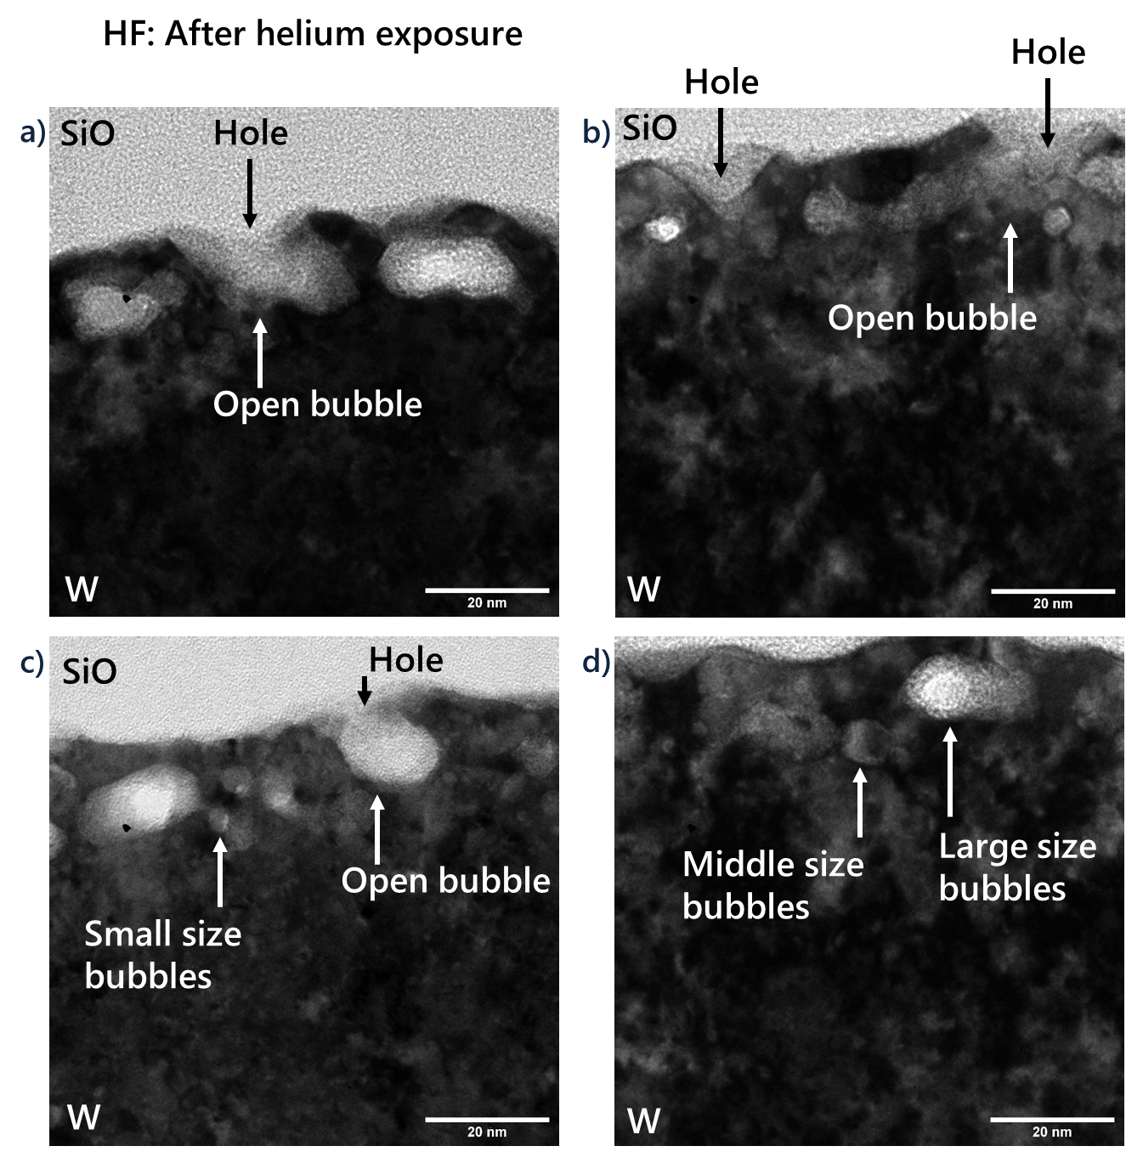
HF after Helium irradiation
HF:
NEAR SURFACE (TEM):
Holes are open bubbles
Bubbles not shaped:
small d<3 nm
middle 3<d<10 nm
large d>10 nm
Many small bubbles close to the surface; up to 40-50 nm below the surface

Slide 5
HF after Helium irradiation: bubbles density
When I do the analysis of the TEM data, the main assumptions are:
Bubbles are spherical: Diameter is recalculated using the area of each bubble However, not all the bubbles are spherical!
In-depth position of each bubble is the distance between the interception point of major and minor radius of the bubble and the surface
The surface is the border line between W (dark contrast) and Pt (brighter contrast) layers (see the previous slide)

Slide 6
HF after Helium irradiation: bubbles density
Bubbles number vs diameter
How many bubbles we cross when we cut the lamella parallel to the sample’s surface (so, density in depth)
Max number of so-called
middle-size bubbles (3-5 nm in diameter)
Max number of bubbles at a depth of ~10 nm below the surface
Bubbles burst when their diameter>distance to the center of the bubble
All bubbles analyzed using one lamella (using 12 under focused and corresponding 12 over focused TEM images):
Note:
The calculation gives good results for bubbles with d>=3nm up to the depth of ~30-40nm

