Slide 1
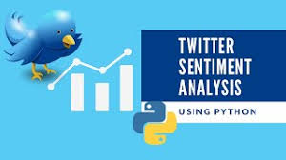
Intro
Build a supervised machine learning model for predicting whether a tweet is offensive.
Develop features that will improve the performance of the model.
Test the model and conduct an error analysis.
Present ideas for improving model performance in the future.
by Tim Poll, Lance Prange, Mani Pola, Remya Ramakrishnan

Slide 2

Exploring and Cleaning the Data
Exploring the Data
Understand how the annotators were classifying the data.
Determine the class balances
Cleaning the Data
Remove noise from the data
Separate punctuation from words

Slide 3
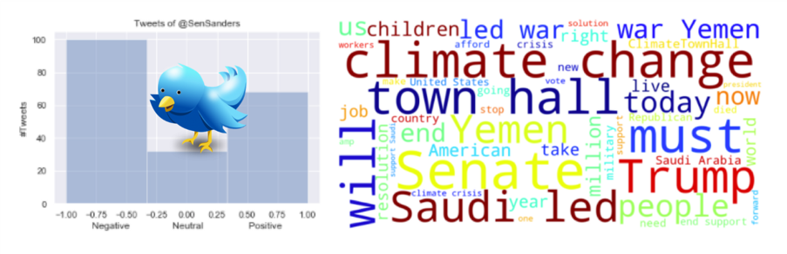
Feature Development Part 1
Lexicon Based Features
Offensive Word Lexicon
Positive Word Lexicon
Commonly Targeted Individuals/Groups Lexicon

Slide 4



Feature Development Part 2
Trump Name Frequency Feature
Exclamation Point Feature
Proper Pronouns Feature

Slide 5
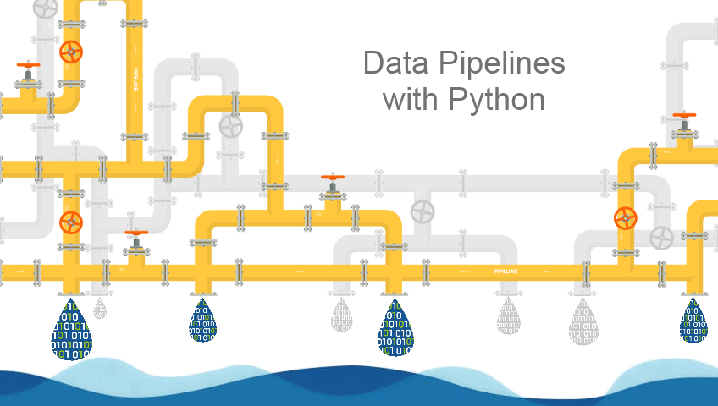
Building the Pipeline
Tools and Methods
Train_test_split
TfidfVectorizer
GridSearchCV
LinearSVC

Slide 6
Results: Feature Scores
Column1 | F1 Micro | F1 Macro | Precision | Recall
Bag of Words (BOW) | 0.7277 | 0.4800 | 0.6193 | 0.4665
BOW + Offensive Word Lexicon | 0.7394 | 0.4901 | 0.6437 | 0.4729
BOW + Exclamation Point | 0.7277 | 0.4800 | 0.6341 | 0.4662
BOW + Trump | 0.7277 | 0.4798 | 0.6193 | 0.4662
BOW + Personal Pronouns | 0.7319 | 0.4780 | 0.6121 | 0.4635
BOW + Positive Word Lexicon | 0.7277 | 0.4804 | 0.6193 | 0.4670
BOW + Targeted Group Lexicon | 0.7300 | 0.4816 | 0.6215 | 0.4678
BOW + Top 3 Features | 0.7387 | 0.4929 | 0.6422 | 0.4736
Tested combinations of features with our bag of words matrix.
Selected top features for highest performing model.

Slide 7

Error Analysis
Validation Data
Ground Truth Frequencies: {'NOT': 1767, 'TIN': 776, 'UNT': 105}
Prediction Frequencies: {'NOT': 2064, 'TIN': 570, 'UNT': 14}
We noticed annotation errors, especially when classifying TIN and UNT.
Our model performed poorly on UNT classification.
F1 Macro score was significantly worse than F1 Micro Score

Slide 8

Accurate annotation is extremely important.
Focus on improving UNT classification.
Offensive tweet classification is a difficult task, but python contains several powerful classification tools.

