Slide 1
Digital Portfolio
STUDENT NAME:REMA FARVEEN SHAHUL HAMEED
REGISTER NO AND NMID: 2426j0219and asbrubd24bscit39
DEPARTMENT: School of computer application
COLLEGE: SHREE Venkateshwara arts and science College/ Bharathiyar university

Slide 2
PROJECT TITLE STUDENT DIGITAL PORTFOLIO

Slide 3


AGENDA
Problem Statement
Project Overview
End Users
Tools and Technologies
Portfolio design and Layout
Features and Functionality
Results and Screenshots
Conclusion
Github Link
3/21/2024 Annual Review

Slide 4

PROBLEM STATEMENT
Without a structured digital
portfolio system:
Students struggle to demonstrate
their competencies beyond grades
and certificates.
Teachers and mentors lack a
centralized tool to evaluate student
progress over time.Without a structured digital
portfolio system:
Students struggle to demonstrate
their competencies beyond grades
and certificates.
Teachers and mentors lack a
centralized tool to evaluate student
progress over time.

Slide 5

PROJECT OVERVIEW
“The Student Digital Portfolio is a dynamic platform that empowers
learners to showcase their academic achievements, skills, and
personal growth in an interactive and professional way, bridging the
gap between traditional records and modern digital presentation.

Slide 6

WHO ARE THE END USERS?
Designed for students to showcase growth,
educators to track progrDesigned for students to showcase growth,
educators to track progress, and parents to witness
achievements—all in one seamless platform.ess, and parents to witness
achievements—all in one seamless platform.

Slide 7

Tools
1. CodePen – For building and showcasing
Small front-end projects (HTML, CSS, JS).
2. GitHub – For storing code, tracking
Versions, and sharing projects.
3. GitHub Pages – Free hosting service to
Publish a personal portfolio website.
4. Google Drive / OneDrive – To store
Certificates, documents, and project
Reports.
Techniques
1. Organize Projects Clearly – Showcase
work by category with short descriptions.
2. Showcase Live Demos – Embed CodePen
projects or use GitHub Pages for previews.
3. Maintain Consistency – Use a clean,
uniform design (fonts, colors, layout).
4. Highlight Skills & Reflections – Link
projects to skills and share learning
outcomes.
5. Keep it Updated – Add new projects,
achievements, and improvements regularly.

Slide 8
FEATURES AND FUNCTIONALITY
1. Project Showcase – Ability to display
projects with descriptions, images, live
demos, and links to source code.
2. Interactive & Accessible – Responsive
design, easy navigation, and multimedia
support (videos, embeds, documents).
3. Professional Connectivity – Integrated
contact section with links to email,
LinkedIn, GitHub, or resume.

Slide 9
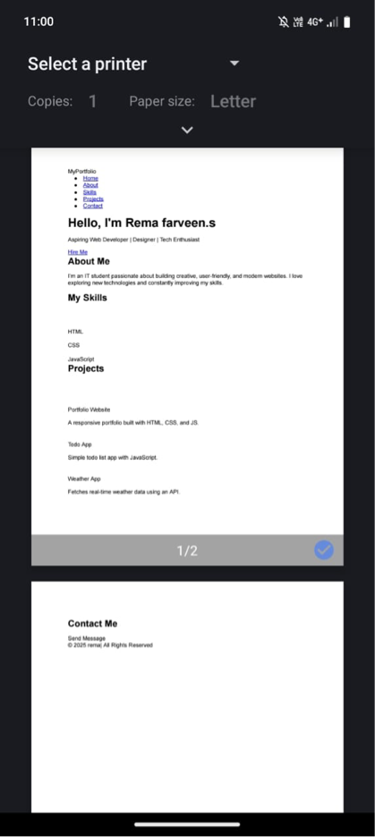

RESULTS AND SCREENSHOTS
3/21/2024 Annual Review

Slide 10
CONCLUSION
This portfolio highlights my growth, skills, and
creativity as a learner. It reflects my progress so far
and my commitment to keep learning, improving,
and taking on new challenges in the future.This portfolio highlights my growth, skills, and
creativity as a learner. It reflects my progress so far
and my commitment to keep learning, improving,
and taking on new challenges in the future.

Slide 11
https://github.com/niharshna-lang/Niharshna.githttps://github.com/niharshna-lang/Niharshna.git

