Slide 1
AGNTCY SDK Evaluation
Multi-Agent Customer Service Platform Implementation

Slide 2
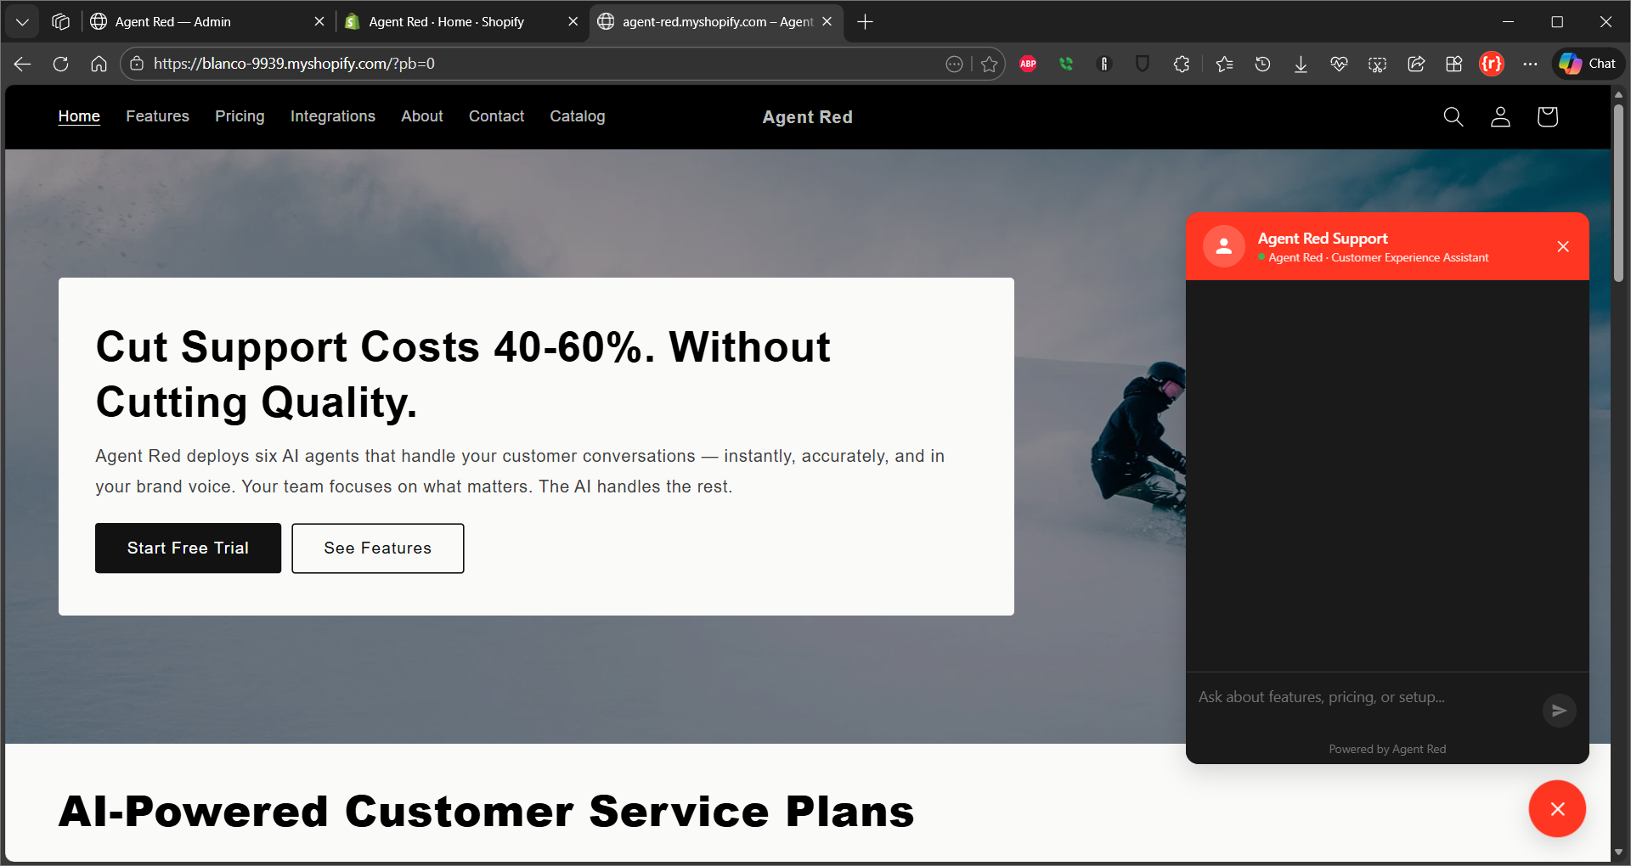

Customer Experience: AI Service Agent with Persistent Customer Memory

Slide 3
KEY BENEFIT 1 OF 3
AI that remembers every customer
Persistent Customer Memory
Builds a profile from every interaction automatically
Recalls purchase history, preferences, and context
Personalized from the first message
4-layer memory: profile, history, patterns, dedicated AI
No competitor offers per-customer AI memory

Slide 4
KEY BENEFIT 2 OF 3
Instant answers, always on
6-Agent AI pipeline
Intent classification routes queries in milliseconds
Knowledge base search with hybrid AI retrieval
Real-time streaming responses via SSE
Safety-first: every response validated before delivery
< 2 second response time, 24/7/365

Slide 5
KEY BENEFIT 3 OF 3
One dashboard, complete control
Built for Shopify merchants
Conversation inbox with full customer context
Knowledge base with document upload and AI search
Widget customizer with live preview
Usage analytics, team management, and billing
Starting at $149/mo: 4 to 21x cheaper than competitors

Slide 6
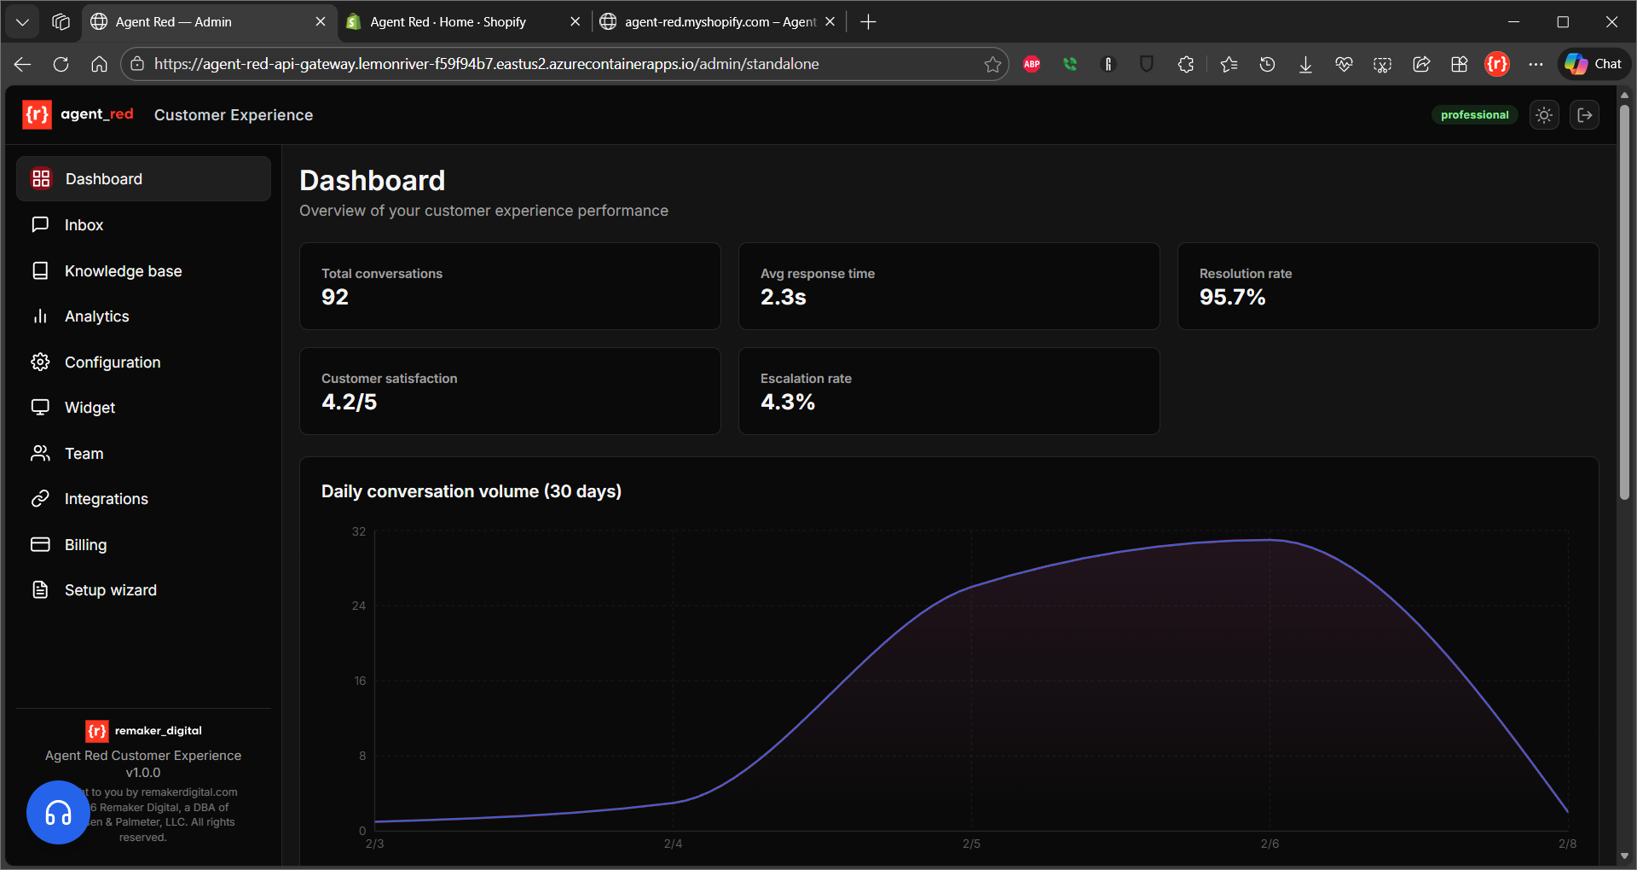

Slide 7
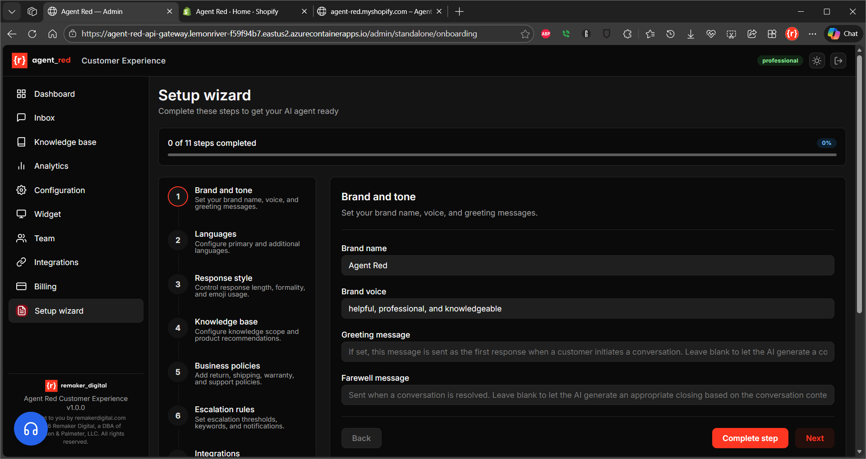

Slide 8
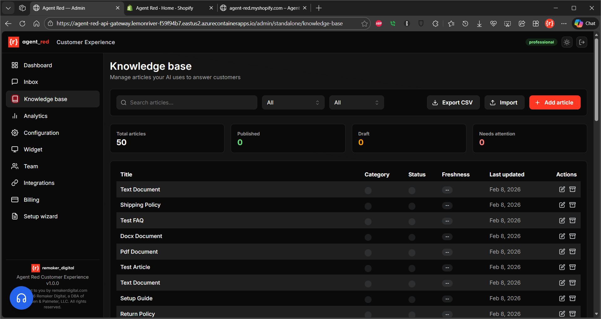

Slide 9
Architectural Goals
Why AGNTCY SDK was selected for this project

Slide 10
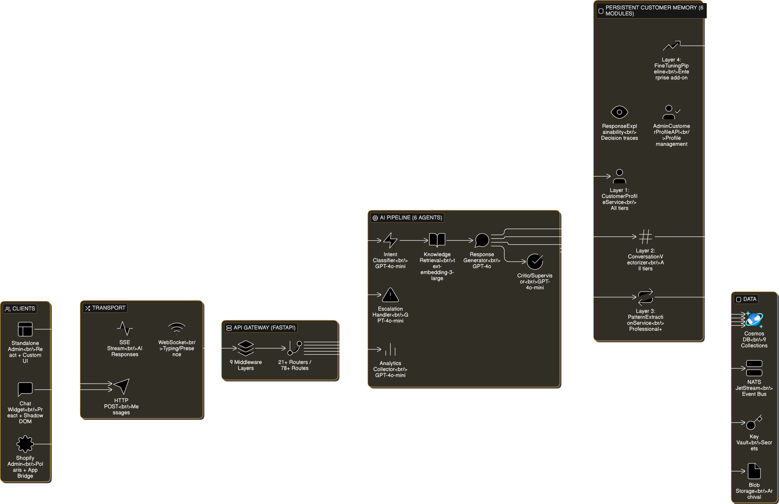
Cloud Architecture
Azure, Docker, Terraform
HA via NSPF, est 99.95%
Autoscaling & throttling, NDU
Secure & GDPR compliant
Core proj. on GitHub (MIT lic.)

Slide 11
Design Goals
Protocol-transport decoupling for environment flexibility
Built-in OpenTelemetry observability for KPI tracking
Factory pattern simplifies multi-agent initialization
A2A message threading (contextId/taskId) for conversation continuity
AppSession handles concurrent customer sessions
Educational value for demonstrating enterprise patterns

Slide 12
Agent Protocol Assignments
A2A Protocol: Intent, Response, Escalation, Analytics, Critic agents
MCP Protocol: Knowledge Retrieval agent (standardized tool interface)
SLIM Transport: Primary agents (secure, low-latency)
NATS Transport: Analytics agent (high-throughput event streaming)
Hybrid approach maximizes protocol strengths

Slide 13
Pros and Cons
Benefits and limitations discovered during implementation

Slide 14
Advantages of AGNTCY SDK
Open-source Apache 2.0 license with no licensing costs
Protocol-transport decoupling enables dev/prod flexibility
Native OpenTelemetry integration for execution tracing
Comprehensive test patterns in SDK examples
Python 3.12+ modern async codebase
Factory singleton pattern ensures consistent configuration

Slide 15
Limitations of AGNTCY SDK
Directory and Identity services not yet available
Limited production deployment documentation
No official Azure integration examples provided
SLIM configuration schema complexity caused issues
Requires custom service discovery implementation
Python 3.12+ requirement excludes older environments

Slide 16
Issues Discovered
Technical challenges encountered during implementation

Slide 17
SLIM Config. Issue (Resolved)
Container failed with InvalidKey error on startup
Root cause: Incorrect YAML schema using server: key
Endpoint format must be host:port without http:// scheme
Correct hierarchy: tracing, runtime, services keys
Resolution documented in SLIM-CONFIGURATION-ISSUE.md
Status: RESOLVED as of 2026-01-25

Slide 18
SDK Feature Gaps
Directory Service marked Coming Soon in documentation
Identity Service requires external auth implementation
MQTT Transport unavailable for edge scenarios
Manual topic configuration needed without service discovery
Custom Azure Key Vault integration required
Session management limits for high-concurrency scenarios

Slide 19
Alternatives Analysis
Frameworks considered and rejection rationale

Slide 20
Transport Alternatives Eval.
NATS: High-throughput but lacks SLIM security features
Azure Service Bus: Managed service but higher latency
HTTP/REST: Simple but no built-in pub-sub patterns
gRPC: Performance but heavier implementation burden
Decision: SLIM primary + NATS for analytics events

Slide 21
Framework Alternatives Considered
LangChain: Popular but less control over agent communication
AutoGen: Microsoft SDK but different architectural model
Custom implementation: Full control but higher development cost
AGNTCY selected for protocol flexibility and observability
Educational value aligned with blog post objectives

Slide 22
Future Testing
Planned validation of SDK benefits and limitations

Slide 23
Performance Testing Plan
Load test 100+ concurrent sessions to validate AppSession limits
Measure P95 message latency across SLIM transport
Compare SLIM vs NATS throughput for analytics events
Benchmark OpenTelemetry tracing overhead (<50ms target)
Stress test agent restart and reconnection behavior
Quantify memory footprint per agent instance

Slide 24
Integration Testing Plan
Validate A2A message routing across all 6 agents
Test MCP tool interface with mock external services
Verify contextId preservation across conversation flows
Measure escalation routing accuracy (target >95%)
Test graceful degradation when agents unavailable
Validate Critic agent content validation accuracy

Slide 25
SLIM Protocol Evaluation
Assessment for similar multi-agent projects

Slide 26
SLIM Protocol Strengths
Secure gateway authentication with password protection
Low-latency point-to-point messaging
Built-in pub-sub patterns for agent communication
TLS 1.3 support for production deployments
Suitable for both local development and production
Lightweight resource footprint in Docker containers

Slide 27
SLIM Protocol Weaknesses
Configuration schema complexity requires careful attention
Limited documentation compared to mature protocols
No built-in service discovery mechanism
Endpoint format is non-standard (no URI scheme)
Requires external tooling for monitoring and metrics
Community support smaller than NATS or RabbitMQ

Slide 28
SLIM Recommendation for Similar Projects
Recommended for: Secure agent communication in controlled environments
Best fit: Projects requiring low-latency with built-in auth
Avoid if: High-throughput streaming is primary use case
Combine with: NATS for event-driven analytics workloads
Production tip: Enable TLS and use Azure Key Vault for credentials
Alternative: Azure Service Bus for fully managed option

Slide 29
Key Takeaways

Slide 30
Key Takeaways
AGNTCY SDK provides solid multi-agent foundation
Protocol-transport decoupling is the primary architectural benefit
Manual implementation needed for directory and identity services
SLIM configuration requires attention to schema format
Hybrid SLIM+NATS approach balances security and throughput
Comprehensive testing planned to quantify production readiness

