Slide 1
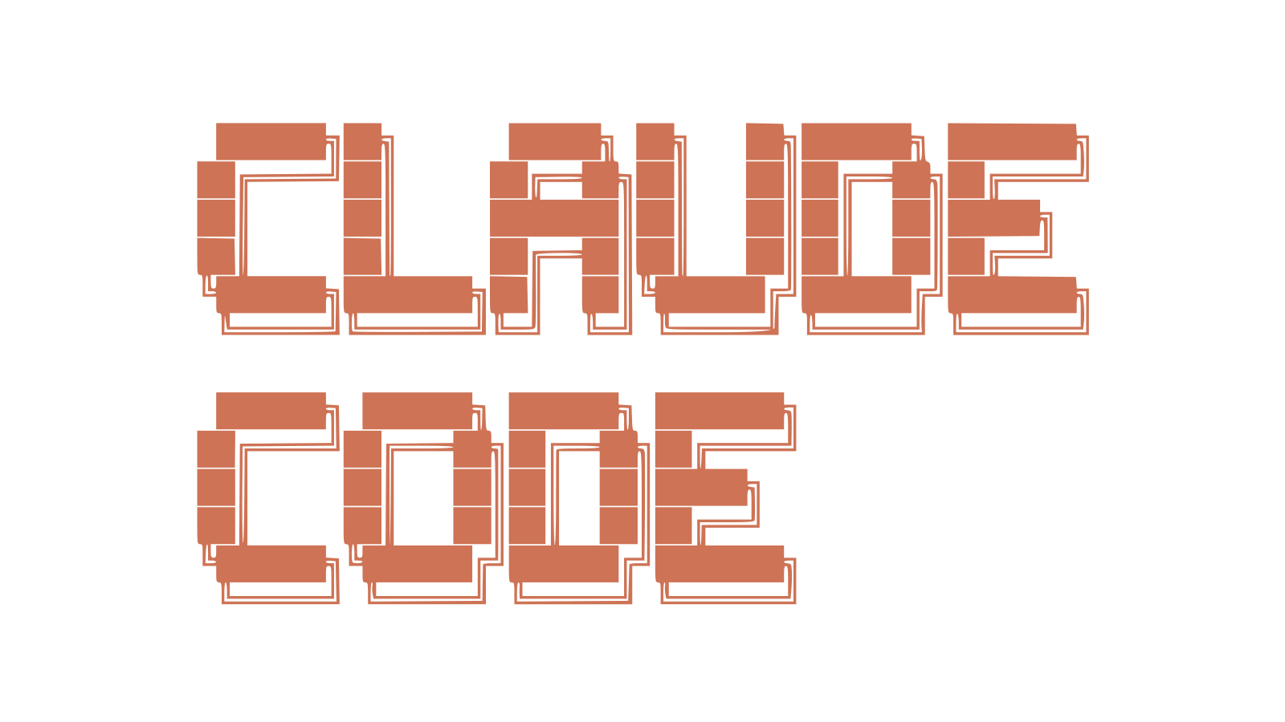
98% faster 97% lower cost
AIOps Automation with Claude Code

Slide 2
Agentic Principles

Slide 3
Agent Architecture:
Intent Classification Agent:
Routes incoming requests to appropriate handlers
Knowledge Retrieval Agent:
Searches internal documentation and knowledge bases
Response Generation Agent:
Crafts contextually appropriate responses
Escalation Agent:
Identifies cases requiring human intervention
Analytics Agent:
Monitors performance and identifies improvement opportunities

Slide 4
Technical Requirements:
Real-time processing with sub-second latency
Scalable to handle 10,000+ concurrent conversations
Integration with existing Azure infrastructure
Compliance with SOC 2 and GDPR requirements
Zero-downtime deployments
Comprehensive observability and monitoring

Slide 5
Non-Functional Requirements:
Development velocity: Deploy new features weekly
Cost optimization: Stay within $5,000/month Azure budget
Team efficiency: Enable all three engineers to contribute regardless of DevOps expertise
Disaster recovery: RPO < 1 hour, RTO < 4 hours
Security: Encryption at rest and in transit, zero-trust architecture

Slide 6
Expectations:
Claude Code transforms natural language requirements into production-ready Terraform configurations
Containerization with Docker Desktop provides consistency across development, staging, and production
Git-based workflows with GitHub Desktop enable collaborative development without CLI complexity
Terraform automation on Azure eliminates manual infrastructure management

Slide 7
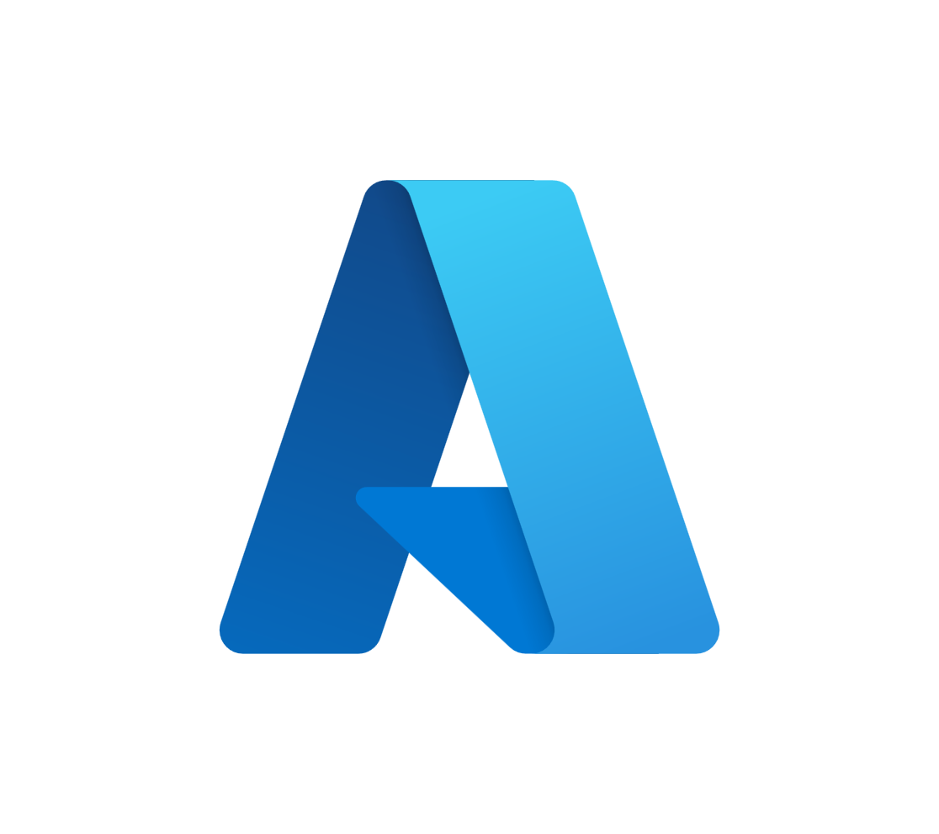

Azure + Databricks
Role | Modular services for storage, compute, and agentic orchestration | Unified platform for data engineering, ML, and analytics
Abstraction | Low-level control over services like Synapse, ADLS, ADF, etc. | High-level, managed Spark + Delta Lake + MLflow
User | Agent developer and UI integration | Data engineering and data science
Performance Tuning | Manual tuning of Synapse, Spark pools, or VMs | Auto-optimized clusters, Photon engine
Governance | Azure Purview, RBAC, and custom metadata solutions | Unity Catalog, RBAC, lineage tracking integrated with Entra ID
Notes:
We are strong Microsoft partners, and we prioritize seamlessness with Azure wherever possible.
There is no either-or decision: our stack builds on and integrates with the Azure cloud stack
You retain control over what you use, and you don’t need to forklift anything – you can adopt Databricks without reversing anything you already have in-flight. It’s parallel to what you’ve already assembled, and there’s a very high degree of forward portability for your current assets moving to Databricks
You can easily uptake Photon, Unity catalog, our workbench, and leave behind a bunch of infrastructure-level concerns that your data practitioners don’t need to be concerned with anymore
And you get the usability benefits of DatabricksIQ across the whole platform

