Slide 1


Database Server

Slide 2
Types of Servers:
File Server
Database Server
File servers store and distribute files. Multiple clients or users may share files stored on a server. In addition, centrally storing files offers easier backup or fault tolerance solutions than attempting to provide security and integrity for files on every device in an organization. File server hardware can be designed to maximize read and write speeds to improve performance.
The amount of data used by companies, users, and other services is staggering. Much of that data is stored in databases. Databases need to be accessible to multiple clients at any given time and can require extraordinary amounts of disk space. Both of these needs lend themselves well to locating such databases on servers. Database servers run database applications and respond to numerous requests from clients. Common database server applications include Oracle, Microsoft SQL Server, DB2, and Informix.

Slide 3
Pros of each Server Type:
File Server
Database Server
Remote Access
When you have access to a dedicated File Server, you can easily access all information remotely. Remote access of information can be critical in many scenarios.
Centralized Management of Permissions
When you use a File Server, you can easily access all your files from one central location.
Data Recovery Made Easy
There are many awesome data recovery features available within the File Server. You could easily retrieve files without any problems.
Increase User Control
The File Server ensures management of all passwords from central location. You would be able to create new users within no time.
Reduced data redundancy
Reduced updating errors and increased consistency
Greater data integrity and independence from applications programs
Improved data access to users through use of host and query languages
Improved data security
Reduced data entry, storage, and retrieval costs
Facilitated development of new applications program

Slide 4
Cons of each Server Type:
File Server
Database Server
If the file server does fail or become corrupted then all data is lost or is unavailable until it can be recovered from back up
Increased network bandwith as everyone is reading and writing files to and from the file server
They usually need a professional IT person to set up and administer.
They are quite expensive, so may not be the best solution for two or three people in a small company.
Database systems are complex, difficult, and time-consuming to design
Substantial hardware and software start-up costs
Damage to database affects virtually all applications programs
Extensive conversion costs in moving form a file-based system to a database system
Initial training required for all programmers and users

Slide 5

Migration Process
Extract and Compile all Data
Organize and Categories Data
Design Database based on how the Data was Catagorized
Write Scripts to Import Data
Test Imported Data to ensure correct placement in Database
Import all data into newly designed Database
Create web application to retrieve and upload files/data.

Slide 6
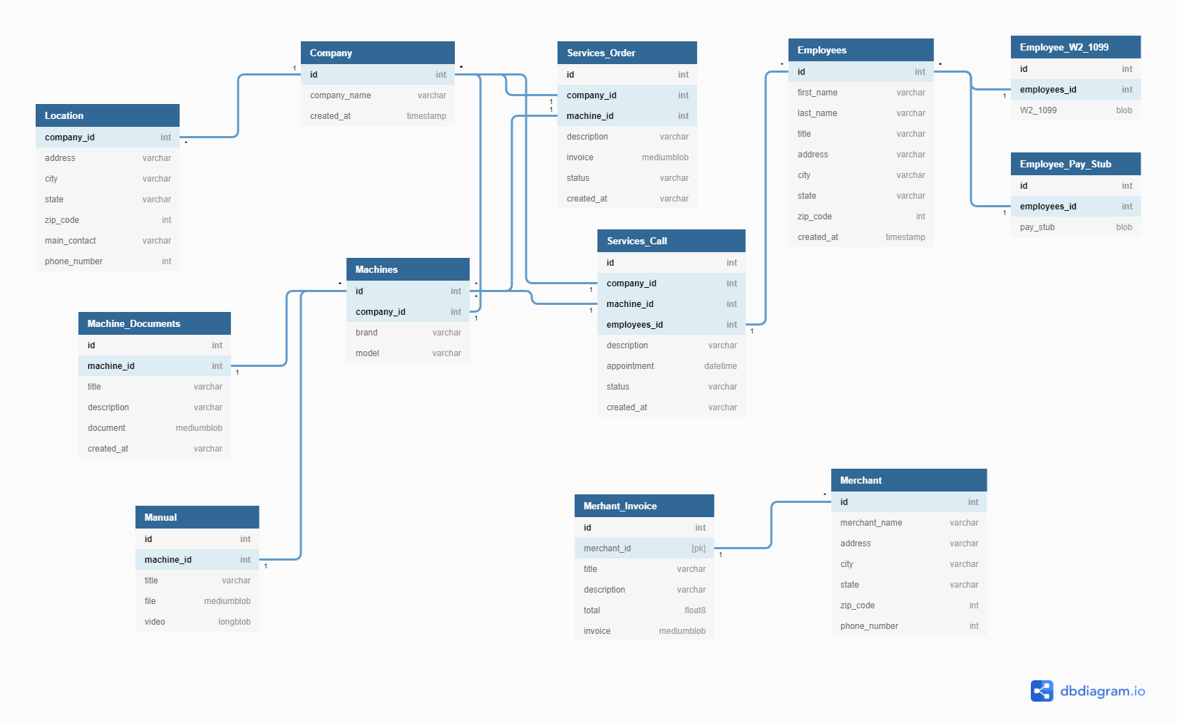
Database Design

Slide 7
Summary
Conculsion:
Deciding what type of server works best for our company's needs and wants.
Address the Pros & Cons of each server type.
Discuss the migration process.
Discuss the Database design.
Discuss creating an application to retrieve and add new files/datas.

