Slide 1


A Postgres Server for point clouds storage and processing
Presented at postgresl PARIS session 6.
https://github.com/Remi-C/Postgres_Day_2014_10_RemiC
Rémi Cura
Julien Perret – Nicolas paparoditis – GildaS Le meur

Slide 2
Warning
A fair warning :
Except PointCloud : the tools I use are research tools.
Good for proof of concept/prototype, NOT for production, NOT reliable
Use it with care.

Slide 3
SUmmary
1. Introduction to Point clouds
2. Why use a DBMS?
3. PointCloud : Efficient storing/QUERYING/LOADING in postgRes
4. In base processing
5. using the server in complex architectures
A. references
B. Annexes (screens, details)

Slide 4
Introduction to Point clouds
What are point clouds
Order of magnitudE

Slide 5
Introduction to Point clouds
Note: sexy point cloud images

Slide 6
Introduction to Point clouds
What are Point Clouds?
A set of unordered 3D points with attributes resulting from a sensing operation.
Unordered: don’t know who the neighbors are .
Attributes: ex: intensity of returning light, class id
Sensing: physical sensing of reality, not like a vector point representing the position of a tree (no semantic).
Mostly from :
Active sensors (laser time of flight based):
Terrestrial tripod
Terrestrial vehicle (cars/robot)
Aerial vehicle (plan/drone)
Passive/mixed : image (stereovision). RGBZ device (Kinect)

Slide 7
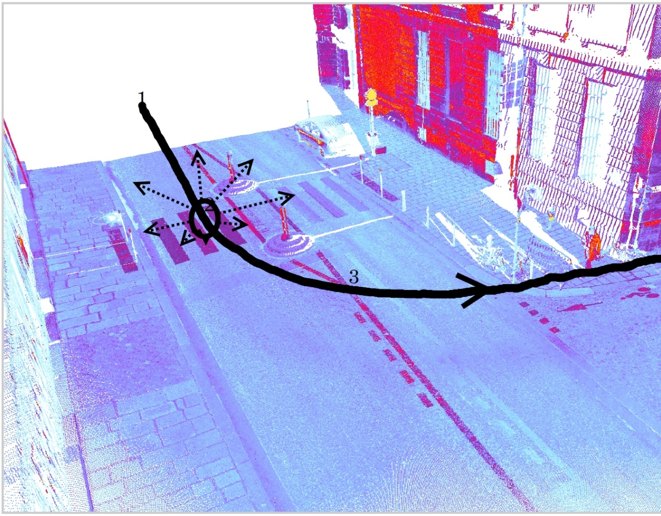
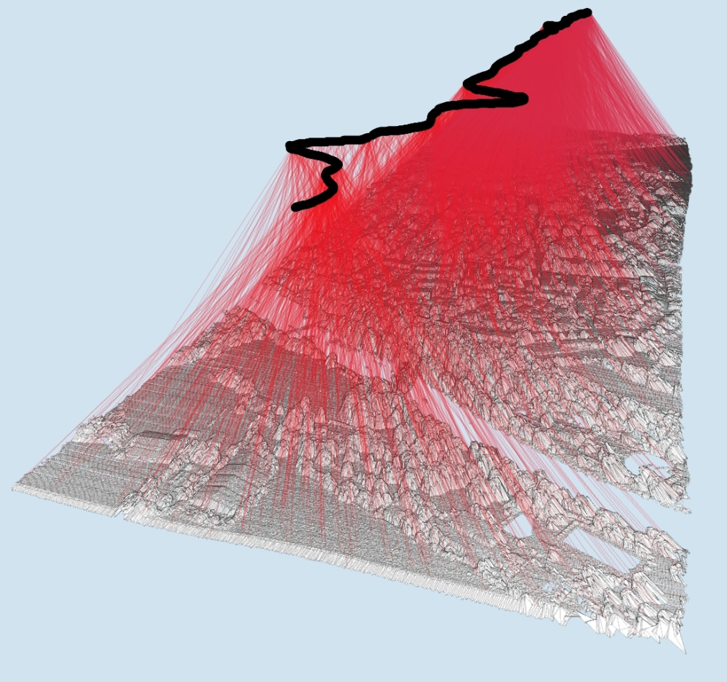
Introduction to Point clouds
Example : aerial and terrestrial point clouds
Non constant very high density
Almost constant low density
Image from J. Demantké Thesis, 2013
Image from J. Demantké Thesis, 2013

Slide 8
Introduction to Point clouds
Why so many people use it?
3D from images is an ill posed problem. (i.e.: given a pixel in image space, what is its position and size in real world )
Very good precision (close and long range)
Reliable
Devices are cheap-ish
Complements very well images.

Slide 9
Introduction to Point clouds
Point clouds are cool, but very BIG
Current devices: 1 Million points/sec, 12+ attributes. Outch !
1 hour: several Billions points.
French mapping agency: 100’s of data sets, aerial + terrestrial, several type of lasers.
Can’t load much more than 20 Millions points in memory => can’t process much more than 10 Millions points at a time.
So much data: personal copy of it is not an option. All data must be centralized on specific storage solution.

Slide 10
Why use a DBMS?
What people do with point clouds?
Using A File system solution
Using A DBMS solution

Slide 11
Why use a DBMS?
What people do with point clouds?
(See [3] in “ressources”)
Create data
Get data based on localization time attributes
Mix data set
Convert data
Process data
Visualize data
Update data

Slide 12

Why use a DBMS?
Illustration of quad tree in filesystem
Typically, point clouds are cut in pieces to form a hierarchy of folders (ex : quad tree).
Level folder cum_folder
Coverage
Folder
Folder
number
0 1 1
1 4 5
2 16 21
3 64 85
4 2.6e+02 3.4e+02
5 1e+03 1.4e+03
6 4.1e+03 5.5e+03
7 1.6e+04 2.2e+04
8 6.6e+04 8.7e+04
9 2.6e+05 3.5e+05
10 1e+06 1.4e+06
11 4.2e+06 5.6e+06
12 1.7e+07 2.2e+07
/s1
4⁰
/s1/s1..4
4¹
/s1/s1..4/s1..4
4²
Greater than max folder number on NTFS and EXT filesystem
Is it sufficient? 100k pts/file
8*10⁶ * 10⁵ = 10¹¹ = 800 Billions pts.
For one laser : 3.6 Billions/h.
Working day : 30 Billions
=> Only 30 days of work for 1 laser!

Slide 13
Why use a DBMS?
File system limitations
Create data
Get data based on localization time attributes
Mix data sets
Convert data
Process data
Visualize data
Update data
Only 1 user at a time
Need to choose a File structure adapted to one and only one query type
Very difficult
OK
User need to create manually buffers of points
OK
Only 1 user at a time

Slide 14
Why use a DBMS?
Using a file system
Everything can be done, but it would amount to redeveloping a DBMS system !
No security of the data
No concurrency
Need a different solution for every kind of geo-data (points, raster, vector)
Comparison to raster world: Who use pure file system solution for data over 100’s of To?

Slide 15
Why use a DBMS?
USing A DBMS solution
Allow concurrency / clusters of servers
All geospatial data in the same place
Efficient querying on localization & time & attributes & data set
Proper management of metadata at the data set level + relational link to other data.
Point clouds as a service : can be integrated in sophisticated client system.
Why use Postgres and not a NoSQL database?
Parallel computing on multi cluster possible (postgres-xc)
Full ACID warranty
Can use python/R/C/Java
All geo data in same place.

Slide 16
PointCloud : efficient storing/querying/Loading in postgres
Storing point clouds in DBMS : 2 approaches
What is PointCloud?
Efficient storage
FAST querying
FAST loading

Slide 17
efficient storing/querying/Loading in postgres
Storing point clouds in DBMS : 2 approaches
1 point =
GPS_time (s) X (m) Y(m) Z(m) reflectance (…. )
54160.295 2068.230 20690.025 45.934 -9.4497
1 row = 1 point
Analogy : ST_Point
1 row = N points
Analogy : ST_MultiPoint
Billions of row -> manual partitioning
Billions of row -> big indexes
Double/float storage -> wasted storage
1 row = 1 point -> no compression
Different laser -> no compatibility
Different laser -> custom code everywhere
Millions of row -> 1 table per dataset
Millions of row -> small indexes
Custom bit width -> efficient storage
1 row = N point -> compress by redundancy
Different laser -> 1 family type
Different laser -> postgres extension
Usage : do we really need to get points 1 by 1?

Slide 18
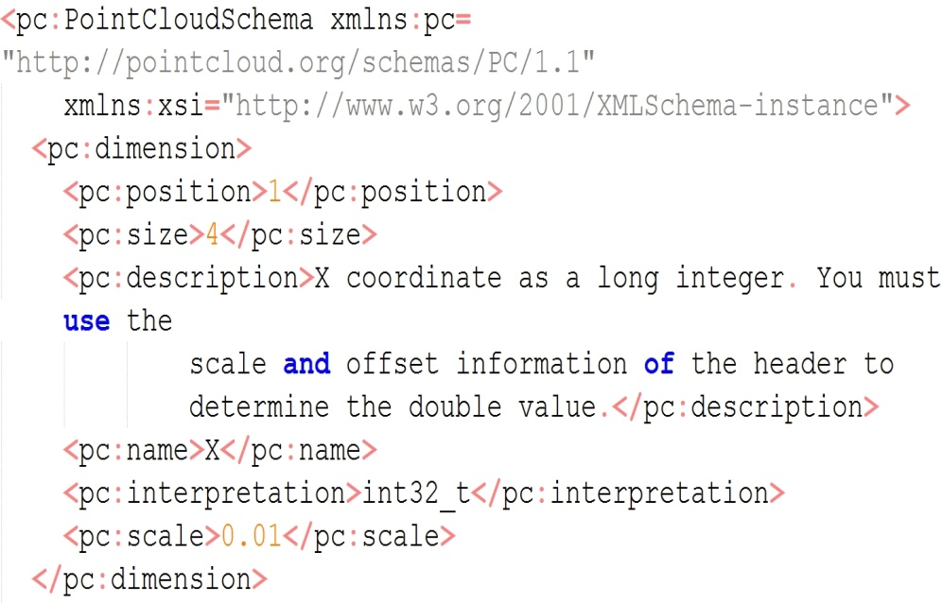
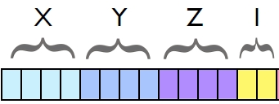
efficient storing/querying/Loading in postgres
What is PointCloud?
A Postgres extension created by P.Ramsey (founder of PostGis) (see ref.).
Strong similarities to PostGIS (design, robustness, reliability, perfs) !
New types (PC_Point, PC_Patch) + cast to geom + functions
PC_PATCH(schema)
XML Schema
BBOX (PostGIS geometry)
Metadata , stats
PC_POINT(schema)
Illustration
from [2]

Slide 19
efficient storing/querying/Loading in postgres
Efficient storage
Why compression is important?
An example form image world :
Full HD Camera : 1920×1080 pixels × 25images × (1+1+1 octet) /sec -> 155 Mbyte/s
Laser : 1 million points * 10 attributes * 2 (doubles) -> 20 Mbyte/s
Yet nobody is speaking of big data regarding video!
WHY?
Because we know very well how to compress images !
Example: standard for professional of video : DNxHD
Full HD : 18 Mbyte/s (1/8) or 4.5 Mbyte/s (1/30)

Slide 20
efficient storing/querying/Loading in postgres
Efficient storage
PointCloud can compress patches.
Compression is always about exploiting similarities.
PointCloud work attribute by attribute for one patch
Depending of the similarities, 3 methods are proposed
Use bit mask : 10001 ; 10002; 10003 -> mask=1000, data = 1,2,3
Use repetition: 10,10,10,10,10,10,10 -> repetition=6, data = 10
Use lzip deflate algorithm (dictionary, tree)
Example :
For this benchmark data , 12 Million points, binary file on disk 600 Mbyte
In database : 25 k patches, (Table=10)+(toast=290)+(index=5) =305 Mbyte
Binary file zipped on disk : 305Mbyte

Slide 21
efficient storing/querying/Loading in postgres
FAST SPATIAL querying
We index patches as polygons.
CREATE INDEX ON patch USING GIST(patch::geometry)
Index in several S.R.S possible
CREATE INDEX ON patch USING GIST(ST_Transform(patch::geometry,4326)::)
FAST Attribute querying
Example : precise time of acquisition
Use a function that compute range of an attribute in a patch rc_compute_range_for_a_patch( patch, text) : NUMRANGE(PC_PatchMin(patch, ‘GPS_Time’),PC_PatchMax(patch, ‘GPS_Time’),'[]');
GIST Index on this function CREATE INDEX ON patch USING GIST(rc_compute_range_for_a_patch(patch,’GPS_Time’)

Slide 22
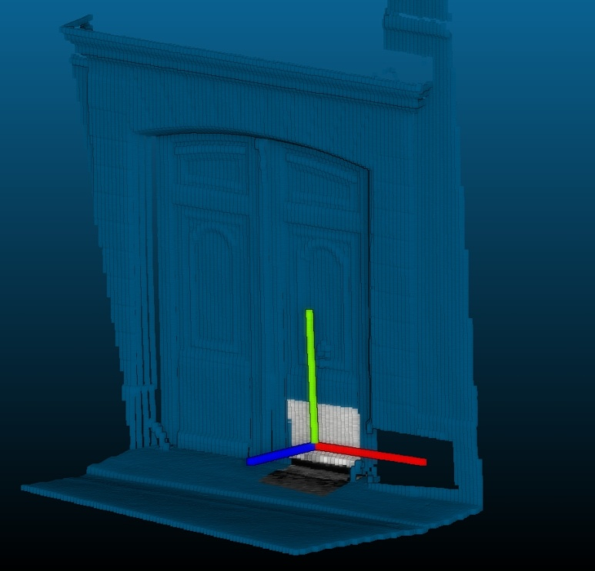
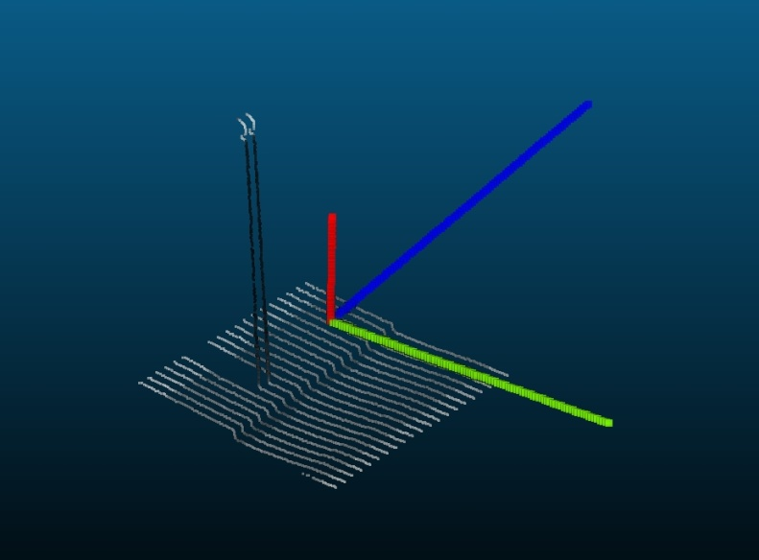
efficient storing/querying/Loading in postgres
BONUS :
FAST Function query : index on ND Descriptor
Define a function computing ND descriptors of the patch
example : How vertical is the patch? (based on ICA)
Create an index on it
(0.1 ,0.002,0.008)
(0.7 ,0.001,0.005)

Slide 23
efficient storing/querying/Loading in postgres
FAST Loading in PointCloud
Simple test : use PDAL (GDAL for point clouds wannabe)
Example of fast loading: project PointCloud_in_db
Parallel loading into a server : we can load as fast as we acquire data !
Prototype. Bash + sql
Patch table:
Id, PC_Patch(n)
Binary Point cloud files
(ply)
Linux Pipe
Temp table
X,Y,Z,I,…
Create patch
(GROUP BY )
Space + time
Write patch
Indexes
Convert to ASCII CSV
Psql+ COPY

Slide 24
ressources
Documentation
tools

Slide 25
Doc
[1] J. Demantké: thesis
[2] P. Ramsey presentation of PointCloud : boundlessgeo.com/wp-content/uploads/2013/10/pgpointcloud-foss4-2013.pdf
[3] : Point cloud data management Peter van Oosterom, Siva Ravada, Mike Horhammer, Oscar Marinez Rubi, Milena Ivanova, Martin Kodde and Theo Tijssen IQmulus Workshop on Processing Large Geospatial Data, 8 July 2014, Cardiff, Wales, UK

Slide 26
TOOLS
POINTCLOUD
CLoudCompare
RPLY
QGIS

Slide 27
Annexes
Sensor view

Slide 28
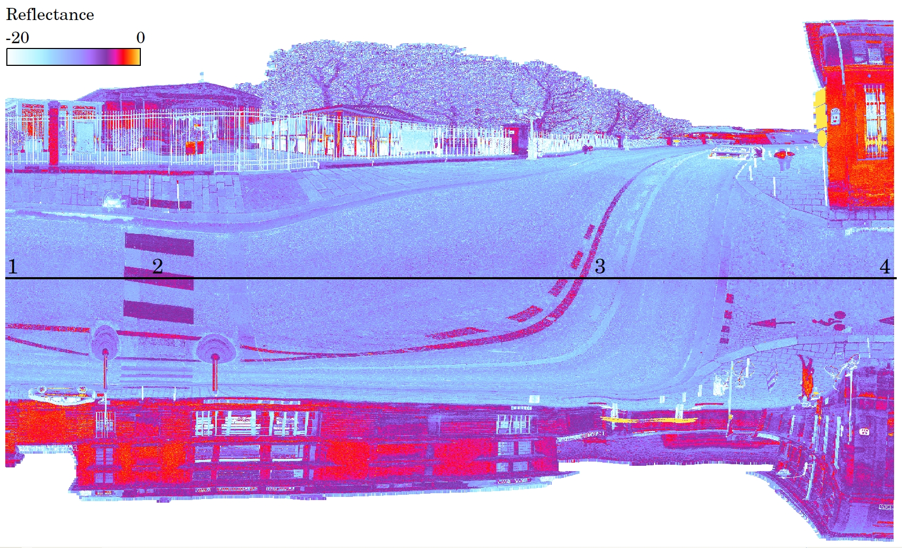
ANNEXES
Sensor view
Image from [1]

Slide 31
Demo postgres
_introduction aux nuages de points & les problématiques de ce genre de données
_serveur de nuages de points :
_stockage en base de données avec PointCloud
_chargement rapide et parallèle
_indexations et performances
Visu :
_visu 2D dans QGIS
_visu 3D interactive dans ITowns
_utilisation (une base de 0.6 milliard et une base de 5.8 milliards de points)
_niveaux de détails (quadtree/octree)
_analyse basique ( PL/R )
Processing Pl/python
_conversion en raster & traitements image basiques en base.
_utilisation par un algo interactif de détection de bord de trottoir (+zoo project)
_perspectives

Slide 32
Demo postgres
LOD maison
Index et filtrage

Slide 33
Demo PLR
Analyse de correlation
Spline fitting
Clustering (espace eucl+reflectance)

Slide 34
Demo python
Icp
filtrage
Detection de plan

Slide 35
Comparaison plpythonu/plr avec le package « fastcluster»

Slide 36
vtk Icp
http://www.vtk.org/Wiki/VTK/Examples/Python/IterativeClosestPoints

Slide 37
PCL : Detection de plans filtrage
https://github.com/strawlab/python-pcl/blob/master/tests/test.py
https://github.com/strawlab/python-pcl/

Slide 38
Conversion en raster
Cuisine perso + trick pour ecrire les fichiers rapidemment
Filtrage
Opencv
Image basique
Detection de cercle/lignes (hough)
Detecteurs
Matching pour trouver les marquages « velos »
http://docs.opencv.org/trunk/doc/py_tutorials/py_feature2d/py_feature_homography/py_feature_homography.html#py-feature-homography

Slide 39
Traitement d’image basique
http://docs.opencv.org/trunk/doc/py_tutorials/py_tutorials.html
Gradient + Detection de cercle avec OpenCV

Slide 40
avancé

Slide 41
24/06
Travail sur clustering dans R

Slide 42
Loading data
Use the github project PointCloud_In_DB
Get the data from IGN pointcloud benchmark
Follow instruction of github project
Install IGN spatial ref using the github project

Slide 43
Patch To Raster
Get the function from PPPP utilities
Get rc_random_string
rc_unnest_with_ordinality
Array_agg_custom (array of array)
Pour ecrire les raster qqpart :
write_file_texte
Activer les sorties pour les rasters :

Slide 44
Patch To Raster
Get the function from PPPP utilities
Get rc_random_string
rc_unnest_with_ordinality
Array_agg_custom (array of array)

Slide 45
Image processing : building detection
Need raster with pointcloud flattened, max height, pixel size = 10cm, + count of point/ pixel
Use python script
Import tif
Keep only pixel that are above the laser
Keep only pixel that have more than 100 pts/pixel
Export tif
Use sfcgal to consolidate lines
Execute sfcgal.sql to enable the sfcgal functions.
Execute code : 120 sec, complex sql
Use python to consolidate lines
1 sec , very few lines.

Slide 46
Image processing : sidewalk detection
Need raster with pointcloud flattened, min height, pixel size = 5cm, + count of point/ pixel
Use python script
Import tif
Keep only pixel that are between -3 and -2 meters (relativ to laser (ground = -2.5meter))
Compute sobel filtering on Z ,using mask found before (nota : gives the local height variation)
Keep values between 1cm and 12 cm (official possible height)
Export tif

Slide 47
Pointcloud processing : from patch to python numpy array
Get function array_of_array from PPPP_utilities
Get function from PPPP/pointcloud : rc_explode
Using pointcloud to perform plan and cylinder detection : env 1sec/patchde 4k points
Using sclearn to perfomr ICA : same
Using sclearn to perform dbscan : 4sec + using point cloud for normal computation + using pointcloud for outliers removal

