Slide 1
MIPAV and CBS tools
Install MIPAV: version 7.0.1 should work fine for CBS tools version 3.0.8
Install the CBS tools plugins:
  Download from http://www.nitrc.org/projects/cbs-tools/
  Plugins → Install plugin
  Select the .jar files to install
  Click Install Plugin(s)
Make sure you have also installed:
  The JIST-CRUISE plugin
  The external-scripts plugin
For more information on install, check the user guide:
https://www.cbs.mpg.de/169392/cbs-tools-userguide.pdf
Note: some of the CBS tools (non linear co-registration, surface coregistraion) call bash scripts and have ANTS (http://stnava.github.io/ANTs/) as dependencies and might therefore not work on non UNIX operating systems.

Slide 2
MIPAV and CBS tools
Check memory usage: 24 Gb minimum
Allocate more if necessary:
  Help → Memory allocation
  Will require to restart MIPAV

Slide 3
MIPAV and CBS tools
Start the JIST layout tools
  Plugins → JIST → JIST layout tools

Slide 4
MIPAV and CBS tools
Start the JIST layout tools
  Plugins → JIST → JIST layout tools
The first time you do this you will have to:
  Set the directory used for storing the JIST module definitions
  Rebuild the libraries: Project → Rebuild library
  Set some Global Preferences: Project → Global Preferences
    Preferred data format: LayoutXML
    Preferred compression: 'gzip' (‘bzip2 if you are space greedy)
    Debug level: 0 or 1 (higher values make JIST more verbose)
Note 1: MIPAV and FSL are fine reading .nii.gz files directly but not SPM. You must first gunzip the files using the gunzip matlab command.
Note 2: Only volumes (.nii) will be compressed. Surface files (*.vtk) will not.

Slide 5
Python wrappers
Python wrappers for the CBS tools are available (no installation of MIPAV is required). Allows integration to nypipe & cie.
  http://nighres.readthedocs.io/en/latest/
  https://riojournal.com/article/12346/
  For more check Pilou’s and Julia’s github repos
    https://github.com/piloubazin
    https://github.com/juhuntenburg
For more MIPAV / CBS tools layout (including high-res surface coregistration)
  The code of Julia’s paper (https://doi.org/10.1093/cercor/bhx030) is there: https://github.com/juhuntenburg/myelinconnect

Slide 6
IMPORTANT to know when using SPM and MIPAV
s-form and q-form transformation matrices
  Nifti image headers have 2 transformation matrices. It is possible to independently report or modify the qform or sform fields.
  The qform and sform stored in a nifti file are intended to fulfil the following functions:
    specify the handedness of the coordinate system (important for getting left and right correct)
    specify the original scanner coordinates (qform only)
    specify standard space coordinates (sform only)
    specify a relationship with another image's coordinates (sform only)
From: https://nifti.nimh.nih.gov/nifti-1/documentation/nifti1fields/nifti1fields_pages/qsform_brief_usage/document_view
MIPAV works on the qform and SPM on the sform. So you might run into problems because of that.
  More info here:
  http://gru.stanford.edu/doku.php/mrTools/coordinateTransforms
  https://fsl.fmrib.ox.ac.uk/fsl/fslwiki/Orientation%20Explained

Slide 7
VTK files
The vtk surfaces from the CBS tools have 4 parts:
      Header
      Vertices: that parts stays the same between inflated and non inflafed surfaces)
      Faces
      Mapping: X values (one column / layer) for each vertex (each row is a vertex).
Extracting data from surfaces
*.vtk files are text files that can be easily read in simple text editor. I have created a set of matlab function to read, extract data, threshold and write back the data from those surfaces.
    The gifti function from SPM should do the trick.
    Otherwise I also wrote write_vtk.m and read_vtk.m files

Slide 8
VTK files
Vizualizing surfaces
  Use Paraview: http://www.paraview.org/
Drawing ROI on surfaces
  Use the modified version of Cosmetic

Slide 9
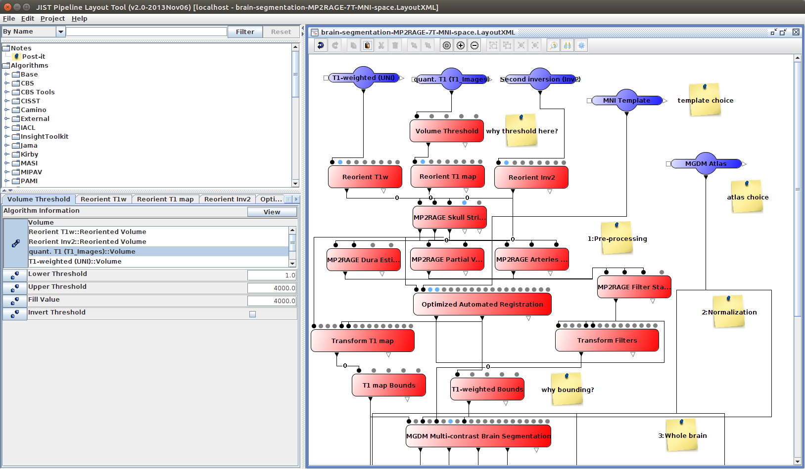
MIPAV and CBS tools
Open one of the segmentation layout from: MipavRootFolder/plugins/layouts-r3.0
For example:
  brain-segmentation-MP2RAGE-7T-MNI-space.LayoutXML

Slide 10
MIPAV and CBS tools
Processing pipelines
Available processing modules
Parameters and description of the active module
The details about a module usually link to the published article where the algorithm was described.

Slide 11
MIPAV and CBS tools
Inputs

Slide 12
MIPAV and CBS tools
Inputs
Several subjects can be processed in parallel pipelines, but the data must entered in the same order in each input module.
If there is only one file in a given module then this file will be used for all subject (e.g. atlas, template…) in parallel pipelines.

Slide 13
MIPAV and CBS tools
Inputs
Several subjects can be processed, but the data must entered in the same order in each input module.
If there is only one file in a given module then this file will be used for all subject (e.g. atlas, template…)
mipav/plugins/atlases/MNI-template/MNI152_T1_04mm_brain.nii.gz
mipav/plugins/atlases/brain-segmentation-prior3.0/brain-atlas-3.0.txt

Slide 14
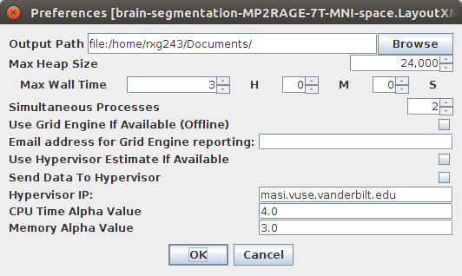
MIPAV and CBS tools
Set a few things in the template preference:
  Project → Layout Preferences
The maximum amount of RAM that can be allocated to that pipeline
The directory where the data will be saved
The maximum number of processes that can run at the same time:
Mostly a computing time vs. RAM trade off

Slide 15
MIPAV and CBS tools
Processing modules

Slide 16
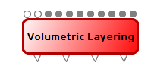
MIPAV and CBS tools
Modules have a number of obligatory inputs: top white pins
The top grey pins are either:
  for optional inputs
  or parameters that can be
    read from a file
    or passed on from another module
    or set manually in the parameter window
The bottom pins are for the output management
Modules can easily be linked to one another
Modules can also also renamed

Slide 17
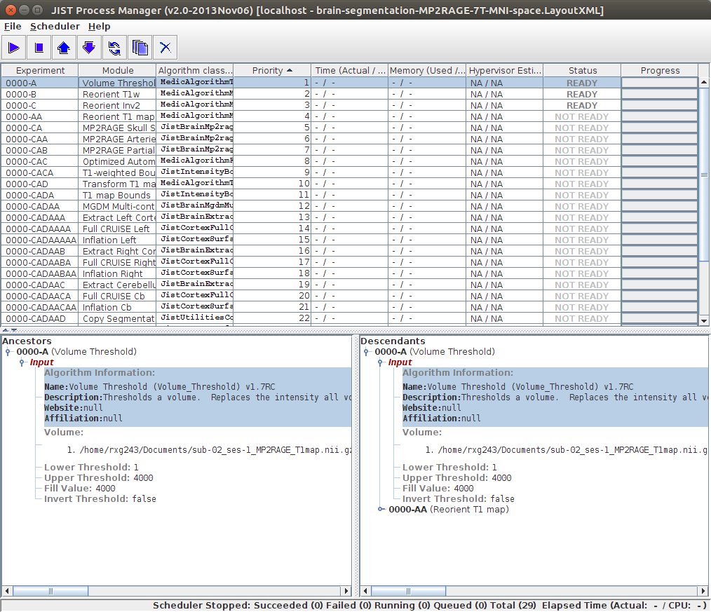
MIPAV and CBS tools
Save the layout and start the process manager:
  Project → Process manager

Slide 18
MIPAV and CBS tools
Process list
Parent (i.e input) modules of the selected process
Children (i.e output) modules of the selected process

Slide 19
MIPAV and CBS tools
The whole pipeline can be run at once Scheduler-> Start Scheduler
Each process with a “ready” status, can be started individually (“run” button or Right click → run)
The priority of each process can be modified (Right click → Promote/Demote)

Slide 20
MIPAV and CBS tools
Process ID
Each parallel pipeline (e.g. subject) gets a different number (0000, 0001, 0002, …)
The letters are related to the parent process of the selected process.
The data of every step will be saved in the output directory specified in the layout preference and organized as follow:
    OutputDir/PipelineNumber/Process-ID/ModuleName/

Slide 21
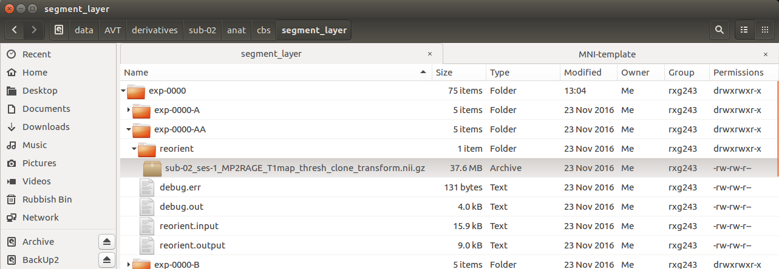
MIPAV and CBS tools
The data of every step will be saved in the output directory specified in the layout preference and organized as follow:
    OutputDir/PipelineNumber/Process-ID/ModuleName/

Slide 22
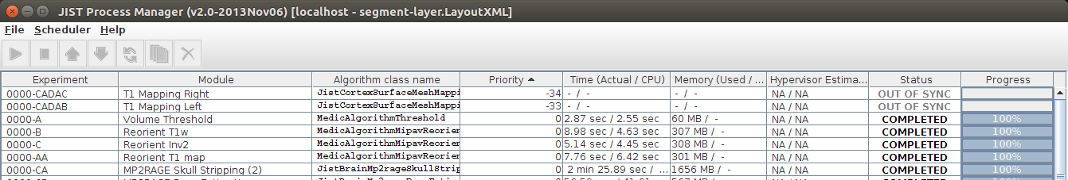
MIPAV and CBS tools
If a layout has been modified (change of parameters, new step added, some output files have been moved) some process (and sometimes all of its children processes) might have an “out of sync” status.
This can be fixed process by process (Right click → Clean) or for all the incriminated processes (Scheduler → Clean Out of Synch).

Slide 23
MIPAV and CBS tools
Sometimes a process might fail to complete… How surprising!
To help you debug what could have gone wrong , check the debug.err and debug.out files in folder of that process
One of the usual suspect is “Not enough memory”, so either allocate more RAM or run fewer processes at once.
Other classical issues:
  the input file has been moved,
  you don’t have write access to the output folder,
  Your hard drive is full!
Once you have fixed the issue you can clean and re-run the process.

Slide 24
MIPAV and CBS tools
brain-segmentation-*.LayoutXML
There is one pipeline optimised for the MP2RAGE of the 7T at the MPI CBS.
Will do the high-res segmentation.
The final resolution of the end product will be determined by the resolution of the MNI template.

Slide 25
MIPAV and CBS tools
brain-segmentation-*.LayoutXML
In this pipeline the Full CRUISE cortex extraction module will also create 3D volume level sets necessary for
    the surface inflation and mapping (central level set)
    and for layering (white matter-grey matter level set and grey matter-CSF level set).
The Surface mesh inflation will create the surface (.vtk) files (normal and inflated): they are based on the surface that goes across the middle of the cortical ribbon
The Surface mesh mapping maps the data from the T1 map volume to the central surface. It can also be used to map a ROI defining volume onto a surface in case we want to only extract certain vertices from that surface.

Slide 26
MIPAV and CBS tools
brain-segmentation-*.LayoutXML
Manual sanity checks and inspection after:
  Skull stripping
    T1 map before (T1_map*_transform.nii) vs. T1 map after (T1_map*_strip.nii) skull stripping
  Segmentation
    T1 map before (T1_map*_bound.nii) vs. T1 map after (T1_map*_seg.nii) segmentation

Slide 27
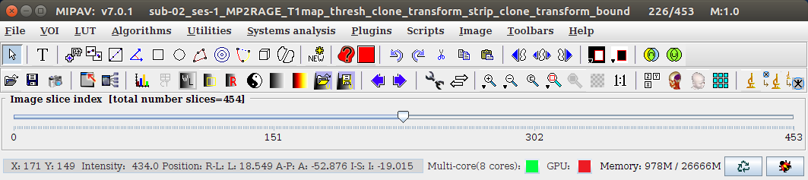
MIPAV and CBS tools
brain-segmentation-*.LayoutXML
Manual sanity checks and inspection after:
To view 1 in the tri-planar view
To view 2 images in sync

Slide 28
MIPAV and CBS tools
Other important modules
Volumetric layering module defines X layers using
    The WM-GM and GM-CSF 3D volumes level sets from the CRUISE module
  to create
    a 4D volume of defining X+1 surfaces using level sets (_surf.nii) with X+1 volume in the 4th dimension
    a 3D volume layer label defining volume (_labels.nii) with X+1 labels (0 is for anything that is non-cortex).
The Profile sampling will sample the values of an intensity image (like the beta image of a GLM) to create the profiles along the X+1 surfaces defined by the 4D level set files of the layering.
The Surface mesh mapping can then be used to map those different surfaces by projecting them onto a reference surface (usually the central surface from the segmentation pipeline). The resulting *.vtk files has X+1 surfaces.

Slide 29
MIPAV and CBS tools
MGDM segmentation
Other important modules
Profile sampling
Surface mesh mapping
Tissue probabilities
Full CRUISE
Mid-depth lvl-set
WM/GM & GM/CSF
level sets
Lvl-set to mesh
Layering
Inflate
Contrast image
e.g T1 map
Profile sampling
Inflated
mid-depth VTK
Mid-d epth VTK
Surface mapping
Mid-depth VTK
with mapping

Slide 30
MIPAV and CBS tools
Other important modules
Smooth surface mesh data will smooth the data along a surface (*.vtk) with a given FWHM
Level set to mesh converts a level set to a .vtk surface (no inflation).
Embedded Syn does non linear co-registration and can for example be used to correct for motion X inhomogeneity interactions.
It requires to install the Advanced Normalization Tools http://stnava.github.io/ANTs/ and will only work on linux as it calls some bash scripts (see the layer-fmri-analysis.Layout for a very simple example)
Multimodal surface registration for surface based registration
Mesh data to volume to map a surface onto a volume: needs a reference volume for dimensions, also make sure that the surface you input in non-inflated. Necessary to define in a volume a ROI drawn on a surface.

