Slide 1
A user friendly checklist
to improve neuroimaging

Slide 2
Bad methods/results reporting affects
reproducibility / replicability / generalizability
efficiency
 |  | Data
 |  | Same | Different
Methods | Same | Reproducible | Replicable
 | Different | Robust | Generalizable

Slide 3
"Although many journals urge authors to describe their methods to a level of detail such that independent investigators can fully reproduce their efforts, the results described here suggest that few studies meet this criterion."

Slide 4
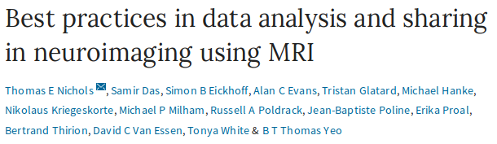

COmmittee on Best practice In Data Analysis & Sharing
(COBIDAS)

Slide 5
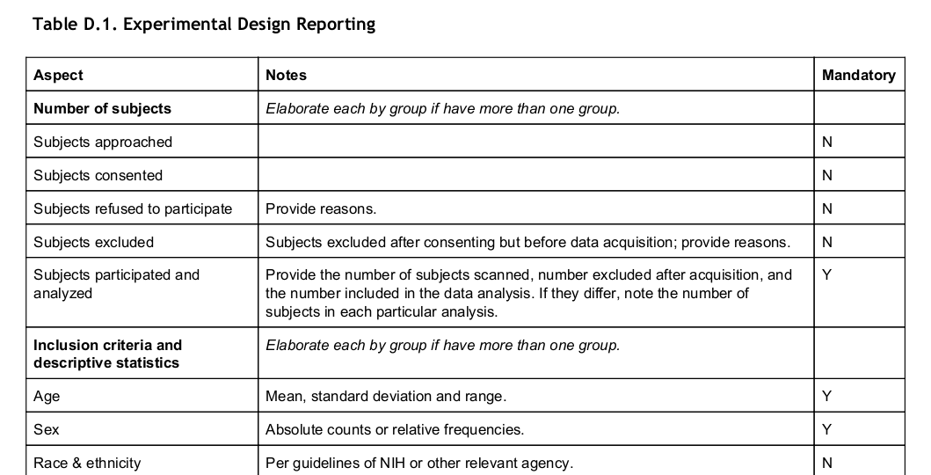
COBIDAS checklist
Experimental Design
Acquisition​
Preprocessing​
Statistical Modeling & Inference ​
Results​
Data Sharing ​
Reproducibility ​

Slide 6
COBIDAS checklist
Not well known
Seldom used to:
Write articles
Review articles
Plan studies
Not user friendly
Notes:
What specific software tools / resources do you feel are missing?
guidelines on minimum standards of study design and reporting of in vivo (animal/human) MR that journals and peer-reviewers could refer to.

Slide 7
GOAL
Make the COBIDAS checklist easier to use
HOW
web based clickable checklist generates a text (json) file
json file→generate method section

Slide 8
EXTENSIONS
Metadata data extraction from BIDS, NIDMs results to autocomplete section of the checklist
Integration with other softwares (SPM, FSL, AFNI):
matlabbatch.mat → json file

Slide 9
Discuss: structure of the JSON file
Discuss: structure of the web interface
Create: POC json file template
Create: POC website to generate a clickable checklist
Please consider joining!
https://github.com/ohbm/hackathon2019/issues/49
https://mattermost.brainhack.org/brainhack/channels/cobidas_checklist

