Slide 1
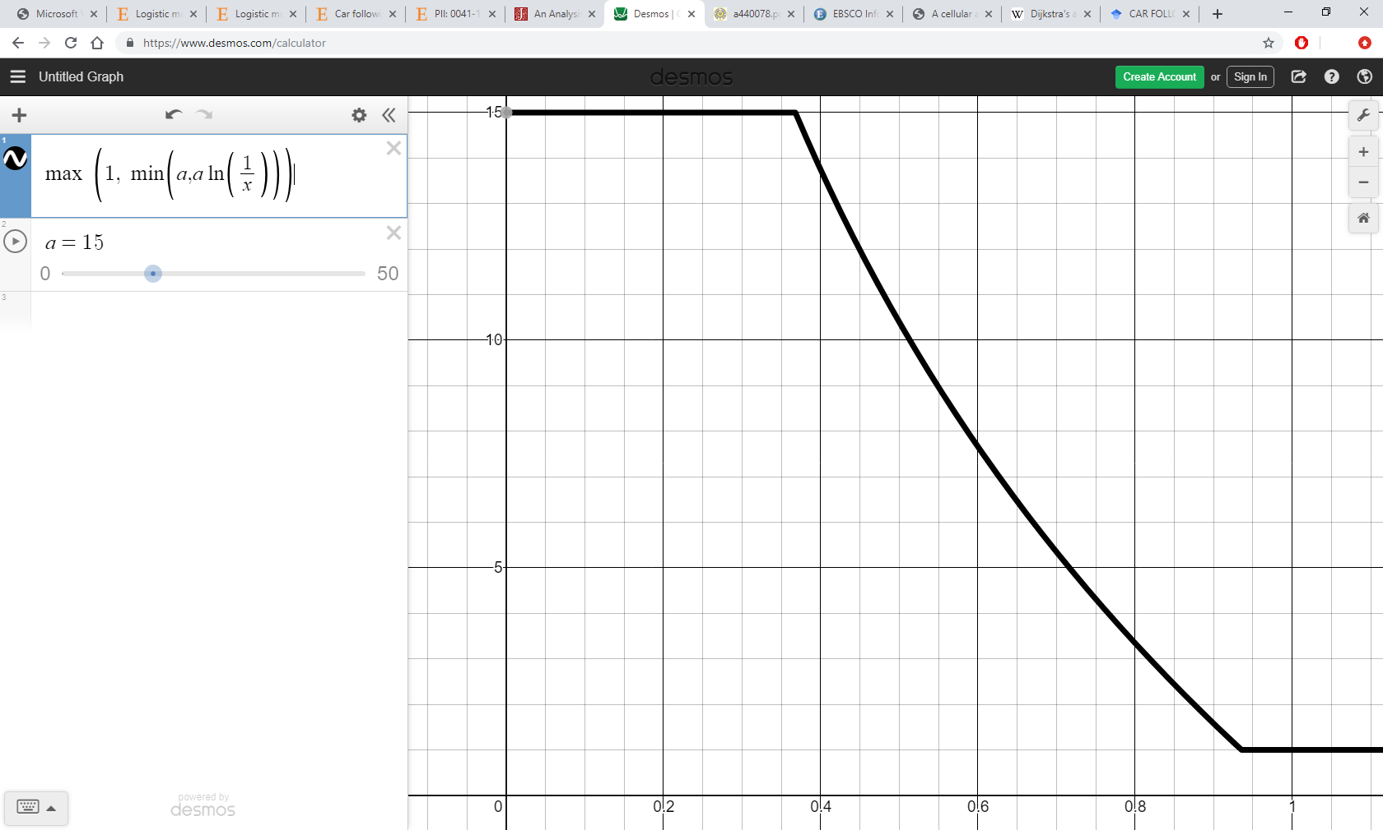
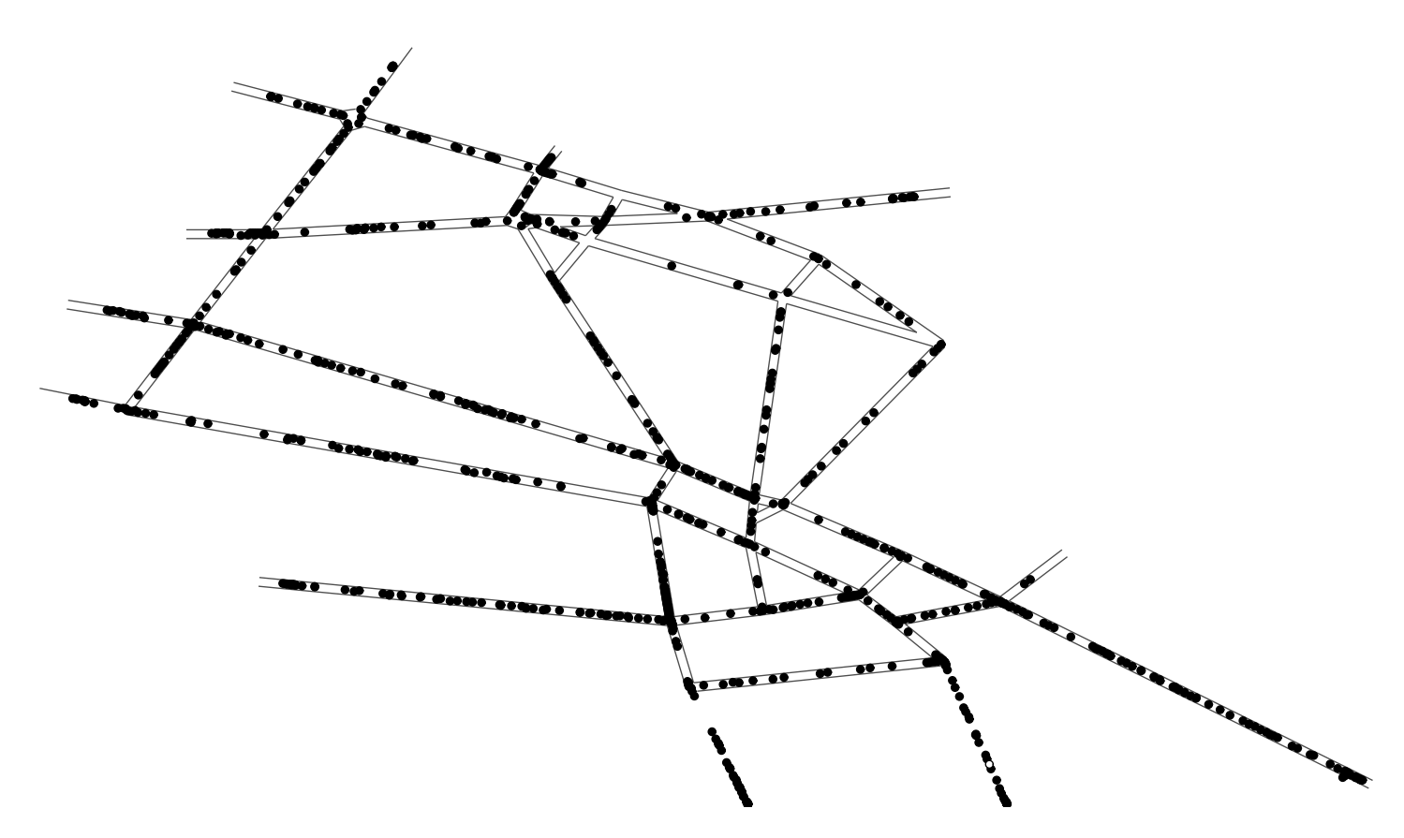

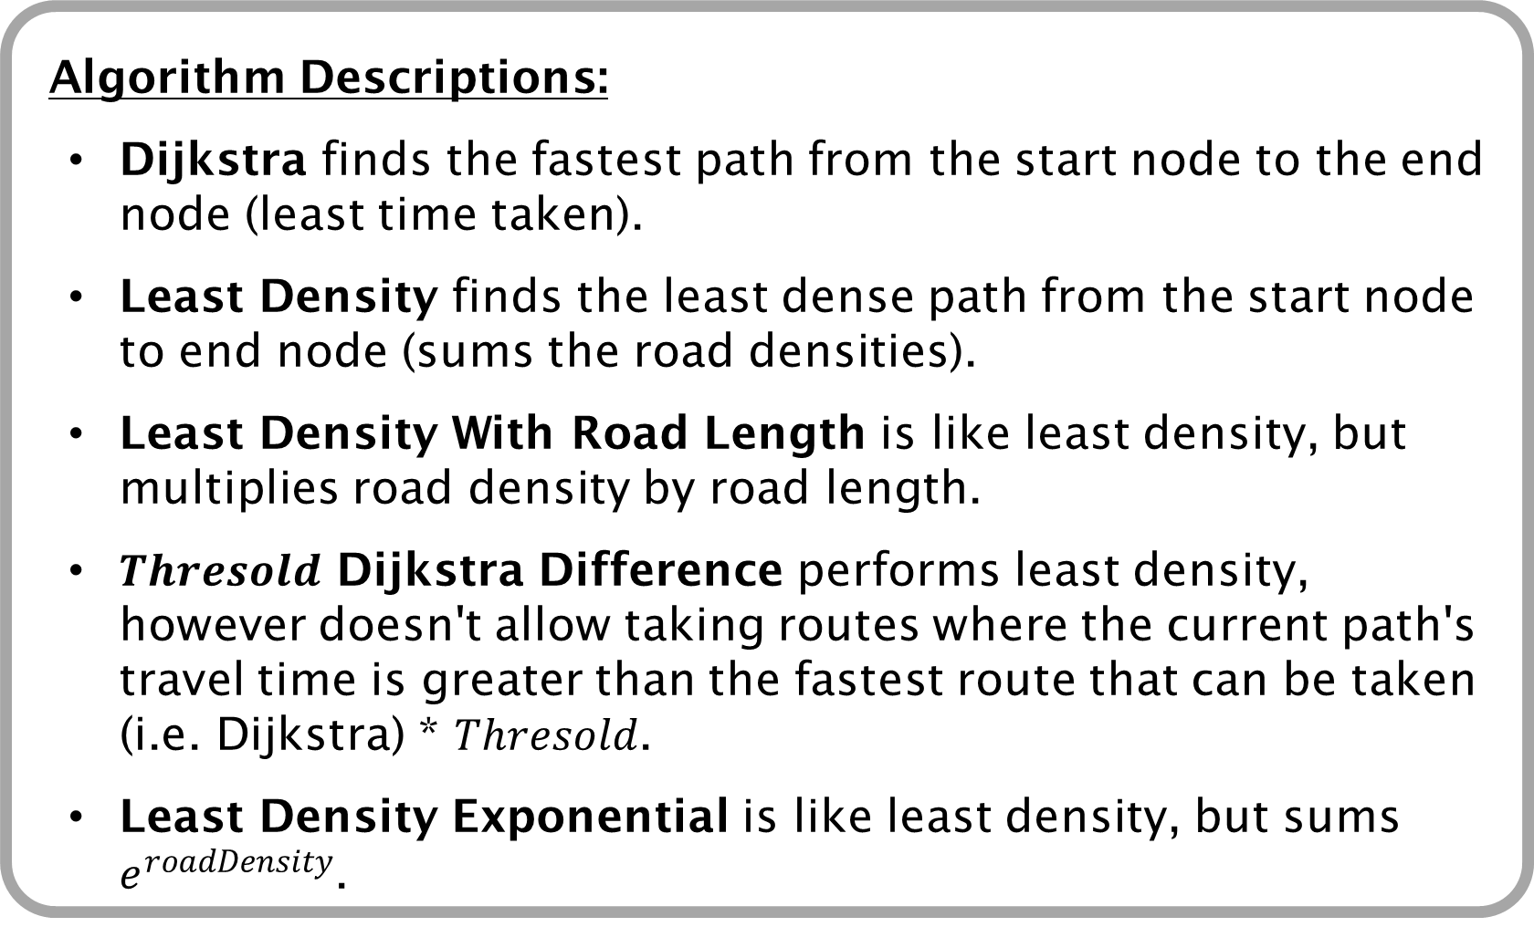
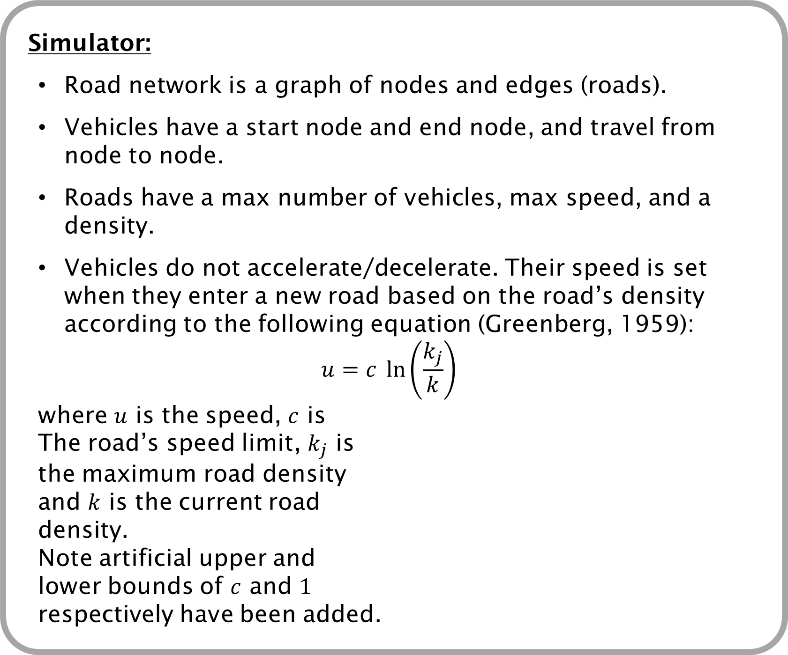


Fair Vehicle Routing
Remi Duneau, Sebastian Stein (Supervisor)
Funded by Auto Trust
Email: rjmd1g17@soton.ac.uk
Abstract:
Vehicle congestion can be a big problem in city environments with regards to fuel consumption and trip time. The aim of this project is to find ways of routing vehicles such that congestion is reduced while each individual vehicle is not routed more unfairly than another over the long term.
Algorithm Descriptions:
Dijkstra finds the fastest path from the start node to the end node (least time taken).
Least Density finds the least dense path from the start node to end node (sums the road densities).
Least Density With Road Length is like least density, but multiplies road density by road length.
$Thresold$ Dijkstra Difference performs least density, however doesn't allow taking routes where the current path's travel time is greater than the fastest route that can be taken (i.e. Dijkstra) * $Thresold$.
Least Density Exponential is like least density, but sums $e^{roadDensity}$.
Simulator:
Road network is a graph of nodes and edges (roads).
Vehicles have a start node and end node, and travel from node to node.
Roads have a max number of vehicles, max speed, and a density.
Vehicles do not accelerate/decelerate. Their speed is set when they enter a new road based on the road’s density according to the following equation (Greenberg, 1959):
$$u=c \ln\left(\frac{k_{j}}{k}\right)$$
where $u$ is the speed, $c$ is
The road’s speed limit, $k_{j}$ is
the maximum road density
and $k$ is the current road
density.
Note artificial upper and
lower bounds of $c$ and $1$
respectively have been added.
Initial speed, $u$
Road density, $k$
Experimental Setup
Different routing algorithms were explored on a simplified network of part of Berlin, Germany (Lochert et al., 2003):
% Difference Meaning:
This graph indicates how much slower a vehicle is by taking the route provided to it instead of the fastest route (Dijkstra). For example, when 500 vehicles are being tracked, the average vehicle being routed by Least Density will take ~27% longer to complete its journey than if it had taken the route obtained by Dijkstra’s algorithm (assuming all other vehicles are still being routed least density).
Future work:
Test Dynamic Algorithms for Dijkstra Difference and Least Density Exponential.
Ensure vehicles are routed fairly over the long term, instead of just one trip, by attributing a score to each vehicle which will determine how close to the fastest time they will be routed.
References:
Greenberg, H., 1959. An analysis of traffic flow. Operations research, 7(1), pp.79-85.
Lochert, C., Hartenstein, H., Tian, J., Fussler, H., Hermann, D. and Mauve, M., 2003, June. A routing strategy for vehicular ad hoc networks in city environments. In IEEE IV2003 Intelligent Vehicles Symposium. Proceedings (Cat. No. 03TH8683) (pp. 156-161). IEEE.

