Slide 1


Representing Languages by Learnable Rewriting Systems
Rémi Eyraud
Colin de la Higuera
Jean-Christophe Janodet

Slide 2
On Languages and Grammars
There exist powerful methods to learn regular languages.
But learning more complex languages, like Context Free Grammars, is hard.
The problem is that the Context Free class of languages is defined by syntactic conditions on grammars.
But a language described by a grammar has properties that do not depend on its syntax.

Slide 3
Tackle the CFG Problem
CF class contains too many different kind of languages. To tackle this problem there exist different solutions:
  To use structured examples;
  To learn a restricted class of CFG;
  To use heuristic methods;
  To change the representation of languages;
  …

Slide 4
Main Results
We develop a new way of defining languages.
We present an algorithm that identifies in the limit all regular languages and a subclass of context-free languages.

Slide 5
String Rewriting Systems (SRS)
A SRS is a set of rewriting rules that allows to replace substrings of words by other substrings.
For example, the rule ab → λ can be applied to the word aabbab as follows:
→ ab
→ ab
aabbab
→ λ
aabbab
→ abab
→ abab

Slide 6
Language Induced
The language induced by a SRS D and a word w is the set of words that can be rewritten into w using the rules of D.
For example, the Dyck language (bracket language) can be described by:
  The grammar S := a S b S, S := λ, or
  The language induced by the SRS D={ab→λ } and the word w = λ.

Slide 7
Limitations of Classical SRS
Classical SRS are not powerful enough to even represent all regular languages.
We need some control on the way rules can be applied (like in applications Grep or Lex):
  Some can be used only at the beginning of words,
  others only at their ends and
  others wherever we want.

Slide 8
Delimited SRS (DSRS)
We add two new symbols ($ and £) to the alphabet called delimiters.
$ is used to mark the beginning of words, £ to mark their ends.
A rule cannot erase or move a delimiter.
We call these systems Delimited SRS.

Slide 9
Examples of DSRS 1/2
The language corresponding to the automaton above can be represented by the DSRS (D,w):
D = {$a → $λ, $bb → $λ, $bab → $b}
and w = b.
The DSRS can represent all regular languages (left congruence).
b
a
λ
b
ba
b
b
a

Slide 10
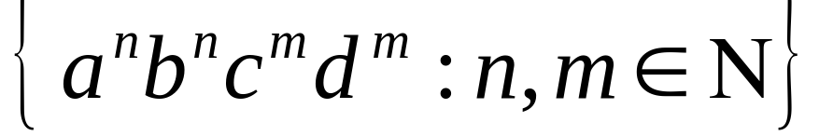
Examples of DSRS 2/2
The language is induced by the DSRS (D,w) such that:
D={aabb → ab, $ab£ → $λ£,
ccdd → cd, $cd£ → $λ£,
$abcd£ → $λ£ }
And w = λ.

Slide 11
Problems with DSRS
Usual problems with rewriting systems:
  Finiteness (F) and polynomiality (P) of derivations;
  Confluence (C) of the systems.
F = {$a → $b, $b → $a};
P = {1£ → 0£, 0£ → c1d£,0c → c1, 1c →0d,
d0 →0d, d1 → 1d, dd → λ}
$1111£ → $1110£ →* $1101£ →* $1110£ → $1100£ →* $1011£ → … →* $0000£
C ={$ab → $λ, ab → ba, baba£ → b£}
$abab£ → $ab£ → $λ£, $abab£ → $ab£ → $ba£
$abab£ → $baab£ → $baba£ → $b£
We introduce two syntactic constraints
that ensure linear derivations and the
confluence of our DSRS.

Slide 12
Learning Algorithm (LARS)
Simplified Version
Input : E+ (set of positive examples),
E- (negatives ones)
F ← all substrings of E+
D ← empty DSRS
While (F is not empty)
l ← next substring of F
For all candidate rules R: l→ r
If R is useful and consistent with E+ and E-
then D ← D U {R}
Return D

Slide 13
About the Order
We look at the substrings using the lexicographic order.
Given a substring s_b, the candidate rules with right hand side u have to be checked as follows:
  s_b → u
  $s_b → $u
  s_b£ → u£
  $s_b£→ $u£

Slide 14
Example of LARS Execution
abababab
ababab
aabb
ababab
aabbab
ab
abb
ba
bba
aab
abba
aaa
bb
bab
aa
aaa
bbb
bbbb
bbb
bb
bbb
bbb
b
bb
b
bb
b
bb
λ
bb
bb
λ
λ
bbb
bababab
babab
bb
babab
bbab
b
bb
ba
bba
b
bba
λ
bb
bab
λ
λ
bbb
abababab
ababab
aabb
ababab
aabbab
ab
abb
b
bb
aab
abb
λ
bb
bab
λ
λ
bbb
λ
λ
λ
λ
λ
λ
b
ba
a
ba
a
aaa
bb
b
aa
aaa
bbb
System : { }
System : { ab → λ }
E+=
E-=
ab → λ
$a → $λ
Candidate rule:
a → λ
$a£ → $λ£
a£ → λ£
As all words of E+ are reduced to the same string, the process is finished.
The Output of LARS is then:
D={ab → λ} and w = λ
This rule is :
Useful;
Consistent.
→ This rule is added to the system
The rule is inconsistent.
The rule is not useful
The rule is not useful
The same reasoning can be done with the candidate rules: b → λ, $b → $λ, $b£ → $λ£, b£ → λ£, b → a, $b → $a, $b£ → $a£.
The rule is inconsistent.

Slide 15
Theoretical Results for LARS
LARS execution time is polynomial in the size of the learning sample.
The language induced by the output of a running of LARS is consistent with the data.

Slide 16
Identification Result
Recall: An algorithm identifies in the limit a class of languages if for all languages of the class there exist two characteristic sets CS+ and CS- such that whenever (CS+, CS-) belong to (E+,E-), the output of the algorithm is equivalent to the target language.
We have shown an identification result for a non-trivial class of languages, but the characteristic sets are not polynomial in general case.

Slide 17
Experimental Results 1/5
On the Dyck language.
  Previous works show that this non linear language is hard to learn.
  Recall: its grammar is: S := a S b S, S := λ.
  LARS learns this correct system: D={ab→λ} and w=λ.
  The characteristic sample contains less than 20 words of size less than 10 letters.

Slide 18
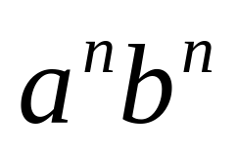


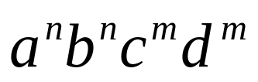
Experimental Results 2/5
On the Language .
  This language has been studied for example by Nakamura and Matsumoto, Sakakibara and Kondo.
  Recall: its grammar is S := a S b, S := λ.
  LARS learns the correct system:
  D={aabb→ab, $ab£→$λ£} and w=λ.
  The characteristic sample for this language and its variants , , contains less than 25 examples.

Slide 19
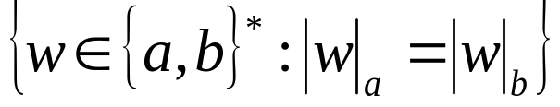

Experimental Results 3/5
On the Language .
  This language has been studied first by Nakamura and Matsumoto.
  Recall: its grammar is S:= a S b S, S:= b S a S, S:= λ.
  LARS learns the correct system:
  D = { ab → λ, ba → λ} and w = λ.
  LARS needs less than 30 examples to learn this language and its variants

Slide 20
Experimental Results 4/5
On the Lukasewitz language.
  Recall: Its grammar is S:= a S S, S:= b.
  The expected DSRS was
  D= { abb → b} and w = b.
  LARS learns the correct system:
  D={$ab → $λ, aab → a} and w=b.

Slide 21
Experimental Results 5/5
LARS is not able to learn any of the languages of the OMPHALOS and ABBADINGO competitions.
The reasons may be:
  Nothing ensures the characteristic sample to belong to the training sets;
  The languages may not be learnable with LARS;
  LARS is not optimized.

Slide 22
Conclusion and Perspectives
The DSRS we use are too constrained to represent some context-free languages.
LARS suffers from it simplicity
Future Works can be based on:
  Improvement of LARS;
  More sophisticated SRS properties;
  Other kind of SRS.

