Slide 1
Projet Info EI2I3 – 20/3/2017
L’ assembleur

Slide 2

File.grafcet
File.asm
File.bin
COMPILATEUR
ASSEMBLEUR
active step e0(led0=0)
step e1(led0=0)
step e2(led0=0)
step e3(led0=1)
transition t0({e0},{e1},but0'rise.(ana0<128))
transition t1({e1},{e2},but0'rise.(ana0>128))
transition t2({e2},{e3},but0'rise.(ana0<128))
transition t3({e3},{e0},but1'rise)
#franchissement de la transition t0
push 14
pushi 1
eq
push 1
push 6
pushi 128
ls
and
and
jf next0000
pushi 1
pop 23
pushi 1
pop 26
next0000:
..
.
269
0:101
1:0
2:102
3:13
4:101
5:0
6:102
7:22
8:101
9:0
10:102
11:26
..
.

Slide 3
Assembleur
File.asm
File.bin
Assembleur:
1ere phase d‘assemblage:
Génère un tableau de OP_CODE
Analyse et décode les intstructions (parseur)
Construit la liste des références indéfinies
2eme phase d‘assemblage:
Complète le tableau de OP_CODE
Résoud les références indéfinies

Slide 4
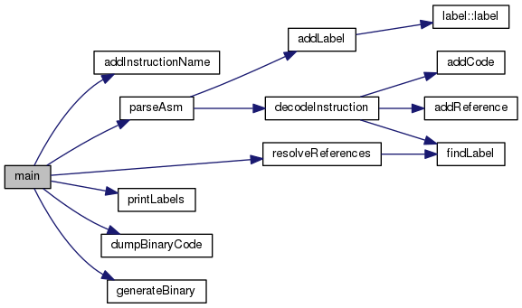
Assembleur

Slide 5
Asm.h: Structures et variables globales
unsigned int codeSegment[MAX_CODESEGMENT_SIZE];
int currentInst;
struct instructionName {
char *name;
int opcod;
int type;
char *format;
int nbops;
} tabInstructionNames[MAX_IDENTS_SIZE];
int currentInstructionName;
struct label {
char *label;
int addr;
} tabLabels[MAX_LABELS_SIZE];
int currentLabel;
struct ref {
char *label;
int addrInCode;
} tabReferences[MAX_LABELS_SIZE];
int currentRef;

Slide 6
Asm.h: Fonctions
void addCode(int v);
void addInstructionName(char *instname, int opcod, int type, char *format, int nbops);
int findLabel(char *labelname);
void addLabel(char *labelname,int addr);
void addReference(char *labelname,int addrInCode);
void resolveReferences();
void decodeInstruction(char *line);
int parseAsm(FILE *fin);
void printLabels();
void dumpBinaryCode();
void generateBinary(FILE *fout);

Slide 7
int parseAsm(FILE *fin)
{
char line[100];
fgets(line,100,fin);
while (strstr(line,"end")==NULL)
{
if (line[0]=='#')
{
}
else
{
char *p=strstr(line,":");
if (p!=NULL)
{
*p='\0';
addLabel(line,currentInst);
}
else
{
decodeInstruction(line);
}
}
fgets(line,100,fin);
}
return 0;
}

Slide 8
void decodeInstruction(char *line)
{
int i,j,l,k,pos,comp;
char *p;
int int_operand;
int found=0;
char dummy[25];
char string_operand[256];
char string_label[25];
char instname[25];
// This stuff just to get the instruction name in the instname string
pos=0;
l=0;
// isalpha : renvoie 1 si l'argument est alphabetic
while (!isalpha(line[pos]))
pos++;
while (isalpha(line[pos]))
instname[l++]=line[pos++];
instname[l++]=0;
for (i=0;i<currentInstructionName;i++){
comp=strcmp(instname,tabInstructionNames[i].name);
if (comp==0){
switch(tabInstructionNames[i].type){
// no operands, just add the codop to the code
// nothing to resolve
case 0:
found=1;
addCode(tabInstructionNames[i].opcod);
break;
// one operand, of type integer
// nothing to resolve
case 1:
found=1; sscanf(line,tabInstructionNames[i].format,dummy,&int_operand);
addCode(tabInstructionNames[i].opcod);
addCode(int_operand);
break;
// one operand, and it's a label
// check if there is something to resolve later
case 3:
found=1; sscanf(line,tabInstructionNames[i].format,dummy,string_label);
addCode(tabInstructionNames[i].opcod);
int fl=findLabel(string_label);
if (fl!=-1)
addCode(tabLabels[fl].addr);
else
{
addReference(string_label,currentInst);
addCode(-1);
}
break;
}
}
}
}

Slide 9
void resolveReferences()
{
int i,fl;
for (i=0;i<currentRef;i++)
{
fl=findLabel(tabReferences[i].label);
codeSegment[tabReferences[i].addrInCode]=tabLabels[fl].addr;
}
}

Slide 10
int findLabel(char *labelname)
{
int i;
for (i=0;i<currentLabel;i++)
if (strcmp(labelname,tabLabels[i].label)==0)
return i;
return -1;
}

