Slide 1
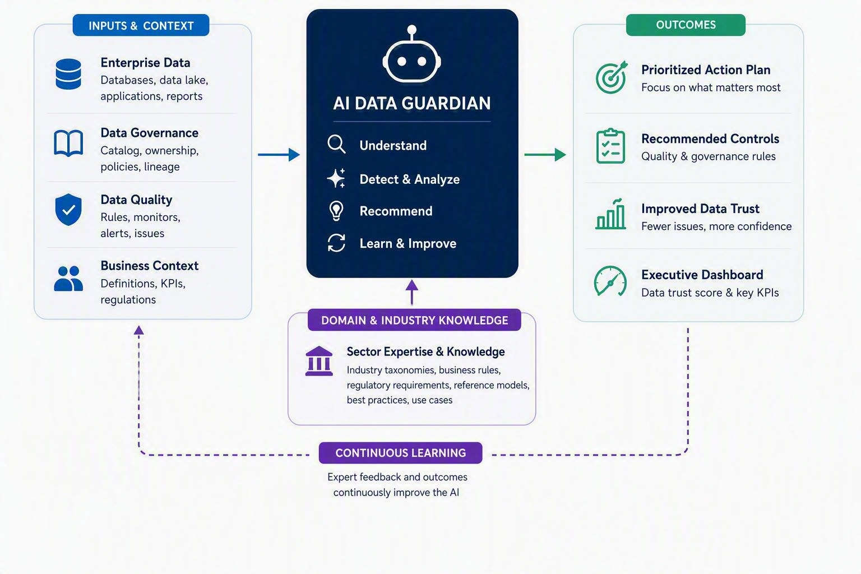
AI DATA GUARDIAN
DRAFT
Transform enterprise data into trusted, governed and AI-ready assets that accelerate analytics, compliance, intelligent automation and agentic AI at scale.
Business Challenge
AI-Enabled Solution
Rising cost of data governance (expert resources)
Governance cannot scale with data growth
Limited reuse of data expertise
AI requires trusted and contextualized Data
Transform Data Office expertise into a reusable AI capability
Automate governance and quality controls at enterprise scale
Generate prioritized remediation plans and recommendations
Continuously learn and improve from expert feedback
🚀
Increasing governance coverage without proportional resource growth
💰
Reduction in manual governance and data quality effort
✅
Higher trust in business, regulatory and AI-driven decisions
🤖
Faster deployment of enterprise AI and autonomous agents
AWS Marketplace Benchmark
Why AI DATA GUARDIAN:
  Build for Purpose, Not Generic by Design
  Lower Total Cost of Ownership
  Industry-Aware Intelligence
Impact · Feasibility · Speed
Business Impact
High
Solution | Similarity
DQ Platform (DQC) | 85%
Monte Carlo Data + AI Observability | 85%
Collibra Data Intelligence Platform | 75%
Feasibility
Medium
Potential Client

