Slide 1

SOFT354: Parallel Computation and distributed systems
Week 8
Dr Robert Merrison-Hort

Slide 2
Today’s lecture
Performance Measures: Speed-up & Efficiency
Limits to Parallelism: Amdahl and Gustafson’s Laws
Introduction to Distributed Memory Computing w/ MPI

Slide 3
Today’s lecture
Performance Measures: Speed-up & Efficiency
Limits to Parallelism: Amdahl and Gustafson’s Laws
Introduction to Distributed Memory Computing w/ MPI

Slide 4
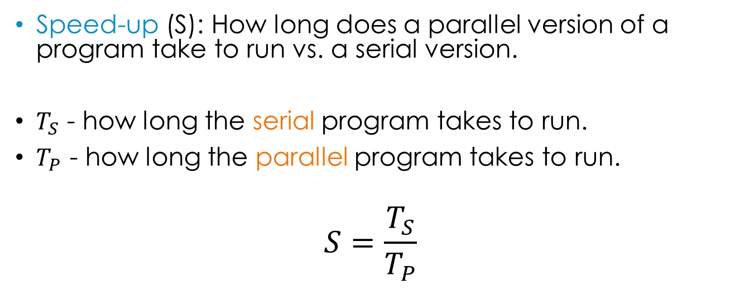
Speed-Up
Speed-up (S): How long does a parallel version of a program take to run vs. a serial version.
$T_{S}$ - how long the serial program takes to run.
$T_{P}$ - how long the parallel program takes to run.
$$S=\frac{T_{S}}{T_{P}}$$
Notes:
For example,

Slide 5

Speed-up: Example
$$S=\frac{T_{S}}{T_{P}}$$
You have a program that can run in parallel, with a configurable number of processors.
You run the program using only a single processor, and it takes 60 seconds.
Then, you run it again (for the same input) using 100 processors, and it takes 10 seconds.
What is the speed-up of this program with 100 processors?
Notes:
T_S = 60, T_P = 10
Speed-up = S = T_S / T_P = 60/10 = 6

Slide 6
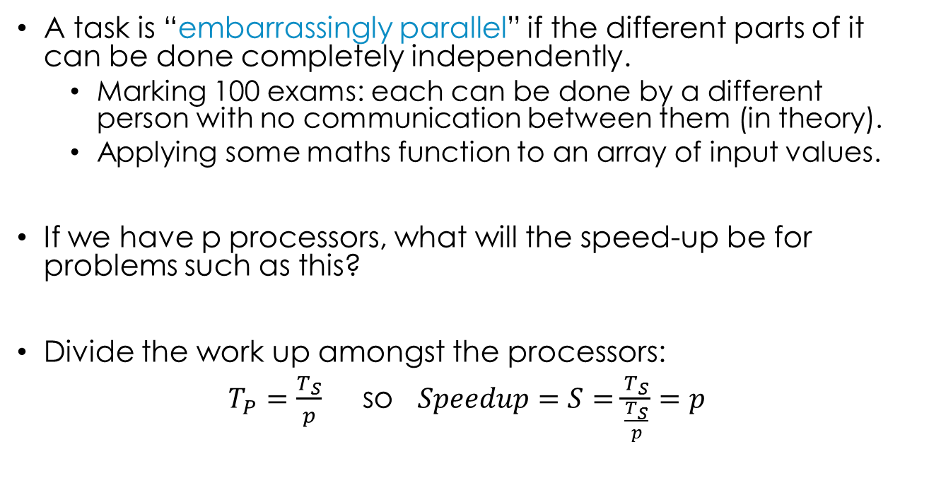
Linear Speed-up
A task is “embarrassingly parallel” if the different parts of it can be done completely independently.
Marking 100 exams: each can be done by a different person with no communication between them (in theory).
Applying some maths function to an array of input values.
If we have p processors, what will the speed-up be for problems such as this?
Divide the work up amongst the processors:
$T_{P}=\frac{T_{S}}{p}$ so $Speedup=S=\frac{T_{S}}{\frac{T_{S}}{p}}=p$

Slide 7
Linear Speed-up
Example: Marking 100 exam papers.
If you have 10 helpers available (p=10) then the work can be done 10 times faster (S=10).
Example: Applying a maths function to an array of 1,000 values.
If you have 100 processors available (p=100) then the work can be done 100 times faster (S=100).
If we have the case that S=p then the program demonstrates linear speed-up.
This is a very good thing, but it’s almost never possible.

Slide 8
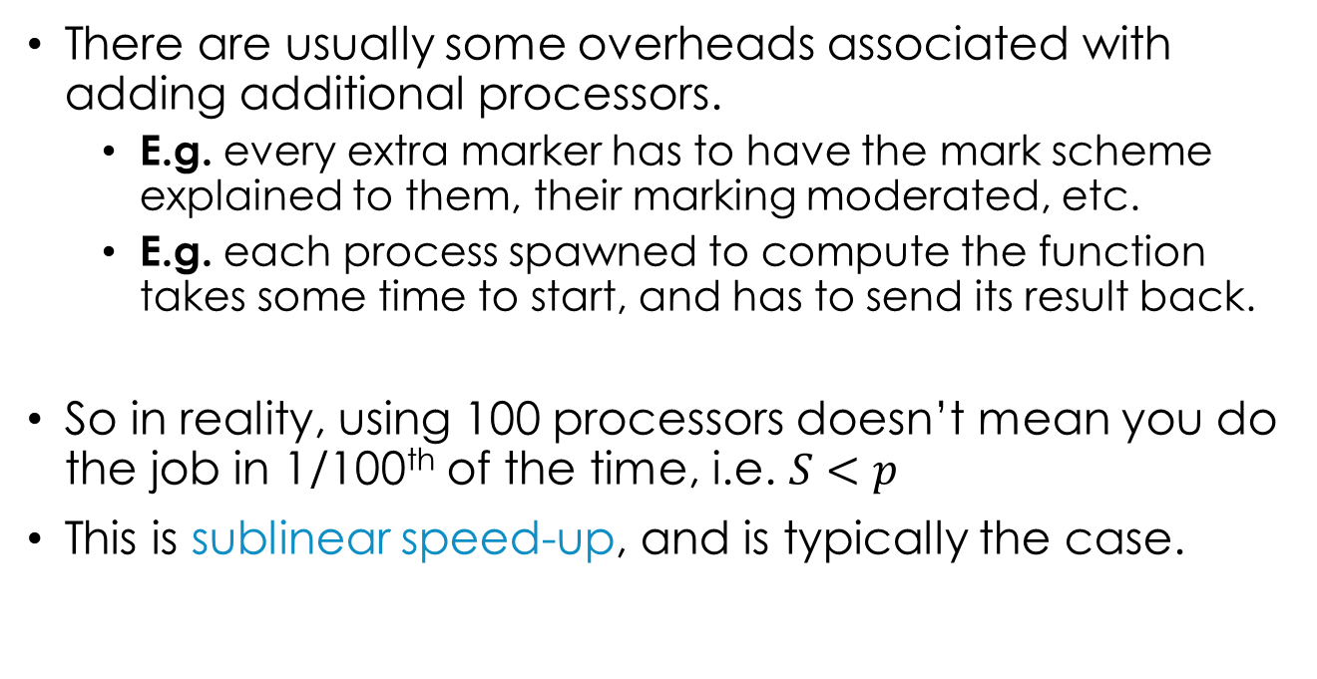
Sublinear speed-up
There are usually some overheads associated with adding additional processors.
E.g. every extra marker has to have the mark scheme explained to them, their marking moderated, etc.
E.g. each process spawned to compute the function takes some time to start, and has to send its result back.
So in reality, using 100 processors doesn’t mean you do the job in 1/100th of the time, i.e. $S<p$
This is sublinear speed-up, and is typically the case.

Slide 9
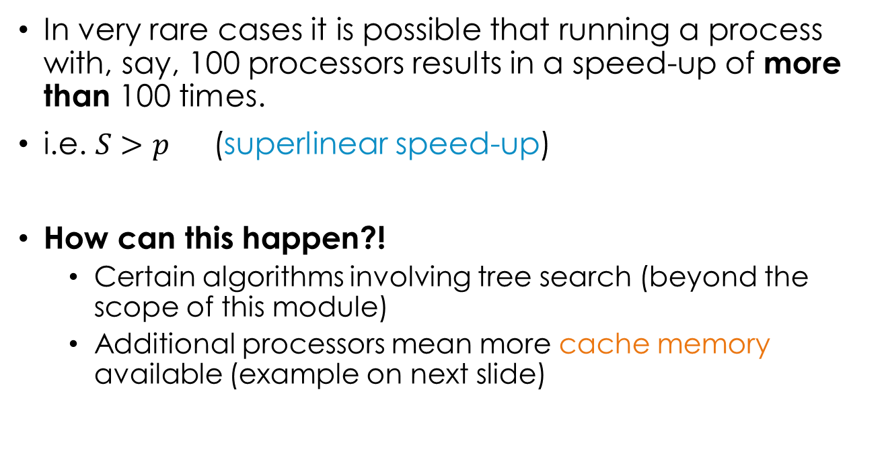
Superlinear speed-up
In very rare cases it is possible that running a process with, say, 100 processors results in a speed-up of more than 100 times.
i.e. $S>p$ (superlinear speed-up)
How can this happen?!
Certain algorithms involving tree search (beyond the scope of this module)
Additional processors mean more cache memory available (example on next slide)

Slide 10
superlinear speed-up
Assume our problem involves processing 100KB of data.
A modern Intel CPU has 64KB of L1 cache per core.
Running on one core
Divide data between two cores
Core 0
Core 0
Core 1
Data
Data
Data
L1 Cache
L1 Cache
L1 Cache
Not all the data can be cached
All the data can be cached, program runs more than twice as fast
Superlinear (and linear) speed-up are rare!

Slide 11
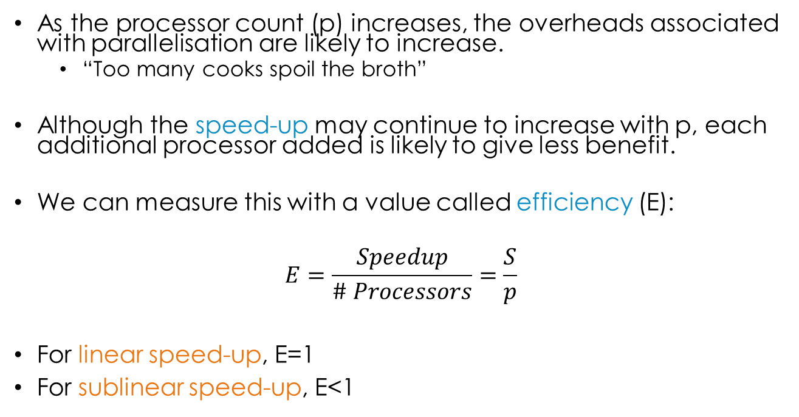
Parallel efficiency
As the processor count (p) increases, the overheads associated with parallelisation are likely to increase.
“Too many cooks spoil the broth”
Although the speed-up may continue to increase with p, each additional processor added is likely to give less benefit.
We can measure this with a value called efficiency (E):
$$E=\frac{Speedup}{\# Processors}=\frac{S}{p}$$
For linear speed-up, E=1
For sublinear speed-up, E<1

Slide 12
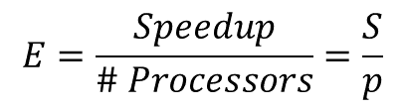
efficiency: Example
$$E=\frac{Speedup}{\# Processors}=\frac{S}{p}$$
You have a program that can run in parallel, with a configurable number of processors.
You run the program using only a single processor, and it takes 20 seconds.
Then, you run it again (for the same input) using 10 processors, and it takes 5 seconds.
What is the efficiency of this program with 10 processors?
Notes:
T_S = 20, T_P = 5
Speed-up = S = T_S / T_P = 20/5 = 4
Efficiency = 4 / 10 = 0.4

Slide 13
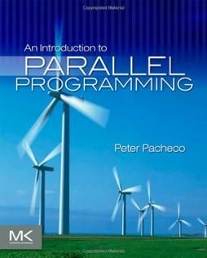
Example speed-ups / efficiencies
From the Pacheco book: MPI Matrix-Vector multiplication (section 2.6.1)

Slide 14
Today’s lecture
Performance Measures: Speed-up & Efficiency
Limits to Parallelism: Amdahl and Gustafson’s Laws
Introduction to Distributed Memory Computing w/ MPI

Slide 15


Amdahl’s law & Gustafson’s law
There’s a limit to how fast you can do something, even if you add more processors ☹
By adding more processors you can always process more data in a given period of time ☺
Gene Amdahl
John Gustafson
Both laws are valid, they’re just looking from different perspectives!

Slide 16
Amdahl’s law
Consider a program that takes 20s to run serially.
Imagine that 5s of this time (25%) is spent running code that cannot be parallelised.
The remaining 15s (75%) can be parallelised with linear speed-up (best case scenario).
How long will the parallel version take with 10 processors? 100?
Notes:
Parallel time = 5 + 15/n
So n=10 -> T_P = 5 + 15/10 = 6.5s
n = 100 -> T_P = 5 + 15/100 = 5.15s

Slide 17
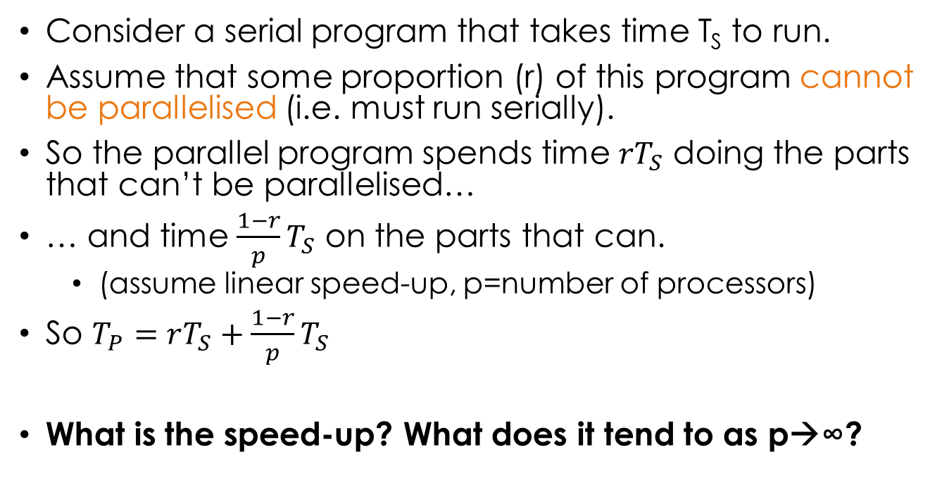
Amdahl’s law
Consider a serial program that takes time T_{S} to run.
Assume that some proportion (r) of this program cannot be parallelised (i.e. must run serially).
So the parallel program spends time ${rT}_{S}$ doing the parts that can’t be parallelised…
… and time $\frac{1−r}{p}T_{S}$ on the parts that can.
(assume linear speed-up, p=number of processors)
So $T_{P}=rT_{S}+\frac{1−r}{p}T_{S}$
What is the speed-up? What does it tend to as p→∞?

Slide 18
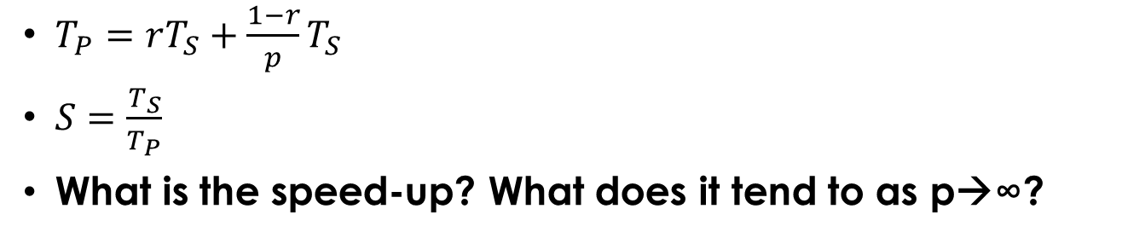
Amdahl’s law
$T_{P}=rT_{S}+\frac{1−r}{p}T_{S}$
$S=\frac{T_{S}}{T_{P}}$
What is the speed-up? What does it tend to as p→∞?
Notes:
S=T_S / (rT_S + (1-r)/p * T_S
= 1 / (r + (1-r)/p)
As p->infinity, S-> 1/r

Slide 19
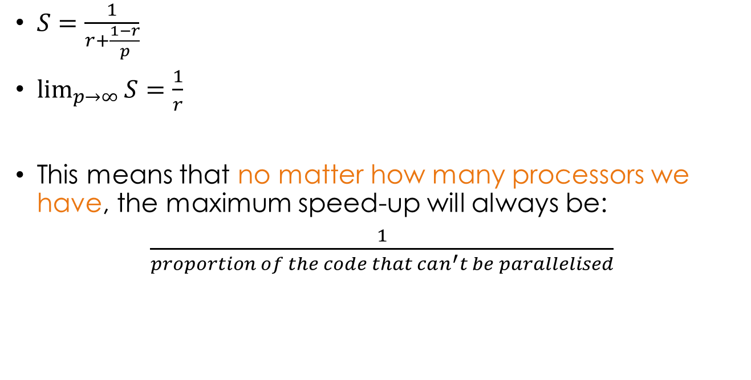
Amdahl’s law
$S=\frac{1}{r+\frac{1−r}{p}}$
$\lim_{p→∞}{S}=\frac{1}{r}$
This means that no matter how many processors we have, the maximum speed-up will always be:
$\frac{1}{proportion of the code that can^{′}t be parallelised}$
Proportion of the code that can’t be parallelised

Slide 20
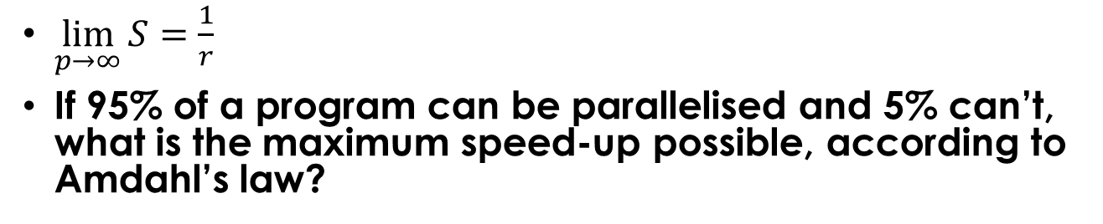
Amdahl’s law
$\lim_{p→∞}{S}=\frac{1}{r}$
If 95% of a program can be parallelised and 5% can’t, what is the maximum speed-up possible, according to Amdahl’s law?
Notes:
1/0.05 = 20

Slide 21
Amdahl’s law
This law makes sense intuitively.
Assume marking exams involves two tasks:
Preparing a mark scheme (done by lecturer, serial part)
Marking the papers (done by PhD students, parallel part)
No matter how many PhD students there are to do the marking, the total amount taken can’t possibly be less than the time it takes to prepare the mark scheme.

Slide 22
Amdahl’s law
This law makes sense intuitively.
Assume processing some data involves two tasks:
Loading a bunch of records from disk (serially)
Performing some transformation on each record (can be done independently by each processor)
No matter how many processors there, the total amount taken can’t possibly be less than the time it takes to load the records from disk.
Is this a disaster?

Slide 23
Amdahl’s law
It’s not as bad as it might seem!
Firstly, with 95% parallelisable code you can potentially get a speed-up of 20x – not too bad.
Something that would take a week takes 8 hours.
Secondly, it assumes you want to process the same amount of data as quickly as possible by adding processors (task-parallel approach).
If the job is more data-parallel, we can always process more data in the same time by adding processors…
= Gustafson’s law

Slide 24
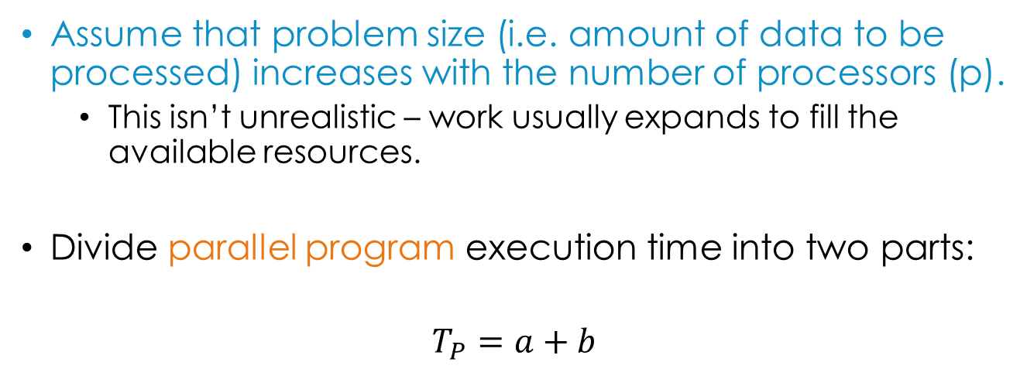
Gustafson’s law
Assume that problem size (i.e. amount of data to be processed) increases with the number of processors (p).
This isn’t unrealistic – work usually expands to fill the available resources.
Divide parallel program execution time into two parts:
$$T_{P}=a+b$$
Time taken in serial execution
Time taken in parallel execution

Slide 25
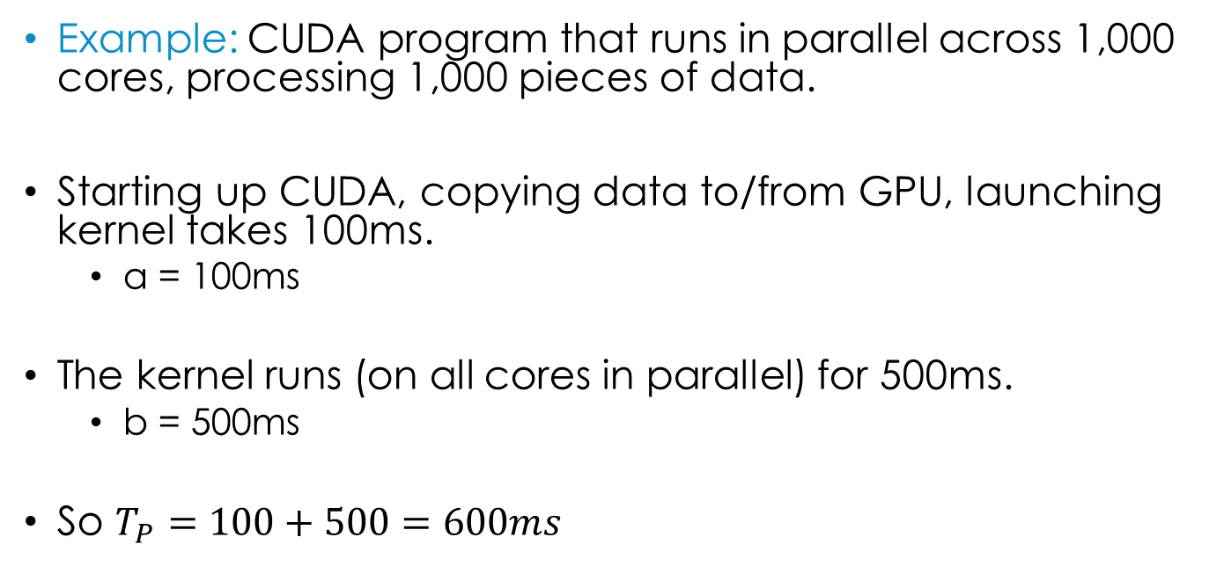

Gustafson’s law
$$T_{P}=a+b$$
Example: CUDA program that runs in parallel across 1,000 cores, processing 1,000 pieces of data.
Starting up CUDA, copying data to/from GPU, launching kernel takes 100ms.
a = 100ms
The kernel runs (on all cores in parallel) for 500ms.
b = 500ms
So $T_{P}=100+500=600ms$
How long would this take if we just used one core? Assume the same value of a.

Slide 26
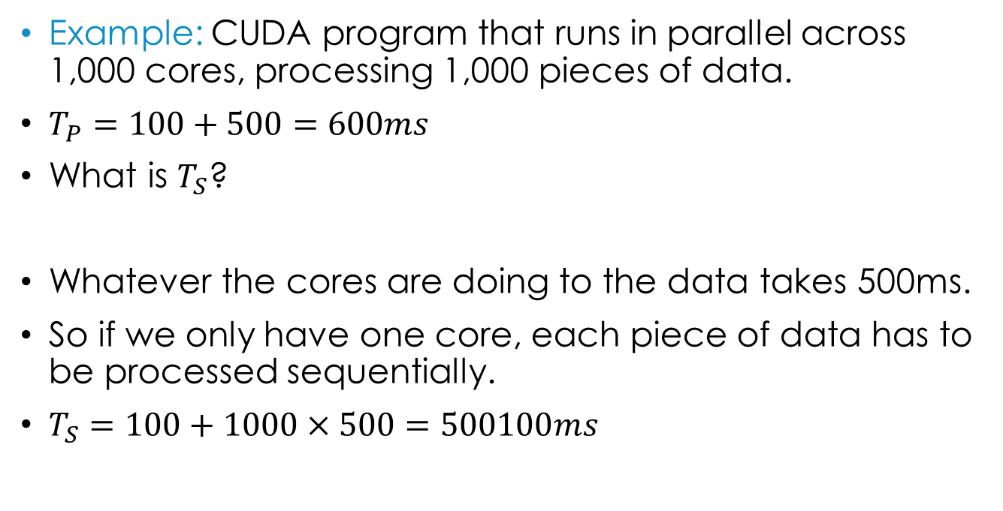
Gustafson’s law
Example: CUDA program that runs in parallel across 1,000 cores, processing 1,000 pieces of data.
$T_{P}=100+500=600ms$
What is $T_{S}$?
Whatever the cores are doing to the data takes 500ms.
So if we only have one core, each piece of data has to be processed sequentially.
$T_{S}=100+1000×500=500100ms$

Slide 27
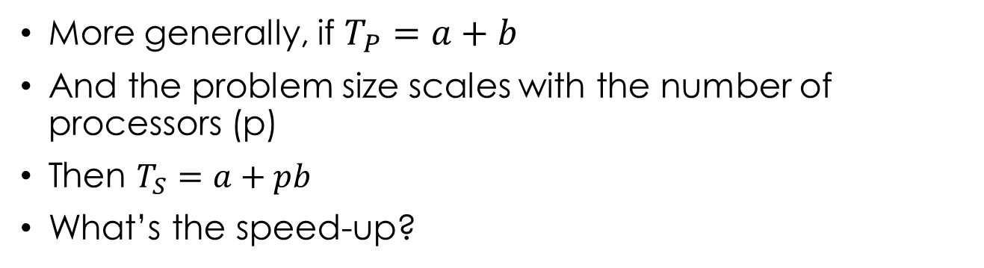
Gustafson’s law
More generally, if $T_{P}=a+b$
And the problem size scales with the number of processors (p)
Then $T_{S}=a+pb$
What’s the speed-up?
Notes:
S = (a + pb) / (a+b)

Slide 28
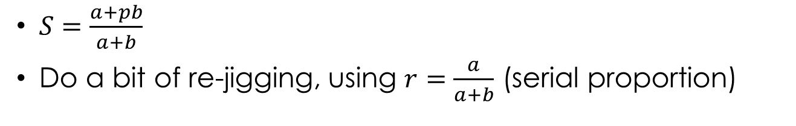
Gustafson’s law
$S=\frac{a+pb}{a+b}$
Do a bit of re-jigging, using $r=\frac{a}{a+b}$ (serial proportion)
Notes:
S = (a/(a+b)) + p*(b/(a+b))
= r + p * ((a+b)/(a+b) – (a / (a+b))
= r + p * (1 – r)
= p + r(1 – p)

Slide 29
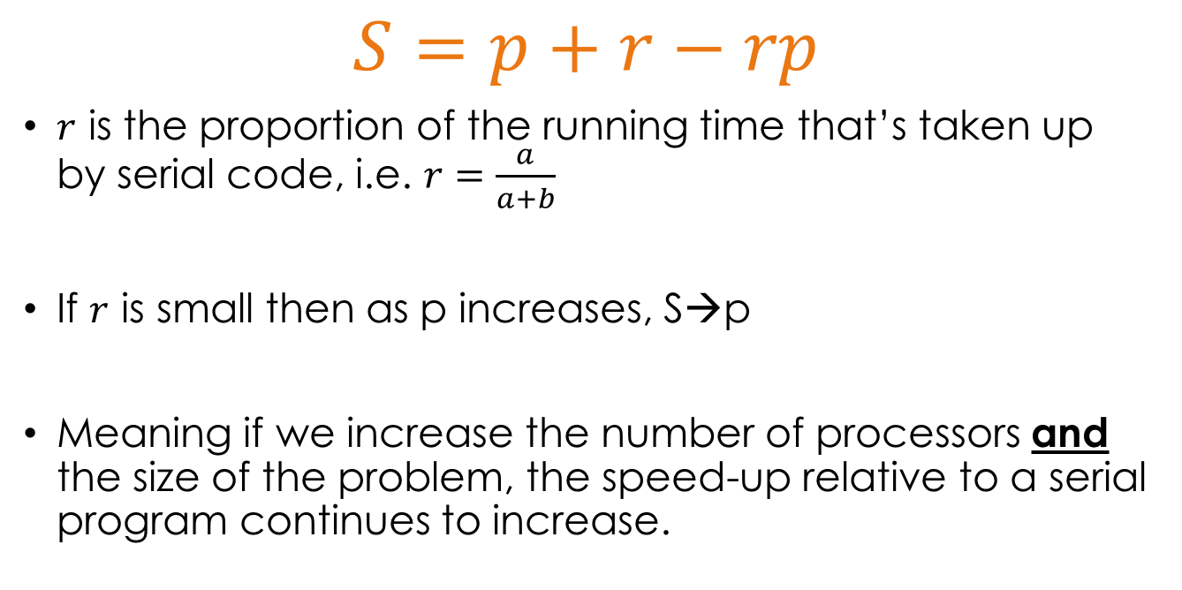
Gustafson’s law
$$S=p+r−rp$$
$r$ is the proportion of the running time that’s taken up by serial code, i.e. $r=\frac{a}{a+b}$
If $r$ is small then as p increases, S→p
Meaning if we increase the number of processors and the size of the problem, the speed-up relative to a serial program continues to increase.

Slide 30
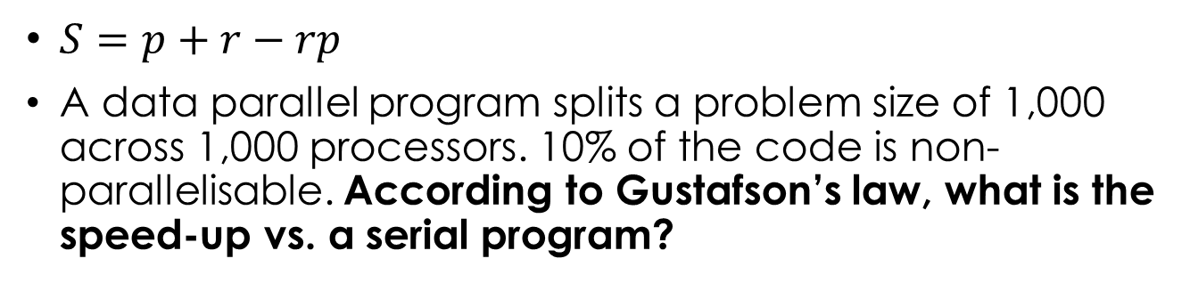
Gustafson’s law
$S=p+r−rp$
A data parallel program splits a problem size of 1,000 across 1,000 processors. 10% of the code is non-parallelisable. According to Gustafson’s law, what is the speed-up vs. a serial program?
Notes:
p = 1000, r=0.1
S = 1000 + 0.1 – 0.1*1000
= 1000 + 0.1 – 100
= 900.1

Slide 31
Gustafson’s law
Back to the marking metaphor…
If the number of exams to mark increases along with the number of PhD students to do the marking, there’s no limit to how many exams can be marked in a week.
The shortest time to do marking is still limited by the time taken to prepare the mark scheme (Amdahl’s Law).

Slide 32
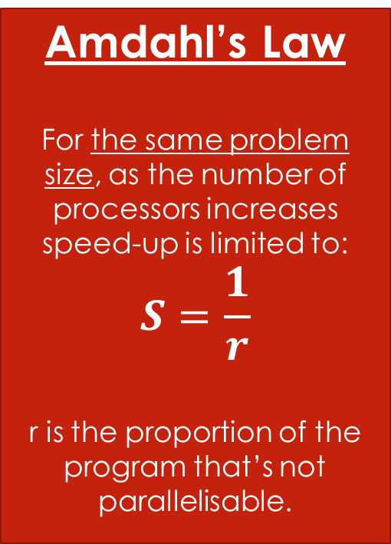
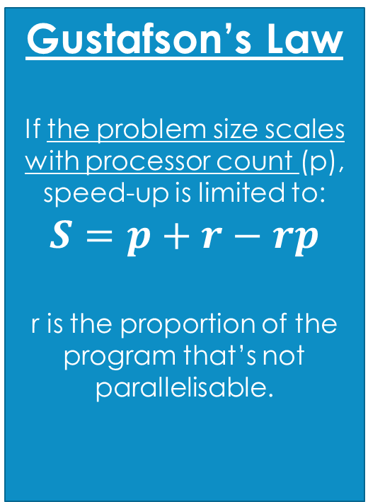
summary
Amdahl’s Law
For the same problem size, as the number of processors increases speed-up is limited to:
$$S=\frac{1}{r}$$
r is the proportion of the program that’s not parallelisable.
Gustafson’s Law
If the problem size scales with processor count (p), speed-up is limited to:
$$S=p+r−rp$$
r is the proportion of the program that’s not parallelisable.

Slide 33
Today’s lecture
Performance Measures: Speed-up & Efficiency
Limits to Parallelism: Amdahl and Gustafson’s Laws
Introduction to Distributed Memory Computing w/ MPI

Slide 34
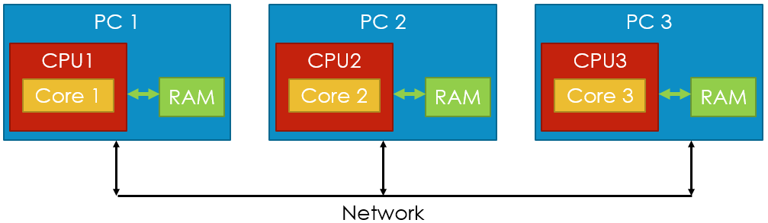
Message passing interface
MPI is an Application Programming Interface (API) for distributed memory parallel programming.
Wait a minute… didn’t I tell you last week that distributed memory was rarely used any more?
It’s rare as a hardware architecture:

Slide 35
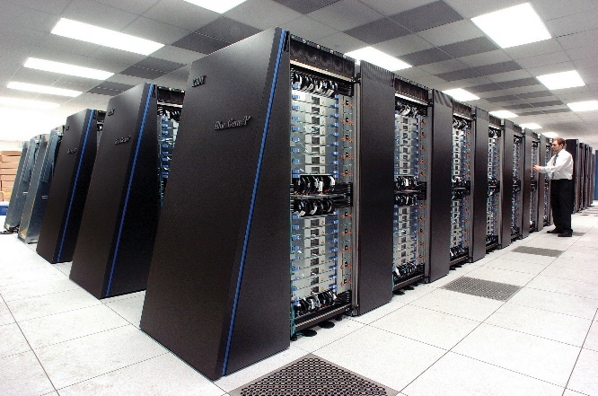
Distributed memory programming
The distributed memory approach is still very widespread as a software architecture.
Probably the majority of large scientific computing programs (i.e. that run on supercomputers) are built using MPI and distributed memory.
Need to understand the difference between threads and processes.

Slide 36
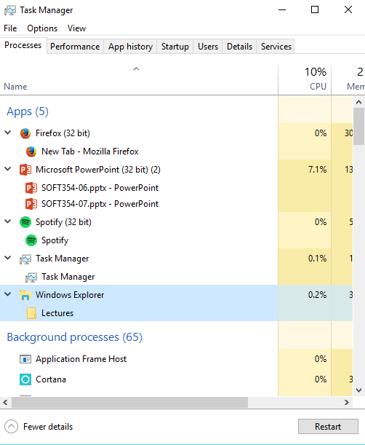
Threads vs processes
Hopefully this is a recap!
Every program you run (or background service, etc.) is a separate process.
Processes cannot normally access each others’ memory → distributed memory.
Communicate in various ways:
Network sockets
Files
Named pipes (OS feature)

Slide 37

Threads vs processes
Each process has one main thread of execution, but can spawn additional ones. E.g.:
One thread for the user interface.
One thread for network I/O.
One thread for data processing.
Each thread can do something different (run different code).
All threads can access their process’s memory → shared memory.
Need to be careful when accessing the same memory from multiple threads to avoid race conditions.
OpenMP (not MPI!) library can help with this.

Slide 38
Threads vs processes
Threads
Processes
“Lightweight”, low memory overhead and can switch between them quickly.
Shared memory means data can be exchanged very easily / quickly.
All need to be on the same machine.
“Heavyweight”, higher memory overhead and switching takes longer.
Distributed memory means communication is harder / slower.
Can be running on different machines.

Slide 39


Threads vs processes
If you need to scale your program up to run on more cores than you have in a single machine, no choice but to use multiple processes.
Can have a hybrid approach here too:
This is a very complex architecture!
Process 0
Process 1
Process 2
Process 0 Memory
Process 1 Memory
Process 2 Memory
Thread 0
Thread 1
Thread 2
Thread 3
Thread 4
Thread 5
Thread 6
Thread 7
Thread 8
Notes:
Note that the different processes here could be running on the same machine, or different machines. All the threads associated with one process must be on the same machine, though.

Slide 40

What exactly is MPI?
It’s not tied to a particular language…
Bindings exist for C/C++, C#, Java, Python, etc.
There’s not one single implementation…
OpenMPI is used in many of the fastest supercomputers.
Also vendor-specific versions, e.g. Microsoft MPI, Intel MPI.
Researchers have even built hardware implementations.
Defines a set of functions (MPI_Send, MPI_Recv, etc) that processes can use to communicate.

Slide 41
Single program multiple data
Usually MPI programs follow a single program multiple data (SPMD) approach.
Write one program and spawn multiple copies of it:
mpiexec –n 100 MyProgram.exe
But you can also use a multiple program multiple data (MPMD) approach:
mpiexec –n 50 MyProgram.exe : -n 50 MyOtherProgram.exe
By default processes just run on the local machine, but can also start them on one or more remote hosts.

Slide 42
MPI Terminology
Communicator: A group of processes that can talk to each other.
Default: MPI_COMM_WORLD – contains all processes.
Rank: An integer uniquely identifying a process within its communicator (0 … <num processes – 1>)
Tag: A (user-defined) integer attached to a message that can be used to indicate the type of message.

Slide 43
Point-to-point communications
For sending individual messages between processes, use the MPI_Send and MPI_Recv functions.
Let’s have a look at these both in detail…

Slide 44
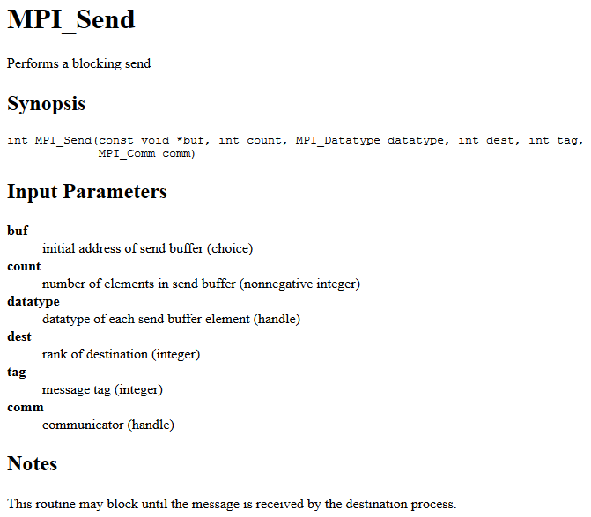
Pointer to the data to send

Slide 45
How many elements to send (1 unless sending an array).

Slide 46
Type of the elements to be sent. MPI_CHAR, MPI_INT, MPI_FLOAT, MPI_DOUBLE, etc.
Can also create derived datatypes (like structs) – later.

Slide 47
Rank of the process to send to.

Slide 48
Tag to attach to the message.

Slide 49
Communicator to send to.

Slide 50
Very important note!

Slide 51
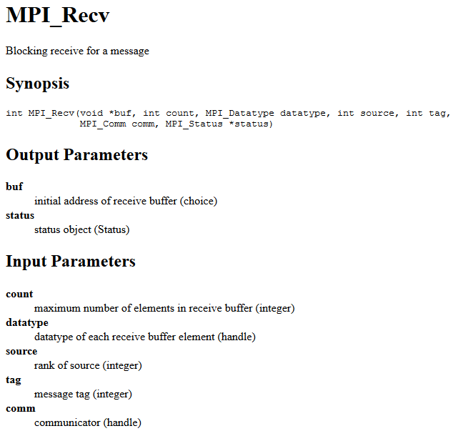
Pointer to where to store the received data.

Slide 52
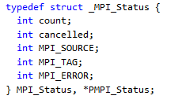
Pointer to an MPI_Status object that will contain message information.

Slide 53
Maximum number of elements to receive. If fewer are sent, MPI_Recv will still return (check status to get actual count).

Slide 54
Type of elements to receive (should match type sent)

Slide 55
Rank of process to receive from (or MPI_ANY_SOURCE)

Slide 56
Tag giving type of message to receive (or MPI_ANY_TAG)

Slide 57
Communicator to receive from

Slide 58
blocking
MPI_Send and MPI_Recv are both (potentially) blocking functions.
(Send may not block for small messages)
This means that every MPI_Send on one process must have a matching MPI_Recv on another process (and vice versa) or the processes will hang!
Very common cause of bugs, as you may have found.
Messages are “nonovertaking”: if a process sends two messages, they will be received in the order they were sent.
No guarantees about what order messages from different processes will arrive.

Slide 59
Collective communication
It’s common to want to send the same data out from one process to all of the others:
for (int i=1; i < commSize; i++) {
MPI_Send(data, dataCount, MPI_FLOAT,
i, msgTag, MPI_COMM_WORLD);
}
The sending process (0) is doing all the work here. MPI provides collective communication functions that can efficiently distribute data amongst processes using a tree structure.
More next week, but for now a preview…

Slide 60
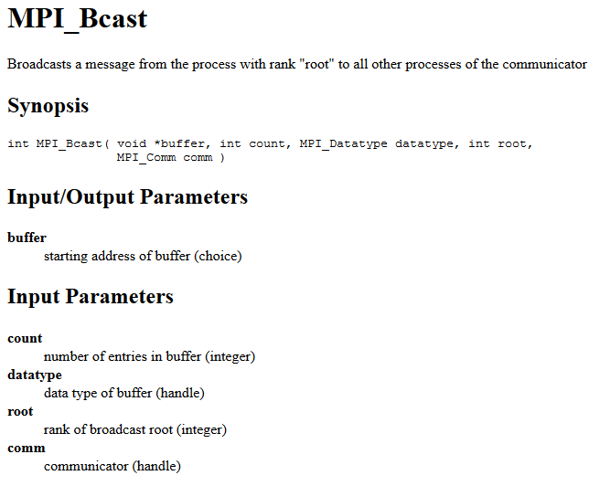

Slide 61
Broadcasting data
float data[dataCount];
// Process 0 loads the data (e.g. from a file)
if (myRank == 0) {
loadData(data);
}
// Distribute data to all processes.
MPI_Bcast(data, dataCount,
MPI_FLOAT, 0, MPI_COMM_WORLD);
// Now all processes will have the same values in
// the ‘data’ array!

Slide 62
summary
Learn the formulas for efficiency, speed-up and Amdahl’s and Gustafson’s laws.
You don’t need to remember how to derive the laws, but you should understand what they mean.
(Learning the derivation will help you remember them!)
If possible, use some of these measures to evaluate your coursework programs’ performance.
(Email me your coursework ideas!)

Slide 63
Summary
MPI (especially OpenMPI) is extremely common in the world of high-performance / scientific computing.
It’s used for distributed memory computing, where parallelism is via multiple processes.
These processes can all be on one machine, or distributed across hundreds.
Multi-threaded (shared memory) computing is also possible – for that use (for example) OpenMP.
All threads must be on the same machine.

Slide 64
summary
The MPI functions are relatively simple, but the way these are implemented can be very smart to maximize performance.
We’ve seen point-to-point communication (MPI_Send, MPI_Recv), and one collective communication function (MPI_Bcast)
We’ll meet more collective communication functions (and look at how they work) next week.

