Slide 1

SOFT354: Parallel Computation and distributed systems
Week 7
Dr Robert Merrison-Hort

Slide 2
Today’s lecture
Mid-Module Survey Results
Coursework
Class Test Results
Overview of Parallel Architectures
(Maybe) Intro to MPI

Slide 3
Mid-module Survey results
14 responses – thanks!
Still up on the DLE if you have something to say.
Common complaints / suggestions:
Mistakes in lectures:
Sorry ☹ All new slides this year – but I’ll do an extra proof-read in future.
Lecture slides not available early:
Honestly – they’re not usually ready the day before. Need to try to get ahead…

Slide 4
Mid-module Survey results
Code samples in lectures hard to follow / too much jumping between slides:
Agreed – I’ll try cut down the code in lectures and jump around less.
No practical solutions:
I don’t like doing this too early, but will prepare solutions to the existing practicals for you.
Lectures too long / bad lecture room:
Complain to your student about the former! Can’t do much about the latter (but test will be in bigger room).

Slide 5

Mid-module Survey results
Too hard:
Unfortunately parallel algorithms (especially for the GPU) tend to be hard to get your head around.
Good news is we’re mostly done with GPU programming, and have plenty of time to slow the pace a bit.
Workshops can’t be finished in 2 hours:
Need to use your own time – I can help via email / meeting.
Lack of book access (anticipated problem):
Library have ordered 4 more paper copies of the CUDA book, online copy no longer limited to one user at a time.
Coursework spec not available…

Slide 6
coursework
Worth 60% of your mark for SOFT354.
Each choose a particular computational problem and then implement two algorithms to solve it:
One serial (single threaded)
One parallel, using CUDA or MPI (your choice)
You will need to compare the performance of the two versions, and analyse which works better and why.
Need to submit your code, and a report describing your results.
Available from 24th November Today, due 25th January.

Slide 7
Class test results
Average Mark: 60%, Highest: 90% (one student)
Generally very pleased – it wasn’t an easy test.
If your mark was < 50% you should worry a bit – go through the solutions and previous lecture slides and make sure you understand them (or email me!)
Actual test will be in a bigger room (FZB205 – downstairs).
Go through four “hardest” questions now…

Slide 8
(ON WHITEBOARD)

Slide 9



Some parallel terminology
If you have a load of stuff to do…
Class tests to mark
Mobile phones to build
Pieces of data to transform
You can get the job done faster by parallelising.

Slide 10


Two approaches to parallelisation
Each worker does a different job, all workers work on each individual item at some point…
One PhD student marks questions 1-5, another marks questions 6-10, another marks 10-15.
One worker solders the circuit board, another builds the screen, another the case.
One core does the first step of transformation, another does the second step, etc…
(I wish!)
“Task Parallelism”

Slide 11
Two approaches to parallelisation
Each worker does the whole process for one item; workers work on different items.
Three PhD students, each one marks ten class tests.
Every worker does every stage of building a phone, but they all work on different phones.
Every core does the complete transformation, but they work on different pieces of data.
“Data Parallelism”

Slide 12



Task Parallel or data parallel?
Say we are using a GPU to convolve a big image.
Each core (or thread) applies the convolution to one small region of the image.
Task Parallel or Data Parallel?
The key question: is each core (or thread) doing basically the same thing task?
Yes! → Data Parallel

Slide 13
Flynn’s taxonomy
Defines four approaches to parallel computation:
Single Instruction stream, Single Data stream (SISD)
Single Instruction stream, Multiple Data streams (SIMD)
Multiple Instruction streams, Single Data stream (MISD)
Multiple Instruction streams, Multiple Data streams (MIMD)

Slide 14
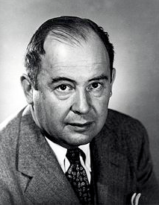
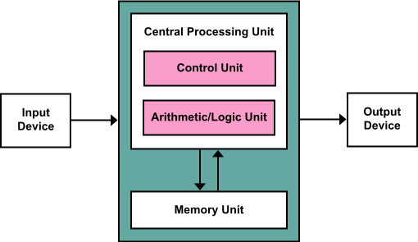
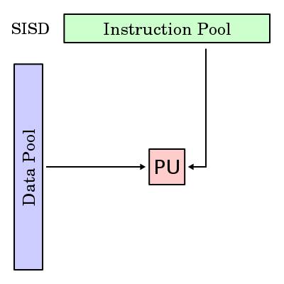
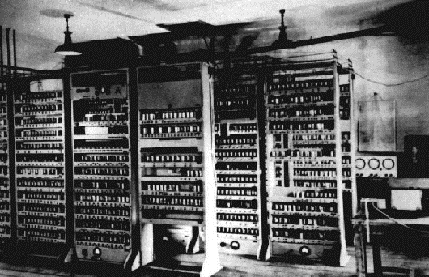
Single instruction, single data
This is the classic von Neumann architecture.
“If people do not believe that mathematics is simple, it is only because they do not realize how complicated life is.”
The CPU does one operation at a time, on one piece of data.
EDVAC
Notes:
PU = Processing Unit

Slide 15
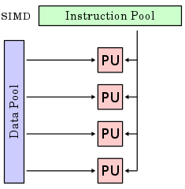
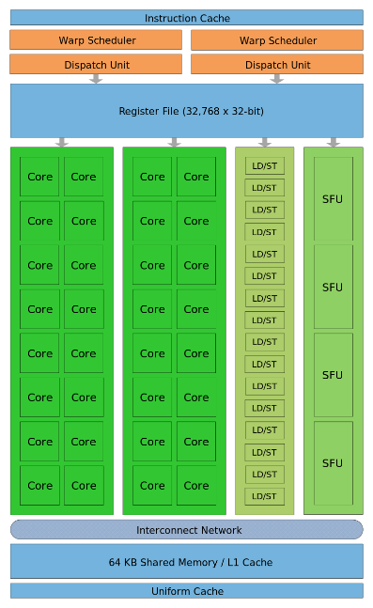
Single instruction, multiple data
Multiple cores that process multiple data streams in parallel, but each core executes the same instruction at once.
This is like one streaming multiprocessor (SM) in a GPU...
… although since different threads can follow different paths through the code (divergence), Nvidia use the term “single instruction, multiple thread” (SIMT).

Slide 16
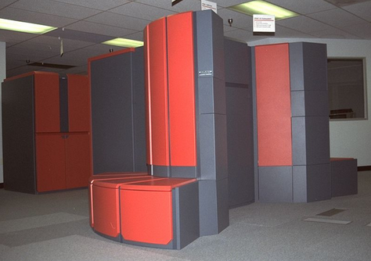
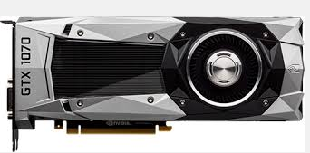
Single instruction, multiple data
Another example of SIMD hardware is a vector processor.
Have special vectorised machine code instructions that operate on many values in parallel.
E.g. “add the ten integers at memory address X to the ten integers at memory address Y”.
Were common in supercomputers in the 70s, 80s and 90s.
Cray Y-MP: 2.5 GFLOPS, $5 million
Geforce GTX1070, 5,783 GFLOPS, $400

Slide 17
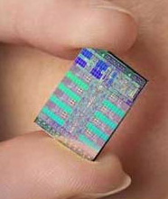

Single instruction, multiple data
The Playstation 3 was based on the Cell processor, which was largely designed as a vector processor.
All modern CPUs contain vector processing circuitry, which compilers can take advantage of by using vectorised instructions.
E.g. Intel call it Streaming SIMD Instructions (SSE).

Slide 18
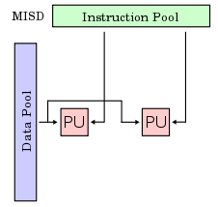
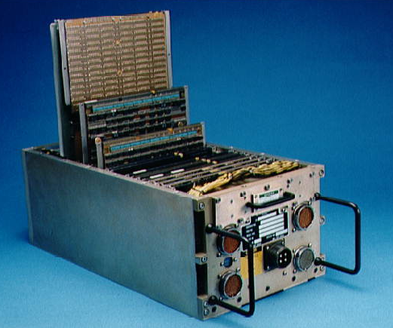
Multiple instructions, single data
MISD is quite uncommon.
In this model, the same data is read from memory into multiple processing units, each of which can have their own instructions.
Most famous example is the space shuttle control computer:
Multiple processing units that read the same data (and, in fact, the same instructions)
All processing units have to agree on the results or an error is raised: fault tolerance.

Slide 19
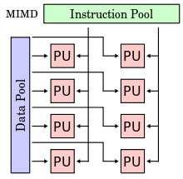
Multiple instructions, multiple data
This is probably the most common form of parallelism (although maybe GPUs will change that…)
Each processing unit (e.g. CPU or CPU core) can access different data from memory, and can run different instructions.
The programs that you’ll write using MPI exploit an MIMD architecture.

Slide 20
MIMD sub-classes
It’s also possible to divide MIMD further into two different groups.
Single Program Multiple Data (SPMD):
Each core runs the same program, but they aren’t all necessarily always at the same point in the program (unlike SIMD).
The programs we’ll write for MPI will be SPMD.
Multiple Program Multiple Data (MPMD):
Each processing core runs a different program.

Slide 21
MIMD sub-classes
Input Video 1
Input Video 2
Input Video 3
Single Program Multiple Data (SPMD)
Core 1
(Decryption Program)
Input
Video 1
Core 1
(“Do Everything” Program)
Output
Video 1
Core 2
(Video Decoder Program)
Input
Video 2
Core 2
(“Do Everything” Program)
Output
Video 2
Multiple Program Multiple Data (MPMD)
Input
Video 3
Core 3
(“Do Everything” Program)
Output
Video 3
Core 3
(Video Filter Program)
Core 4
(Video Encoder Program)
Input
Video 4
Core 4
(“Do Everything” Program)
Output
Video 4
Core 5
(Encryption Program)
Input
Video 5
Core 5
(“Do Everything” Program)
Output
Video 5
Output Videos
Notes:
Assume we’ve got a bunch of videos that are encrypted and encoded. We want to decrypt and decode them all, then do some transformation, then encode and encrypt them again.

Slide 22

Types of MIMD architecture
Shared Memory: Each processing core can directly access the same memory, maybe with some local cache.
E.g. A PC with two CPUs, each with 4 cores. All the cores can access the PC’s RAM.
PC 1
CPU1
CPU2
Core 1
Core 5
(completely different to OpenMPI!)
Core 2
RAM
Core 6
Core 3
Core 7
Core 4
Core 8
For Relatively Small-Scale Computing Problems
Notes:
Don’t confuse a shared memory MIMD system with shared memory in CUDA!

Slide 23
Types of MIMD architecture
Distributed Memory: Each processing core has its own private memory. It can only access another core’s memory indirectly.
E.g. A cluster of single core PCs connected to each other over a network. They can only access each others’ RAM by sending requests over the network.
PC 1
PC 2
PC 3
CPU1
CPU2
CPU3
Core 1
RAM
Core 2
RAM
Core 3
RAM
Network
No longer common!
Notes:
Don’t confuse a shared memory MIMD system with shared memory in CUDA!

Slide 24
Types of MIMD architecture
Hybrid Memory: Groups of processing cores share memory, but memory not shared between groups.
E.g. a cluster of multi-core PCs. Within each PC cores share memory, but cores in different PCs access each others’ memory by sending requests over the network.
PC 1
PC 2
CPU1
CPU2
CPU3
CPU2
Core 1
Core 5
Core 9
Core 13
Core 2
RAM
Core 6
Core 10
RAM
Core 14
Core 3
Core 7
Core 11
Core 15
Core 4
Core 8
Core 12
Core 16
Network
All Modern Supercomputers
Notes:
Don’t confuse a shared memory MIMD system with shared memory in CUDA!

Slide 25
Summary
Not Parallel!
GPUs (SIMT)
Vector Processors
Most Common
Not Common
(Redundancy)
Single Program, Multiple Data
Multiple Program, Multiple Data
Shared Memory (one PC)
Distributed Memory (uncommon)
Hybrid Memory (cluster)

