Slide 1

SOFT354: Parallel Computation and distributed systems
Week 4
Dr Robert Merrison-Hort

Slide 2
Today’s lecture
Two halves:
First we will look at an issue that can cause CUDA kernels to run much slower than expected: divergence.
Then we will carefully work through writing a matrix multiplication kernel, both with and without shared memory.

Slide 3
reminder
Practice test in two weeks: Thursday 3th November.
In the usual lecture slot / room.
Doesn’t count towards your mark (but take it seriously!)
Short sentence / single word / number answers only.
Bring a calculator (though there shouldn’t be anything you can’t work out in your head / on paper).

Slide 4
branch divergence
As general rule, try to avoid branching statements (e.g. if / else, switch) in kernel code.
As we’ll see in a minute, these can sometimes make your kernel run much less efficiently.
But only in some circumstances!
To understand why, need to remember how threads are executed on the GPU.

Slide 5
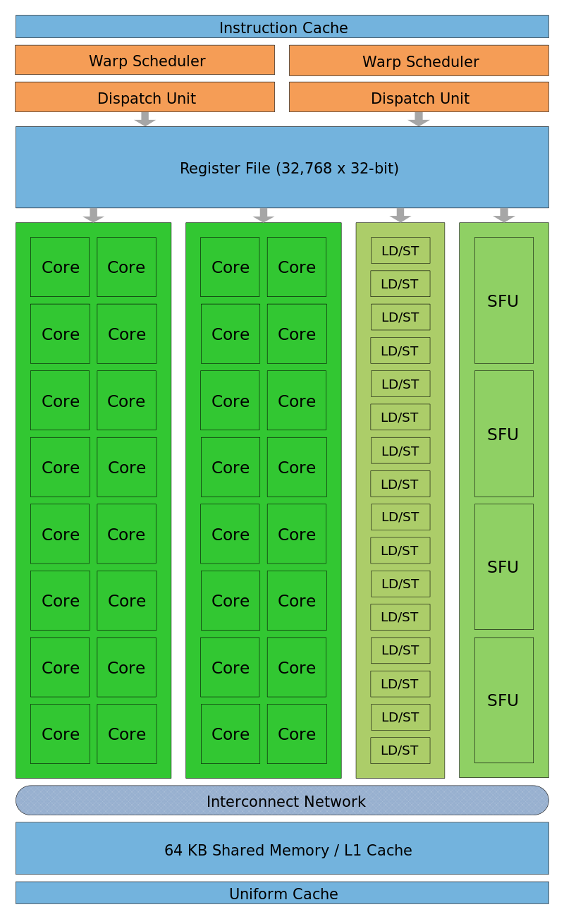
Warps reminder
When a streaming multiprocessor has a block of threads assigned to it, it breaks it down into warps.
Each warp is a set of 32 threads.
A streaming multiprocessor has 32 cores – it executes all the threads in a warp in parallel.
Crucially, all the threads in a warp share the same instruction pointer.
Notes:
Sharing the same instruction pointer means each thread must be executing the same instruction at the same time.
(Actually if you get into the detail it’s half warps that are scheduled together, but really it’s to just think about whole warps).

Slide 6
Parallel fizzbuzz
Common interview question:
Write a program that prints the numbers from 1 to 100. But for multiples of three print "Fizz" instead of the number and for the multiples of five print "Buzz". For numbers which are multiples of both three and five print "FizzBuzz".
Majority of computer science graduates can’t* (???)
Let’s write a parallel version…
This is not a good solution – don’t use it in a job interview!
It’s a simple way of demonstrating branch divergence.
*https://blog.codinghorror.com/why-cant-programmers-program/
Notes:
The article linked here became quite popular, so probably now all comp. sci. students are trained to solve FizzBuzz and nobody uses it as a useful interview question any more!

Slide 7
Parallel fizzbuzz
Array of N integers, entry i contains:
The value -1 if i is divisible by 2. (“Fizz”)
The value -2 if i is divisible by 3. (“Buzz”)
The value -3 if i is divisible by 2 and 3. (“FizzBuzz”)
Otherwise just the value of i.
__device__ int d_outputs[N];
__global__ void kernel()
{
int i = blockIdx.x* blockDim.x + threadIdx.x;
bool isDivisibleBy2 = (i % 2) == 0;
if (isDivisibleBy2) {
d_outputs[i] = -1;
} else {
d_outputs[i] = 0;
}
bool isDivisibleByThree = (i % 3) == 0;
if (isDivisibleByThree) {
d_outputs[i] -= 2;
}
if (d_outputs[i] == 0) {
d_outputs[i] = i;
}
}
i % M (or “i modulo M”) gives the remainder when i is divided by M. If it’s zero, i is divisible by M.

Slide 8
Parallel fizzbuzz
__global__ void kernel()
{
int i = blockIdx.x* blockDim.x + threadIdx.x;
bool isDivisibleBy2 = (i % 2) == 0;
if (isDivisibleBy2) {
d_outputs[i] = -1;
} else {
d_outputs[i] = 0;
}
...
Consider the first two threads in a warp running in parallel.
Thread 0 |  | Thread 1

Slide 9
Parallel fizzbuzz
__global__ void kernel()
{
int i = blockIdx.x* blockDim.x + threadIdx.x;
bool isDivisibleBy2 = (i % 2) == 0;
if (isDivisibleBy2) {
d_outputs[i] = -1;
} else {
d_outputs[i] = 0;
}
...
Consider the first four threads in a warp running in parallel.
Thread 0 |  | Thread 1
i |  | i
0 |  | 1

Slide 10
Parallel fizzbuzz
__global__ void kernel()
{
int i = blockIdx.x* blockDim.x + threadIdx.x;
bool isDivisibleBy2 = (i % 2) == 0;
if (isDivisibleBy2) {
d_outputs[i] = -1;
} else {
d_outputs[i] = 0;
}
...
Consider the first four threads in a warp running in parallel.
Thread 0 |  | Thread 1
i | isDivisibleBy2 | i | isDivisibleBy2
0 |  | 1
0 | true | 1 | false

Slide 11
Parallel fizzbuzz
__global__ void kernel()
{
int i = blockIdx.x* blockDim.x + threadIdx.x;
bool isDivisibleBy2 = (i % 2) == 0;
if (isDivisibleBy2) {
d_outputs[i] = -1;
} else {
d_outputs[i] = 0;
}
...
Consider the first four threads in a warp running in parallel.
Thread 0 |  | Thread 1
i | isDivisibleBy2 | i | isDivisibleBy2
0 |  | 1
0 | true | 1 | false
Which instruction runs next?

Slide 12
Divergence!
__global__ void kernel()
{
int i = blockIdx.x* blockDim.x + threadIdx.x;
bool isDivisibleBy2 = (i % 2) == 0;
if (isDivisibleBy2) {
d_outputs[i] = -1;
} else {
d_outputs[i] = 0;
}
...
Thread 0 should run the “if” part, thread 1 should run the “else” part…
But the threads share an instruction pointer, so both have to be on the same instruction.
What does the streaming multiprocessor do?

Slide 13
Divergence!
__global__ void kernel()
{
int i = blockIdx.x* blockDim.x + threadIdx.x;
bool isDivisibleBy2 = (i % 2) == 0;
if (isDivisibleBy2) {
d_outputs[i] = -1;
} else {
d_outputs[i] = 0;
}
...
First, it marks all threads that should take the “else” part as deactivated and runs the “if” block.
The deactivated threads don’t do anything during this.
Then, it marks all the threads that should take the “if” part as deactivated and runs the “else” block.
Again, deactivated threads don’t do anything now.

Slide 14
Divergence is inefficient
If different threads have to run different blocks of code, each block has to be run serially.
With the FizzBuzz example it’s not so bad, since each block of code has just one statement…
… but if you had two large blocks of code they’d both have to run, one after another, even if only one thread had to run one of them.

Slide 15
Divergence is inefficient
__global__ void kernel()
{
if (threadIdx.x == 0) {
expensiveFunction();
} else {
anotherExpensiveFunction();
}
}
expensiveFunction and anotherExpensiveFunction both take 1,000 cycles to run.
Question:
We execute kernel on 32 blocks, 32 threads in each.
i.e. kernel<<<32, 32>>>();
How many cycles will expensiveFunction use?
32*1000=32,000.
What about anotherExpensiveFunction?
32*1000=32,000.
64,000 total cycles in function calls. What if we reorganise?
Notes:
expensiveFunction is called once in each block (with 1 active thread).
anotherExpensiveFunction is called once in each block (with 31 active threads).

Slide 16
Divergence is inefficient
__global__ void kernel()
{
if (blockIdx.x == 0) {
expensiveFunction();
} else {
anotherExpensiveFunction();
}
}
expensiveFunction and anotherExpensiveFunction both take 1,000 cycles to run.
Question:
We execute kernel on 32 blocks, 32 threads in each.
i.e. kernel<<<32, 32>>>();
How many cycles will expensiveFunction use?
1*1000=1,000.
What about anotherExpensiveFunction?
31*1000=31,000.
32,000 total cycles in function calls → twice as fast!
Notes:
expensiveFunction is called only in block 0 (with 32 active threads).
anotherExpensiveFunction is called once in each other block block (with 32 active threads).

Slide 17
Back to fizzbuzz
__device__ int d_outputs[N];
__global__ void kernel()
{
int i = blockIdx.x* blockDim.x + threadIdx.x;
bool isDivisibleBy2 = (i % 2) == 0;
if (isDivisibleBy2) {
d_outputs[i] = -1;
} else {
d_outputs[i] = 0;
}
bool isDivisibleByThree = (i % 3) == 0;
if (isDivisibleByThree) {
d_outputs[i] -= 2;
}
if (d_outputs[i] == 0) {
d_outputs[i] = i;
}
}
Here we have if statements without matching elses.
This isn’t so bad.
If there’s a single thread in a warp where the condition is true, the code in the block will run.

Slide 18
Back to fizzbuzz
if (isDivisibleByThree) {
d_outputs[i] -= 2;
}
In every warp there’ll be at least once thread where this condition is true (it’s true for every 3rd thread).
But there aren’t two pieces of code to be run, since there’s no else block, so performance hit isn’t too bad.
Would be faster if all the threads with (i%3)==0 were together in the same warps – then the other warps wouldn’t need to run the block.
But that’s not really practical…

Slide 19
divergence
Active Threads
int i = blockIdx.x* blockDim.x + threadIdx.x;
bool isDivisibleBy2 = (i % 2) == 0;
if (isDivisibleBy2) {
0
1
2
3
4
5
6
7
d_outputs[i] = -1;
0
1
2
3
4
5
6
7
d_outputs[i] = 0;
0
1
2
3
4
5
6
7
bool isDivisibleByThree = (i % 3) == 0;
if (isDivisibleByThree) {
0
1
2
3
4
5
6
7
d_outputs[i] -= 2;
0
1
2
3
4
5
6
7
if (d_outputs[i] == 0) {
0
1
2
3
4
5
6
7
d_outputs[i] = i;
0
1
2
3
4
5
6
7

Slide 20
divergence
Divergence gets worse the more code paths you have:
if (condition1) {
expensiveOperation1();
}
else if (condition2) {
expensiveOperation2();
}
else if (condition3) {
expensiveOperation3();
}
else {
expensiveOperation4();
}
If a warp contains at least one thread where each condition is true, then all four expensive operations have to run!
Golden rule: if possible, organise blocks so that threads in the same warp follow the same path.

Slide 21
__syncthreads and divergence
Reminder from last week: __syncthreads() causes a thread to pause until all of the threads in its block have reached the same __syncthreads() call.
Example: if threads co-operate to load data into shared memory, they should wait until every thread has done its loading before starting work.
Long story short: don’t use __syncthreads inside any sections of code that might only run on some threads in a block.

Slide 22
__syncthreads and divergence
__global__ kernel()
{
int globalId =
blockIdx.x*blockDim.x +
threadIdx.x;
if (globalId < M) {
}
}
This is common pattern that we’ve seen before.
Kernel works even if the number of threads is bigger than the problem size.
But what if part of the kernel involves loading data into shared memory?

Slide 23

__syncthreads and divergence
__global__ kernel()
{
int globalId =
blockIdx.x*blockDim.x +
threadIdx.x;
if (globalId < M) {
// (load some data)
__syncthreads();
// (process data)
}
}
Don’t do this!
Thread M-1 will execute the code in the if block (including __syncthreads).
Thread M won’t.
If these two threads are in the same block, thread M-1 will be waiting forever for thread M to sync – deadlock!
Notes:
You may find that actually code like this sometimes works. That’s because actually __syncthreads() happens at the warp level, so within a block as long as at least one thread in every warp runs the __syncthread or no threads in any warps runs it there won’t be a deadlock (http://stackoverflow.com/a/30382467). Just because it can work sometimes doesn’t mean it’s right though, so avoid it!

Slide 24

__syncthreads and divergence
__global__ kernel()
{
int globalId =
blockIdx.x*blockDim.x +
threadIdx.x;
if (globalId < M) {
// (load some data)
}
__syncthreads();
if (globalId < M) {
// (process data)
}
}
Now all threads in a block will run __syncthreads.
Messier, but won’t deadlock!

Slide 25
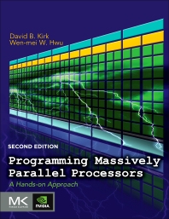
Matrix multiplication
We’re going to develop a kernel that calculates AxB, where A and B are both nxn matrices.
Start with a simple version, then see how to dramatically increase performance with shared memory.
Following example in Kirk & Hwu.

Slide 26
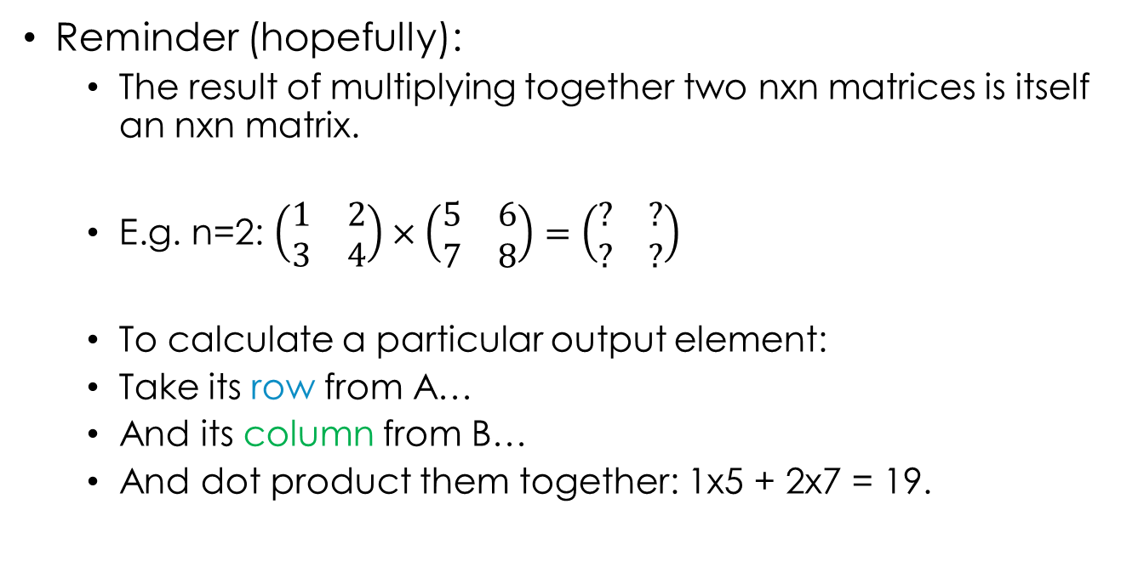
Matrix multiplication
Reminder (hopefully):
The result of multiplying together two nxn matrices is itself an nxn matrix.
E.g. n=2: $\left(\begin{matrix}1 & 2 \\ 3 & 4\end{matrix}\right)×\left(\begin{matrix}5 & 6 \\ 7 & 8\end{matrix}\right)=\left(\begin{matrix}? & ? \\ ? & ?\end{matrix}\right)$
To calculate a particular output element:
Take its row from A…
And its column from B…
And dot product them together: 1x5 + 2x7 = 19.
A
B

Slide 27

Matrix multiplication
Reminder (hopefully):
The result of multiplying together two nxn matrices is itself an nxn matrix.
E.g. n=2: $\left(\begin{matrix}1 & 2 \\ 3 & 4\end{matrix}\right)×\left(\begin{matrix}5 & 6 \\ 7 & 8\end{matrix}\right)=\left(\begin{matrix}19 & ? \\ ? & ?\end{matrix}\right)$
To calculate a particular output element:
Take its row from A…
And its column from B…
And dot product them together: 1x5 + 2x7 = 19.
A
B

Slide 28
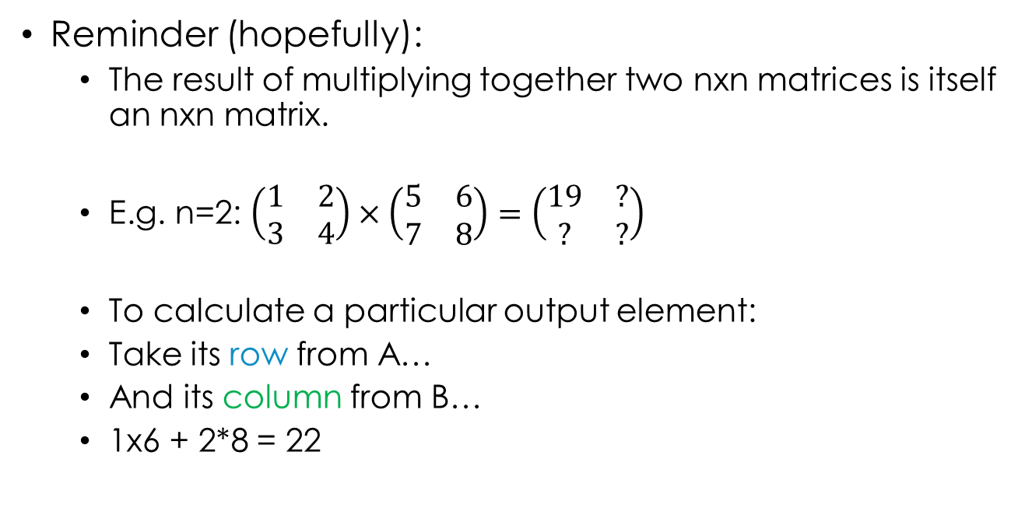
Matrix multiplication
Reminder (hopefully):
The result of multiplying together two nxn matrices is itself an nxn matrix.
E.g. n=2: $\left(\begin{matrix}1 & 2 \\ 3 & 4\end{matrix}\right)×\left(\begin{matrix}5 & 6 \\ 7 & 8\end{matrix}\right)=\left(\begin{matrix}19 & ? \\ ? & ?\end{matrix}\right)$
To calculate a particular output element:
Take its row from A…
And its column from B…
1x6 + 2*8 = 22
A
B

Slide 29

Matrix multiplication
Reminder (hopefully):
The result of multiplying together two nxn matrices is itself an nxn matrix.
E.g. n=2: $\left(\begin{matrix}1 & 2 \\ 3 & 4\end{matrix}\right)×\left(\begin{matrix}5 & 6 \\ 7 & 8\end{matrix}\right)=\left(\begin{matrix}19 & 22 \\ ? & ?\end{matrix}\right)$
To calculate a particular output element:
Take its row from A…
And its column from B…
1x6 + 2*8 = 22
A
B

Slide 30

Matrix multiplication
Reminder (hopefully):
The result of multiplying together two nxn matrices is itself an nxn matrix.
E.g. n=2: $\left(\begin{matrix}1 & 2 \\ 3 & 4\end{matrix}\right)×\left(\begin{matrix}5 & 6 \\ 7 & 8\end{matrix}\right)=\left(\begin{matrix}19 & 22 \\ ? & ?\end{matrix}\right)$
To calculate a particular output element:
Take its row from A…
And its column from B…
3x5 + 4*7 = 43
A
B

Slide 31
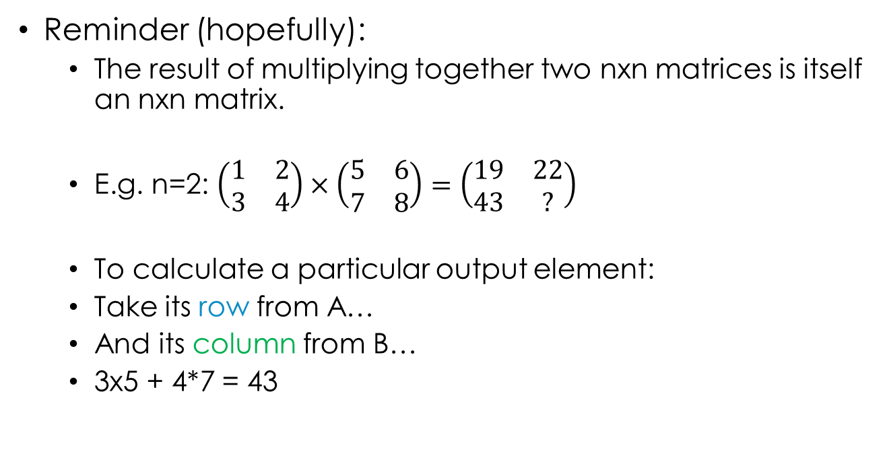
Matrix multiplication
Reminder (hopefully):
The result of multiplying together two nxn matrices is itself an nxn matrix.
E.g. n=2: $\left(\begin{matrix}1 & 2 \\ 3 & 4\end{matrix}\right)×\left(\begin{matrix}5 & 6 \\ 7 & 8\end{matrix}\right)=\left(\begin{matrix}19 & 22 \\ 43 & ?\end{matrix}\right)$
To calculate a particular output element:
Take its row from A…
And its column from B…
3x5 + 4*7 = 43
A
B

Slide 32

Matrix multiplication
Reminder (hopefully):
The result of multiplying together two nxn matrices is itself an nxn matrix.
E.g. n=2: $\left(\begin{matrix}1 & 2 \\ 3 & 4\end{matrix}\right)×\left(\begin{matrix}5 & 6 \\ 7 & 8\end{matrix}\right)=\left(\begin{matrix}19 & 22 \\ 43 & ?\end{matrix}\right)$
To calculate a particular output element:
Take its row from A…
And its column from B…
3x6 + 4*8 = 50
A
B

Slide 33

Matrix multiplication
Reminder (hopefully):
The result of multiplying together two nxn matrices is itself an nxn matrix.
E.g. n=2: $\left(\begin{matrix}1 & 2 \\ 3 & 4\end{matrix}\right)×\left(\begin{matrix}5 & 6 \\ 7 & 8\end{matrix}\right)=\left(\begin{matrix}19 & 22 \\ 43 & 50\end{matrix}\right)$
To calculate a particular output element:
Take its row from A…
And its column from B…
3x6 + 4*8 = 50
A
B

Slide 34
Matrix multiplication
Trick to remember this:
Draw out the result matrix.
Write A to the left of it.
Write B above it.
5 | 6
7 | 8
B
A
1 | 2
3 | 4
? | ?
? | ?

Slide 35
Matrix multiplication
Trick to remember this:
Draw out the result matrix.
Write A to the left of it.
Write B above it.
Then, to calculate an element, look along to get one vector, and up to get the other, and dot product them.
5 | 6
7 | 8
B
A
1 | 2
3 | 4
? | ?
? | ?

Slide 36
Matrix multiplication
Trick to remember this:
Draw out the result matrix.
Write A to the left of it.
Write B above it.
Then, to calculate an element, look along to get one vector, and up to get the other, and dot product them.
5 | 6
7 | 8
B
A
1 | 2
3 | 4
19 | ?
? | ?

Slide 37
Matrix multiplication
Trick to remember this:
Draw out the result matrix.
Write A to the left of it.
Write B above it.
Then, to calculate an element, look along to get one vector, and up to get the other, and dot product them.
5 | 6
7 | 8
B
A
1 | 2
3 | 4
19 | ?
? | ?

Slide 38
Matrix multiplication
Trick to remember this:
Draw out the result matrix.
Write A to the left of it.
Write B above it.
Then, to calculate an element, look along to get one vector, and up to get the other, and dot product them.
5 | 6
7 | 8
B
A
1 | 2
3 | 4
19 | 22
? | ?

Slide 39
Matrix multiplication
Trick to remember this:
Draw out the result matrix.
Write A to the left of it.
Write B above it.
Then, to calculate an element, look along to get one vector, and up to get the other, and dot product them.
5 | 6
7 | 8
B
A
1 | 2
3 | 4
19 | 22
? | ?

Slide 40
Matrix multiplication
Trick to remember this:
Draw out the result matrix.
Write A to the left of it.
Write B above it.
Then, to calculate an element, look along to get one vector, and up to get the other, and dot product them.
5 | 6
7 | 8
B
A
1 | 2
3 | 4
19 | 22
43 | ?

Slide 41
Matrix multiplication
Trick to remember this:
Draw out the result matrix.
Write A to the left of it.
Write B above it.
Then, to calculate an element, look along to get one vector, and up to get the other, and dot product them.
5 | 6
7 | 8
B
A
1 | 2
3 | 4
19 | 22
43 | ?

Slide 42
Matrix multiplication
Trick to remember this:
Draw out the result matrix.
Write A to the left of it.
Write B above it.
Then, to calculate an element, look along to get one vector, and up to get the other, and dot product them.
5 | 6
7 | 8
B
A
1 | 2
3 | 4
19 | 22
43 | 50

Slide 43
Break
Practice matrix multiplications.
I recommend using the “trick” method for laying them out – this will help you follow the explanation of the algorithm we’ll develop.

Slide 44
motivation
What’s the complexity of this algorithm?
To compute each element in the result array, need to calculate dot product of two n-dimensional vectors.
This takes O(n) time.
There are n*n output vectors, so total complexity is O(n³).
Cleverer algorithms exist, but best is still O(n^{2.373})
For realistic scenarios (e.g. machine learning), n can be very large (1,00; 1,000; more…) – need to parallelise!

Slide 45
Simple approach
2D grid of threads – one for each output element.
2D Input arrays: d_A[n][n], d_B[n][n]. Output array: d_C[n][n].
x₀ y₀ | x₁ y₀ | … | x_{n-1} y₀
x₀ y₁
… |  | …
x₀ y_{n-1} |  |  | x_{n-1} y_{n-1}

Slide 46
Simple approach
So a thread at position x,y needs to dot product row y of d_A and column x of d_B.
B
5 | 6
7 | 8
__global__ void kernel()
{
int x = blockIdx.x*blockDim.x +
threadIdx.x;
int y = blockIdx.y*blockDim.y +
threadIdx.y;
if (x < n && y < n) {
float dotProd = 0.0f;
for (int i = 0; i < n; i++) {
dotProd += d_A[y][i] * d_B[i][x];
}
d_C[y][x] = dotProd;
}
}
A
1 | 2
3 | 4
19 | 22
43 | 50

Slide 47
Shared memory
This algorithm works perfectly well, and will be a lot faster than doing the multiplication on the CPU.
E.g. on my Quadro 2000, n=2000 takes 1086ms.
The kernel has a lot of global memory access. We can improve this by temporarily caching to shared memory.
Reminder from last week’s lecture…

Slide 48
Shared memory
A variable with the __shared__ modifier has its memory allocated in the streaming multiprocessors’ shared memory area.
This is fast but local to the SM.
Each block has a separate copy of any __shared__ variables.
All threads in a block can access their block’s copy of the shared variables, but not other blocks’ copies.

Slide 49
Shared memory matrix multiplication
To see how we can use shared memory for matrix multiplication, let’s look at what happens in one block.
Assume n=4, and blocks are 2x2 threads.
Block 0,0
Block 1,0
Block 0,1
Block 1,1
What elements of A and B do the threads in the first block (0,0) access?

Slide 50
These two threads both access this row of A.
B
Block 0,0
Block 1,0
Block 0,1
Block 1,1
A

Slide 51
These two threads both access this row of A.
And these two access this row.
B
Block 0,0
Block 1,0
Block 0,1
Block 1,1
A

Slide 52
These two threads both access this column of B.
B
Block 0,0
Block 1,0
Block 0,1
Block 1,1
A

Slide 53
These two threads both access this column of B.
And these two both access this column.
B
Block 0,0
Block 1,0
Block 0,1
Block 1,1
A

Slide 54
These rows and columns are each accessed by this block twice in total.
If we just load them once (into shared memory), global memory access is halved.
B
Block 0,0
Block 1,0
Block 0,1
Block 1,1
A
Notes:
The global memory access is reduced by a factor of 2 because our blocks contain 2x2 threads. If the blocks contained 16x16 threads, global memory access would be reduced by a factor of 16 – not bad! (assumes there’s enough shared memory for that…)

Slide 55
Co-operative memory loading
Typical strategy (same as last week’s example): each thread loads part of the data into shared memory.
Loading all of the required rows and columns into shared memory at once would use a lot of memory if n is large, so divide the process up into phases.
Take the size of a block to be mxm, where for simplicity m evenly divides n (so no half-blocks required).
The number of phases required will then be n/m.

Slide 56
In the first phase, the threads in the block load these elements.
Each thread loads one element from A…
… and one from B.
B
Block 0,0
Block 1,0
Block 0,1
Block 1,1
A

Slide 57
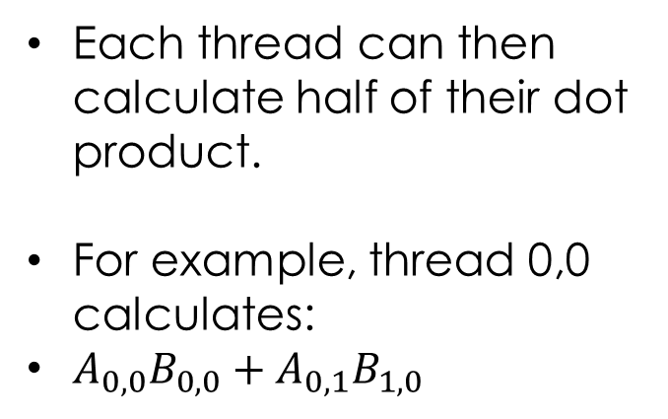
B_{0,0}
B_{1,0}
Each thread can then calculate half of their dot product.
For example, thread 0,0 calculates:
$A_{0,0}B_{0,0}+A_{0,1}B_{1,0}$
B
A_{0,0} | A_{0,1}
Block 0,0
Block 1,0
Block 0,1
Block 1,1
A

Slide 58
In the second phase, the threads in the block load these elements.
Each thread loads one element from A…
… and one from B.
B
Block 0,0
Block 1,0
Block 0,1
Block 1,1
A

Slide 59
B_{2,0}
B_{3,0}
If the matrices were 6x6 (n=6) but the blocks still 2x2 (m=2), we’d need three phases.
Number of phases = n/m.
B
 |  | A_{0,2} | A_{0,3}
Block 0,0
Block 1,0
Block 0,1
Block 1,1
A

Slide 60
Code!
Assumptions:
d_A, d_B, d_C are nxn matrices.
blockDim.x = blockDim.y = m; m evenly divides n.
__shared__ float s_A[m][m], s_B[m][m];
__global__ void kernelShared()
{
int x = blockIdx.x*m + threadIdx.x;
int y = blockIdx.y*m + threadIdx.y;
if (x < n && y < n) {
int phases = n / m;
float dotProd = 0.0f;
for (int p = 0; p < phases; p++) {
}
}
d_C[y][x] = dotProd;
}

Slide 61
Code!
Assumptions:
d_A, d_B, d_C are nxn matrices.
blockDim.x = blockDim.y = m; m evenly divides n.
__shared__ float s_A[m*m], s_B[m*m];
__global__ void kernel()
{
int x = blockIdx.x*m + threadIdx.x;
int y = blockIdx.y*m + threadIdx.y;
if (x < n && y < n) {
int phases = n/m;
float dotProd = 0.0f;
for (int p = 0; p < phases; p++) {
[...]
}
d_C[y*n+x] = dotProd;
}
}
// What row and column in A and B should
// this thread load into shared memory?
int a_row = blockIdx.y*m + threadIdx.y;
int a_col = p*m + threadIdx.x;
int b_row = p*m + threadIdx.y;
int b_col = blockIdx.x*m + threadIdx.x;
// Load into shared memory.
s_A[threadIdx.y][threadIdx.x] = d_A[a_row][a_col];
s_B[threadIdx.y][threadIdx.x] = d_B[b_row][b_col];
// Add to partial dot product.
for (int j = 0; j < m; j++) {
dotProd += s_A[threadIdx.y][j] *
s_B[j][threadIdx.x];
}
What’s missing?

Slide 62
Code!
Assumptions:
d_A, d_B, d_C are nxn matrices.
blockDim.x = blockDim.y = m; m evenly divides n.
__shared__ float s_A[m*m], s_B[m*m];
__global__ void kernel()
{
int x = blockIdx.x*m + threadIdx.x;
int y = blockIdx.y*m + threadIdx.y;
if (x < n && y < n) {
int phases = n/m;
float dotProd = 0.0f;
for (int p = 0; p < phases; p++) {
[...]
}
d_C[y*n+x] = dotProd;
}
}
// What row and column in A and B should
// this thread load into shared memory?
int a_row = blockIdx.y*m + threadIdx.y;
int a_col = p*m + threadIdx.x;
int b_row = p*m + threadIdx.y;
int b_col = blockIdx.x*m + threadIdx.x;
// Load into shared memory.
s_A[threadIdx.y][threadIdx.x] = d_A[a_row][a_col];
s_B[threadIdx.y][threadIdx.x] = d_B[b_row][b_col];
__syncthreads();
// Add to partial dot product.
for (int j = 0; j < m; j++) {
dotProd += s_A[threadIdx.y][j] *
s_B[j][threadIdx.x];
}
__syncthreads();
Notes:
First __syncthreads makes sure all threads have loaded their bit of global memory into shared memory before continuing with the calculation.
Second __syncthreads prevents one thread for loading its next phase’s value from global memory before all threads have finished their current calculation.

Slide 63
__syncthreads?
__shared__ float s_A[m*m], s_B[m*m];
__global__ void kernel()
{
int x = blockIdx.x*m + threadIdx.x;
int y = blockIdx.y*m + threadIdx.y;
if (x < n && y < n) {
int phases = n/m;
float dotProd = 0.0f;
for (int p = 0; p < phases; p++) {
[...]
}
d_C[y*n+x] = dotProd;
}
}
This code does exactly what I said you should avoid: __syncthreads() inside an if statement.
Moving outside would be a nightmare, since it’s also inside a for loop…
So need to make sure that blocks are either all inside or all outside the matrix:
assert((n%m)==0);

Slide 64
Results
GTX 460, n=2000, m=25

Slide 65

Compute to global memory ratio
$CGMA=\frac{\# floating point operations}{\# global memory accesses}$
Homework: what’s the CGMA of the simple and shared memory versions of the kernel?

Slide 66
Conclusions
Try to avoid branching in kernels…
… but when you can’t, organise so that threads in the same warp follow the same path.
By using shared memory cleverly, you can speed things up a lot!

