Slide 1

SOFT354: Parallel Computation and distributed systems
Week 2
Dr Robert Merrison-Hort

Slide 2
Today’s lecture

Slide 3

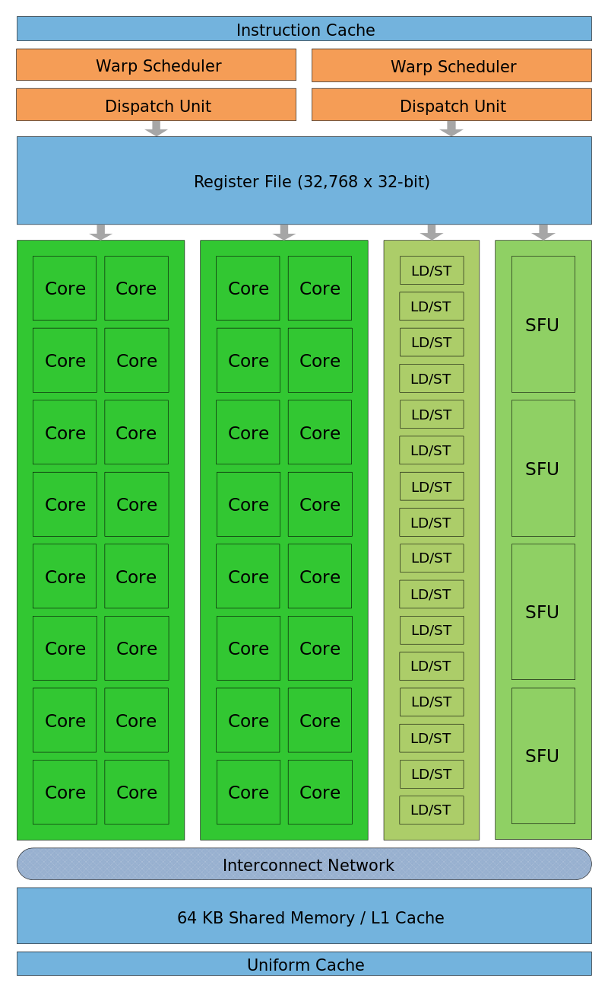
Today’s lecture
All about memories…
… in CUDA.
Why it’s important to understand memory.
Optimizing RAM↔GPU memory transfers.
Different types of memory in CUDA.

Slide 4
Memory matters
Compute to Global Memory Access Ratio (CGMA):
How many floating point operations does a program do for every global memory access operation.
GPUs have > 200GB/s global memory bandwidth.
= 50,000 floating point values per second.
If CGMA = 1.0, then data is processed at 50GFLOPs (giga-floating point operations per second).
But modern GPUs can do > 1,500 GFLOPs.
So we need CGMA much greater than 1.
Copying from CPU to the GPU is even slower than global memory access…

Slide 5
Host and device memory
Host memory is the PC’s normal RAM.
Device memory is the “video” RAM on the GPU.
E.g. Geforce GTX 480 has 1.5GB.
Code in a kernel can only access device memory.
Host code (e.g. your main() function) can access device memory using functions like cudaMemcpy.

Slide 6
Sin(x) example
In the workshop you wrote a program to compute sin(x) for a bunch of values of x.
Each thread computes one value.
Two pairs of arrays:
On the host: input, result
On the device: d_input, d_result

Slide 7
Sin(x) example
Host
Device
input
d_input
?
?
?
?
?
?
?
?
?
?
?
?
?
?
?
?
?
?
?
?
result
d_result
Serially initialize input data on host.
Copy input to GPU.
Kernel runs, computes sin(x) in parallel.
Copy result back to host (e.g. to print).

Slide 8
Sin(x) example
Host
Device
input
d_input
0
?
0.2
?
0.4
?
0.6
?
0.8
?
?
?
?
?
?
?
?
?
?
?
?
?
?
?
?
result
d_result
Serially initialize input data on host.
Copy input to GPU.
Kernel runs, computes sin(x) in parallel.
Copy result back to host (e.g. to print).

Slide 9
Sin(x) example
Host
Device
input
d_input
0
0.2
0.4
0.6
0.8
cudaMemcpy
0
?
0.2
?
0.4
?
0.6
?
0.8
?
?
?
?
?
?
?
?
?
?
?
result
d_result
Serially initialize input data on host.
Copy input to GPU.
Kernel runs, computes sin(x) in parallel.
Copy result back to host (e.g. to print).

Slide 10
Sin(x) example
Host
Device
input
d_input
0
0.2
0.4
0.6
0.8
0
0.2
0.4
0.6
0.8
kernel
kernel
kernel
kernel
kernel
?
?
?
?
?
?
?
?
?
?
0
0.2
0.39
0.56
0.72
result
d_result
Serially initialize input data on host.
Copy input to GPU.
Kernel runs, computes sin(x) in parallel.
Copy result back to host (e.g. to print).

Slide 11
Sin(x) example
Host
Device
input
d_input
0
0.2
0.4
0.6
0.8
0
0.2
0.4
0.6
0.8
?
cudaMemcpy
0
?
0.2
?
0.39
?
0.56
?
0.72
0
0.2
0.39
0.56
0.72
result
d_result
Serially initialize input data on host.
Copy input to GPU.
Kernel runs, computes sin(x) in parallel.
Copy result back to host (e.g. to print).

Slide 12
static vs dynamic allocation
Arrays can be statically or dynamically allocated.
With static allocation the size of the array must be known at compile time – space is reserved in the program’s memory map.
float staticArray[10];
With dynamic allocation the size of the array can be calculated at runtime.
float* dynamicArray = (float*)malloc(n*sizeof(float));
n can be a non-constant variable
Notes:
For example, with a dynamically allocated array you could read the size of a file or get some input from the user and then base the size of the allocated array on this.

Slide 13

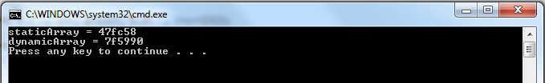
static vs dynamic allocation
In both cases the variable is just the memory address of the first element in the array.
Arrays are just pointers; pointers are just integers!
Notes:
Here staticArray will be allocated on the stack (if it’s in a function) or global memory (if it’s not), and dynamicArray will be allocated on the heap. This is why their memory addresses are very different.

Slide 14

Static vs dynamic allocation
In the workshop we had two pairs of arrays.
First pair:
Static or dynamic allocation?
The size is n, but since n is constant the size is known at compile time.
In host or device memory?
Nothing special, so by default use host memory.

Slide 15

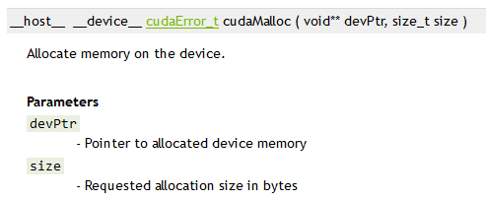
Static vs dynamic allocation
In the workshop we had two pairs of arrays.
Second pair:
Static or dynamic allocation?
cudaMalloc always allocates memory dynamically.
In host or device memory?

Slide 16
Static vs dynamic allocation
 | Allocate in Host Memory | Allocate in Device Memory
Static | float h_array[10]; | __device__ float d_array[10];
Dynamic | float* h_array = (float*)malloc(10*sizeof(float)); | float* d_array; cudaMalloc(&d_array, 10*sizeof(float));
cudaMalloc returns a cudaError_t, not the address of the allocated memory, so need to pass a pointer to a pointer.
If you use malloc inside a kernel it will allocate memory on the device.
Notes:
With cudaMalloc, we want the memory address of the allocated memory to be stored in the variable d_array. If you just pass a variable into a function without using pointers the function can’t modify the variable’s value, so cudaMalloc would have no way of changing the value of d_array. Instead, we pass in a pointer to d_array. It can then change the value of d_array so that it points to the allocated memory.

Slide 17
Allocating memory in kernels is rare
A common mistake in the practical sessions this week was the put the cudaMalloc call inside the kernel.
This is technically possible, but not what we want to do.
Every thread would allocate enough space for the whole array!
(and probably run out of memory doing so)
Instead we allocate enough space to hold one copy of the array in device memory, and each thread accesses a different bit of it.

Slide 18
Freeing dynamic memory
Dynamically allocated memory isn’t automatically cleaned up – you need to free it when you’re done.
If you keep allocating without freeing – crash!
// Free dynamically allocated host memory.
free(h_array);
h_array = NULL;
// Free dynamically allocated device memory.
cudaFree(d_array);
d_array = NULL;
No dangling pointers!
Notes:
Dangling (or “wild”) pointers are ones that point to a memory address where the memory has been de-allocated (or may have been reallocated for another purpose). They can cause very dangerous bugs.

Slide 19
Copying to static device arrays
When you use static allocation for device memory, e.g.
__device__ float d_array[10];
the variable d_array isn’t a pointer to a memory address on the GPU, it’s a symbol.
This means you can’t directly pass d_array into cudaMemcpy to copy data into/out of it. Two options:
cudaGetSymbolAddress
cudaMemcpyToSymbol / cudaMemcpyFromSymbol

Slide 20
cudaGetSymbolAddress
Gives the actual device memory address of a particular statically allocated symbol.
E.g. to copy data TO the device:
// h_array is an array allocated on
// the host.
// d_array is a __device__ array.
float* ptr;
cudaGetSymbolAddress(&ptr, d_array);
cudaMemcpy(ptr,
h_array,
sizeof(h_array),
cudaMemcpyHostToDevice);

Slide 21
cudaMemcpy*Symbol
(preferred way)
Like cudaMemcpy, but one of the arguments can be a symbol instead of a memory address.
First parameter is always destination address/symbol, second is always source address/symbol.
Copying from host to device:
Copying from device to host:
cudaMemcpyToSymbol(d_array, h_array, sizeof(h_array));
Symbol
cudaMemcpyFromSymbol(h_array, d_array, sizeof(h_array));

Slide 22
Accessing static memory from a kernel
In the workshop exercise the device memory was allocated dynamically in the host code:
This meant we had to pass pointers to the allocated device memory as arguments when calling the kernel:
float *d_input, *d_result;
cudaMalloc(&d_input, n*sizeof(float));
cudaMalloc(&d_result, n*sizeof(float));
sinKernel <<<100, 1000>>>(d_input, d_result, n);

Slide 23
Accessing static memory from a kernel
If instead you make the device arrays statically allocated (in global scope, not main):
The kernel can automatically access these variables without needing pointers passed as arguments:
const int n = 1000;
__device__ float d_input[n];
__device__ float d_result[n];
__global__ void sinKernel() {
int globalId = blockIdx.x * blockDim.x + threadIdx.x;
if (globalId < n) {
d_result[globalId] = sin(d_input[n]);
}
}

Slide 24
Static vs dynamic allocation
If you can, use static allocation.
Doesn’t require time-consuming calls to memory allocation functions.
Don’t need to worry about freeing memory after use.
But it’s often not possible (e.g. when size of input data isn’t known in advance).

Slide 25
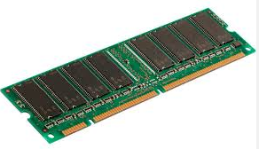
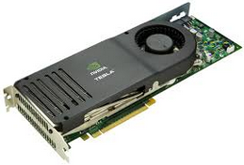
Pinned memory
Technique for speeding up RAM↔GPU memory transfers.
Transfers between the RAM and GPU can be very fast – they use Direct Memory Access (DMA) to do the copy without involving the CPU.
PCI Express Bus
~8GB/s

Slide 26
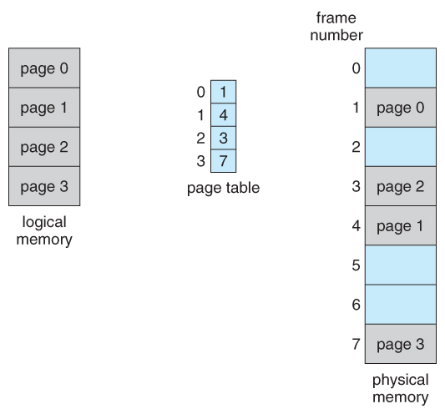
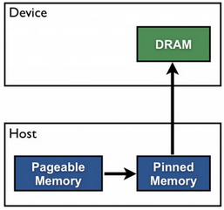
Pinned memory
But, operating systems use paged virtual memory.
The address you get from malloc() doesn’t correspond to a physical address in RAM, but to a “page” that can be moved around…
… which is no good for a DMA transfer.
So when transferring from RAM to GPU, CUDA first copies the data into “pinned” RAM, where it won’t get moved.
(and similarly for GPU→RAM)
Slow!
Notes:
The memory might even have been swapped out to the hard disk, if it hasn’t been used for a while. Then when you use it, the memory manager puts it back into RAM automatically for you.

Slide 27
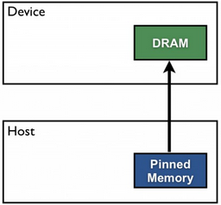
Pinned memory
If you know that you have an array in host memory that’ll be frequently used for device ↔ host transfers, you can specify that it should be pinned.
Transfers between that memory and the GPU can happen entirely with DMA, without having to involve the CPU / page table.
This can give a big speedup.

Slide 28
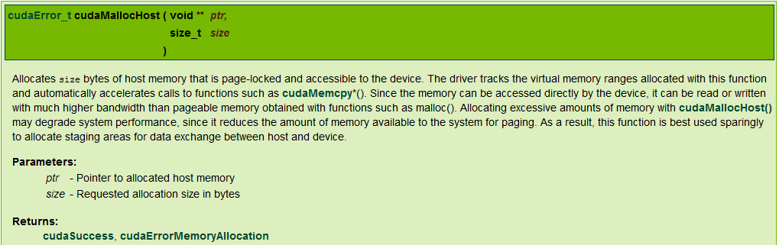
cudaHostMalloc
Like malloc, dynamically allocates an array in RAM.
Unlike malloc, the memory will be pinned, meaning calls to cudaMemcpy involving it will be faster.
Use cudaFreeHost to deallocate when the memory isn’t needed any more.

Slide 29
cudaHostMalloc
Unpinned version from the workshop:
// Allocate host arrays to store input and result.
const int n = 1000;
float h_input[n], h_result[n];
Faster pinned version:
const int n = 1000;
float *h_input, *h_result;
cudaHostMalloc(&h_input, n*sizeof(float));
cudaHostMalloc(&h_result, n*sizeof(float));
Note: for n=1000 you might not notice much difference, as the array is only 4kb!
Notes:
Note that the memory in the original example is statically allocated, but to use cudaHostMalloc it has to be dynamically allocated. Generally there’s no difference in performance between using statically and dynamically allocated memory, the difference is only between pinned memory (which must be dynamically allocated) and unpinned memory (which can be statically or dynamically allocated).

Slide 30
Other cuda memories
So far we’ve seen two ways of allocating memory on the device:
Static: __device__ float d_array[10];
Dynamic: cudaMalloc(&d_array, 10*sizeof(float));
Both of these approaches allocate memory in the GPU’s global memory (RAM), which is:
By far the biggest area of memory (e.g. Tesla K20 = 5GB)
Also the slowest, e.g. 440 clock cycles to read (Tesla K20)
There are other smaller, faster memories that we can use to dramatically increase performance.
E.g. shared memory: 48KB/core but only ~50 cycles to read.
Notes:
It’s hard to find values for different memory latencies in CUDA, but someone here has run some benchmarks: http://stackoverflow.com/questions/4097635/how-many-memory-latency-cycles-per-memory-access-type-in-opencl-cuda

Slide 31
caching
Caching is key to the performance of modern computers.
Faster memory is more expensive.
Arrange memory in a hierarchy, from smallest and fastest:
Registers: part of a processing core, can be accessed in 1 cycle but < 1KB of storage.
To biggest and slowest:
RAM: located on a different chip to the core, 100s of cycles to read but can be GBs.
Registers
L1 Cache (e.g. 64KB)
L2 Cache (e.g. 512KB)
L3 Cache (e.g. 24MB)
RAM (e.g. 8GB)
Hard Disk (Virtual Memory)
Smaller
Faster

Slide 32
caching
Most programs execute in a serial fashion with various looping constructs.
If a program calls a function it’s likely to call it again soon: keep its instructions nearby.
If a program accesses a memory location it’s likely to access it again soon: keep the data nearby.
This is the main principle of temporal locality:
reusing data and re-executing the same code.

Slide 33

caching
You’re in the library doing a research project that needs many books.
The library shelves are RAM: lots of data!
Every time you needed some fact you could find the book on a shelf, get the fact, then put the book back and return to your desk.
You’d get fit, but miss the deadline!
You need some cache!

Slide 34

caching
Keep the books you’ve looked at most recently open on your desk.
Now you can find things in them very quickly – this is your L1 cache.
But you only have space to keep a few books open at once…

Slide 35

Caching
Keep the books you’ve looked at recently (but not most recently) in a stack on your desk.
You can keep a fair number of books near you like this, but it takes a bit longer to look things up – this is your L2 cache.
Notes:
Not a perfect example because in reality any value in L1 cache is also in L2 cache and RAM whereas a book can only be in one place at once!

Slide 36




Caching
Registers (?)
L1 Cache
L2 Cache
RAM

Slide 37
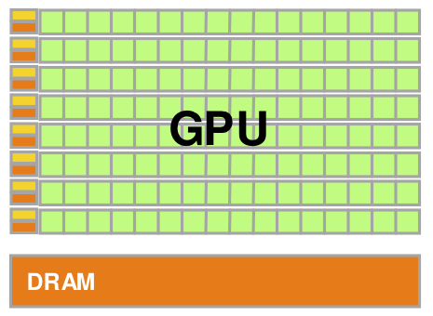
Caching in GPUs
The situation is a bit more complicated in GPUs due to how their cores are organised.
Remember from last week:
A GPU is divided into a number of streaming multiprocessors (SMs).
Each SM has a number of parallel CUDA cores.
GTX480s in BGB203 have 15 SMs, each with 32 CUDA cores.

Slide 38
Caching in GPUs
The figure shows one streaming multiprocessor (Fermi architecture).
Each SM has 32,768 registers available for the threads in the SM to use.
It also has 64KB of shared memory / L1 cache that is shared between all cores in the SM.
And smaller “uniform cache” that is similarly fast (in some circumstances).
Notes:
This is Fermi architecture SM, like the ones in BGB203. The next generation (Kepler) had 192 cores per SM, the one after that (Maxwel) 128, and the newest (Pascal) has 64. However, it doesn’t make sense to just compare the core count between generations, as many other things also change.

Slide 39
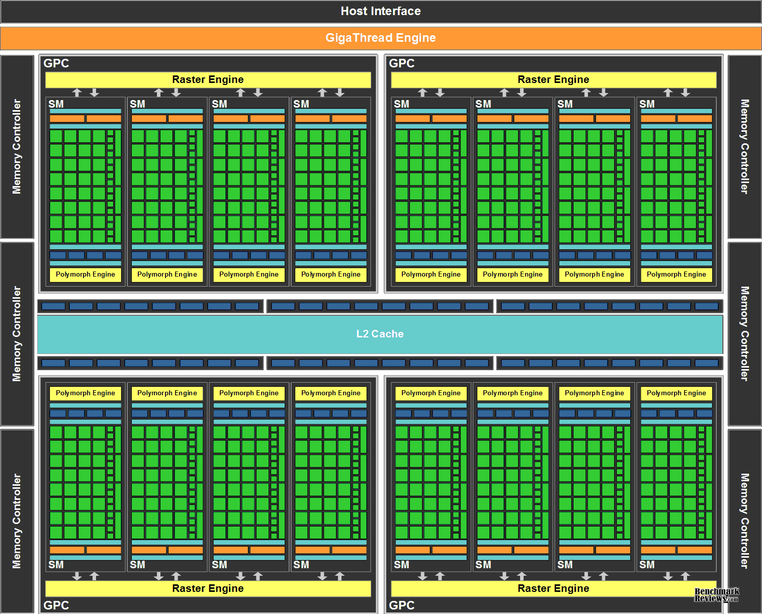
CACHING IN GPUS
This zoomed out view shows 16 SMs in a Fermi architecture.
There is an additional L2 cache that is shared between all SMs.

Slide 40
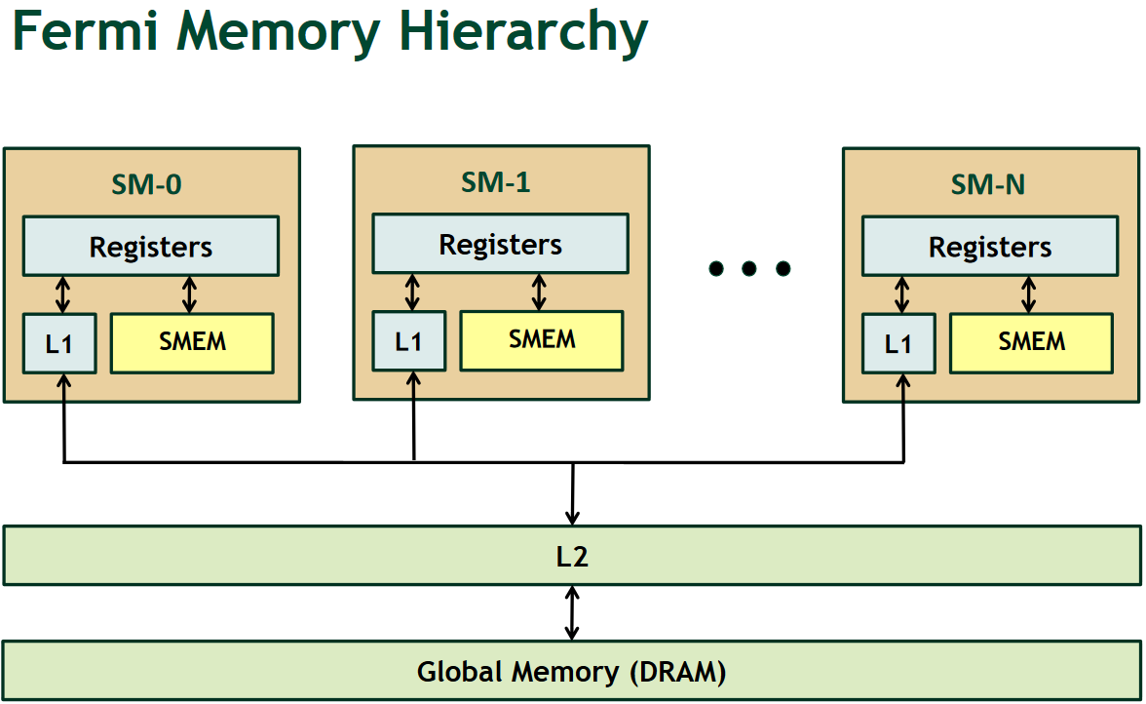
Caching in GPUs
http://on-demand.gputechconf.com/gtc-express/2011/presentations/register_spilling.pdf

Slide 41

GPU Memories: Summary
Registers: fastest, accessible by a single thread.
L1 Cache / Shared Memory: located in an SM, shared between threads in that SM, extremely fast.
Uniform Cache: Similar to L1 – will see difference shortly.
L2 Cache: Shared between all SMs, much faster than RAM but slower than L1.
Global Memory (RAM): Big & slow, shared between all SMs. Only memory we can read/write from host (cudaMemcpy).
How do we use each of these?

Slide 42
L1 and l2 cache
Firstly, you don’t need to worry about the L1 and L2 caches too much.
The GPU automatically takes care of caching frequently used data in these.
If you really want to squeeze every ounce of performance you need to understand the details, but not today…

Slide 43

GPU Memories: Summary
Registers: fastest, accessible by a single thread.
L1 Cache / Shared Memory: located in an SM, shared between threads in that SM, extremely fast.
Uniform Cache: Similar to L1 – will see difference shortly.
L2 Cache: Shared between all SMs, much faster than RAM but slower than L1.
Global Memory (RAM): Big & slow, shared between all SMs. Only memory we can read/write from host (cudaMemcpy).

Slide 44
Global memory
We’ve already seen how to allocate global memory:
Static: __device__ float d_array[10];
Dynamic: cudaMalloc(&d_array, 10*sizeof(float));
Access it from the host code:
cudaMemcpyToSymbol
cudaMemcpyFromSymbol
cudaMemcpy
And access it in a kernel (static allocation here):
__global__ void sinKernel() {
int globalId = blockIdx.x * blockDim.x + threadIdx.x;
if (globalId < n) {
d_result[globalId] = sin(d_input[n]);
...
Notes:
Remember we need to pass pointers to the allocated memory as parameters to the kernel if we dynamically allocate the memory using cudaMalloc.

Slide 45
GPU Memories: Summary
Registers: fastest, accessible by a single thread.
L1 Cache / Shared Memory: located in an SM, shared between threads in that SM, extremely fast.
Uniform Cache: Similar to L1 – will see difference shortly.
L2 Cache: Shared between all SMs, much faster than RAM but slower than L1.
Global Memory (RAM): Big & slow, shared between all SMs. Only memory we can read/write from host (cudaMemcpy).

Slide 46
Registers
Most local variables you create in kernels will be stored in registers.
__global__ void sinKernel() {
int globalId = blockIdx.x * blockDim.x + threadIdx.x;
Stored in a register.
There are two main exceptions:
Arrays where you access elements using a variable:
__global__ void sinKernel() {
int array[10];
for (int i = 0; i < 10; i++) array[i] = i;

Slide 47
Registers
Most local variables you create in kernels will be stored in registers.
__global__ void sinKernel() {
int globalId = blockIdx.x * blockDim.x + threadIdx.x;
Stored in a register.
There are two main exceptions:
Arrays where you access elements using a variable.
If you use more than the available register space (in Fermi: 63 registers / thread by default):
__global__ void sinKernel() {
int array[63];// In registers (if no variable indexing)
int extraInt; // Spilled into “local memory”

Slide 48
“Local” memory
Local variables from kernels that can’t be stored in registers get stored in a special region of global memory that can only be accessed by one thread.
As only 1 thread has access this is called local memory, even though it’s physically in global memory…
… obviously …
Global memory is slow, so you want to avoid this!
(although may not be disastrous if cached in L1/L2)

Slide 49
GPU Memories: Summary
Registers: fastest, accessible by a single thread.
L1 Cache / Shared Memory: located in an SM, shared between threads in that SM, extremely fast.
Uniform Cache: Similar to L1 – will see difference shortly.
L2 Cache: Shared between all SMs, much faster than RAM but slower than L1.
Global Memory (RAM): Big & slow, shared between all SMs. Only memory we can read/write from host (cudaMemcpy).

Slide 50
Uniform cache
The uniform cache is an on-chip (part of each SM) cache that is designed for broadcasting data.
If multiple threads access the same address in the uniform cache at the same time, the data is sent to them all simultaneously.
Threads can’t change the value of data in the uniform cache.

Slide 51
Constant memory
To take advantage of the uniform cache we need to specify that a particular variable in global memory can’t change.
Use the __constant__ modifier:
These variables will be stored in the device’s global memory, in a special area reserved for constant data.
When a thread accesses data from here, it will be cached in the uniform cache and optimized for broadcast reads.
__constant__ float d_constArray[10];
__constant__ float d_constValue;
Notes:
Note that you can still copy data to a device variable marked __constant__ from the host, but you can’t modify it in the kernel.

Slide 52
GPU Memories: Summary
Registers: fastest, accessible by a single thread.
L1 Cache / Shared Memory: located in an SM, shared between threads in that SM, extremely fast.
Uniform Cache: Similar to L1 – will see difference shortly.
L2 Cache: Shared between all SMs, much faster than RAM but slower than L1.
Global Memory (RAM): Big & slow, shared between all SMs. Only memory we can read/write from host (cudaMemcpy).

Slide 53
Shared memory
The most interesting type of memory!
All threads running on a SM have access to it.
As fast as L1.
But: you (the programmer) are in charge of how it’s used.
If you use it cleverly, you can get big increases in performance.

Slide 54
GPU Memories: Summary
Registers: fastest, accessible by a single thread.
L1 Cache / Shared Memory: located in an SM, shared between threads in that SM, extremely fast.
Uniform Cache: Similar to L1 – will see difference shortly.
L2 Cache: Shared between all SMs, much faster than RAM but slower than L1.
Global Memory (RAM): Big & slow, shared between all SMs. Only memory we can read/write from host (cudaMemcpy).
tbc…

Slide 55
Summary
Memory access is often the limiting factor in high performance software.
To get the best performance you need to understand the differences between different memories.

Slide 56
Summary
Global memory is huge but relatively slow.
We can copy between main RAM and the GPU’s global memory using cudaMemcpy.
This is the slowest type of transfer, but can be sped up by pinning data in RAM.

Slide 57
Summary
Global memory has a few smaller regions that have specific uses:
Constant memory: if we put variables here, they will be cached for broadcast in the SMs’ uniform caches.
Local memory: any of a thread’s local variables that can’t go in registers go here.
Global Memory
Constant Memory
Local Memory

Slide 58
Summary
Various types of cache that can be used:
L2 cache: fairly big (MBs), but shared between all SMs.
L1 cache: smaller, extremely fast, one per SM.
Shared memory: similar to L1 cache, but programmer manages its usage.
Uniform cache: optimized for broadcasting values, one per SM. Caches data from constant memory.
Automatic

Slide 59
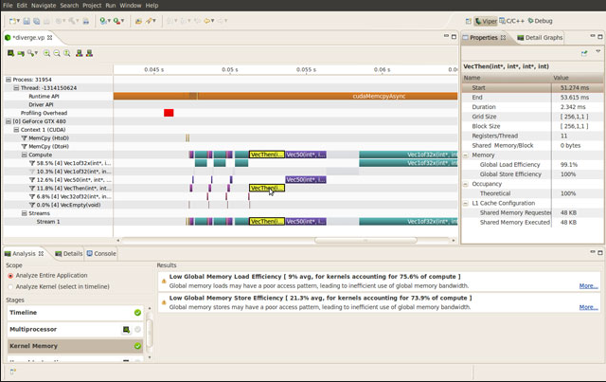
Next week’s workshop
Some experiments with performance for various linear algebra operations.
Looking at the performance implications of register spilling, constant memory, memory pinning.
Debugging and profiling using Nvidia Nsight.

