Slide 1

SOFT354: Parallel Computation and distributed systems
Week 3
Dr Robert Merrison-Hort

Slide 2
Today’s lecture
Today we will be looking at further ways to increase the performance of CUDA programs.
Begin by looking at how threads and blocks are organised, and how a streaming multiprocessor decides what to run.
Optimization techniques:
Increase thread occupancy.
Coalesced memory access.
Shared memory.

Slide 3
Thread organisation
Remember:
A block consists of multiple threads.
A grid consists of multiple blocks.
So far we’ve used one dimensional grids and blocks:
E.g. addKernel <<<10, 1000 >>>();
Runs addKernel on ten blocks of 1,000 threads each.
CUDA allows blocks and grids to be two or three-dimensional as well.

Slide 4


2D blocks and grids
A 2D arrangement of threads is commonly used when doing image processing.
Simple example: invert colours.
~12 million pixels – allocate one thread per pixel.

Slide 5
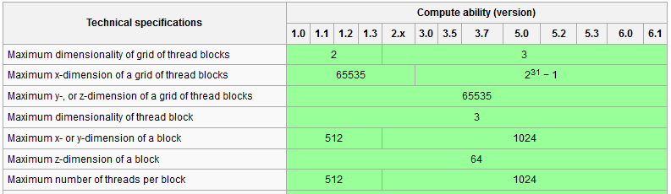
2D blocks and grids
How many blocks should we use?
Picture (from my phone) dimensions are 2992x4000.
One block of 2992x4000 threads? Can’t – two reasons:
Notes:
In compute capability 2, the x and y dimensions of a block must be less than 1024. Also, the maximum total number of threads in a block is 1024.

Slide 6
2D blocks and grids
Let’s use 32x32 blocks → 1,024 threads per block.
Might get better performance with fewer – experiment!
How many blocks do we need?
x direction: 2,992 / 32 = 93.5
y direction: 4,000 / 32 = 125
Can’t have half a block so round up: 94x125 blocks of 32x32 threads each.

Slide 7
94 x 125 grid
Block 0,124
Block 1,124
Block 2,124
Block 93,124
32 threads
32 threads
…
…
Block 0,1
Block 1,1
Block 2,1
Block 93,1
…
Block 0,0
Block 1,0
Block 2,0
Block 93,0

Slide 8
2d Blocks and Grids
To launch a kernel with grid / block dimensions that aren’t one dimensional use dim3 objects.
Need to give z dimensions as well – just set to 1.
dim3 gridSize(94, 125, 1);
dim3 blockSize(32, 32, 1);
invertKernel<<<gridSize, blockSize>>>();
Kernel can now determine its global position in the image using blockIdx, blockDim and threadIdx:
__global__ void invertKernel() {
int globalIdX = blockIdx.x * blockDim.x + threadIdx.x;
int globalIdY = blockIdx.y * blockDim.y + threadIdx.y;
if (globalIdX < 2992 && globalIdY < 4000) {
// Do something...
}
}

Slide 9


2d Blocks and Grids
Since we rounded up the number of blocks in the x direction, some threads are off the edge of the image:
Use the if statement to cause these threads to do nothing.

Slide 10
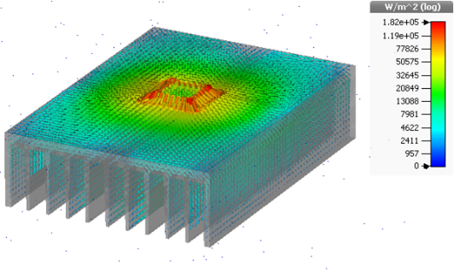
3d blocks and grids
You can also arrange blocks and/or grids in three dimensions, i.e.
dim3 gridSize(100, 100, 100);
dim3 blockSize(10, 10, 10);
someKernel<<<gridSize, blockSize>>>();
__global__ void someKernel() {
int globalIdX = blockIdx.x * blockDim.x + threadIdx.x;
int globalIdY = blockIdx.y * blockDim.y + threadIdx.y;
int globalIdZ = blockIdx.z * blockDim.z + threadIdx.z;
Mostly used when simulating something in 3D space, e.g. spread of heat through an object.

Slide 11
Linearization of blocks and grids
2D and 3D blocks and grids are just a convenience.
CUDA will convert your blocks into a 1D array of threads…
… and your grid into a 1D array of blocks.
This is done with z as the most significant co-ordinate, then y, then x. So if we consider threads T_{x,y,z} and have a 2x2x2 block, they will be linearized as:
T_{0,0,0}; T_{1,0,0}; T_{0,1,0}; T_{1,1,0}; T_{0,0,1}; T_{1,0,1}; T_{0,1,1}; T_{1,1,1}
Notes:
This all happens behind the scenes, you don’t need to worry too much about remembering it.

Slide 12
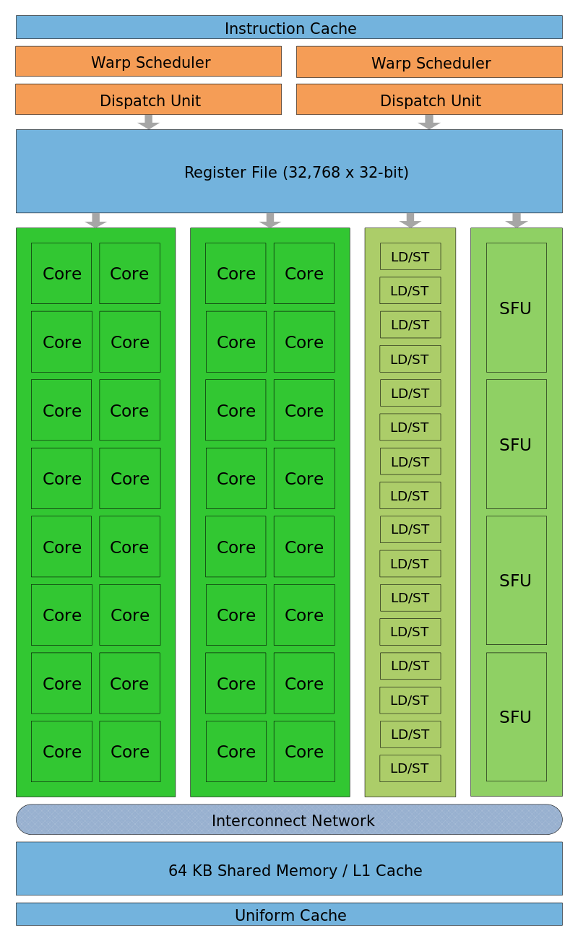
Block assignment
A GPU has multiple streaming multiprocessors (SMs).
E.g. GTX480 has 15.
Each SM has one or more blocks assigned to it (“resident”) at any given time.
Only whole blocks can be assigned to SMs, therefore all threads in a block will run on the same SM.

Slide 13
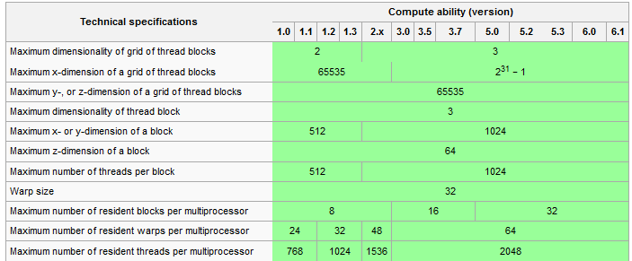
Block assignment
The number of blocks/threads that can be resident in an SM depends on the device’s Compute Capability.
Notes:
The PCs in BGB307 have two GTX 480s (CC 2.0) and one GTX680 (CC 3.0).

Slide 14
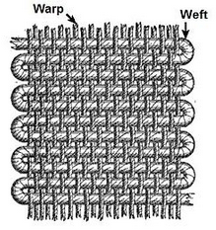
warps
When a streaming multiprocessor is assigned a block of threads it breaks it down into warps.
Each warp is a set of 32 threads that will be executed in parallel. Threads are assigned to warps by dividing the linearized block into 32-thread chunks.
Name comes from weaving: a warp is a set of threads that are held parallel that the weft is woven through.

Slide 15
Warp scheduling
Generally you don’t need to worry too much about warps – they’re an implementation detail.
But by understanding how an SM schedules warps you can improve performance.
Any given time a warp can be in one of three states:
Running: currently being executed by the SM.
Waiting: can’t run because it’s waiting on something – usually some data to be read from memory.
Ready: not running, but not waiting on anything.
Notes:
Only one warp can be in the Running state on any SM at once.

Slide 16
Warp scheduling
This is the ideal situation.
When the currently running warp finishes, there are two more ready to go.
The cores will be kept busy – no time wasted.
Warp 6
Running
Warp 4
Ready
Warp 3
Warp 2
Warp 1
Waiting
Warp 0

Slide 17
Warp scheduling
This is not a good situation.
All of the warps in the SM are waiting for something (probably a memory read).
No warps can be scheduled, so the CUDA cores in the SM are essentially idle.
This is inefficient, since the available resources aren’t being fully utilized.
Warp 6
Warp 4
Warp 3
Waiting
Warp 2
Warp 1
Warp 0

Slide 18
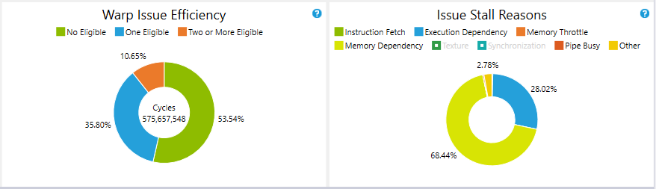
Warp scheduling
Nvidia Nsight shows you statistics about how often it’s unable to schedule any warps:
The green section in the left figure shows how often all warps in a SM were waiting, so none could be executed.
The graph on the right shows the reasons for these “stalls” – note that it’s usually due to waiting for memory.

Slide 19
Reducing stalls
The most effective way to reduce stalls (assuming they’re mostly caused by memory access) is to use memory more effectively.
Coalesced memory reads and shared memory.
But it’s also important to maximize the number of warps resident in an SM (its occupancy).
The more resident warps, the more chance there’s one ready to be executed.

Slide 20
occupancy
Assume we’re using a Compute Capability 2.0 device:
How many warps can be resident in a SM with the following block sizes?
8x8
16x16
32x32

Slide 21
occupancy
8x8 blocks:
64 threads per block (2 warps).
But each SM can only contain up to 8 blocks.
So maximum number of resident threads is 8*64=512.
Much less than the capacity (1536 threads).
16x16 blocks:
256 threads per block (8 warps)
If SM contains 6 blocks, 6*256=1536 threads.
Maximum possible occupancy – very good!

Slide 22
occupancy
32x32 blocks:
1024 threads per block (32 warps).
Maximum capacity is 1536 threads.
But can only allocate whole blocks to a SM, so there’s only space for one.
So maximum number of resident threads is 1024.
Much less than the capacity (1536 threads).

Slide 23
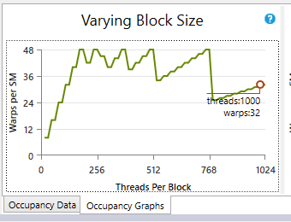
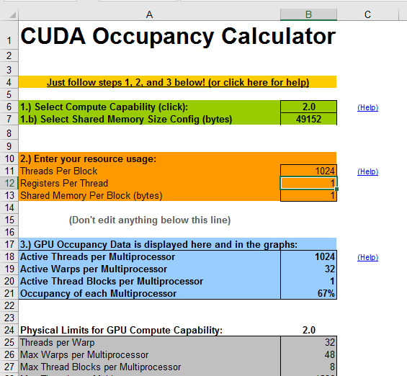
occupancy
Nsight can show you the optimal block size to maximize occupancy.
Also see Nvidia occupancy calculator spreadsheet (on the DLE).
There are limits to how many registers and shared memory a SM has – this can also limit occupancy.

Slide 24
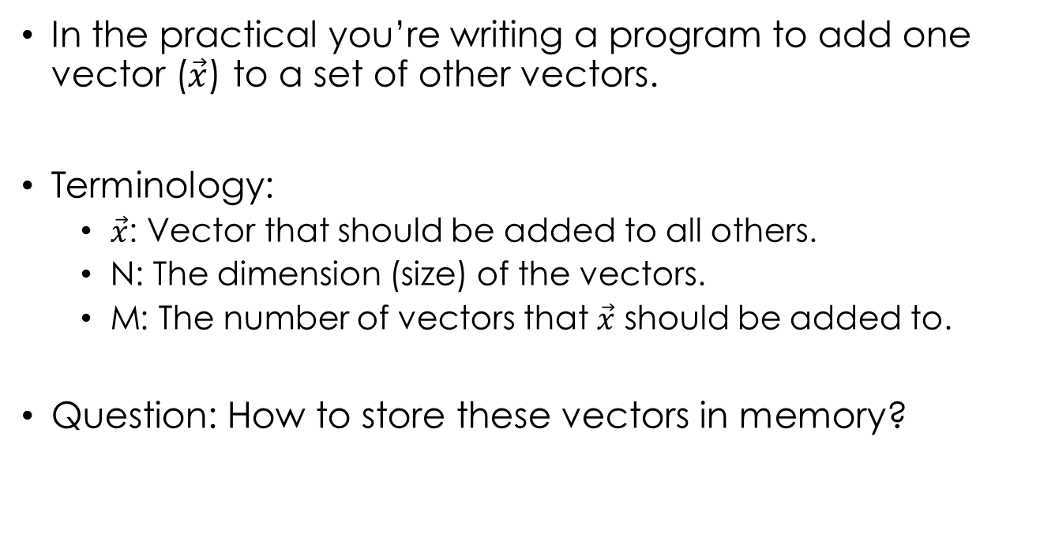
Coalesced memory access
In the practical you’re writing a program to add one vector ($\vec{x}$) to a set of other vectors.
Terminology:
$\vec{x}$: Vector that should be added to all others.
N: The dimension (size) of the vectors.
M: The number of vectors that $\vec{x}$ should be added to.
Question: How to store these vectors in memory?

Slide 25
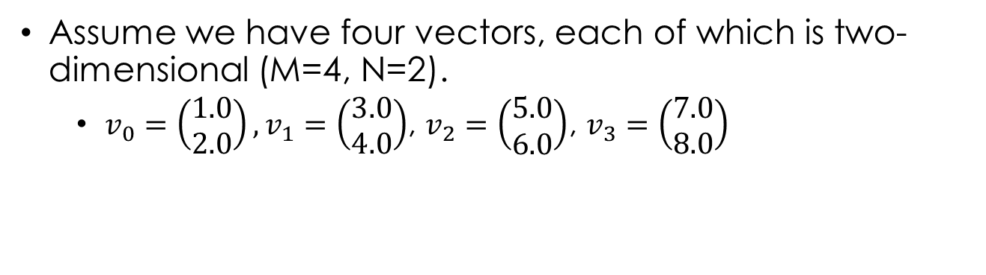
Parallel vector add
Assume we have four vectors, each of which is two-dimensional (M=4, N=2).
$v_{0}=\left(\begin{matrix}1.0 \\ 2.0\end{matrix}\right),v_{1}=\left(\begin{matrix}3.0 \\ 4.0\end{matrix}\right)$, $v_{2}=\left(\begin{matrix}5.0 \\ 6.0\end{matrix}\right)$, $v_{3}=\left(\begin{matrix}7.0 \\ 8.0\end{matrix}\right)$

Slide 26
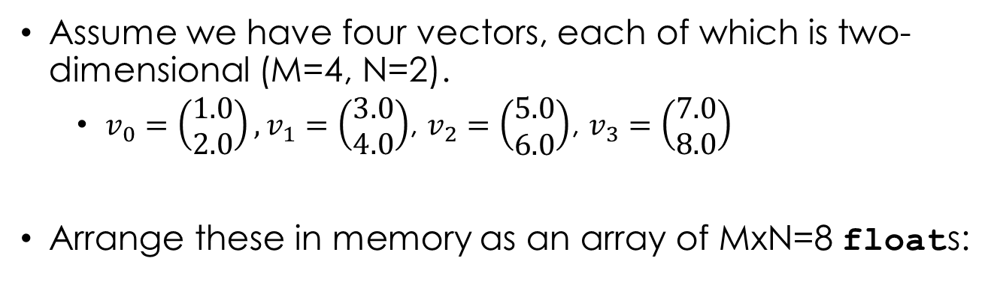
Parallel vector add
Assume we have four vectors, each of which is two-dimensional (M=4, N=2).
$v_{0}=\left(\begin{matrix}1.0 \\ 2.0\end{matrix}\right),v_{1}=\left(\begin{matrix}3.0 \\ 4.0\end{matrix}\right)$, $v_{2}=\left(\begin{matrix}5.0 \\ 6.0\end{matrix}\right)$, $v_{3}=\left(\begin{matrix}7.0 \\ 8.0\end{matrix}\right)$
Arrange these in memory as an array of MxN=8 floats:
1.0
2.0
3.0
4.0
5.0
6.0
7.0
8.0
0
1
2
3
4
5
6
7

Slide 27
Parallel vector add
Assume we have four vectors, each of which is two-dimensional (M=4, N=2).
$v_{0}=\left(\begin{matrix}1.0 \\ 2.0\end{matrix}\right),v_{1}=\left(\begin{matrix}3.0 \\ 4.0\end{matrix}\right)$, $v_{2}=\left(\begin{matrix}5.0 \\ 6.0\end{matrix}\right)$, $v_{3}=\left(\begin{matrix}7.0 \\ 8.0\end{matrix}\right)$
Arrange these in memory as an array of MxN=8 floats:
1.0
2.0
3.0
4.0
5.0
6.0
7.0
8.0
0
1
2
3
4
5
6
7
Obvious approach (vector major): put the vectors one after each other.

Slide 28
Parallel vector add
Assume we have four vectors, each of which is two-dimensional (M=4, N=2).
$v_{0}=\left(\begin{matrix}1.0 \\ 2.0\end{matrix}\right),v_{1}=\left(\begin{matrix}3.0 \\ 4.0\end{matrix}\right)$, $v_{2}=\left(\begin{matrix}5.0 \\ 6.0\end{matrix}\right)$, $v_{3}=\left(\begin{matrix}7.0 \\ 8.0\end{matrix}\right)$
Arrange these in memory as an array of MxN=8 floats:
1.0
2.0
3.0
4.0
5.0
6.0
7.0
8.0
0
1
2
3
4
5
6
7
Obvious approach (vector major): put the vectors one after each other.

Slide 29
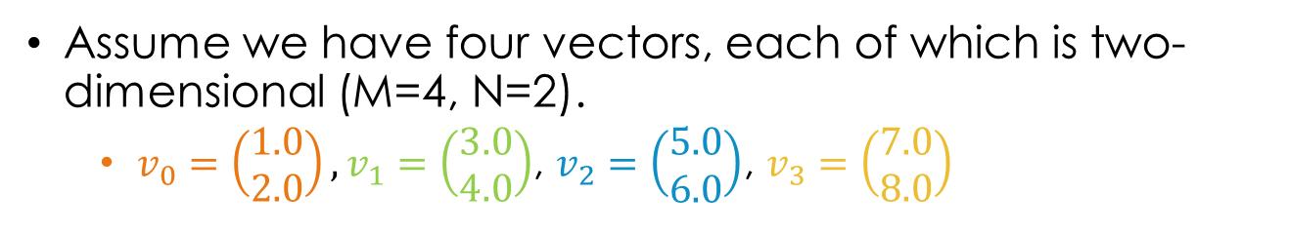

Vector major order
Assume we have four vectors, each of which is two-dimensional (M=4, N=2).
$v_{0}=\left(\begin{matrix}1.0 \\ 2.0\end{matrix}\right),v_{1}=\left(\begin{matrix}3.0 \\ 4.0\end{matrix}\right)$, $v_{2}=\left(\begin{matrix}5.0 \\ 6.0\end{matrix}\right)$, $v_{3}=\left(\begin{matrix}7.0 \\ 8.0\end{matrix}\right)$
1.0
2.0
3.0
4.0
5.0
6.0
7.0
8.0
0
1
2
3
4
5
6
7
Each thread should add vector $\vec{x}$ to vector $\vec{v_{i}}$, where i is the global index of the thread:
for (int j = 0; j < N; j++)
{
d_vectors[globalID*N + j] += d_x[j];
}

Slide 30
Vector major order
d_vectors
1.0
2.0
3.0
4.0
5.0
6.0
7.0
8.0
d_x
0.1
0.5
0
1
2
3
4
5
6
7
0
1
for (int j = 0; j < N; j++)
{
d_vectors[globalID*N + j] += d_x[j];
}
Assume four threads all running at the same time. What memory will they access for each value of j?
j | Thread 0 | Thread 1 | Thread 2 | Thread 3

Slide 31
Vector major order
d_vectors
1.0
2.0
3.0
4.0
5.0
6.0
7.0
8.0
d_x
0.1
0.5
0
1
2
3
4
5
6
7
0
1
for (int j = 0; j < N; j++)
{
d_vectors[globalID*N + j] += d_x[j];
}
Assume four threads all running at the same time. What memory will they access for each value of j?
j | Thread 0 | Thread 1 | Thread 2 | Thread 3
0 | d_vectors[0] d_x[0] | d_vectors[2] d_x[0] | d_vectors[4] d_x[0] | d_vectors[6] d_x[0]

Slide 32
Vector major order
d_vectors
1.0
2.0
3.0
4.0
5.0
6.0
7.0
8.0
d_x
0.1
0.5
0
1
2
3
4
5
6
7
0
1
for (int j = 0; j < N; j++)
{
d_vectors[globalID*N + j] += d_x[j];
}
Assume four threads all running at the same time. What memory will they access for each value of j?
j | Thread 0 | Thread 1 | Thread 2 | Thread 3
0 | d_vectors[0] d_x[0] | d_vectors[2] d_x[0] | d_vectors[4] d_x[0] | d_vectors[6] d_x[0]
1 | d_vectors[0] d_x[1] | d_vectors[2] d_x[1] | d_vectors[4] d_x[1] | d_vectors[6] d_x[1]

Slide 33
Coalesced Memory Access
For the vector major case there are gaps between the memory addresses that each thread accesses:
d_vectors
1.0
2.0
3.0
4.0
5.0
6.0
7.0
8.0
0
1
2
3
4
5
6
7
What is the gap between memory locations?
In this case, 2.
More generally, N (the size of the vectors).
If threads in a warp simultaneously access memory addresses that are close together (within 128 bytes) then the accesses are coalesced into one transaction (much faster).
In this example the memory range is 7*4=28 bytes, but bigger N or M would result in multiple memory accesses being required.
Notes:
A float is 4 bytes, hence 7*4.

Slide 34

Component major order
Assume we have four vectors, each of which is two-dimensional (M=4, N=2).
$v_{0}=\left(\begin{matrix}1.0 \\ 2.0\end{matrix}\right),v_{1}=\left(\begin{matrix}3.0 \\ 4.0\end{matrix}\right)$, $v_{2}=\left(\begin{matrix}5.0 \\ 6.0\end{matrix}\right)$, $v_{3}=\left(\begin{matrix}7.0 \\ 8.0\end{matrix}\right)$
1.0
3.0
5.0
7.0
2.0
4.0
6.0
8.0
0
1
2
3
4
5
6
7
Put all the first components first…

Slide 35
Component major order
Assume we have four vectors, each of which is two-dimensional (M=4, N=2).
$v_{0}=\left(\begin{matrix}1.0 \\ 2.0\end{matrix}\right),v_{1}=\left(\begin{matrix}3.0 \\ 4.0\end{matrix}\right)$, $v_{2}=\left(\begin{matrix}5.0 \\ 6.0\end{matrix}\right)$, $v_{3}=\left(\begin{matrix}7.0 \\ 8.0\end{matrix}\right)$
Not multiplying global index by anything to get element number – good sign!
1.0
3.0
5.0
7.0
2.0
4.0
6.0
8.0
0
1
2
3
4
5
6
7
Put all the first components first…
… then all the second components.
New kernel:
for (int j = 0; j < N; j++)
{
d_vectors[j*M + globalID] += d_x[j];
}

Slide 36
Component major order
d_vectors
1.0
3.0
5.0
7.0
2.0
4.0
6.0
8.0
d_x
0.1
0.5
0
1
2
3
4
5
6
7
0
1
for (int j = 0; j < N; j++)
{
d_vectors[j*M + globalID] += d_x[j];
}
Assume four threads all running at the same time. What memory will they access for each value of j?
j | Thread 0 | Thread 1 | Thread 2 | Thread 3

Slide 37
Component major order
d_vectors
1.0
3.0
5.0
7.0
2.0
4.0
6.0
8.0
d_x
0.1
0.5
0
1
2
3
4
5
6
7
0
1
for (int j = 0; j < N; j++)
{
d_vectors[j*M + globalID] += d_x[j];
}
Assume four threads all running at the same time. What memory will they access for each value of j?
j | Thread 0 | Thread 1 | Thread 2 | Thread 3
0 | d_vectors[0] d_x[0] | d_vectors[1] d_x[0] | d_vectors[2] d_x[0] | d_vectors[3] d_x[0]

Slide 38
Component major order
d_vectors
1.0
3.0
5.0
7.0
2.0
4.0
6.0
8.0
d_x
0.1
0.5
0
1
2
3
4
5
6
7
0
1
for (int j = 0; j < N; j++)
{
d_vectors[j*M + globalID] += d_x[j];
}
Assume four threads all running at the same time. What memory will they access for each value of j?
j | Thread 0 | Thread 1 | Thread 2 | Thread 3
0 | d_vectors[0] d_x[0] | d_vectors[1] d_x[0] | d_vectors[2] d_x[0] | d_vectors[3] d_x[0]
1 | d_vectors[4] d_x[1] | d_vectors[5] d_x[1] | d_vectors[6] d_x[1] | d_vectors[7] d_x[1]

Slide 39
Coalesced memory access
In the component major case, adjacent threads access adjacent memory addresses in parallel:
d_vectors
1.0
3.0
5.0
7.0
2.0
4.0
6.0
8.0
0
1
2
3
4
5
6
7
No matter what the values of M and N, all 32 threads in a warp will access memory addresses within 128 bytes of each other (since 32*4=128 bytes).
This can dramatically improve performance.

Slide 40
Coalesced memory access
When you have structured data (e.g. vectors, objects with different attributes), you’ll usually want to group by element number / attribute in memory.
Another example: neural simulation. Each neuron has a voltage (v) and gating variable (g) associated with it.
Simulate one neuron in each thread.
Traditional layout:
Coalesce-optimized layout:
v₀
g₀
v₁
g₁
v₂
g₂
v₃
g₃
v₄
g₄
v₀
v₁
v₂
v₃
v₄
g₀
g₁
g₂
g₃
g₄

Slide 41
Shared memory
We’ve already met two types of statically allocated device memory:
__device__ variables are stored in global memory, which is huge but slow.
__constant__ variables are cached in the SM; can be read by all threads in a single cycle, but are read-only.
Now we’ll look at the last (and most interesting / difficult) modifier that we’ll consider: __shared__.

Slide 42
Shared memory
A variable with the __shared__ modifier has its memory allocated in the streaming multiprocessors’ shared memory area.
This is fast but local to the SM.
Each block has a separate copy of any __shared__ variables.
All threads in a block can access their block’s copy of the shared variables, but not other blocks’ copies.

Slide 43

Shared memory
Shared memory can be used to allow threads within a block to communicate with each other very quickly.
Common pattern is when all threads in a block need the same chunk of global memory:
Each thread loads a bit of the global data into shared memory (happens in parallel).
Library metaphor: study group makes a list of books they need, everyone fetches a book from global memory (the shelves) and puts it on a shared desk.

Slide 44
Shared memory example: Vicsek
Model from particle physics:
https://en.wikipedia.org/wiki/Vicsek_model
Simulates a bunch of particles that move around with constant speed but in a variable direction.
Each particle’s direction of movement is affected by the directions of other nearby particles.

Slide 45
Shared memory example: Vicsek

Slide 46
Shared memory example: Vicsek
Run one thread for each particle.
Pseudo-code for kernel:
let p1 = this particle
for each particle p2:
calculate distance between p1 and p2
if less than threshold:
modify p1 angle using p2 angle
update p1 position using its speed and angle

Slide 47
Vicsek: without shared memory

Slide 48
Vicsek: With shared memory

Slide 49
Vicsek comparison
(Live demo hopefully)
If not:
10,000 particles running on my laptop.
Without shared memory: update takes ~38ms.
With shared memory: update takes ~25ms.
→ about 35% faster!

Slide 50
Shared memory and occupancy
Since each block has its own copy of any shared variables, this can limit occupancy.
So in CC2.x, if your kernel uses 48KB of shared memory, each block needs 48KB so only one block can be resident at once.
Trade-off between shared memory usage and occupancy can often just be down to experimentation.

Slide 51
Shared memory
Vicsek was a straightforward example – you can do much cleverer things with shared memory.
Now we’ve pretty much covered all the basics of CUDA we can look at some particular implementations of parallel algorithms – you’ll see some clever uses of shared memory.
But that’s all for today…

Slide 52
conclusions
Threads are organised into blocks, which are organised into a grid.
The threads in a block and / or the blocks in a grid can be organised as 1D, 2D or 3D structures.
Whatever the dimensionality, blocks and threads are linearized into a big 1D array of threads.
Whole blocks are allocated to streaming multiprocessors as they become available.

Slide 53
conclusions
When a block is allocated to a multiprocessor it is divided into warps of 32 threads.
Want to avoid the situation where all warps in an SM are waiting and not runnable. Two strategies:
Maximize the number of warps in an SM (its occupancy) by optimizing block size.
Reduce the time spent waiting for memory access by using coalescing and shared memory.

