Slide 1
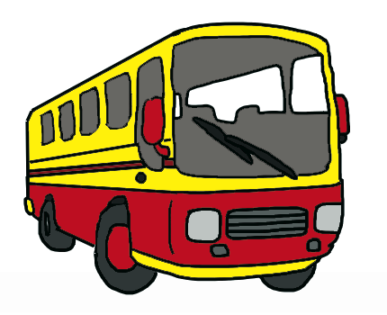
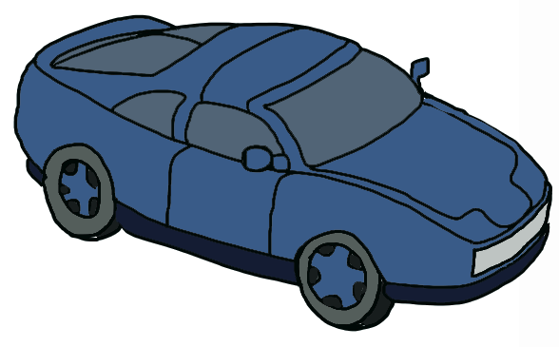
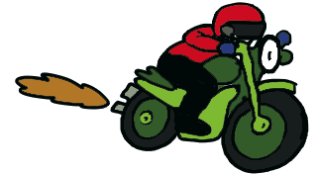
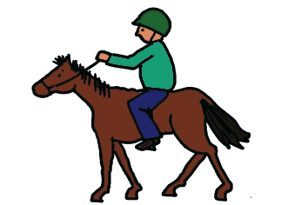
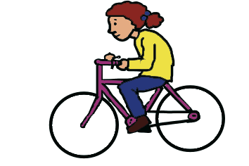
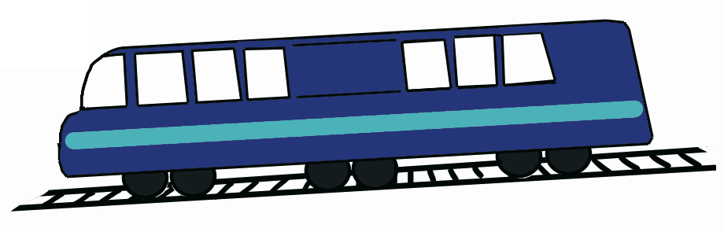
Les transports
Memory tricks for choosing the correct preposition

Slide 2
When we go somewhere using a means of transport, the following prepositions are used:
à
en
Here’s a simple memory trick to help you to remember when to use each one.

Slide 3
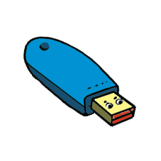
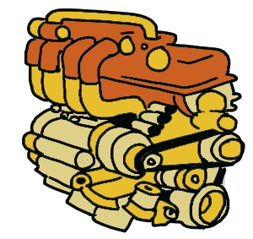
Does the means of transport have an engine?
= en
engine
If it does you say ‘en’ before it, as ‘en’ is at the beginning of ‘engine’.

Slide 4
Does a car have an engine?
Yes!
en voiture
Je vais en voiture…
(I go by car…)

Slide 5
Does a bus have an engine?
Yes!
en autobus
Je vais en autobus…
(I go by bus…)

Slide 6
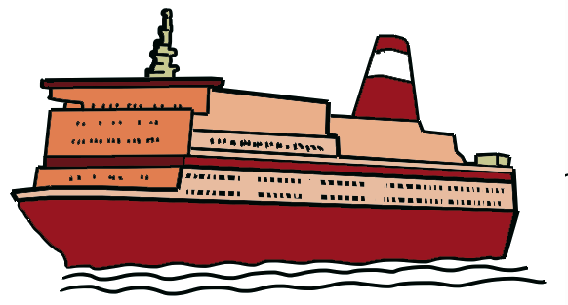
Does a boat have an engine?
Yes!
en bateau
Je vais en bateau…
(I go by boat…)

Slide 7
Does a train have an engine?
Yes!
en train
Je vais en train…
(I go by train…)

Slide 8
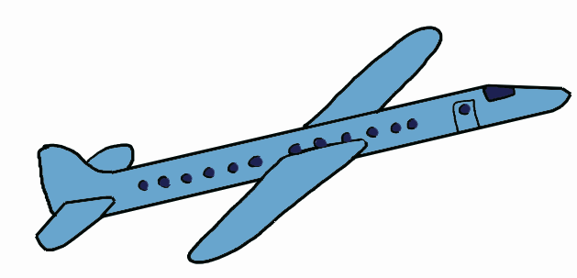
Does a plane have an engine?
Yes!
en avion
Je vais en avion…
(I go by plane…)

Slide 9
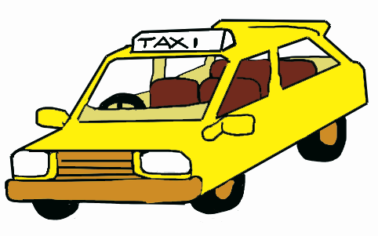
Does a taxi have an engine?
Yes!
en taxi
Je vais en taxi…
(I go by taxi…)

Slide 10
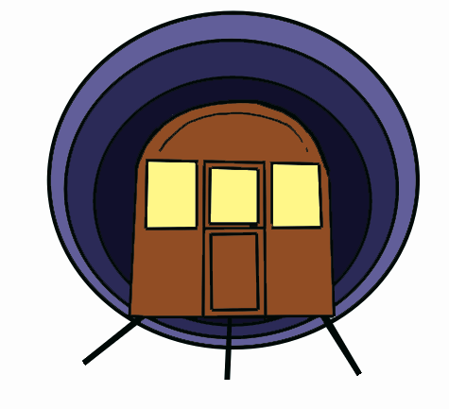
Does an underground train have an engine?
Yes!
en métro
Je vais en métro…
(I go by underground…)

Slide 11
If the means of transport doesn’t have an engine, you cannot say ‘en’. Use the first letter of the alphabet and add a grave accent to it: à.
= à
engine

Slide 12
Does a bicycle have an engine?
No!
à vélo / à bicyclette
Je vais à vélo… / Je vais à bicyclette…
(I go by bicycle…)

Slide 13
Does a horse have an engine?
No!
à cheval
Je vais à cheval…
(I go by horse…)

Slide 14
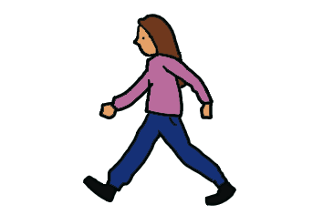
Do you have an engine in your feet?
No!
à pied
Je vais à pied…
(I go on foot…)

Slide 15

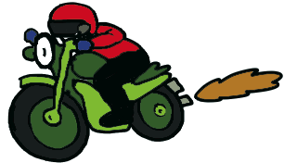
Warning
Why do we say à moto?
Even though a motorbike has an engine, remember that originally it was a bike to which an engine was added. Therefore we say ‘à moto’ and not ‘en moto’.
à moto / à motocyclette
Je vais à moto… / Je vais à motocyclette…
(I go by motocycle…)

Slide 16
Remember: if the means of transport has an engine, use en.
en avion
en voiture
en taxi
en autobus
engine
en métro
en bateau
en train

Slide 17
If the means of transport does NOT have an engine, use à
à vélo /
à bicyclette
à pied
à cheval
Warning
à moto /
à motocyclette

