Slide 1
ME 352
FLUID DYNAMICS 2

Slide 2
Course Outline
Chapter 1: Basic Equations in Integral Form for a Control Volume (Mass Conservation Equation, Momentum Equation, Moment of Momentum Equation)
Chapter 2: Dimensional and Model Analysis
Chapter 3: Viscous Flow
Chapter 4: Turbulent Flow

Slide 3
Assessment
There will be frequent Pop Quizzes
Two Class Tests
Two Assignments
Mid-Semester Exams
End of Semester Exams

Slide 4
Chapter 1: Basic Equations in Integral Form
for a Control Volume

Slide 5
Main Topics
  System vs Control Volume Concept
  Application of System Derivatives to the Control Volume
  Conservation of Mass
  Momentum Equation for Inertial Control Volume
  Momentum Equation for an Accelerating Control Volume
  Moment of Momentum Equation for Inertial Control Volume

Slide 6
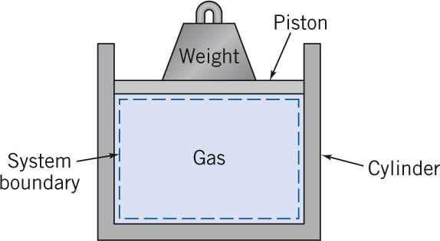
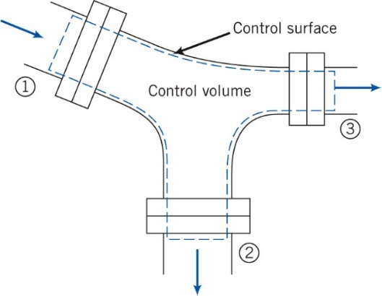
System vs. Control Volume
A system is a fixed quantity of matter or any region of space separated from its surroundings by a boundary. The boundary may be fixed or moving.
There are three types of systems in the field of thermo-fluids
  Isolated System: No mass or energy can cross its boundary
  Closed System: Energy can cross system boundary but mass can not
  Open System: Both mass and energy can cross its boundary
In Fluid Mechanics an open system is called a Control Volume (CV)

Slide 7
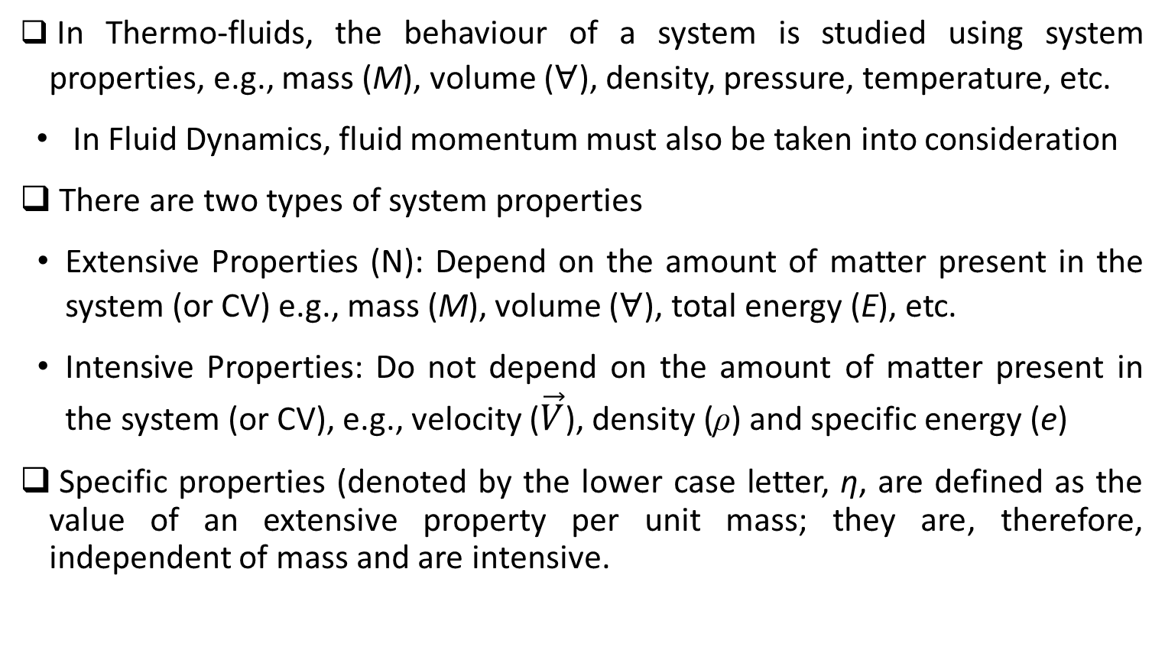
System vs. Control Volume
In Thermo-fluids, the behaviour of a system is studied using system properties, e.g., mass (M), volume ($∀$), density, pressure, temperature, etc.
  In Fluid Dynamics, fluid momentum must also be taken into consideration
There are two types of system properties
  Extensive Properties (N): Depend on the amount of matter present in the system (or CV) e.g., mass (M), volume ($∀$), total energy (E), etc.
  Intensive Properties: Do not depend on the amount of matter present in the system (or CV), e.g., velocity ($\vec{V}$), density (ρ) and specific energy (e)
Specific properties (denoted by the lower case letter, η, are defined as the value of an extensive property per unit mass; they are, therefore, independent of mass and are intensive.

Slide 8
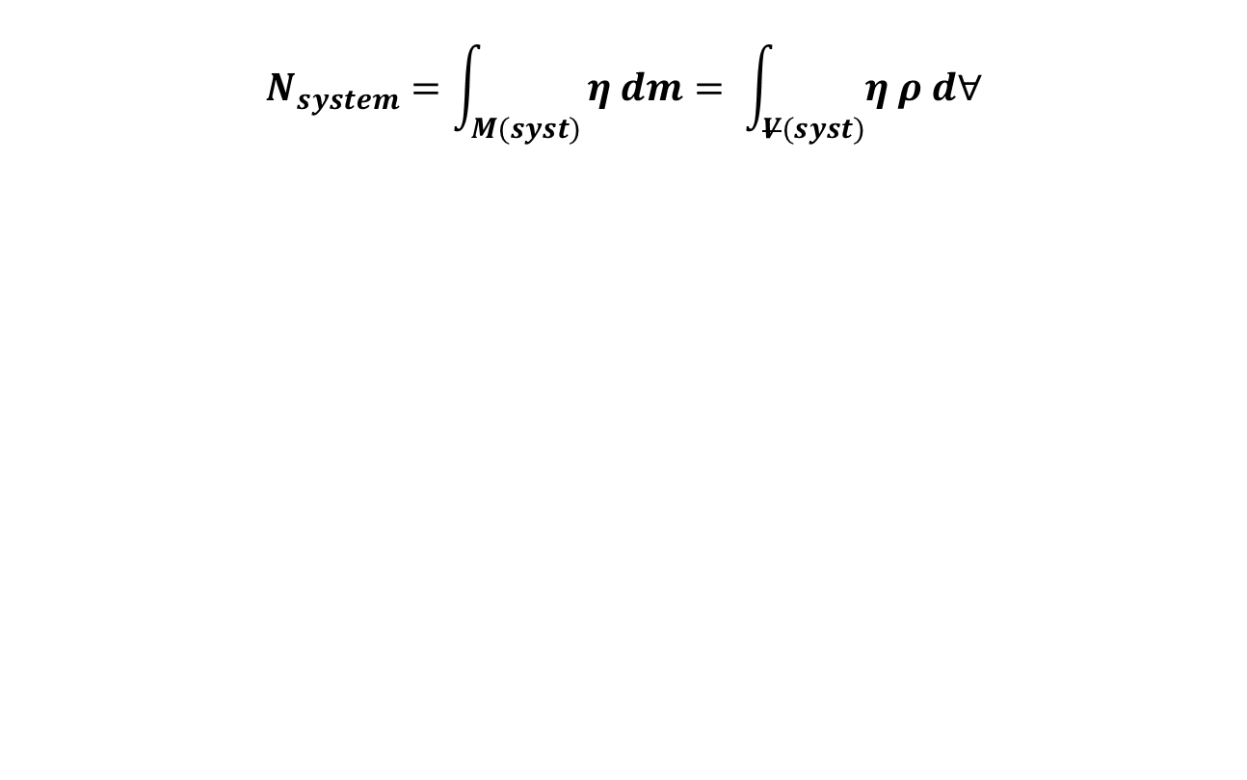
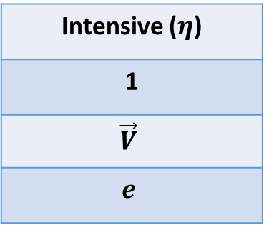
Extensive and Intensive Properties
$$N_{system}=\int_{M(syst)}{η dm= \int_{V(syst)}{η ρ d∀}}$$
Property
Mass
Momentum
Energy
Extensive (N)
M
P
E
Intensive ($η$)
1
$$\vec{V}$$
$$e$$

Slide 9

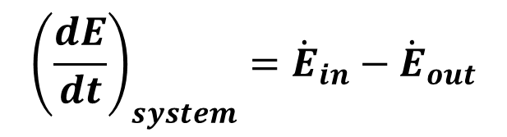
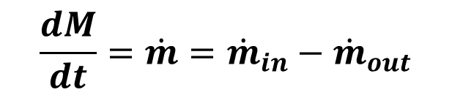
Basic Laws of a Thermodynamic System
Closed System:
Energy Conservation
$$Q−W= ∆E$$
Open System:
Mass Conservation
$$\frac{dM}{dt}=\dot{m}={\dot{m}}_{in}−{\dot{m}}_{out}$$
Energy Conservation
$${\left(\frac{dE}{dt}\right)}_{system}={\dot{E}}_{in}−{\dot{E}}_{out}$$

Slide 10
Basic Laws of a Control Volume
Mass Conservation
Momentum Conservation (Linear & Angular Momentum)
For a control volume, the laws are more meaningful when expressed in integral form than differential form. This is accomplished using the Reynolds Transport Theorem (RTT)

Slide 11
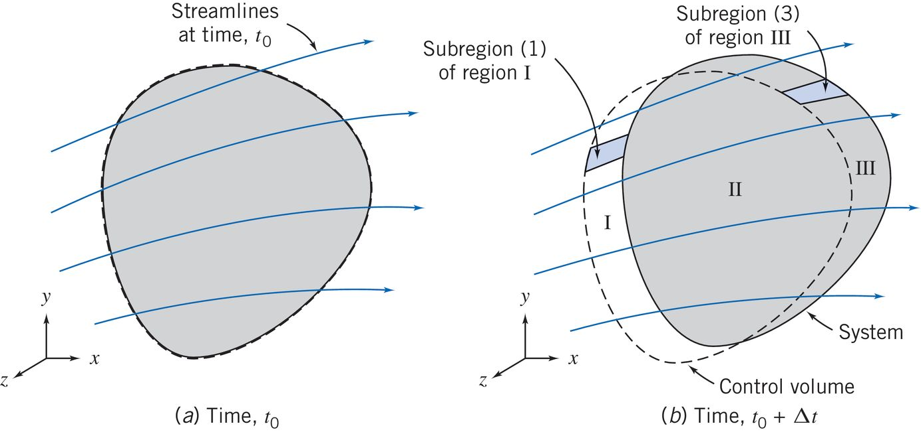
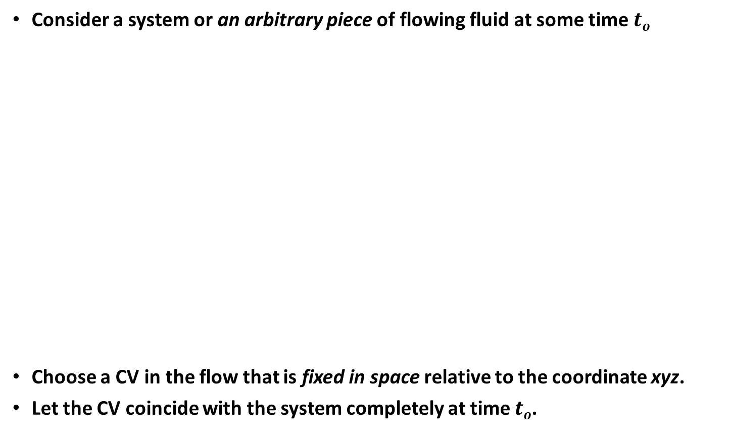
Reynolds Transport Theorem (RTT)
Consider a system or an arbitrary piece of flowing fluid at some time $to$
Choose a CV in the flow that is fixed in space relative to the coordinate xyz.
Let the CV coincide with the system completely at time $to$.

Slide 12
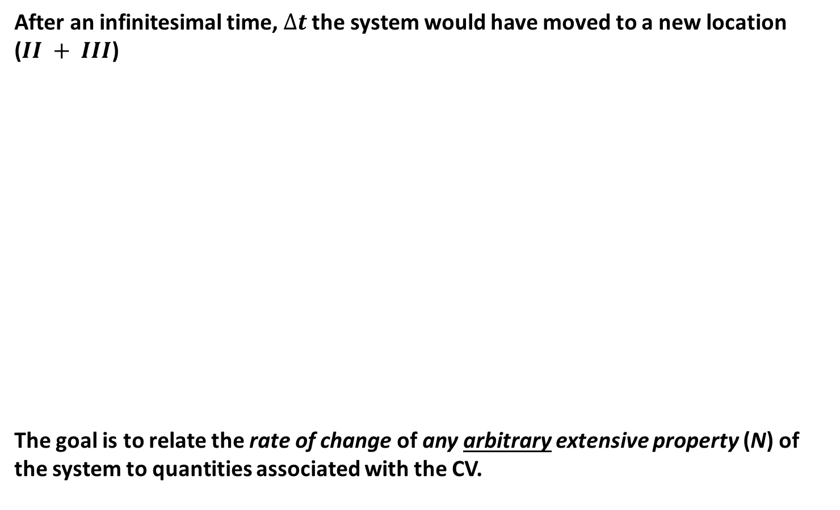
Reynolds Transport Theorem (RTT)
After an infinitesimal time,$∆t$ the system would have moved to a new location ($II + III$)
The goal is to relate the rate of change of any arbitrary extensive property (N) of the system to quantities associated with the CV.

Slide 13

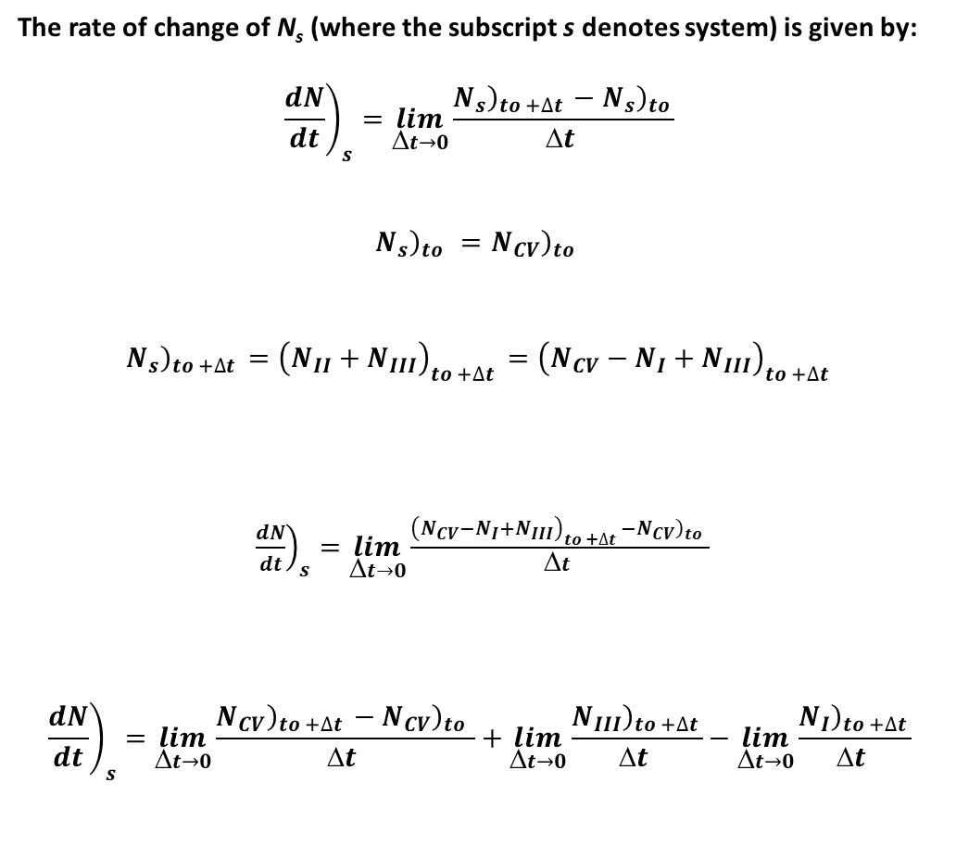
Derivation of RTT
The rate of change of N_{s} (where the subscript s denotes system) is given by:
$${\left.\frac{dN}{dt}\right)}_{s}=\lim_{Δt→0}{\frac{{\left.N_{s}\right)}_{to +∆t }−{\left.N_{s}\right)}_{to }}{Δt }}$$
$${\left.N_{s}\right)}_{to }={\left.N_{CV}\right)}_{to }$$
$${\left.N_{s}\right)}_{to +∆t }={\left.\left(N_{II}\right.+N_{III}\right)}_{to +∆t }={\left.\left(N_{CV}\right.−N_{I}+N_{III}\right)}_{to +∆t }$$
${\left.\frac{dN}{dt}\right)}_{s}=\lim_{Δt→0}{\frac{{\left.\left(N_{CV}\right.−N_{I}+N_{III}\right)}_{to +∆t }−{\left.N_{CV}\right)}_{to }}{Δt }}$
$${\left.\frac{dN}{dt}\right)}_{s}=\lim_{t→0}{\frac{{\left.N_{CV}\right)}_{to +∆t }−{\left.N_{CV}\right)}_{to }}{t }}+\lim_{t→0}{\frac{{\left.N_{III}\right)}_{to +∆t }}{t }}−\lim_{t→0}{\frac{{\left.N_{I}\right)}_{to +∆t }}{t }}$$
Term I
Term II
Term III

Slide 14
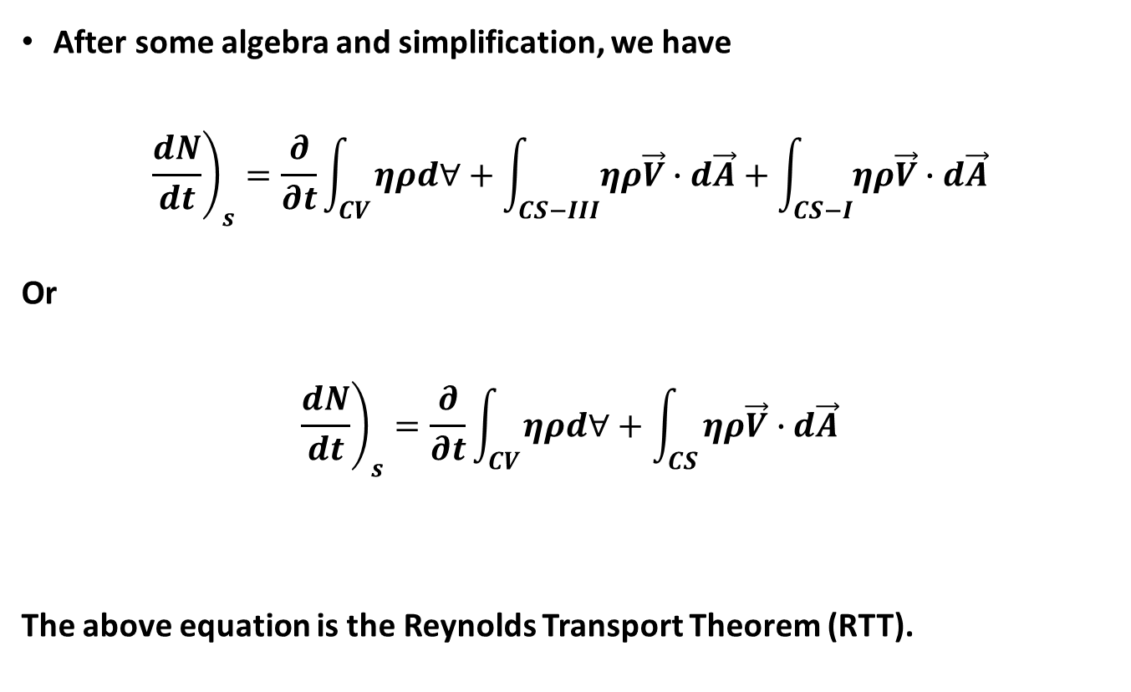
Derivation of RTT
After some algebra and simplification, we have
$${\left.\frac{dN}{dt}\right)}_{s}=\frac{∂}{∂t}\int_{CV}{ηρd∀}+\int_{CS−III}{ηρ\vec{V}∙d\vec{A}}+\int_{CS−I}{ηρ\vec{V}∙d\vec{A}}$$
Or
$${\left.\frac{dN}{dt}\right)}_{s}=\frac{∂}{∂t}\int_{CV}{ηρd∀}+\int_{CS}{ηρ\vec{V}∙d\vec{A}}$$
The above equation is the Reynolds Transport Theorem (RTT).

Slide 15

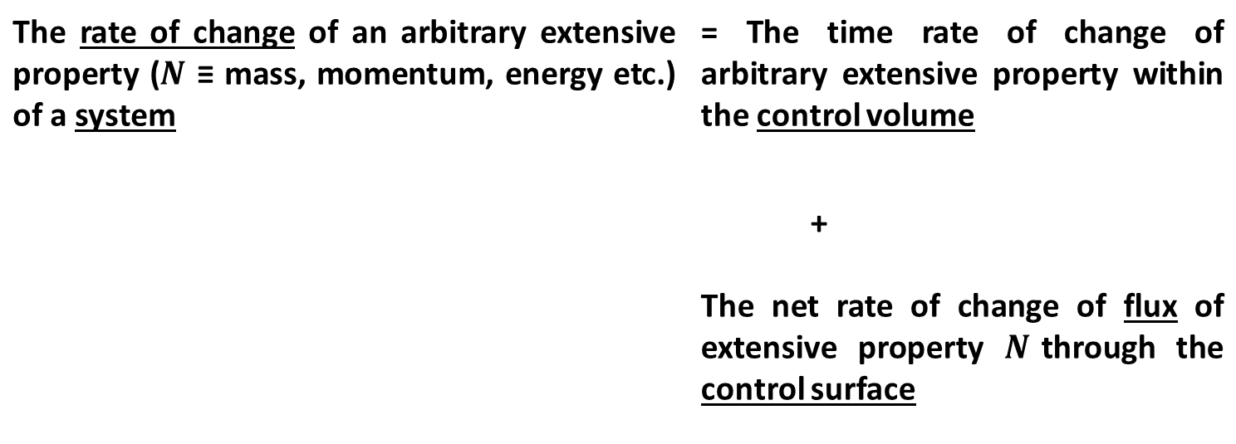
Reynolds Transport Theorem (RTT)
$${\left.\frac{dN}{dt}\right)}_{s}=\frac{∂}{∂t}\int_{CV}{ηρd∀}+\int_{CS}{ηρ\vec{V}∙d\vec{A}}$$
The rate of change of an arbitrary extensive property ($N$ ≡ mass, momentum, energy etc.) of a system | = The time rate of change of arbitrary extensive property within the control volume
 | + The net rate of change of flux of extensive property $N$through the control surface

Slide 16
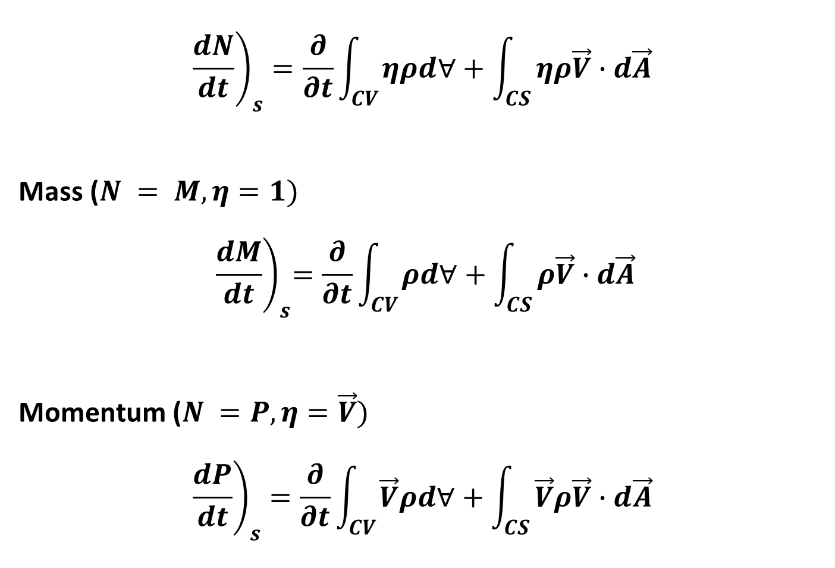
$${\left.\frac{dN}{dt}\right)}_{s}=\frac{∂}{∂t}\int_{CV}{ηρd∀}+\int_{CS}{ηρ\vec{V}∙d\vec{A}}$$
Mass ($N = M,η=1)$
$${ \left.\frac{dM}{dt}\right)}_{s}=\frac{∂}{∂t}\int_{CV}{ρd∀}+\int_{CS}{ρ\vec{V}∙d\vec{A}}$$
Momentum ($N =P,η=\vec{V})$
$${\left.\frac{dP}{dt}\right)}_{s}=\frac{∂}{∂t}\int_{CV}{\vec{V}ρd∀}+\int_{CS}{\vec{V}ρ\vec{V}∙d\vec{A}}$$

Slide 17
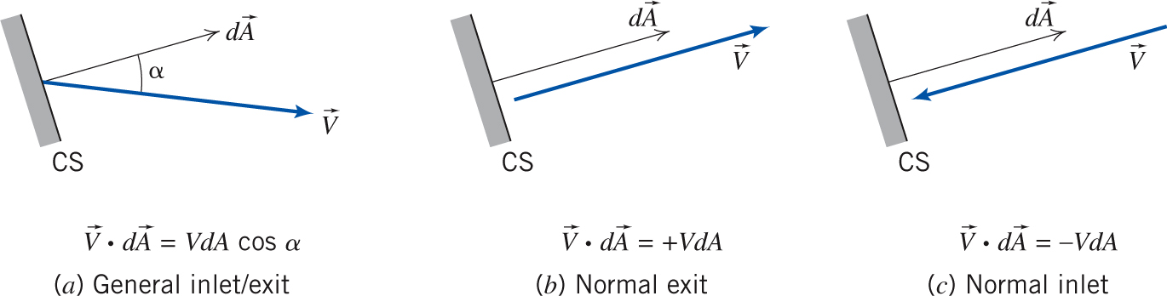
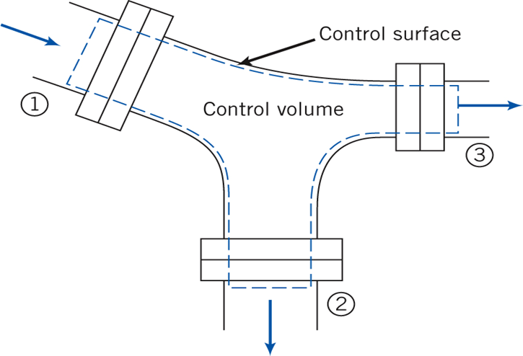
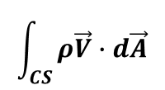
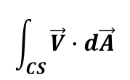
Mass/Volume Flux
$$\int_{CS}{ρ\vec{V}∙d\vec{A}}$$
$$\int_{CS}{\vec{V}∙d\vec{A}}$$

Slide 18
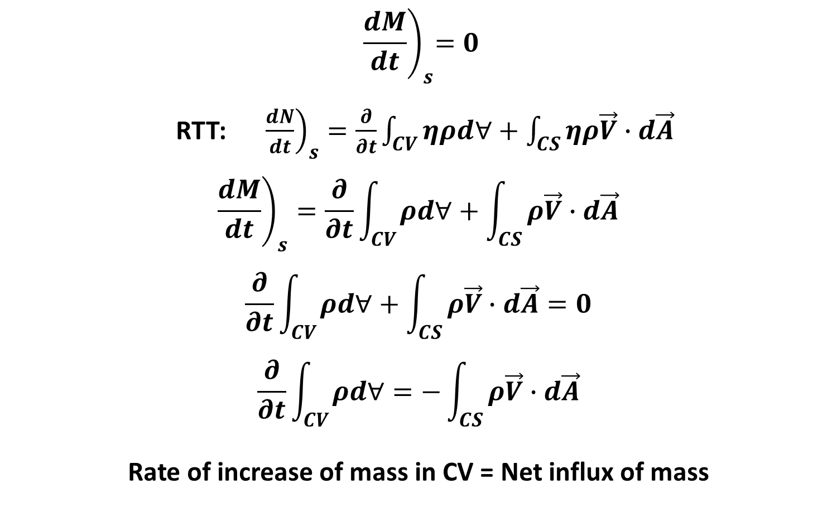
Conservation Mass
$${ \left.\frac{dM}{dt}\right)}_{s}=0$$
RTT: ${\left.\frac{dN}{dt}\right)}_{s}=\frac{∂}{∂t}\int_{CV}{ηρd∀}+\int_{CS}{ηρ\vec{V}∙d\vec{A}}$
$${\left.\frac{dM}{dt}\right)}_{s}=\frac{∂}{∂t}\int_{CV}{ρd∀}+\int_{CS}{ρ\vec{V}∙d\vec{A}}$$
$$\frac{∂}{∂t}\int_{CV}{ρd∀}+\int_{CS}{ρ\vec{V}∙d\vec{A}}=0$$
$$\frac{∂}{∂t}\int_{CV}{ρd∀}=−\int_{CS}{ρ\vec{V}∙d\vec{A}}$$
Rate of increase of mass in CV = Net influx of mass

Slide 19
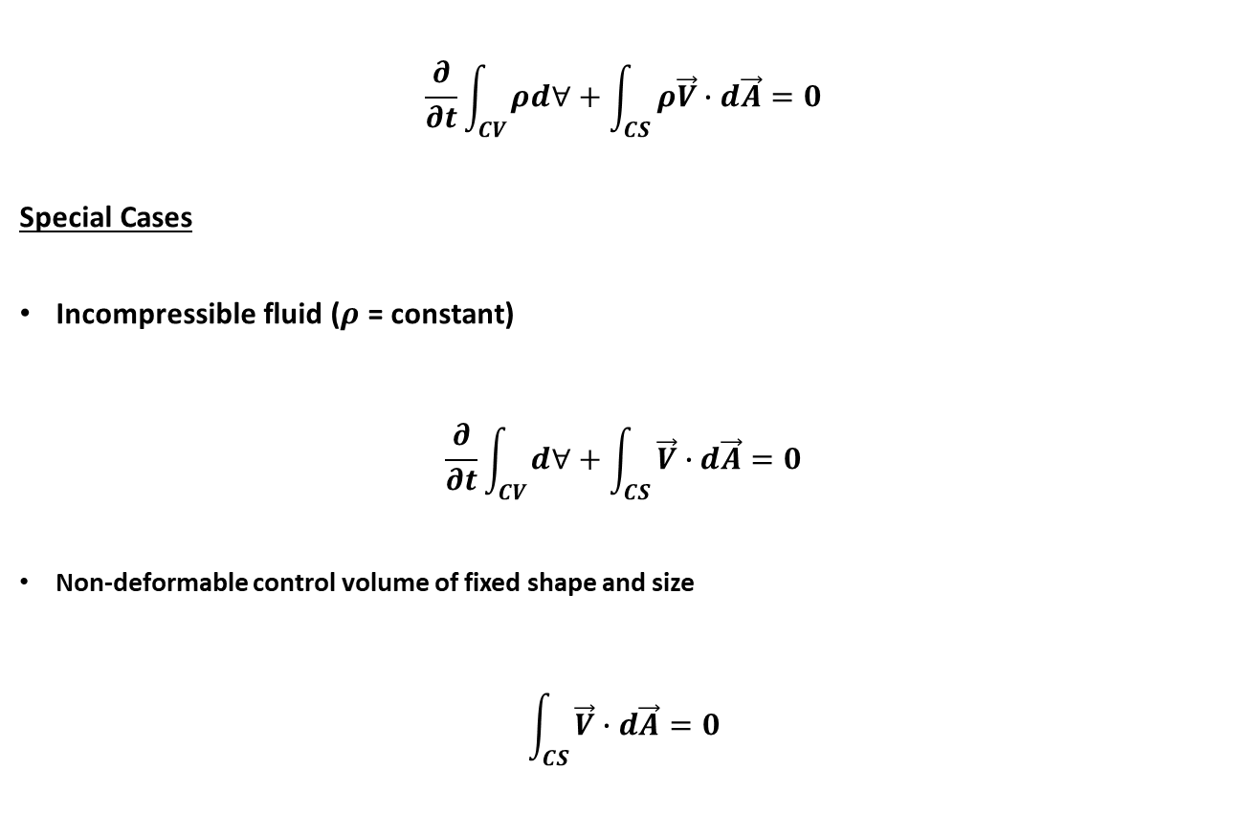
Conservation Mass
$$\frac{∂}{∂t}\int_{CV}{ρd∀}+\int_{CS}{ρ\vec{V}∙d\vec{A}}=0$$
Special Cases
Incompressible fluid ($ρ$ = constant)
$$\frac{∂}{∂t}\int_{CV}{d∀}+\int_{CS}{\vec{V}∙d\vec{A}}=0$$
Non-deformable control volume of fixed shape and size
$$\int_{CS}{\vec{V}∙d\vec{A}}=0$$

Slide 20
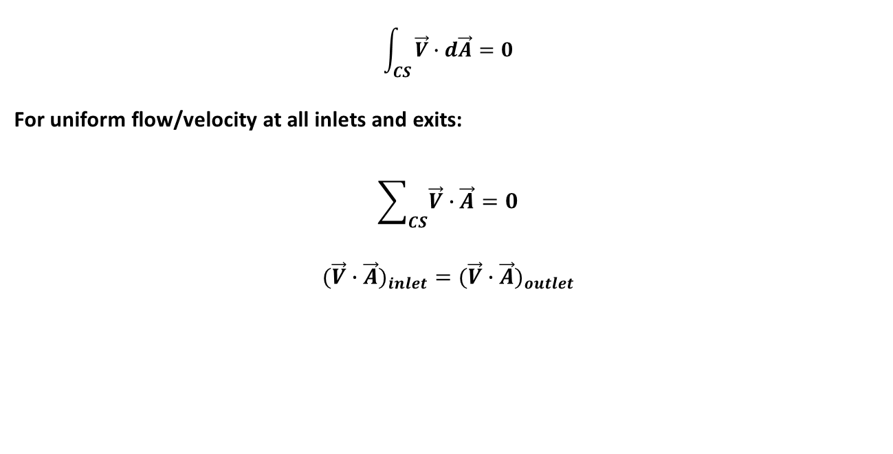
Conservation Mass
$$\int_{CS}{\vec{V}∙d\vec{A}}=0$$
For uniform flow/velocity at all inlets and exits:
$$\sum_{CS}{\vec{V}∙\vec{A}}=0$$
$$({\vec{V}∙\vec{A})}_{inlet}=({\vec{V}∙\vec{A})}_{outlet}$$

Slide 21
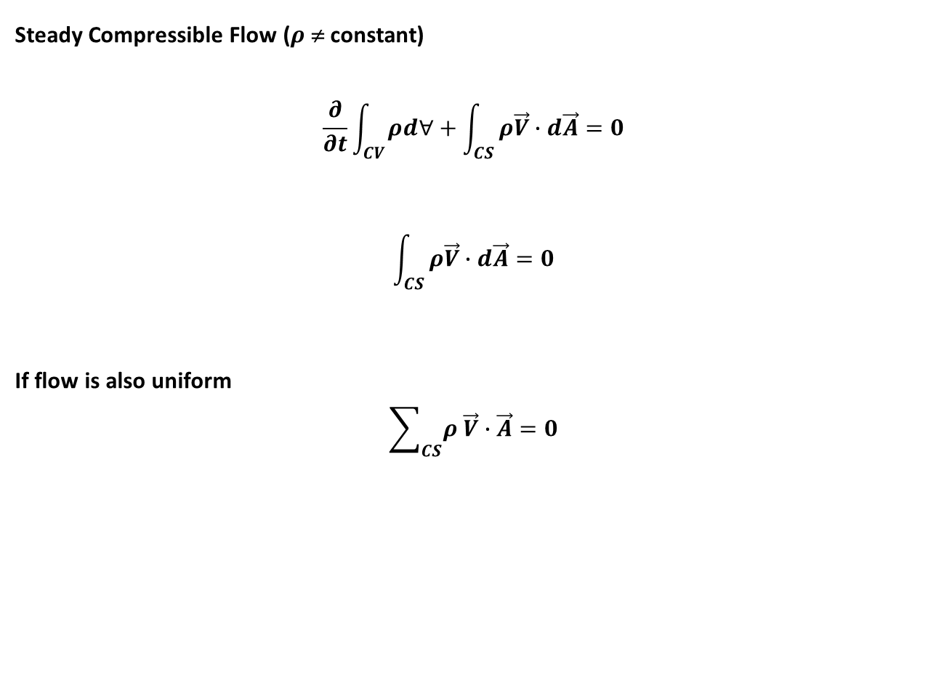
Conservation Mass
Steady Compressible Flow ($ρ$ ≠ constant)
$$\frac{∂}{∂t}\int_{CV}{ρd∀}+\int_{CS}{ρ\vec{V}∙d\vec{A}}=0$$
$$\int_{CS}{ρ\vec{V}∙d\vec{A}}=0$$
If flow is also uniform
$$\sum_{CS}{ρ \vec{V}∙\vec{A}}=0$$
0

Slide 22
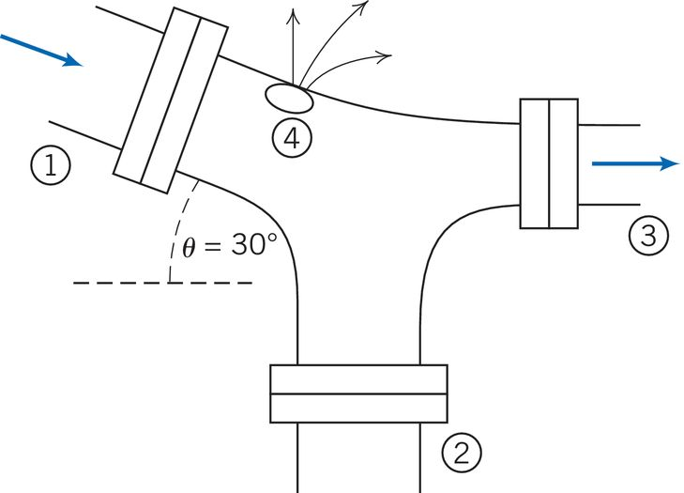
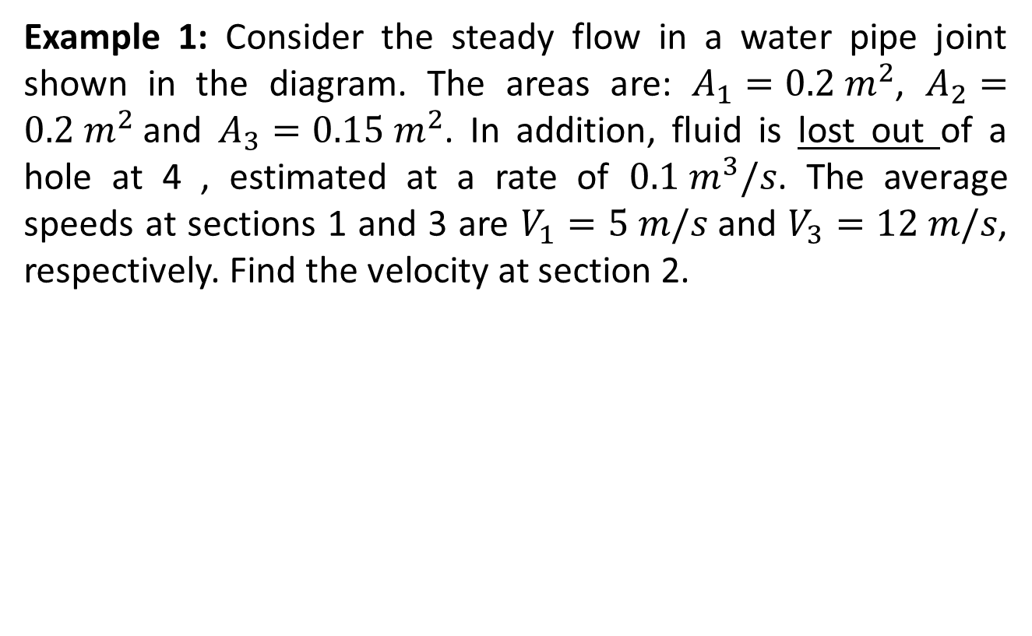
Example 1 (Steady Flow)
Example 1: Consider the steady flow in a water pipe joint shown in the diagram. The areas are: $A_{1}=0.2 m^{2}$, $A_{2}=0.2{ m}^{2}$and $A_{3}=0.15 m^{2}$. In addition, fluid is lost out of a hole at 4 , estimated at a rate of $0.1 m^{3}/s$. The average speeds at sections 1 and 3 are $V_{1}=5 m/s$and $V_{3}=12 m/s$, respectively. Find the velocity at section 2.

Slide 23
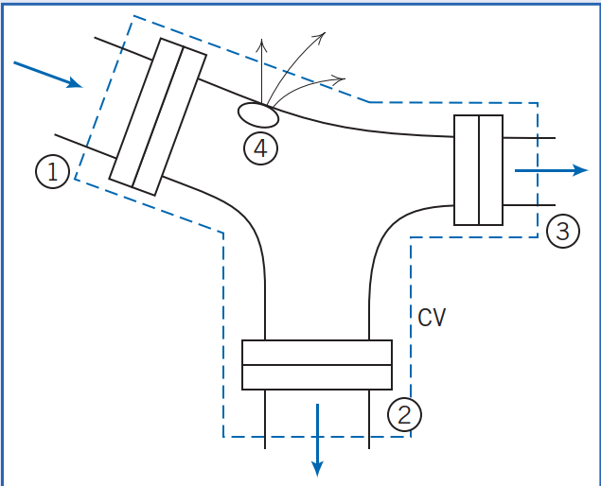
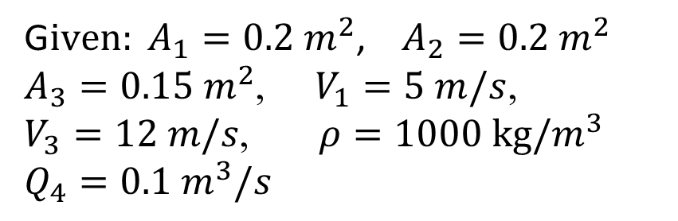
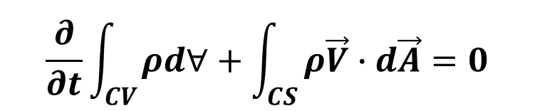
Example 1 - Solution
G$iven: A_{1}=0.2 m^{2}$, $A_{2}=0.2{ m}^{2}$ $A_{3}=0.15 m^{2}$, $V_{1}=5 m/s$, $V_{3}=12 m/s$, $ρ=1000 kg/m^{3}$
$$Q_{4}=0.1 m^{3}/s$$
$$\frac{∂}{∂t}\int_{CV}{ρd∀}+\int_{CS}{ρ\vec{V}∙d\vec{A}}=0$$
Assumptions:
Steady flow
Incompressible flow
Uniform flow at all sections
Let’s also assume that the flow out of Section 2 is outwards

Slide 24
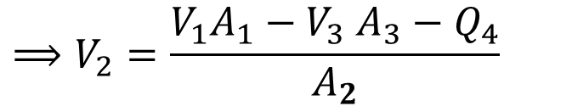
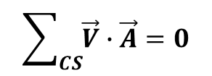

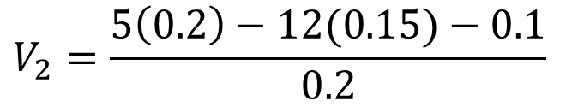
Example 1 - Solution
The general control volume equation
becomes
$$⟹V_{2}=\frac{V_{1}A_{1}{− V}_{3}A_{3}−Q_{4}}{A_{2}}$$
$$\sum_{CS}{\vec{V}∙\vec{A}}=0$$
$$V_{2}=\frac{5\left(0.2\right)−12(0.15)−0.1}{0.2}$$
$$⟹ \vec{V_{1}}∙\vec{A_{1}}+\vec{V_{2}}∙\vec{A_{2}}+\vec{V_{3}}∙\vec{A_{3}}+Q_{4}=0$$
$$\vec{V_{1}}∙\vec{A_{1}}=−V_{1}A_{1}$$
$$V_{2}=−4.5 m/s$$
$$\vec{V_{2}}∙\vec{A_{2}}=+V_{2}A_{2}$$
Comments: Negative value of V₂ means there is an inflow at Section 2. Thus, our initial assumption of outflow was invalid!
$$\vec{V_{3}}∙\vec{A_{3}}={+V}_{3}A_{3}$$
$$⟹−V_{1}A_{1}+V_{2}A_{2}{+V}_{3}A_{3}+Q_{4}=0$$

Slide 25
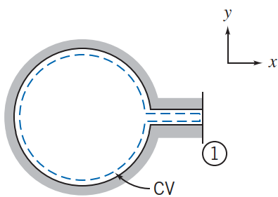
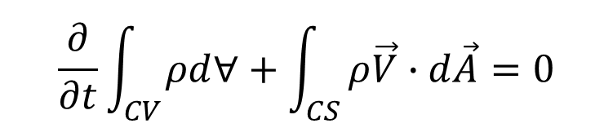
Example 2: Unsteady Compressible Flow
A tank of 0.4 m³ volume contains compressed air. A valve is opened and air escapes with a velocity of 250 m/s through an opening of 100 mm² area. The temperature of the air passing through the opening is -20ºC and the absolute pressure is 300 kPa. Find the rate of change of density of the air in the tank at this moment.
Solution:
$$\frac{∂}{∂t}\int_{CV}{ρd∀}+\int_{CS}{ρ\vec{V}∙d\vec{A}}=0$$
Assumptions:
Properties in the tank are uniform but depend on time
Uniform flow at Section 1

Slide 26
Example 2: Unsteady Compressible Flow
A tank of 0.4 m³ volume contains compressed air. A valve is opened and air escapes with a velocity of 250 m/s through an opening of 100 mm² area. The temperature of the air passing through the opening is -20ºC and the absolute pressure is 300 kPa. Find the rate of change of density of the air in the tank at this moment.
Solution:
$$\frac{∂}{∂t}\int_{CV}{ρd∀}+\int_{CS}{ρ\vec{V}∙d\vec{A}}=0$$
Assumptions:
Properties in the tank are uniform but depend on time
Uniform flow at Section 1

Slide 27

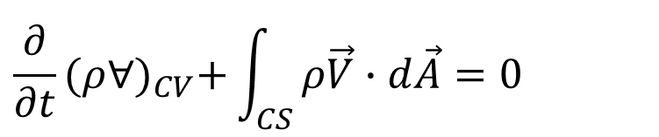
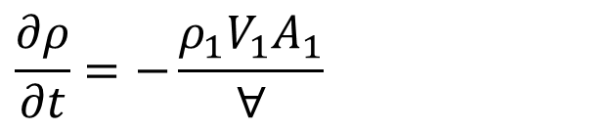
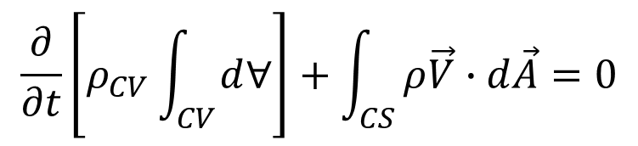
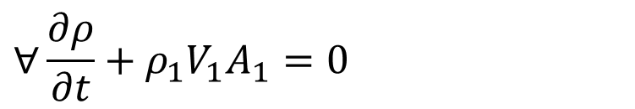
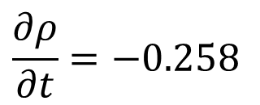
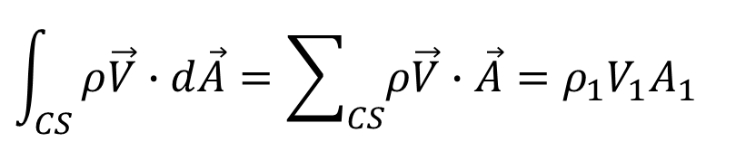
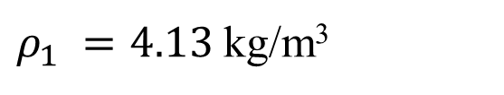
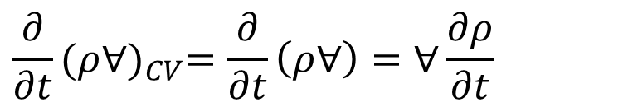
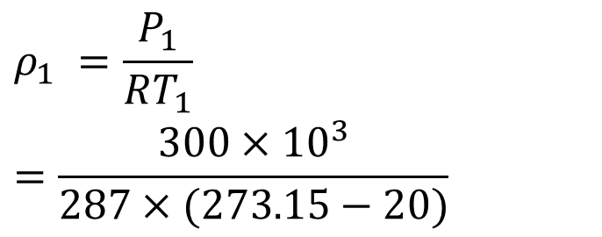
Example 2 (Solution Contd.)
$$\frac{∂}{∂t}\left[ρ_{CV}\int_{CV}{d∀}\right]+\int_{CS}{ρ\vec{V}∙d\vec{A}}=0$$
$$\frac{∂ρ}{∂t}=−\frac{ρ_{1}V_{1}A_{1}}{∀}$$
Using the ideal gas equation, the density at Section 1 can be calculated as
$$\frac{∂}{∂t}{(ρ∀)}_{CV}+\int_{CS}{ρ\vec{V}∙d\vec{A}}=0$$
Evaluating term by term
$$P_{1}=ρ_{1}RT_{1}$$
$$\frac{∂}{∂t}{(ρ∀)}_{CV}=\frac{∂}{∂t}\left(ρ∀\right)=∀\frac{∂ρ}{∂t}$$
$$ρ_{1} =\frac{P_{1}}{RT_{1}} =\frac{300×{10}^{3}}{287×(273.15−20)}$$
$$\int_{CS}{ρ\vec{V}∙d\vec{A}}=\sum_{CS}{ρ\vec{V}∙\vec{A}=ρ_{1}V_{1}A_{1}}$$
$ρ_{1} =4.13$ kg/m³
$$∀\frac{∂ρ}{∂t}+ρ_{1}V_{1}A_{1}=0$$
$$\frac{∂ρ}{∂t}=−0.258$$
(kg/m³)/s

Slide 28
Practice Problems
1. A 0.3 m by 0.5 m rectangular air duct carries a flow of 0.45 m³/s at a density of 2 kg/m³. Calculate the mean velocity of the air in the duct. If the duct tapers to 0.15 m by 0.5 m size, what is the mean velocity in this section if the density is 1.5 kg/m³ there?
2. Water from a pipe 500 mm in diameter flows into two smaller branches at a T-junction. If the diameters of the smaller branches are 300 mm and 200 mm, and the flow mean velocities inside them are 1.5 m/s and 3.5 m/s, respectively, what is the mean velocity of the flow in the pipe?
3. Water from a cylindrical tank, 500 mm in diameter, drains through a small circular hole of diameter 80 mm. Calculate the rate of change of the liquid level in the tank at the instant when the average velocity through the drain is 2.5 m/s.

Slide 29
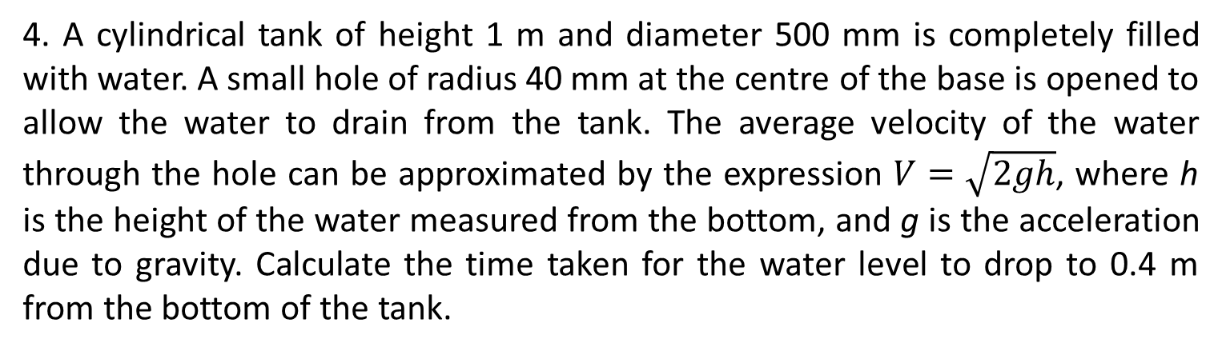
Practice Problems
4. A cylindrical tank of height 1 m and diameter 500 mm is completely filled with water. A small hole of radius 40 mm at the centre of the base is opened to allow the water to drain from the tank. The average velocity of the water through the hole can be approximated by the expression $V=\sqrt{2gh}$, where h is the height of the water measured from the bottom, and g is the acceleration due to gravity. Calculate the time taken for the water level to drop to 0.4 m from the bottom of the tank.

Slide 30
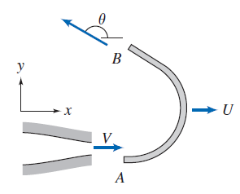
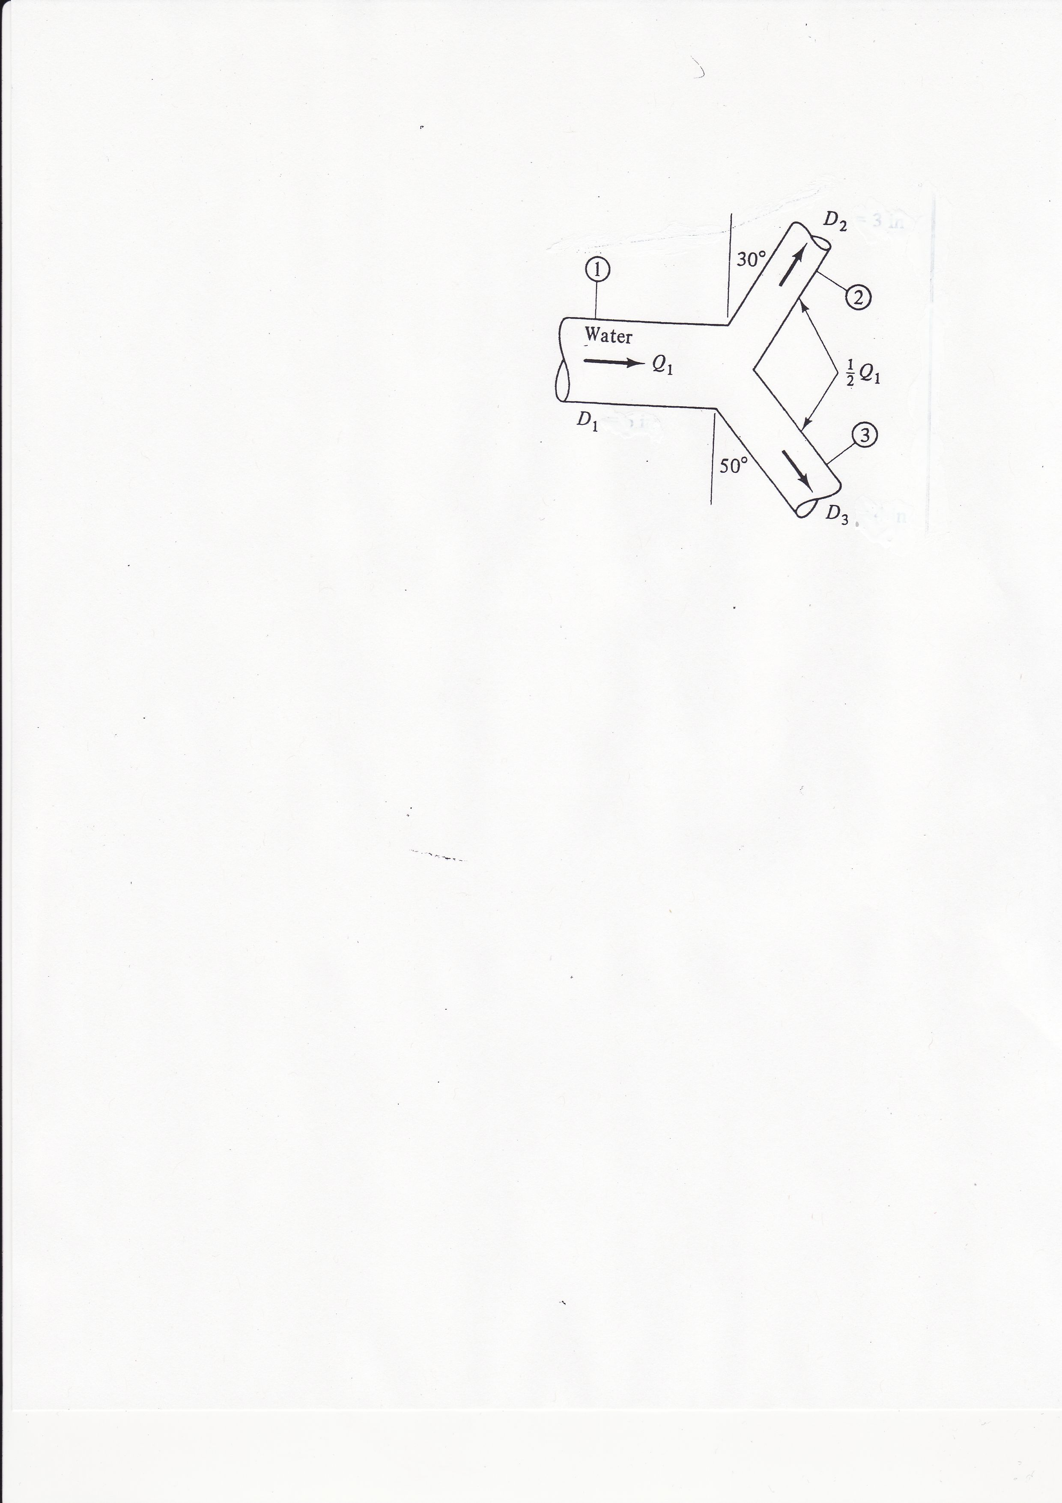
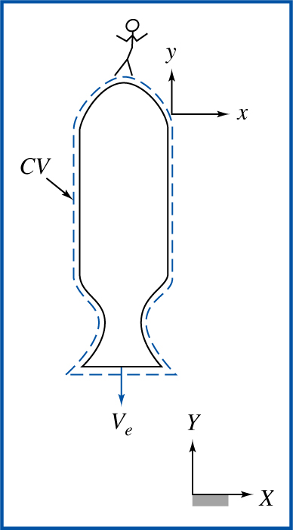




Momentum Equation
$$D_{2}$$
$$P_{1}$$
$$60°$$
$$D_{3}$$

Slide 31
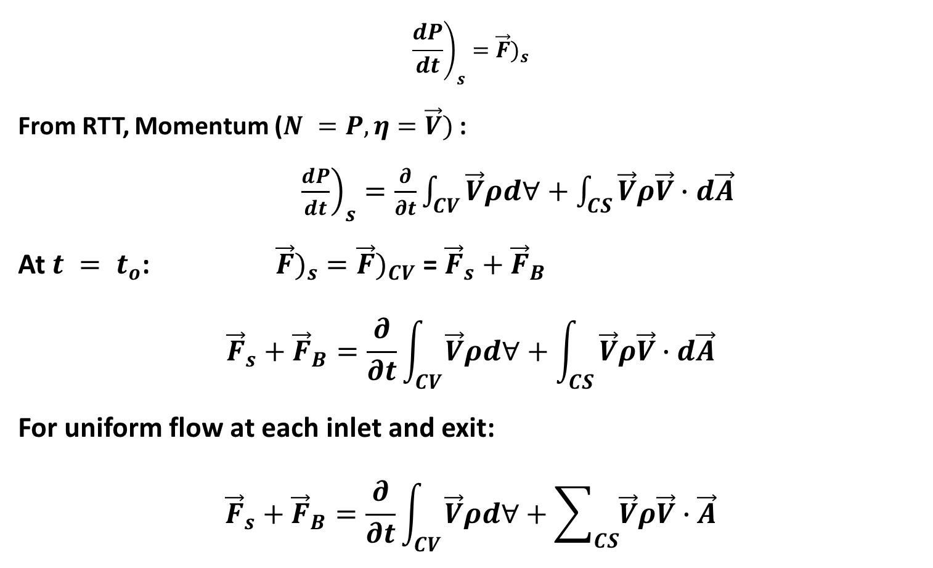
Momentum Equation for Inertial Control Volume
$${\left.\frac{dP}{dt}\right)}_{s}={\vec{F})}_{s}$$
From RTT, Momentum ($N =P,η=\vec{V})$:
${\left.\frac{dP}{dt}\right)}_{s}=\frac{∂}{∂t}\int_{CV}{\vec{V}ρd∀}+\int_{CS}{\vec{V}ρ\vec{V}∙d\vec{A}}$
At $t = t_{o}$:${\vec{F})}_{s}={\vec{F})}_{CV}$ = ${\vec{F}}_{s}+{\vec{F}}_{B}$
$${\vec{F}}_{s}+{\vec{F}}_{B}=\frac{∂}{∂t}\int_{CV}{\vec{V}ρd∀}+\int_{CS}{\vec{V}ρ\vec{V}∙d\vec{A}}$$
For uniform flow at each inlet and exit:
$${\vec{F}}_{s}+{\vec{F}}_{B}=\frac{∂}{∂t}\int_{CV}{\vec{V}ρd∀}+\sum_{CS}{\vec{V}ρ\vec{V}∙\vec{A}}$$

Slide 32
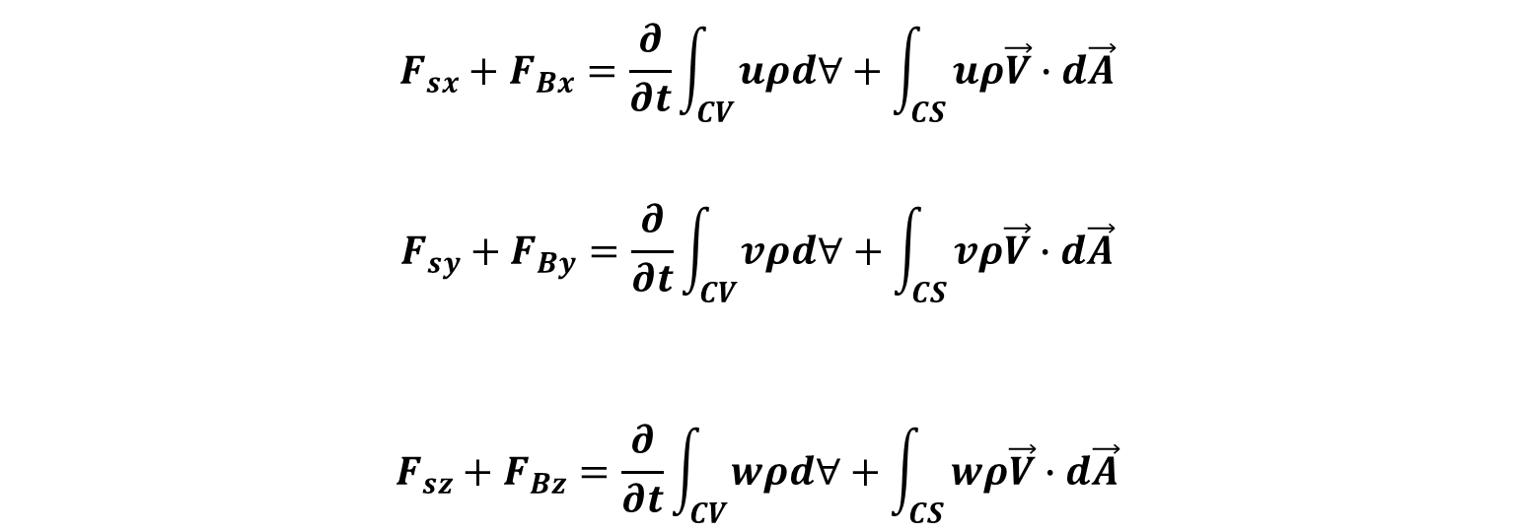


Momentum Equation for Inertial Control Volume
$${\vec{F}}_{s}+{\vec{F}}_{B}=\frac{∂}{∂t}\int_{CV}{\vec{V}ρd∀}+\int_{CS}{\vec{V}ρ\vec{V}∙d\vec{A}}$$
In the $xyz$ coordinates:
$\vec{V}=u\hat{i}+v\hat{j}$ +$w\hat{k}$
where $u, v$and $w$ are scalar components of $\vec{V}$
$$F_{sx}+F_{Bx}=\frac{∂}{∂t}\int_{CV}{uρd∀}+\int_{CS}{uρ\vec{V}∙d\vec{A}}$$
$$F_{sy}+F_{By}=\frac{∂}{∂t}\int_{CV}{vρd∀}+\int_{CS}{vρ\vec{V}∙d\vec{A}}$$
$$F_{sz}+F_{Bz}=\frac{∂}{∂t}\int_{CV}{wρd∀}+\int_{CS}{wρ\vec{V}∙d\vec{A}}$$

Slide 33
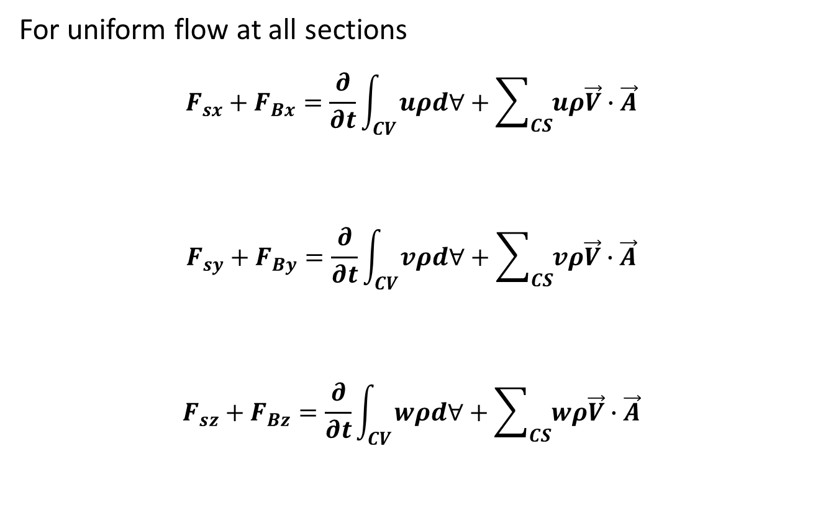
Momentum Equation for Inertial Control Volume
For uniform flow at all sections
$$F_{sx}+F_{Bx}=\frac{∂}{∂t}\int_{CV}{uρd∀}+\sum_{CS}{uρ\vec{V}∙\vec{A}}$$
$$F_{sy}+F_{By}=\frac{∂}{∂t}\int_{CV}{vρd∀}+\sum_{CS}{vρ\vec{V}∙\vec{A}}$$
$$F_{sz}+F_{Bz}=\frac{∂}{∂t}\int_{CV}{wρd∀}+\sum_{CS}{wρ\vec{V}∙\vec{A}}$$

Slide 34
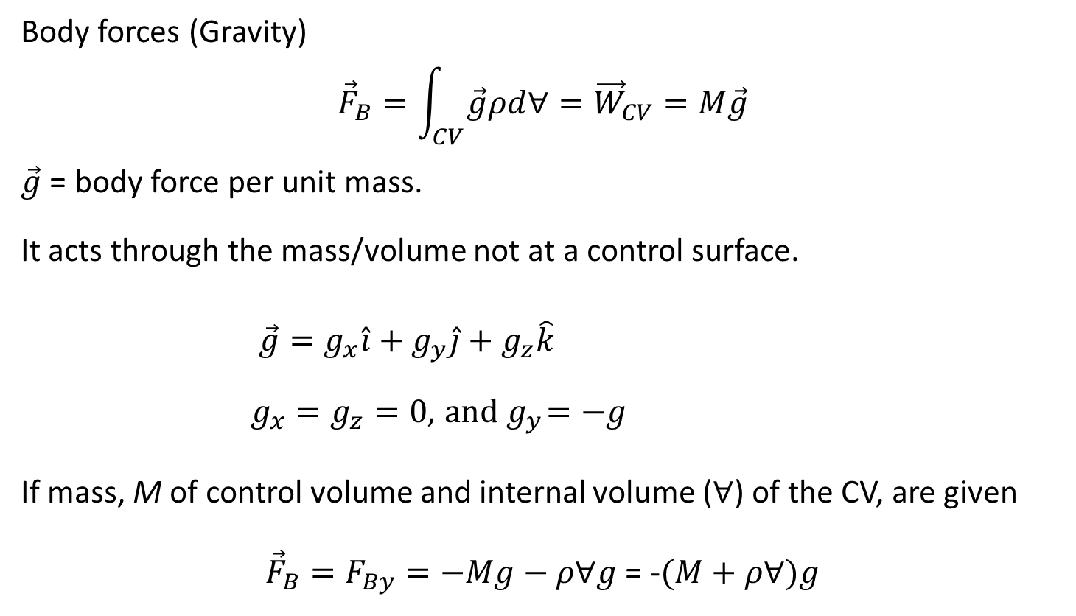
Momentum Equation for Inertial Control Volume
Body forces (Gravity)
$${\vec{F}}_{B}=\int_{CV}{\vec{g}ρd∀}={\vec{W}}_{CV}=M\vec{g}$$
$\vec{g}$ = body force per unit mass.
It acts through the mass/volume not at a control surface.
$\vec{g}=g_{x}\hat{i}+g_{y}\hat{j}+g_{z}\hat{k}$
$g_{x}=g_{z}=0,{ and g}_{y}=−g$
If mass, M of control volume and internal volume ($∀$) of the CV, are given
${\vec{F}}_{B}=F_{By}=−Mg−ρ∀g$ = -$(M+ρ∀)g$
g
y

Slide 35
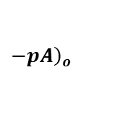


Momentum Equation for Inertial Control Volume
Surface forces (${\vec{F}}_{S}$) = Pressure Force + Viscous Force + Reaction Force
Pressure Force: ${\vec{F}}_{S−P}=\int_{A}{−pd\vec{A}}≡pA$
The negative sign ensures that pressure forces are always acting onto the control surface.
Use gauge pressure, $P_{gauge}$ in calculations for simplicity.
Viscous Force: Resistance/Frictional Force/Drag
Reaction Force:
CV
$${\left.pA\right)}_{i}$$
$$−{\left.pA\right)}_{o}$$
inlet
outlet

Slide 36




Example problems
Consider the Y-section shown below. The mass of the section is M kg, and its internal volume is V m³. Assume the flow is incompressible, steady and uniform. If the fluid density is $ρ$,
Determine the components of velocity (u and v) at each section
Determine the mass flux, $ρ\vec{V}∙\vec{A} at each section$
Determine the surface (pressure) and body forces
$$V_{1}$$
$$A_{1}$$
$$P_{1}$$
α
$$V_{2}$$
$$A_{2}$$
$$P_{2}$$
θ
$$V_{3}$$
$$A_{3}$$
$$P_{3}$$

Slide 37

 | Section 1 | Section 2 | Section 3
$$u$$
$$v$$
$$ρ\vec{V}∙\vec{A}$$
$$F_{sx}$$
$$F_{sy}$$
$$F_{Bx}$$
$$F_{By}$$

Slide 38

Force Exerted by a Flowing Fluid on a Pipe Bend
Let F_{x} and F_{y} be the components of the force exerted by the flowing fluid on the bend in the x and y –directions respectively,
then the force exerted by the bend on the fluid in the direction of x and y will be equal to F_{x} and F_{y} but in the opposite i.e in x – direction = - F_{x} and y – direction = -F_{y}
The other external forces on the fluid are P₁ A₁ and P₂ A₂ on section 1 and 2 respectively

Slide 39


Force Exerted by a Flowing Fluid on a Pipe Bend
$${∑Fx=F}_{sx}+F_{Bx}=\frac{∂}{∂t}\int_{CV}{uρd∀}+\sum_{CS}{uρ\vec{V}∙\vec{A}}$$
Net force acting on the fluid in the x- direction = rate of change of momentum in x- direction
$$∑Fx {=P}_{1}A_{1}−P_{2}A_{2}\cos{θ}−F_{x}$$
$\sum_{CS}{uρ\vec{V}∙\vec{A}}$=?

Slide 40

Force Exerted by a Flowing Fluid on a Pipe Bend
$$\sum_{CS}{uρ\vec{V}∙\vec{A}=}V_{1}\left(−ρV_{1}A_{1}\right)+V_{2}cosθ\left(ρV_{2}A_{2}\right)$$
$=V_{2}cosθ\left(ρV_{2}A_{2}\right)$ ${− V}_{1}\left(ρV_{1}A_{1}\right)$
$=V_{2}cosθ\left(ρQ\right)$ ${− V}_{1}\left(ρQ\right)$
$${∴ P}_{1}A_{1}−P_{2}A_{2}\cos{θ}−F_{x}=ρQ\left(V_{2}\cos{θ}−V_{1}\right)$$
$F_{x}=P_{1}A_{1}−P_{2}A_{2}\cos{θ}$ +$ρQ\left({V_{1}−V}_{2}\cos{θ}\right)$

Slide 41

Force Exerted by a Flowing Fluid on a Pipe Bend
A similar analysis in the y- direction yields
$${∑Fy=F}_{sy}+F_{By}=\frac{∂}{∂t}\int_{CV}{vρd∀}+\sum_{CS}{vρ\vec{V}∙\vec{A}}$$
$$0−P_{2}A_{2}\sin{θ}−F_{y}=ρQ\left(V_{2}\sin{θ}−0\right)$$
$$F_{y}=−P_{2}A_{2}\sin{θ}−ρQ\left(V_{2}\sin{θ}\right)$$
The magnitude of the resultant force F=$\sqrt{F_{x}^{2}+F_{y}^{2}}$
The angle made by the resultant force with the horizontal direction is given by $\tan{θ}={F_{y}}/{F_{x}}$

Slide 42

Momentum Equation Example 3
A nozzle of exit diameter 20 mm is fitted to a pipe of diameter 40 mm. Find the force exerted by the nozzle on the water which is flowing through the pipe at a rate of $1.2{m^{3}}/{minute}$. Assume pressure at the exit of the nozzle to be atmospheric.
D₁ = 40 mm
Q₁ = 1.2 m³/min
D₂ = 20 mm
Q₂ = 1.2 m³/min

Slide 43

Momentum Equation Example 3
Given $D_{1}=40 mm=0.04 m$, $D_{2}=20 mm=0.02 m$ and
Discharge $Q=1.2{m^{3}}/{min}=0.02{m^{3}}/s$
Inlet Area, $A_{1}=\frac{πD_{1}^{2}}{4}=\frac{π{(0.04)}^{2}}{4}=1.256 x {10}^{−3}m^{2}$
Outlet Area, $A_{2}=\frac{πD_{2}^{2}}{4}=\frac{π{(0.02)}^{2}}{4}=3.14 x {10}^{−4}{ m}^{2}$
Applying continuity equation at (1) and (2), $A_{1}V_{1}=A_{2}V_{2}=Q$
$$V_{1}=\frac{Q}{A_{1}}=\frac{0.02}{1.256 x {10}^{−5}}=15.92m/s$$

Slide 44

Momentum Equation Example 3
$$V_{2}=\frac{Q}{A_{2}}=\frac{0.02}{3.14 x {10}^{−4}}=63.69m/s$$
Applying Bernoulli’s equation at section (1) and (2)
$$\frac{P_{1}}{ρg}+\frac{V_{1}^{2}}{2g}+z_{1}=\frac{P_{2}}{ρg}+\frac{V_{2}^{2}}{2g}+z_{1 }$$
But z1 = z2 and atmospheric pressure at exit implies $P_{2}=$ 0
$$∴ \frac{P_{1}}{ρg}=\frac{V_{2}^{2}}{2g}−\frac{V_{1}^{2}}{2g}=\frac{{63.69}^{2}}{2 x 9.81}−\frac{{15.92}^{2}}{2 x 9.81}$$
$$⟹ P_{1}=1000 × 9.81\left[\frac{{63.69}^{2}}{2 x 9.81}−\frac{{15.92}^{2}}{2 x 9.81}\right]=190.1472 × {10}^{4}N/{m^{2}}$$

Slide 45

Momentum Equation Example 3
Let the force exerted on the water be $F_{x}$
Applying the momentum equation in the x-direction leads to
$$⇒P_{1}A_{1}−P_{2}A_{2}+F_{x}=ρQ\left(V_{2}−V_{1}\right)$$
$P_{1}=190.1472 × {10}^{4}$ and $P_{2}=0$
$$190.1472 × {10}^{4} × 1.256 × {10}^{−3}+F_{x}=1000 × 0.02(63.64−15.92)$$
$$F_{x}=916.15−2388.24=−1472.1N$$
-Negative sign means the force exerted by nozzle on the water is from right to left

Slide 46

Practice Problems
(1) A pipe of 300 mm diameter conveying 0.3 m³/s of water has a right angled bend in a horizontal plane. Find the resultant force exerted on the bend if the pressure at inlet and outlet of the bend are 24.525 N/cm² and 23.544 N/cm² respectively.
(2) A 45 ° reducing bend, with 0.6096 m diameter upstream and 0.3048 m diameter downstream, has water flowing through it at the rate of 0.4445 m³/s under a pressure of 144.7899 kPa. Neglecting any loss in the bend, calculate the force exerted by the water on the reducing bend

Slide 47
Practice Problems
(3) In a 45° reducing bend a 0.5 m² area. Find the magnitude and direction of the force required to hold the duct in position if the velocity of the flow at the 1 m² section is 10 m/s, and pressure is 300 N/mm². Take density of air as 1.2 kg/m³.
(4) The diameter of a pipe-bend is 300 mm at inlet and 150 mm at outlet and the flow is turned through 120° in a vertical plane. The axis at inlet is horizontal and the centre of the outlet section is 1.4 m below the centre of the inlet section. The total volume of fluid contained in the bend is 0.085 m³. Neglecting friction, calculate the magnitude and direction of the net force exerted on the bend by water flowing through it at 0.23 m³/s when the inlet gauge pressure 140 kPa.

