Slide 1
ME 352
FLUID DYNAMICS 2

Slide 2
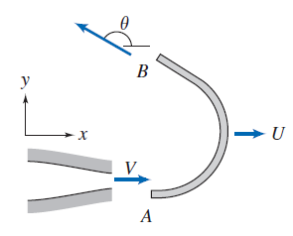
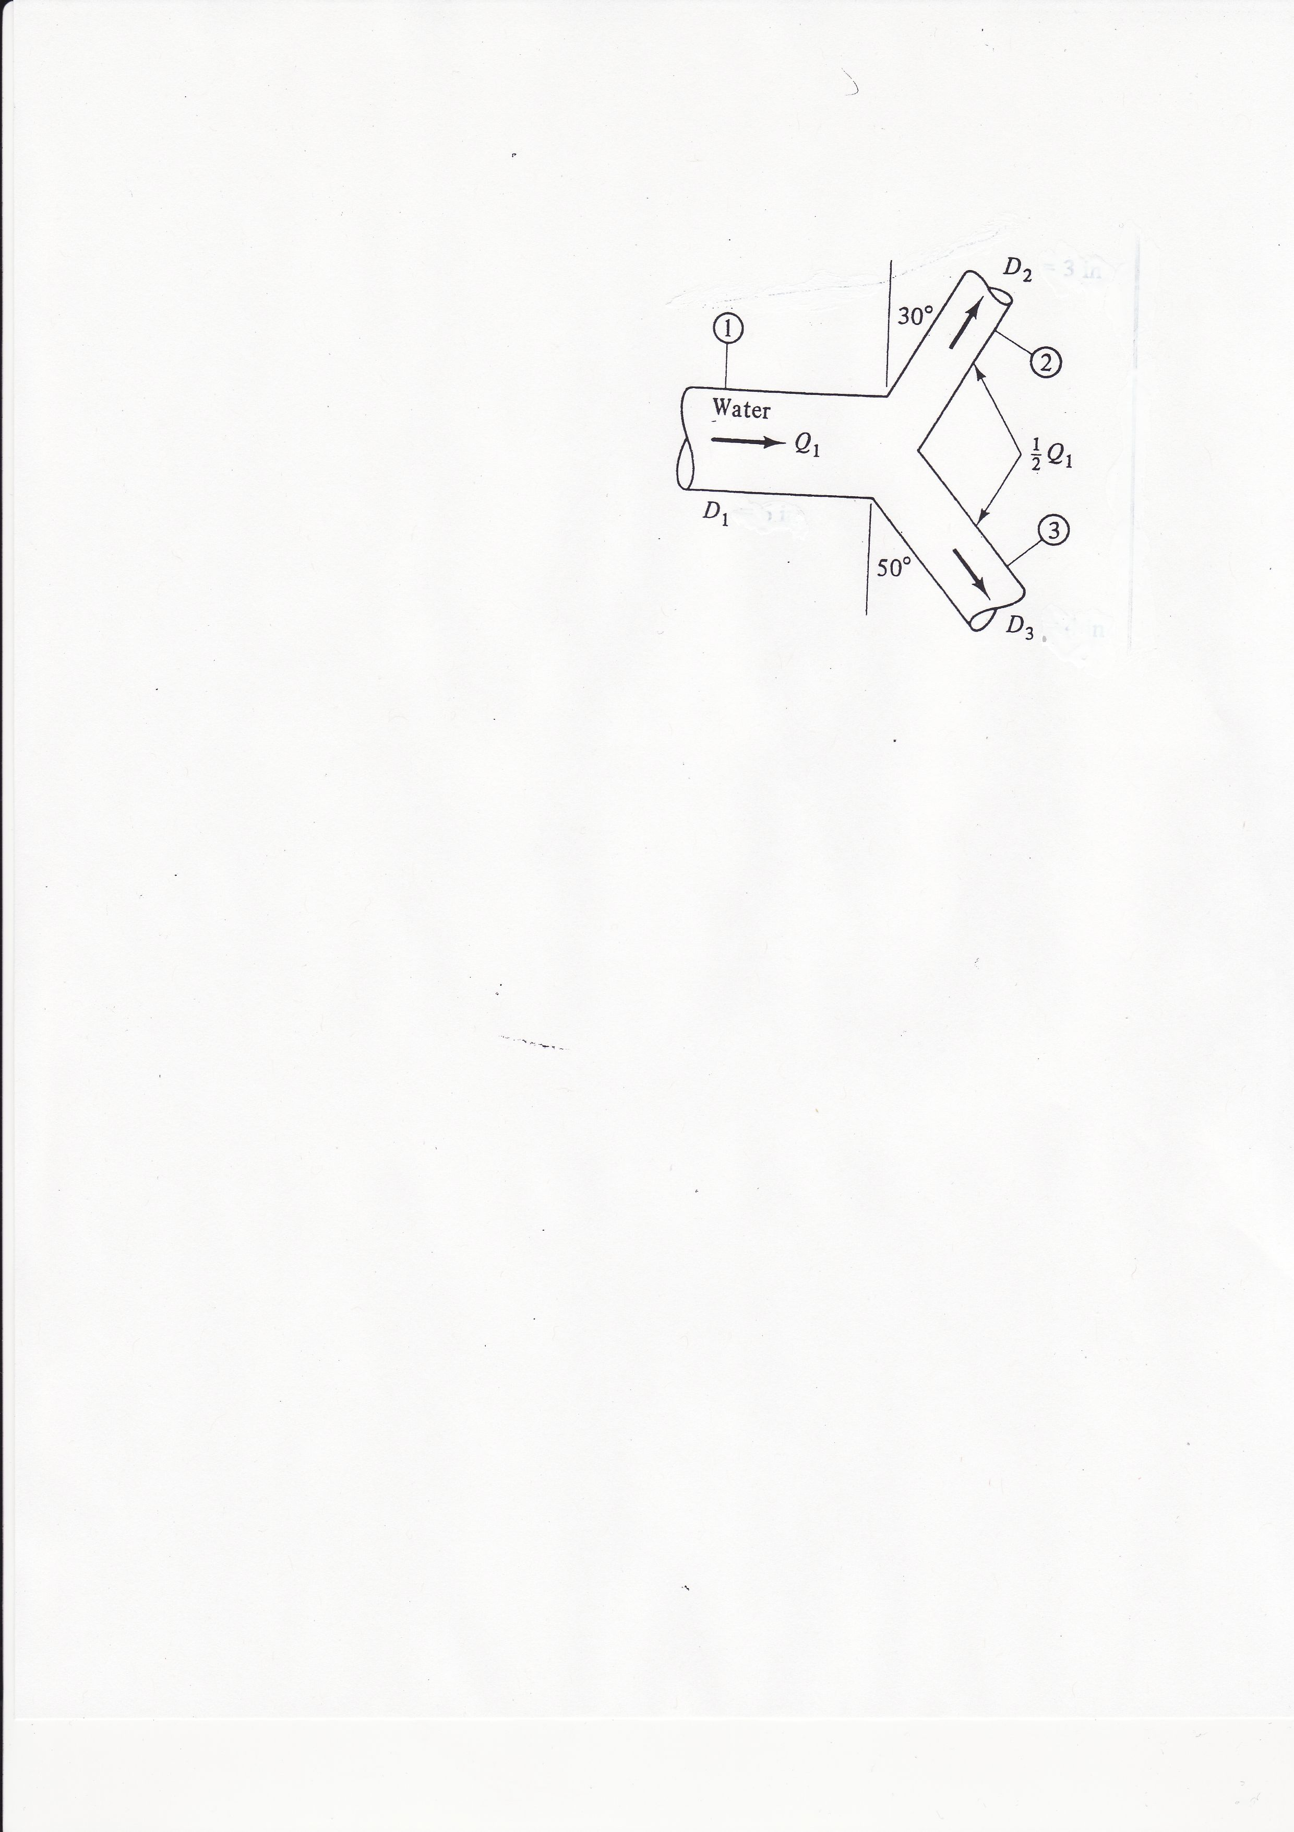
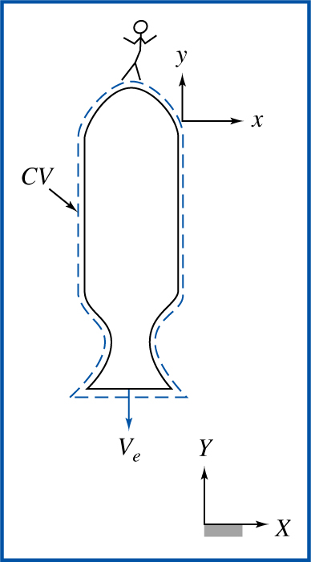




Some Applications of the Momentum Equation
$$D_{2}$$
$$P_{1}$$
$$60°$$
$$D_{3}$$

Slide 3
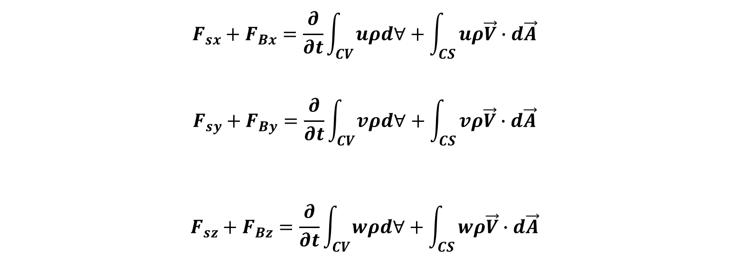


Momentum Equation for Inertial Control Volume
$${\vec{F}}_{s}+{\vec{F}}_{B}=\frac{∂}{∂t}\int_{CV}{\vec{V}ρd∀}+\int_{CS}{\vec{V}ρ\vec{V}∙d\vec{A}}$$
In the $xyz$ coordinates:
$\vec{V}=u\hat{i}+v\hat{j}$ +$w\hat{k}$
where $u, v$and $w$ are scalar components of $\vec{V}$
$$F_{sx}+F_{Bx}=\frac{∂}{∂t}\int_{CV}{uρd∀}+\int_{CS}{uρ\vec{V}∙d\vec{A}}$$
$$F_{sy}+F_{By}=\frac{∂}{∂t}\int_{CV}{vρd∀}+\int_{CS}{vρ\vec{V}∙d\vec{A}}$$
$$F_{sz}+F_{Bz}=\frac{∂}{∂t}\int_{CV}{wρd∀}+\int_{CS}{wρ\vec{V}∙d\vec{A}}$$

Slide 4
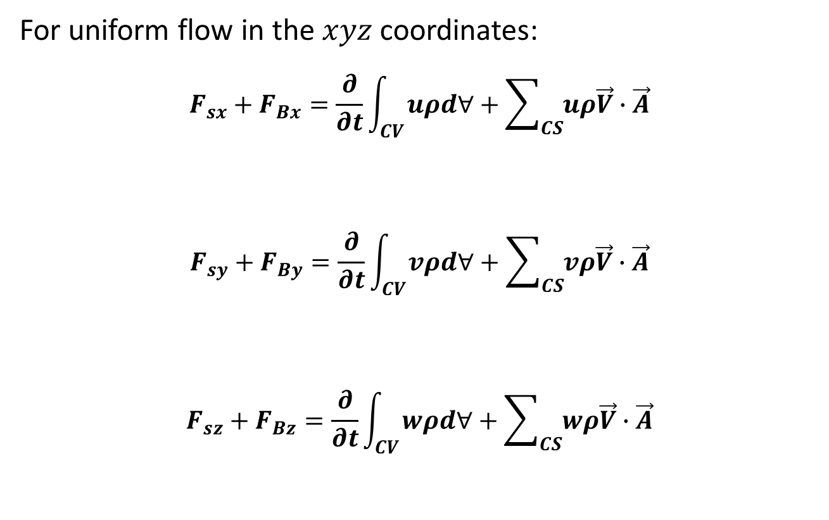
Momentum Equation for Inertial Control Volume
For uniform flow in the $xyz$ coordinates:
$$F_{sx}+F_{Bx}=\frac{∂}{∂t}\int_{CV}{uρd∀}+\sum_{CS}{uρ\vec{V}∙\vec{A}}$$
$$F_{sy}+F_{By}=\frac{∂}{∂t}\int_{CV}{vρd∀}+\sum_{CS}{vρ\vec{V}∙\vec{A}}$$
$$F_{sz}+F_{Bz}=\frac{∂}{∂t}\int_{CV}{wρd∀}+\sum_{CS}{wρ\vec{V}∙\vec{A}}$$

Slide 5
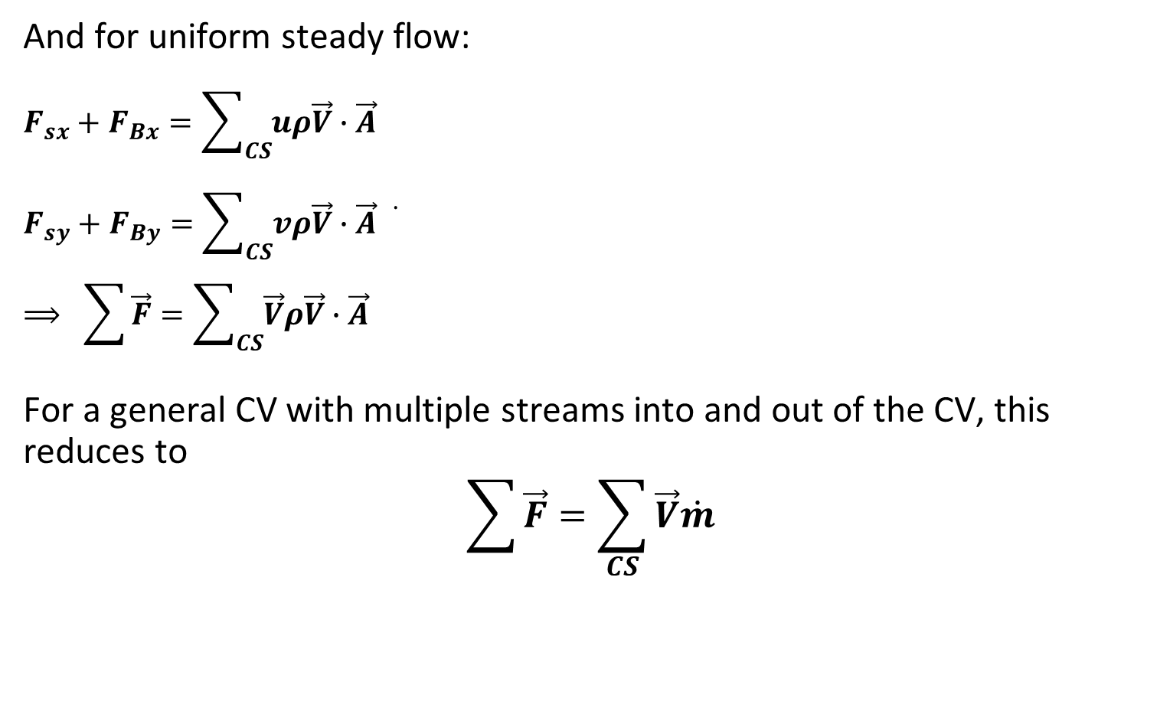
Momentum Equation for Inertial Control Volume
And for uniform steady flow:
$$F_{sx}+F_{Bx}=\sum_{CS}{uρ\vec{V}∙\vec{A}}$$
$$F_{sy}+F_{By}=\sum_{CS}{vρ\vec{V}∙\vec{A}}\dot{}$$
$$⟹ \sum{\vec{F}}=\sum_{CS}{\vec{V}ρ\vec{V}∙\vec{A}}$$
For a general CV with multiple streams into and out of the CV, this reduces to
$$\sum{\vec{F}}=\sum_{CS}{\vec{V}\dot{m}}$$

Slide 6
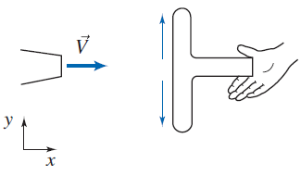
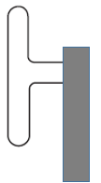
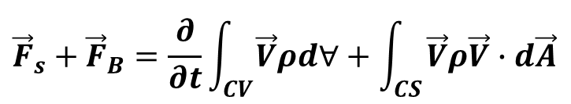
Examples
1. Water from a stationary nozzle strikes a flat plate as shown. The water leaves the nozzle at 15 m/s; the nozzle area is 0.01 m². Assuming the water is directed normal to the plate, and flows along the plate, determine the horizontal force of the water on the plate.
Solution:
V₂, A₂
2
V₁
A₁
$${\vec{F}}_{s}+{\vec{F}}_{B}=\frac{∂}{∂t}\int_{CV}{\vec{V}ρd∀}+\int_{CS}{\vec{V}ρ\vec{V}∙d\vec{A}}$$
1
3
V₃, A₃

Slide 7


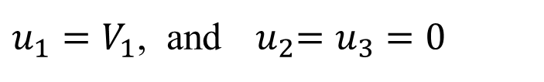
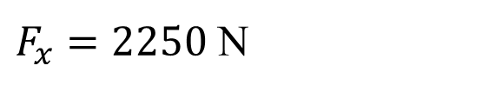
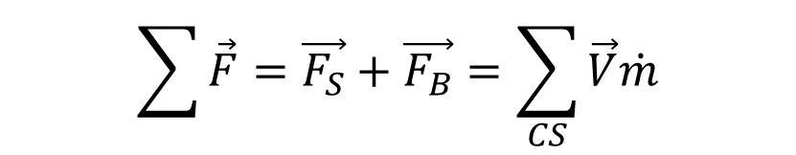

Solution Contd.
V₂, A₂
2
Assumptions:
Steady flow
Incompressible flow
Uniform flow at all sections
V₁
A₁
1
3
Application of the above assumptions leads to
V₃, A₃
$$\sum{\vec{F}}=\vec{F_{S}}+\vec{F_{B}}=\sum_{CS}{\vec{V}\dot{m}}$$
$$⟹ F_{x}=ρA_{1}V_{1}^{2}$$
$$F_{x}=1000×0.01×{15}^{2}$$
If F_{x} is the x-component of the fluid
force acting on the plate, then we have
$F_{x}=2250$ N
$${−F}_{x}=\left({u_{2}\dot{m}}_{2}+{u_{3}\dot{m}}_{3}\right)−{u_{1}\dot{m}}_{1}$$
$u_{1}=V_{1}$, and${ u}_{2}=u_{3}=0$
$$⟹ {−F}_{x}=−u_{1}{\dot{m}}_{1}$$

Slide 8
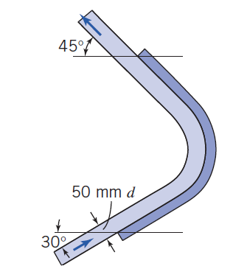
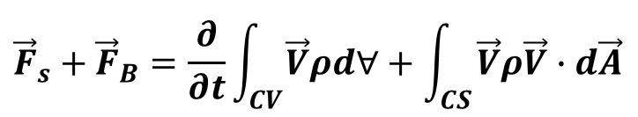
Examples
2. Calculate the magnitude and direction of the vertical and horizontal components and the total force exerted on the stationary blade below by a 50 mm jet of water moving at 15 m/s. Assume negligible body forces in the vertical direction.
Solution:
$${\vec{F}}_{s}+{\vec{F}}_{B}=\frac{∂}{∂t}\int_{CV}{\vec{V}ρd∀}+\int_{CS}{\vec{V}ρ\vec{V}∙d\vec{A}}$$

Slide 9
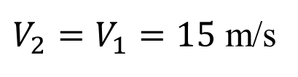


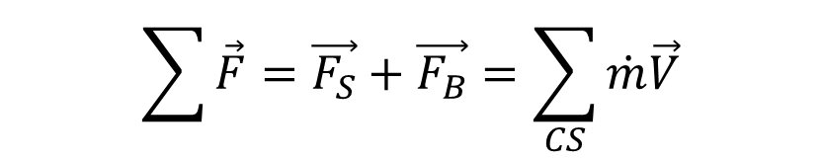
V₂ = ?
Assumptions:
Steady flow
Incompressible flow
Uniform flow at all sections
Jet cross-section remains uniform
$$\sum{\vec{F}}=\vec{F_{S}}+\vec{F_{B}}=\sum_{CS}{\dot{m}\vec{V}}$$
A₁
V₁
Let F_{x} and F_{y} respectively denote the x- and y-components of the fluid force acting on the curved blade.
Application of assumption implies
$$A_{1}=A_{2}$$
From the continuity equation,
$${ρA}_{1}V_{1}={ρA}_{2}V_{2}$$
$V_{2}=V_{1}=15$ m/s

Slide 10
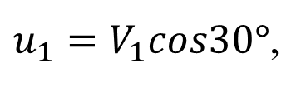


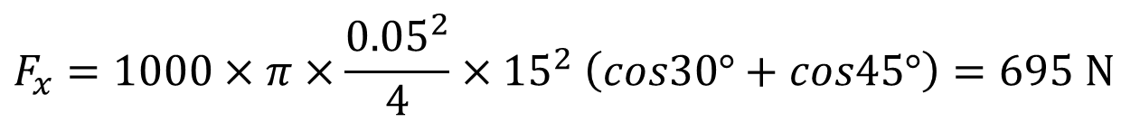

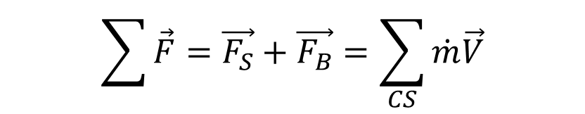

V₂ = ?
$$\sum{\vec{F}}=\vec{F_{S}}+\vec{F_{B}}=\sum_{CS}{\dot{m}\vec{V}}$$
In the x-direction:
$${−F}_{x}=−u_{1}{\dot{m}}_{1}{+u_{2}\dot{m}}_{2}$$
$$⟹ F_{x}={\dot{m}}_{1}u_{1}−{\dot{m}}_{2}u_{2}$$
A₁
$${\dot{m}}_{1}={\dot{m}}_{2}={ρA}_{1}V_{1}$$
V₁
$u_{1}=V_{1}cos30°$,
$$u_{2}=−V_{2}cos45°$$
$$∴ F_{x}=ρA_{1}V_{1}^{2}cos30°+ρA_{1}V_{1}^{2}cos45°$$
$$F_{x}=1000×π×\frac{{0.05}^{2}}{4}×{15}^{2} \left(cos30°+cos45°\right)=695 N$$
In the y-direction:
$${−F}_{y}=−v_{1}{\dot{m}}_{1}+v_{2}{\dot{m}}_{2}$$

Slide 11
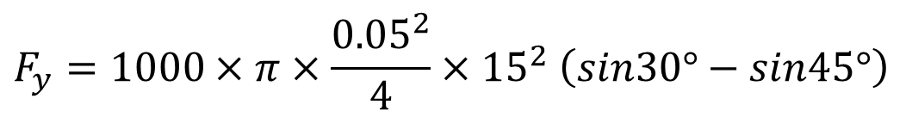



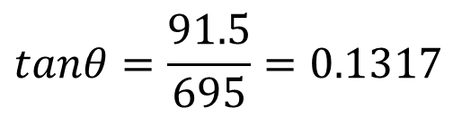
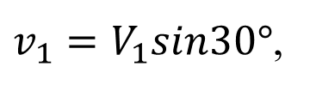
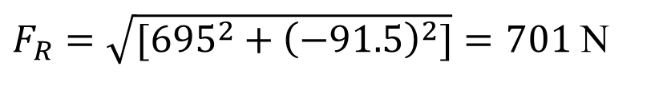


V₂ = V₁
$$⟹ F_{y}={\dot{m}}_{1}v_{1}−{\dot{m}}_{2}v_{2}$$
$v_{1}=V_{1}sin30°$,
$$v_{2}=V_{2}sin45°$$
$$∴ F_{y}=ρA_{1}V_{1}^{2}sin30°−ρA_{1}V_{1}^{2}sin45°$$
$$F_{y}=1000×π×\frac{{0.05}^{2}}{4}×{15}^{2} \left(sin30°−sin45°\right)$$
$$F_{y}=−91.5 N$$
A₁
V₁
The resultant force acting on the blade is
F_{x}
θ
$F_{R}=\sqrt{[{695}^{2}+{\left(−91.5\right)}^{2}]}=701$ N
F_{R}
$$tanθ=\frac{91.5}{695}=0.1317$$
F_{y}
$$θ=\tan^{−1}\left(0.1317\right)=7.5°$$

Slide 12
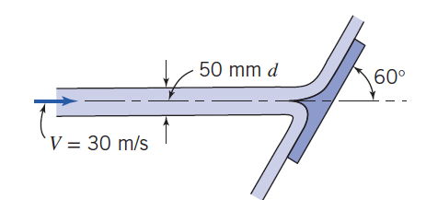
Practice Problems
1. Water is accelerated by a nozzle to an average speed of 20 m/s, and strikes a stationary vertical plate at a rate of 10 kg/s with a normal velocity of 20 m/s. After striking the plate, the water stream splatters off in all directions in the plane of the plate. Determine the force needed to prevent the plate from moving horizontally due to the water stream.
2. A water jet of 50 mm moving at 30 m/s is divided in half by a splitter on the stationary flat plate shown below. Calculate the magnitude and direction of the force on the plate. Assume that flow is in a horizontal plane.

Slide 13
Practice Problems
3. A stationary curved vane deflects a 50 mm diameter jet of water through 150⁰. Due to friction over the surface, the water leaving the vane has only 80 % of its original velocity. Calculate the mass flow rate needed to produce a fluid dynamic force of 2000 N on the vane.
4. A boat travelling at 12 m/s in fresh water has a 600 mm diameter propeller which takes water at 4.25 m³/s between its blades. Assuming that the effect of the propeller hub and the boat hull on flow conditions are negligible, calculate (a) the thrust on the boat, (b) the efficiency of the propulsion, and (c) the power input to the propeller.
5. A wind turbine 30 m high with a blade span of 40 m is subjected to 30 km/h steady winds. If the combined turbine-generator efficiency of the wind turbine is 35%, determine (a) the power output of the turbine, (b) the horizontal force of the wind on the supporting mast of the turbine, and (c) the bending moment on the mast of the turbine.

Slide 14
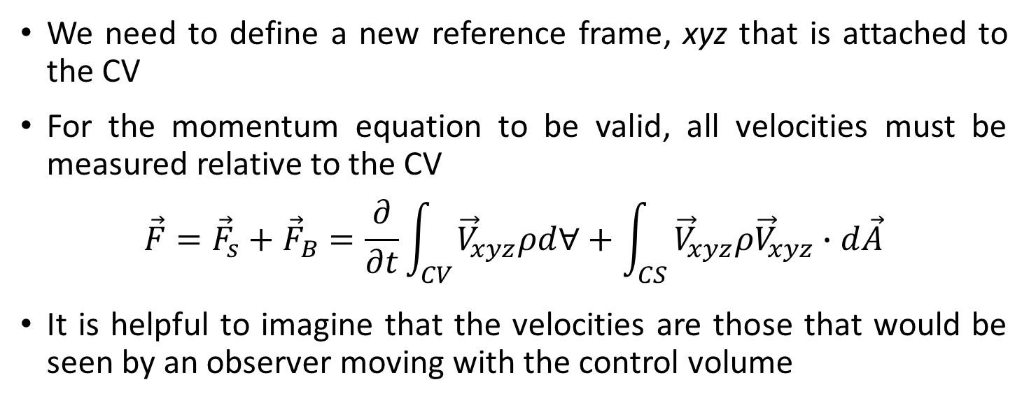

Control Volume Moving with Constant Velocity
Y
CV
y
$${\vec{V}}_{xyz}$$
U_{CV}
X
system
x
inertial reference frame
We need to define a new reference frame, xyz that is attached to the CV
For the momentum equation to be valid, all velocities must be measured relative to the CV
$$\vec{F}={\vec{F}}_{s}+{\vec{F}}_{B}=\frac{∂}{∂t}\int_{CV}{{\vec{V}}_{xyz}ρd∀}+\int_{CS}{{\vec{V}}_{xyz}ρ{\vec{V}}_{xyz}∙d\vec{A}}$$
It is helpful to imagine that the velocities are those that would be seen by an observer moving with the control volume

Slide 15
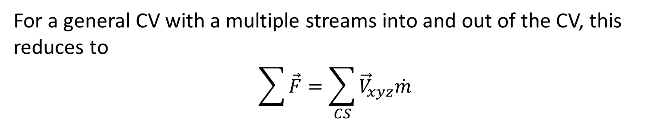
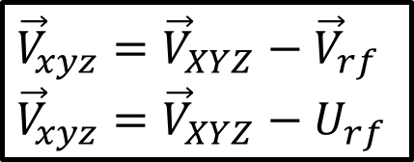



Control Volume Moving with Constant Velocity
For a general CV with a multiple streams into and out of the CV, this reduces to
$$\sum{\vec{F}}=\sum_{CS}{{\vec{V}}_{xyz}\dot{m}}$$
But ${\vec{V}}_{xyz}$ = ?
Y
CV
y
$${\vec{V}}_{xyz}$$
U_{rf}
X
system
x
Using the concept of relative velocity
$${\vec{V}}_{xyz}={\vec{V}}_{XYZ}−{\vec{V}}_{rf}$$
$${\vec{V}}_{xyz}={\vec{V}}_{XYZ}−U_{rf}$$
$${\vec{V}}_{XYZ}={\vec{V}}_{xyz}+{\vec{V}}_{rf}$$

Slide 16
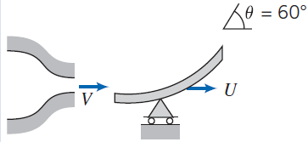
Control Volume Moving with Constant Velocity
Example 1: A vane with a turning angle of 60° moves at a constant speed of U = 10 m/s. The vane receives a jet of water that leaves a stationary nozzle with a speed of V = 30 m/s. The nozzle has an exit area of 0.003 m². Determine the x and y components of the force acting on the vane.

Slide 17
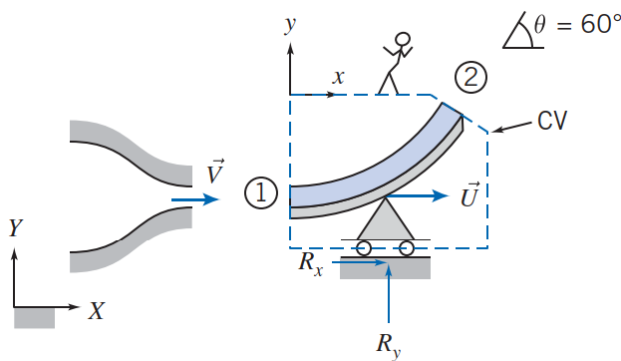
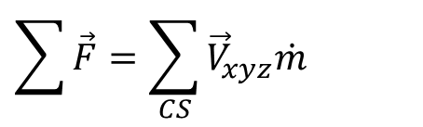
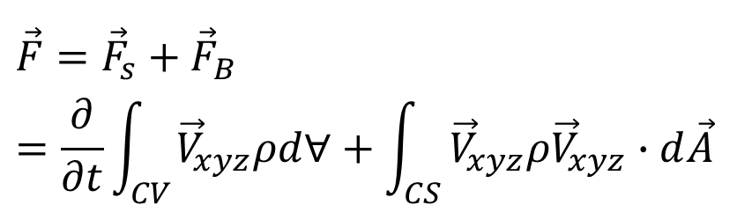
Control Volume Moving with Constant Velocity
Solution:
$$\vec{F}={\vec{F}}_{s}+{\vec{F}}_{B}=\frac{∂}{∂t}\int_{CV}{{\vec{V}}_{xyz}ρd∀}+\int_{CS}{{\vec{V}}_{xyz}ρ{\vec{V}}_{xyz}∙d\vec{A}}$$
Assumptions:
Steady flow relative to the vane
Incompressible flow
Uniform flow at all sections
Jet cross-section remains uniform
$$\sum{\vec{F}}=\sum_{CS}{{\vec{V}}_{xyz}\dot{m}}$$
Let F_{x} and F_{y} respectively denote the x- and y-components of the fluid force acting on the vane.

Slide 18



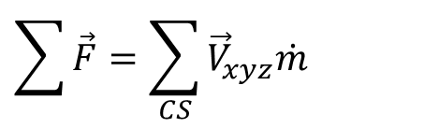
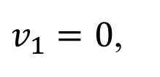













Control Volume Moving with Constant Velocity
$$\sum{\vec{F}}=\sum_{CS}{{\vec{V}}_{xyz}\dot{m}}$$
$$F_{x}=ρA{(V−U)}^{2}−ρA{(V−U)}^{2}cos60°$$
$$=ρA{\left(V−U\right)}^{2}(1−cos60°)$$
$${−F}_{x}=−u_{1}{\dot{m}}_{1}{+u_{2}\dot{m}}_{2}$$
$$=1000×{\left(30−10\right)}^{2}×(1−0.5)$$
$$⟹ F_{x}={u_{1}\dot{m}}_{1}−{u_{2}\dot{m}}_{2}$$
$$=600 N$$
Similarly,
$$⟹ F_{x}=u_{1}ρA_{1}V_{1}−u_{2}ρA_{2}V_{2}$$
$${−F}_{y}−Mg=−v_{1}{\dot{m}}_{1}{+v_{2}\dot{m}}_{2}$$
$$u_{1}=V−U$$
$$F_{y}=−v_{1}{\dot{m}}_{1}{+v_{2}\dot{m}}_{2}−Mg$$
$$V_{1}=V−U$$
$$u_{2}=\left(V−U\right)cos60°$$
Neglecting the weight of the CV, we have
$$V_{2}=V−U$$
$$F_{y}=v_{1}ρA_{1}V_{1}−v_{2}ρA_{2}V_{2}$$
By assumption #4,
$v_{1}=0$,
$$v_{2}=\left(V−U\right)sin60°$$
$$A_{1}=A_{2}=A$$

Slide 19
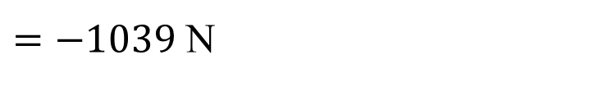
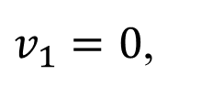




Control Volume Moving with Constant Velocity
$$F_{y}=v_{1}ρA_{1}V_{1}−v_{2}ρA_{2}V_{2}$$
$v_{1}=0$,
$$v_{2}=\left(V−U\right)sin60°$$
$$F_{y}=−ρA{(V−U)}^{2}sin60°$$
$$=−1000×{\left(30−10\right)}^{2}×0.866$$
$=−1039$ N

Slide 20
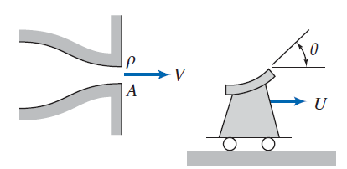
Control Volume Moving with Constant Velocity
Practice Problems
1. Water from a stationary nozzle impinges on a moving vane with a turning angle of θ = 120°. The vane moves away from the nozzle with constant speed, U = 10 m/s, and receives a jet that leaves the nozzle with speed V = 30 m/s. The nozzle has an exit area of 0.004 m². Find the force that must be applied to maintain the vane speed constant.

Slide 21
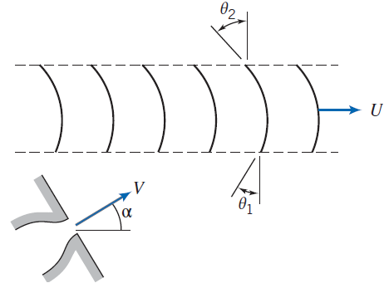
Control Volume Moving with Constant Velocity
2. Consider a series of turning vanes struck by a continuous jet of water that leaves a nozzle of diameter 50 mm at constant speed V = 100 m/s. The vanes move with constant speed, U = 50 m/s, and also all the mass flow leaving the jet crosses the vanes. The curvature of the vanes is described by angles θ₁ = 30° and θ₂ = 45°, as shown. Evaluate the nozzle angle, α, required to ensure that the jet enters tangent to the leading edge of each vane. Calculate the force that must be applied to maintain the vane speed constant.

Slide 22
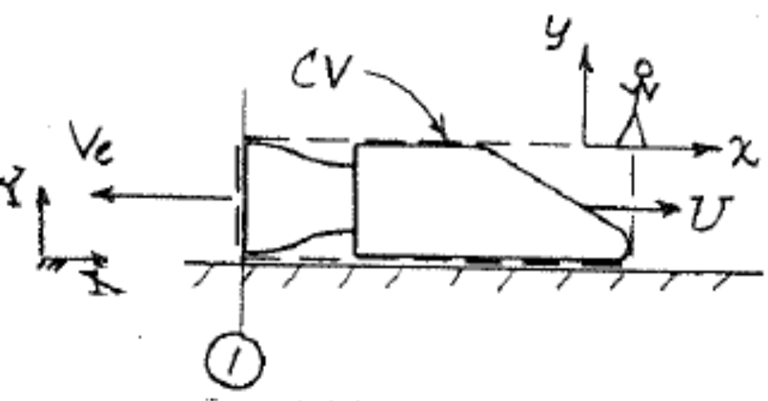
Control Volume with Rectilinear Acceleration
XYZ: stationary/non-accelerating CV/inertial reference frame
xyz: accelerating CV/noninertial reference frame

Slide 23
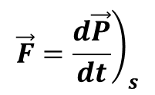
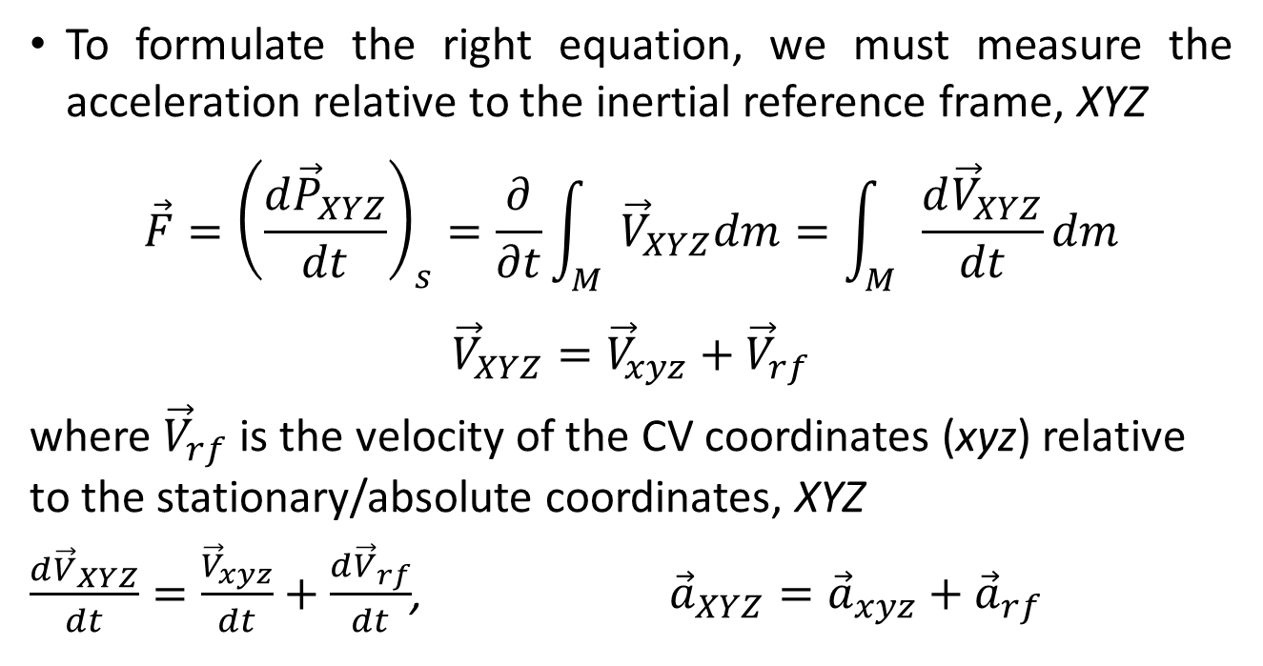
Control Volume with Rectilinear Acceleration
$${\vec{F}=\left.\frac{d\vec{P}}{dt}\right)}_{s}$$
To formulate the right equation, we must measure the acceleration relative to the inertial reference frame, XYZ
$$\vec{F}={\left(\frac{d{\vec{P}}_{XYZ}}{dt}\right)}_{s}=\frac{∂}{∂t}\int_{M}{{\vec{V}}_{XYZ}dm}=\int_{M}{\frac{d{\vec{V}}_{XYZ}}{dt}dm}$$
$${\vec{V}}_{XYZ}={\vec{V}}_{xyz}+{\vec{V}}_{rf}$$
where ${\vec{V}}_{rf}$ is the velocity of the CV coordinates (xyz) relative to the stationary/absolute coordinates, XYZ
$\frac{{d\vec{V}}_{XYZ}}{dt}=\frac{{\vec{V}}_{xyz}}{dt}+\frac{{d\vec{V}}_{rf}}{dt}$, ${\vec{a}}_{XYZ}={\vec{a}}_{xyz}+{\vec{a}}_{rf}$
[1]
[2]
[3]

Slide 24
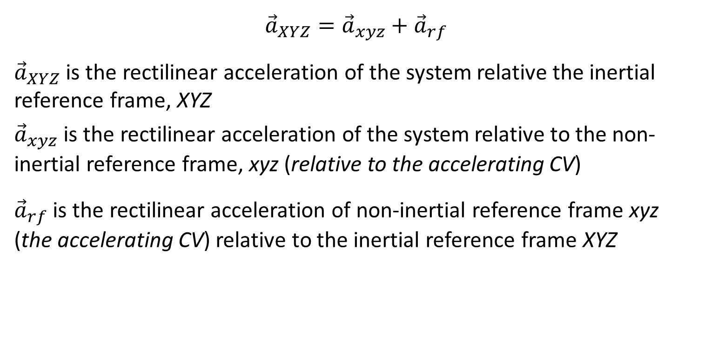
Control Volume with Rectilinear Acceleration
$${\vec{a}}_{XYZ}={\vec{a}}_{xyz}+{\vec{a}}_{rf}$$
${\vec{a}}_{XYZ}$ is the rectilinear acceleration of the system relative the inertial reference frame, XYZ
${\vec{a}}_{xyz}$ is the rectilinear acceleration of the system relative to the non-inertial reference frame, xyz (relative to the accelerating CV)
${\vec{a}}_{rf}$ is the rectilinear acceleration of non-inertial reference frame xyz (the accelerating CV) relative to the inertial reference frame XYZ

Slide 25

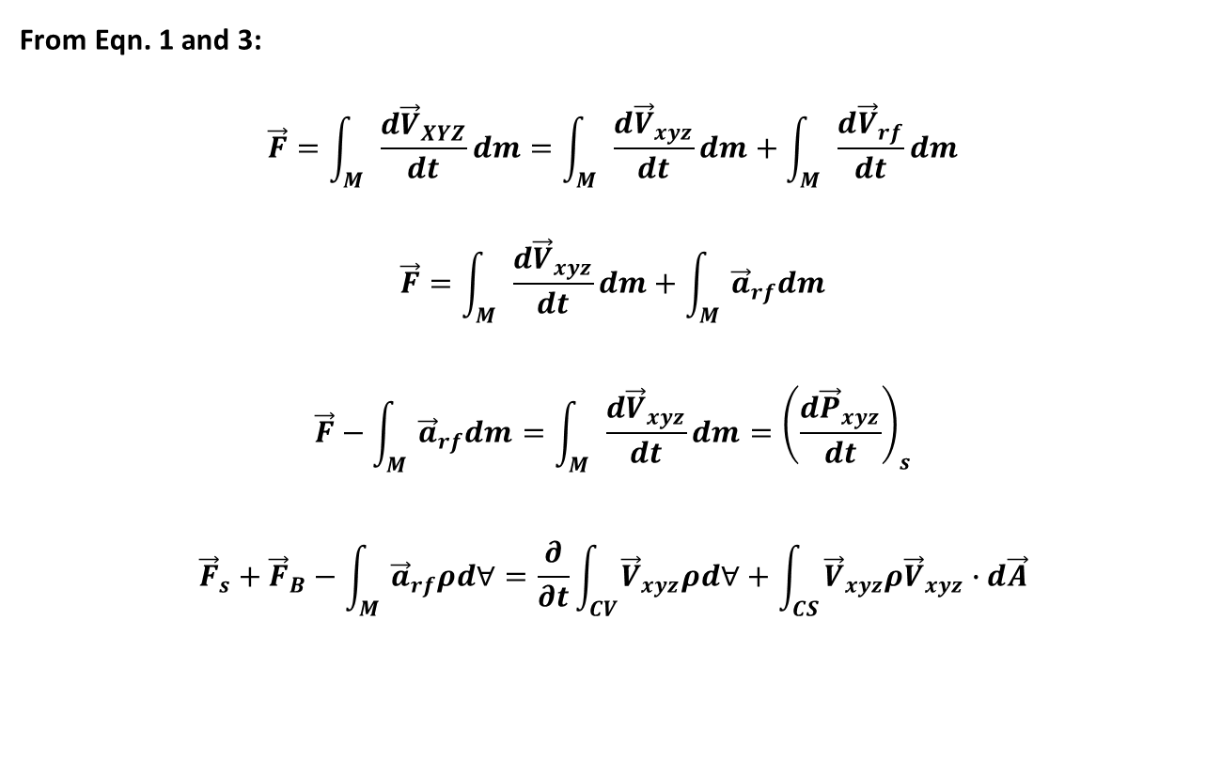
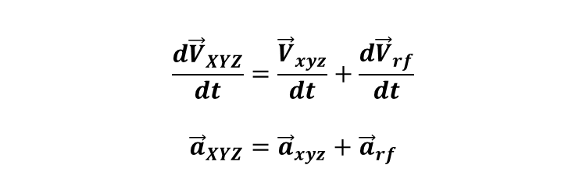
Control Volume with Rectilinear Acceleration
$$\frac{{d\vec{V}}_{XYZ}}{dt}=\frac{{\vec{V}}_{xyz}}{dt}+\frac{{d\vec{V}}_{rf}}{dt}$$
$${\vec{a}}_{XYZ}={\vec{a}}_{xyz}+{\vec{a}}_{rf}$$
$$\vec{F}={\left(\frac{d{\vec{P}}_{XYZ}}{dt}\right)}_{s}=\int_{M}{\frac{d{\vec{V}}_{XYZ}}{dt}dm}$$
From Eqn. 1 and 3:
$$\vec{F}=\int_{M}{\frac{d{\vec{V}}_{XYZ}}{dt}dm}=\int_{M}{\frac{d{\vec{V}}_{xyz}}{dt}dm}+\int_{M}{\frac{d{\vec{V}}_{rf}}{dt}dm}$$
$$\vec{F}=\int_{M}{\frac{d{\vec{V}}_{xyz}}{dt}dm}+\int_{M}{{\vec{a}}_{rf}dm}$$
$$\vec{F}−\int_{M}{{\vec{a}}_{rf}dm}=\int_{M}{\frac{d{\vec{V}}_{xyz}}{dt}dm}={\left(\frac{d{\vec{P}}_{xyz}}{dt}\right)}_{s}$$
$${\vec{F}}_{s}+{\vec{F}}_{B}−\int_{M}{{\vec{a}}_{rf}ρd∀}=\frac{∂}{∂t}\int_{CV}{{\vec{V}}_{xyz}ρd∀}+\int_{CS}{{\vec{V}}_{xyz}ρ{\vec{V}}_{xyz}∙d\vec{A}}$$

Slide 26
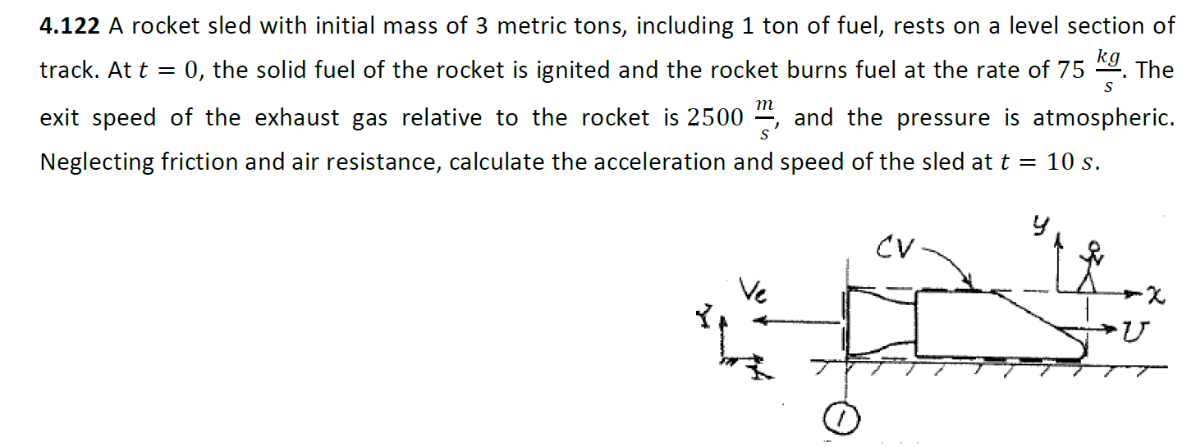
Example 1: A rocket sled with initial mass of 3 metric tons, including 1 ton of fuel, rests on a level section of track. A t = 0, the solid fuel of the rocket is ignited and the rocket burns fuel at the rate of 75 kg/s. The exit speed of the exhaust gas relative to the rocket is 2500 m/s, and the pressure is atmospheric. Neglecting friction and air resistance, calculate the acceleration and speed of the sled at t = 10 s.
Solution:
We are to find acceleration dU/dt and speed U of the sled at t = 10 s.

Slide 27

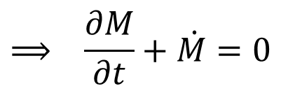
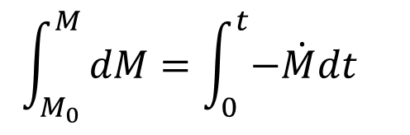
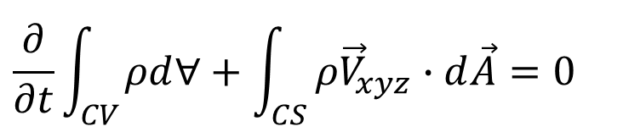

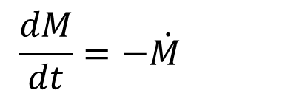
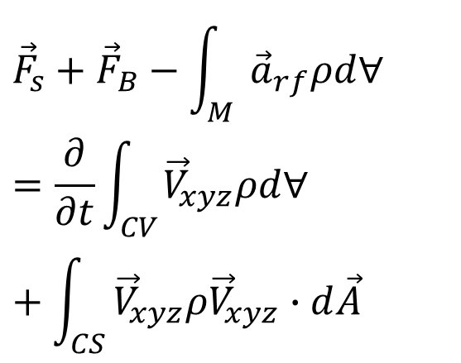
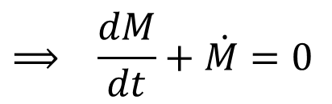

Continuity:
$$\frac{∂}{∂t}\int_{CV}{ρd∀}+\int_{CS}{ρ{\vec{V}}_{xyz}∙d\vec{A}}=0$$
$$M−M_{0} =−\dot{M}t$$
$$M=M_{0}−\dot{M}t$$
$$⟹ \frac{∂M}{∂t}+\dot{M}=0$$
Momentum equation:
$$⟹ \frac{dM}{dt}+\dot{M}=0$$
$${\vec{F}}_{s}+{\vec{F}}_{B}−\int_{M}{{\vec{a}}_{rf}ρd∀}=\frac{∂}{∂t}\int_{CV}{{\vec{V}}_{xyz}ρd∀}+\int_{CS}{{\vec{V}}_{xyz}ρ{\vec{V}}_{xyz}∙d\vec{A}}$$
$$\frac{dM}{dt}=−\dot{M}$$
$$dM =−\dot{M}dt$$
$$\int_{M_{0}}^{M}{dM=\int_{0}^{t}{−\dot{M}dt}}$$

Slide 28



$$F_{Sx}+F_{Bx}−\int_{M}{{\vec{a}}_{rfx}ρd∀}=\frac{∂}{∂t}\int_{CV}{u_{xyz}ρd∀}+\int_{CS}{u_{xyz}ρ{\vec{V}}_{xyz}∙d\vec{A}}$$
$$⟹ −{\vec{a}}_{rfx}\int_{M}{ρd∀}=\int_{CS}{u_{xyz}ρ{\vec{V}}_{xyz}∙d\vec{A}}$$
$$−{\vec{a}}_{rfx}M=\sum_{CS}{u_{xyz}\dot{m}=u_{1}{\dot{m}}_{1}}$$
$$−{\vec{a}}_{rfx}M={−V}_{e}\dot{M}$$

Slide 29

2. A small rocket, with an initial mass of 400 kg, is to be launched vertically. Upon ignition the rocket consumes fuel at the rate of 5 kg/s and ejects gas at atmospheric pressure with a speed of 3500 m/s relative to the rocket. Determine the initial acceleration of the rocket and the rocket speed after 10 s, if air resistance is neglected.

Slide 30

3. A cart is propelled by a liquid jet issuing horizontally from a tank as shown. The track is horizontal, resistance to motion may be neglected. The tank is pressurized so that the jet speed may be considered constant. Obtain a general expression for the speed of the cart as it accelerates from rest. If M₀ = 100 kg, ρ = 999 kg/m³, and A = 0.005 m², find the jet speed V required for the cart to reach a speed of 1.5 m/s after 30 seconds. For this condition, plot the cart speed U as a function of time. Plot the cart speed after 30 seconds as a function of jet speed.

Slide 31


Angular Momentum Principle (Moment of Momentum Equation)
Basic Law, and Transport Theorem

Slide 32


Angular Momentum Principle (Moment of Momentum Equation)

Slide 33

Examples
1. Water flows through the 90° reducing elbow shown below. At Section 1, the absolute pressure is 220 kPa and the cross-sectional area is 0.01 m². At Section 2 which is located 0.3 m to the right of Section 1, the cross-sectional area and velocity are 0.0025 m² and 16 m/s, respectively. The elbow discharges to the atmosphere.
(a) Calculate the force exerted by the fluid on the elbow.
(b) Estimate the moment exerted by the fluid on the elbow.
Take P_{atm} = 101 kPa
0.2 m

Slide 34





MOMENT OF MOMENTUM EQUATION
Example 1 - Solution
Given: P_{1abs} = 220 kPa
$A_{1}=0.01$ m²
$A_{2}=0.0025$ m²
$\vec{V_{2}}=−16j$ m/s
(a) Force on the elbow:
$${\vec{F}}_{s}+{\vec{F}}_{B}=\frac{∂}{∂t}\int_{CV}{\vec{V}ρd∀}+\int_{CS}{\vec{V}ρ\vec{V}∙d\vec{A}}$$

Slide 35











MOMENT OF MOMENTUM EQUATION
Example 1 - Solution
$$V_{1}= ?$$
Assumptions:
Uniform flow at each section
Incompressible flow
Steady flow
Negligible weight of elbow and
water in the elbow
$${ρA}_{1}V_{1}=ρA_{2}V_{2}$$
$$V_{1}=\frac{A_{2}V_{2}}{A_{1}}=\frac{0.0025×16}{0.01}$$
$V_{1}=4$m/s
$$⟹ \vec{F_{S}}+\vec{F_{B}}=\sum_{CS}{\vec{V}\dot{m}}$$
$$∴ F_{x}=(220−101)×1000$$
$$×0.01+1000×0.01×4^{2}$$
$${P_{1g}A_{1}−F}_{x}=−u_{1}{\dot{m}}_{1}{+u_{2}\dot{m}}_{2}$$
$F_{x}=1350$ N
$$F_{x}=P_{1g}A_{1}+u_{1}{\dot{m}}_{1}$$
$$=P_{1g}A_{1}+ρA_{1}V_{1}^{2}$$

Slide 36







MOMENT OF MOMENTUM EQUATION
Example 1 - Solution
In the y-direction
$$F_{Sy}+F_{By}=\sum_{CS}{v\dot{m}}$$
$${⟹ −F}_{y}=−v_{1}{\dot{m}}_{1}{+v_{2}\dot{m}}_{2}$$
$$F_{y}=−v_{2}{\dot{m}}_{2}$$
$v_{2}=−V_{2}$ and${\dot{m}}_{2}=ρA_{2}V_{2}$
$$F_{y}=ρA_{2}V_{2}^{2}$$
$$F_{y}=1000×0.0025×{16}^{2}$$
$=640$ N

Slide 37




MOMENT OF MOMENTUM EQUATION
Example 1 - Solution
(b) Torque on the elbow
$$\vec{r}×{\vec{F}}_{s}+\int_{CV}{\vec{r}×\vec{g}ρd∀+{\vec{T}}_{shaft}}=\frac{∂}{∂t}\int_{CV}{\vec{r}×\vec{V}ρd∀}+\int_{CS}{\vec{r}×\vec{V}ρ\vec{V}∙d\vec{A}}$$
$${\vec{T}}_{flange}={\left.\vec{r}×{\vec{F}}_{s}\right)}_{flange}=\sum_{CS}{\vec{r}×\vec{V}\dot{m}}$$
$${\vec{T}}_{flange}={\vec{r}}_{1}×{\vec{V}}_{1}\left({−ρA}_{1}V_{1}\right)+{\vec{r}}_{2}×{\vec{V}}_{2}({−ρA}_{2}V_{2})$$
$${\vec{r}}_{1}=0i+0j=0$$
$${\vec{r}}_{2}=0.3i−0.2j$$

Slide 38





MOMENT OF MOMENTUM EQUATION
Example 1 - Solution
$${\vec{r}}_{1}=0i+0j=0$$
$${\vec{r}}_{2}=0.3i−0.2j$$
$${\vec{r}}_{1}×{\vec{V}}_{1}=0$$
$${\vec{r}}_{2}×{\vec{V}}_{2}=(0.3i−0.2j)×(−16j)$$
$$=−4.8k$$
${\vec{T}}_{flange}=−4.8k\left(1000×0.0025×16\right)=$ $−192k$ Nm

