Slide 1
ME 352
FLUID DYNAMICS 2
Chapter 2: Dimensional and Model Analysis

Slide 2
Main Topics
Nature of Dimensional Analysis
Methods of Dimensional Analysis
  The Rayleigh Method
  Buckingham Pi Theorem
Significant Dimensionless Groups in Fluid Mechanics
Flow Similarity and Model Studies

Slide 3
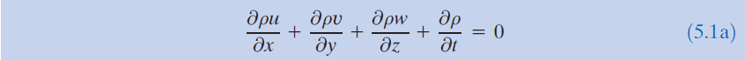
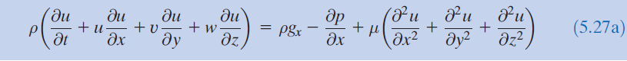
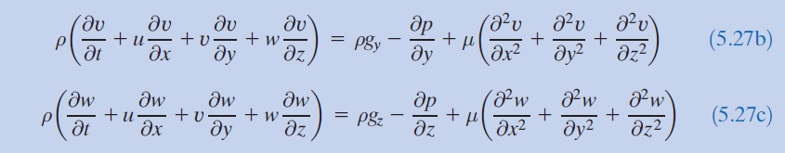
Dimensional and Model Analysis
Flow phenomena depend in a complex way on the geometric and fluid/flow parameters.
Detailed flow information will require exact solutions to the Continuity and Navier-Stokes Equations.

Slide 4
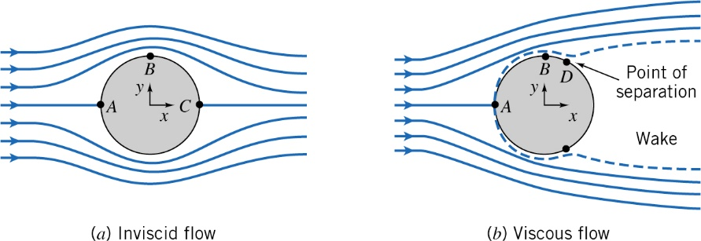
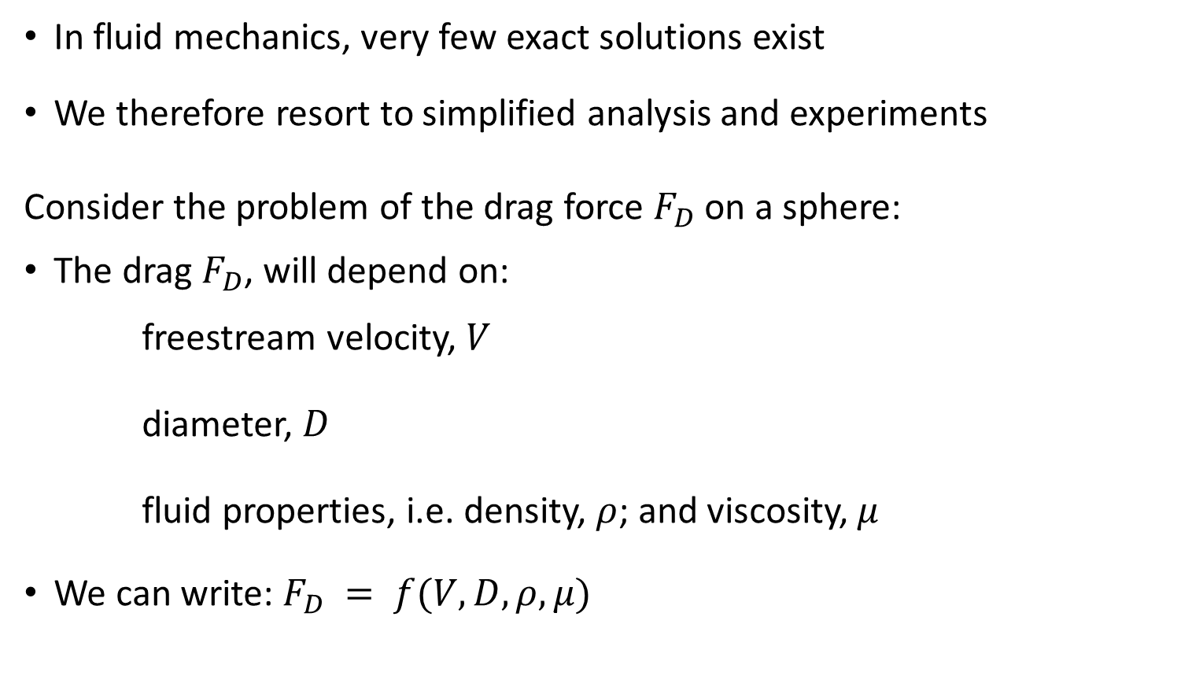
Dimensional and Model Analysis
In fluid mechanics, very few exact solutions exist
We therefore resort to simplified analysis and experiments
Consider the problem of the drag force $F_{D}$ on a sphere:
The drag $F_{D}$, will depend on:
freestream velocity, $V$
diameter, $D$
fluid properties, i.e. density, $ρ$; and viscosity, $μ$
We can write: $F_{D} = f(V, D,ρ,μ)$

Slide 5
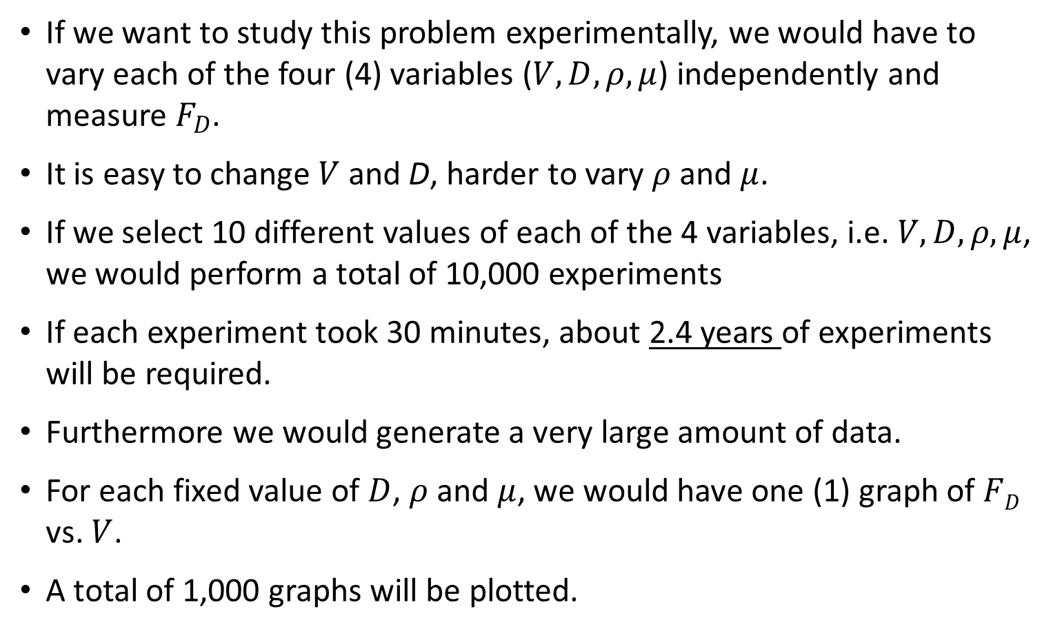
Dimensional and Model Analysis
If we want to study this problem experimentally, we would have to vary each of the four (4) variables ($V, D,ρ,μ$) independently and measure $F_{D}$.
It is easy to change $V$ and D, harder to vary $ρ$and $μ$.
If we select 10 different values of each of the 4 variables, i.e. $V, D, ρ,μ$, we would perform a total of 10,000 experiments
If each experiment took 30 minutes, about 2.4 years of experiments will be required.
Furthermore we would generate a very large amount of data.
For each fixed value of $D$, $ρ$and $μ$, we would have one (1) graph of $FD$ vs. $V$.
A total of 1,000 graphs will be plotted.

Slide 6
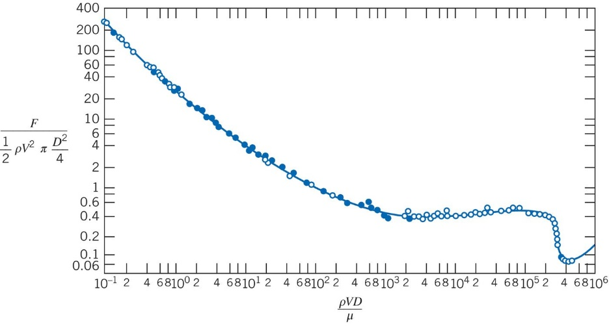
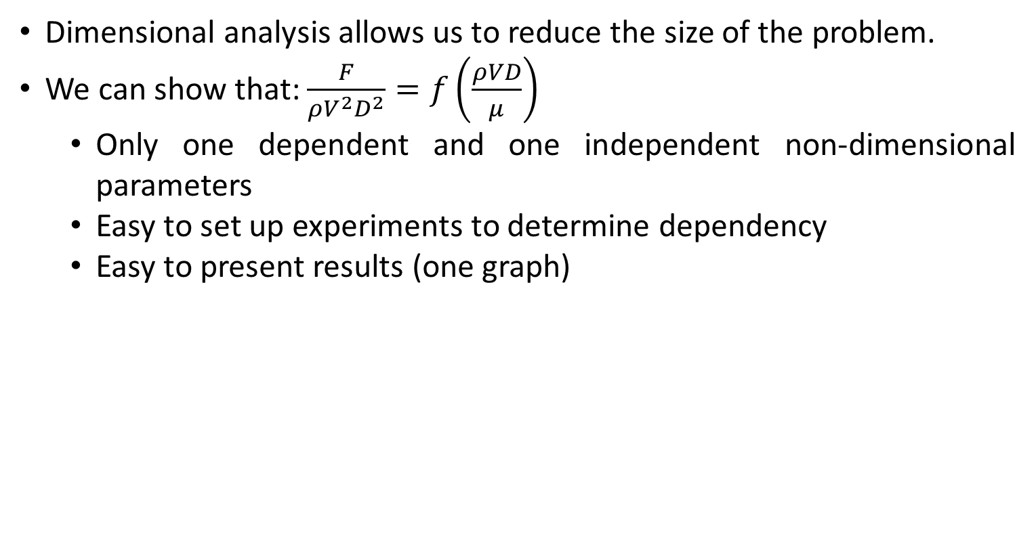
Dimensional and Model Analysis
Dimensional analysis allows us to reduce the size of the problem.
We can show that: $\frac{F}{ρV^{2}D^{2}}=f\left(\frac{ρVD}{μ}\right)$
  Only one dependent and one independent non-dimensional parameters
  Easy to set up experiments to determine dependency
  Easy to present results (one graph)

Slide 7
Dimensional and Model Analysis
Another factor to consider is experimental modeling.
Suppose we want to build a hydraulic turbine for use in a hydroelectric power generating station.
These turbines are physically very large (of order 10 m), and they handle large flow rates.
A full-scale test facility would be extremely expensive! (millions of dollars, about the same cost as the power station)
The turbine designer would want to perform tests on smaller turbine models that require lower flow rates, produce less power, cost less, etc.
Dimensional analysis is a tool that is invaluable in scale model testing.

Slide 8
Dimensional and Model Analysis
Benefits
  Reduce number of experiments and facilitates interpretation of experimental results
  Enormous saving of time
  Enormous saving of money

Slide 9
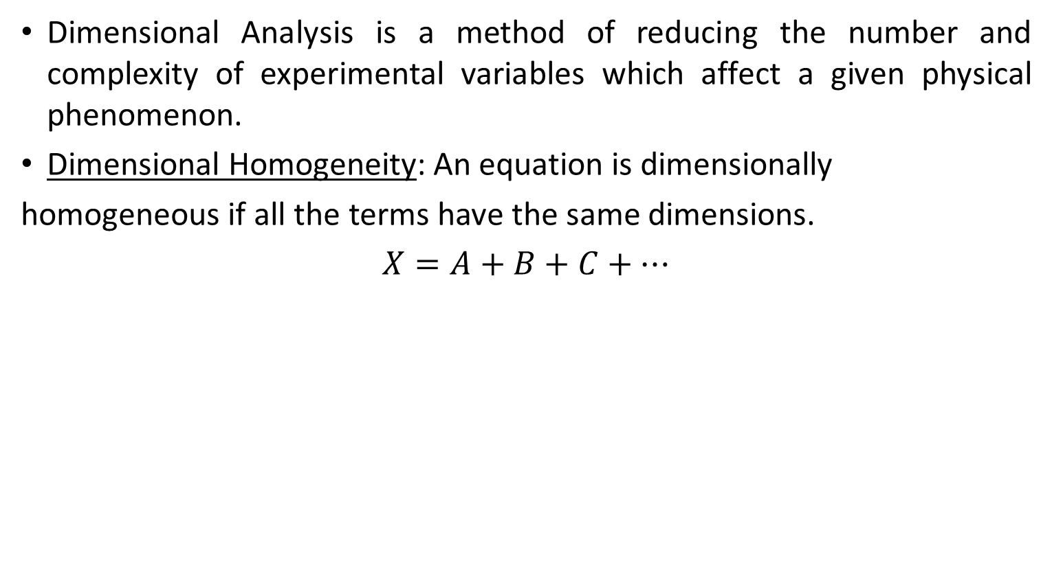
Dimensional and Model Analysis
Dimensional Analysis is a method of reducing the number and complexity of experimental variables which affect a given physical phenomenon.
Dimensional Homogeneity: An equation is dimensionally
homogeneous if all the terms have the same dimensions.
$$X=A+B+C+…$$

Slide 10
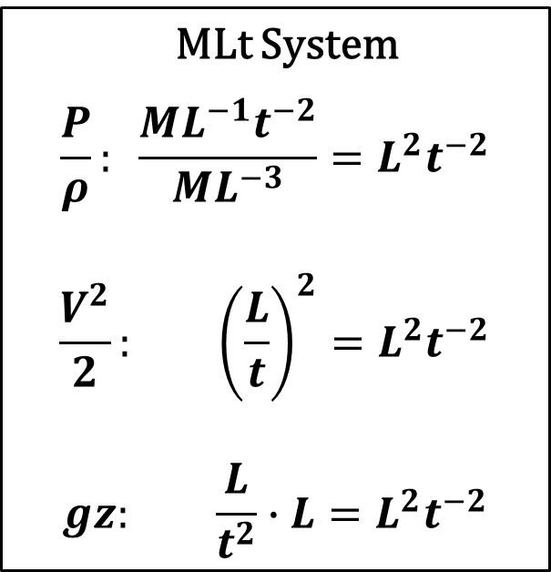
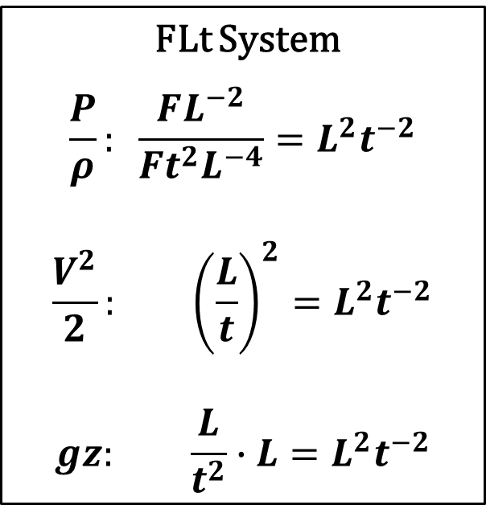
Dimensional Homogeneity
Bernoulli’s equation: $\frac{P}{ρ}+\frac{V^{2}}{2}+gz=constant$
MLt System
$$\frac{P}{ρ}: \frac{ML^{−1}t^{−2}}{ML^{−3}}=L^{2}t^{−2}$$
$$\frac{V^{2}}{2}: {\left(\frac{L}{t}\right)}^{2}=L^{2}t^{−2}$$
$$gz: \frac{L}{t^{2}}∙L=L^{2}t^{−2}$$
FLt System
$$\frac{P}{ρ}: \frac{FL^{−2}}{Ft^{2}L^{−4}}=L^{2}t^{−2}$$
$$\frac{V^{2}}{2}: {\left(\frac{L}{t}\right)}^{2}=L^{2}t^{−2}$$
$$gz: \frac{L}{t^{2}}∙L=L^{2}t^{−2}$$

Slide 11
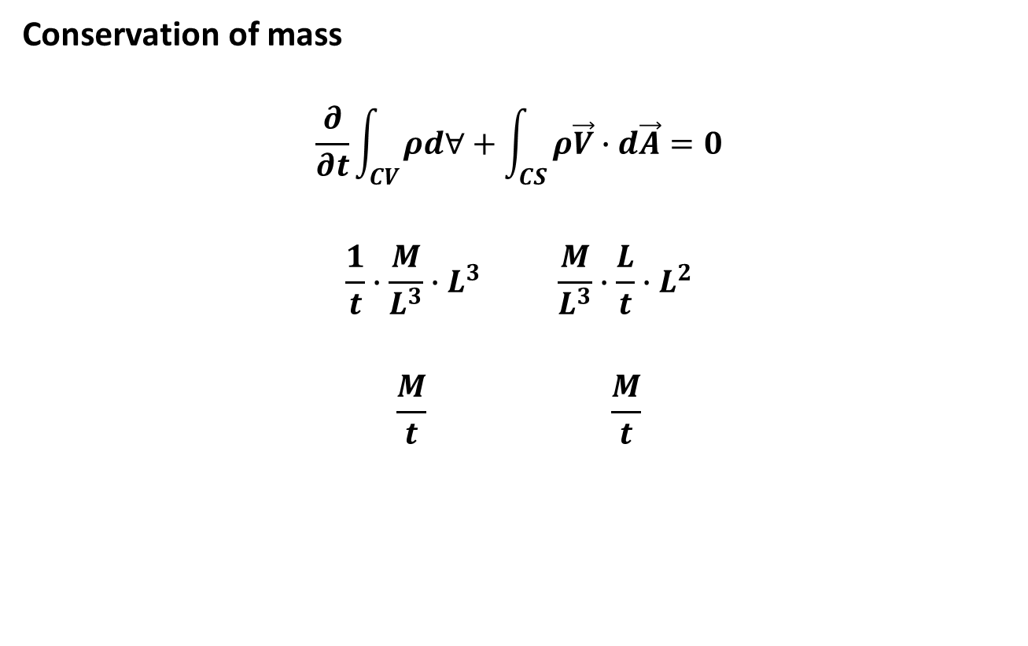
Dimensional Homogeneity
Conservation of mass
$$\frac{∂}{∂t}\int_{CV}{ρd∀}+\int_{CS}{ρ\vec{V}∙d\vec{A}}=0$$
$$\frac{1}{t}∙\frac{M}{L^{3}}∙L^{3} \frac{M}{L^{3}}∙\frac{L}{t}∙L^{2}$$
$$\frac{M}{t} \frac{M}{t}$$

Slide 12
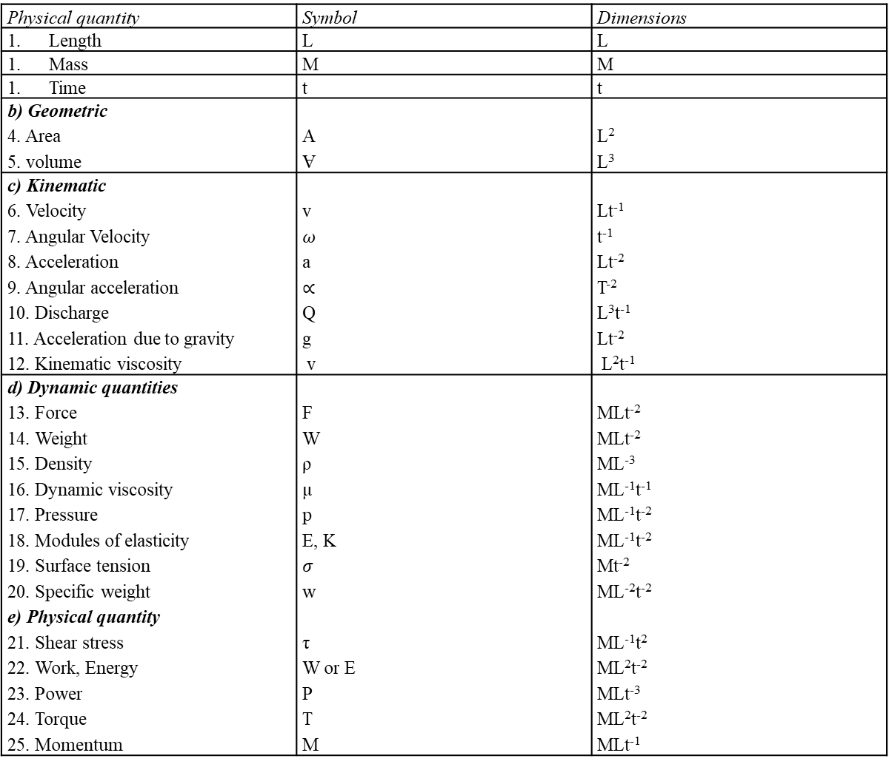
Table$2.1 Physical quantities and dimensions$ (MLt System)
Physical quantity | Symbol | Dimensions
Length | L | L
Mass | M | M
Time | t | t
b) Geometric 4. Area 5. volume | A Ɐ | L² L³
c) Kinematic 6. Velocity 7. Angular Velocity 8. Acceleration 9. Angular acceleration 10. Discharge 11. Acceleration due to gravity 12. Kinematic viscosity | v $ω$ a $∝$ Q g v | Lt⁻¹ t⁻¹ Lt⁻² T⁻² L³t⁻¹ Lt⁻² L²t⁻¹
d) Dynamic quantities 13. Force 14. Weight 15. Density 16. Dynamic viscosity 17. Pressure 18. Modules of elasticity 19. Surface tension 20. Specific weight e) Physical quantity 21. Shear stress 22. Work, Energy 23. Power 24. Torque 25. Momentum | F W ρ µ p E, K $σ$ w τ W or E P T M | MLt⁻² MLt⁻² ML⁻³ ML⁻¹t⁻¹ ML⁻¹t⁻² ML⁻¹t⁻² Mt⁻² ML⁻²t⁻² ML⁻¹t² ML²t⁻² MLt⁻³ ML²t⁻² MLt⁻¹

Slide 13
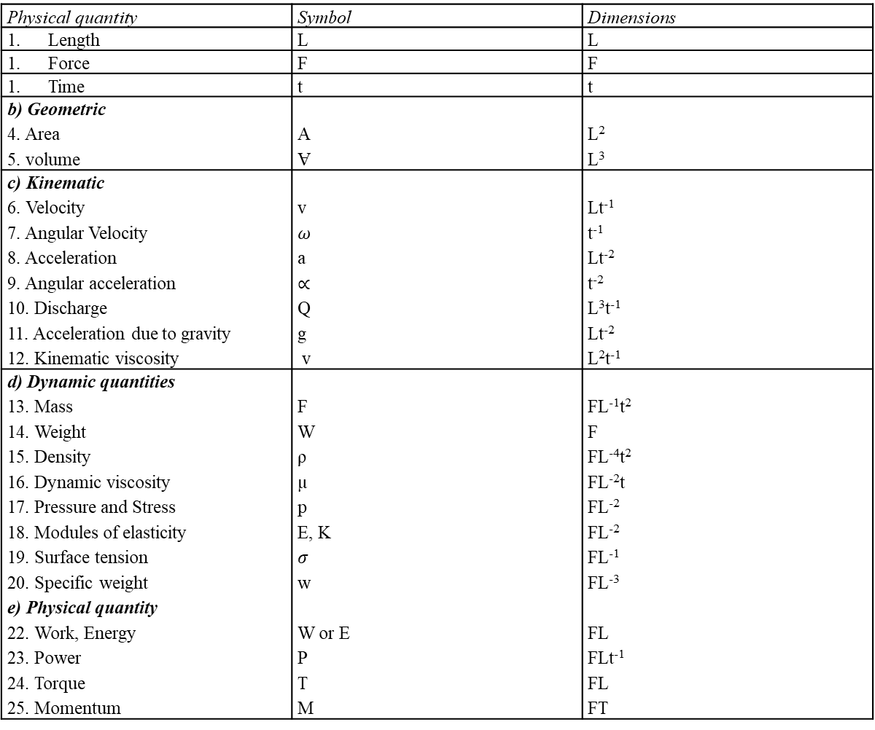
Table$2.2 Physical quantities and dimensions$ (FLt System)
Physical quantity | Symbol | Dimensions
Length | L | L
Force | F | F
Time | t | t
b) Geometric 4. Area 5. volume | A Ɐ | L² L³
c) Kinematic 6. Velocity 7. Angular Velocity 8. Acceleration 9. Angular acceleration 10. Discharge 11. Acceleration due to gravity 12. Kinematic viscosity | v $ω$ a $∝$ Q g v | Lt⁻¹ t⁻¹ Lt⁻² t⁻² L³t⁻¹ Lt⁻² L²t⁻¹
d) Dynamic quantities 13. Mass 14. Weight 15. Density 16. Dynamic viscosity 17. Pressure and Stress 18. Modules of elasticity 19. Surface tension 20. Specific weight e) Physical quantity 22. Work, Energy 23. Power 24. Torque 25. Momentum | F W ρ µ p E, K $σ$ w W or E P T M | FL⁻¹t² F FL⁻⁴t² FL⁻²t FL⁻² FL⁻² FL⁻¹ FL⁻³ FL FLt⁻¹ FL FT

Slide 14
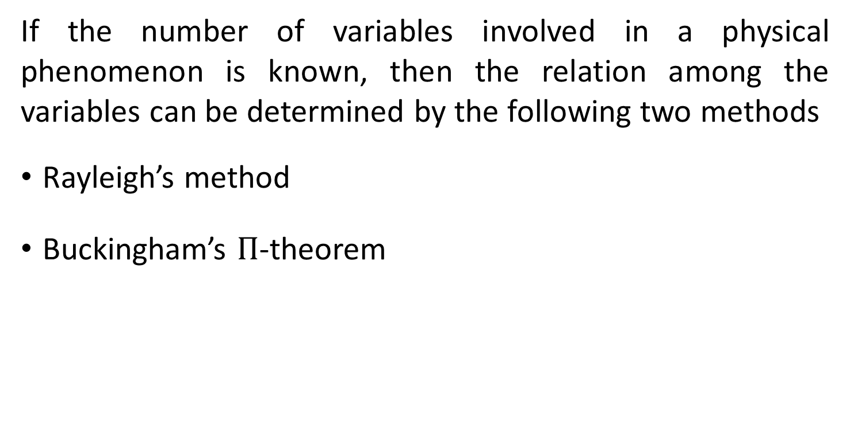
Methods of Dimensional Analysis
If the number of variables involved in a physical phenomenon is known, then the relation among the variables can be determined by the following two methods
Rayleigh’s method
Buckingham’s $Π$-theorem

Slide 15
THE RAYLEIGH METHOD
Used for determining the expression for a variable which depends on maximum of three variables only. If the number of independent variables becomes more than three then it is very difficult to find the expression for the dependent variable.
Let X be a variable, which depends on X₁, X₂, and X₃ variables.
Then according to Rayleigh’s method X is a function of X₁, X₂, and X₃.
Mathematically, X = f(X₁,X₂,X₃). Or X= KX₁ª. X₂^{b}. X₃^{c}.
  where K is a constant and a, b and c are arbitrary powers.
  The variables of a, b and c are obtained by comparing the powers of the fundamental dimensions on both sides. Thus the expression is obtained for the dependent variable.

Slide 16
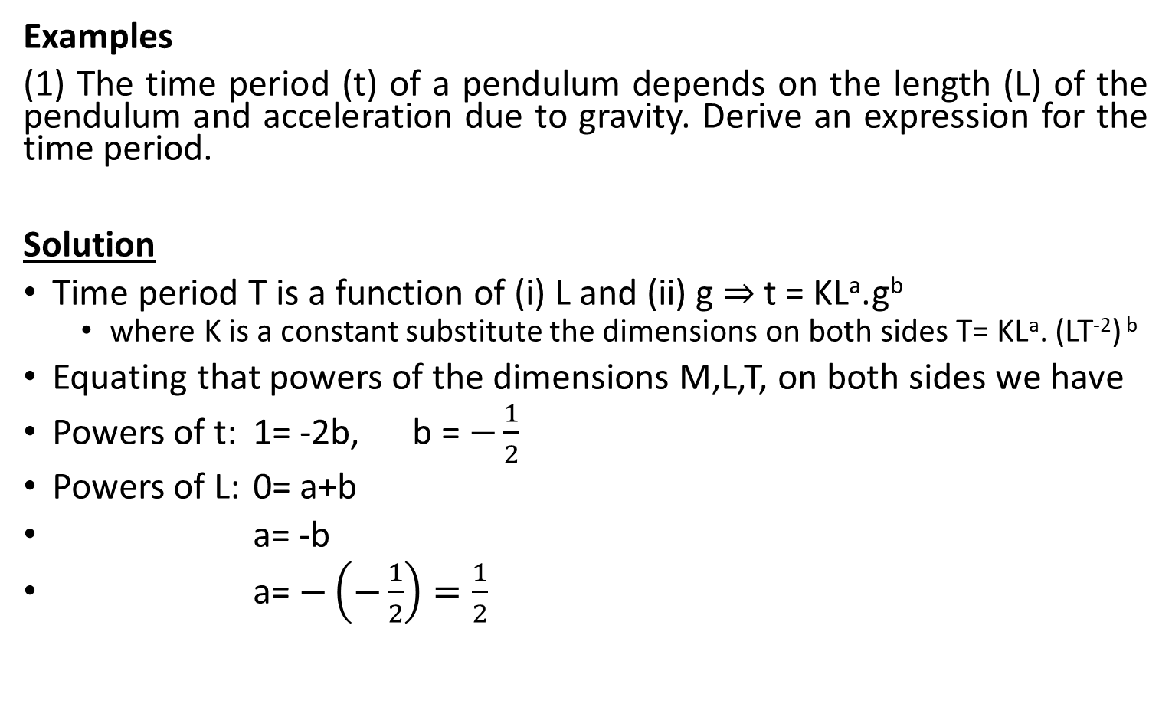
RAYLEIGH METHOD
Examples
(1) The time period (t) of a pendulum depends on the length (L) of the pendulum and acceleration due to gravity. Derive an expression for the time period.
Solution
Time period T is a function of (i) L and (ii) g $⇒$ t = KLª.g^{b}
  where K is a constant substitute the dimensions on both sides T= KLª. (LT⁻²) ^{b}
Equating that powers of the dimensions M,L,T, on both sides we have
Powers of t: 1= -2b, b = $−\frac{1}{2}$
Powers of L: 0= a+b
a= -b
a= $−\left(−\frac{1}{2}\right)=\frac{1}{2}$

Slide 17
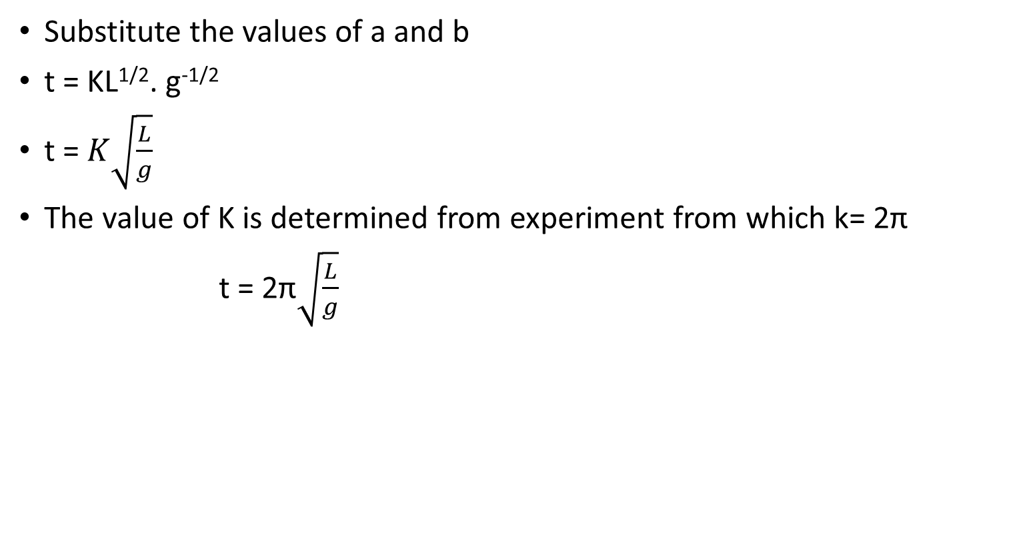
Solution contd.
Substitute the values of a and b
t = KL^{1/2}. g^{-1/2}
t = $K\sqrt{\frac{L}{g}}$
The value of K is determined from experiment from which k= 2π
t = 2π$\sqrt{\frac{L}{g}}$

Slide 18
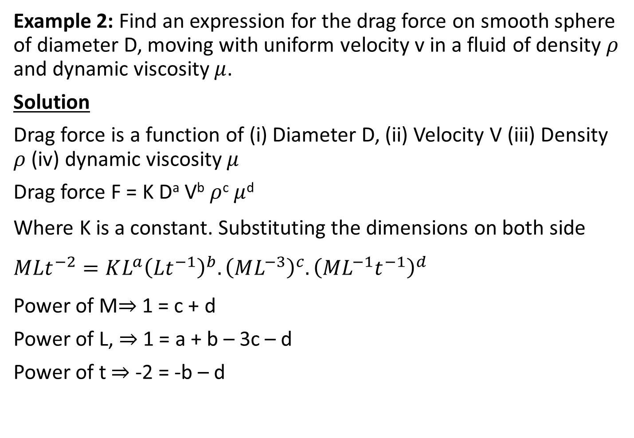
RAYLEIGH METHOD
Example 2: Find an expression for the drag force on smooth sphere of diameter D, moving with uniform velocity v in a fluid of density $ρ$ and dynamic viscosity $μ$.
Solution
Drag force is a function of (i) Diameter D, (ii) Velocity V (iii) Density $ρ$ (iv) dynamic viscosity $μ$
Drag force F = K Dª V^{b} $ρ$^{c} $μ$^{d}
Where K is a constant. Substituting the dimensions on both side $MLt^{−2}=KL^{a}{\left({Lt}^{−1}\right)}^{b}.{\left(ML^{−3}\right)}^{c}.{\left(ML^{−1}t^{−1}\right)}^{d}$
Power of M$⇒$ 1 = c + d
Power of L, $⇒$ 1 = a + b – 3c – d
Power of t $⇒$ -2 = -b – d

Slide 19
Solution 2 contd
We have 3 unknowns. It is impossible to find all unknowns. However we can express three of the variables in terms of the fourth variable.
c = 1 – d
b = 2 – d
a = 1 – b + 3c + d
= 1 – (2 – d) + 3(1 – d) + d
= 1 - 2 + d + 3 – 3d + d
a = 2 – d

Slide 20
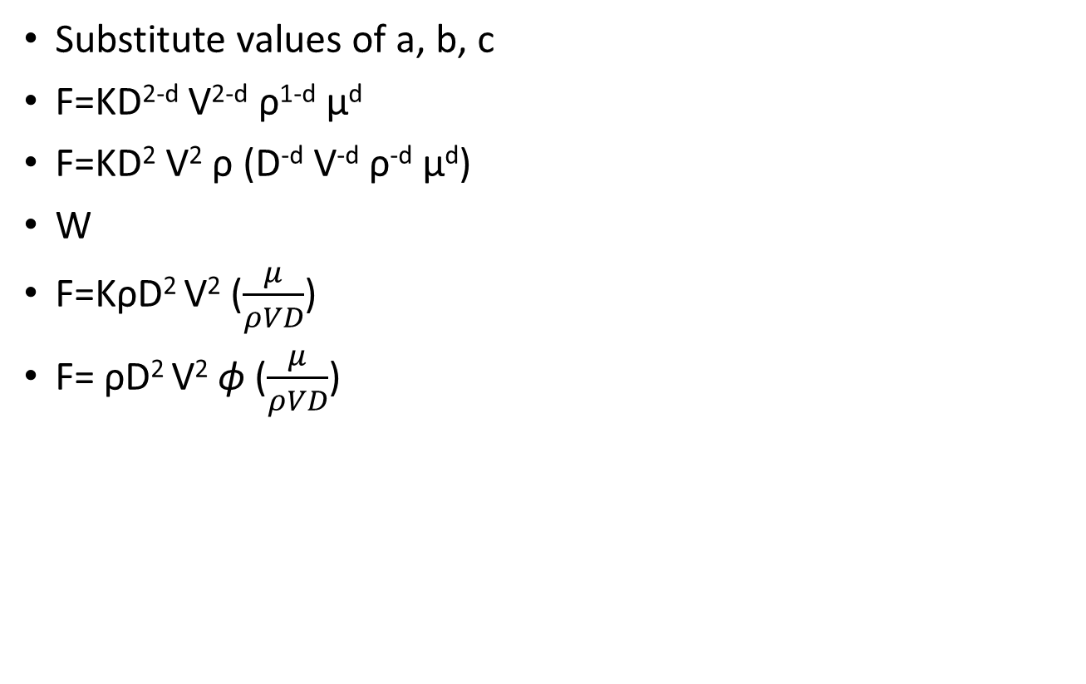
Solution 2 contd.
Substitute values of a, b, c
F=KD^{2-d} V^{2-d} ρ^{1-d} μ^{d}
F=KD² V² ρ (D^{-d} V^{-d} ρ^{-d} μ^{d})
W
F=KρD² V² ($\frac{μ}{ρVD}$)
F= ρD² V² ϕ ($\frac{μ}{ρVD}$)

Slide 21
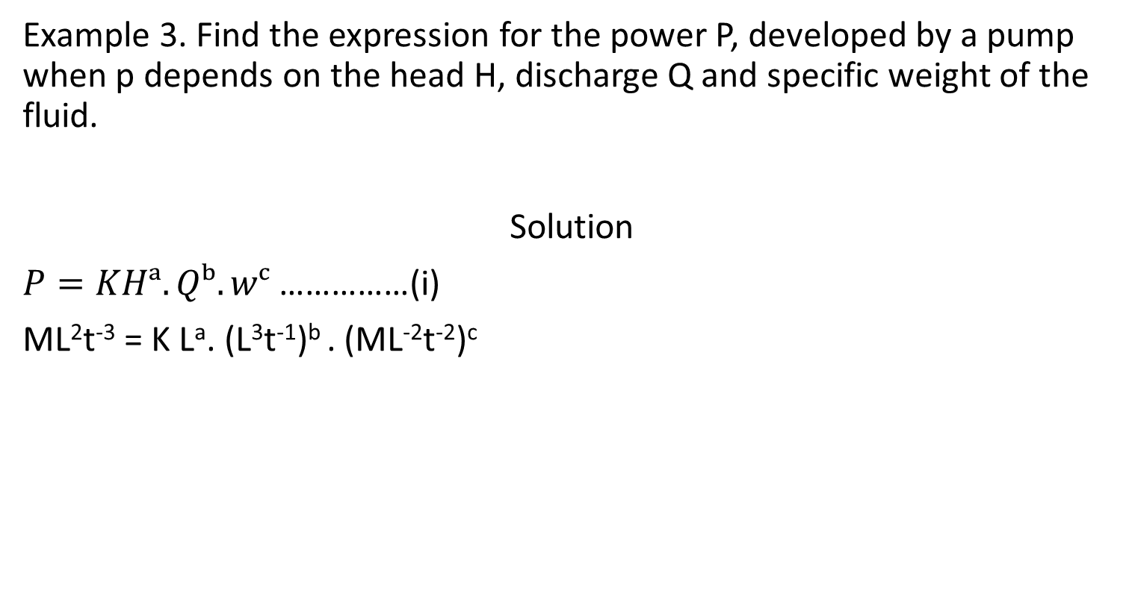
RAYLEIGH METHOD
Example 3. Find the expression for the power P, developed by a pump when p depends on the head H, discharge Q and specific weight of the fluid.
Solution
$P=KHᵃ.Qᵇ.wᶜ$ ……………(i)
ML²t⁻³ = K Lª. (L³t⁻¹)^{b} . (ML⁻²t⁻²)^{c}

Slide 22
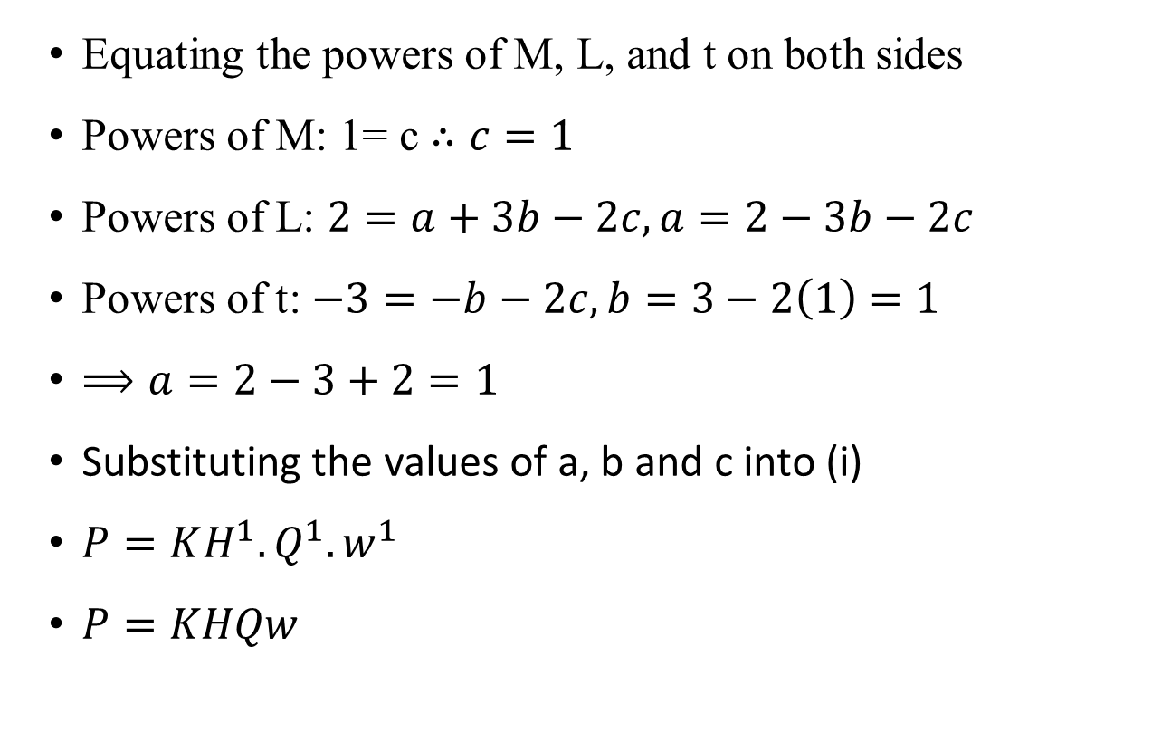
Solution 3 contd.
Equating the powers of M, L, and t on both sides
Powers of M: 1= c $∴c=1$
Powers of L: $2=a+3b−2c, a=2−3b−2c$
Powers of t: $−3=−b−2c, b=3−2\left(1\right)=1$
$⟹a=2−3+2=1$
Substituting the values of a, b and c into (i)
$P=KH^{1}.Q^{1}.w^{1}$
$P=KHQw$

Slide 23
The FLt system of Fundamental Dimensions
Self-Assessment: Repeat Example 3 using the FLt system of fundamental dimensions

Slide 24







The Dimension Matrix Approach
This is a technique that arranges the exponents of the
dimensions of the variables in a table, forming a matrix.
Example: The thrust F of a propeller depends upon its diameter, D, speed of advance, V, number of revolutions per second, N, the fluid density, ρ, and dynamic viscosity, μ. Find an expression for F in terms of these quantities.
Solution:
Propeller thrust, F = f (V, D, N, ρ, μ)
$⟹ F=KVᵃ.Dᵇ.Nᶜ.ρd.μe$
F V D N ρ μ
Let’s use primary dimensions
M. L. t to solve the problem.
$$\frac{ML}{t^{2}}$$
$$\frac{L}{t}$$
$$L$$
$$\frac{1}{t}$$
$$\frac{M}{L^{3}}$$
$$\frac{M}{Lt}$$

Slide 25
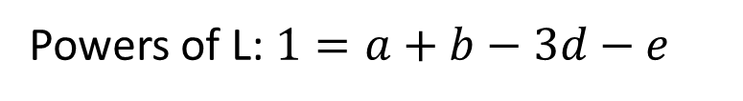

The Dimension Matrix Approach
Solution contd:
The dimension matrix of exponents is shown in the table below.
Variable | F | V | D | N | ρ | μ
M | 1 | 0 | 0 | 0 | 1 | 1
L | 1 | 1 | 1 | 0 | -3 | -1
t | -2 | -1 | 0 | -1 | 0 | -1
Substituting the dimensions for the variables and neglecting K yields
$MLt^{−2}=(Lt^{−1})ᵃ.Lᵇ.(t^{−1})ᶜ.(ML^{−3})d.(ML^{−1}t^{−1})e$
Powers of M: $1=d+e$
Powers of L: $1=a+b−3d−e$

Slide 26

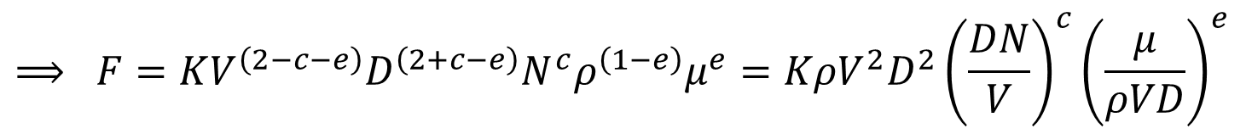
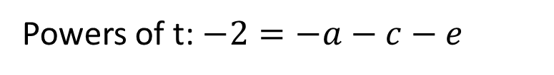

Solution contd:
$MLt^{−2}=(Lt^{−1})ᵃ.Lᵇ.(t^{−1})ᶜ.(ML^{−3})d.(ML^{−1}t^{−1})e$
Powers of t: $−2=−a−c−e$
These result in three equations in five variables. Expressing a, b and d in terms of c and e, yields
$d=1−e$
$a=2−c−e$
$b=1−a+3d+e=1−\left(2−c−e\right)+3\left(1−e\right)+e$
$$=2+c−e$$
$F=KVᵃ.Dᵇ.Nᶜ.ρd.μe$
$$⟹ F=KV^{\left(2−c−e\right)}D^{\left(2+c−e\right)}N^{c}ρ^{\left(1−e\right)}μ^{e}=KρV^{2}D^{2}{\left(\frac{DN}{V}\right)}^{c}{\left(\frac{μ}{ρVD}\right)}^{e}$$

Slide 27
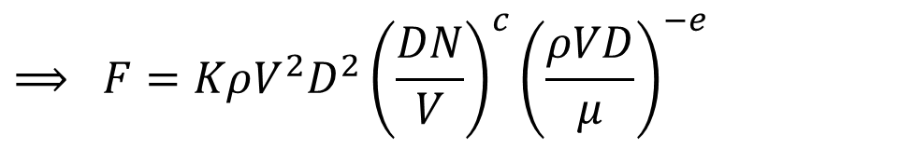
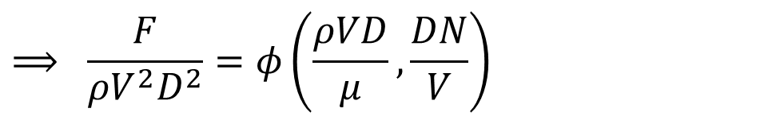
Solution contd:
$$⟹ F=KρV^{2}D^{2}{\left(\frac{DN}{V}\right)}^{c}{\left(\frac{ρVD}{μ}\right)}^{−e}$$
$$⟹ \frac{F}{ρV^{2}D^{2}}=φ\left(\frac{ρVD}{μ},\frac{DN}{V}\right)$$

Slide 28
BUCKINGHAM Pi-Theorem
The Rayleigh’s method becomes difficult if the variables are more than the fundamental dimensions (M, L, T).
This difficulty is overcome by the Buckingham Π-Theorem, which states that “if there are n variables (independent and dependent variables) in a given flow phenomenon, the relationship between these variables can be transformed into a corresponding relationship between (n-m) independent dimensionless terms”.
Each dimensionless term is called a Π-term. Let X₁, X₂, X_{3,}….., X_{n} be the variables involved in the physical problem.

Slide 29
BUCKINGHAM Pi-Theorem
Let X₁, be the dependent variable and X₂, X₃…..X_{n} be the
independent variables on which X₁ depends.
Then X₁ is a function of X₂,X₃……X_{n} and mathematically
X₁= f(X₂,X₃……X_{n}), (1)
or g(X₁,X₂,X₃……X_{n}) = 0 (2)
The above equation, containing n variables, is dimensionally homogeneous.
According to the Buckingham Π theorem, the equation
g(X₁,X₂,X₃……X_{n}) = 0.
can be written in terms of a smaller number of dimensionless groups or Π terms equal to (n-m).

Slide 30
BUCKINGHAM Pi-Theorem
That is, equation (2) is equivalent to
g(Π₁, Π₂,…… Π_{n-m}) = 0 (3)
where Π₁ is the dimensionless group or Π-term corresponding to the dependent variable. This implies that equation (3) can be rewritten in the form
Π₁ = g₁(Π₂,…… Π_{n-m}) (4)
where Π₂,…… Π_{n-m} are Pi- or dimensionless groups formed from various combinations of the remaining independent variables.
Usually, m is the minimum number i of independent or fundamental dimensions (eg., M, L and t) required to define the dimensions of all the n variables, X₁,X₂,X₃,…X_{n}.

Slide 31
How are the Π-Groups Determined?
The purpose of the Buckingham theorem is to reduce the number of original dimensional parameters to a smaller set of dimensionless parameters.
The dimensionality reduction (n - m) is obtained by selecting a set of r repeating parameters, setting m = r, and forming the Pi terms from the remaining variables and various combinations of the repeating variables.
But earlier, we said m = i, where i is the number of independent or fundamental dimensions in the problem. This is because in the majority of dimensionless analysis problems, r = i. However, this is not always true.
The rule of setting r = i (or m = i), spectacularly breaks down when different systems of fundamental dimensions yield different values of i (e.g., using MLt or FLt systems).

Slide 32
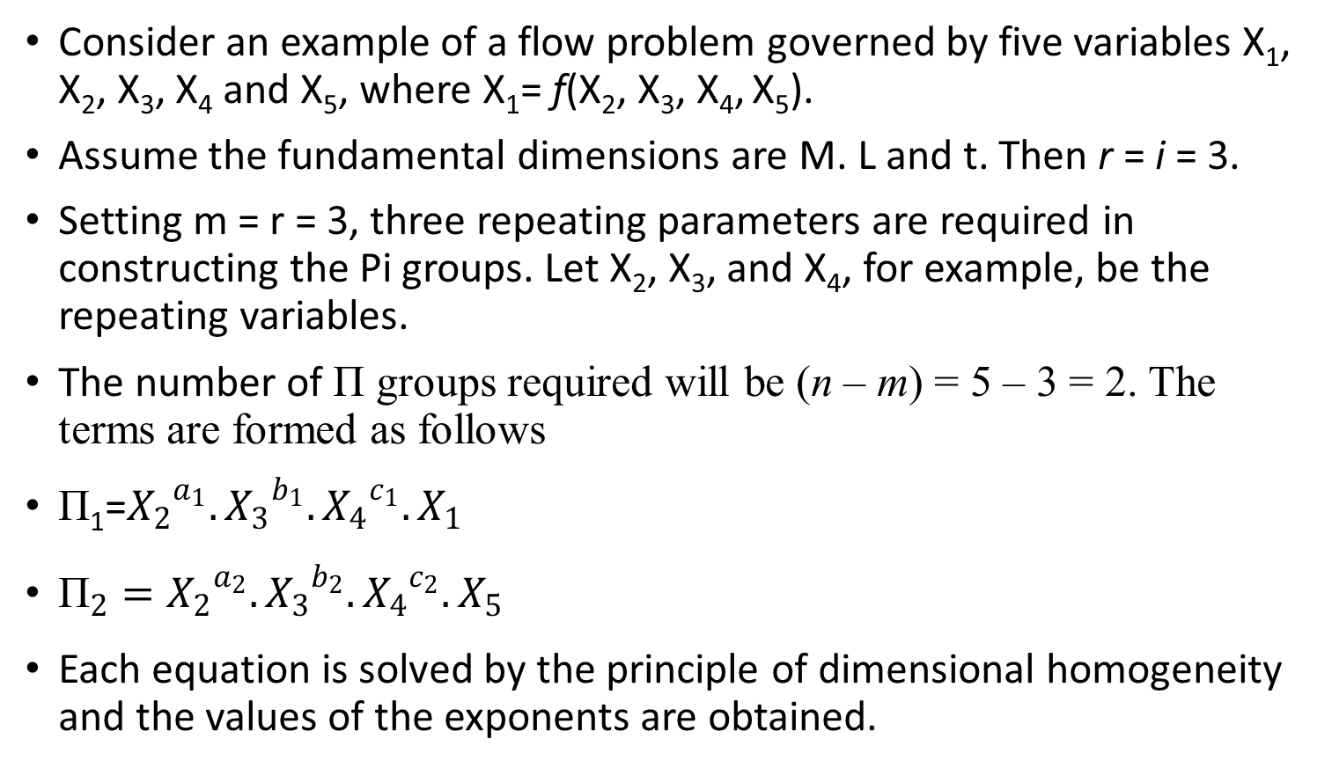
How are the Π-Groups Determined?
Consider an example of a flow problem governed by five variables X₁, X₂, X₃, X₄ and X₅, where X₁= f(X₂, X₃, X₄, X₅).
Assume the fundamental dimensions are M. L and t. Then r = i = 3.
Setting m = r = 3, three repeating parameters are required in constructing the Pi groups. Let X₂, X₃, and X₄, for example, be the repeating variables.
The number of Π groups required will be (n – m) = 5 – 3 = 2. The terms are formed as follows
Π₁=${X_{2}}^{a_{1}}.{X_{3}}^{b_{1}}.{X_{4}}^{c_{1}}.X_{1}$
${\text{Π}}_{2}={X_{2}}^{a_{2}}.{X_{3}}^{b_{2}}.{X_{4}}^{c_{2}}.X_{5}$
Each equation is solved by the principle of dimensional homogeneity and the values of the exponents are obtained.

Slide 33
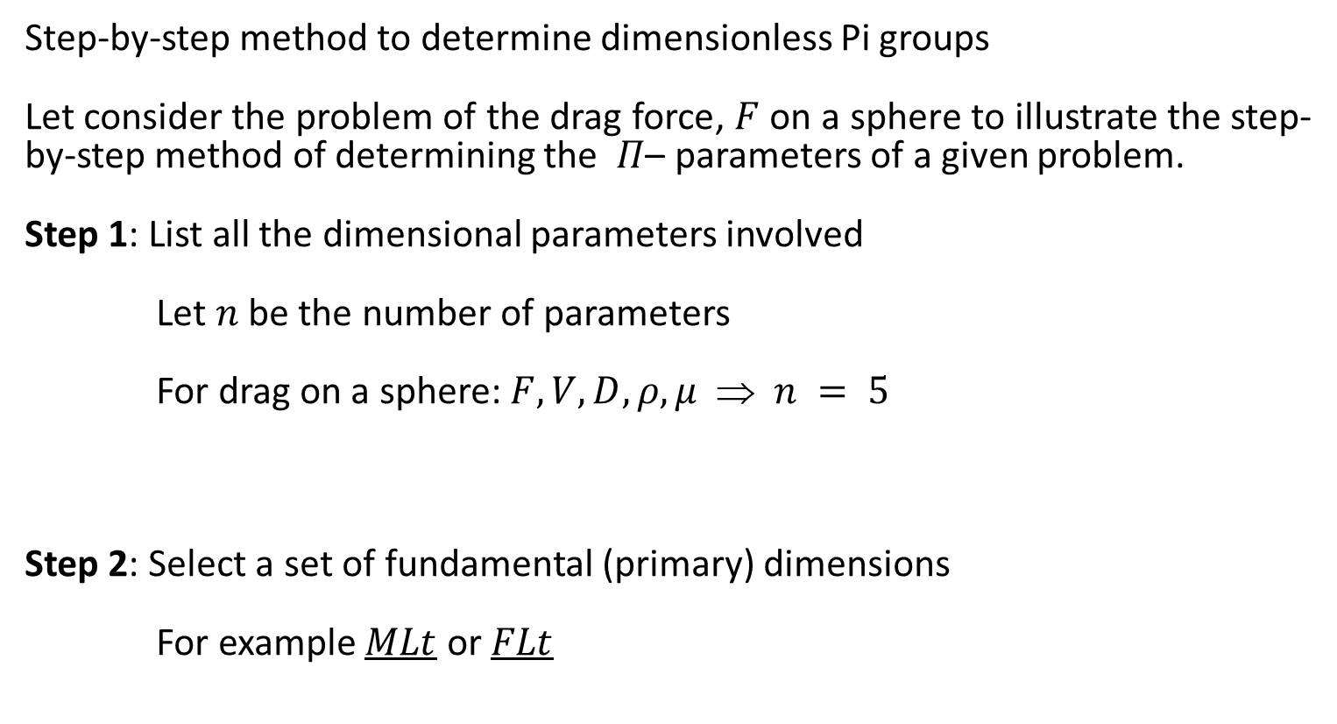
Application of the Pi Theorem
Step-by-step method to determine dimensionless Pi groups
Let consider the problem of the drag force, $F$ on a sphere to illustrate the step-by-step method of determining the$Π$– parameters of a given problem.
Step 1: List all the dimensional parameters involved
Let $n$ be the number of parameters
For drag on a sphere: $F, V, D,ρ,μ$ ⇒ $n = 5$
Step 2: Select a set of fundamental (primary) dimensions
For example $MLt$ or $FLt$

Slide 34
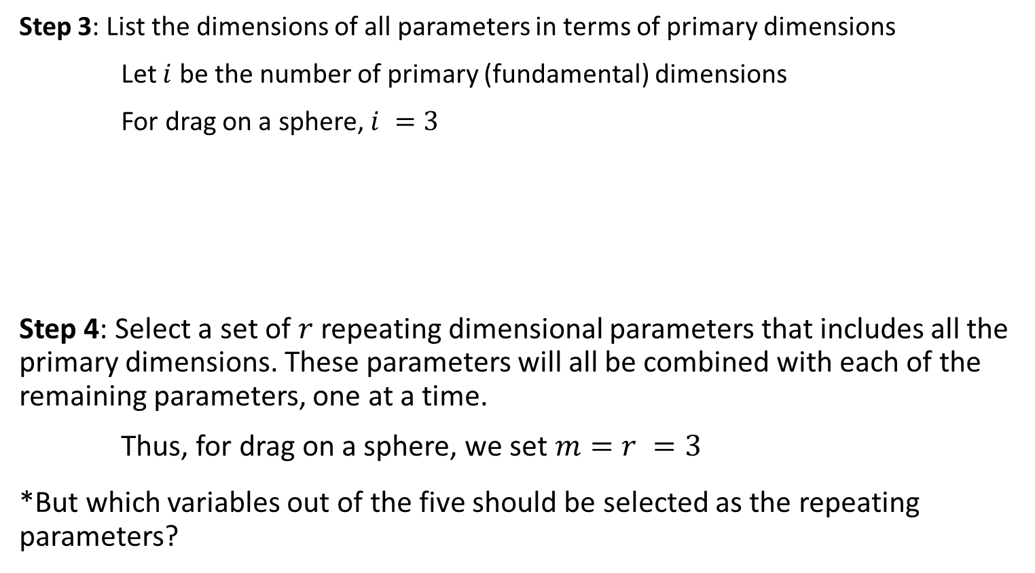
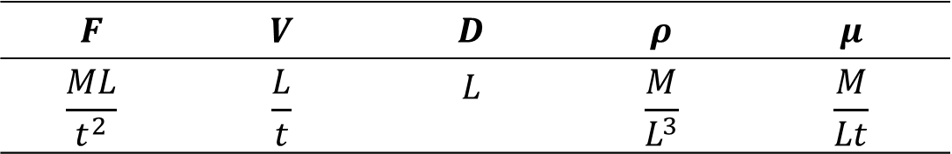
Application of the Pi Theorem
Step 3: List the dimensions of all parameters in terms of primary dimensions
Let $i$ be the number of primary (fundamental) dimensions
For drag on a sphere, $i =3$
Step 4: Select a set of $r$repeating dimensional parameters that includes all the primary dimensions. These parameters will all be combined with each of the remaining parameters, one at a time.
Thus, for drag on a sphere, we set $m=r =3$
*But which variables out of the five should be selected as the repeating parameters?
$$F$$ | $$V$$ | $$D$$ | $$ρ$$ | $$μ$$
$$\frac{ML}{t^{2}}$$ | $$\frac{L}{t}$$ | $$L$$ | $$\frac{M}{L^{3}}$$ | $$\frac{M}{Lt}$$

Slide 35
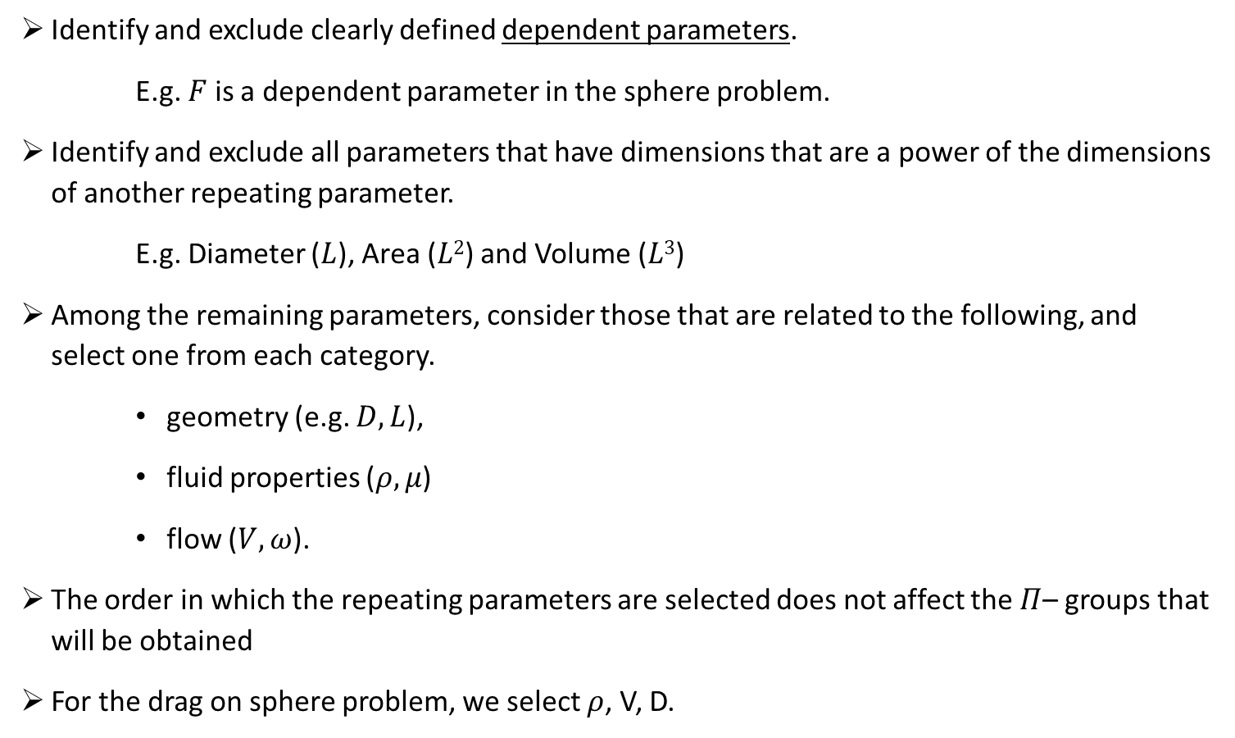
Tips for Selecting the Repeating Parameters
  Identify and exclude clearly defined dependent parameters.
  E.g. $F$ is a dependent parameter in the sphere problem.
  Identify and exclude all parameters that have dimensions that are a power of the dimensions of another repeating parameter.
  E.g. Diameter ($L$), Area ($L2$) and Volume ($L3$)
  Among the remaining parameters, consider those that are related to the following, and select one from each category.
    geometry (e.g. $D, L$),
    fluid properties ($ρ, μ$)
    flow ($V, ω$).
  The order in which the repeating parameters are selected does not affect the $Π$– groups that will be obtained
  For the drag on sphere problem, we select $ρ$, V, D.

Slide 36
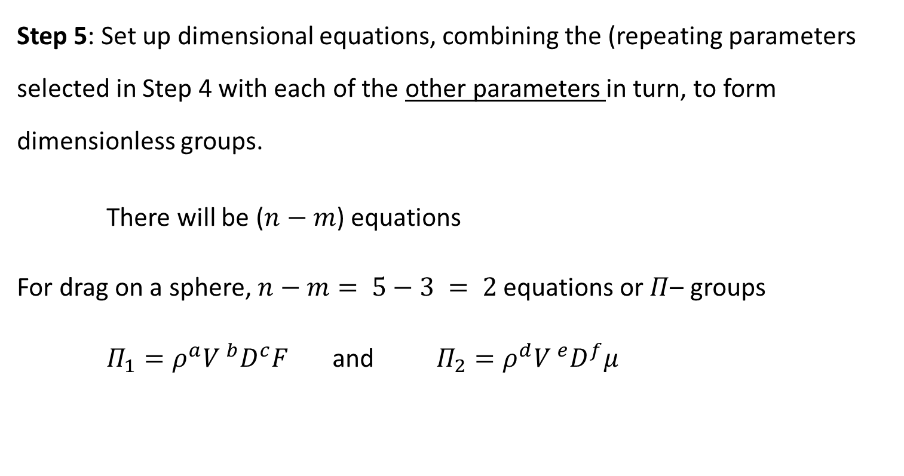
Application of the Pi Theorem
Step 5: Set up dimensional equations, combining the (repeating parameters selected in Step 4 with each of the other parameters in turn, to form dimensionless groups.
There will be ($n−m$) equations
For drag on a sphere,$n−m= 5−3 = 2$equations or $Π$– groups
$Π_{1}=ρ^{a}{V }^{b}D^{c}F$ and $Π_{2}=ρ^{d}{V }^{e}D^{f}μ$

Slide 37
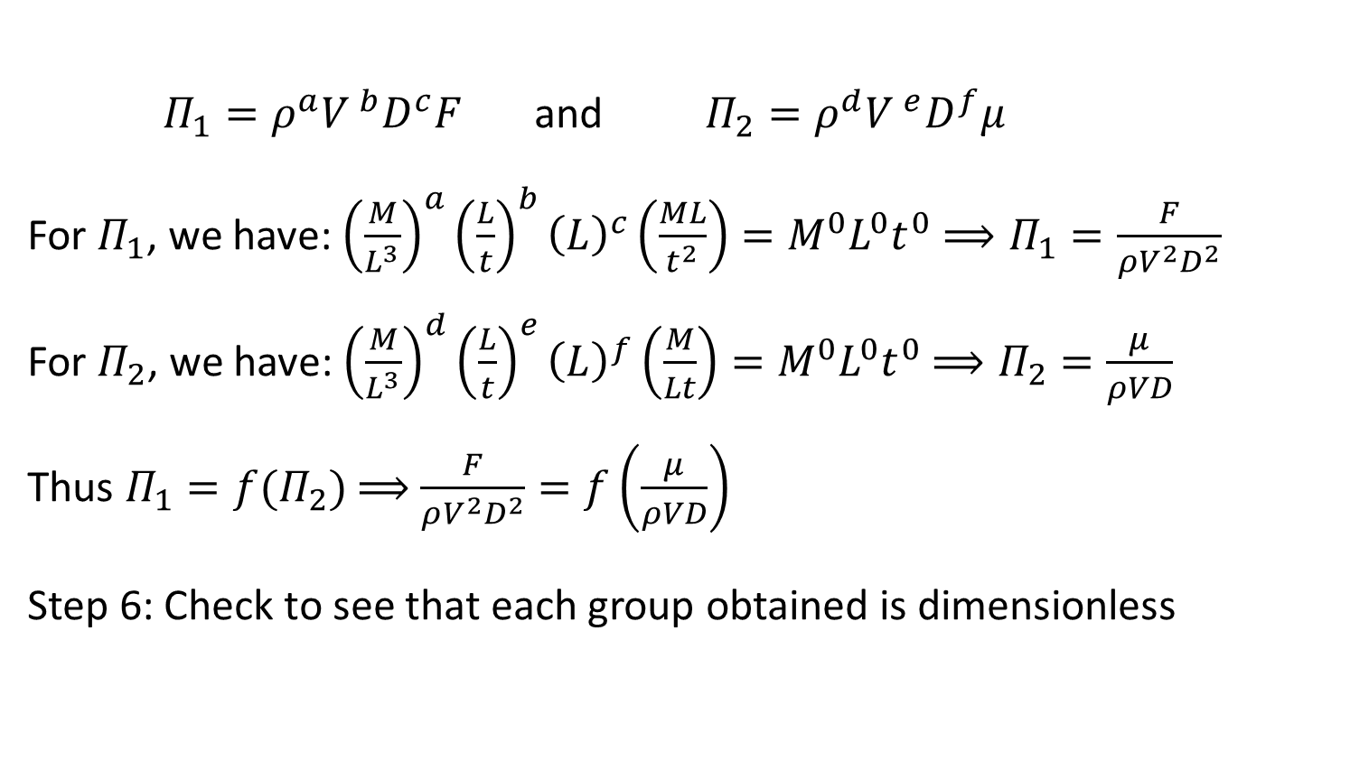
Application of the Pi Theorem
$Π_{1}=ρ^{a}{V }^{b}D^{c}F$ and $Π_{2}=ρ^{d}{V }^{e}D^{f}μ$
For $Π_{1}$, we have: ${\left(\frac{M}{L^{3}}\right)}^{a}{\left(\frac{L}{t}\right)}^{b}{\left(L\right)}^{c}\left(\frac{ML}{t^{2}}\right)=M^{0}L^{0}t^{0}$ $⟹Π_{1}=\frac{F}{ρV^{2}D^{2}}$
For $Π_{2}$, we have: ${\left(\frac{M}{L^{3}}\right)}^{d}{\left(\frac{L}{t}\right)}^{e}{\left(L\right)}^{f}\left(\frac{M}{Lt}\right)=M^{0}L^{0}t^{0}$ $⟹Π_{2}=\frac{μ}{ρVD}$
Thus $Π_{1}=f(Π_{2})$ $⟹$ $\frac{F}{ρV^{2}D^{2}}=f\left(\frac{μ}{ρVD}\right)$
Step 6: Check to see that each group obtained is dimensionless

Slide 38
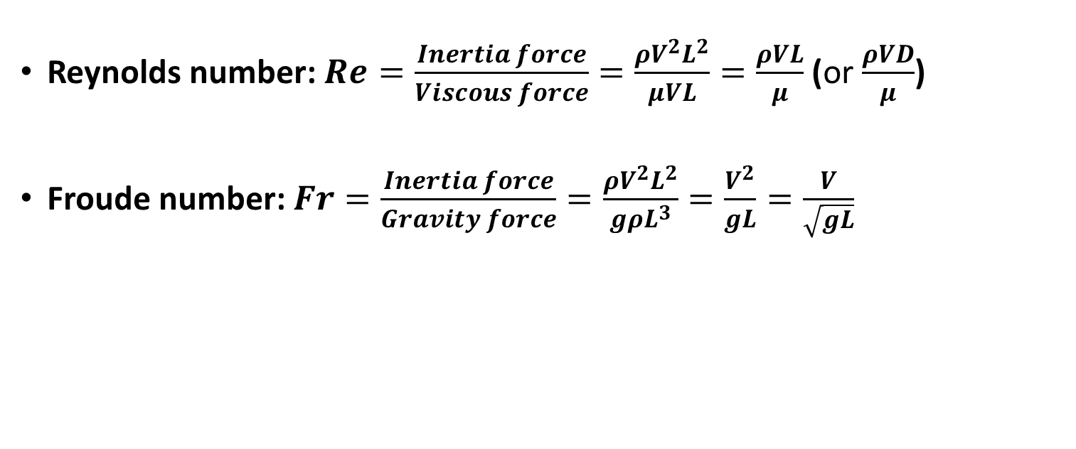
Dimensionless Groups of Significance
Reynolds number: $Re=\frac{Inertia force}{Viscous force}=\frac{ρV^{2}L^{2}}{μVL}=\frac{ρVL}{μ}$ (or $\frac{ρVD}{μ}$)
Froude number: $Fr=\frac{Inertia force}{Gravity force}=\frac{ρV^{2}L^{2}}{gρL^{3}}=\frac{V^{2}}{gL}=\frac{V}{\sqrt{gL}}$

Slide 39
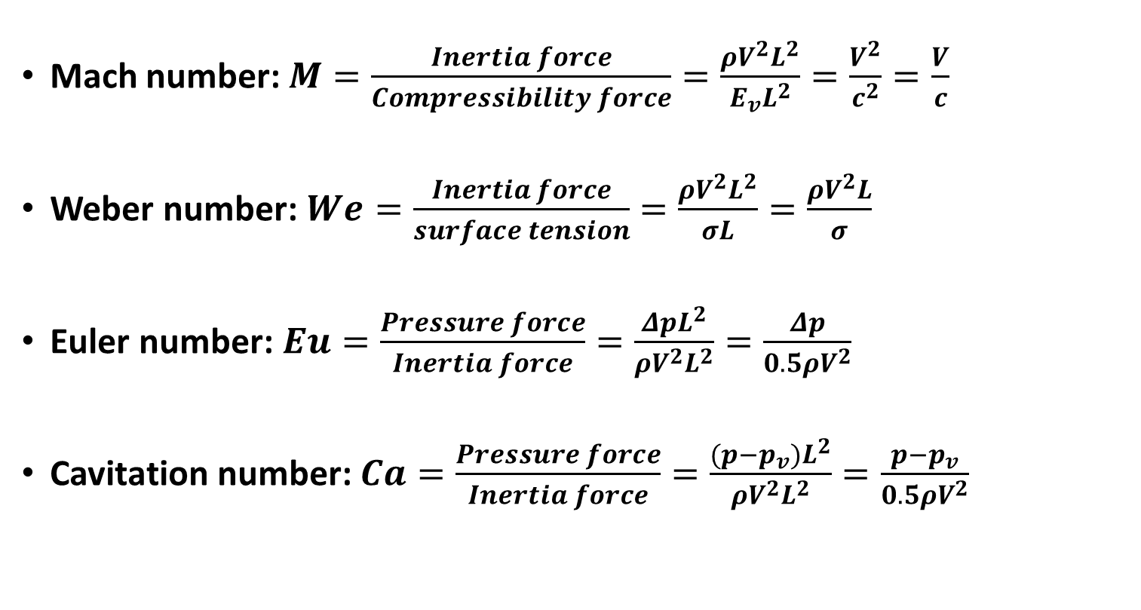
Dimensionless Groups of Significance
Mach number: $M=\frac{Inertia force}{Compressibility force}=\frac{ρV^{2}L^{2}}{E_{v}L^{2}}=\frac{V^{2}}{c^{2}}=\frac{V}{c}$
Weber number:$We=\frac{Inertia force}{surface tension}=\frac{ρV^{2}L^{2}}{σL}=\frac{ρV^{2}L}{σ}$
Euler number:$Eu=\frac{Pressure force}{Inertia force}=\frac{ΔpL^{2}}{ρV^{2}L^{2}}=\frac{Δp}{0.5ρV^{2}}$
Cavitation number: $Ca=\frac{Pressure force}{Inertia force}=\frac{(p−p_{v})L^{2}}{ρV^{2}L^{2}}=\frac{p−p_{v}}{0.5ρV^{2}}$

Slide 40

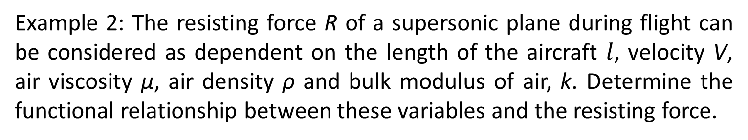



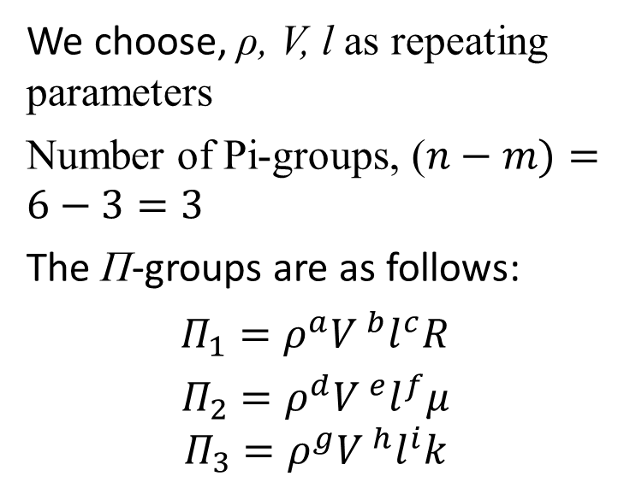


Application of the Pi Theorem
Example 2: The resisting force R of a supersonic plane during flight can be considered as dependent on the length of the aircraft $l$, velocity V, air viscosity μ, air density ρ and bulk modulus of air, k. Determine the functional relationship between these variables and the resisting force.
Solution:
R = f (l, V, ρ, μ, k)
We choose, ρ, V, l as repeating parameters
Number of Pi-groups, ($n−m)=6−3=3$
The Π-groups are as follows:
$Π_{1}=ρ^{a}{V }^{b}l^{c}R$
$$Π_{2}=ρ^{d}{V }^{e}l^{f}μ$$
$$Π_{3}=ρ^{g}{V }^{h}l^{i}k$$
R l V ρ μ k
$$\frac{ML}{t^{2}}$$
$$L$$
$$\frac{L}{t}$$
$$\frac{M}{L^{3}}$$
$$\frac{M}{Lt}$$
$$\frac{M}{Lt^{2}}$$
n = 6, r = 3
Number of repeating parameters
m = r = 3

Slide 41
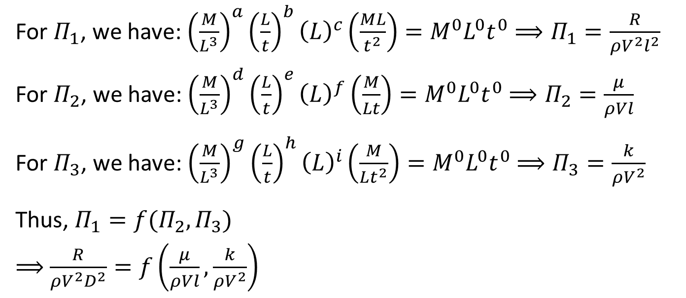
Solution Contd.:
For $Π_{1}$, we have: ${\left(\frac{M}{L^{3}}\right)}^{a}{\left(\frac{L}{t}\right)}^{b}{\left(L\right)}^{c}\left(\frac{ML}{t^{2}}\right)=M^{0}L^{0}t^{0}$ $⟹Π_{1}=\frac{R}{ρV^{2}l^{2}}$
For $Π_{2}$, we have: ${\left(\frac{M}{L^{3}}\right)}^{d}{\left(\frac{L}{t}\right)}^{e}{\left(L\right)}^{f}\left(\frac{M}{Lt}\right)=M^{0}L^{0}t^{0}$ $⟹Π_{2}=\frac{μ}{ρVl}$
For $Π_{3}$, we have: ${\left(\frac{M}{L^{3}}\right)}^{g}{\left(\frac{L}{t}\right)}^{h}{\left(L\right)}^{i}\left(\frac{M}{Lt^{2}}\right)=M^{0}L^{0}t^{0}$ $⟹Π_{3}=\frac{k}{ρV^{2}}$
Thus, $Π_{1}=f(Π_{2},Π_{3})$
$⟹$ $\frac{R}{ρV^{2}D^{2}}=f\left(\frac{μ}{ρVl},\frac{k}{ρV^{2}}\right)$

Slide 42
Practice Problems on Buckingham Pi Theorem
1. The pressure drop, Δp, for steady, incompressible flow through a straight horizontal pipe depends on the pipe length, L, the average velocity V, the fluid viscosity, μ, the pipe diameter, D, the fluid density, ρ, and the average roughness height, e. Determine a set of dimensionless groups that can be used to correlate data.
2. The efficiency η of a fan depends on density ρ, dynamic viscosity μ of the fluid, angular velocity ω, diameter D of the rotor and the discharge Q. Express η in terms of dimensionless parameters.
3. The speed of shallow water waves in the ocean (e.g., seismic sea waves or tsunamis) depends only on the still water depth and the acceleration due to gravity. Using Buckingham Π-theorem, derive an expression for the wave speed.

