Slide 1
MODEL ANALYSIS
Model analysis is an experimental method of solving complex flow problems that explores the similarity between the actual flow problem and a scaled replica of the problem.
A model is a scaled replica of the actual structure or system under study. The actual system is called a prototype. In most cases the model is smaller than the prototype but in some cases the model is larger than the prototype.
Advantages of dimensional and model analysis.
The performance of the actual fluid system can be easily predicted in advance from its model.

Slide 2
2. With the help of dimensional analysis, a relationship between the variables influencing a flow problem in terms of dimensionless parameters is obtained. This relationship helps in conduction of tests on the model.
3. The merits of alternative designs can be predicted with the help of model testing. The most economical and safe design may be finally adopted.
NB: The tests performed on a model can be used to obtain in advance, useful information about the performance of the prototype only if a complete similarity exists between the model and the prototype.

Slide 3
SIMILITUDE
Similitude is defined as the similarity between the model and its prototype in every respect. That is the model and the prototype have similar properties or model and prototype are completely similar. Three types of similarities must exist between the model and the prototype. These are:
1. Geometric similarity
2. Kinematic similarity
3. Dynamic similarity

Slide 4
Geometric Similarity
Geometric similarity is said to exist between the model and its prototype if the ratio of all corresponding linear dimensions in the model and prototype are equal.
Let L_{m} = length of model
D_{m} = Diameter of model
B_{m} = Breadth of model
A_{m} = area of model
V_{m} = volume of model

Slide 5
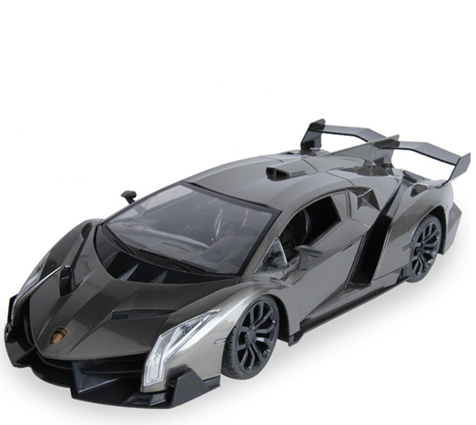
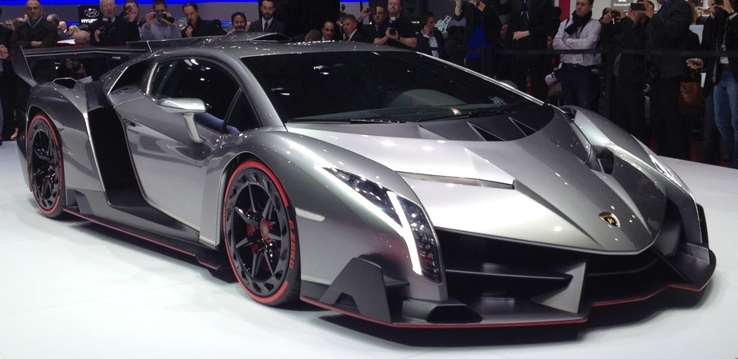
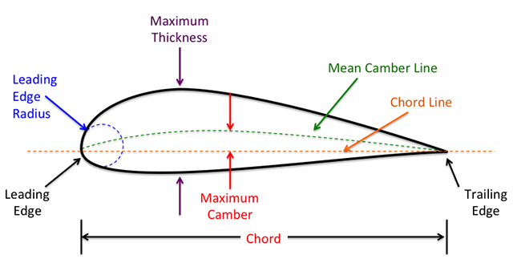
Geometric Similarity
Model
Prototype

Slide 6
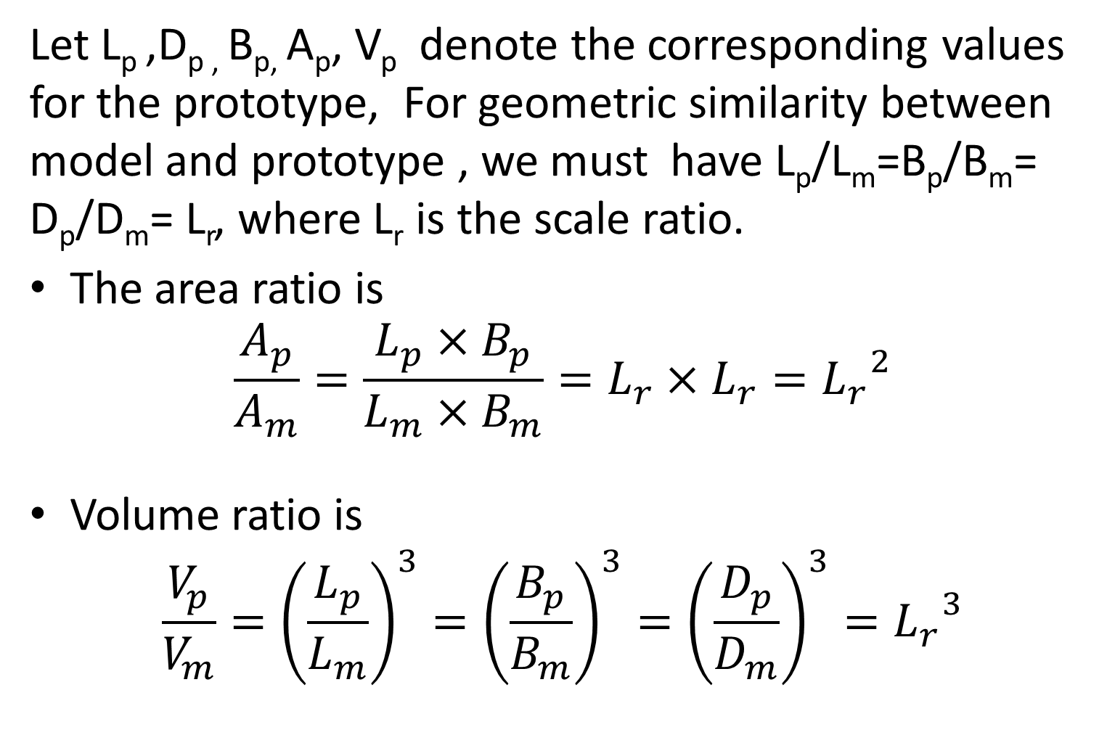
Let L_{p} ,D_{p ,} B_{p,} A_{p}, V_{p} denote the corresponding values for the prototype, For geometric similarity between model and prototype , we must have L_{p}/L_{m}=B_{p}/B_{m}= D_{p}/D_{m}= L_{r}, where L_{r} is the scale ratio.
The area ratio is
$$\frac{A_{p}}{A_{m}}=\frac{L_{p}×B_{p}}{L_{m}×B_{m}}=L_{r}×L_{r}={L_{r}}^{2}$$
Volume ratio is
$$\frac{V_{p}}{V_{m}}={\left(\frac{L_{p}}{L_{m}}\right)}^{3}={\left(\frac{B_{p}}{B_{m}}\right)}^{3}={\left(\frac{D_{p}}{D_{m}}\right)}^{3}={L_{r}}^{3}$$

Slide 7
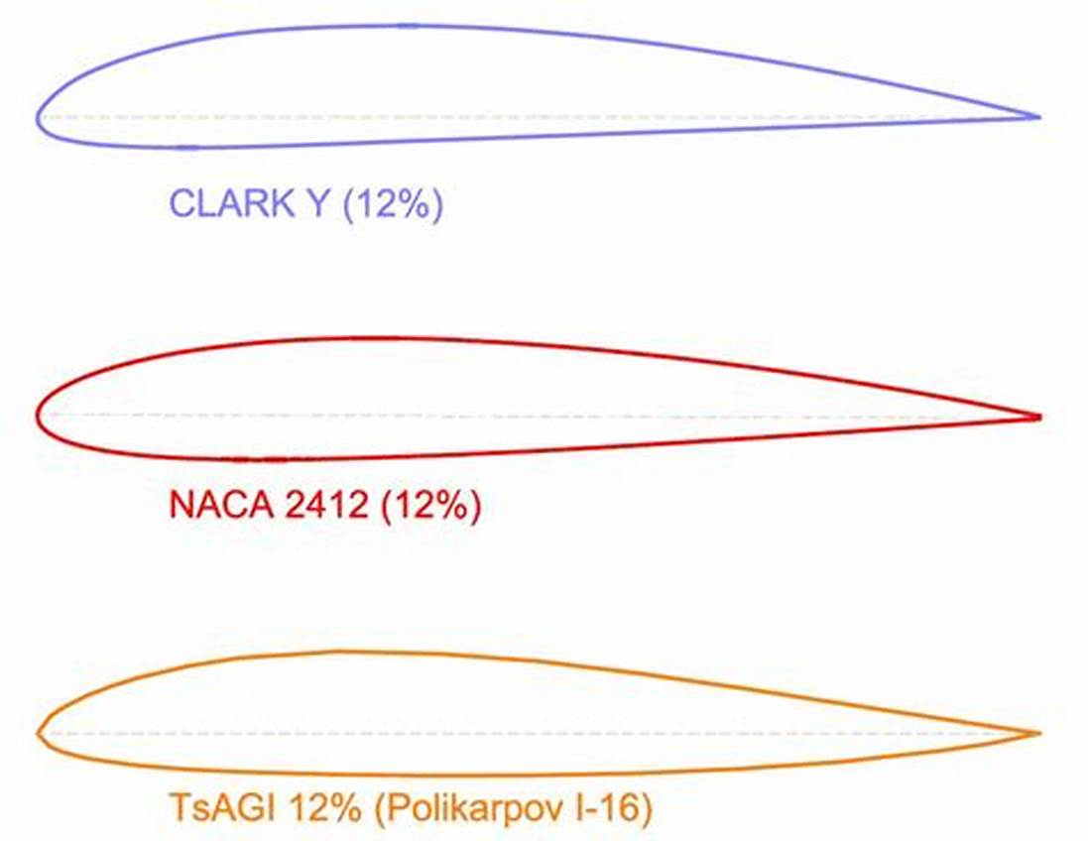
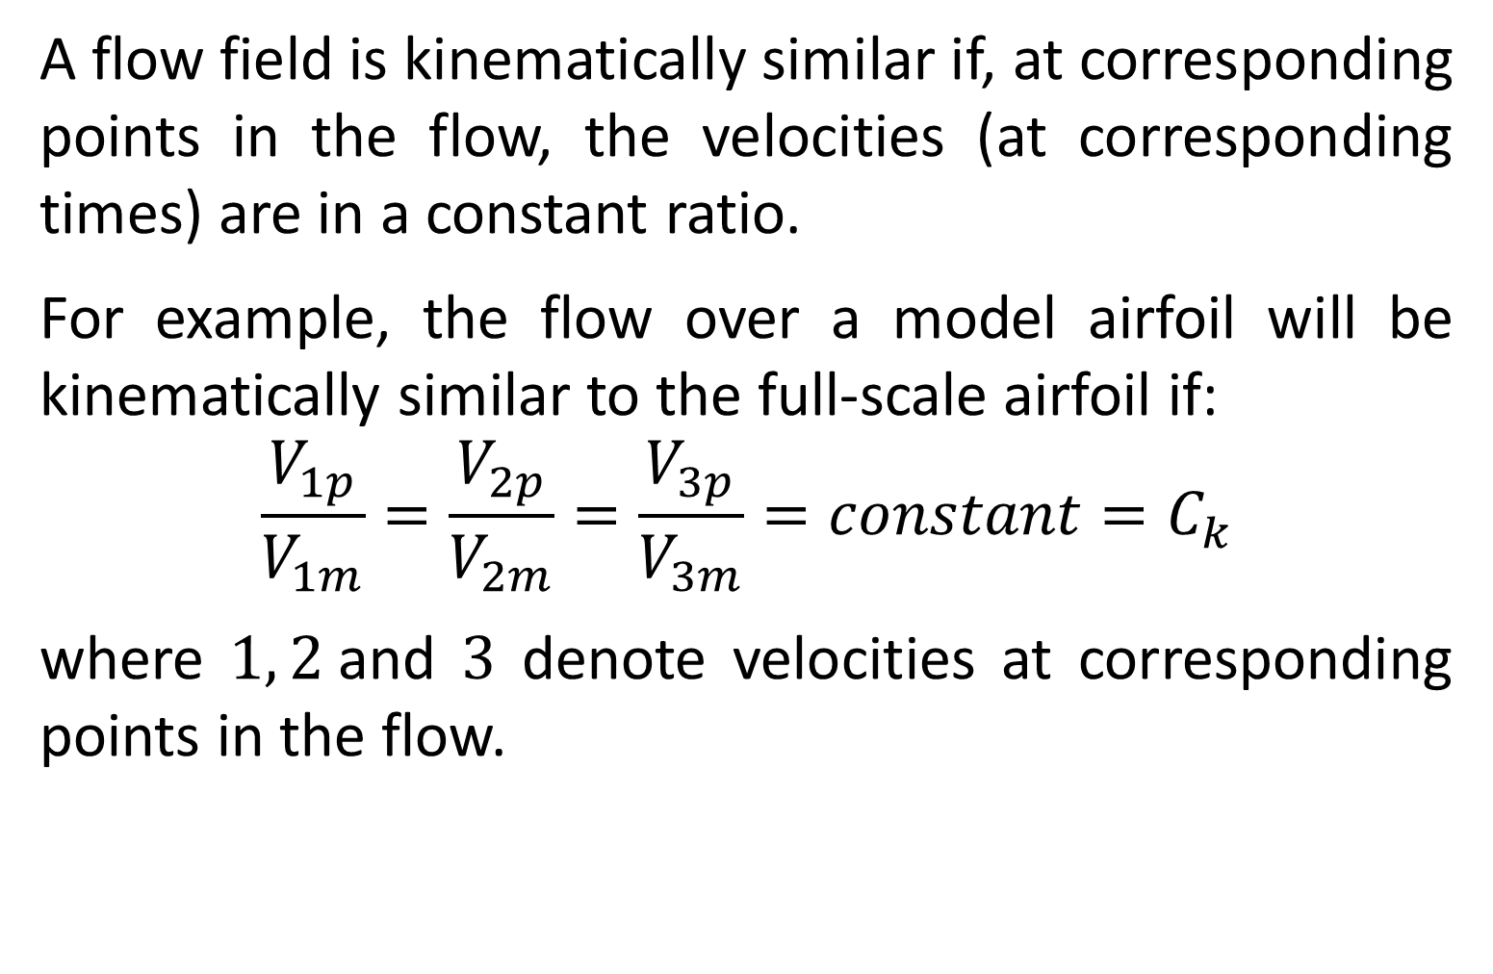
Kinematic Similarity
A flow field is kinematically similar if, at corresponding points in the flow, the velocities (at corresponding times) are in a constant ratio.
For example, the flow over a model airfoil will be kinematically similar to the full-scale airfoil if:
$$\frac{V_{1p}}{V_{1m}}=\frac{V_{2p}}{V_{2m}}=\frac{V_{3p}}{V_{3m}}=constant=C_{k}$$
where $1, 2$and $3$ denote velocities at corresponding points in the flow.
2
2
1
3
1
3
Notes:
Illustrate with pVd

Slide 8
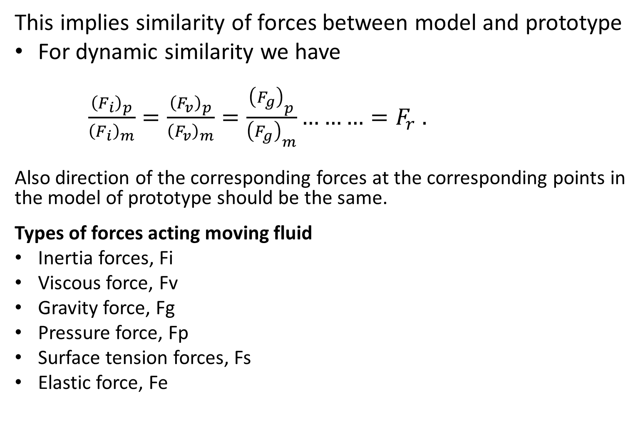
Dynamic Similarity
This implies similarity of forces between model and prototype
For dynamic similarity we have
$\frac{{\left(F_{i}\right)}_{p}}{{\left(F_{i}\right)}_{m}}=\frac{{\left(F_{v}\right)}_{p}}{{\left(F_{v}\right)}_{m}}=\frac{{\left(F_{g}\right)}_{p}}{{\left(F_{g}\right)}_{m}}………=F_{r} .$
Also direction of the corresponding forces at the corresponding points in the model of prototype should be the same.
Types of forces acting moving fluid
Inertia forces, Fi
Viscous force, Fv
Gravity force, Fg
Pressure force, Fp
Surface tension forces, Fs
Elastic force, Fe

Slide 9
Inertia force (F_{i}): The product of mass and acceleration of the flowing fluid and acts in the direction opposite to the direction of acceleration. It always existing in the fluid flow problems.
Viscous force, (F_{v}): The product of shear stress (t) due to viscosity and area.
Gravity force (F_{g}): The product of mass and acceleration due to gravity of the flowing fluid. It is present in case of open surface flow.
Pressure force (F_{p}): The product of pressure and cross-sectional area of the flowing fluid. It is present in pipe flow.
Surface tension force (F_{s}): The product of surface tension and length of surface of the flowing fluid.
Elastic force (F_{e}): The product of elastic stress and area of the flowing fluid.

Slide 10
Significant Dimensionless Numbers in Fluid Mechanics
These are dimensionless numbers obtained by dividing the inertia force by either the (i) viscous force, or (ii) gravity force, or (iii) pressure force, or (iv) surface tension force, or (v) elastic force. As these are ratios they are dimensionless and are also called non-dimensional parameters.
Important dimensionless numbers in fluid mechanics
are
1. Reynolds number, Re
2. Froude number, Fr
3. Weber number, We
4. Mach number, M

Slide 11
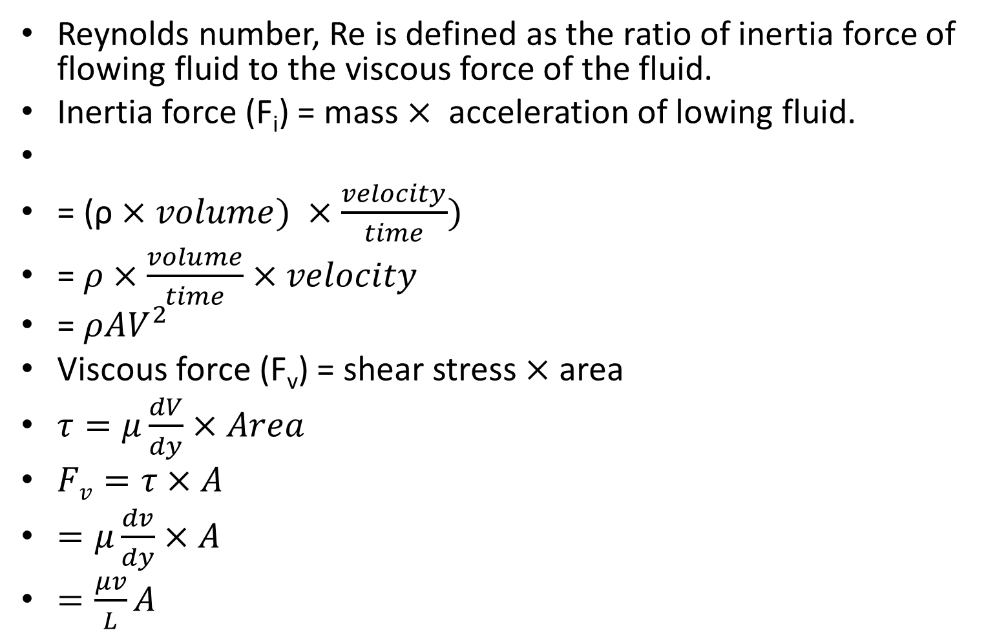
Reynolds Number (Re)
Reynolds number, Re is defined as the ratio of inertia force of flowing fluid to the viscous force of the fluid.
Inertia force (F_{i}) = mass $×$acceleration of lowing fluid.
= (ρ $×volume) ×\frac{velocity}{time})$
= $ρ×\frac{volume}{time}×velocity$
= $ρAV^{2}$
Viscous force (F_{v}) = shear stress $×$ area
$τ=μ\frac{dV}{dy}×Area$
$Fv=τ×A$
$=μ\frac{dv}{dy}×A$
$=\frac{μv}{L}A$

Slide 12
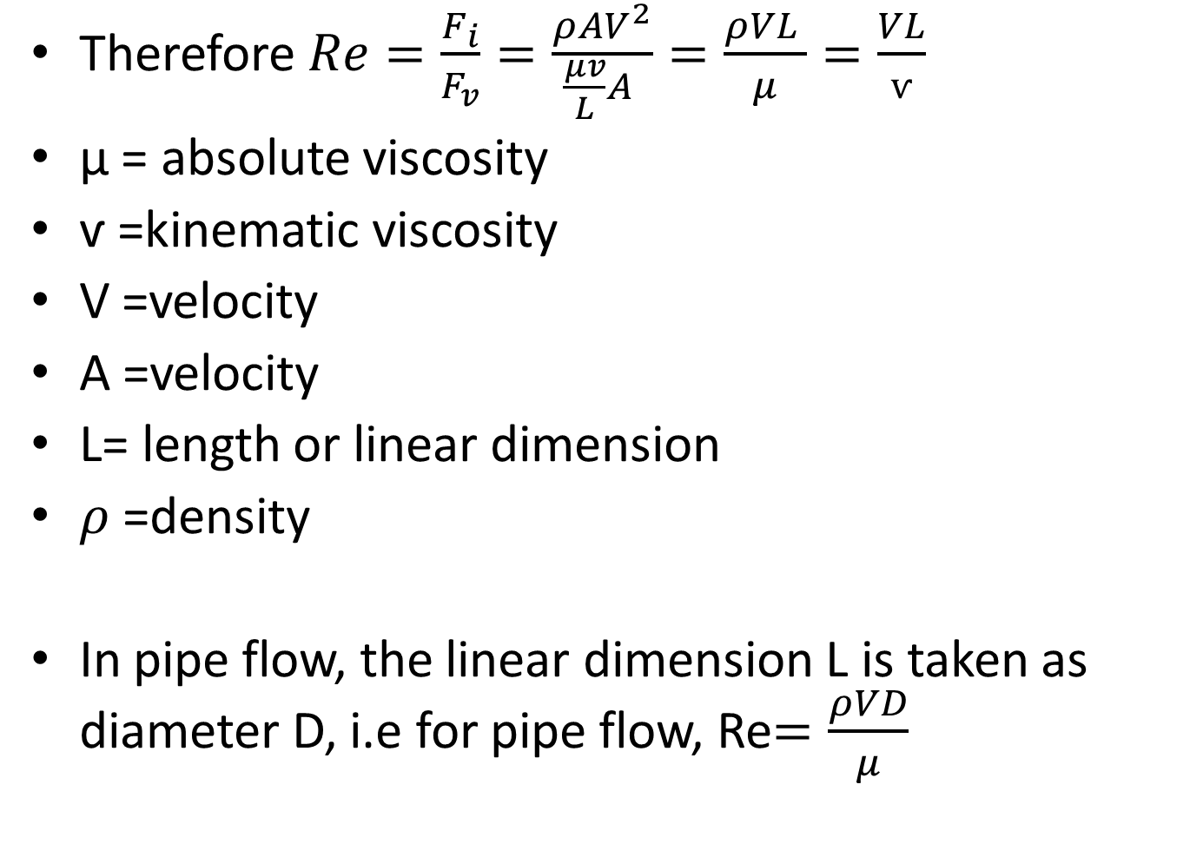
Therefore $Re=\frac{F_{i}}{F_{v}}=\frac{ρAV^{2}}{\frac{μv}{L}A }=\frac{ρVL }{μ}=\frac{VL}{ѵ}$
μ = absolute viscosity
ѵ =kinematic viscosity
V =velocity
A =velocity
L= length or linear dimension
$ρ$ =density
In pipe flow, the linear dimension L is taken as diameter D, i.e for pipe flow, Re$=\frac{ρVD}{μ}$

Slide 13
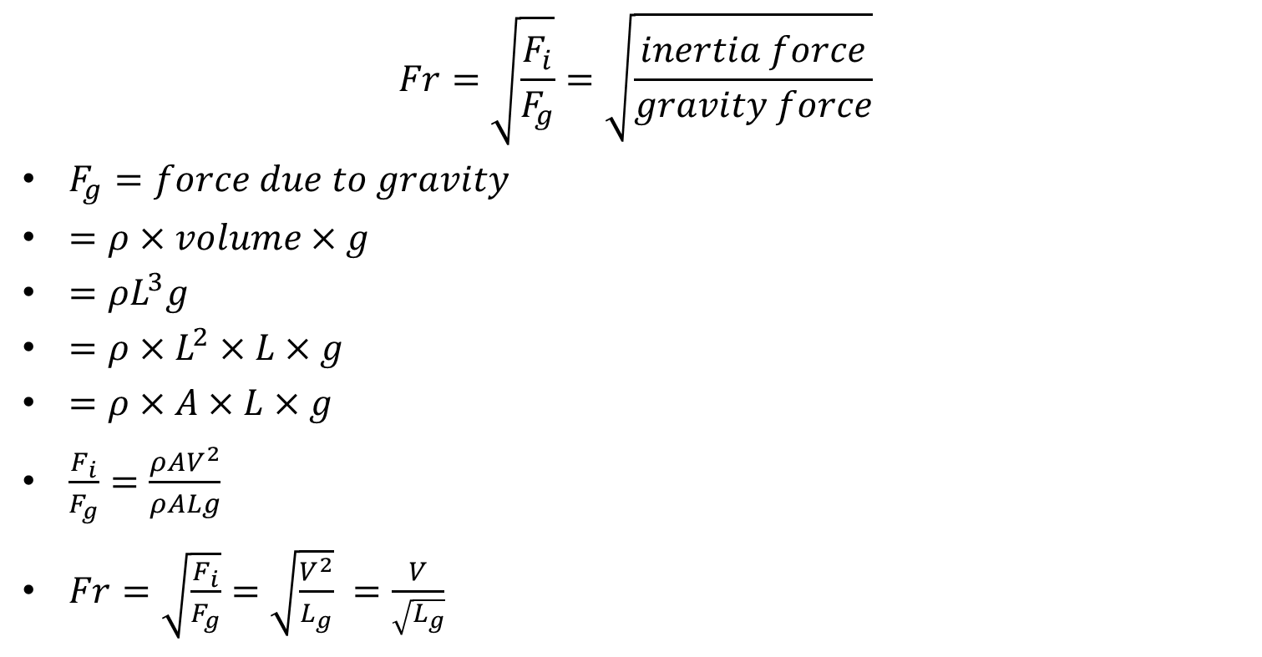
Froude Number (Fr)
$$Fr=\sqrt{\frac{F_{i}}{F_{g}}}=\sqrt{\frac{inertia force}{gravity force}}$$
$F_{g}=force due to gravity$
$=ρ×volume×g$
$=ρL^{3}g$
$=ρ×L^{2}×L×g$
$=ρ×A×L×g$
$\frac{F_{i}}{F_{g}}=\frac{ρAV^{2}}{ρALg}$
$Fr=\sqrt{\frac{F_{i}}{F_{g}}}=\sqrt{\frac{V^{2}}{L_{g}}} =\frac{V}{\sqrt{L_{g}}}$

Slide 14
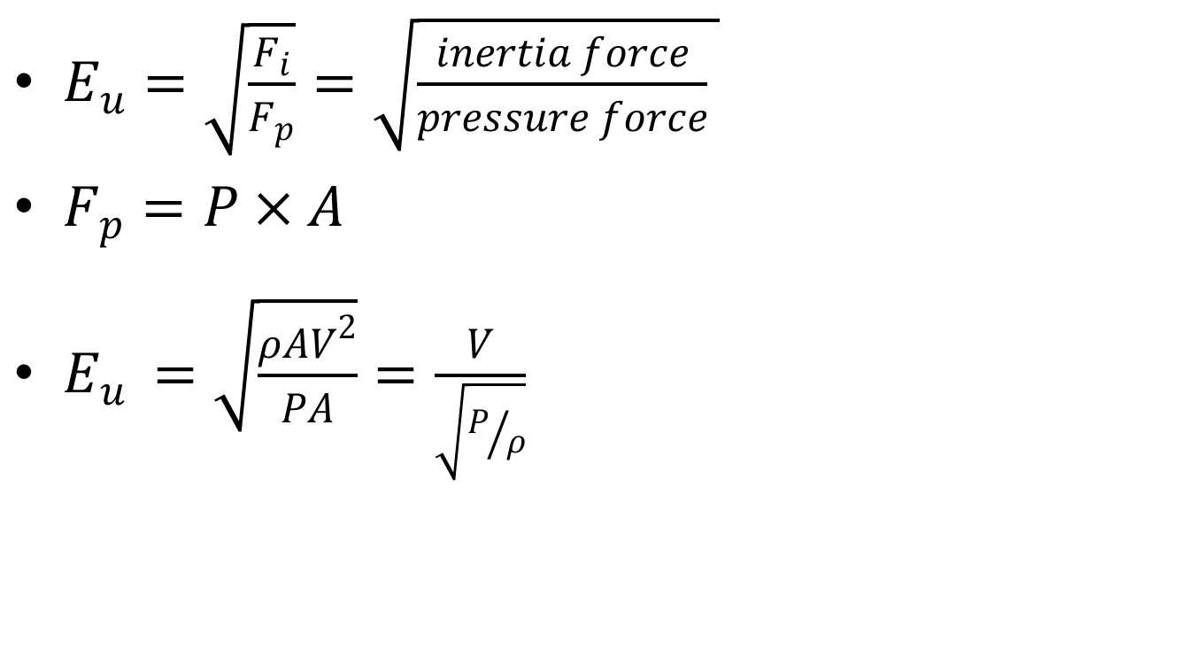
Euler Number (Eu)
$E_{u}=\sqrt{\frac{F_{i}}{F_{p}}}=\sqrt{\frac{inertia force}{pressure force} }$
$F_{p}=P×A$
$E_{u }=\sqrt{\frac{ρAV^{2}}{PA}}=\frac{V}{\sqrt{P/ρ}}$

Slide 15

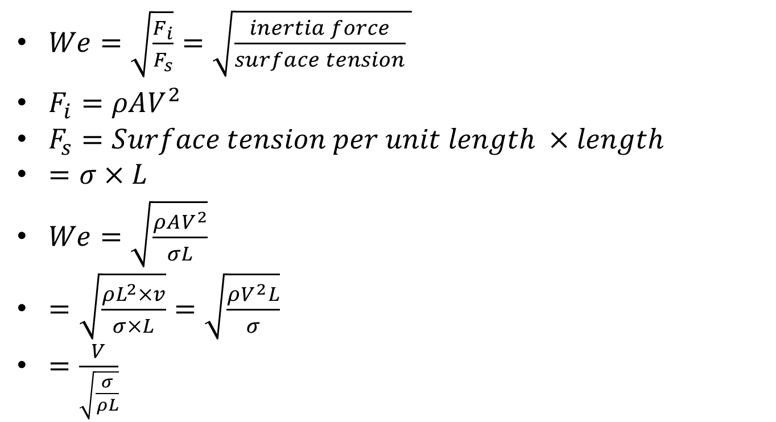
Weber Number (We)
$We=\sqrt{\frac{F_{i}}{F_{s}}}=\sqrt{\frac{inertia force}{surface tension} }$
$F_{i}=ρAV^{2}$
$F_{s}=Surface tension per unit length ×length$
$=σ×L$
$We=\sqrt{\frac{ρAV^{2}}{σL}}$
$=\sqrt{\frac{ρL^{2}×v}{σ×L}}=\sqrt{\frac{ρV^{2}L}{σ}}$
$=\frac{V}{\sqrt{\frac{σ}{ρL}}}$

Slide 16
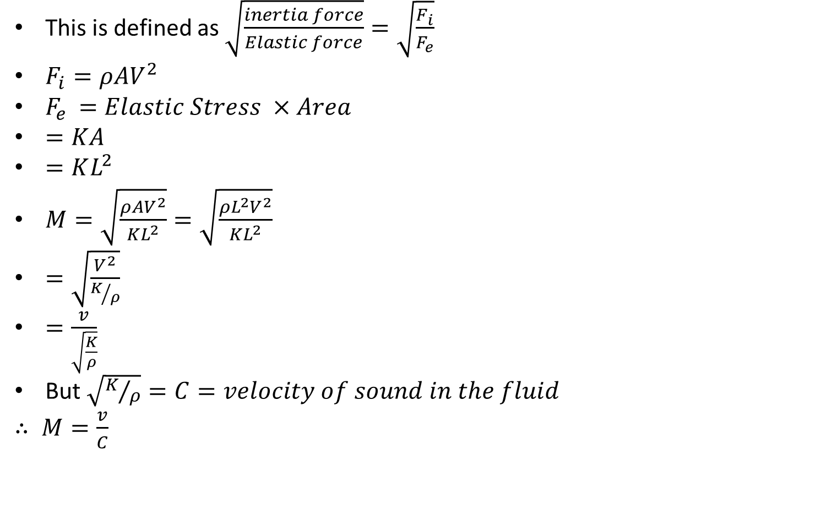
Mach Number (M)
This is defined as $\sqrt{\frac{inertia force}{Elastic force}}=\sqrt{\frac{F_{i}}{F_{e}}}$
$F_{i}=ρAV^{2}$
$F_{e }=Elastic Stress ×Area$
$=KA$
$=KL^{2}$
$M=\sqrt{\frac{ρAV^{2}}{KL^{2}}}=\sqrt{\frac{ρL^{2}V^{2}}{KL^{2}}}$
$=\sqrt{\frac{V^{2}}{K/ρ}}$
$=\frac{v}{\sqrt{\frac{K}{ρ}}}$
But $\sqrt{K/ρ}=C=velocity of sound in the fluid$
$∴ M=\frac{v}{C}$

Slide 17
Model laws or similarity laws
Dynamic similarity between the model and the prototype requires that the ratio of the corresponding force acting at the corresponding points in the model and the prototype should be equal. That is, for dynamic similarity between model and prototype, the dimensionless numbers should be the same for the model and the prototype.
However, it is difficult to satisfy the condition that the dimensionless numbers (Re, Fr, We, Eu, M) be the same for the model and the prototype.
Hence models are designed on the basis of ratio of force which dominates in the phenomenon. The laws on which the models are designed for dynamic similarity are called model laws or laws of similarity

Slide 18
Model laws are:
Reynolds model law
Froude model law
Euler model law
Weber model law
Mach model law

Slide 19
Reynolds model law:
Law in which models are based on Reynolds number similarity. Models based on Reynolds number include:
Pipe flow
Resistance experienced by sub-marines, airplanes or fully immersed bodies.
These are fluid flow problems where viscous forces predominate. Models are designed for dynamic similarity of Reynolds number, which state that the Reynolds number for the model must be equal to the Reynolds number for the prototype.

Slide 20
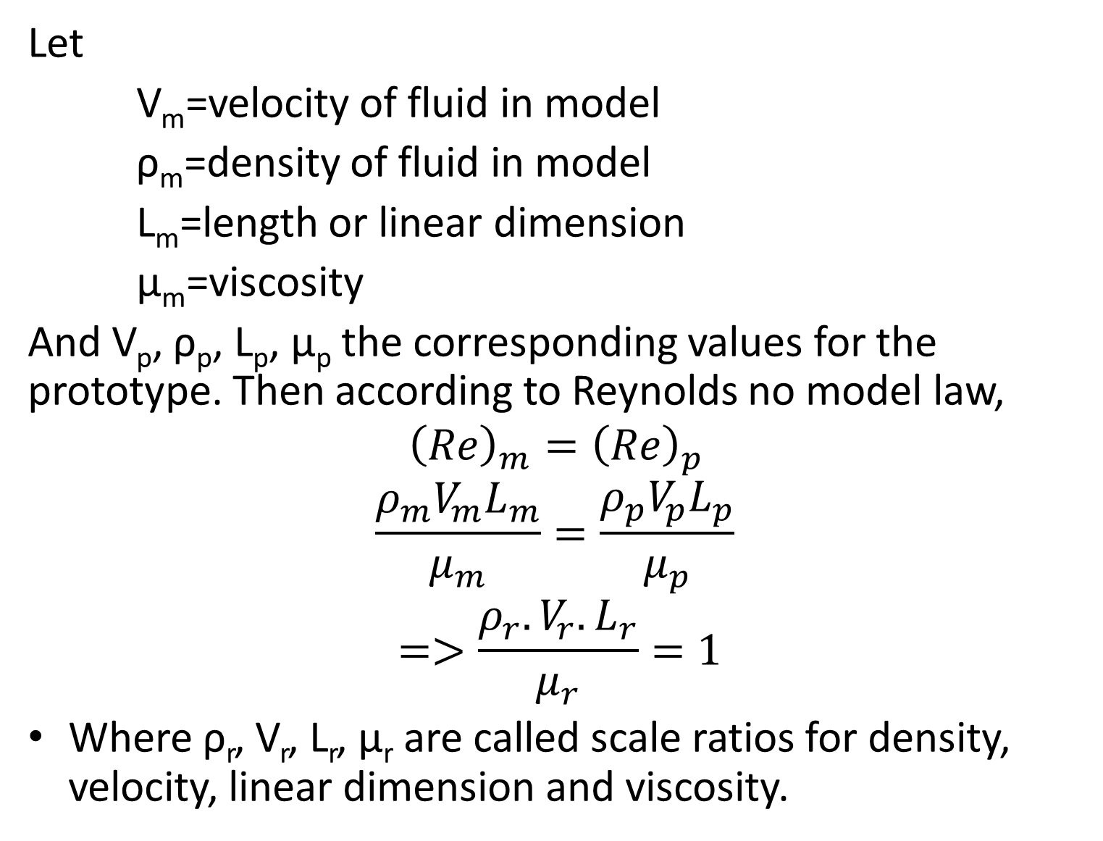
Let
V_{m}=velocity of fluid in model
ρ_{m}=density of fluid in model
L_{m}=length or linear dimension
μ_{m}=viscosity
And V_{p}, ρ_{p}, L_{p}, μ_{p} the corresponding values for the prototype. Then according to Reynolds no model law,
$${\left(Re\right)}_{m}={\left(Re\right)}_{p }$$
$$\frac{ρ_{m}V_{m}L_{m}}{μ_{m}}=\frac{ρ_{p}V_{p}L_{p}}{μ_{p}}$$
$$=>\frac{ρ_{r}.V_{r}.L_{r}}{μ_{r}}=1$$
Where ρ_{r}, V_{r}, L_{r}, μ_{r} are called scale ratios for density, velocity, linear dimension and viscosity.

Slide 21
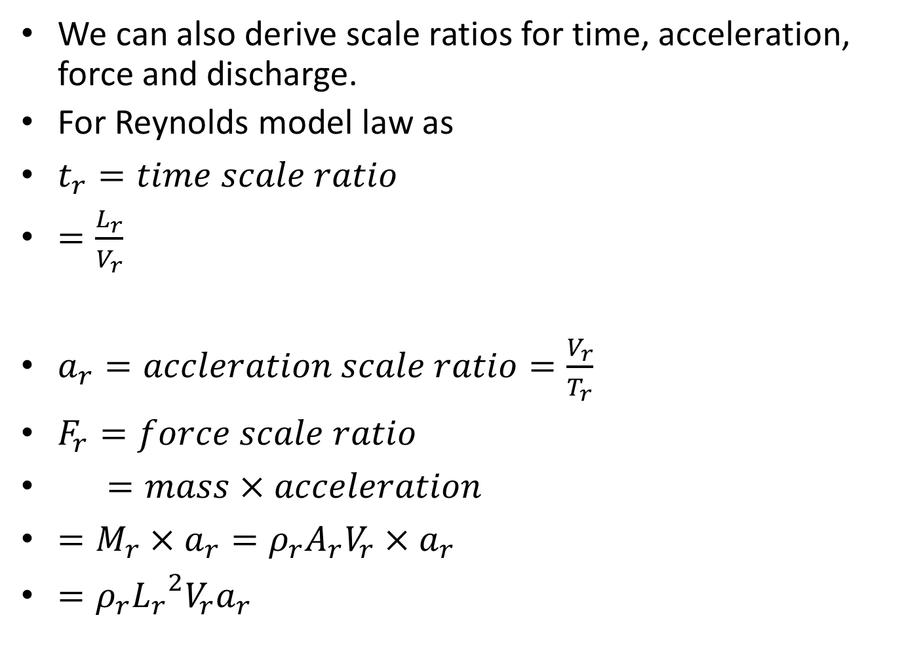
We can also derive scale ratios for time, acceleration, force and discharge.
For Reynolds model law as
$t_{r}=time scale ratio$
$=\frac{L_{r}}{V_{r}}$
$a_{r}=accleration scale ratio=\frac{V_{r}}{T_{r}}$
$F_{r}=force scale ratio$
$=mass×acceleration$
$=M_{r}×a_{r}=ρ_{r}A_{r}V_{r}×a_{r}$
$=ρ_{r}{L_{r}}^{2}V_{r}a_{r}$

Slide 22
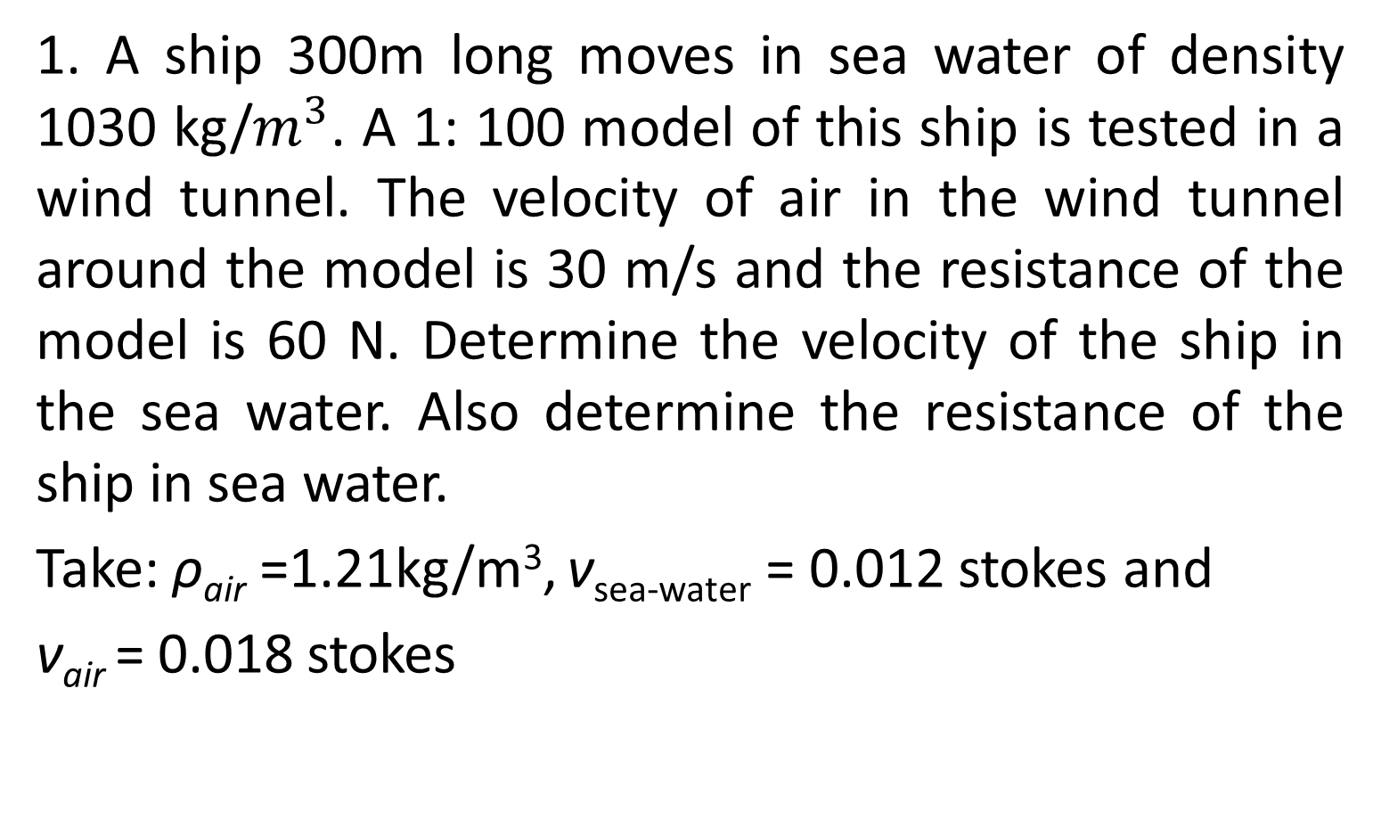
Examples on Re Similarity
1. A ship 300m long moves in sea water of density 1030 kg/$m^{3}$. A 1: 100 model of this ship is tested in a wind tunnel. The velocity of air in the wind tunnel around the model is 30 m/s and the resistance of the model is 60 N. Determine the velocity of the ship in the sea water. Also determine the resistance of the ship in sea water.
Take: ρ_{air} =1.21kg/m³, ν_{sea-water} = 0.012 stokes and
ν_{air} = 0.018 stokes

Slide 23
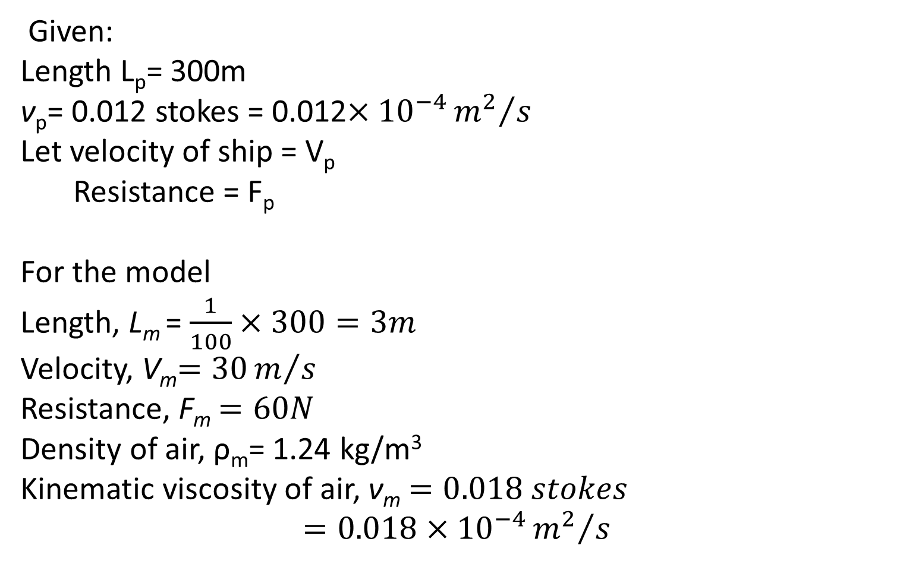
Solution
Given:
Length L_{p}= 300m
ν_{p}= 0.012 stokes = 0.012$×{10}^{−4}{m^{2}}/s$
Let velocity of ship = V_{p}
Resistance = F_{p}
For the model
Length, L_{m} = $\frac{1}{100}×300=3m$
Velocity, V_{m}$=30m/s$
Resistance, F_{m}$=60N$
Density of air, ρ_{m}= 1.24 kg/m³
Kinematic viscosity of air, ν_{m}$=0.018 stokes$
$$=0.018×{10}^{−4}{m^{2}}/s$$

Slide 24
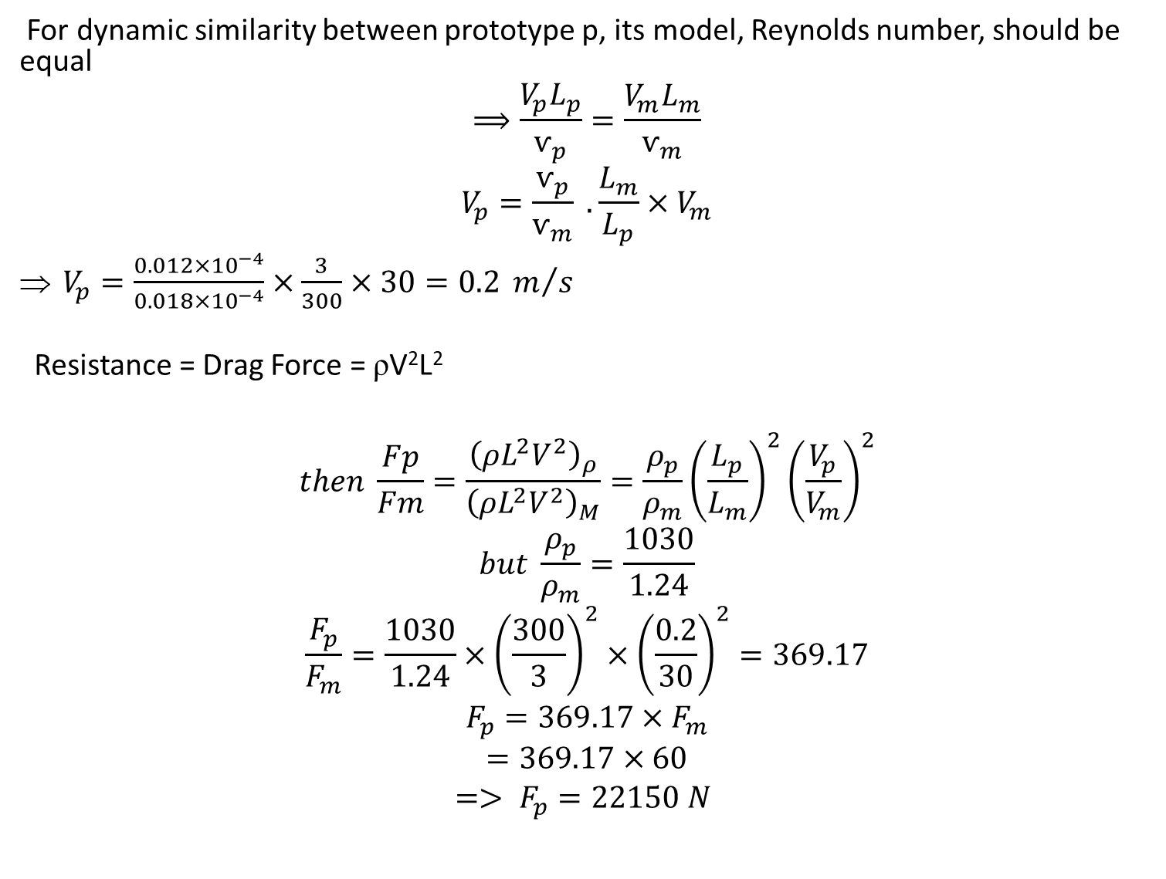
For dynamic similarity between prototype p, its model, Reynolds number, should be equal
$$⟹\frac{V_{p}L_{p}}{ѵ_{p}}=\frac{V_{m}L_{m}}{ѵ_{m}}$$
$$V_{p}=\frac{ѵ_{p}}{ѵ_{m}} . \frac{L_{m}}{L_{p}}×V_{m}$$
$V_{p}=\frac{0.012×{10}^{−4}}{0.018×{10}^{−4}}×\frac{3}{300}×30=0.2 m/s$
Resistance = Drag Force = ρV²L²
$$then \frac{Fp}{Fm}=\frac{{\left(ρL^{2}V^{2}\right)}_{ρ}}{{\left(ρL^{2}V^{2}\right)}_{M}}=\frac{ρ_{p}}{ρ_{m}}{\left(\frac{L_{p}}{L_{m}}\right)}^{2}{\left(\frac{V_{p}}{V_{m}}\right)}^{2}$$
$$but \frac{ρ_{p}}{ρ_{m}}=\frac{1030}{1.24}$$
$$\frac{F_{p}}{F_{m}}=\frac{1030}{1.24}×{\left(\frac{300}{3}\right)}^{2}×{\left(\frac{0.2}{30}\right)}^{2}=369.17$$
$$F_{p}=369.17×F_{m}$$
$$=369.17×60$$
$$=> F_{p}=22150 N$$

Slide 25
Examples on Re Similarity
2. An airship is to operate at 20 m/s in air at standard conditions. A model is constructed to 1:20 scale and tested in a wind tunnel at the same air temperature to determine drag. What criterion should be considered to obtain dynamic similarity? If the model is tested at 75 m/s, what pressure should be used in the wind tunnel? If the model drag force is 250 N, what will be the drag of the prototype?

Slide 26
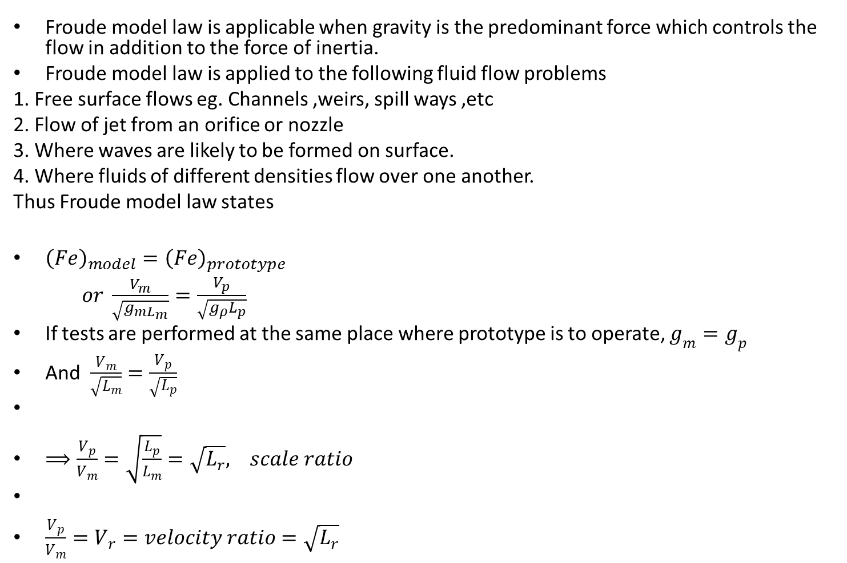
Froude (No.) law
Froude model law is applicable when gravity is the predominant force which controls the flow in addition to the force of inertia.
Froude model law is applied to the following fluid flow problems
1. Free surface flows eg. Channels ,weirs, spill ways ,etc
2. Flow of jet from an orifice or nozzle
3. Where waves are likely to be formed on surface.
4. Where fluids of different densities flow over one another.
Thus Froude model law states
${\left(Fe\right)}_{model}={\left(Fe\right)}_{prototype}$
$or \frac{V_{m}}{\sqrt{g_{mL_{m}}}}=\frac{V_{p}}{\sqrt{g_{ρ}L_{p}}}$
If tests are performed at the same place where prototype is to operate, $g_{m}=g_{p}$
And $\frac{V_{m}}{\sqrt{L_{m}}}=\frac{V_{p}}{\sqrt{L_{p}}}$
$⟹\frac{V_{p}}{V_{m}}=\sqrt{\frac{L_{p}}{L_{m}}}=\sqrt{L_{r}}, scale ratio$
$\frac{V_{p}}{V_{m}}=V_{r}=velocity ratio=\sqrt{L_{r}}$

Slide 27
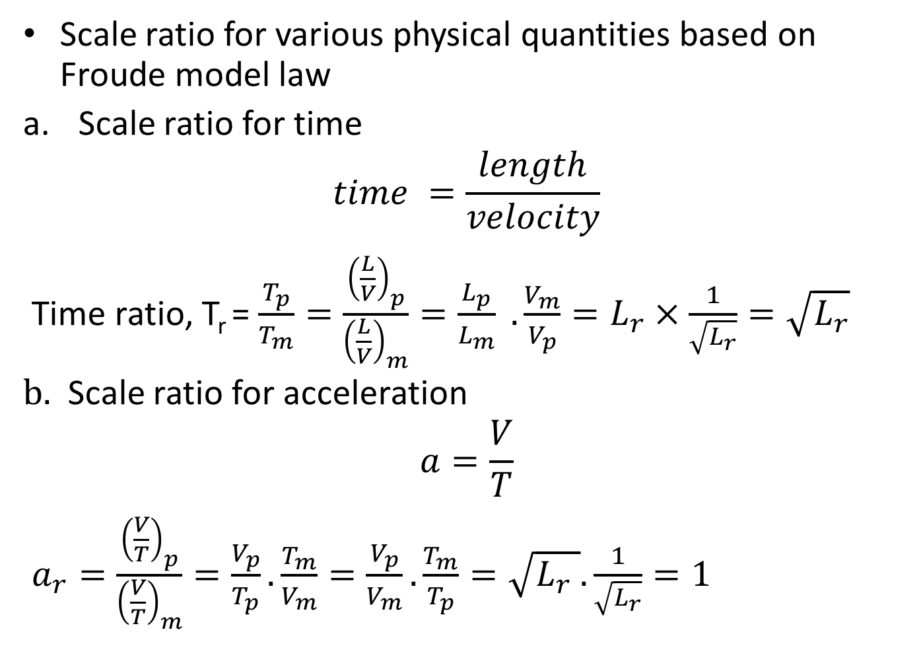
Scale ratio for various physical quantities based on Froude model law
Scale ratio for time
$$time =\frac{length}{velocity}$$
Time ratio, T_{r} = $\frac{T_{p}}{T_{m}}=\frac{{\left(\frac{L}{V}\right)}_{p}}{{\left(\frac{L}{V}\right)}_{m}}=\frac{L_{p}}{L_{m}} . \frac{V_{m}}{V_{p}}=L_{r}×\frac{1}{\sqrt{L_{r}}}=\sqrt{L_{r}}$
$b.$ Scale ratio for acceleration
$$a=\frac{V}{T}$$
$a_{r}=\frac{{\left(\frac{V}{T}\right)}_{p}}{{\left(\frac{V}{T}\right)}_{m}}=\frac{V_{p}}{T_{p}}.\frac{T_{m}}{V_{m}}=\frac{V_{p}}{V_{m}}.\frac{T_{m}}{T_{p}}=\sqrt{L_{r} }.\frac{1}{\sqrt{L_{r}}}=1$

Slide 28
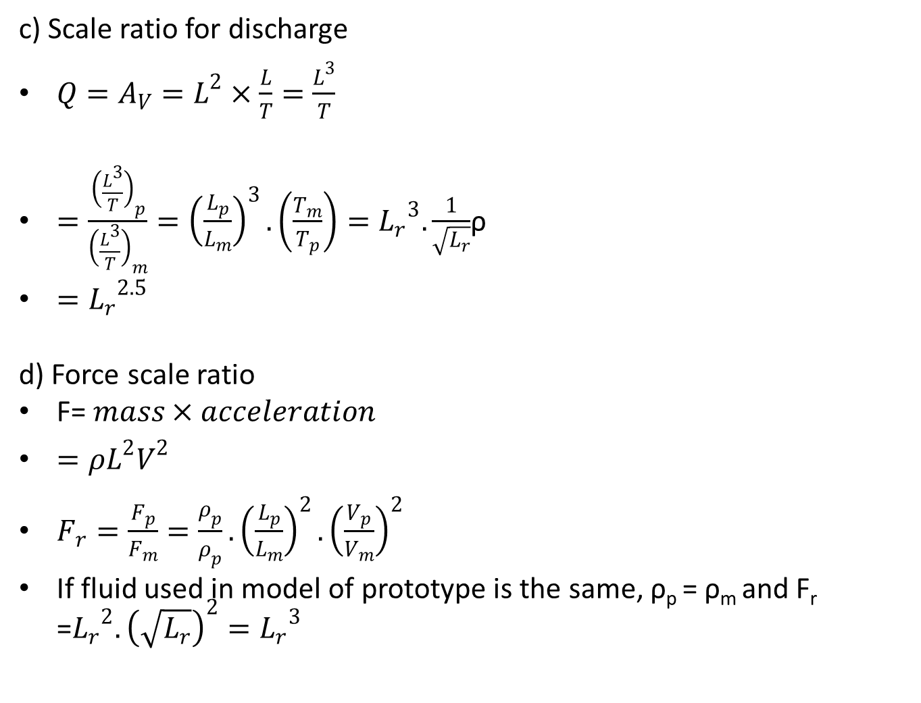
c) Scale ratio for discharge
$Q=A_{V}=L^{2}×\frac{L}{T}=\frac{L^{3}}{T}$
$=\frac{{\left(\frac{L^{3}}{T}\right)}_{p}}{{\left(\frac{L^{3}}{T}\right)}_{m}}={\left(\frac{L_{p}}{L_{m}}\right)}^{3}. \left(\frac{T_{m}}{T_{p}}\right)={L_{r}}^{3}. \frac{1}{\sqrt{L_{r}}}$ρ
$={L_{r}}^{2.5}$
d) Force scale ratio
F= $mass×acceleration$
$=ρL^{2}V^{2}$
$F_{r}=\frac{F_{p}}{F_{m}}=\frac{ρ_{p}}{ρ_{p}}.{\left(\frac{L_{p}}{L_{m}}\right)}^{2}.{\left(\frac{V_{p}}{V_{m}}\right)}^{2}$
If fluid used in model of prototype is the same, ρ_{p} = ρ_{m} and F_{r} =${L_{r}}^{2}. {\left(\sqrt{L_{r}}\right)}^{2}={L_{r}}^{3}$

Slide 29
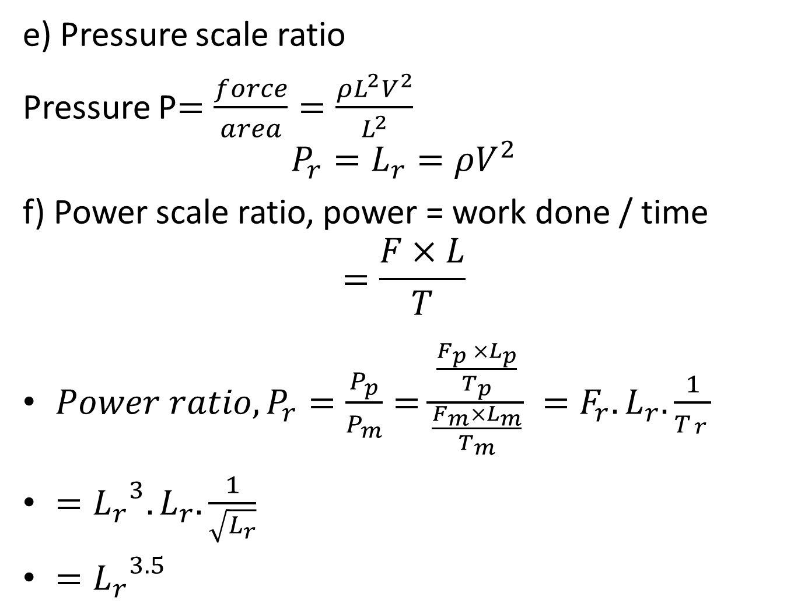
e) Pressure scale ratio
Pressure P$=\frac{force}{area}=\frac{{ρL}^{2}V^{2}}{L^{2}}$
$$P_{r}=L_{r}=ρV^{2}$$
f) Power scale ratio, power = work done / time
$$=\frac{F×L}{T}$$
$Power ratio, P_{r}=\frac{P_{p}}{P_{m}}=\frac{\frac{F_{p }×L_{p}}{T_{p}}}{\frac{F_{m}×L_{m}}{T_{m}}} =F_{r}.L_{r}.\frac{1}{T_{\begin{aligned}r \\ \end{aligned}}}$
$={L_{r}}^{3}. L_{r}.\frac{1}{\sqrt{L_{r}}}$
$={L_{r}}^{3.5}$

Slide 30
Exercise 3
A ship model of scale 1/50 is towed through sea water at a speed of 1m/s. A force of 2N is required to tow the model. Find the speed of ship and the propulsive force on the ship if prototype is subjected to wave resistance only.

Slide 31
Euler’s model law
Euler’s model law applies to fluid flow problems where flow takes place in close pipe with turbulence fully developed. So that viscous forces are negligible and gravity force and surface tension forces are present. Where the phenomenon of cavitation takes places.

Slide 32
Weber model law
Applied where we have
Capillary rise in narrow passages
Capillary movement of water is soil
Capillary waves in channels

Slide 33
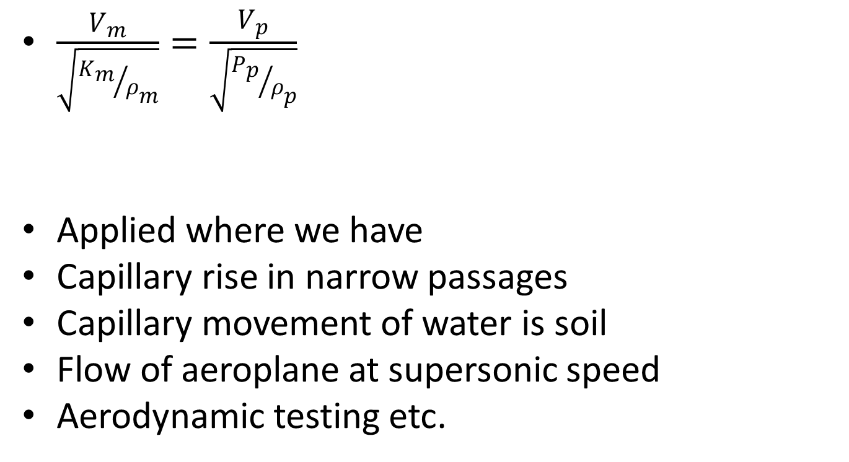
Mach model
$\frac{V_{m}}{\sqrt{{K_{m}}/{ρ_{m}}}}=\frac{V_{p}}{\sqrt{{P_{p}}/{ρ_{p}}}}$
Applied where we have
Capillary rise in narrow passages
Capillary movement of water is soil
Flow of aeroplane at supersonic speed
Aerodynamic testing etc.

