Slide 1
CHAPTER 3: LAMINAR FLOW
Outline:
Entrance Flow and Developed Flow
Laminar Flow in a Pipe
  Determination of the Velocity Distribution
  Other Pipe Flow Quantities
Head Losses in Viscous Flow
  Frictional (Major) Losses
  Additional (Minor) Losses

Slide 2
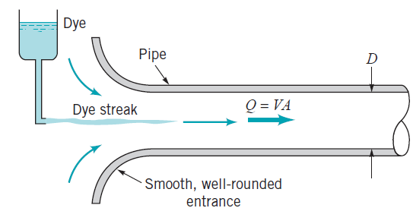
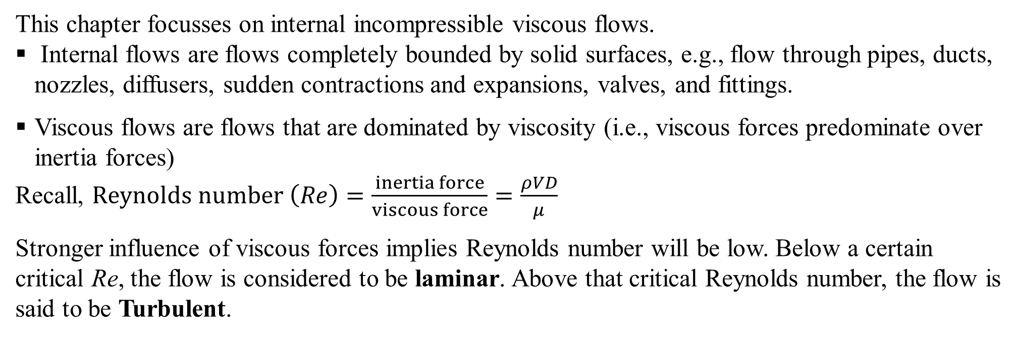
INTRODUCTION
This chapter focusses on internal incompressible viscous flows.
Internal flows are flows completely bounded by solid surfaces, e.g., flow through pipes, ducts, nozzles, diffusers, sudden contractions and expansions, valves, and fittings.
Viscous flows are flows that are dominated by viscosity (i.e., viscous forces predominate over inertia forces)
Recall, $Reynolds number \left(Re\right)=\frac{inertia force}{viscous force}=\frac{ρVD}{μ}$
Stronger influence of viscous forces implies Reynolds number will be low. Below a certain critical Re, the flow is considered to be laminar. Above that critical Reynolds number, the flow is said to be Turbulent.
Thus, Internal flows may be laminar or turbulent. This can be demonstrated using Reynolds viscous flow experiment in a pipe.

Slide 3
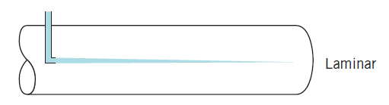
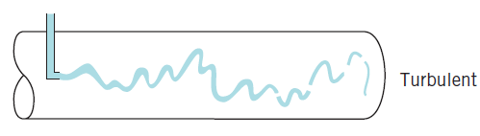
Laminar vs Turbulent Flow
At low flow rates (low Reynolds numbers) the dye injected into the flow remains in a single filament (streakline) along the tube; there is little dispersion of dye because the flow is laminar. A laminar flow is one in which the fluid flows in laminae, or layers; there is no mixing of adjacent fluid layers.
At high flow rates (large Re), the dye filament eventually becomes unstable and breaks up into a random motion throughout the tube; the line of dye is stretched and twisted into a multitude of entangled threads that quickly disperses throughout the entire flow field. This behaviour is characteristic of turbulent flow.

Slide 4
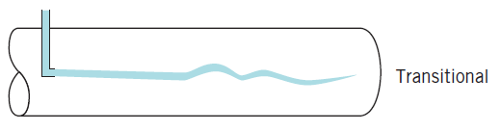
Laminar vs Turbulent Flow
At intermediate flow rates (transition Re), the dye streak fluctuates in time and space, and intermittent bursts of irregular behaviour appear along the streak. Under these circumstances the flow is said to be transitional.
Observations:
In laminar flow, flow velocity at any point is independent of time (i.e., u, v and w are invariant
with time, t). Thus, when an ensemble or collection of instantaneous velocities is averaged over time, the mean velocity will be equal to the instantaneous value.
In turbulent flow, the flow velocity (u, v, and w) at any point is a function of time. This is due
to the occurrence of small, high-frequency fluctuations in the instantaneous flow velocity. Thus, when an ensemble of instantaneous flow velocities is averaged over time, the mean velocity at any point is not equal to the instantaneous value at that point.

Slide 5
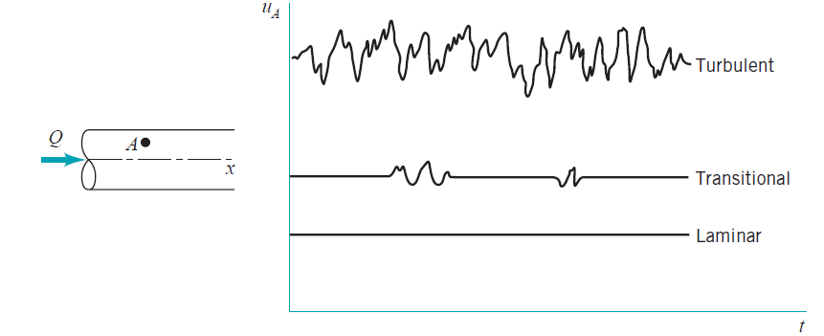
Laminar vs Turbulent Flow
Observations:
Transitional flows are relatively more complex because the flow is intermittently turbulent (i.e.,
the instantaneous flow velocity is sometimes turbulent and laminar at other times)
In laminar flow, the velocity fluctuations are dampened by the viscous forces because Re is low
In turbulent flow, the viscous forces are unable to damp out the random fluctuations in the fluid
motion

Slide 6
Laminar vs Turbulent Flow
Observations:
For pipe flow, transition to turbulence occurs at Reynolds numbers (Re) ≈ 2300 based on the
average velocity and pipe diameter. This is also known as the transition Reynolds number for flow through a pipe
Sample Problems
1. Consider a pipe with a diameter of 5 cm and a fluid with a dynamic viscosity of 0.001 kg/(m.s) flowing through it. The velocity of the fluid is 2 m/s. Calculate the Reynolds number and determine the flow regime.
2. In an engineering application, you observe a fluid exhibits laminar flow characteristics in a pipe of 1 cm diameter. If you wish to maintain laminar flow while doubling the pipe diameter, what adjustments, if any, would you need to make to the velocity of the fluid?
3. An industrial heat exchanger operates with turbulent flow to maximize heat transfer. However, the noise generated from turbulence is causing issues. Propose a potential solution that maintains heat transfer efficiency while reducing noise levels.

Slide 7
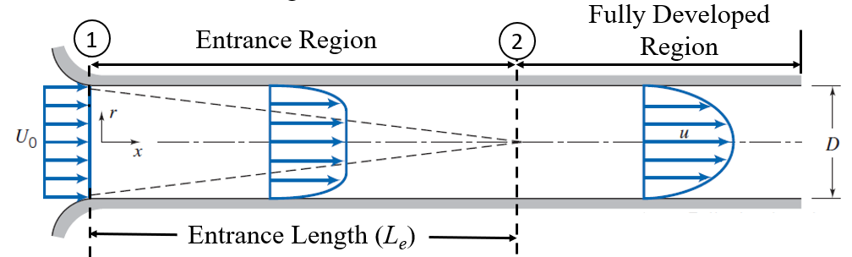
ENTRANCE FLOW AND DEVELOPED FLOW
When considering internal flows we are interested primarily in developed flows. A developed flow results when the velocity profile ceases to change in the flow direction.
Entrance Region
The region starting from the entrance of the pipe, duct, etc., to the location where fully developed flow begins is known as the entrance region.
In the pipe flow above, the flow enters the pipe with a nearly uniform velocity profile at section 1.
Through the pipe, viscous effects cause the fluid to stick to the wall (no-slip boundary condition)
As the flow moves downstream, a boundary layer dominated by viscous effects develops along the pipe
wall. The boundary layer keeps growing until the flow reaches the end of the entrance region (section 2).
Because of the growing boundary layer, the velocity profile changes with distance x along the pipe

Slide 8
ENTRANCE FLOW AND DEVELOPED FLOW
Inviscid Core
At section 2, the boundary layer has grown in thickness to completely fill the pipe
Viscous effects are only important inside the boundary layer
In the inviscid core (i.e., outside the boundary layer), viscous effects are negligible
The distance from the entrance of the pipe to the location of the start of fully developed flow is called the entrance length.

Slide 9
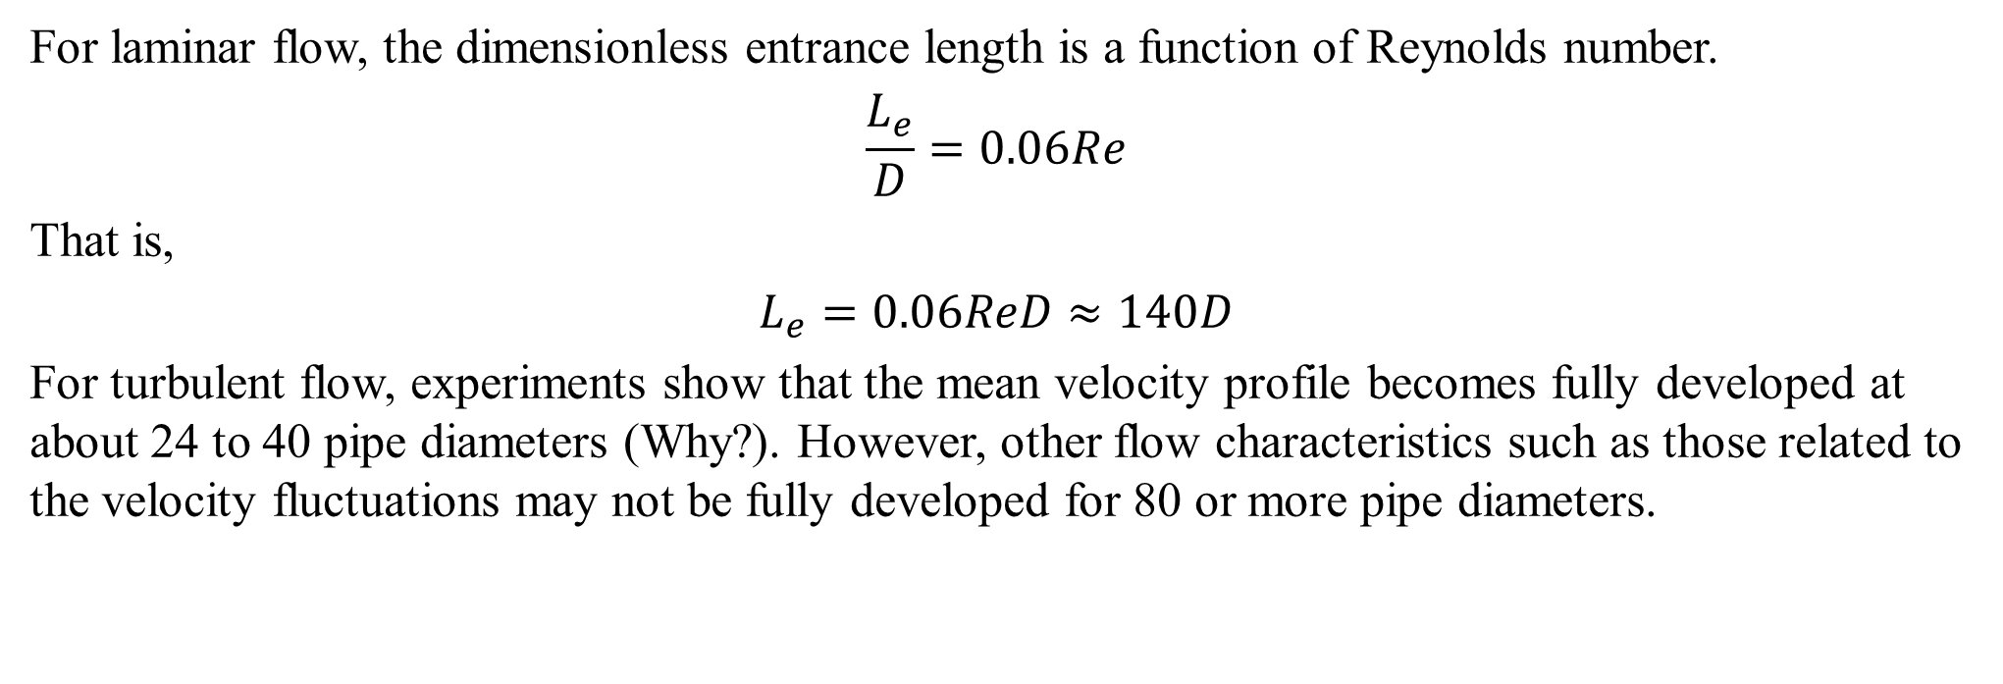
ENTRANCE FLOW AND DEVELOPED FLOW
Inviscid Core
For laminar flow, the dimensionless entrance length is a function of Reynolds number.
$$\frac{L_{e}}{D}=0.06Re$$
That is,
$$L_{e}=0.06ReD≈140D$$
For turbulent flow, experiments show that the mean velocity profile becomes fully developed at about 24 to 40 pipe diameters (Why?). However, other flow characteristics such as those related to the velocity fluctuations may not be fully developed for 80 or more pipe diameters.

Slide 10
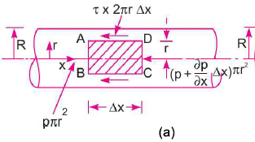
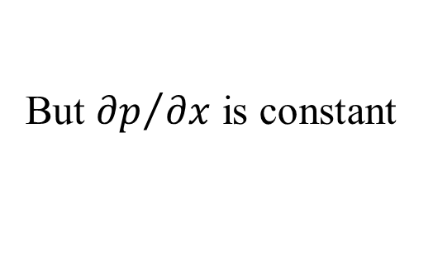
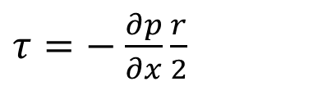
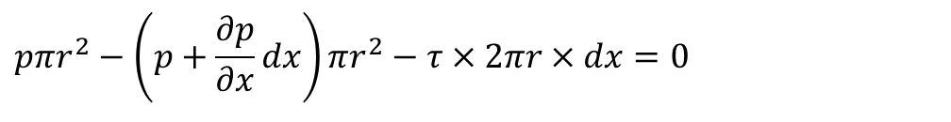
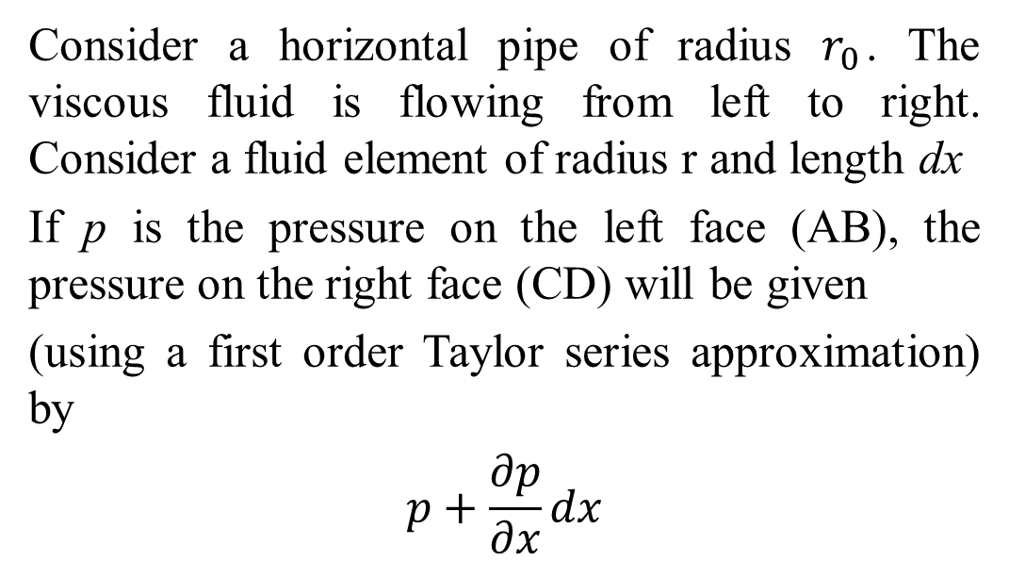
LAMINAR FLOW IN A PIPE
Derivation of the Mean Velocity Profile
Consider a horizontal pipe of radius $r_{0}$. The viscous fluid is flowing from left to right. Consider a fluid element of radius r and length dx
If p is the pressure on the left face (AB), the pressure on the right face (CD) will be given
(using a first order Taylor series approximation) by
$$p+\frac{∂p}{∂x}dx$$
For a non-accelerating fluid element, the resultant force, ∑F must be equal to zero.
$$pπr^{2}−\left(p+\frac{∂p}{∂x}dx\right)πr^{2}−τ×2πr×dx=0$$
$τ=−$ $\frac{∂p}{∂x}\frac{r}{2}$
But ${∂p}/{∂x}$ is constant
which simplifies to

Slide 11
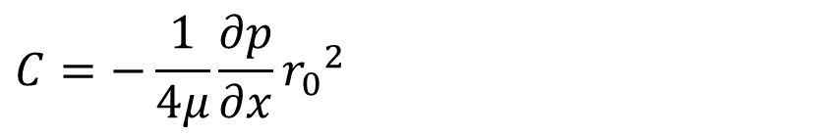
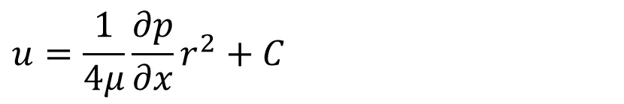
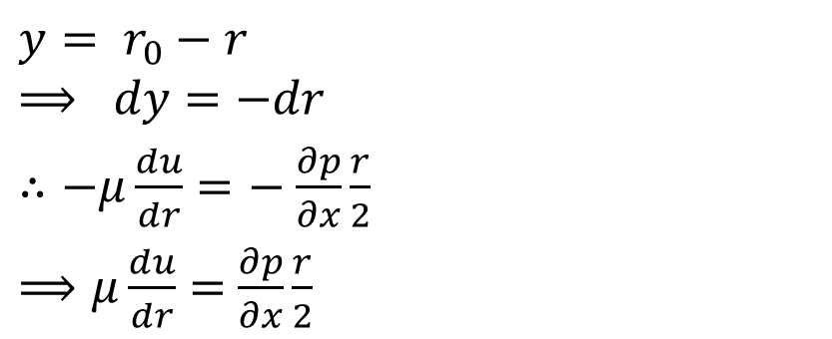
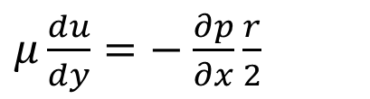
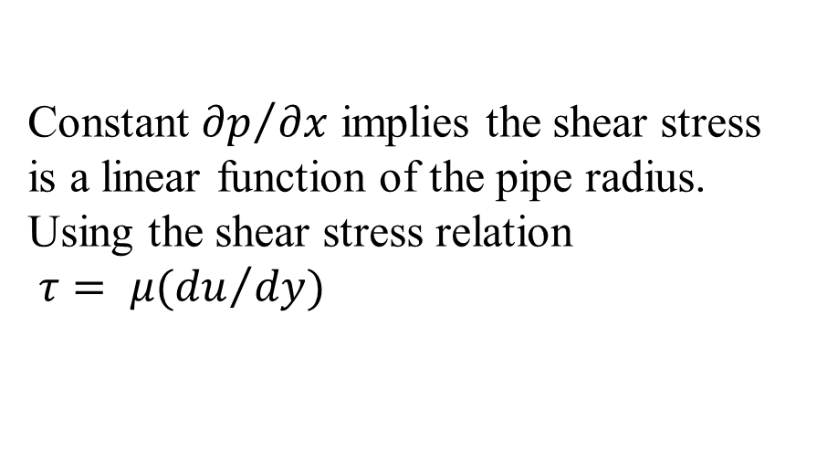
LAMINAR FLOW IN A PIPE
Derivation of the Mean Velocity Profile
The distance y is measured from the pipe wall.
$$y= r_{0}−r$$
$$⟹ dy=−dr$$
$∴−μ\frac{du}{dr}=−$ $\frac{∂p}{∂x}\frac{r}{2}$
$⟹μ\frac{du}{dr}=$ $\frac{∂p}{∂x}\frac{r}{2}$
Constant ${∂p}/{∂x}$ implies the shear stress is a linear function of the pipe radius. Using the shear stress relation
$τ= μ({du}/{dy})$
$$u=\frac{1}{4μ}\frac{∂p}{∂x}r^{2}+C$$
Using the no-slip boundary condition: u = 0, r = r_{o} gives
$μ\frac{du}{dy}=−$ $\frac{∂p}{∂x}\frac{r}{2}$
$$C=−\frac{1}{4μ}\frac{∂p}{∂x}{r_{0}}^{2}$$

Slide 12
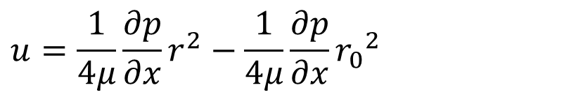
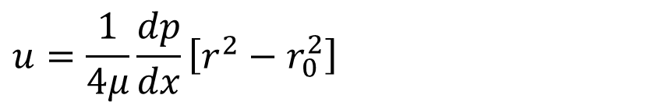
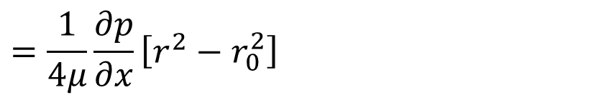
LAMINAR FLOW IN A PIPE
$$u=\frac{1}{4μ}\frac{∂p}{∂x}r^{2}−\frac{1}{4μ}\frac{∂p}{∂x}{r_{0}}^{2}$$
$$=\frac{1}{4μ}\frac{∂p}{∂x}\left[r^{2}−r_{0}^{2}\right]$$
$$u=\frac{1}{4μ}\frac{dp}{dx}\left[r^{2}−r_{0}^{2}\right]$$
Or
The above result gives a parabolic profile, often referred to as Poiseuille flow.

Slide 13
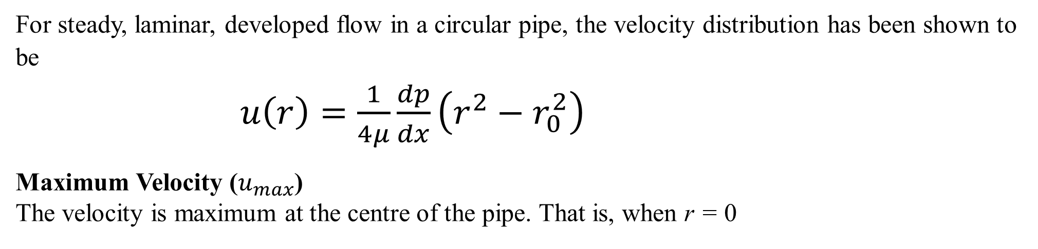
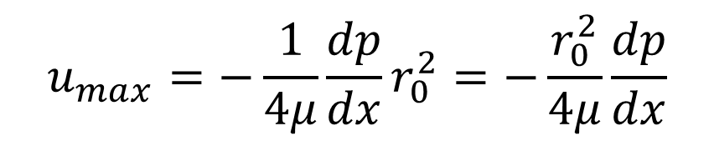
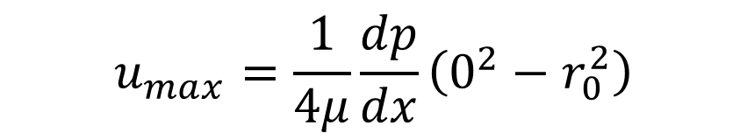
OTHER PIPE FLOW QUANTITIES
For steady, laminar, developed flow in a circular pipe, the velocity distribution has been shown to be
$u\left(r\right)=\frac{1}{4μ}\frac{dp}{dx}\left(r^{2}−r_{0}^{2}\right)$
Maximum Velocity ($u_{max}$)
The velocity is maximum at the centre of the pipe. That is, when r = 0
$$u_{max}=\frac{1}{4μ}\frac{dp}{dx}\left(0^{2}−r_{0}^{2}\right)$$
$$u_{max}=−\frac{1}{4μ}\frac{dp}{dx}r_{0}^{2}=−\frac{r_{0}^{2}}{4μ}\frac{dp}{dx}$$

Slide 14
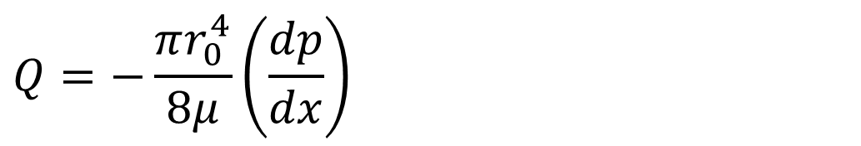
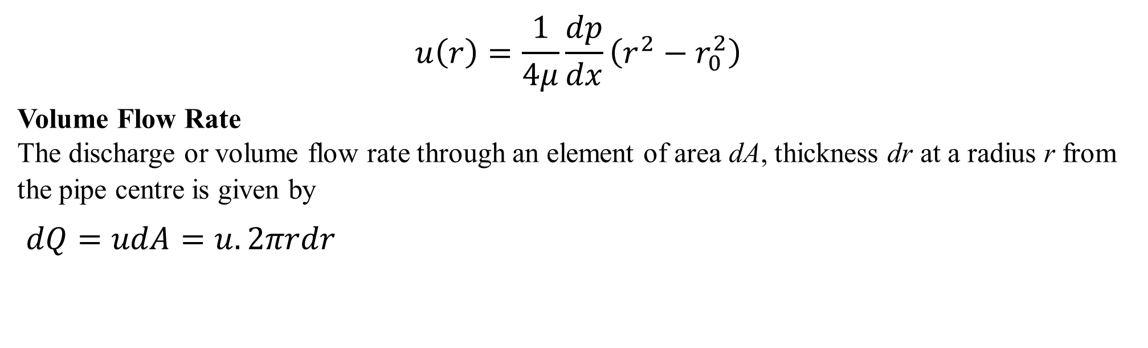
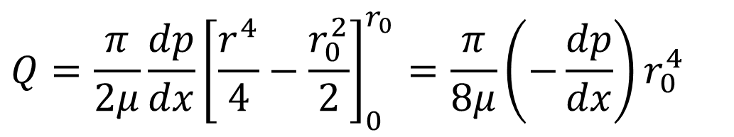
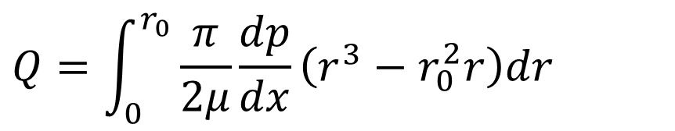
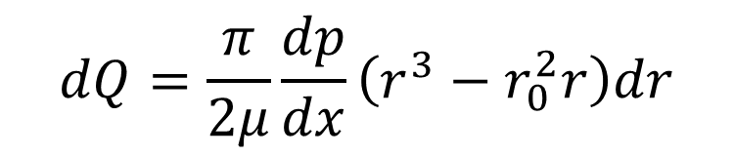
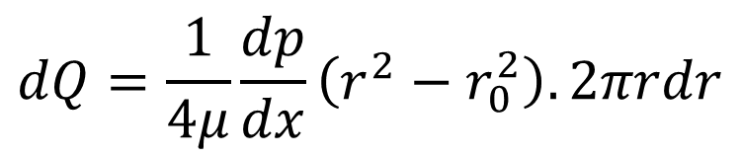
OTHER PIPE FLOW QUANTITIES
$$u\left(r\right)=\frac{1}{4μ}\frac{dp}{dx}\left(r^{2}−r_{0}^{2}\right)$$
Volume Flow Rate
The discharge or volume flow rate through an element of area dA, thickness dr at a radius r from the pipe centre is given by
$dQ=udA=u.2πrdr$
$$Q=\int_{0}^{r_{0}}{\frac{π}{2μ}\frac{dp}{dx}\left(r^{3}−r_{0}^{2}r\right)dr}$$
$$Q=\frac{π}{2μ}\frac{dp}{dx}{\left[\frac{r^{4}}{4}−\frac{r_{0}^{2}}{2}\right]}_{0}^{r_{0}}=\frac{π}{8μ}\left(−\frac{dp}{dx}\right)r_{0}^{4}$$
$$dQ=\frac{1}{4μ}\frac{dp}{dx}\left(r^{2}−r_{0}^{2}\right).2πrdr$$
$$dQ=\frac{π}{2μ}\frac{dp}{dx}\left(r^{3}−r_{0}^{2}r\right)dr$$
$$Q=−\frac{πr_{0}^{4}}{8μ}\left(\frac{dp}{dx}\right)$$

Slide 15
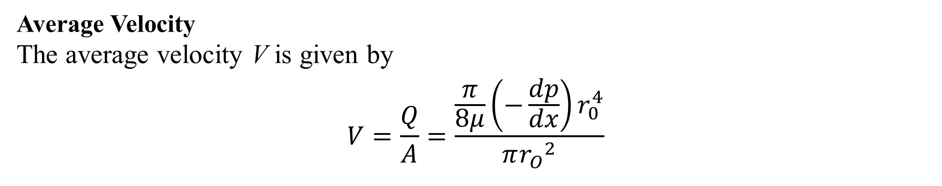
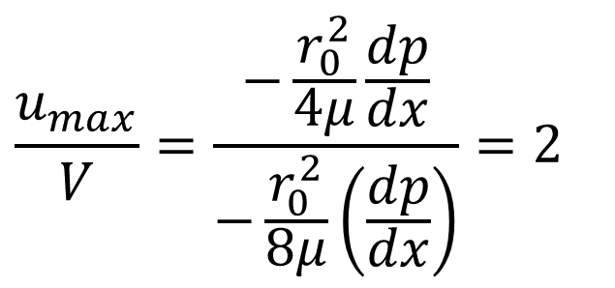
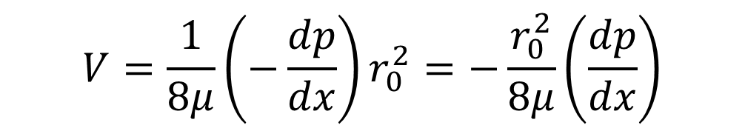
OTHER PIPE FLOW QUANTITIES
Average Velocity
The average velocity V is given by
$$V=\frac{Q}{A}=\frac{\frac{π}{8μ}\left(−\frac{dp}{dx}\right)r_{0}^{4}}{π{r_{O}}^{2}}$$
$$V=\frac{1}{8μ}\left(−\frac{dp}{dx}\right)r_{0}^{2}=−\frac{r_{0}^{2}}{8μ}\left(\frac{dp}{dx}\right)$$
Ratio of Maximum to Average Velocity (${u_{max}}/V$)
$$\frac{u_{max}}{V}=\frac{−\frac{r_{0}^{2}}{4μ}\frac{dp}{dx}}{−\frac{r_{0}^{2}}{8μ}\left(\frac{dp}{dx}\right)}=2$$

Slide 16
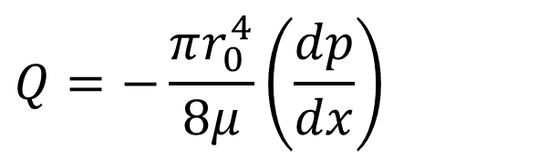
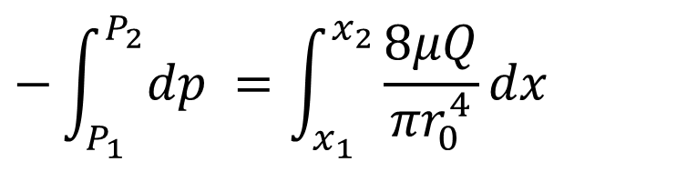
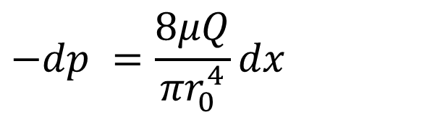
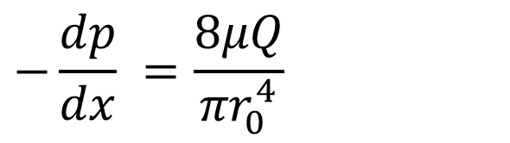
OTHER PIPE FLOW QUANTITIES
Pressure Drop for a Given Length of Pipe
1
2
y
x
x₁
L
x₂
(i) As a Function of Discharge (Q)
$$−dp =\frac{8μQ}{{πr}_{0}^{4}}dx$$
$$Q=−\frac{πr_{0}^{4}}{8μ}\left(\frac{dp}{dx}\right)$$
$$−\int_{P_{1}}^{P_{2}}{dp} =\int_{x_{1}}^{x_{2}}{\frac{8μQ}{{πr}_{0}^{4}}}dx$$
$$−\frac{dp}{dx} =\frac{8μQ}{{πr}_{0}^{4}}$$

Slide 17
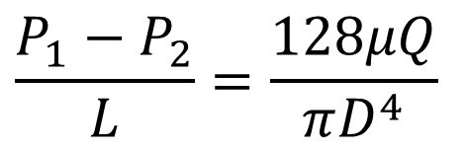
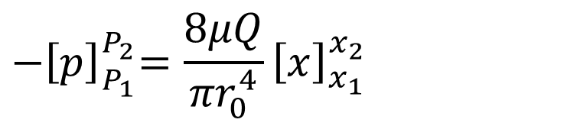
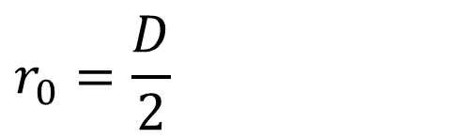
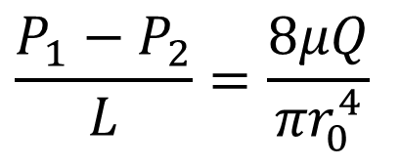
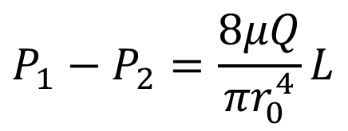
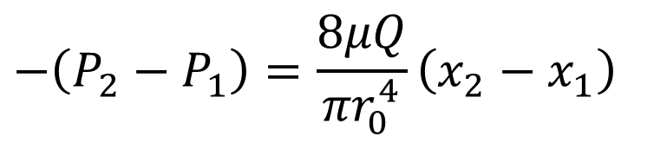
OTHER PIPE FLOW QUANTITIES
Pressure Drop for a Given Length of Pipe
1
2
y
x
x₁
L
x₂
(i) As a Function of Discharge (Q)
$$r_{0}=\frac{D}{2}$$
$$P_{1}−P_{2}=\frac{8μQ}{{πr}_{0}^{4}}L$$
$${−\left[p\right]}_{P_{1}}^{P_{2}}=\frac{8μQ}{{πr}_{0}^{4}}{\left[x\right]}_{x_{1}}^{x_{2}}$$
$$\frac{P_{1}−P_{2}}{L}=\frac{128μQ}{πD^{4}}$$
$$−\left(P_{2}−P_{1}\right)=\frac{8μQ}{{πr}_{0}^{4}}\left(x_{2}−x_{1}\right)$$
$$\frac{P_{1}−P_{2}}{L}=\frac{8μQ}{{πr}_{0}^{4}}$$

Slide 18
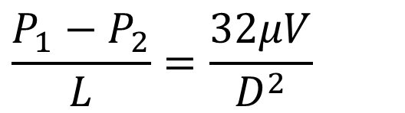
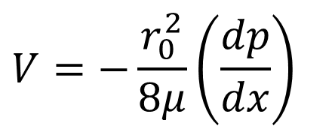
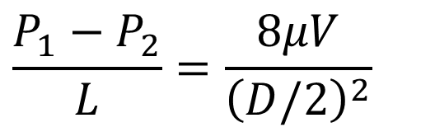
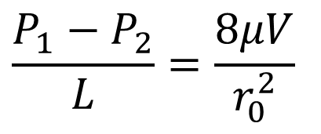
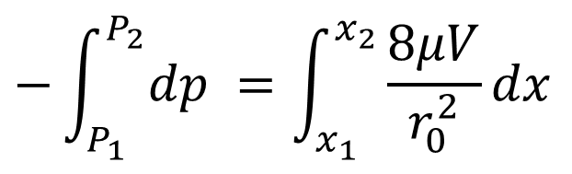
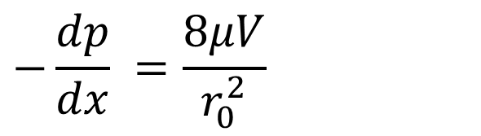
OTHER PIPE FLOW QUANTITIES
Pressure Drop for a Given Length of Pipe
1
2
y
x
x₁
L
x₂
(ii) As a Function of Average Velocity (V)
$$V=−\frac{r_{0}^{2}}{8μ}\left(\frac{dp}{dx}\right)$$
$$\frac{P_{1}−P_{2}}{L}=\frac{8μV}{{\left(D/2\right)}^{2}}$$
$$−\int_{P_{1}}^{P_{2}}{dp} =\int_{x_{1}}^{x_{2}}{\frac{8μV}{r_{0}^{2}}}dx$$
$$−\frac{dp}{dx} =\frac{8μV}{r_{0}^{2}}$$
$$\frac{P_{1}−P_{2}}{L}=\frac{32μV}{D^{2}}$$
$$\frac{P_{1}−P_{2}}{L}=\frac{8μV}{r_{0}^{2}}$$

Slide 19
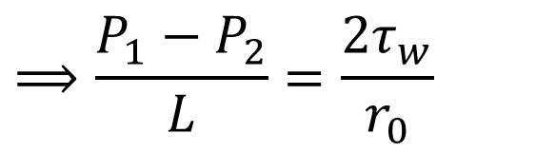






OTHER PIPE FLOW QUANTITIES
Pressure Drop for a Given Length of Pipe
1
2
y
x
x₁
L
x₂
(iii) As a Function of the Wall Shear Stress ($τ_{w}$)
$$τ=−\frac{dp}{dx}\frac{r}{2}$$
$$⟹\frac{ΔP}{L}=\frac{{2τ}_{w}}{r_{0}}$$
Recall
$$−\frac{dp}{dx}=\frac{{2τ}_{w}}{r_{0}}$$
At $r=r_{0}\text{, }τ=τ_{w}$
$$⟹\frac{P_{1}−P_{2}}{L}=\frac{{2τ}_{w}}{r_{0}}$$
$$⟹ΔP=\frac{{2τ}_{w}L}{r_{0}}$$
$$⟹ τ_{w}=−\frac{dp}{dx}\frac{r_{0}}{2}$$

Slide 20




OTHER PIPE FLOW QUANTITIES
Pressure Drop for a Given Length of Pipe
(iv) As a Function of the friction factor ($f$)
For any generic fully developed internal flow (laminar, turbulent, circular or non-circular pipe), the pressure drop is expressed as
$$ΔP=f\frac{L}{D}\frac{ρV^{2}}{2}$$
where $ρV^{2}/2$ is the dynamic pressure and f is the Darcy-Weisbach friction factor, given by
$$f=\frac{8τ_{w}}{ρV^{2}}$$
This is different from the friction coefficient or Fanning friction factor C_{f} given by
$$C_{f}=\frac{2τ_{w}}{ρV^{2}}$$
which is more widely used in characterizing turbulent flows.

Slide 21

OTHER PIPE FLOW QUANTITIES
Friction Factor
For laminar flow in a pipe, the friction factor is also given by
$$f=\frac{64}{Re}$$
where $Re=ρVD/μ$ is the Reynolds number based on the pipe diameter and average velocity.

Slide 22








SOLVED EXAMPLES
Example 1: Oil, of relative density 0.83 and dynamic viscosity 0.08 kg/(m.s), passes through a circular pipe of 12 mm diameter with a mean velocity of 2.3 m/s. Determine:
(a) the Reynolds number;
(b) the maximum velocity;
(c) the volumetric flow rate;
(d) the pressure drop per unit length.
$$Re=286$$
This value of Re is well within the range of laminar flows, so the relations for laminar flow may be used
Solution
$$ρ=0.83 ×1000{kg}/{m^{3}}=830{kg}/{m^{3}}$$
(b)
$$\frac{u_{max}}{V}=2$$
$${⟹u}_{max}=2V=2×2.3=4.6 m/s$$
$$μ=0.08{kg}/{(m.s)}$$
$$D=12 mm=0.012 m$$
(c)
$$\frac{Q}{A}=V$$
$$⟹Q=AV=\frac{πD^{2}}{4}V$$
$$V=2.3m/s$$
(a)
$$Re=\frac{ρVD}{μ}=\frac{830×2.3×0.012}{0.08}$$
$=286$
$$Q=\frac{π×{0.012}^{2}×2.3}{4}=2.6×{10}^{−4} m3/s$$

Slide 23

SOLVED EXAMPLES
Example 1: Oil, of relative density 0.83 and dynamic viscosity 0.08 kg/(m.s), passes through a circular pipe of 12 mm diameter with a mean velocity of 2.3 m/s. Determine:
(a) the Reynolds number;
(b) the maximum velocity;
(c) the volumetric flow rate;
(d) the pressure drop per unit length.
Solution
$$ρ=0.83 ×1000{kg}/{m^{3}}=830{kg}/{m^{3}}$$
$$μ=0.08{kg}/{(m.s)}$$
$$D=12 mm=0.012 m$$
$$V=2.3m/s$$
(d)
$$\frac{∆P}{L}=\frac{128μQ}{πD^{4}}=\frac{128×0.08×2.6×{10}^{−4}}{π×{0.012}^{4}}$$
$$=4.1kPa/m$$

Slide 24













SOLVED EXAMPLES
Example 2: An oil of viscosity 0.1 Ns/m² and density 900 kg/m³ is flowing through a circular pipe of diameter 50 mm. The flow rate through the pipe is 3.5 litre/s. Find the pressure drop across a length of 300 m of the pipe and the shear stress at the pipe wall. Assume the flow is laminar.
Solution
$$ρ=900{kg}/{m^{3}};$$
$μ=0.08{kg}/{(m.s)}$;
$$D=50 mm=0.05 m;$$
$$L=300 m$$
$$Q=3.5{litres}/{s=3.5×{10}^{−3} m3/s}$$
$$ΔP=\frac{{2τ}_{0}L}{r_{0}}$$
$$\frac{∆P}{L}=\frac{128μQ}{πD^{4}}$$
$${⟹ τ}_{w}=\frac{r_{0}ΔP}{2L}$$
$$∆P=\frac{128μQL}{πD^{4}}=\frac{128×0.1×3.5×{10}^{−3}}{π×{0.05}^{4}}×300$$
$${ τ}_{w}=\frac{0.025×684.5×{10}^{3}}{2×300}$$
$$∆P=684.5 kPa$$
$$\text{The} \text{wall} \text{shear} \text{stress} τ_{0} \text{is} \text{given} \text{by}$$
$$=28.52 Pa$$

Slide 25

SOLVED EXAMPLES
Example 3: Derive an expression for the velocity distribution between horizontal, concentric pipes for steady, incompressible developed flow.

Slide 26

SOLUTION
$p2πdr−\left(p+dp\right)2πrdr+τ2πrdx−\left(τ+dτ\right)2π\left(r+dr\right)dx=0$
Simplifying, there results
$\frac{dp}{dx}=−\frac{τ}{r}−\frac{dτ}{dr}$
Substituting $r=−{μdu}/{dr}$ we have
$$\frac{dp}{dx}=μ(\frac{1}{r}\frac{du}{dr}+\frac{d^{2}u}{dr^{2}})$$
$$=\frac{u}{r}\frac{d}{dr}(r\frac{du}{dr})$$
This is integrated to yield
$r\frac{du}{dr}=\frac{1}{2μ}\frac{dp}{dx}r^{2}+A$
Integration again gives
$u\left(r\right)=\frac{1}{4μ}\frac{dp}{dx}r^{2}+Alnr+B$
Where A and B are arbitrary constants.
They are found by setting $u=0$ at $r=r_{1}$ and at $r=r_{2}$;

Slide 27

That is, $0=\frac{1}{4μ}\frac{dp}{dx}{r_{1}}^{2}+Alnr_{1}+B$
$0=\frac{1}{4μ}\frac{dp}{dx}{r_{2}}^{2}+Alnr_{2}+B$
The solution is
$A=\frac{1}{4μ}\frac{dp}{dx}\frac{{r_{1}}^{2}−{r_{2}}^{2}}{ln⁡({r_{2}}/{r_{1})}}$
$$B=−Alnr_{2}−\frac{{r_{2}}^{2}}{4μ}\frac{dp}{dx}$$
thus
$$u\left(r\right)=\frac{1}{4μ}\frac{dp}{dx}[r^{2}−{r_{2}}^{2}+\frac{{r_{2}}^{2}−{r_{1}}^{2}}{ln⁡({r_{2}}/{r_{1})}}ln⁡(r/{r_{2})}]$$
This is integrated to give the flow rate
$$Q=\int_{r_{1}}^{r_{2}}{u\left(r\right)2πrdr}$$
$$=\frac{π}{8μ}\frac{dp}{dx}[{r_{2}}^{4}−{r_{1}}^{4}+\frac{{({r_{2}}^{2}−{r_{1}}^{2})}^{2}}{ln⁡({r_{2}}/{r_{1})}}$$

Slide 28

Energy Considerations in Pipe Flow
In ME 252, it was seen that for inviscid flow between any two sections or stations, the total energy per unit weight is given by the Bernoulli theorem as
$$\left(\frac{p_{1}}{ρg}+\frac{V_{1}^{2}}{2g}+z_{1}\right)=\left(\frac{p_{2}}{ρg}+\frac{V_{2}^{2}}{2g}+z_{2}\right)$$
which is based on the assumption of frictionless flow and uniform velocity profile at all sections.
That is, the expression
$$\left(\frac{p}{ρg}+\frac{V^{2}}{2g}+z\right)$$
which is a measure of the total mechanical energy per unit weight (or total head) in the flow is constant.
For flows affected by viscosity (e.g., flow in pipes), the total head (total mechanical energy per unit mass ) can not be assumed to be constant! Why?

Slide 29

Energy Considerations in Pipe Flow
For viscous flow, the total head or total mechanical energy per unit mass will continuously decrease in the flow direction as friction “eats” the mechanical energy.
This calls for modification of the Bernoulli equation to account for energy loss due to
fluid friction
To derive the modified Bernoullin equation, we use the control volume formulation of the first law of thermodynamics, setting N = E and η = e in the RTT.
$${\dot{Q}−\dot{W}=\left.\frac{dE}{dt}\right)}_{system}=\frac{∂}{∂t}\int_{CV}{eρdV}+\int_{CS}{eρ\vec{V}∙d\vec{A}}$$
By substituting e = u + v²/2 + gz and $\dot{W}={\dot{W}}_{shaft}+$ ${\dot{W}}_{normal}+{\dot{W}}_{shear}+{\dot{W}}_{other}$, and simplifying, the integral form of the energy conservation equation becomes
$$\dot{Q}−{\dot{W}}_{s}−{\dot{W}}_{shear}−{\dot{W}}_{other}=\frac{∂}{∂t}\int_{CV}{eρdV}+\int_{CS}{[\left(u+Pv\right)+\frac{V^{2}}{2}+gz]ρ\vec{V}∙d\vec{A}}$$

Slide 30


Energy Considerations in Pipe Flow
Consider a steady flow through a pipe shown below:
The basic energy equation is given as
$$\dot{Q}−{\dot{W}}_{s}−{\dot{W}}_{shear}−{\dot{W}}_{other}=\frac{∂}{∂t}\int_{CV}{eρdV}+\int_{CS}{[\left(u+Pv\right)+\frac{V^{2}}{2}+gz]ρ\vec{V}∙d\vec{A}}$$

Slide 31

Energy Considerations in Pipe Flow
$$\dot{Q}−{\dot{W}}_{s}−{\dot{W}}_{shear}−{\dot{W}}_{other}=\frac{∂}{∂t}\int_{CV}{eρdV}+\int_{CS}{[\left(u−Pv\right)+\frac{V^{2}}{2}+gz]ρ\vec{V}∙d\vec{A}}$$
Assumptions
${\dot{ W}}_{s}=0, {\dot{W}}_{other}=0$
  ${\dot{W}}_{shear}=0$ (because the velocity at the wall is zero)
  Steady flow
  Incompressible flow
  Internal energy and pressure uniform across sections (1) and (2)
These assumptions reduce the basic equation to:
$$\dot{Q}=\dot{m}\left(u_{2}−u_{1}\right)+\dot{m}\left(\frac{p_{2}}{ρ}−\frac{p_{1}}{ρ}\right)+\dot{m}g\left(z_{2}−z_{1}\right)+\dot{m}\left(\frac{α_{2}{\overline{V}}_{2}^{2}}{2}−\frac{α_{1}{\overline{V}}_{1}^{2}}{2}\right)$$
Note that $α$ is called the kinetic energy coefficient

Slide 32

Energy Considerations in Pipe Flow
Dividing through by the mass flow rate and rearranging, we have
$$\frac{δQ}{dm}=u_{2}−u_{1}+\frac{p_{2}}{ρ}−\frac{p_{1}}{ρ}+gz_{2}−gz_{1}+\frac{α_{2}{\overline{V}}_{2}^{2}}{2}−\frac{α_{1}{\overline{V}}_{1}^{2}}{2}$$
$$⟹ \left(\frac{p_{1}}{ρ}+\frac{α_{1}{\overline{V}}_{1}^{2}}{2}+gz_{1}\right)−\left(\frac{p_{2}}{ρ}+\frac{α_{2}{\overline{V}}_{2}^{2}}{2}+gz_{2}\right)=\left(u_{2}−u_{1}\right)−\frac{δQ}{dm}$$
Writing [$\left(u_{2}−u_{1}\right)−\frac{δQ}{dm}$] as the total energy loss per unit mass, $h_{lT}$, we have
$$\left(\frac{p_{1}}{ρ}+\frac{α_{1}{\overline{V}}_{1}^{2}}{2}+gz_{1}\right)−\left(\frac{p_{2}}{ρ}+\frac{α_{2}{\overline{V}}_{2}^{2}}{2}+gz_{2}\right)=h_{lT}$$
Dividing through by g, gives the equivalent total energy loss per unit weight as

Slide 33

Energy Considerations in Pipe Flow
$$\left(\frac{p_{1}}{ρg}+\frac{α_{1}{\overline{V}}_{1}^{2}}{2g}+z_{1}\right)−\left(\frac{p_{2}}{ρg}+\frac{α_{2}{\overline{V}}_{2}^{2}}{2g}+z_{2}\right)=\frac{h_{lT}}{g}=H_{lT}$$
where $h_{lT}$ (or $H_{lT}$) is the total head loss between sections (1) and (2).
Units: $h_{lT}$ ($m^{2}s^{−2}$) and $H_{lT}$ (m)

Slide 34


Kinetic Energy Coefficient (α)
Kinetic energy coefficient is a correction factor that allows the use of average velocity,
$\overline{V}$ in the energy equation to compute the kinetic energy at a cross section.
Laminar flow: $α=2$
Turbulent flow: $1.03 ≤α≤1.08 (use α=1)$

Slide 35

HEAD LOSSES IN PIPE FLOW
It is often necessary to determine the head loss, h_{L} in a pipe flow.
Consider a typical piping system shown below.
Identify the sources of head loss
Head losses: friction in pipes, ${90}^{°}$ and ${45}^{°}$ elbows, gate valve, contraction

Slide 36





Types of Head Losses
Total Head losses
($h_{lT}$ = $h_{l}$ + ${ h}_{lm}$)
Major losses
($h_{l}$)
Minor Losses
($h_{lm}$)
frictional/viscous forces
Valves
Fittings: bends, expansions and contractions
Notes:
Ask for questions

Slide 37

Types of Head Losses
Head losses are grouped into Major and Minor losses
Major losses ($h_{l}$): due to frictional/viscous forces
Minor losses ($h_{lm}$): valves, bends, contractions and expansions
Total head loss, $h_{lT} = h_{l} + h_{lm }$
Or, $H_{lT} = H_{l} + H_{lm }$
Notes:
Ask for questions

Slide 38

Calculation of Major Losses
The major head losses in a pipe flow can be expressed as follows:
$$H_{l}=f\frac{L}{D}\frac{{\overline{V}}^{2}}{2g}$$
$L$ is the length of the pipe
$D$ is the pipe diameter
$\overline{V}$ is average velocity
$f$ is the friction factor

Slide 39

Calculation of Friction Factor, $f$
The friction factor, $f$ depends on
  Flow regime (Re): Laminar or Turbulent
  Surface condition (for turbulent flows): Smooth or Rough
The friction factor, $f$ can be obtained from correlations (equations) or Moody chart
For a laminar flow, $f$ depends only on Re:
$f=\frac{64}{Re}$

Slide 40

Calculation of Friction Factor, $f$
For turbulent flow ($Re>2300$), the walls of the pipe may be
  hydraulically smooth
  transitionally rough
  fully rough.
For a turbulent flow over a smooth wall ($2300<Re<{10}^{5}$)
  Blasius correlation:
  $$f=0.3164{Re }^{−0.25}$$

Slide 41

Calculation of Friction Factor, $f$
Turbulent flow over transitionally rough or fully rough walls
  Colebrook correlation:
$\frac{1}{\sqrt{f}}=−2.0\log\left(\frac{e/D}{3.7}+\frac{2.51}{Re\sqrt{f}}\right)$
    $$\frac{1}{\sqrt{f}}=−1.8\log\left({\left(\frac{e/D}{3.7}\right)}^{1.11}+\frac{6.9}{Re}\right)$$
    $$f_{o}=0.25{\left[\log\left(\frac{e/D}{3.7}+\frac{5.74}{{Re}^{0.9}}\right)\right]}^{−2}$$
[1]
[2]
[3]

Slide 42




Calculation of Friction Factor (Moody Chart)
The moody chart can also be used to determine the friction factor, $f$
$$f=0.024$$
$$Re=2×{10}^{5}$$
$$e/D=0.002$$

Slide 43

Calculation of Friction Factor (Moody Chart)
Find the friction factor, $f$ for $Re =1×{10}^{7}$ and $e/D =0.01$

Slide 44
Calculation of Friction Factor (Moody Chart)
Find the friction factor, $f$ for $Re =1×{10}^{7}$ and $e/D =0.01$
0.038

Slide 45


Slide 46

Roughness, $e$

Slide 47


Summary of Major Head Losses
$$H_{l}=f\frac{L}{D}\frac{{\overline{V}}^{2}}{2g}$$
Calculate Reynolds number
Determine flow regime: Laminar vs Turbulent
  If turbulent, determine if surface is smooth or rough
  If rough, determine pipe material and determine roughness height
Determine friction factor, $f,$using Moody chart or appropriate correlation

Slide 48

Calculation of Minor Losses
Minor head losses are usually expressed in one of the following two ways:
$$h_{lm}^{k}=K\frac{{\overline{V}}^{2}}{2}$$
where $K$ is the loss coefficient.
$$h_{lm}^{k}=f\frac{L_{e}}{D}\frac{{\overline{V}}^{2}}{2}$$
where $L_{e}$ is an equivalent length of a straight pipe
$f$ is the friction factor obtained from the flow through the main pipe
Values of the loss coefficients, $K$ and dimensionless equivalent lengths $Le/D$ for some common fittings are available in textbooks.
[6a]
[6b]

Slide 49


Minor Loss: Contraction and Expansion
$$h_{lm}=K\frac{{\overline{V}}^{2}}{2}$$

Slide 50


Minor Loss: Pipe Entrances
$$h_{lm}=K\frac{{\overline{V}}^{2}}{2}$$

Slide 51



Minor Loss: Valves and Fittings
$$h_{lm}=K\frac{{\overline{V}}^{2}}{2}$$

Slide 52







Solution of Pipe Flow Problems: Single Path
$$P_{1}$$
$$∆P=P_{1}−P_{2}$$
$$P_{2}$$
$$Q$$
$$D$$
1
2
$$L$$

Slide 53

Solution of Pipe Flow Problems: Single Path
${ H}_{l}=f\frac{L}{D}\frac{{\overline{V}}^{2}}{2g}$ $h_{lm}=K\frac{{\overline{V}}^{2}}{2}$ $f(Re=\frac{\overline{V}D}{ν},e/D$)
Our goal is to determine one of the following:
Find $∆p$ for a given $L, D$and $Q$: Use energy equation directly
Find $L$ for a given $∆p$ , $D$ and $Q$: Use energy equation directly
Find $Q$ for a given $∆p$ , $L$, and $D$:
`` Manually iterate energy equation and friction factor formula to find $V$ (or $Q$), or
Directly solve, simultaneously, energy equation and friction factor formula using Excel
Find $D$ for a given $∆p$ , $L$, and $Q$:
Manually iterate energy equation and friction factor formula to find $D$, or
Directly solve, simultaneously, energy equation and friction factor formula using Excel

Slide 54




Noncircular Ducts
$$H_{l}=f\frac{L}{D}\frac{{\overline{V}}^{2}}{2g}$$
$f=φ(Re,\frac{e}{D})$
$$Re=\frac{ρ\overline{V}D}{μ}=\frac{\overline{V}D}{ν}$$
For non-circular ducts, we use the concept of hydraulic diameter, i.e., we replace the diameter ($D$) in our analysis by the hydraulic diameter ($D_{h}$) of the non-circular duct.
The hydraulic diameter can be calculated from the following:
$$D_{h}=\frac{4A}{P}$$
where $A$ is the cross-sectional area, and P is the wetted perimeter.

Slide 55



Noncircular Ducts
$$A=h × h; P=4h ⇒D_{h}= \frac{4h^{2}}{4h} =h$$
Square duct
$$A=b × h; P=2\left(b+h\right) ⇒ D_{h}= \frac{4bh}{2\left(b+h\right)} =\frac{2bh}{\left(b+h\right)}$$
Rectangular duct
$$A=\frac{πD^{2}}{4}; P=πD ⇒ D_{h}= \frac{πD^{2}}{πD} =D$$
Circular duct
$$A=b × h; P=b+2h ⟹{ D}_{h}= \frac{4bh}{b+2h}$$
Open channel

Slide 56


FURTHER EXAMPLES
Example 1: Water at $20℃$ is transported for 500 m in a 4 cm diameter wrought iron horizontal pipe with a flow rate of $0.003{m^{3}}/s$. Calculate the pressure drop over the 500 m length pipe.
Solution
The average velocity is
$V=\frac{Q}{A}$
$=\frac{0.003}{π × {0.02}^{2}}=2.39m/s$
The Reynolds number is
$Re=\frac{VD}{v}$
$=\frac{2.39 × 0.04}{{10}^{−6}}=9.6 × {10}^{4}$

Slide 57


Slide 58

FURTHER EXAMPLES
but $e$ = 0.046, we have, using $D=40mm$,
$$\frac{e}{D}=\frac{0.046}{40}=0.00115$$
The friction factor is read from the Moody diagram to be $f=0.023$
The head loss is calculated as
$$H_{L}=f\frac{L}{D}\frac{V^{2}}{2g}=0.023\frac{500}{0.04}\frac{{2.39}^{2}}{2 × 9.81}84 m$$
This answer is given to two significant numbers since the friction factor is known to at most two significant numbers. The pressure drop is found to be
$∆p=ρgH_{L}$
$=9800 × 84=820000 Pa$

Slide 59


FURTHER EXAMPLES
Example 2: A pressure drop of 700 kPa is measured over a 300 m length of horizontal, 10 cm diameter wrought iron pipe that transports oil ($S=0.9, v={10}^{−5}{m^{2}}/s$). Calculate the flow rate.
Solution
The relative roughness is $\frac{e}{D}=\frac{0.046}{100}=0.00046$
Assuming that the flow rate is completely turbulent (Re is not needed), the Moody diagram gives $f=0.0165$
The head loss is found to be
$H_{L}=\frac{∆p}{γ} =\frac{700 000}{9800 × 0.9}=79.4 m$
The velocity is calculated to be
$V={\left(\frac{2gDh_{L}}{fL}\right)}^{1/2}$ $={\left(\frac{2 x 9.8 × 0.1 × 7.94}{0.0165 × 300}\right)}^{1/2}=5.61 m/s$

Slide 60

FURTHER EXAMPLES
This provides us with a Reynolds number of
$$Re=\frac{VD}{v} =\frac{5.61 × 0.1}{{10}^{−5}}=5.61 × {10}^{4}$$
Using the Reynolds number and $\frac{e}{D}=0.00046$, the moody diagram gives the friction factor as $f=0.023$
This corrects the original value for $f$. The velocity is recalculated to be
$$V= {\left(\frac{2 × 9.8 × 0.1 × 7.94}{0.023 × 300}\right)}^{1/2}=4.75 m/s$$
The Reynolds number is then
$$Re=\frac{4.75 × 0.1}{{10}^{−5}}=4.75 × {10}^{4}$$
From the Moody diagram $f=0.023$ appears to be satisfactory. Thus the flow rate is
$$Q=VA =4.75 × π × {0.05}^{2}=0.037{m^{3}}/s$$

Slide 61


FURTHER EXAMPLES
Example 3: Drawn tubing of what diameter should be selected to transport $0.002{m^{3}}/s$ of $20℃$ water over a 400m length so that the head loss does not exceed 30m?
Solution
In this problem we do not know D. Thus, a trial-and-error solution is anticipated. The average velocity is related to D by
$$V=\frac{Q}{A} =\frac{0.002}{π{D^{2}}/4}=\frac{0.00255}{D^{2}}$$
$$\frac{0.002}{π{D^{2}}/4}=\frac{0.00255}{D^{2}}$$
The friction factor and D are related as follows:
$$H_{L}=f\frac{L}{D}\frac{V^{2}}{2g}$$

Slide 62

FURTHER EXAMPLES
Solution
$$H_{L}=f\frac{L}{D}\frac{V^{2}}{2g} ⟹ 30=f\frac{400}{D}\frac{{(0.00255/D^{2})}^{2}}{2×9.8}$$
$$D^{5}=4.42 × {10}^{−6}f$$
The Reynolds number is
$$Re=\frac{VD}{v} =\frac{0.00255D}{1× {10}^{−6}}=\frac{2550}{D}$$
Now, let us simply guess a value for $f$ and check with the relations above and the Moody diagram.

Slide 63

FURTHER EXAMPLES
Solution contd.
The value of $f=0.02$ is acceptable, yielding a diameter of 3.88 cm. Since this diameter would undoubtedly not be standard, a diameter of
$$D=4cm$$
would be the tube size selected. This tube would have a head loss less than the limit $H_{l}=30m$ imposed in the problem statement.
Any larger diameter tube would also satisfy this criterion but would be more costly, so should not be selected.

