Slide 1
INITIAL STABILITY

Slide 2
DEFINITIONS
1.The centre of gravity of a body ‘G’ is the point through which the force of gravity is considered to act vertically downwards with a force equal to the weight of the body. KG is VCG of the ship.
2. The centre of buoyancy ‘B’ is the point through which the force of buoyancy is considered to act vertically upwards with a force equal to the weight of water displaced. It is the centre of gravity of the underwater volume. KB is VCB of the ship.
3. To float at rest in still water, a vessel must displace her own weight of water, and the centre of gravity must be in the same vertical line as the centre of buoyancy.
4. KM KB BM. Also KM KG GM.

Slide 3
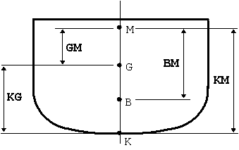
LINEAR MEASUREMENTS IN STABILITY
KG - Height of the ships Center of Gravity the above Keel
KM - Height of Metacenter above the Keel
GM - Metacentric Height: This measurement is calculated by subtracting KG from KM (GM = KM - KG). GM is a measure of the ship's initial stability.
BM - Metacentric Radius: The distance between the Center of Buoyancy and the Metacenter. It is actually the radius of the circle for the movements of "B" at small angles of heel.

Slide 4
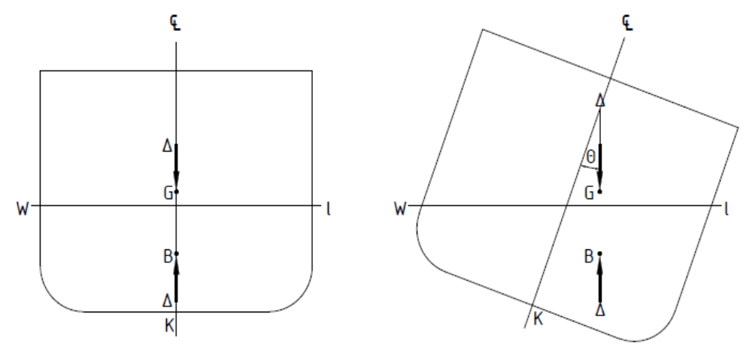
DEFINITION OF LIST
A vessel in static equilibrium with the vertical forces acting along the centreline is said to be UPRIGHT
A vessel with its centre of gravity off the centreline will be in static equilibrium inclined. Under such a condition it is said to be LISTED

Slide 5
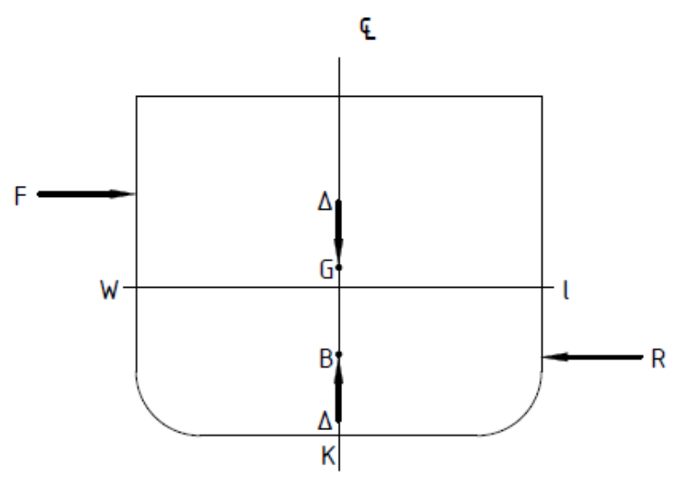
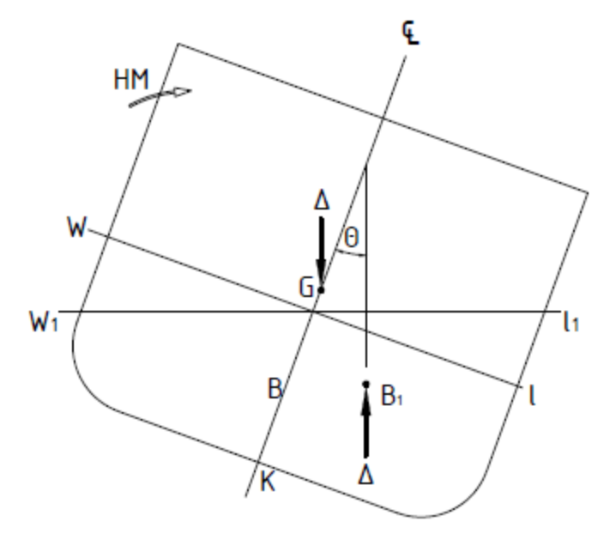
HEEL & HEELING MOMENT
When an external force acts broadside on a vessel, a moment comes into action and causes it to incline
This moment is referred to as HEELING MOMENT (HM), the inclination as HEEL and the angle as the ANGLE OF HEEL (θ)
Heel is hence a condition of dynamic equilibrium
As soon as the disturbing force is removed, the vessel will return to the upright

Slide 6
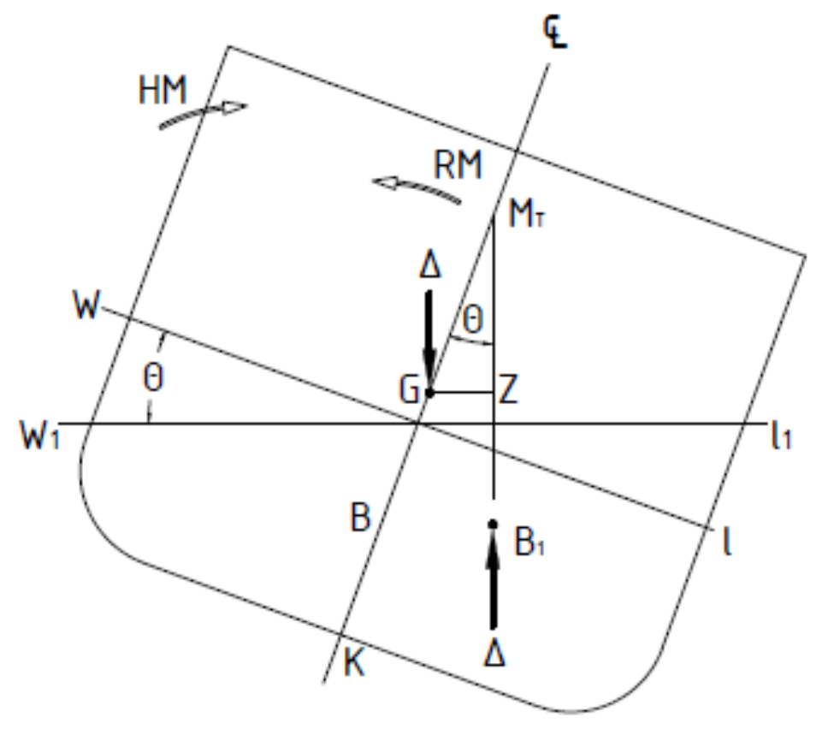
RIGHTING MOMENT
As a vessel heels, the displacement and buoyancy forces come together to form a couple which acts counter to the HM
This couple is referred to as the RIGHTING MOMENT (RM) or MOMENT OF STATICAL STABILITY
It is responsible for returning a vessel upright when the disturbing force is removed, and a vessel which demonstrates such capability is said to be stable
Stability is hence defined as the ability for a vessel to bring itself upright when heeled by an external force

Slide 7
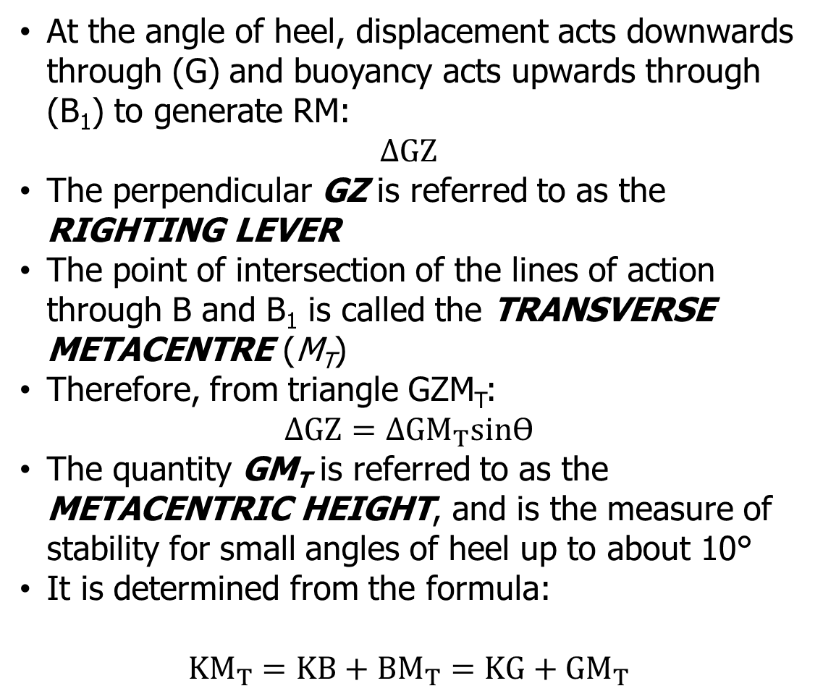
RIGHTING MOMENT & METACENTRIC HEIGHT
At the angle of heel, displacement acts downwards through (G) and buoyancy acts upwards through (B₁) to generate RM:
$$∆GZ$$
The perpendicular GZ is referred to as the RIGHTING LEVER
The point of intersection of the lines of action through B and B₁ is called the TRANSVERSE METACENTRE (M_{T})
Therefore, from triangle GZM_{T}:
$$∆GZ=∆{GM}_{T}sinӨ$$
The quantity GM_{T} is referred to as the METACENTRIC HEIGHT, and is the measure of stability for small angles of heel up to about 10°
It is determined from the formula:
$${KM}_{T}=KB+{BM}_{T}=KG+{GM}_{T}$$

Slide 8
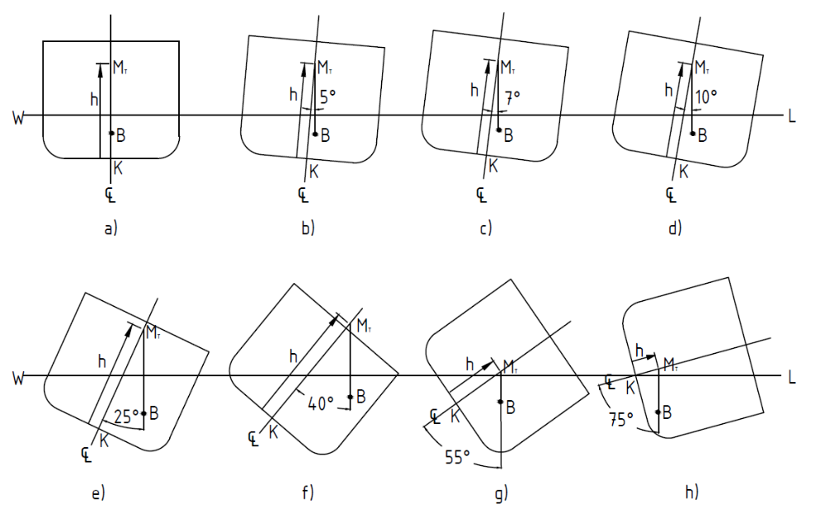
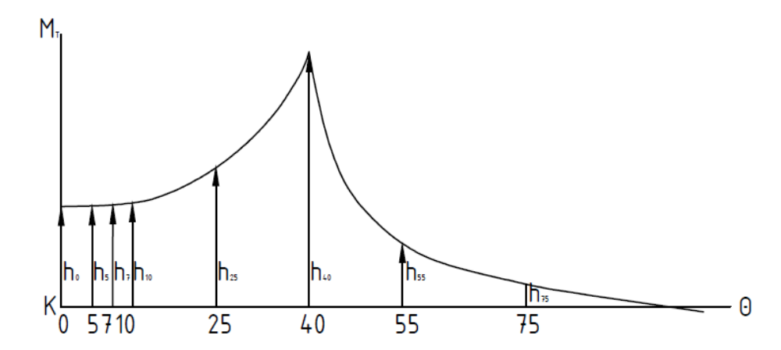
INITIAL STABILITY
When the value of KM_{T} is calculated for different angles of heel, it practically remains constant from zero up to about 10º
Hence the concept of Initial Stability means statical stability at small angles of heel

Slide 9
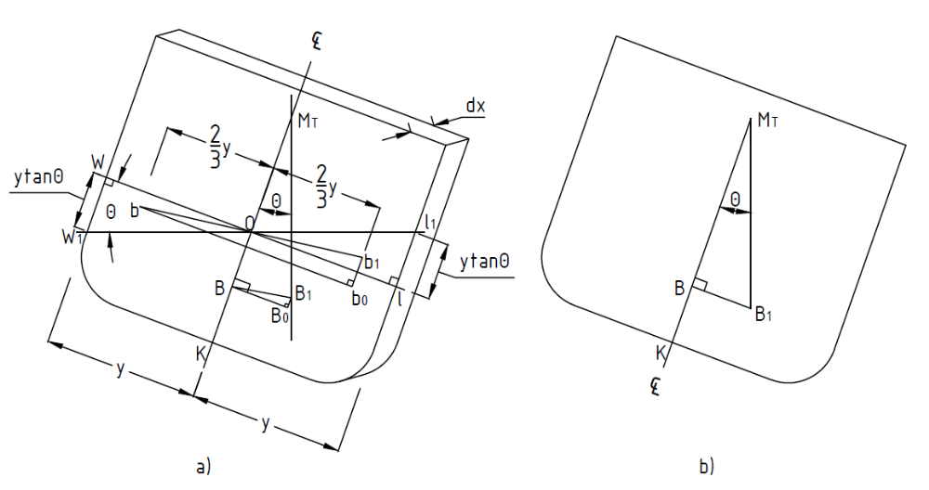
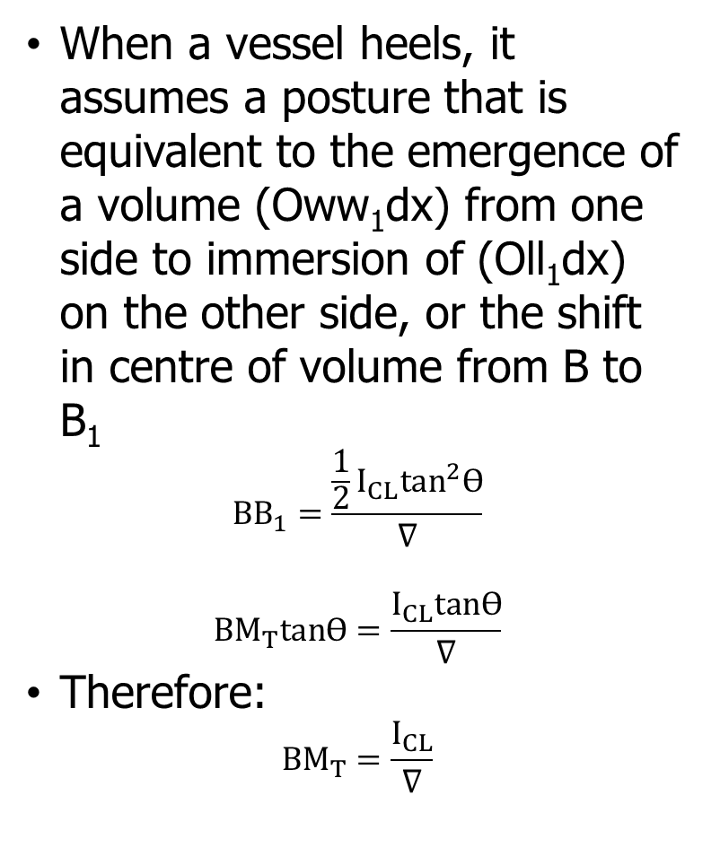
DETERMINATION OF BM_{T}
When a vessel heels, it assumes a posture that is equivalent to the emergence of a volume (Oww₁dx) from one side to immersion of (Oll₁dx) on the other side, or the shift in centre of volume from B to B₁
$${BB}_{1}=\frac{\frac{1}{2}I_{CL}\tan^{2}Ө}{∇}$$
$$BM_{T}tanӨ=\frac{I_{CL}tanӨ}{∇}$$
Therefore:
$${BM}_{T}=\frac{I_{CL}}{∇}$$

Slide 10
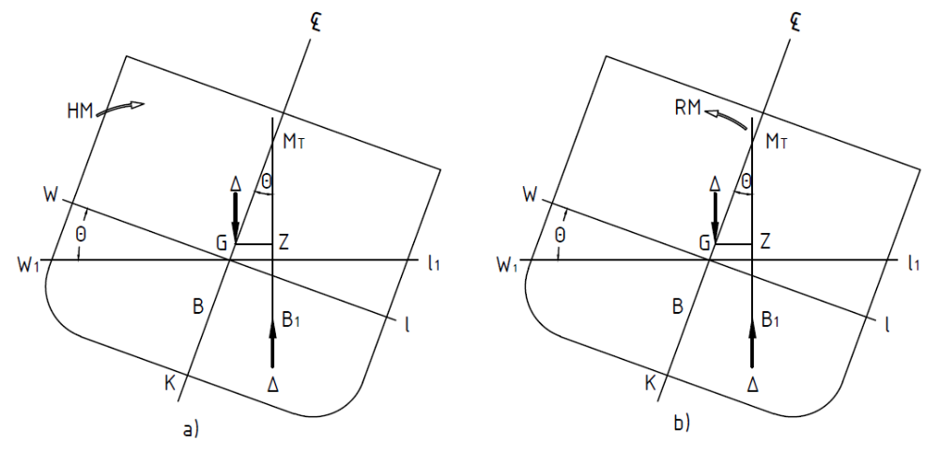
STATES OF EQUILIBRIUM
Stable Equilibrium
  Where KM_{T} > KG
  GM_{T} is considered positive
A vessel is said to be in stable equilibrium
RM will hence oppose HM when heeled

Slide 11
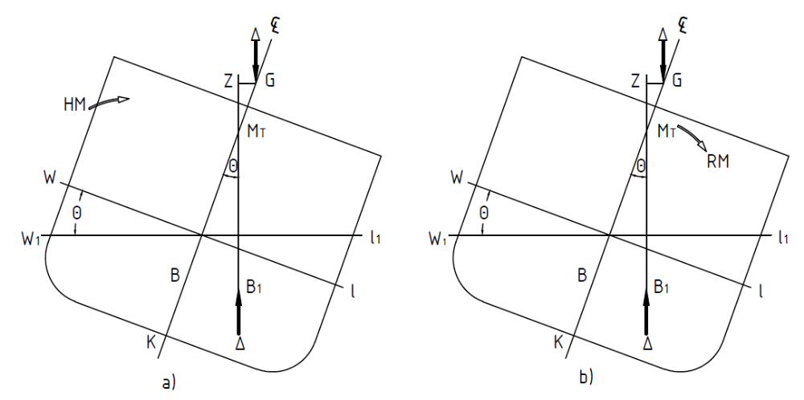
STATES OF EQUILIBRIUM
Unstable Equilibrium
  Where KM_{T} < KG
  GM_{T} is considered negative
A vessel is said to be in unstable equilibrium
RM will hence assist HM when heeled

Slide 12
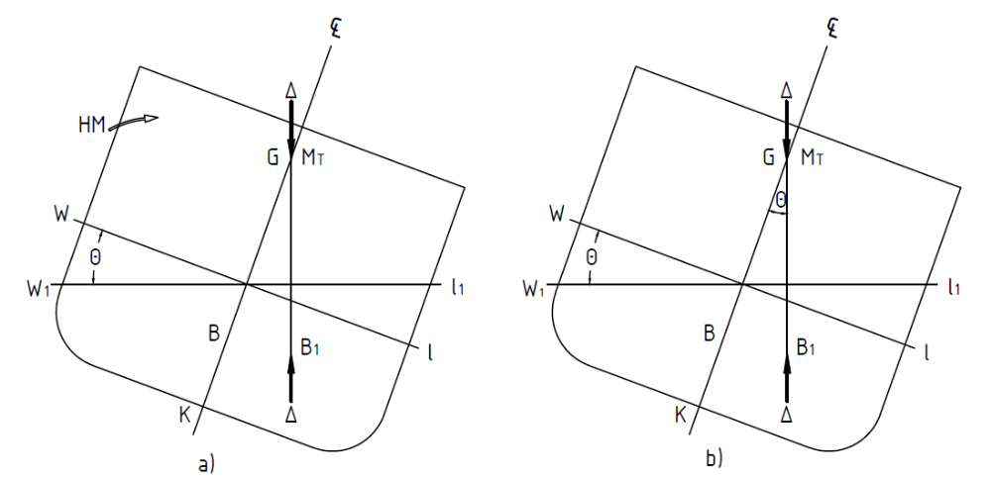
STATES OF EQUILIBRIUM
Neutral Equilibrium
  Where KM_{T} = KG
  GM_{T} is zero
A vessel is said to be in neutral equilibrium
Vessel has no RM when upright

Slide 13
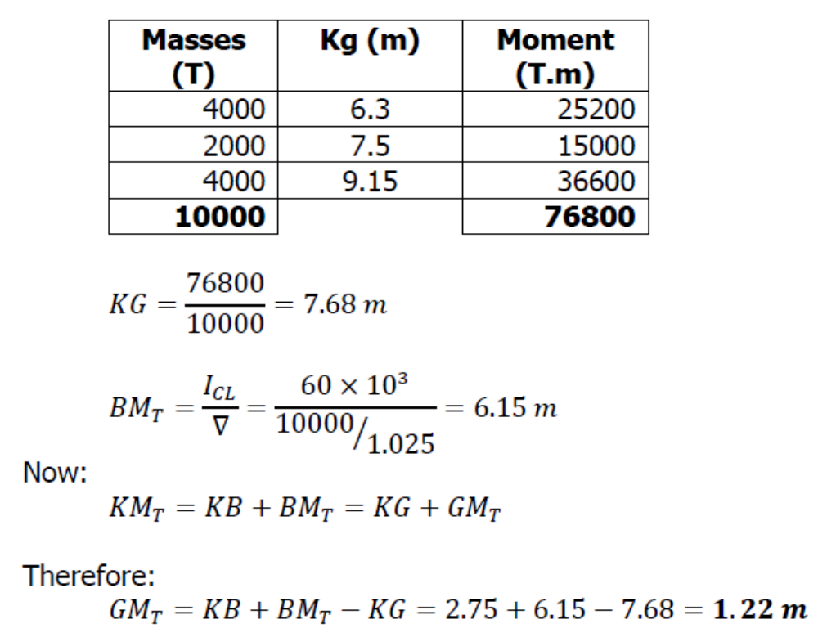
WORKED EXAMPLES
Q2
A vessel or 10 000 tonne displacement has a second moment of area of waterplane about the centerline to be 60 x 10³ m⁴. The centre of buoyancy is 2.75 m above the keel and the following are the disposition of the displacement mass on board.
4000 tonne at 6.30 m above the keel
2000 tonne at 7.50 m above the keel
4000 tonne at 9.15 m above the keel
Calculate the metacentric height.

Slide 14
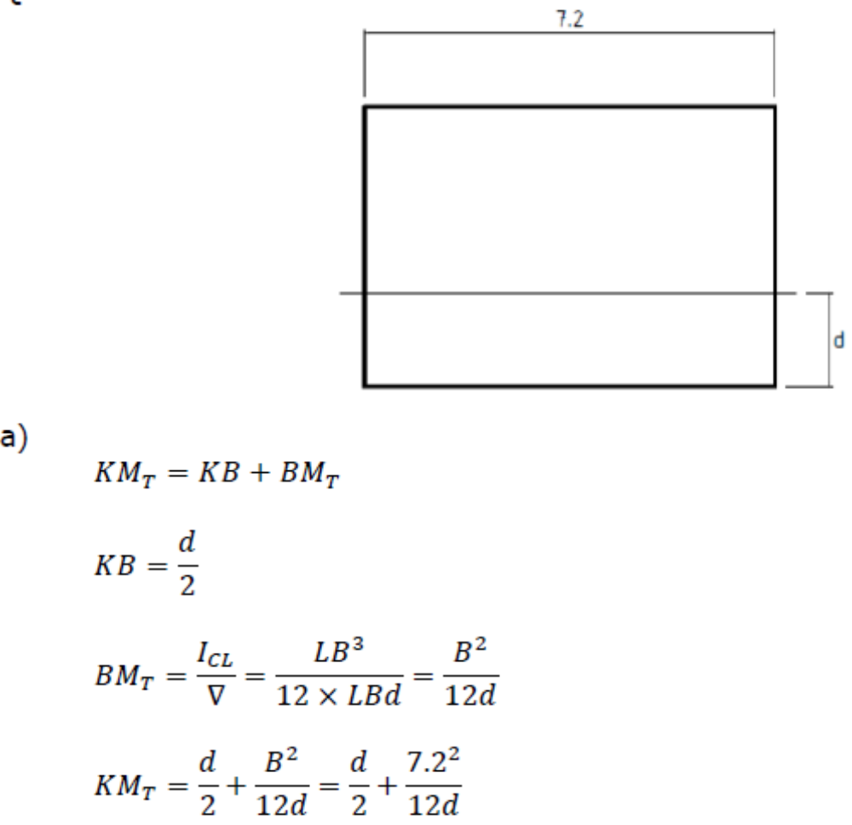
WORKED EXAMPLES
Q3
A vessel of constant rectangular cross-section is 7.2 m wide.
Draw the metacentric diagram for the vessel using 0.5 m intervals of draught up to the 4.0 m waterline.
If the centre of gravity is 3.0 m above the keel, determine from the diagram the limits of draught between which the vessel will be unstable.

Slide 15
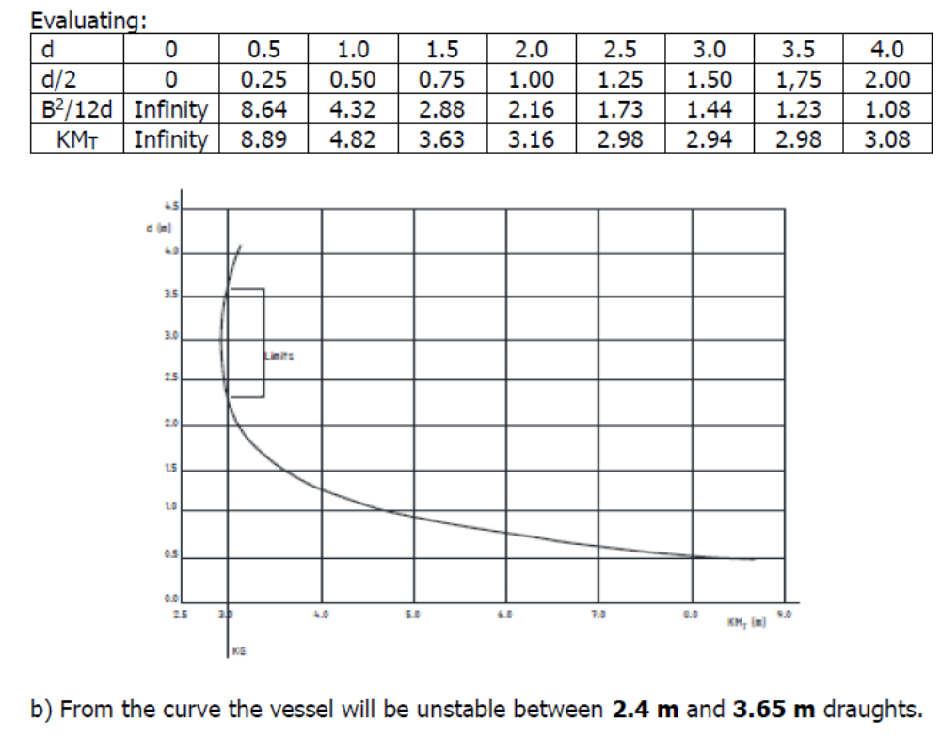
WORKED EXAMPLES

Slide 16
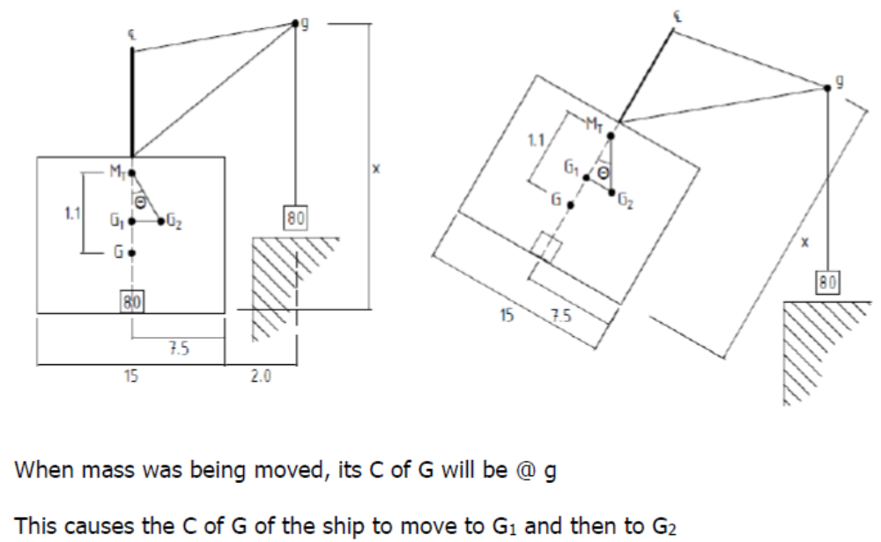
WORKED EXAMPLES
Q4
A ship of 12 000 tonne displacement and 15 m beam has a metacentric height of 1.1 m. A mass 80 tonne is lifted from its position on the centreline at the bottom of the lower hold by one of the ship’s derricks, and placed on the quay 2.0 m from the ship’s side. The ship heels to a maximum of 3.5º when the mass is being moved.
Calculate the height of the derrick head above the centre of gravity of the mass.
By how much does the GM_{T} alter during the operation?

Slide 17
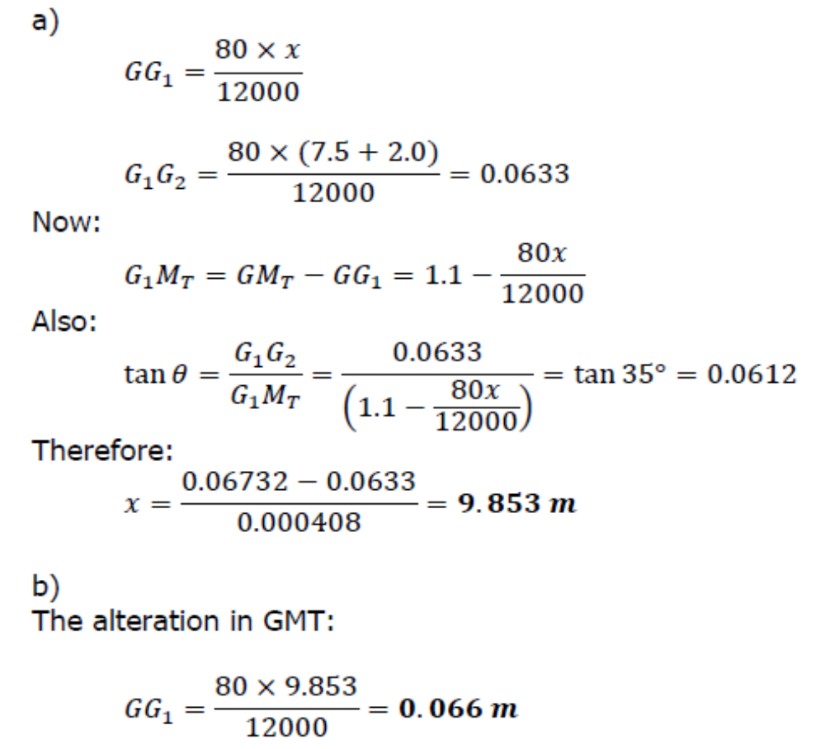
WORKED EXAMPLES

