Slide 1
SEALS and GASKETS

Slide 2
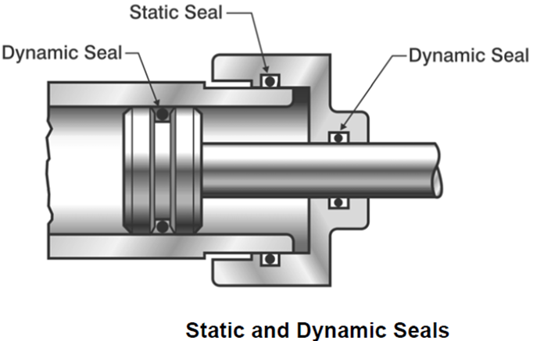
SEALS
A seal is a device or substance used to join two things together so as to prevent them coming apart or to prevent anything passing between them. Seals are used for both STATIC and DYNAMIC applications.

Slide 3
SEALS
Machines such as pumps, mixers, compressors, turbines, agitators, and components as hydraulic and pneumatics cylinders, valves, etc are constantly being challenged in separating zones. This zone separation is greatly achieved with the aid of mechanical seals and gaskets. The design of these seals have had some success but the industry continues to face some challenges.
All seals leak to some extent and a seal is said to be failed if it leaks excessively for that very application.
Measuring Leakage:
It is fluid that leaks and therefore the measurement must track liquid and gas. In measuring liquids, litres per hour is used, but in this case since very small quantity leaks the units will be milliliters per hour (ml/hr) and the gas (volatile organic compounds) be expressed in concentration as particles per million (ppm).
As a rule of thumb, an emission rate of 100 ppm is equal to a mass leakage rate of 5.6 g/hr or a milliliter of liquid contains about 20 drops

Slide 4
SEALS
Static seals such as gaskets, bolt seals, back-up rings and sealants are used to stop leakage through a mechanical joint when there is no relative motion of mating surfaces. In a truly static seal, the mating grand parts are not subject to relative movement except for thermal expansion and movement from application of fluid pressure, ie they permit up to 10 – 11 scc/sec helium. Truly static seals are designed to provide a complete barrier to a potential leakage path. These seals are ZERO leakage seals. Some design of static seals, semi-static seals, can accommodate limited movement of the surfaces being sealed due to changes in pressure, vibration or thermal cycling such as an expansion joint. Fluid with low viscosity have a higher probability of leaking or flowing at a higher rate. This is so because resistance of a fluid flow at a given temperature is viscosity.
Notes:
scc/sec reads as standard cubic centimeter per second
Leak rate value is 1 mbar l/s if in a vacuum –reservoir with a volume of 1 litre the pressure rises or drops in 1 second about 1 mbar.

Slide 5
SEALS
A dynamic seal is a mechanical device used to control leakage of fluid from one
region to another when there is rotating, oscillating or reciprocating motion between the sealing interfaces.

Slide 6
Failure
A review of failure rate data suggests the following characteristics be included in the failure rate model for gaskets and seals:
- Material characteristics
- Amount of seal compression
- Surface irregularities
Seal size.
- Fluid pressure
- Extent of pressure pulses
- Temperature
- Fluid viscosity
- Contamination level
- Fluid/material compatibility
- Leakage requirements
- Assembly/quality control procedures

Slide 7
Benefits of excellent sealing
Equipment reliability
Reduction in fluid replacement in some cases
Reduction or elimination of contamination
Reduction or elimination of pollution (fugitive emission)
Improvement in safety

Slide 8
Seal Materials:
Metals eg AISI 316
Elastomers eg propylene
Ceramics eg silicon carbide, tungsten carbide
Compression set: the permanent deformation that takes place lower than the yield point of the material. The lower the percentage, the better the material resists permanent deformation under a given deflection and temperature range.

Slide 9
