Slide 1

TEAM 3 – SCRUM 4 JAVA WEB APP AND SOAP WEB SERVICES

Slide 2
Team3_scrum4 piano project
Scrum Team Members
Jason Nelson (Scrum Master)
Mario Montes
Jacob Jorgensen
Project Goal
Build a Java-based Web App and a SOAP Web Service to create Piano objects.
Technologies Used
Java
JSP / HTML
XML / SOAP WEB SERVICES
IBM WEBSPHERE SERVER

Slide 3
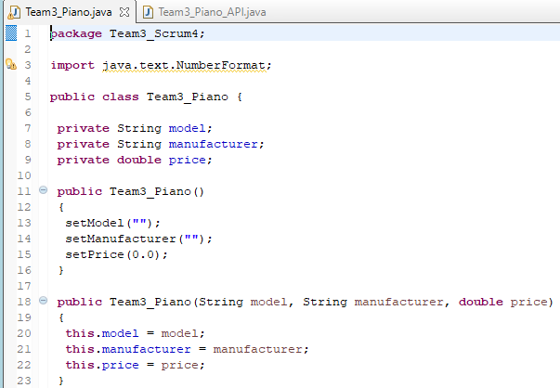
Team3_Piano.java – Piano data class
Stores piano details: model, manufacturer, and price.
It’s just a simple container for data.
Key Features:
Three private properties: model, manufacturer, price.
Two constructors:
Empty constructor (sets default values).
Full constructor (sets all three fields).
Getters and Setters for each property.

Slide 4
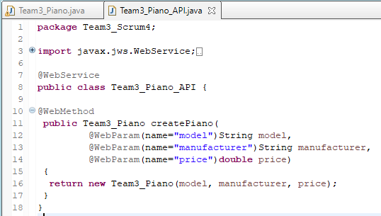
Team3_Piano_API.java – Piano Web Service class
Creates a Piano object when users send input.
Key Features:
Marked with @WebService: means it can be called by other programs (SOAP).
Has a createPiano() method
Takes model, manufacturer, and price as inputs.
Builds and returns a Team3_Piano object.
Each input is labeled with @WebParam(name=“…”) to match what users see.
Keeps everything simple and focused on just creating Piano objects.

Slide 5
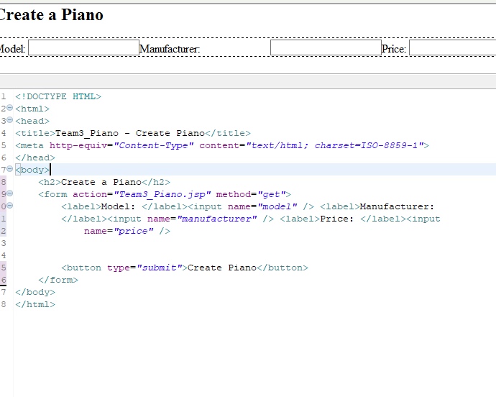
Web Content: HTMl Page
Sets up a web form with inputs for piano model, piano manufacturer, and piano price.
Passes those values to the team3_piano.jsp file to generate a piano object.

Slide 6
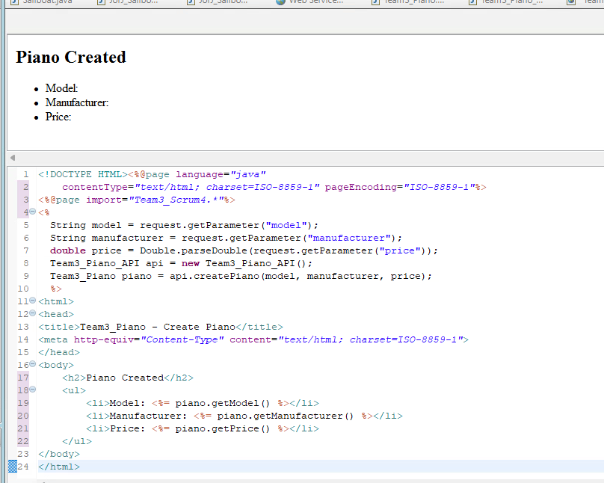
Web Content: java page
Receives the model, manufacturer, and price from the get request using request.getparameter()
Creates a new api object
Creates a new piano object by calling the api’s createPiano() method and passing all 3 values into it.
Then displays the html page using the piano’s get methods to populate the list items.

Slide 7
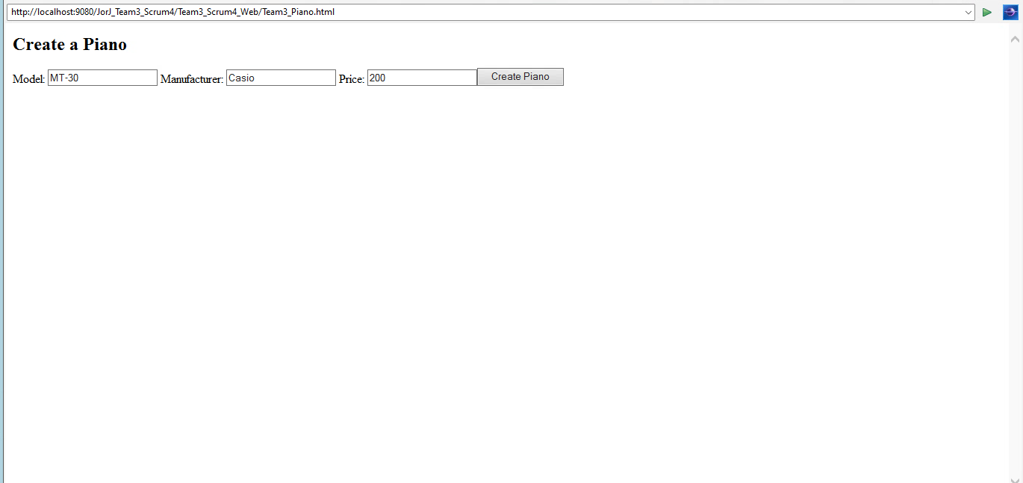
HTML before get request

Slide 8
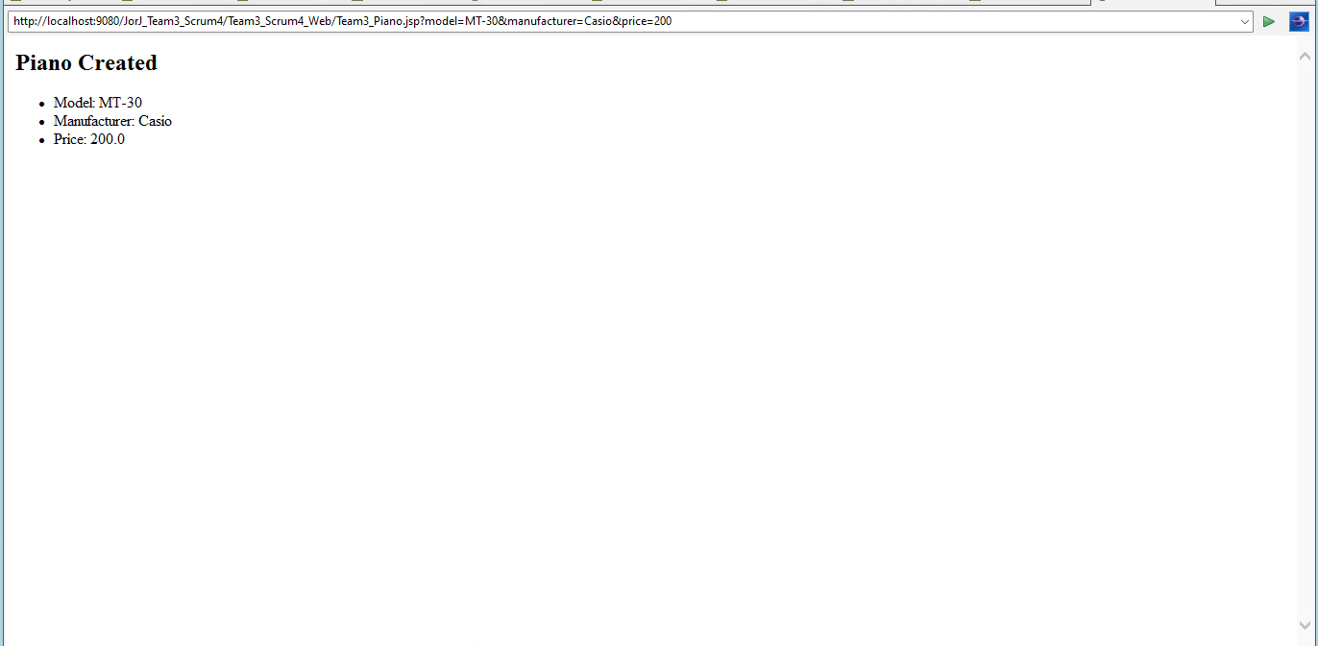
Java page after get request

Slide 9
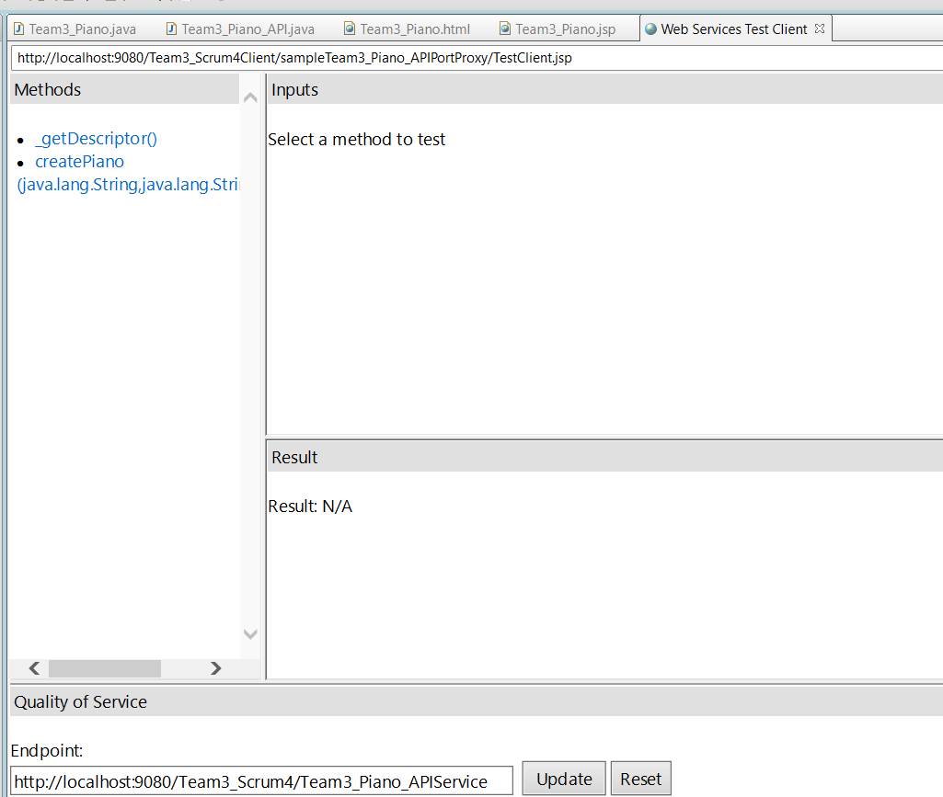
After successfully creating soap web service test client
Service operations loaded successfully: createPiano is ready.
Endpoint URL shows where the service is running.

Slide 10
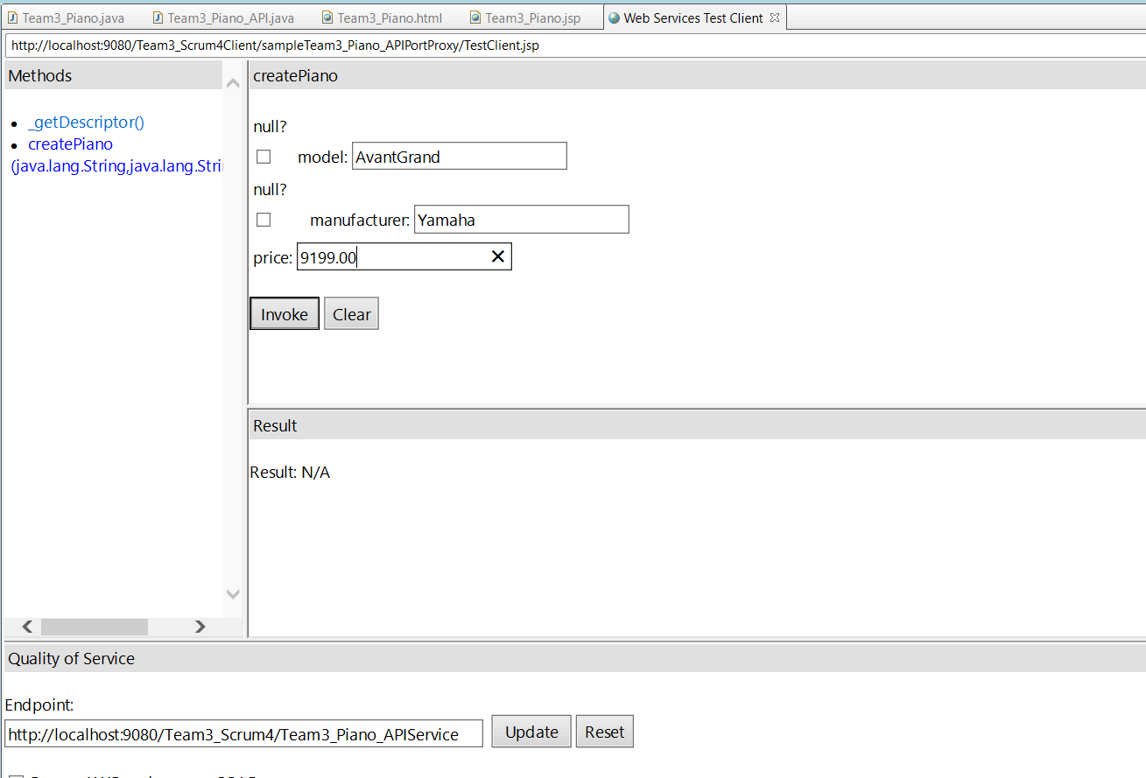
Before invoking createpiano() method of api
Filled out model, manufacturer, and price inputs.
Getting ready to send request to the createPiano() method.

Slide 11
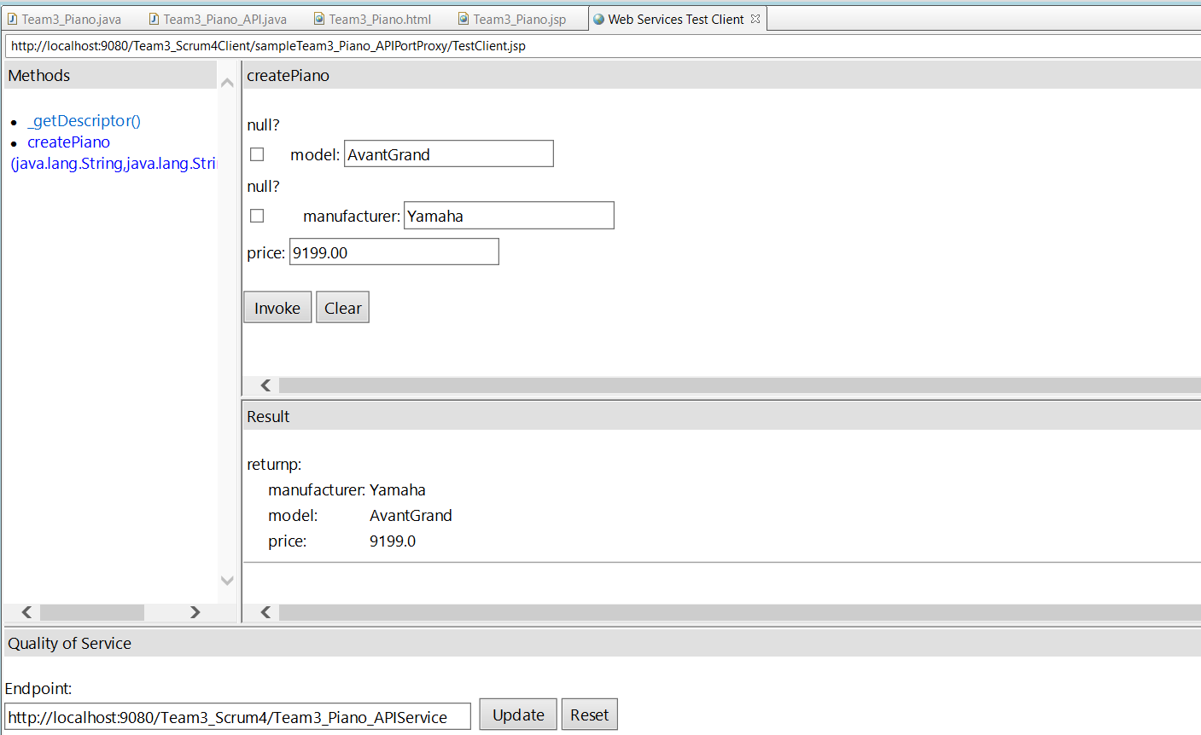
After invoking createpiano() method of api
SOAP request sent successfully to the service.
Service returned a Piano object with correct values.
Model, Manufacturer, and Price displayed properly in the result.

Slide 12

THANK YOU

