Slide 1
Application Layer
Chapter 7
  DNS – Domain Name System
  Electronic Mail
  The Web
  Streaming Audio and Video
  Content Delivery
Revised: August 2011
Notes:
Gray units can be optionally omitted without causing later gaps

Slide 2
The Application Layer
Uses transport services to build distributed applications
The software that enables users to interact with the network and accomplish tasks
Application
Transport
Network
Link
Physical

Slide 3
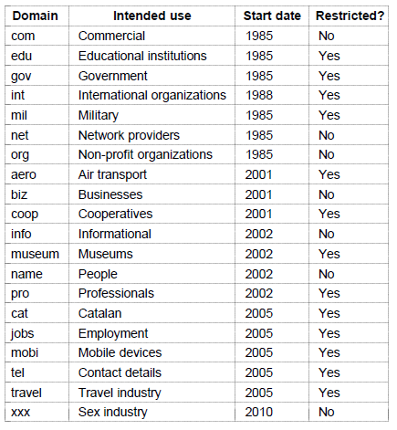
The DNS Name Space (1)
Generic top-level domains are controlled by ICANN who appoints registrars to run them
This one was controversial

Slide 4
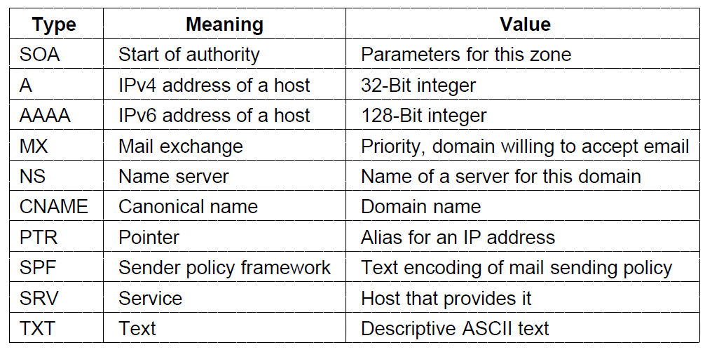
Domain Resource Records (1)
The key resource records in the namespace are IP addresses (A/AAAA) and name servers (NS), but there are others too (e.g., MX)

Slide 5
Name Servers (2)
Finding the IP address for a given hostname is called resolution and is done with the DNS protocol.
Resolution:
  Computer requests local name server to resolve
  Local name server asks the root name server
  Root returns the name server for a lower zone
  Continue down zones until name server can answer
DNS protocol:
  Runs on UDP port 53, retransmits lost messages
  Caches name server answers for better performance

Slide 6
Electronic Mail
  Architecture and services »
  The user agent »
  Message formats »
  Message transfer »
  Final delivery »

Slide 7
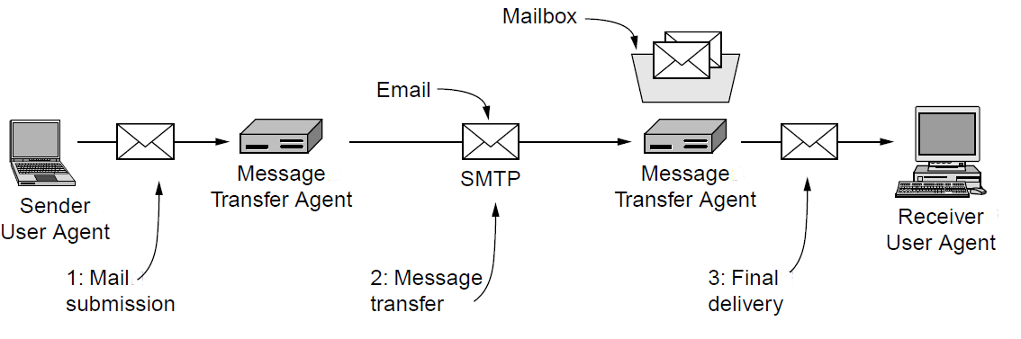
Architecture and Services (1)
The key components and steps (numbered) to send email
Architecture of the email system

Slide 8
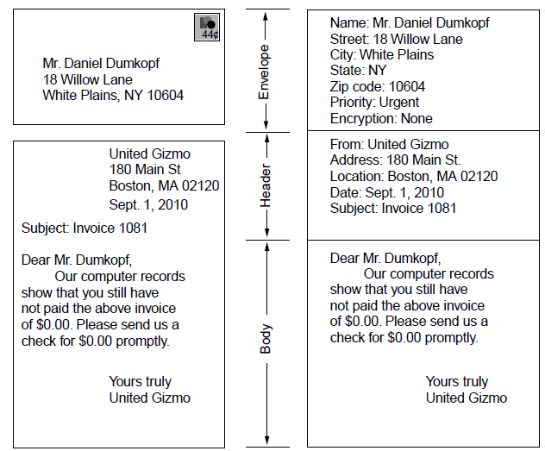
Architecture and Services (2)
Envelope
Message (= header and body)
Paper mail
Electronic mail

Slide 9
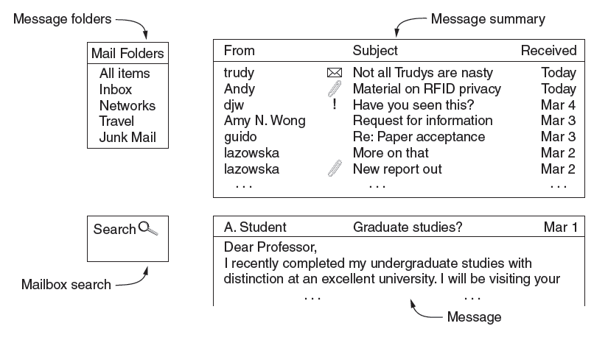
The User Agent
What users see – interface elements of a typical user agent

Slide 10
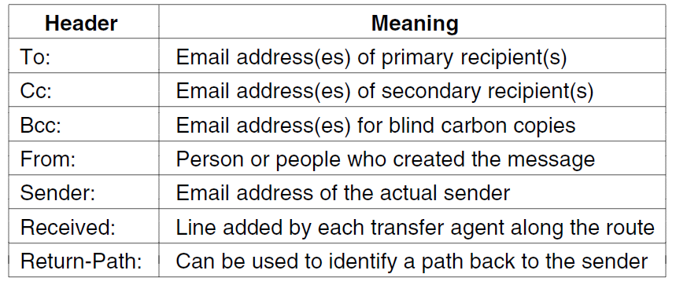
Message Formats (1)
Header fields related to message transport; headers are readable ASCII text

Slide 11
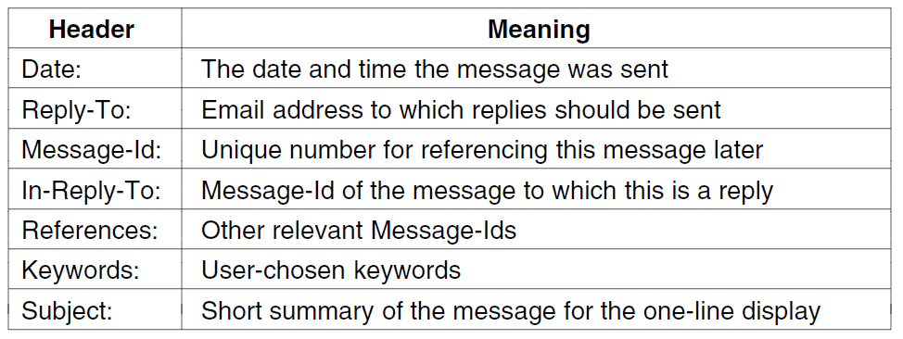
Message Formats (2)
Other header fields useful for user agents

Slide 12
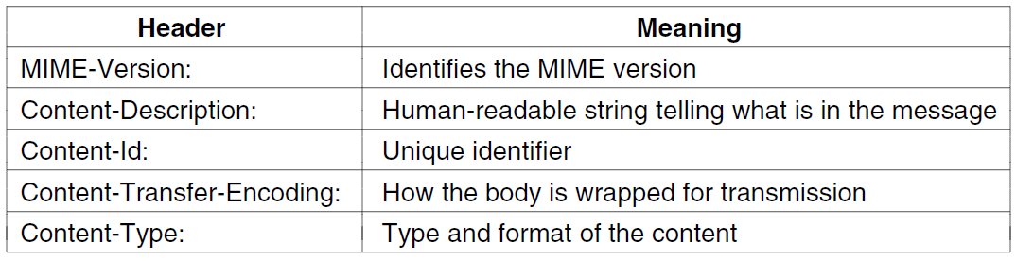
Message Formats (3)
MIME(Multi-Purpose Internet Mail Extensions) header fields used to describe what content is in the body of the message

Slide 13
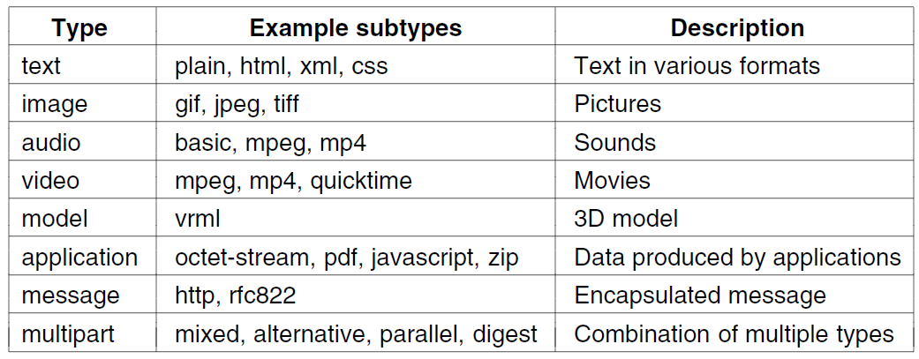
Message Formats (4)
Common MIME content types and subtypes

Slide 14
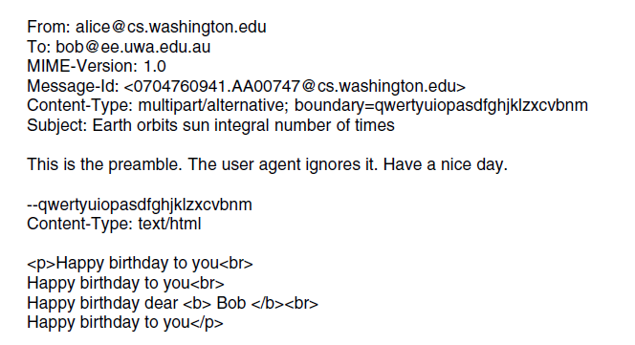
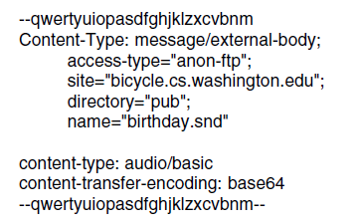
Message Formats (5)
Putting it all together: a multipart message containing HTML and audio alternatives.
One part (HTML)
Another
(audio)

Slide 15
Message Transfer (1)
Messages are transferred with SMTP (Simple Mail Transfer Protocol)
  Readable text commands
  Submission from user agent to MTA(mail transfer agent) on port 587
  One MTA to the next MTA on port 25
  Other protocols for final delivery (IMAP, POP3)

Slide 16
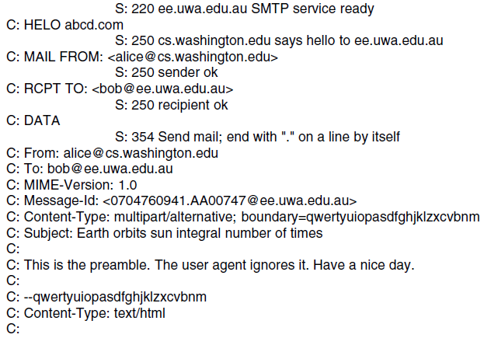
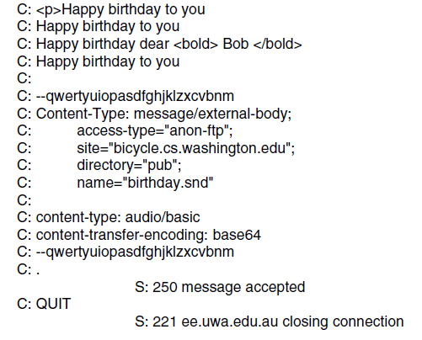
Message Transfer (2)
Sending a message:
From Alice to Bob
SMTP commands are marked [pink]
. . . (rest of message) . . .

Slide 17
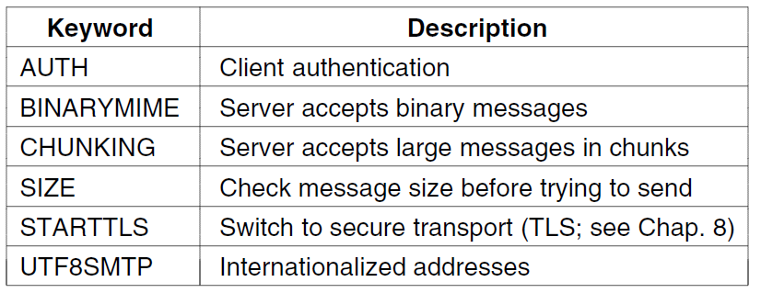
Message Transfer (3)
Common SMTP extensions (not in simple example)

Slide 18
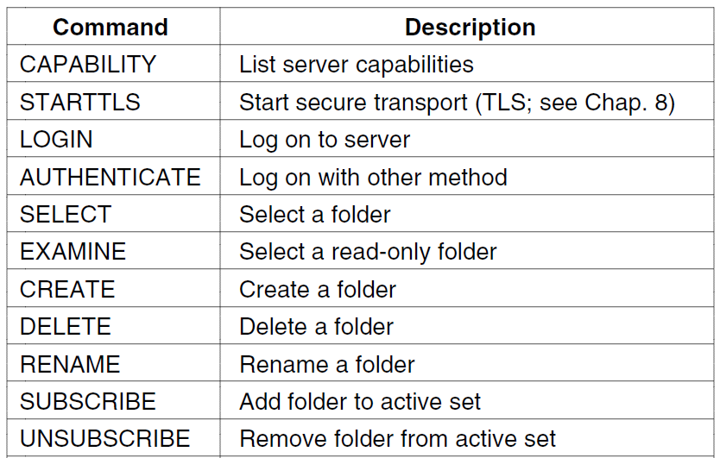
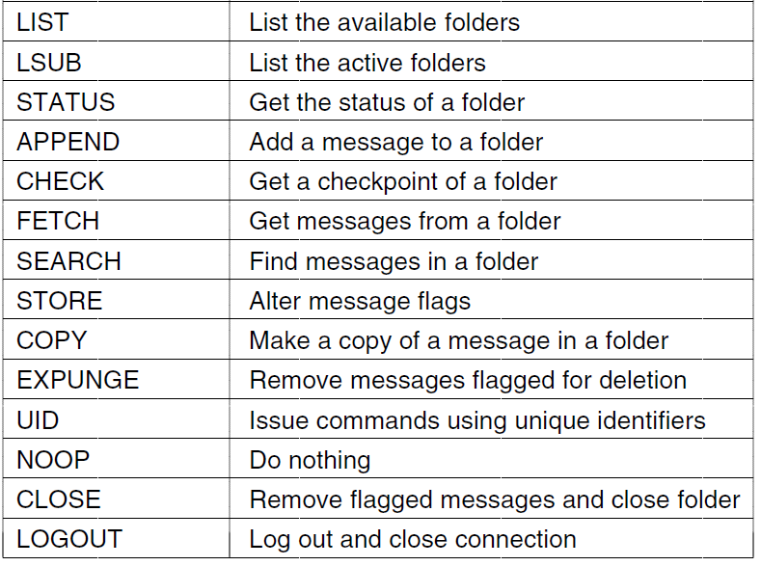
Final Delivery (1)
User agent uses protocol like IMAP(Internet Message Access Protocol) for final delivery
  Has commands to manipulate folders / messages [right]
Alternatively, a Web interface (with proprietary protocol) might be used

Slide 19
The World Wide Web
  Architectural overview »
  Static Web pages »
  Dynamic pages and Web applications »
  HTTP – HyperText Transfer Protocol »
  The mobile Web »
  Web search »

Slide 20
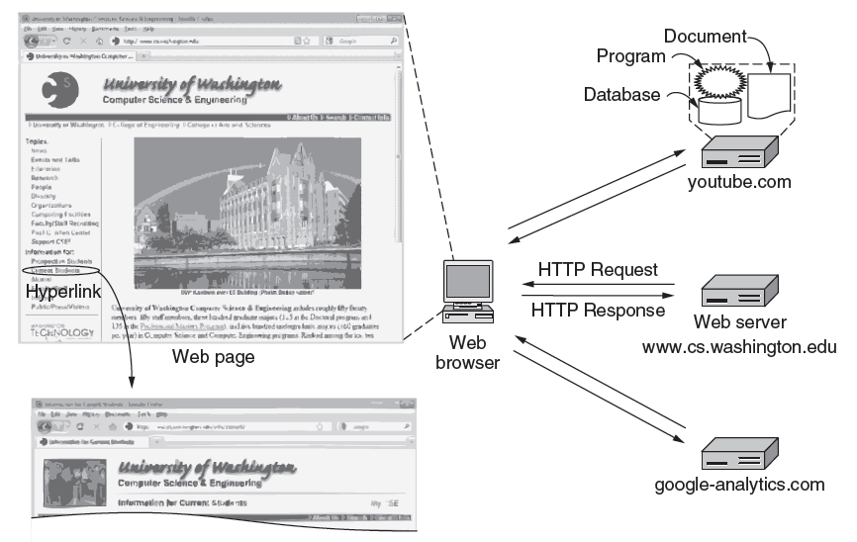
Architectural Overview (1)
HTTP transfers pages from servers to browsers

Slide 21
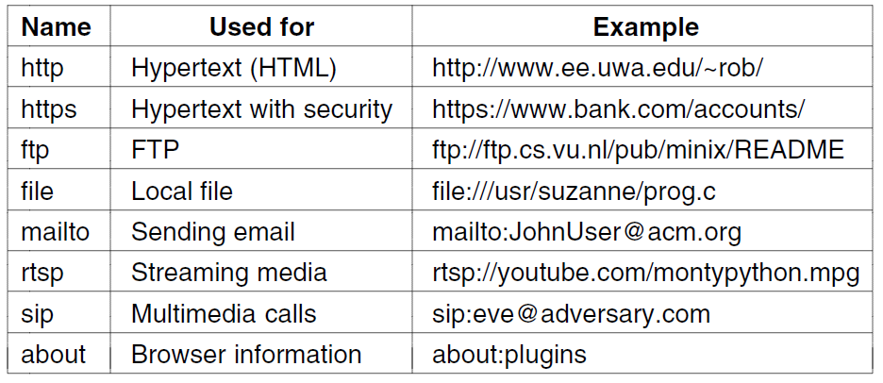
Architectural Overview (2)
Pages are named with URLs (Uniform Resource Locators)
  Example: http://www.phdcomics.com/comics.php
Protocol
Server
Page on server
Our
focus
Common URL protocols

Slide 22
Architectural Overview (3)
  Steps a client (browser) takes to follow a hyperlink:
    Determine the protocol (HTTP)
    Ask DNS for the IP address of server
    Make a TCP connection to server
    Send request for the page; server sends it back
    Fetch other URLs as needed to display the page
    Close idle TCP connections
Steps a server takes to serve pages:
    Accept a TCP connection from client
    Get page request and map it to a resource (e.g., file name)
    Get the resource (e.g., file from disk)
    Send contents of the resource to the client.
    Release idle TCP connections

Slide 23
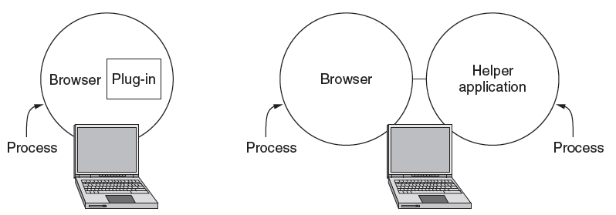
Architectural Overview (4)
Content type is identified by MIME types
  Browser takes the appropriate action to display
  Plug-ins / helper apps extend browser for new types

Slide 24
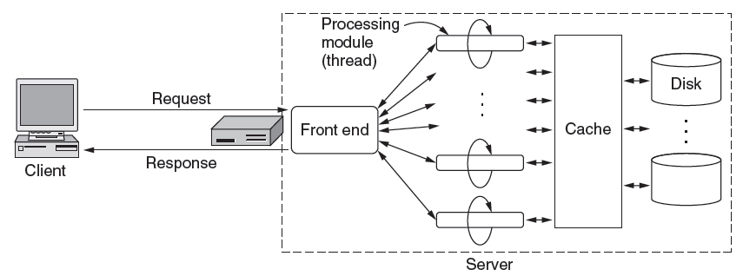
Architectural Overview (5)
To scale performance, Web servers can use:
  Caching, multiple threads, and a front end

Slide 25
Architectural Overview (6)
Server steps, revisited:
  Resolve name of Web page requested
  Perform access control on the Web page
  Check the cache
  Fetch requested page from disk or run program
  Determine the rest of the response
  Return the response to the client
  Make an entry in the server log

Slide 26
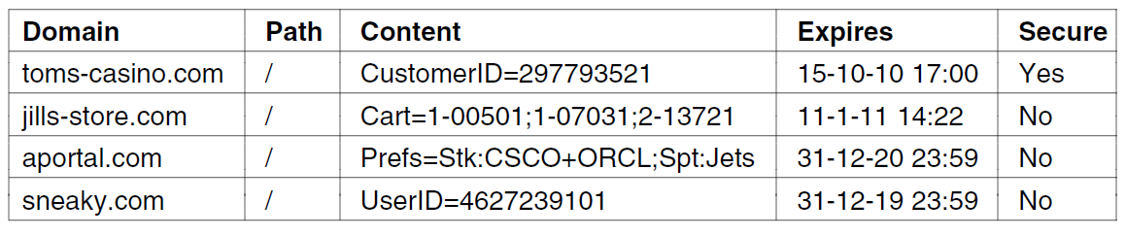
Architectural Overview (7)
Cookies support stateful client/server interactions
  Server sends cookies (state) with page response
  Client stores cookies across page fetches
  Client sends cookies back to server with requests
Examples of cookies

Slide 27
Static Web Pages (1)
Static Web pages are simply files
  Have the same contents for each viewing
Can be visually rich and interactive nonetheless:
  HTML that mixes text and images
  Forms that gather user input
  Style sheets that tailor presentation
  Vector graphics, videos, and more (over) . . .

Slide 28
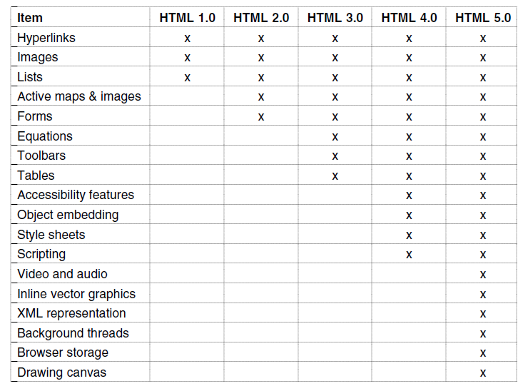
Static Web Pages (2)
Progression of features through HTML 5.0

Slide 29
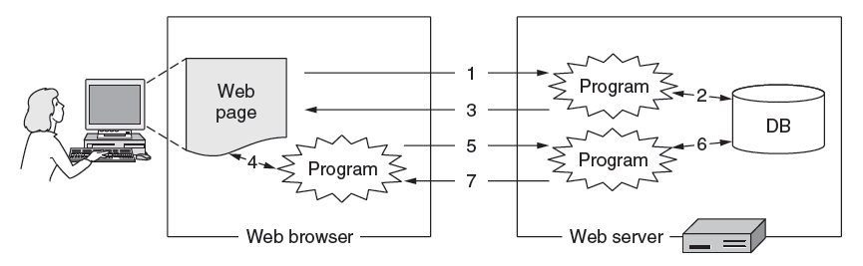
Dynamic Pages & Web Applications (1)
Dynamic pages are generated by programs running at the server (with a database) and the client
  E.g., PHP at server, JavaScript at client
  Pages vary each time like using an application

Slide 30
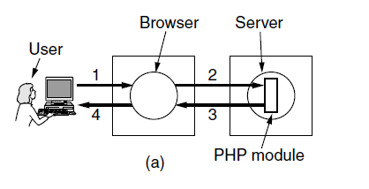
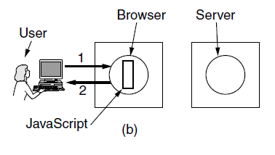
Dynamic Pages & Web Applications (2)
The difference between server and client programs
Server-side scripting with PHP
Client-side scripting with JavaScript

Slide 31
HTTP (1)
HTTP (HyperText Transfer Protocol) is a request-response protocol that runs on top of TCP
  Fetches pages from server to client
  Server usually runs on port 80
  Headers are given in readable ASCII
  Content is described with MIME types
  Protocol has support for pipelining requests
  Protocol has support for caching

Slide 32
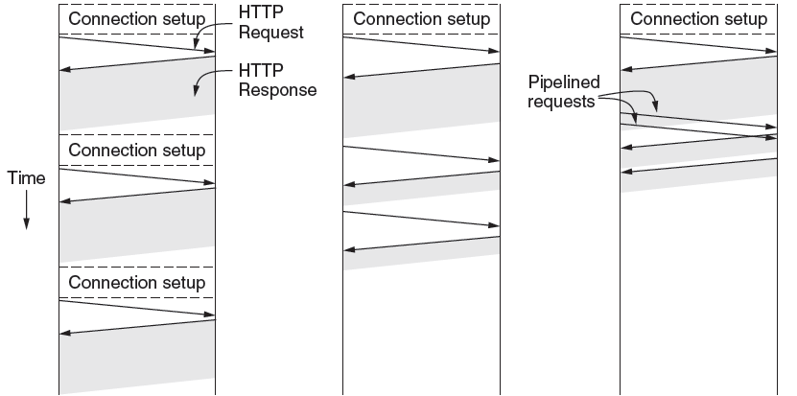
HTTP (2)
HTTP uses persistent connections to improve performance
One connection for each request
Sequential requests on one connection
Pipelined requests on one connection

Slide 33
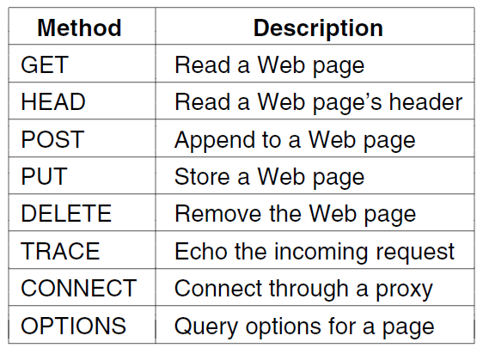
HTTP (3)
HTTP has several request methods.
Fetch a page
Used to send input data to a server program

Slide 34
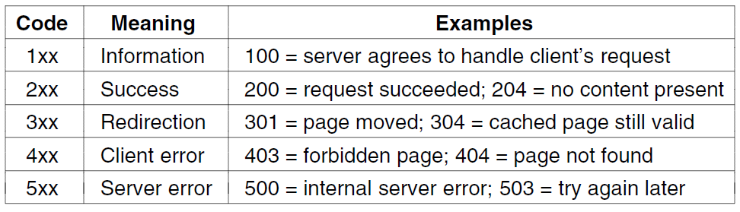
HTTP (4)
Response codes tell the client how the request managed:

Slide 35
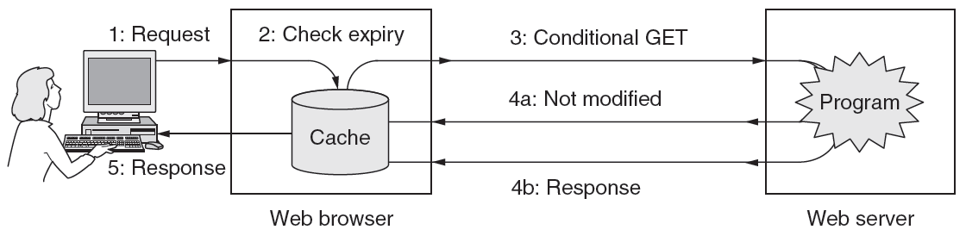
HTTP (5)
HTTP caching checks to see if the browser has a known fresh copy, and if not if the server has updated the page
  Uses a collection of headers for the checks
  Can include further levels of caching (e.g., proxy)

Slide 36
The Mobile Web
Mobiles (phones, tablets) are challenging as clients:
    Relatively small screens
    Limited input capabilities, lengthy input.
    Network bandwidth is limited
    Connectivity may be intermittent.
    Computing power is limited
Strategies to handle them:
  Content: servers provide mobile-friendly versions; transcoding can also be used
  Protocols: no real need for specialized protocols; HTTP with header compression sufficient

Slide 37
Web Search
Search has proved hugely popular, together with advertising that has proved hugely profitable
  A simple interface for users to navigate the Web
Search engine requires:
  Content from all sites, accessed by crawling. Follow links to new pages, but beware programs.
  Indexing, which benefits from known and discovered structure (such as XML) to increase relevance

Slide 38
Streaming Audio and Video
Audio and video have become key types of traffic, e.g., voice over IP, and video streaming.
  Digital audio »
  Digital video »
  Streaming stored media »
  Streaming live media »
  Real-time conferencing »

Slide 39
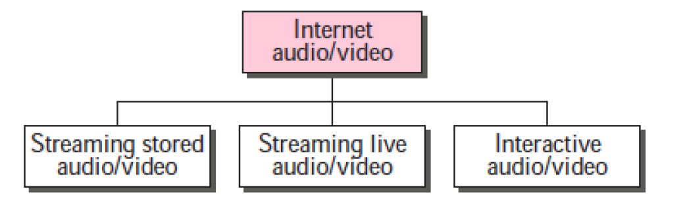
Audio and Video services

Slide 40
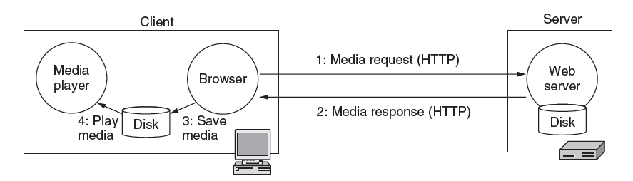
Streaming Stored Media (1)
A simple method to stream stored media, e.g., for video on demand, is to fetch the video as a file download
  But has large startup delay, except for short files

Slide 41
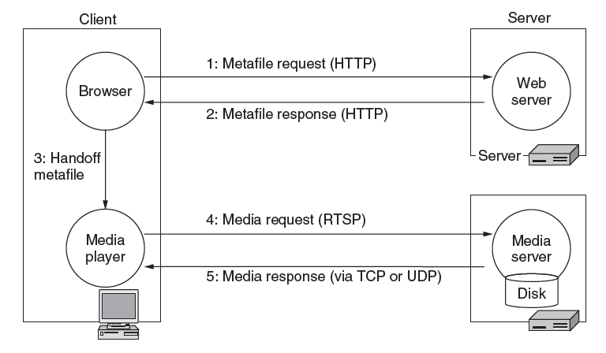
Streaming Stored Media (2)
Effective streaming starts the playout during transport
  With RTSP (Real-Time Streaming Protocol)

Slide 42
Streaming Stored Media (3)
Key problem: how to handle transmission errors
Strategy | Advantage | Disadvantage
Use reliable transport (TCP) | Repairs all errors | Increases jitter significantly
Add FEC (e.g., parity) | Repairs most errors | Increases overhead, decoding complexity and jitter
Interleave media | Masks most errors | Slightly increases decoding complexity and jitter

Slide 43
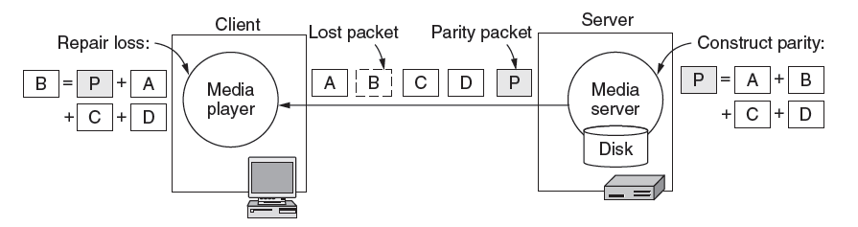
Streaming Stored Media (4)
Parity packet can repair one lost packet in a group of N
  Decoding is delayed for N packets

Slide 44
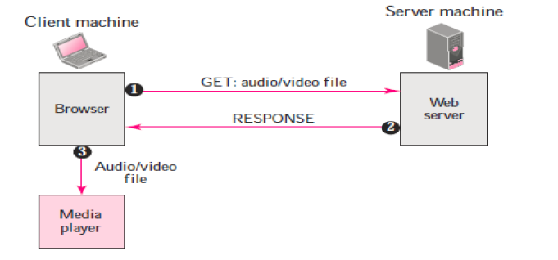
1st approach Using a web server

Slide 45
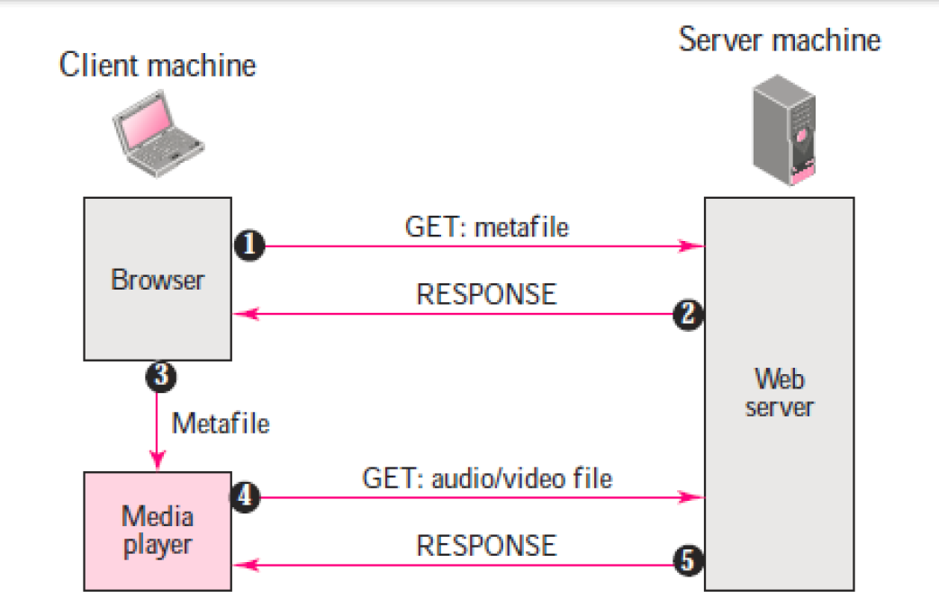
2nd approach: Using a web server with metafile

Slide 46
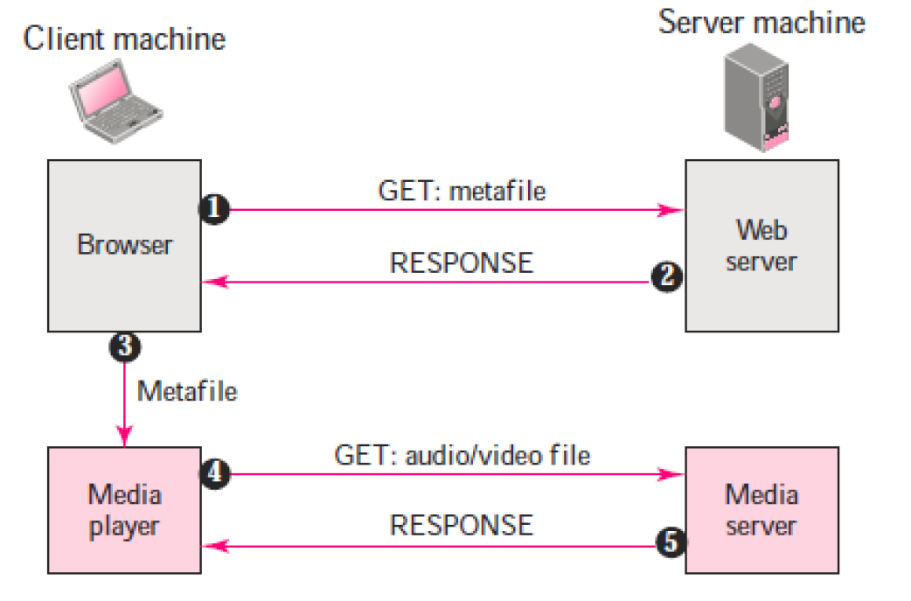
3rd approach Using a media server

Slide 47
Streaming Live Media (1)
Streaming live media is similar to the stored case plus:
  Can’t stream faster than “live rate” to get ahead
  Often have many users viewing at the same time
    UDP with multicast greatly improves efficiency. It is rarely available, so many TCP connections are used.
Notes:
An example of streaming live media is watching the French Open tennis tournament.
IP multicast is usually not available across the Internet. It is most likely to be available in a single providers network, such as a closed IPTV cable network.

Slide 48
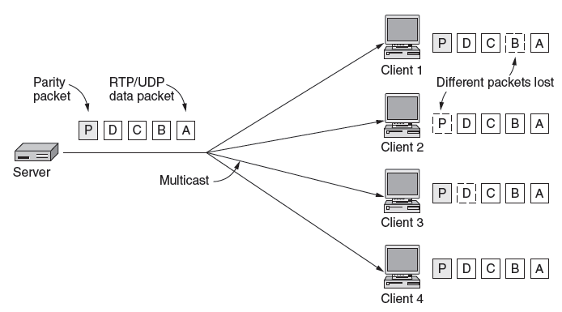
Streaming Live Media (2)
With multicast streaming media, parity is effective
  Clients can each lose a different packet and recover

Slide 49
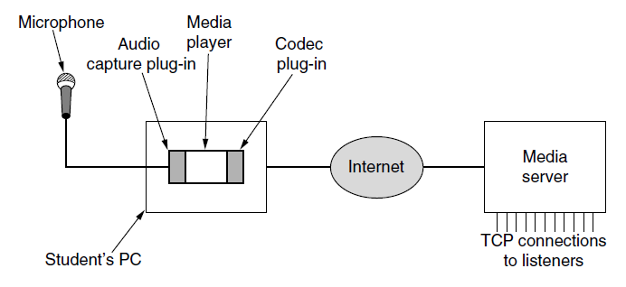
Streaming Live Media (2)
Production side of a student radio station.
As before

Slide 50
Streaming live data
The stations broadcast through the Internet.
The communication is multicast and live. Live streaming is better suited to the multicast services of IP and the use of protocols such as UDP and RTP.
Examples: Internet Radio, Internet Television (ITV), Internet protocol television (IPTV)

Slide 51
Real-Time Conferencing (1)
Real-time conferencing has two or more connected live media streams, e.g., voice over IP, Skype video call
Key issue over live streaming is low (interactive) latency
  Want to reduce delay to near propagation
  Benefits from network support, e.g., QoS
  Or, benefits from ample bandwidth (no congestion)

Slide 52
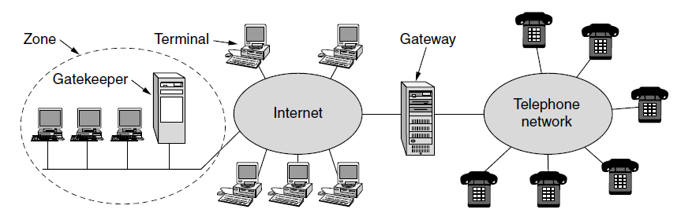
Real-Time Conferencing (2)
H.323 architecture for Internet telephony supports calls between Internet computers and PSTN phones.
VoIP
call
Internet/PSTN
Internet
Gatekeeper controls calls for LAN hosts

Slide 53
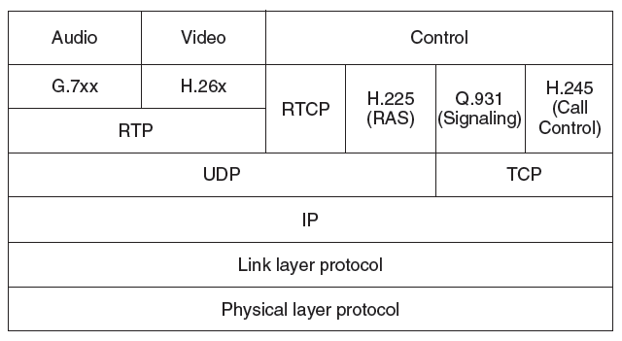
Real-Time Conferencing (3)
H.323 protocol stack:
  Call is digital audio/video over RTP/UDP/IP
  Call setup is handled by other protocols (Q.931 etc.)

Slide 54
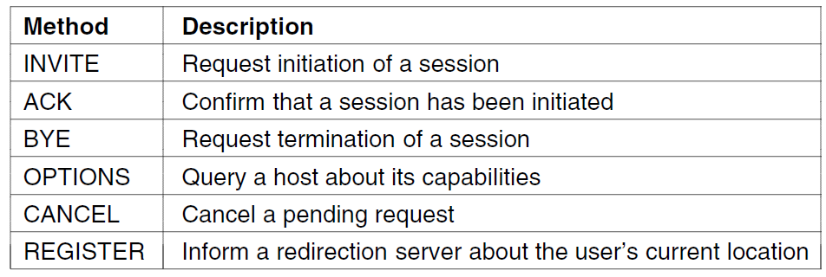
Real-Time Conferencing (5)
SIP (Session Initiation Protocol) is an alternative to H.323 to set up real-time calls
  Simple, text-based protocol with URLs for addresses
  Data is carried with RTP / RTCP as before

Slide 55
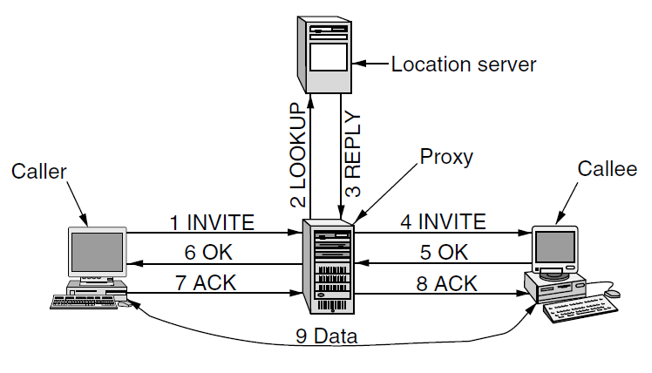
Real-Time Conferencing (6)
Setting up a call with the SIP three-way handshake
  Proxy server lets a remote callee be connected
  Call data flows directly between caller/callee

Slide 56
Content Delivery
Delivery of content, especially Web and video, to users is a major component of Internet traffic
  Content and Internet traffic »
  Server farms and Web proxies »
  Content delivery networks »
  Peer-to-peer networks »

Slide 57
Content and Internet Traffic
Internet traffic:
Internet traffic is the flow of data within the entire Internet, or in certain network links of its constituent networks
  Shifts seismically (email→FTP→Web→P2P→video)
  Has many small/unpopular and few large/popular flows – mice and elephants

Slide 58
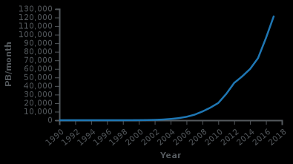
Content and internet traffic

Slide 59
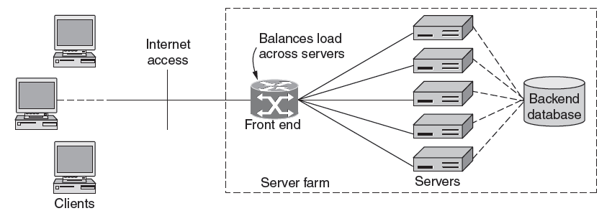
Server Farms and Web Proxies (1)
Server farms enable large-scale Web servers:
  Front-end load-balances requests over servers
  Servers access the same backend database

Slide 60
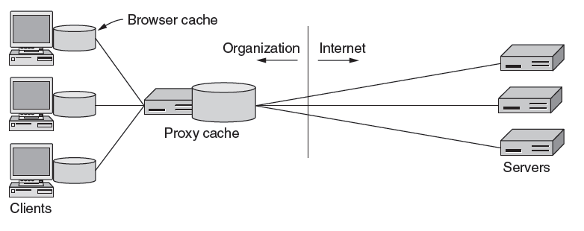
Server Farms and Web Proxies (2)
Proxy caches help organizations to scale the Web
  Caches server content over clients for performance
  Also implements organization policies (e.g., access)

Slide 61
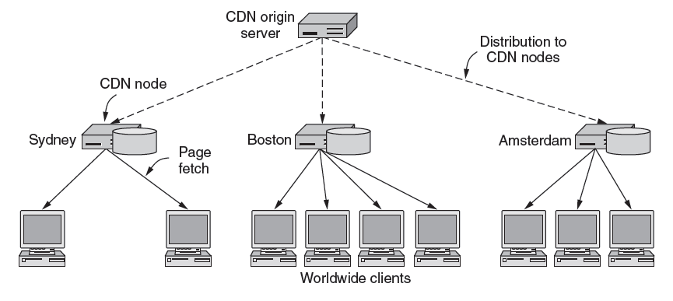
CDNs – Content Delivery Networks (1)
CDNs scale Web servers by having clients get content from a nearby CDN node (cache)

Slide 62
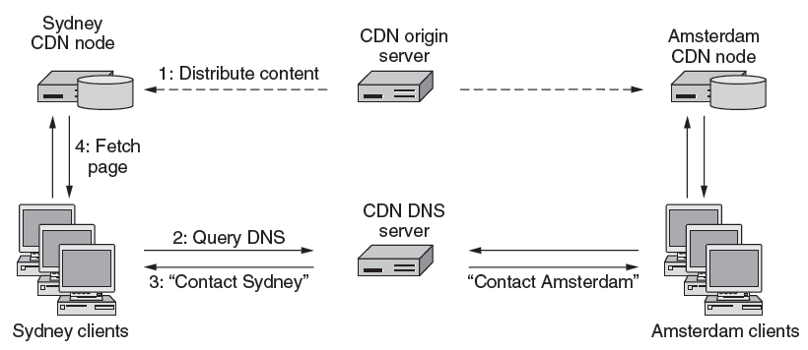
Content Delivery Networks (2)
Directing clients to nearby CDN nodes with DNS:
  Client query returns local CDN node as response
  Local CDN node caches content for nearby clients and reduces load on the origin server

Slide 63
Peer-to-Peer Networks (1)
P2P (Peer-to-Peer) is an alternative CDN architecture with no dedicated infrastructure (i.e., servers)
  Clients serve content to each other as peers
Challenges when servers are removed:
CLASS ACTIVITY
  How do peers find each other?
  How do peers support rapid content downloads?
  How do peers encourage each other to upload?

Slide 64
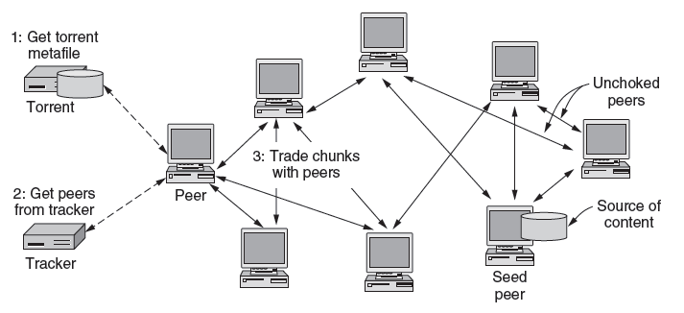
Peer-to-Peer Networks (2)
Bit Torrent lets peers download torrents
    Peers find each other via Tracker in torrent file
    Peers swap chunks (parts of content) with partners, preferring those who send most quickly [2]
    Many peers speed download; preference helps uploads [3]

Slide 65
Peer-to-Peer Networks (3)
Distributed Hash Tables (DHTs) are a fully distributed index that scales to very many clients/entries
  Need to follow O(log N) path for N entries
  Can use as Tracker to find peers with no servers [1]
  Look up torrent (identifier) in DHT to find IP of peers

Slide 66
End
Chapter 7

