Slide 1








Slide 2


Explain the different classes of IP addresses
Configure IP addresses
Subdivide an IP network
Discuss advanced routing concepts such as CIDR(Classless Inter- Domain Routing), summarization, and VLSM(Variable Length Subnet Masking)
Convert between decimal, binary, and hexadecimal numbering systems
Explain the differences between IPv4 and IPv6

Slide 3


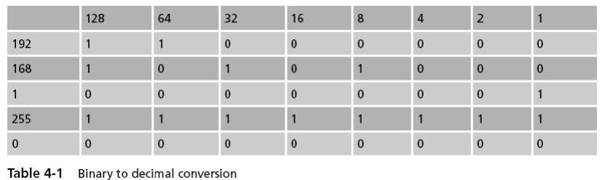
An IP address has 32 bits divided into four octets
To make the address easier to read, people use decimal numbers
to represent the binary digits
– Example: 192.168.1.1
Dotted decimal notation – When binary IP addresses are written in decimal format

Slide 4
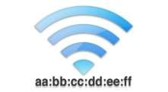
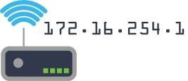
MAC address –
Identifies a specific NIC in a computer on a network –
Each MAC address is unique – TCP/IP networks can use MAC addresses in communication
Network devices cannot efficiently route traffic using MAC addresses because they: –
Are not grouped logically
Cannot be modified
Do not give information about physical or logical network configuration
IP addressing –
Devised for use on large networks
IP addresses have a hierarchical structure and do provide logical groupings
IP address identifies both a network and a host

Slide 5

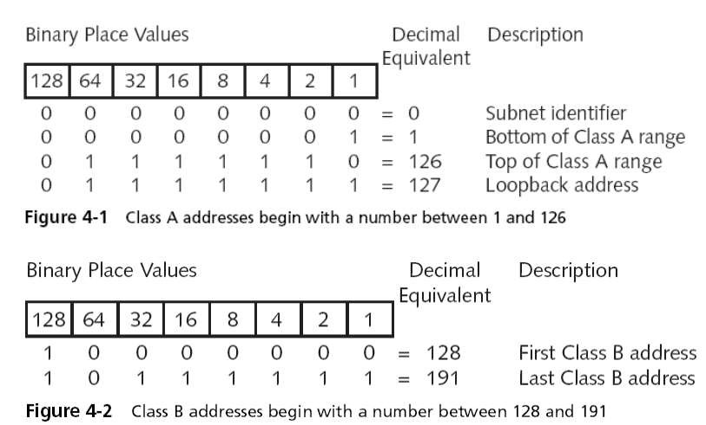
Class A –
  Reserved for governments and large corporations throughout the world
  Each Class A address supports 16,777,214 hosts
Class B –
  Addresses are assigned to large- and medium-sized companies
  Each Class B address supports 65,534 hosts

Slide 6
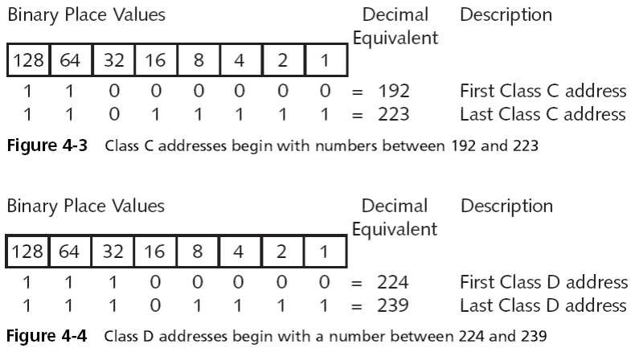
Class C –
  Addresses are assigned to groups that do not meet the qualifications to obtain Class A or B addresses
  Each Class C address supports 254 hosts
Class D –
  Addresses (also known as multicast addresses) are reserved for
multicasting
  Multicasting is the sending of a stream of data (usually audio and video) to multiple computers simultaneously.

Slide 7
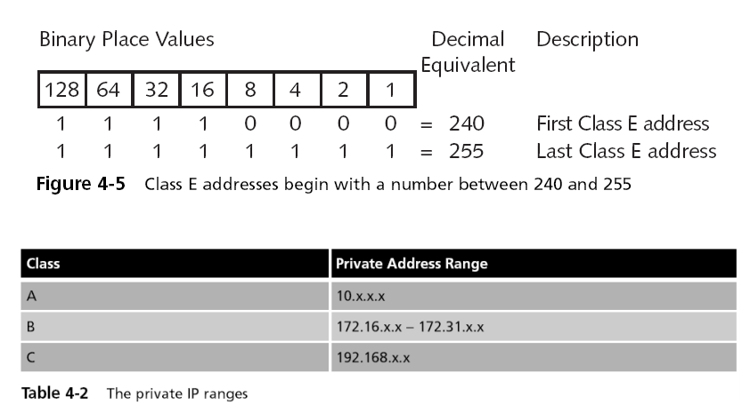
Class E –
  Addresses are reserved for research, testing, and experimentation
  The Class E range starts where Class D leaves off
Private IP ranges –
  Many companies use private IP addresses for their internal networks
  Will not be routable on the Internet
  Gateway devices have network interface connections to the internal network and the Internet
  Route packets between them

Slide 8
IP addresses identify both the network and the host –
  The division between the two is not specific to a certain number of octets
Subnet mask –
  Indicates how much of the IP address represents the network or subnet
  Standard (default) subnet masks: –
    Class A subnet mask is 255.0.0.0
    Class B subnet mask is 255.255.0.0
    Class C subnet mask is 255.255.255.0
TCP/IP hosts use the combination of the IP address and the subnet mask
  To determine if other addresses are local or remote
  The binary AND operation is used to perform the calculation
Subnetting –
  Manipulation of the subnet mask to get more network numbers
Subnet address –
  Network is identified by the first, or first few, octets
  A TCP/IP host must have a nonzero host identifier
Broadcast address –
  When the entire host portion of an IP address is all binary ones
  Examples: 190.55.255.255 and 199.192.65.63

Slide 9
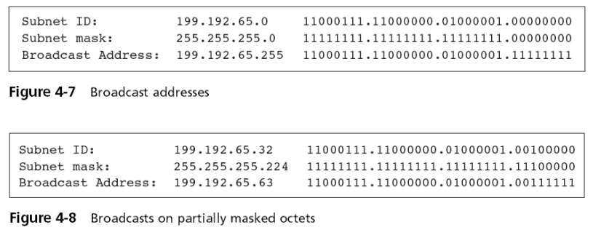
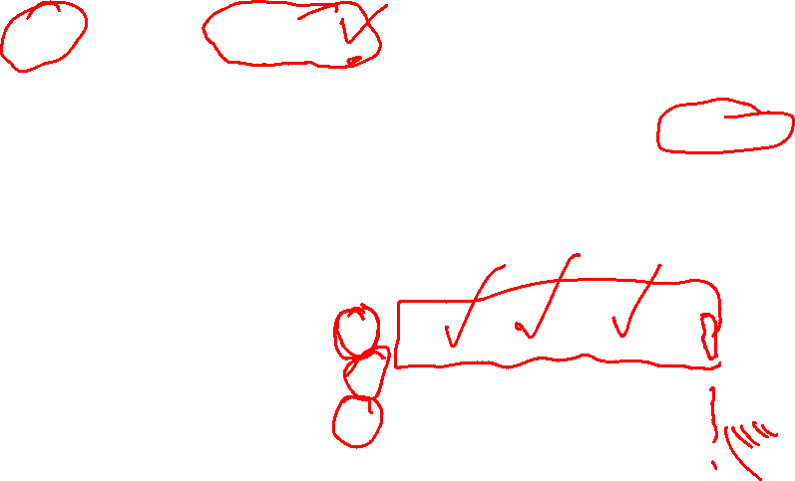
Notes:
Broadcast address is obtained by setting all the host bits to 1
To get the subnet mask all host bits to 0

Slide 10
Flooded broadcasts –
  Broadcasts for any subnet
  Use the IP address 255.255.255.255
  A router does not propagate flooded broadcasts because they are considered local
Directed broadcasts are for a specific subnet –
  Routers can forward directed broadcasts
  For example, a packet sent to the Class B address 129.30.255.255 would be a broadcast for network 129.30.0.0

Slide 11
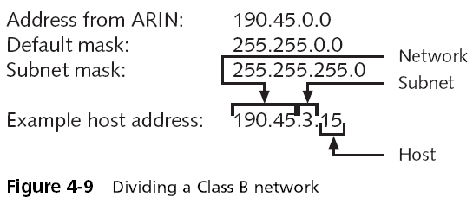

Reasons for subnetting –
  To match the physical layout of the organization
  To match the administrative structure of the organization
  To plan for future growth
  To reduce network traffic

Slide 12
When network administrators create subnets –
  They borrow bits from the original host field to make a set of subnets
  The number of borrowed bits determines how many sub networks and hosts will be available
Class C addresses also can be subdivided –
  Not as many options or available masks exist because only the last octet can be manipulated with this class

Slide 13
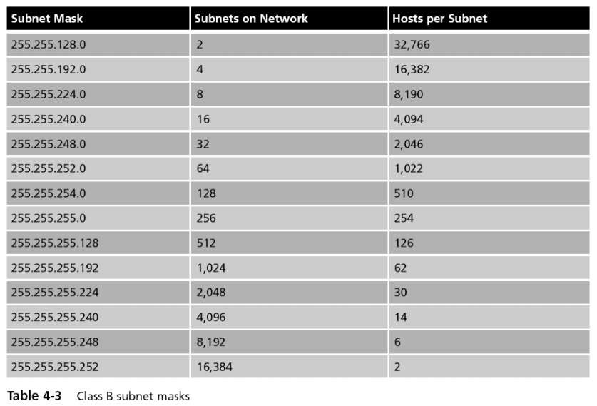

Slide 14
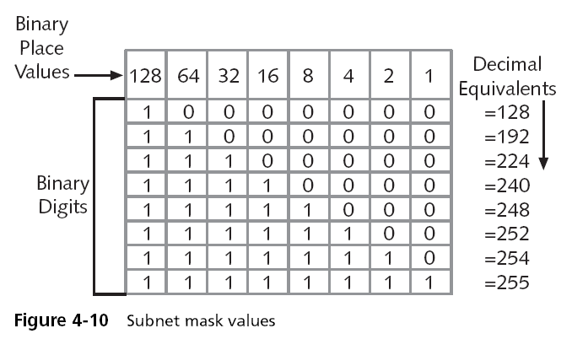

Slide 15
Suppose you had a network with: –
  Five different segments
  Somewhere between 15 and 20 TCP/IP hosts on each network segment
You just received your Class C address from ARIN (199.1.10.0)
Only one subnet mask can handle your network configuration: 255.255.255.224 (/27)
  This subnet mask will allow you to create eight subnets and to
place up to 30 hosts per network
Determine the subnet identifiers (IP addresses)
  Write the last masking octet as a binary number
  Determine the binary place of the last masking digit
Calculate the subnets
  Begin with the major network number (subnet zero) and increment by 32
  Stop counting when you reach the value of the mask
Determine the valid ranges for your hosts on each subnet
  Take the ranges between each subnet identifier
  Remove the broadcast address for each subnet

Slide 17
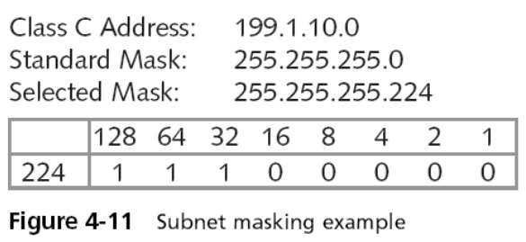
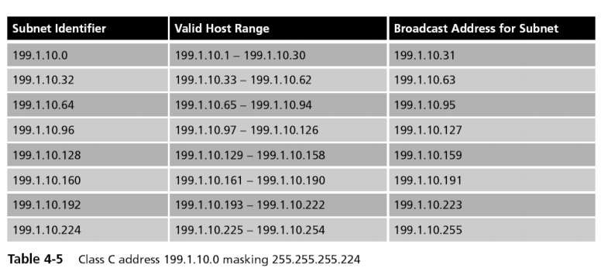

Slide 18

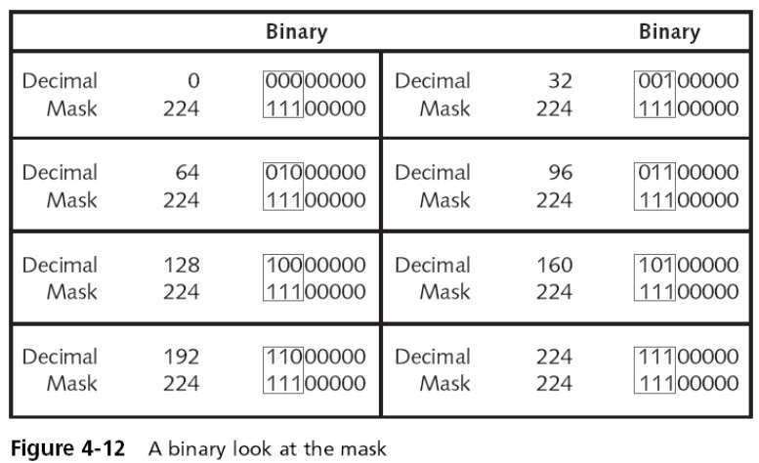

Slide 19
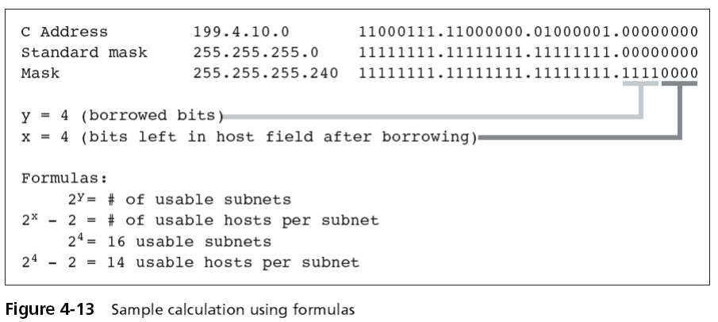

Slide 20
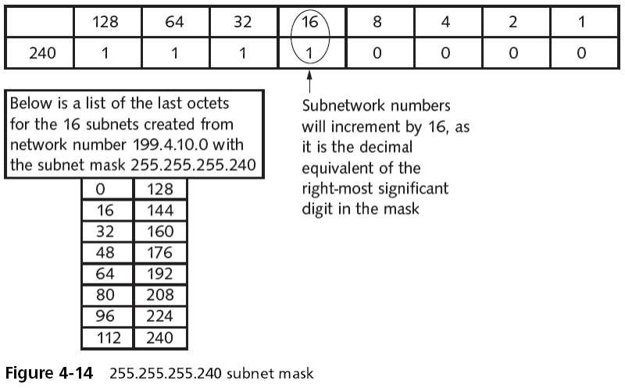

Slide 21

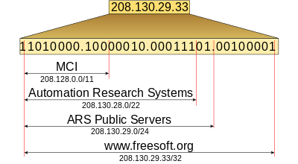
Classless Inter-Domain Routing (CIDR) –
  Developed to slow the exhaustion of IP addresses
  Based on assigning IP addresses on criteria other than octet boundaries
CIDR addressing method allows the use of a prefix to designate the
number of network bits in the mask –
  Example: 200.16.1.48 /25 (CIDR notation)
  The first 25 bits in the mask are network bits (1s)
The prefix can be longer than the default subnet mask (subnetting) or it can be shorter than the default mask (supernetting)

Slide 22
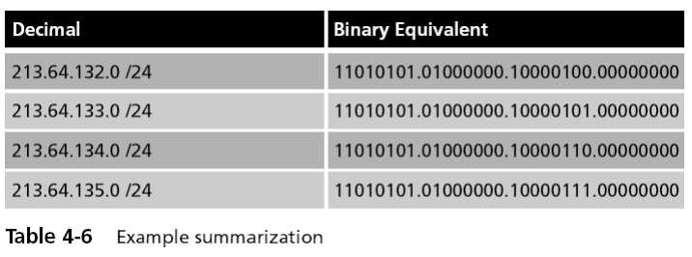
Summarization –
  Also know as route aggregation or supernetting
  Allows many IP subnets to be advertised as one
Reduces the number of entries in the router’s routing table
Summarizes a group of subnets
  Count the number of bits that are common to all of the networks you want to advertise
  Then use the prefix that identifies the number of common bits

Slide 23
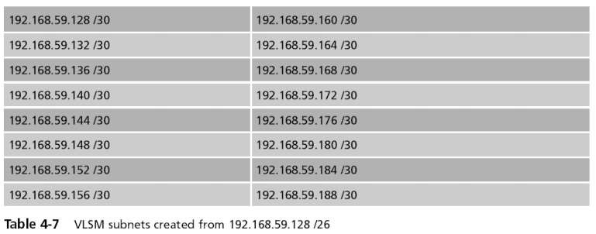
Variable length subnet masking (VLSM) –
  Allows different masks on the subnets
  Essentially done by subnetting the subnets
Basic routing protocols such as RIP version 1 and IGRP
  Do not support VLSM because they do not carry subnet mask
information in their routing table updates
  Are classful routing protocols
RIP version 2, OSPF, or EIGRP are classless protocols

Slide 24
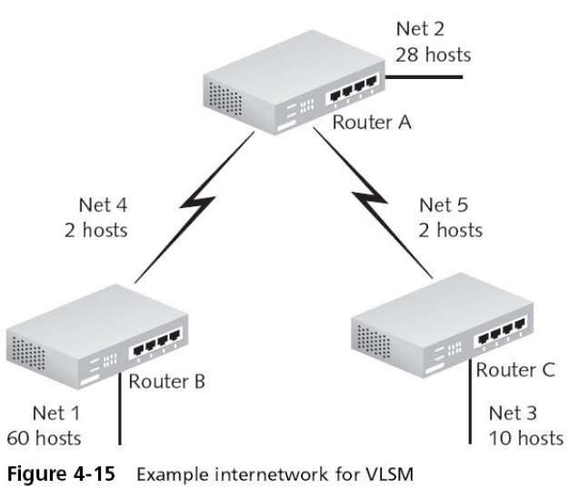

Slide 25
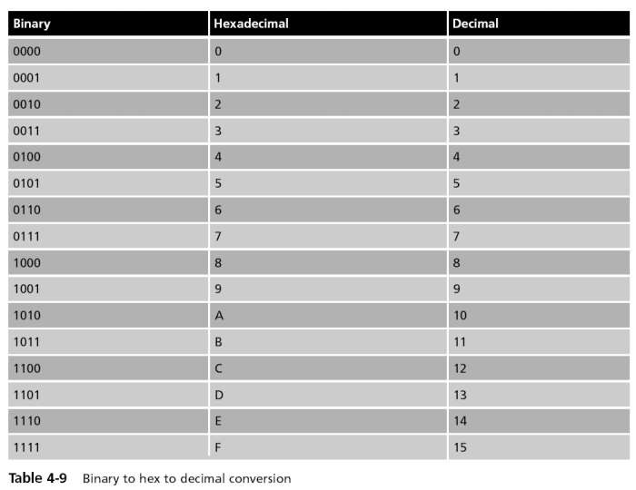

Slide 26

IP version 4 (IPv4) – The version of IP currently deployed on most systems today
IP version 6 (IPv6) – Originally designed to address the eventual depletion of IPv4 addresses
CIDR has slowed the exhaustion of IPv4 address space and made the move to IPv6 less urgent – However, CIDR is destined to become obsolete because it is based on IPv4
Network address translation (NAT) – Another technique developed in part to slow the depletion of IPv4 addresses – Allows a single IP address to provide connectivity for many hosts
NAT is CPU intensive and expensive – Some protocols do not work well with NAT, such as the IP Security Protocol (IPSec)
IPv4 does not provide security in itself – Has led to security issues with DNS and ARP
Security concerns were factored into the design of IPv6
IPv4 networks rely on broadcasting – Inefficient because many hosts unnecessarily see and partially process traffic not ultimately destined for them
IPv6 does away completely with broadcasting and replaces it with multicasting
IPv6 addresses are 128 bits compared with IPv4’s 32-bit structure

Slide 27
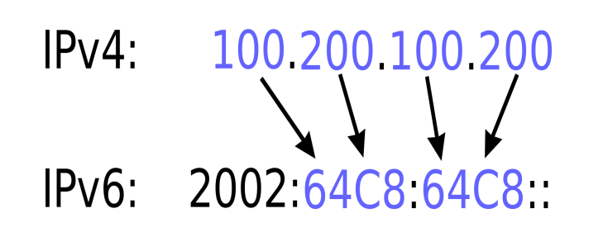
IPv6 addresses are expressed as hexadecimal numbers – Example:
3FFE:0501:0008:0000:0260:97FF:FE40:EFAB
IPv6 can be subnetted – CIDR notation is also used with IPv6
Example: 2001:702:21:: /48
Organizations requesting an IPv6 address may be assigned a /64 prefix
– Minimum subnet with space for over a billion hosts

Slide 28


Dual stack –
  Involves enabling IPv6 on all routers, switches, and end nodes but not disabling IPv4
  Both version 4 and version 6 stacks run at the same time
Tunneling –
  Encapsulates IPv6 traffic inside IPv4 packets
  Done when portions of a network are running IPv6 and other network areas have not been upgraded yet
  Greatest concern: security

Slide 29
Exercise
UL expanded its campus, and it was allocated a class B network address, 172.20.0.0, by the ISP. 5 departments: Administrator, Computer Science, Engineering, Library, and Student Labs.
Each department has approx. 25 computers; UL requires that each subnet accommodate at least 30 usable host addresses to allow future expansion. After analyzing the requirements, the admin decides to use the subnet mask 255.255.255.224 (/27). As the engineer, design the subnetting scheme.
Determine the number of subnets that can be created using the given mask.
Determine the number of usable host addresses available in each subnet
Determine the subnet ID, first usable host address, last usable address, and broadcast address for the 5 subnets. Use a table to present your answer

Slide 30

Solution
Network address: 172.20.0.0
Default mask prefix /16
New subnet mask 255.255.255.224 CIDR prefix /27
Number of borrowed bits: 27 – 16 = 11 borrowed from the original class B host portion
Number of subnets 2^11 = 2048, the network can be divided into
Number of usable host per subnet 2^5 = 32-2 = 30
Subnet ID and broadcast address
D. subnet incremental by 32 ( 256 – 224) = 32
First 5 subnets
subnet | Subnet ID | First usable | Last usable | broadcast
1 | 172.20.0.0 | 1 | 30 | 31
2 | 172.20.0.
3 | 172.20.0.
4 | 172.20.0.
5 | 172.20.0.
6 | 172.20.0.

Slide 31
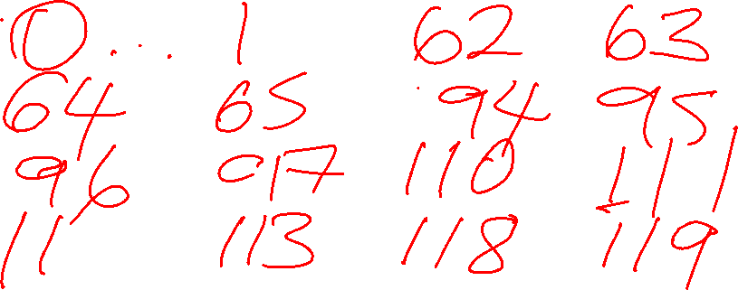

Slide 32

Example 2
Practice Scenario: Campus Network Subnetting (VLSM)
The University of Limpopo is constructing a new academic building to accommodate the increasing number of students and staff. To improve network performance, security, and management, the university's IT department has decided that each department will operate on its own subnet instead of sharing a single network.
The Internet Service Provider has allocated the network 172.20.0.0/24 for the building. Based on the current requirements and projected growth, the IT department has estimated the maximum number of devices that each department will need to support.
Department | Estimated Devices
Computer Science Laboratories | 60
Lecture Hall Wi-Fi | 30
Administration Offices | 12
Server Room | 4
Notes:
Allocate addresses efficiently using VLSM.

Slide 33
A. subnet mask for computer science lab – 192 ( 2^6-2)
B. lecture hall 2^5-2 = 30 mask 224
C. admin office needs 12 (2^4-2) 240
Server room needs 4 hosts 2^3 =8-2= 6 mask 248
To allocated subnets
256 -192 = 64,
Notes:
Computer science lab - /26
Lecture hall /27

Slide 34

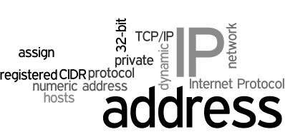
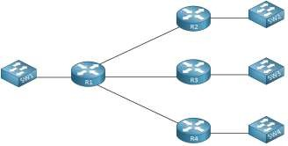
The ICANN and the ARIN work together to subdivide and issue addresses for Internet clients
Three classes of addresses (A, B, and C) are available to organizations
The two additional address categories are Class D and Class E
Subnetting involves subdividing assigned addresses
Routing tables can be created manually and dynamically
Advanced routing protocols such as RIP version 2, OSPF, and EIGRP support variable length subnet masking (VLSM)
The hexadecimal numbering system is also known as base 16 because
it has 16 available numerals
IPv6 is the latest version of IP addressing

Slide 35
EXAMPLE 1
A COMPANY HAS ALLOCATED THE NETWORK ADDRESS 192.168.50.0/24 FOR ITS NEW OFFICE. THE NETWORK ADMINISTRATOR MUST DIVIDE THE NETWORK INTO SEPARATE SUBNETS FOR THE FOLLOWING DEPARTMENTS:
Administration: 50 hosts
Finance: 25 hosts
IT Support: 12 hosts
Server Room: 6 hosts
To minimise wastage of IP addresses, the administrator decides to use Variable Length Subnet Masking (VLSM).

Slide 36
EXAMPLE 2
A college has been allocated the network 172.16.20.0/24. The network must support four departments:
Computer Science: 70 hosts
Administration: 30 hosts
Library: 14 hosts
Server Room: 5 hosts
Using VLSM, allocate suitable subnets to each department and determine the subnet mask, network address, usable host range, and broadcast address.

Slide 37
Example 3
The University is establishing a new Cybersecurity Teaching Laboratory. The network administrator has been allocated the IPv4 network 192.168.40.0/24. The laboratory network must be divided into at least five equal-sized subnets, and each subnet must support at least 25 usable host addresses.
Without using VLSM:
a) Determine the number of bits that must be borrowed from the host portion of the original network.
b) Determine the new subnet mask in both dotted-decimal and CIDR notation.
c) Determine the total number of subnets created and the number of usable hosts available in each subnet.
d) Provide the network address, first usable address, last usable address and broadcast address of the third subnet.

Slide 38
Example 4
Troubleshooting an Incorrect IP Configuration
A technician is configuring computers in a university laboratory. The laboratory uses the subnet 172.20.32.0/20.
Three computers have been assigned the following addresses:
Computer IP address
PC-A 172.20.35.120/20
PC-B 172.20.47.250/20
PC-C 172.20.48.10/20
The technician claims that all three computers belong to the same subnet.
a) Determine the subnet mask in dotted-decimal notation.
b) Determine the network address and broadcast address of the subnet containing PC-A.
c) Determine whether PC-B belongs to the same subnet as PC-A. Justify your answer.
d) Determine whether PC-C belongs to the same subnet as PC-A. Justify your answer using the calculated address range.

Slide 39
The University has been allocated 192.168.100.0/24 for a new building. Four units require separate networks:
Unit Required hosts
Student Computer Laboratory 100
Staff Offices 50
Research Laboratory 25
Network Management 10
The network administrator wants to minimise wasted IPv4 addresses by using Variable Length Subnet Masking (VLSM).
a) Arrange the four networks in the correct order in which addresses should be allocated. Explain the principle used.
b) Design an appropriate VLSM addressing scheme. For each subnet, provide:
• Network address ,CIDR prefix , First usable host
• Last usable host
• Broadcast address
c) State the first address block that remains available after all four networks have been allocated.

Slide 40
Network Administrator's Addressing Decision
A company has been allocated 192.168.200.0/24. An administrator divides the network using the subnet mask 255.255.255.224.
A server is configured with:
IP address: 192.168.200.95
Subnet mask: 255.255.255.224
Another technician argues:
“192.168.200.95 is a valid host address because it falls within the 192.168.200.0–192.168.200.255 address range.”
Evaluate this statement.
a) Convert the given subnet mask to CIDR notation.
b) Determine the block size/increment.
c) Identify the subnet containing 192.168.200.95.
d) Determine the network and broadcast addresses of this subnet.
e) Determine whether 192.168.200.95 can be assigned to the server and justify your answer.

Slide 41
A university wants to divide the private network 10.50.0.0/16 among different research laboratories. For administrative simplicity, all laboratories must initially receive equal-sized subnets. The university requires at least 20 separate subnets, with each subnet capable of supporting at least 1,000 usable host addresses.
As the network administrator:
a) Determine the minimum number of subnet bits that must be borrowed to provide at least 20 subnets.
b) Determine the resulting prefix length and subnet mask.
c) Determine the number of usable hosts supported by each subnet.
d) Based on your calculations, determine whether the proposed subnetting scheme satisfies both requirements. Justify your answer mathematically.
e) Determine the network address of the 6th subnet.

Slide 42


