Slide 1
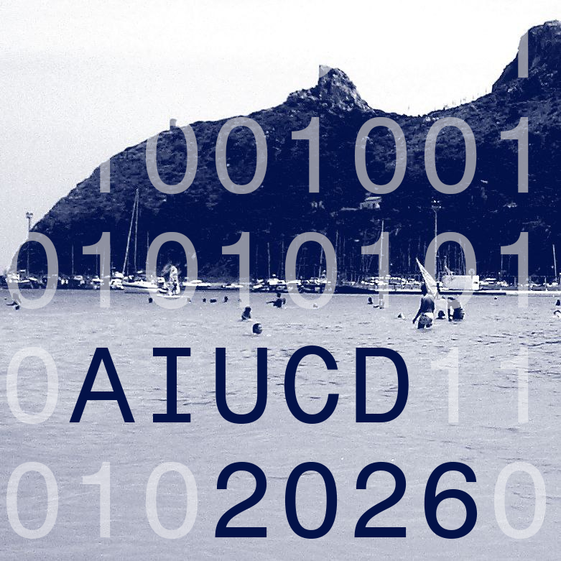
AIUCD 2026 · CAGLIARI
Assessing LLM Capabilities in Cultural Heritage
Recent Trends and Gaps in Benchmarks
Remo Grillo¹˒² · Gianmarco Spinaci¹˒² · Lukas Klic² · Giovanni Colavizza¹˒³
¹ Dip. di Filologia Classica e Italianistica, Università di Bologna
² I Tatti — The Harvard University Center for Italian Renaissance Studies, Firenze
³ Dept. of Communication & Centre for Digital and Computational Humanities, University of Copenhagen
15TH AIUCD CONFERENCE

Slide 2
MOTIVATION
From experiment to infrastructure — 2024–2026
CONVERGENCE 01
LLMs enter the everyday
Large & multimodal models have moved from experiments to systematic integration in GLAM and Digital-Humanities workflows: access, description, indexing, research assistance.
CONVERGENCE 02
Benchmarks are saturating
General-purpose suites hit near-ceiling performance, eroding their discriminative value and pushing the field toward “frontier” evaluations.
So the question is not “which model is better?” —
but “what are we measuring, and at what epistemic cost?”

Slide 3
THE CORE ARGUMENT
A benchmark is never a neutral ruler
Benchmarks are technical and epistemic tools: they don’t just check fit — they define what counts as “understanding”.
They enable comparability, but can mislead where correctness is contextual, interpretive, and inseparable from sources.
THE GAP
Quantitative score
≠ operational usefulness
A recurring distance between what leaderboards reward and what cultural institutions actually need.
Headline scores overstate practical capability — they under-specify provenance, evidence and ambiguity.
And they rarely reflect end-to-end pipeline behaviour in real institutions.

Slide 4
SCOPE & WORKING DEFINITIONS
Three material types, three ways in
CH, pragmatically: museums, archives, libraries and art-historical contexts — plus the infrastructures that represent them (knowledge graphs · metadata · thesauri · search).
MATERIAL TYPE
Structured data
Knowledge graphs & linked data — collections, authorities, events, relations.
MATERIAL TYPE
Images
Artworks & exhibits demanding symbolic and interpretive reading.
MATERIAL TYPE
Unstructured text
Catalogue prose, finding aids, correspondence, OCR’d sources.
Part 1 · KGQA
Part 2 · VQA
Part 3 · Documents
LLMs enter CH workflows three ways → (i) narrative / descriptive generation · (ii) extraction into structured fields · (iii) tool- & retrieval-mediated use

Slide 5
PART 1 OF 3 — STRUCTURED DATA
Knowledge Graph Question Answering
Can a system translate a domain question into an executable graph query (SPARQL) that respects the target schema, ontology and modelling choices?

Slide 6
KGQA · THREE SUB-TRENDS
From query execution to requirements fidelity
TREND A
Ontology text-to-SPARQL
Path-based prompting over CIDOC-CRM; “difficulty” operationalised as graph-traversal depth.
Caveat: templated, auto-generated questions lack real-world grounding.
TREND B
Competency Questions
NL requirements that scope & validate an ontology — anchoring evaluation to documented user needs and real specialist inquiry.
TREND C
Benchmarking the benchmark
A “meta” step: making CQ generation itself comparable. Upstream choices shape the meaning of every downstream score.
TCRMQ
CIDOC-QA-BENCHMARK
ArCo
Zeri
HiCO
Polifonia · IDEA
Bench4KE
AskCQ

Slide 7
PART 2 OF 3 — VISUAL DATA
Visual Question Answering
Can a system move beyond surface features to the symbolic interpretation and narrative inference artworks demand — when accuracy degrades systematically as reasoning complexity rises?

Slide 8
VQA · ACCURACY & REASONING DEPTH
Accuracy decays as reasoning deepens
Early VQA (Antol 2015; AQUA): synthetic Q–A pairs, exact-match scoring → 35–60% reflects pattern exploitation, not visual reasoning.
100
75
50
New generation (VQArt-Bench): symbolic interpretation & narrative inference, zero-shot.
25
0
Accuracy degrades systematically as reasoning complexity rises — models stay anchored to surface features.
Recognition
Attribution
Symbolic
Narrative
REASONING COMPLEXITY →
Fig. 1 — Accuracy vs. reasoning complexity. Schematic of reported trend.

Slide 9
VQA · BROAD VS. DOMAIN-SPECIFIC
Wide coverage, shallow culture
100%
85%
Large cross-disciplinary suites (MMMU, HSSBench) include CH — but humanities accuracy sits around or below 60%.
75%
58%
≈ 60% ceiling
54%
50%
A structural trade-off: broad coverage vs. cultural specificity.
25%
0%
General
MMMU
HSSBench
→ Domain-specific benchmarks remain essential for testing contextual grounding and interpretive reasoning.
(broad tasks)
humanities
humanities
Fig. 2 — Humanities accuracy on broad benchmarks. Schematic (≈ ≤ 60%).

Slide 10
PART 3 OF 3 — UNSTRUCTURED DOCUMENTS
Question Answering over Unstructured Documents
When the source itself fights back — catalogue prose, finding aids, correspondence, OCR’d primary sources — under orthographic variation, multilinguality, and the demand that every output stays traceable to a document and page.

Slide 11
UNSTRUCTURED DOCUMENTS · THREE TRACKS
Not just answers — how systems cope
1
QA over historical collections
Retrieval & grounding implicit. Difficulty + time-sensitivity; same sources across raw OCR / corrected OCR / page images expose where pipelines break.
ArchivalQA
ChroniclingAmericaQA
2
Upstream extraction & normalization
“Making text usable” is itself benchmarked — field-level extraction from index cards before any QA can run.
Humanities Data Benchmark
Zettelkatalog
3
Evidential, relational claims
Who, where, when — relational, temporally-qualified extraction. DH-facing RAG pairs automatic scoring with expert judgement.
HIPE-2026
Topic-RAG
FolkRAG

Slide 12
CROSS-CUTTING METHODOLOGY · 1
Can we even trust the score?
VALIDITY THREAT
Contamination & memorization
Public CH sources are plausibly in pre-training data; some models reconstruct test sets from memory, not reasoning.
→ Anti-leakage strategies, e.g. never-web-indexed reference documents.
ROBUSTNESS AXIS
Primary-source noise
OCR errors & layout effects treated as an explicit robustness axis — not assumed away.
→ Keep the task fixed, vary the representation, localize where pipelines break.

Slide 13
CROSS-CUTTING METHODOLOGY · 2
What “knowledge” is being tested?
TREND
WHAT IT MEASURES
BENCHMARKS
Historical interpretation
Scale-first, multilingual, catalogue-aligned — only partially captures interpretive work.
Museum-65
Cultural bias
Culture as a measurable bias, not just content — geo-linguistic asymmetries.
CulturalVQA · CVQA (31 langs / 30 countries)
Expert-level knowledge
MCQs over Seshat vs. open-ended primary sources — the gap between apparent and usable performance.
HiST-LLM · HistBench
Synthetic data
Scalable, but risks confining evaluation to the epistemic boundaries of the generating model.
LLM-generated Q&A

Slide 14
THE BIFURCATION
The field is quietly splitting in two
Massive benchmarks for training & stress-testing (Museum-65) — optimize for base capability.
base capability
HistBench
expert curation
CulturalVQA
Small, high-validity benchmarks for humanities fidelity (CulturalVQA, HistBench) — optimize for practice fidelity.
The community is implicitly choosing one or the other.
Museum-65
practice fidelity
train / stress-test
Bridging them needs end-to-end pipelines, specialized rubrics, anti-contamination.
SCALE / COVERAGE →
Fig. 3 — Scale vs. validity. Conceptual map.

Slide 15
GAPS & POINTS OF INTERVENTION
Isolated scores ≠ whole-pipeline performance
1
Vary input conditions
Clean / noisy / image as standard practice, not an afterthought.
2
Evaluate structured tasks against needs
Against modelling assumptions & user requirements — not just whether a query executes.
3
Allow warranted alternatives
For interpretive tasks, accept plural answers rather than forcing a single gold.
4
Report operational constraints
Cost, latency, maintainability as first-class metrics.

Slide 16
CONCLUSION
The question isn’t whether models are “good” in the abstract.
It is whether full workflows produce outputs that stay inspectable and defensible in humanities settings.
Without provenance, uncertainty and end-to-end behaviour, benchmarks reward test-shaped behaviour — not systems we can responsibly adopt.

Slide 17
Thank you
Assessing LLM Capabilities in Cultural Heritage:
Recent Trends and Gaps in Benchmarks
Remo Grillo · Gianmarco Spinaci · Lukas Klic · Giovanni Colavizza
Università di Bologna · I Tatti – Harvard · University of Copenhagen
rgrillo@itatti.harvard.edu

