Slide 1
Beer Recommendation Model
Tomer Danon
Data Science Capstone
University of Denver

Slide 2
Introduction
Background
5 years in beer industry.
3 years experience in brewing industry
Novel Strand Brewing
Interesting, fun, and exciting project!
Applicable to many platforms/apps.
Great for portfolio!

Slide 3
Introduction
Abstract
“How was you visit to ___?”
“Are you enjoying your recent purchase of____?
Many user-based review platforms exist
Google, Yelp!, Trip Advisor, etc.
BeerAdvocate, Untapped, ratebeer.com, etc.
Large amounts of data about user preferences.
Opportunity! Use this data to recommend new products based on shared preferences → collaborative filtering

Slide 4
The Dataset
Source
Beer reviews from BeerAdvocate.com
Online beer community since 1996
Data ~10 years old
Attributes:
Ratings for aroma, appearance, palate, taste, and overall (average) rating.
Brewery name, beer style, username
Beer ID, Brewery ID

Slide 5
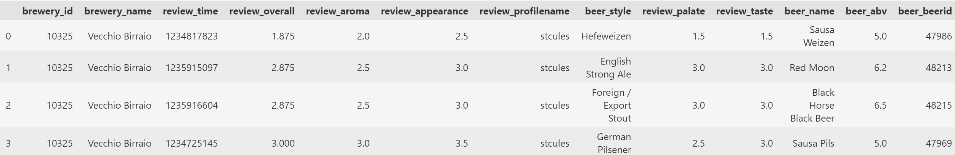
The Dataset
Overview
1,586,614
Reviews
33,388
Users
66,055
Beers
104
Styles
5,743
Breweries

Slide 6
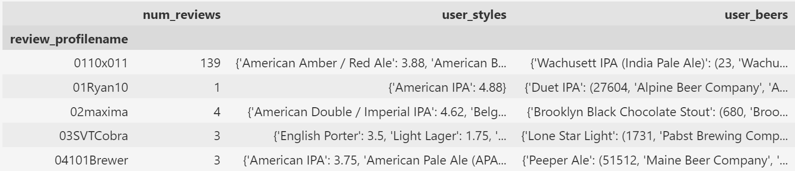
Data Cleaning & Preparation
Users DataFrame
How many reviews?
Scores per styles reviewed
Beer info & scores per beers reviewed

Slide 7
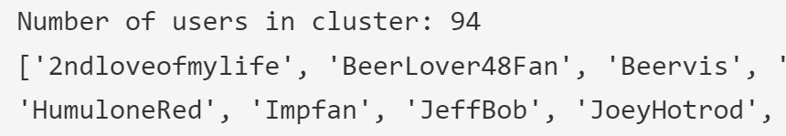
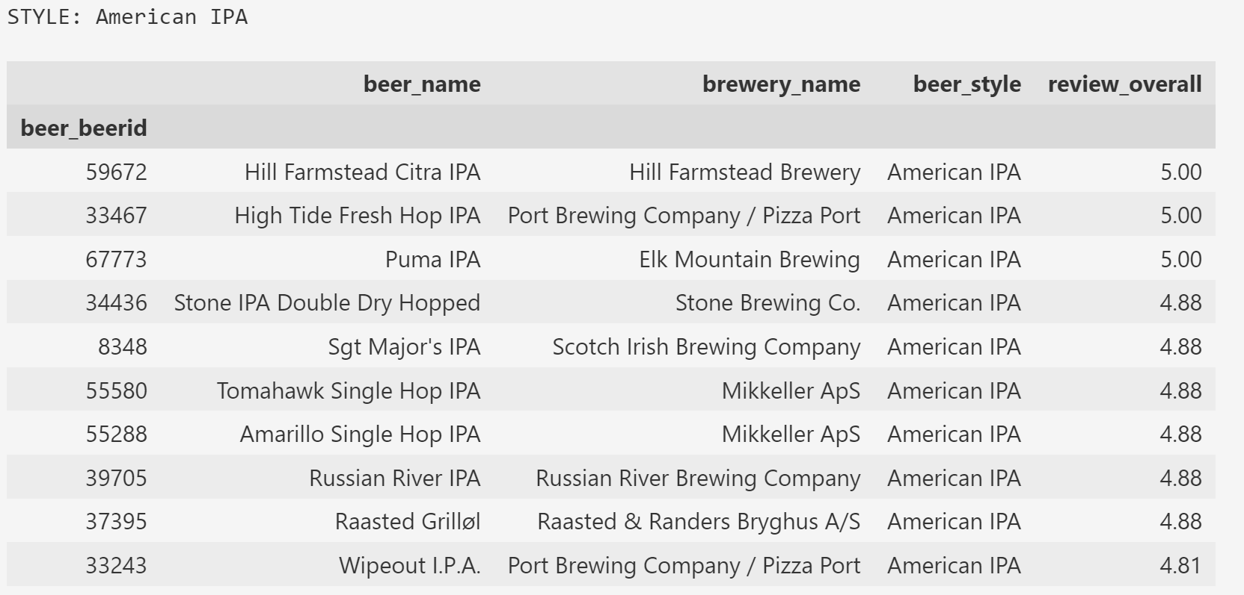
Recommendation Model
Style or Beer
New user provides beer style or beer name preferences.
Find users who have an average rating of 4.25 or higher for all preferred styles or beers - CLUSTER.
Find beers of the preferred styles or beer from the users in the cluster.
Group by beer and average score from all of the user clusters
Suggest top 10.

Slide 8
Conclusions
Evaluation requires user feedback on the recommendations they receive.
Potential design improvement for a machine learning algorithm.

Slide 9
Thank You! Questions?
Tomer Danon
MS Data Science @ DU
Tomer.Danon@du.edu
danont@gmail.com
Connect with me on LinkedIn!

