Slide 1
Short Answer Scoring
Supervised by
Prof. Aly Aly Fahmy
Dr. Mohammad El-Ramly
TA. Omar Khaled
Implemented by
20140056 | Islam Emam Mohamed
20140128 | Remon Atef Boshra
20140116 | Rami Mohamed Salah El-Din
20140109 | Khaled Yousef Omar
20140214 | Mohamed Ahmed El-Sayed

Slide 2

What is the project
An automated short answer scoring research-based program.

Slide 3
Our solutions
NLP
Disco-semantic similarity
simMetrics syntax similarity
Machine Learning
KNN
SVM
Naive Bayes
Deep Learning
Fully connected Neural Network

Slide 4
Data preprocessing
Data Cleaning
Tokenization
Data Stemming
Stop words cleaning
Data Embeddings
Doc2Vec
Word2Vec
InferSent
Skip-thoughts

Slide 5
Embeddings Comparison
InferSent Model
Based on Bi-directional lstm NN
Trained on huge data-set consist of 57,000 human generated sentences labeled on 3 cat.
Made by facebook research
Skip-Thoughts Model
Similar idea to word2vec skip-gram
Based on RNN encoder-decoder

Slide 6
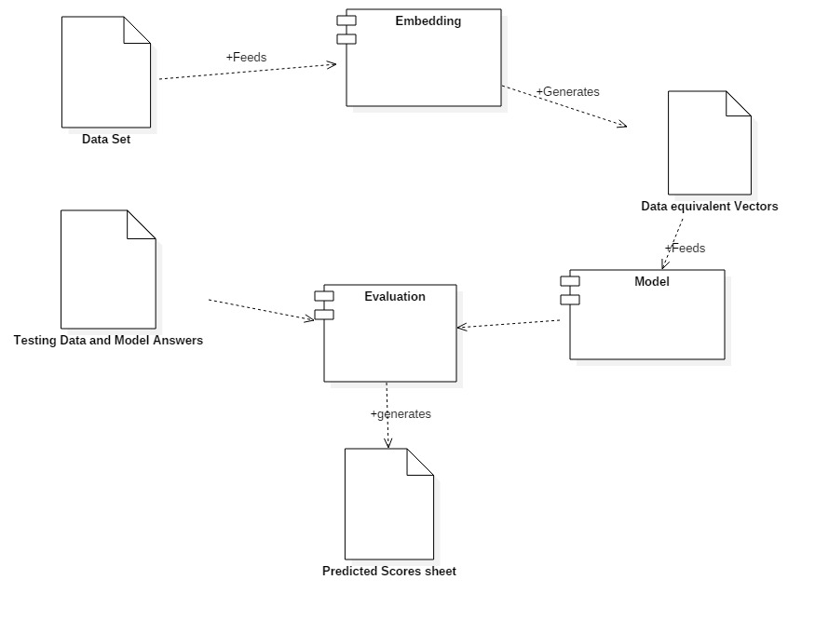
Classification System Component Diagram

Slide 7
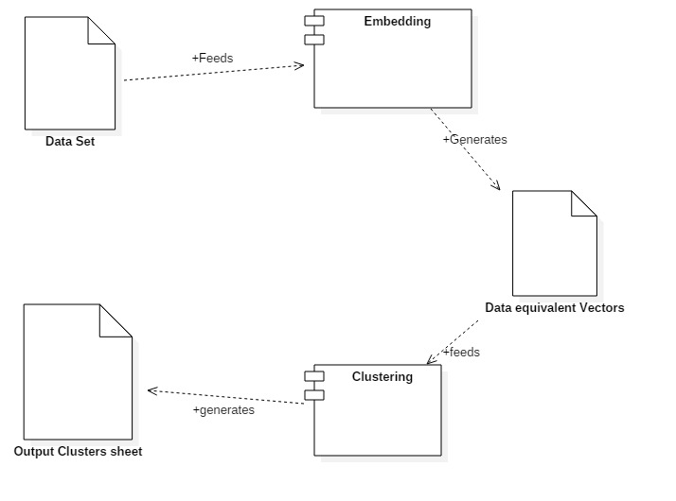
Clustering System Component Diagram

Slide 8
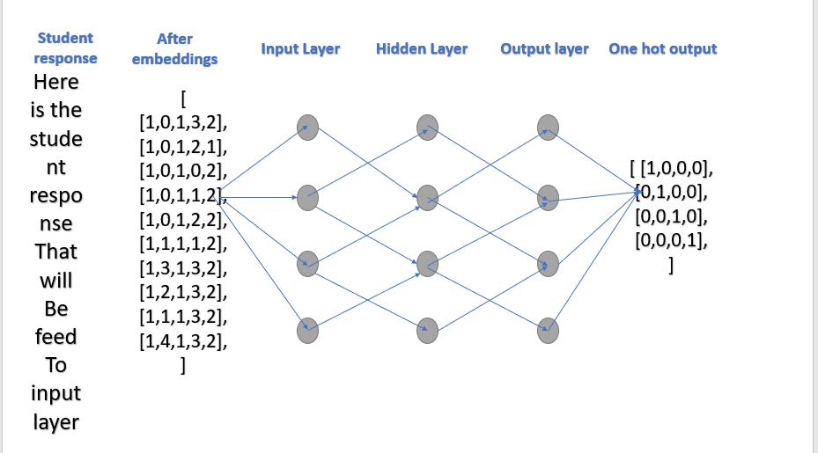
How our model works

Slide 9
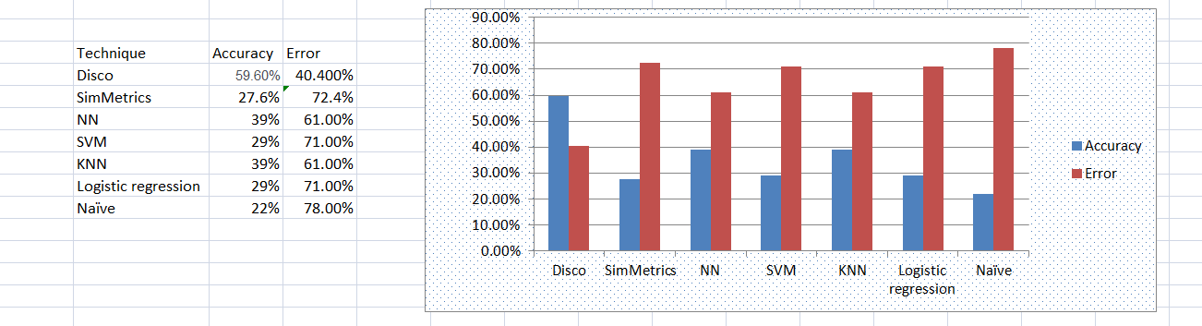
Statistics

Slide 10
Neural Network Models results
Data Set | Embeddings | Accuracy
Prof. Ali Fahmy & Dr. Wael Gomaa | Word2Vec | 55%
Kaggle Data Set | Doc2Vec | 40%
Kaggle Data Set | InferSent | 50%
Kaggle Data Set | Skip-Thoughts | 43%

Slide 11
Any Questions ?

