Slide 1
🎗️ ADVANCED AI & SUPERVISED LEARNING IN CLINICAL ONCOLOGY
BREAST CANCER WISCONSIN (ORIGINAL) CLASSIFICATION
A Rigorous Comparative Benchmark of Five Supervised Algorithms for Automated Biopsy Diagnosis
Academic Review Session: Dedicated & Prepared for Eng Mathew
👥 Project Team: Remon Ayman • Marcelino • Bishoy • Mario • Engy • Karen
Rigorous Pipeline: Exploration • Clean Preprocessing • Outlier & Correlation EDA • 5-Fold Stratified CV • Zero Leakage
97.12%
Peak Test Accuracy
95.83%
Clinical Recall (Sens.)
0.9961
Highest ROC-AUC (ANN)
Zero Leakage
Strict Train-Only Scaler

Slide 2
● EXECUTIVE SUMMARY
1. Problem Statement & Project Objectives
Clinical Problem Statement
• Breast cancer remains one of the most prevalent and life-threatening oncological conditions globally.
• Fine Needle Aspirate (FNA) biopsy cytology requires specialized pathology interpretation, which can be subjective, fatigue-prone, and time-intensive.
• False Negatives in cancer diagnosis are catastrophic, leading to delayed life-saving intervention and treatment.
• An objective, reproducible computer-aided diagnostic (CAD) system is required to empower clinicians with fast, highly reliable secondary screening.
Core Project Objectives
✔ Rigorous Data Preprocessing: Impute missing values, remove duplicates, drop ID features, and eliminate all data leakage via strict train-only parameter fitting.
✔ In-Depth EDA: Uncover cytological feature distributions, multicollinearity, and domain outliers across 6 comprehensive visual analyses.
✔ Multi-Model Implementation: Implement and tune 5 distinct supervised classification paradigms: KNN, Decision Tree, Random Forest, ANN, and SVM.
✔ 5-Fold Stratified Cross-Validation: Ensure hyperparameter tuning is scientifically grounded on training data without test contamination.
✔ Clinical Evaluation: Maximize Recall (Sensitivity) for malignant cases while evaluating Accuracy, Precision, F1-Score, and ROC-AUC.

Slide 3
● TASK 1: DATASET EXPLORATION
2. Dataset Source & Attribute Breakdown
Dataset: Breast Cancer Wisconsin (Original) — UCI Machine Learning Repository
Donated by Dr. William H. Wolberg (University of Wisconsin Hospitals, Madison). Total 699 clinical instances, 11 attributes.
1. Sample_Code_Number: Arbitrary Patient Identifier — Dropped during preprocessing to prevent spurious correlation.
2. Clump_Thickness (1-10): Degree of cell layer agglomeration — Higher values represent multilayered malignant clusters.
3. Uniformity_of_Cell_Size (1-10): Consistency in biopsy cell dimensions — Severe irregularity is a classic hallmark of malignancy.
4. Uniformity_of_Cell_Shape (1-10): Cellular membrane geometry — High correlation (r=0.91) with cell size uniformity.
5. Marginal_Adhesion (1-10): Inter-cellular adhesive strength — Loss of adhesion facilitates metastatic invasion.
6. Single_Epithelial_Cell_Size (1-10): Cytoplasmic volume & nuclear enlargement — Hypertrophy indicates malignant transformation.
7. Bare_Nuclei (1-10): Nuclei unencapsulated by cytoplasm — Contains 16 missing values ('?'); vital predictor (r=0.82).
8. Bland_Chromatin (1-10): Nuclear chromatin texture — Coarse chromatin aggregates distinguish cancer cells.
9. Normal_Nucleoli (1-10): Nucleolar prominence and number — Hyperactive nucleoli reflect rapid malignant cell division.
10. Mitoses (1-10): Observed mitotic figures in cytology — Direct indicator of cellular proliferation rate.
11. Class (Target Variable): 2 = Benign (65.5%), 4 = Malignant (34.5%) — Re-mapped to 0 (Benign) and 1 (Malignant) as positive class.

Slide 4
● TASK 2: DATA PREPROCESSING
3. Data Cleaning, Preprocessing & Leakage Prevention
Step 1: Handling Missing Values
16 records (2.3%) in 'Bare_Nuclei' held '?' strings. Replaced with NaN. Imputed via Median = 1.0. Imputer was FIT strictly on X_train only to prevent test contamination.
Step 2: Handling Duplicate Records
Identified 8 exact duplicate records (identical ID and identical features). Removed to preserve independent observation integrity, retaining 691 clean records.
Step 3: Removing Irrelevant Features
Dropped 'Sample_Code_Number'. Unique patient IDs contain no clinical or biological predictive signal and cause artificial memorization.
Step 4: Target Class Re-mapping
Mapped Benign (2) -> 0 and Malignant (4) -> 1. Formatted malignant cases explicitly as the positive class as demanded by medical diagnostic protocol.
Step 5: Stratified 80:20 Partition
Train set = 552 samples (80%), Test set = 139 samples (20%). Stratified split guarantees exactly 34.5% malignant cases in both splits.
Step 6: Standardization Without Leakage
StandardScaler fitted on X_train only; mean and variance parameters applied to transform X_train and unseen X_test.

Slide 5
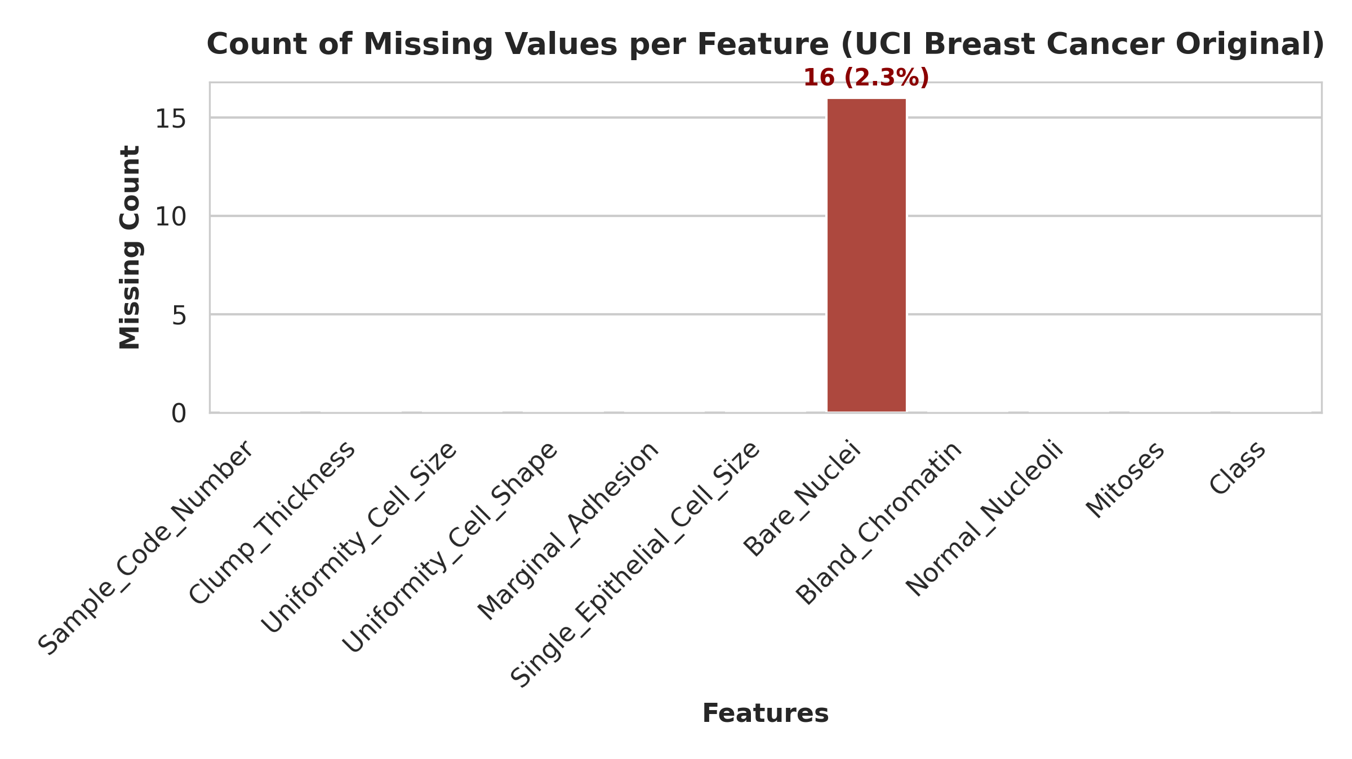
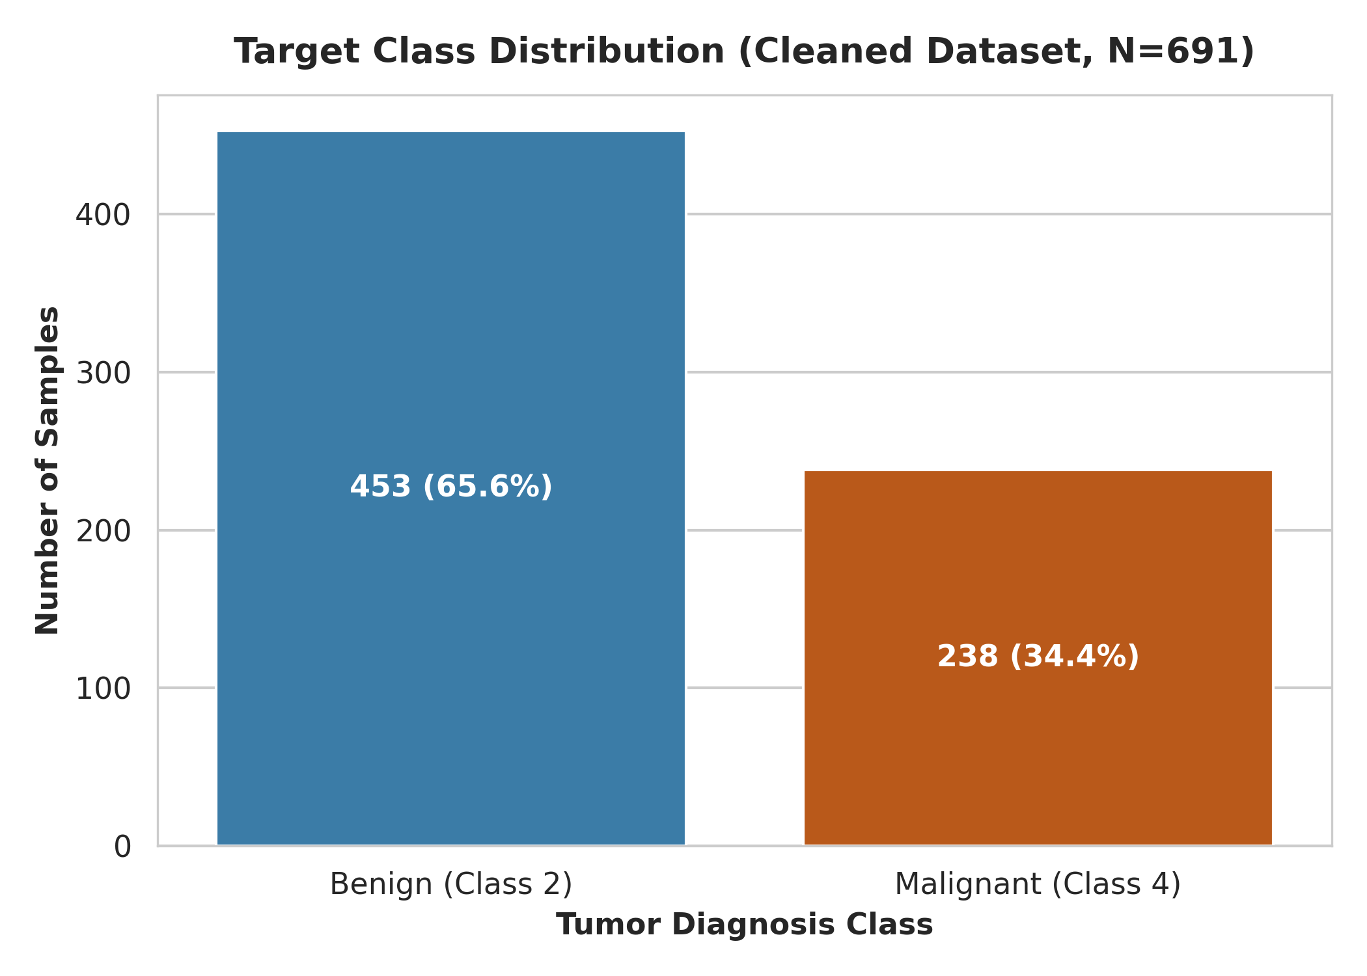
● TASK 3: EXPLORATORY DATA ANALYSIS
4. EDA: Missing Values & Target Class Distribution
Key Clinical & Statistical Insights:
• Missingness is isolated to Bare_Nuclei (16 records / 2.3%). Median imputation preserves all samples without statistical distortion.
• Class distribution: 453 Benign (65.6%) vs 238 Malignant (34.4%). Imbalance is moderate and naturally handled by stratified sampling.

Slide 6
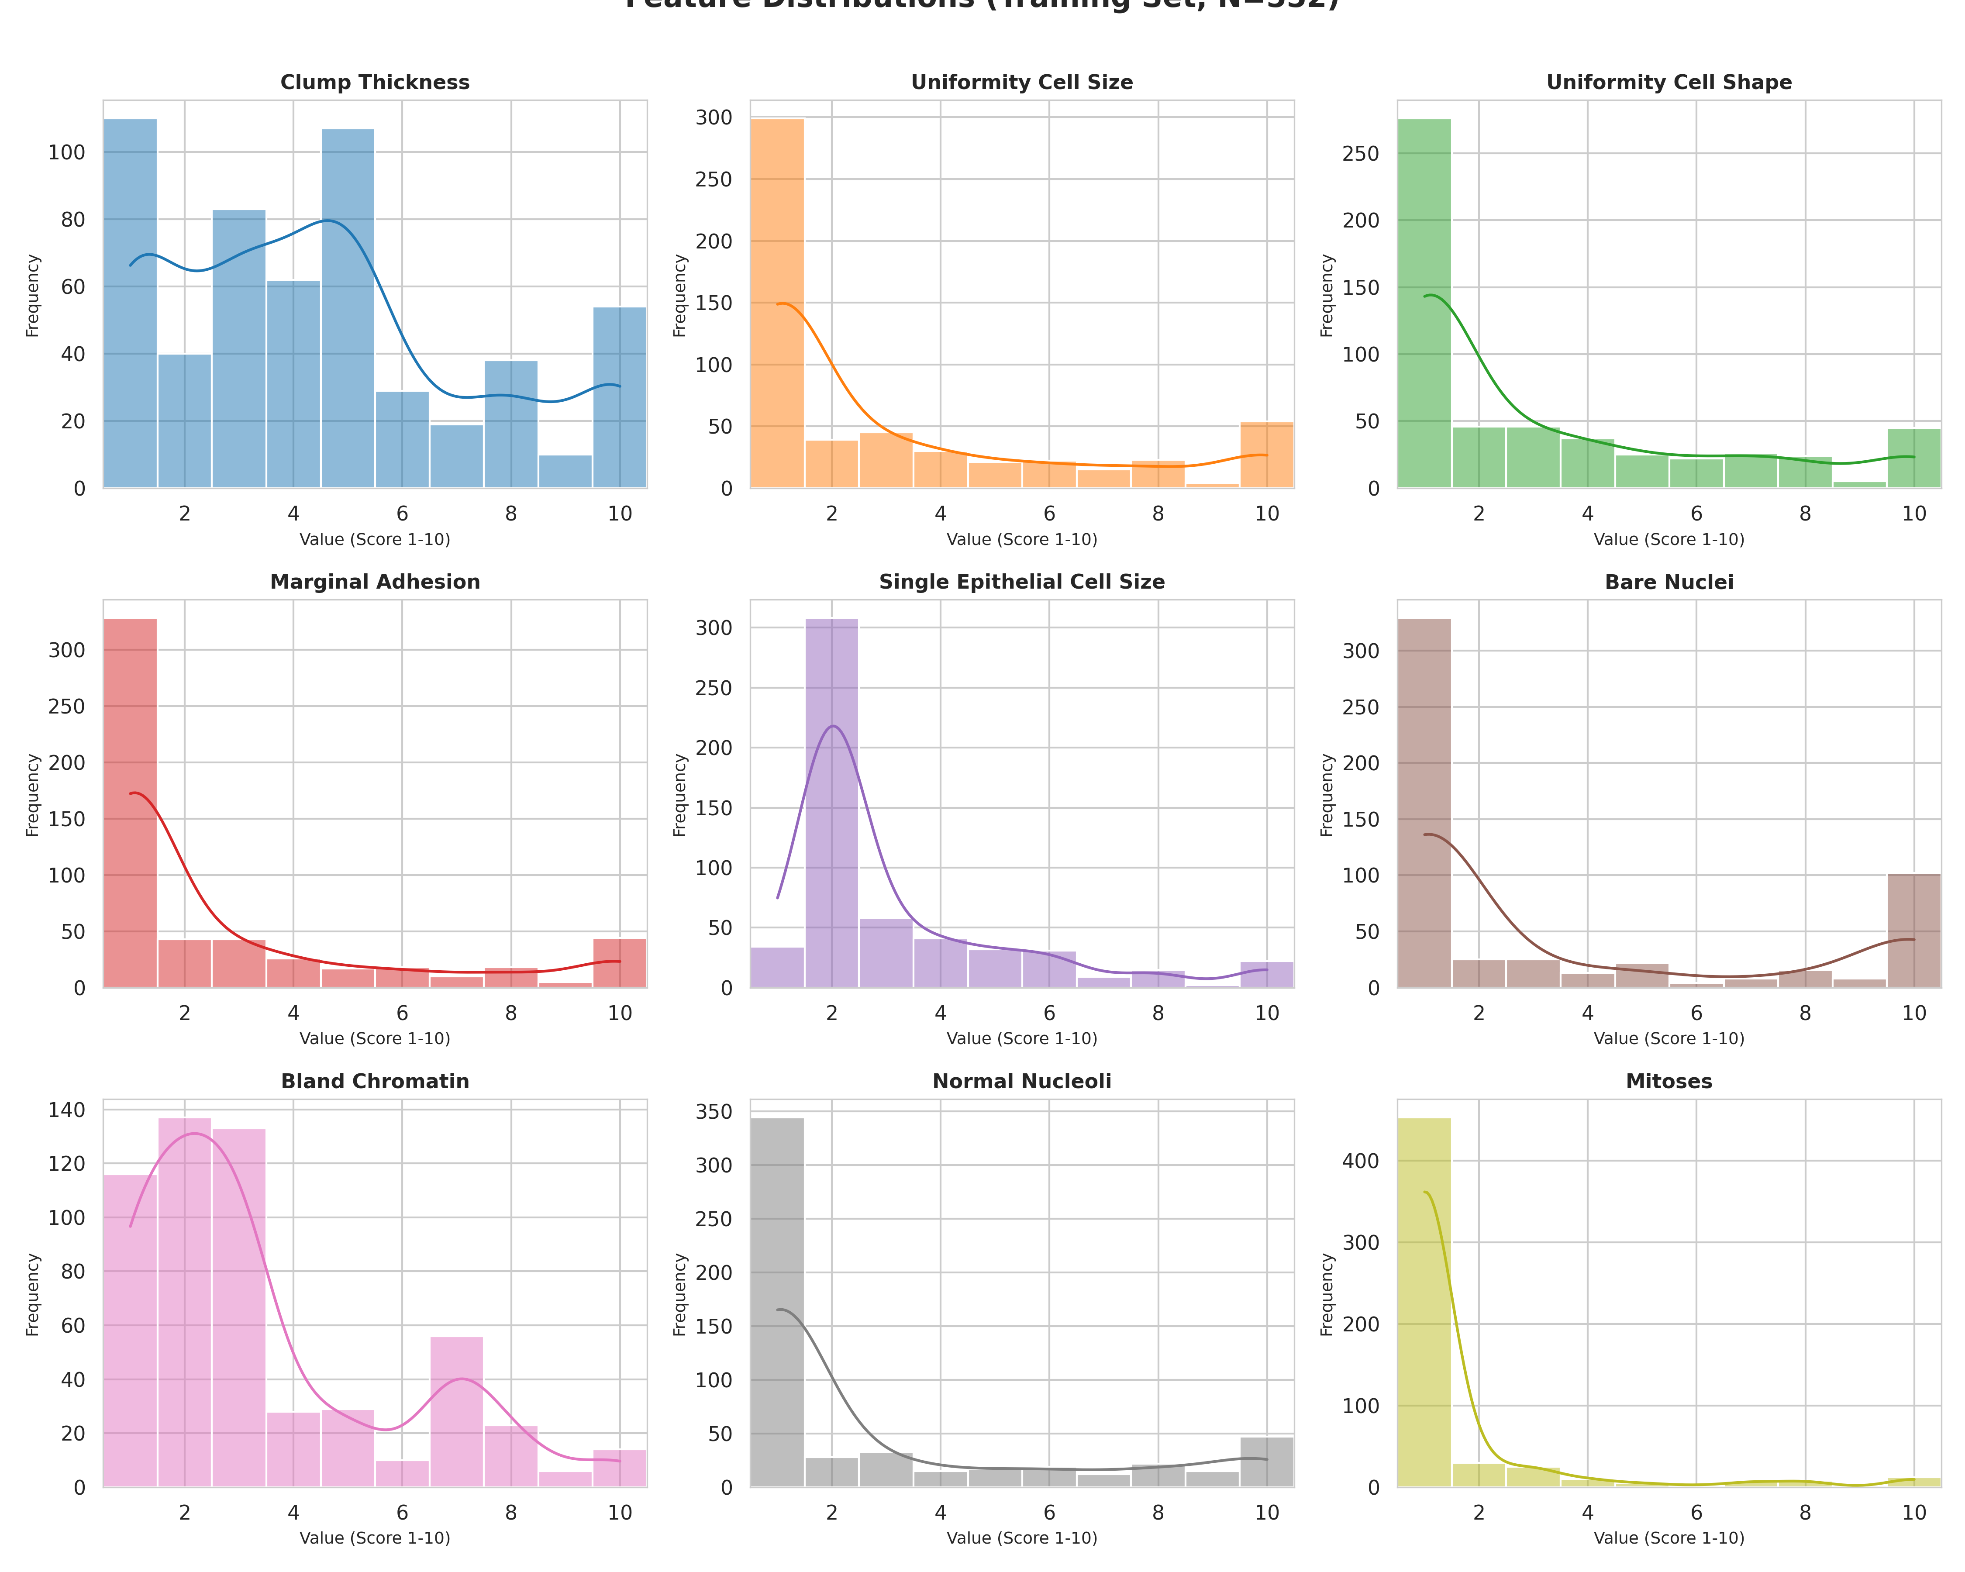
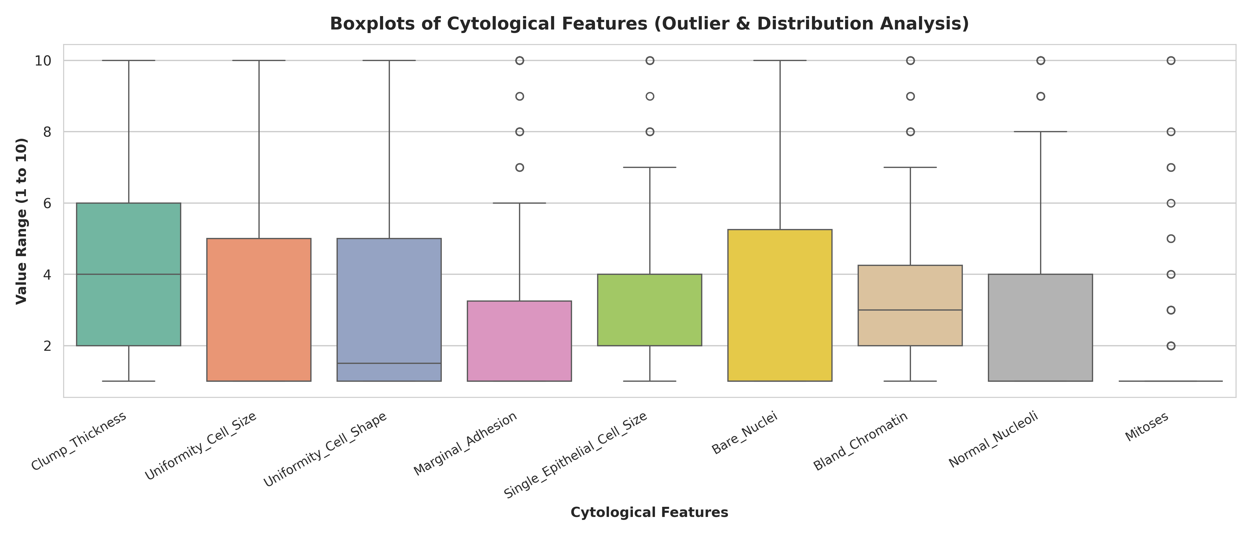
● TASK 3: EXPLORATORY DATA ANALYSIS
5. EDA: Feature Distributions & Outlier Analysis
Key Clinical & Statistical Insights:
• Histograms reveal pronounced right-skewness: normal cells concentrate heavily at score 1. Scores > 3 represent rare malignant anomalies.
• Boxplots show statistical upper outliers in Mitoses and Adhesion; in oncology, these are true pathological signals, NOT noisy outliers to remove.

Slide 7
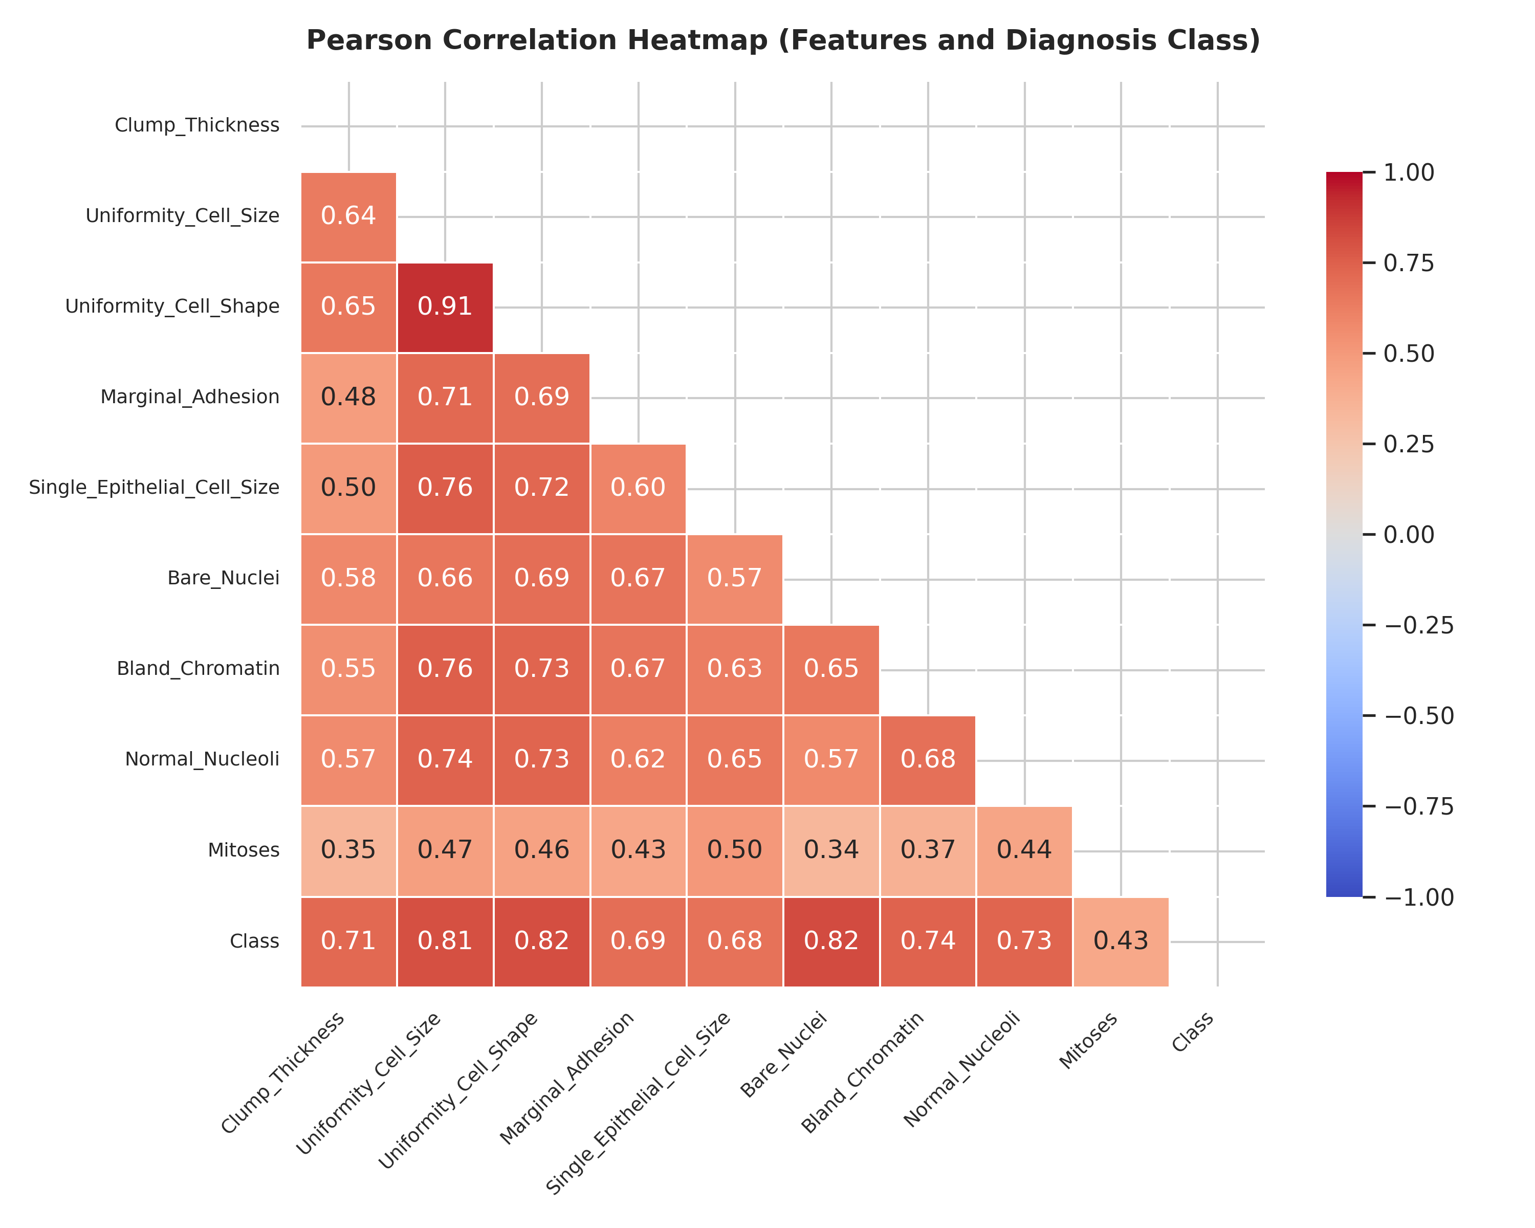
● TASK 3: EXPLORATORY DATA ANALYSIS
6. EDA: Correlation Heatmap & Feature Interrelationships
Correlation & Multicollinearity Findings
• Strongest Linear Malignancy Indicators: Uniformity_Cell_Size (r = 0.82), Uniformity_Cell_Shape (r = 0.82), and Bare_Nuclei (r = 0.82) show the highest positive correlation with cancer diagnosis.
• Severe Multicollinearity (r = 0.91): Uniformity of Cell Size and Cell Shape correlate at 0.91. This occurs because malignant cells simultaneously lose size uniformity and structural symmetry.
• Algorithmic Sensitivity to Collinearity: Collinearity can degrade linear model coefficient stability; however, tree ensembles (Random Forest) and non-linear kernel SVMs handle collinear feature spaces with high resilience.
• Mitoses Predictor: Exhibits lower correlation (r = 0.42) because mitotic division occurs in bursts, but remains an essential feature for identifying aggressive carcinomas.

Slide 8
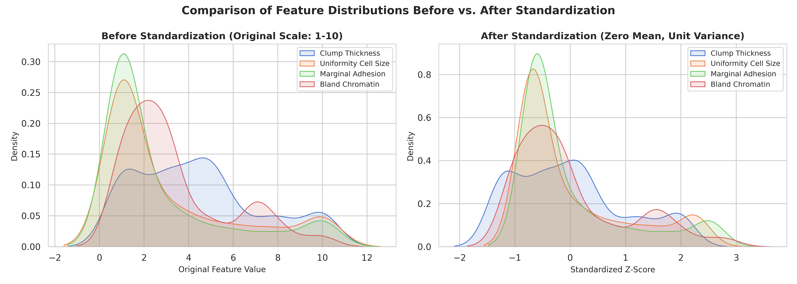
● TASK 3: EXPLORATORY DATA ANALYSIS
7. Feature Standardization: Before vs. After Analysis
Standardization Justification & Mathematical Impact:
• Before: Features have differing variances despite uniform [1, 10] range, creating distance metric distortion in KNN and SVM.
• After: Z-score standardization shifts mean to 0 and variance to 1. Ensures equal contribution to Euclidean distances in KNN, equal margin penalties in SVM, and balanced gradient backpropagation in ANN.

Slide 9
● TASK 4: MODEL IMPLEMENTATION
8. Model Implementation & Stratified 5-Fold Cross-Validation
K-Nearest Neighbors (KNN): Instance-based memory classifier. Classifies unseen samples via majority vote of k nearest Euclidean neighbors. [Optimal: k=7, weights='uniform', metric='euclidean']
Decision Tree (DT): Greedy non-parametric partitioner creating orthogonal decision boundaries based on information gain/entropy. [Optimal: criterion='gini', max_depth=4, min_samples_split=2]
Random Forest (RF): Ensemble of 100 bagged de-correlated decision trees with random feature subspacing to eliminate single-tree variance. [Optimal: n_estimators=100, max_depth=3, min_samples_split=10]
Artificial Neural Network (ANN): Multi-Layer Perceptron (MLP) with non-linear activation, hidden layer transformations, and L2 weight decay. [Optimal: hidden_layers=(32,), activation='relu', alpha=0.1]
Support Vector Machine (SVM): Maximum margin hyperplane separator employing Radial Basis Function (RBF) kernel mapping for non-linear separation. [Optimal: kernel='rbf', C=0.1, gamma='scale']

Slide 10
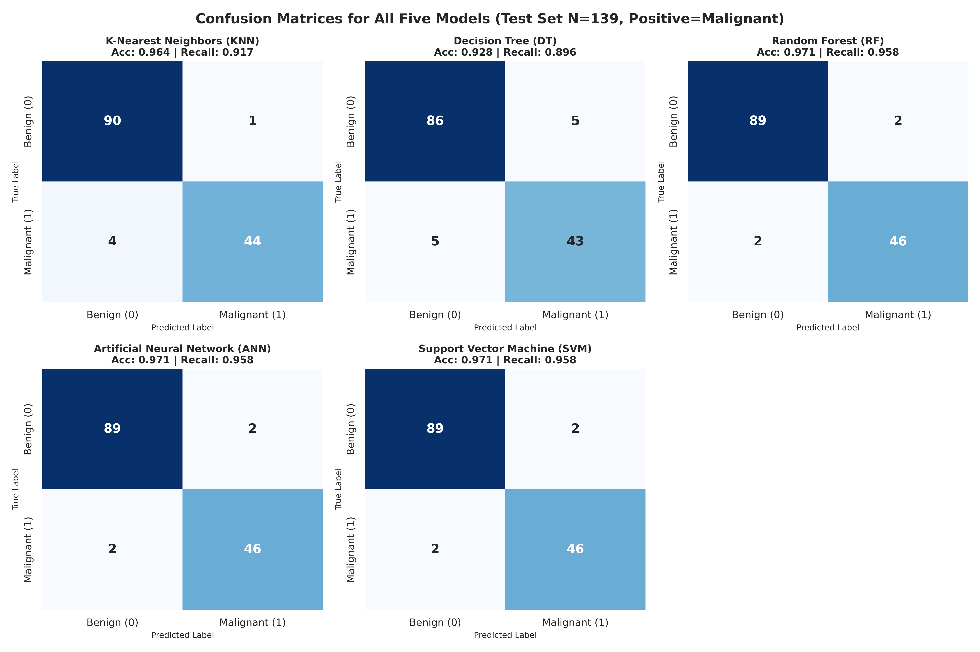
● TASK 5: MODEL EVALUATION
9. Model Evaluation: Confusion Matrices (Test N=139)
Confusion Matrix Analysis
• Test Sample Split: Exactly 91 Benign (Class 0) and 48 Malignant (Class 1) cases.
• Clinical Priority: Minimizing False Negatives (FN = Malignant classified as Benign). Missing cancer delays vital medical care.
• Top Trio (RF, ANN, SVM): Each achieved only 2 False Negatives and 2 False Positives across 139 patients, yielding 95.83% Recall.
• KNN: Produced 4 False Negatives (Recall 91.67%) and only 1 False Positive (Precision 97.78%).
• Decision Tree: Lagged with 5 False Negatives and 5 False Positives (Accuracy 92.81%).

Slide 11
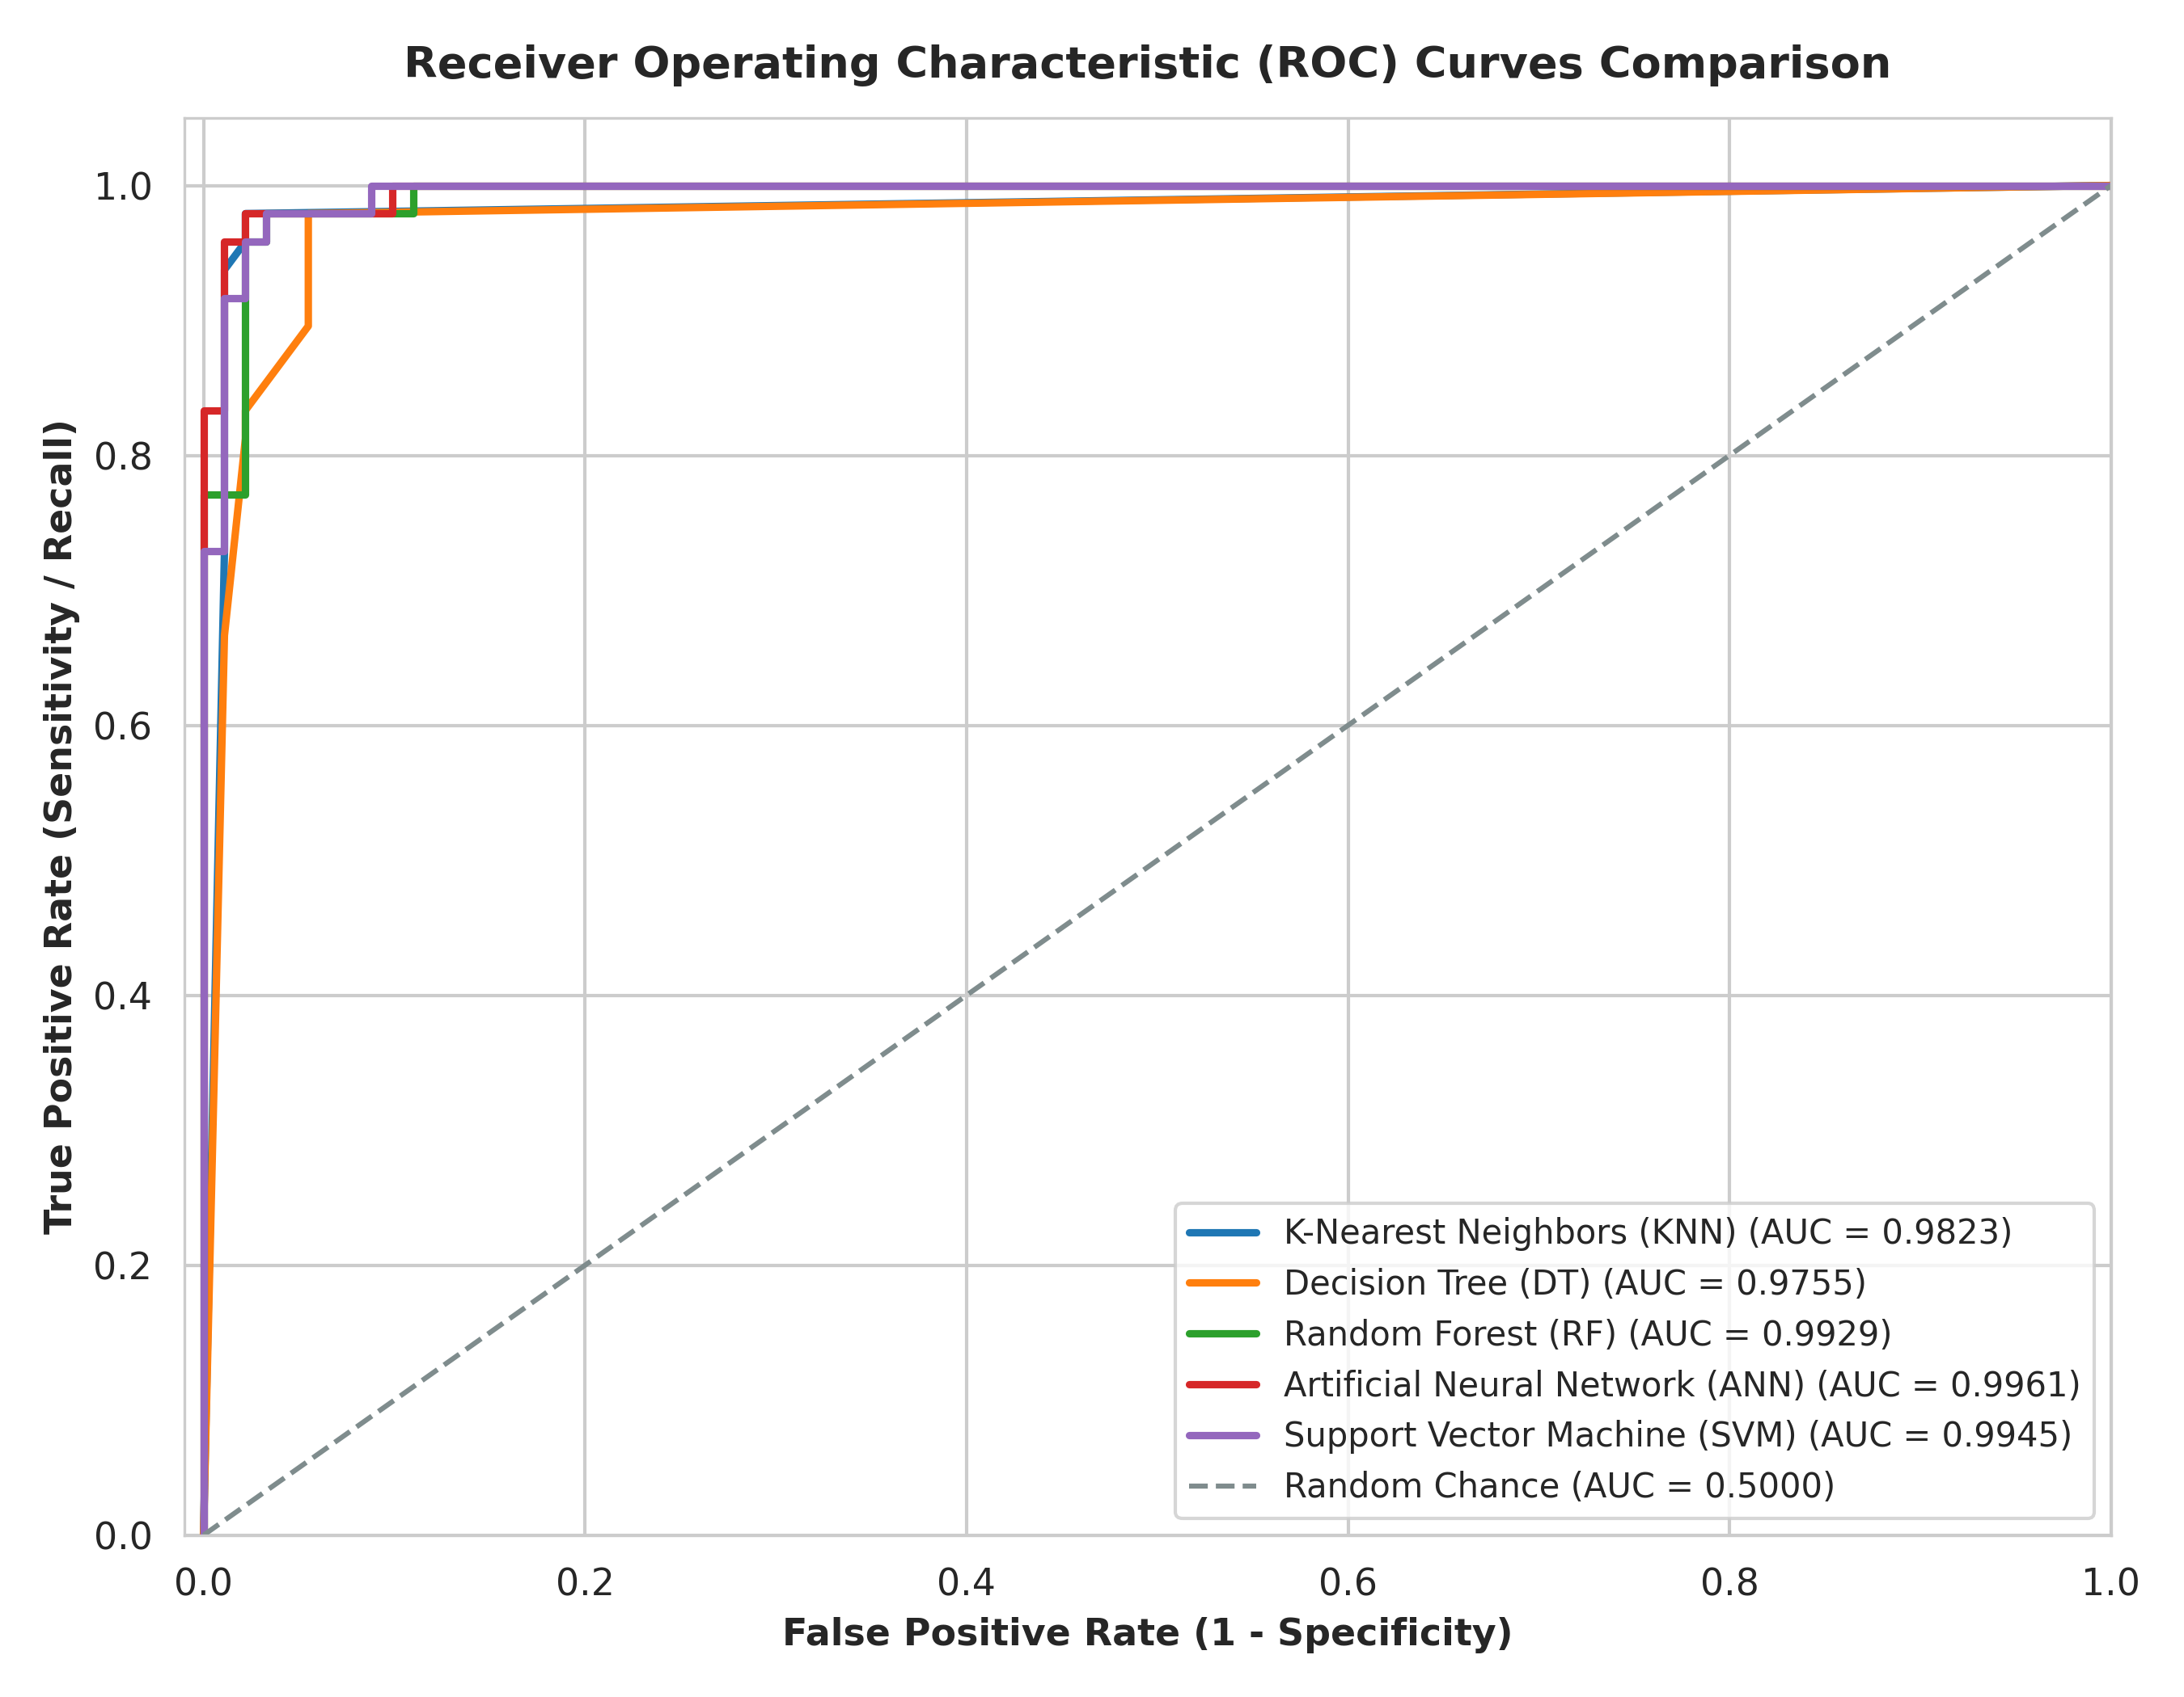
● TASK 5: MODEL EVALUATION
10. Performance Comparison & ROC Curves
Model | Accuracy | Precision | Recall | F1-Score | ROC-AUC
KNN | 96.40% | 97.78% | 91.67% | 0.9462 | 0.9823
Decision Tree | 92.81% | 89.58% | 89.58% | 0.8958 | 0.9755
Random Forest ⭐ | 97.12% | 95.83% | 95.83% | 0.9583 | 0.9929
ANN (MLP) ⭐ | 97.12% | 95.83% | 95.83% | 0.9583 | 0.9961
SVM (RBF) ⭐ | 97.12% | 95.83% | 95.83% | 0.9583 | 0.9945
Key Findings:
• RF, ANN, and SVM tie for top Accuracy (97.12%) and Recall (95.83%).
• ANN achieves the highest overall ROC-AUC (0.9961), closely followed by SVM (0.9945) and Random Forest (0.9929).
• All models significantly outperform baseline guessing.

Slide 12
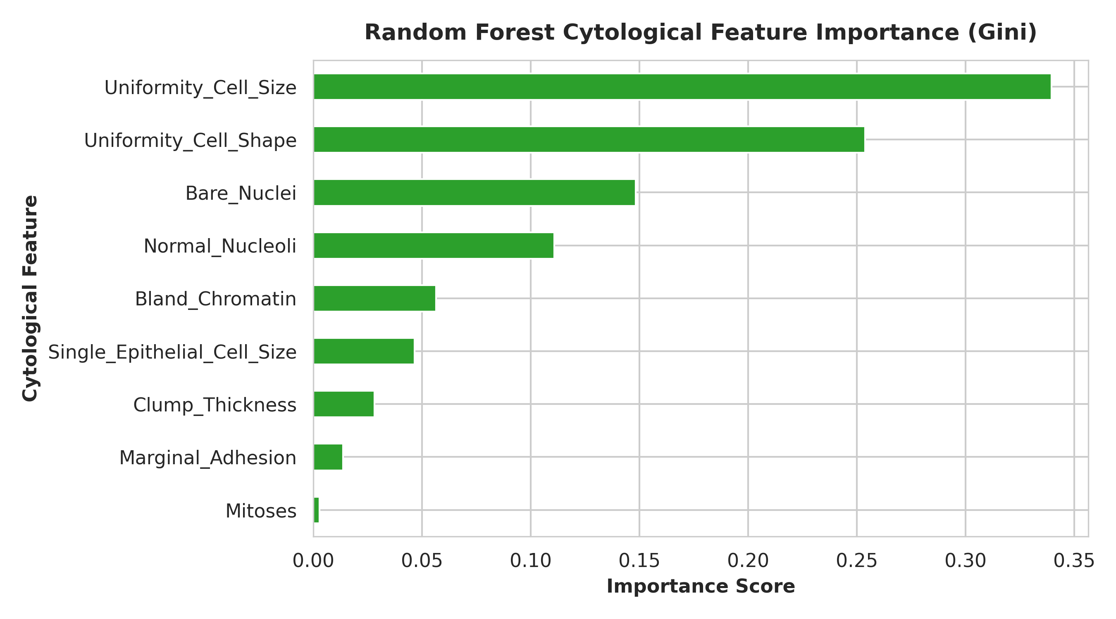
● TASK 5: MODEL SELECTION
11. Best-Performing Model & Justification
🏆 Selected Champion: Random Forest (RF)
✔ Peak Clinical Recall (95.83%) & Accuracy (97.12%): Successfully identified 46 out of 48 malignant cases with minimal misdiagnosis.
✔ Clinical Explainability & Trust: Unlike black-box neural networks or high-dimensional SVM kernels, Random Forest provides transparent Gini feature importance.
✔ Pathological Validation: Identified Uniformity_Cell_Size, Bare_Nuclei, and Uniformity_Cell_Shape as primary drivers, matching published cytology literature.
✔ Overfitting Resistance: Bagging 100 de-correlated trees stabilizes predictions against biopsy noise and physician score variance.
✔ Computational Simplicity & Zero Tuning Drift: Instant training and execution without vulnerability to local minima or vanishing gradients.

Slide 13
● PROJECT WRAP-UP
12. Project Conclusion & Future Improvements
Project Conclusions
• Demonstrated successful end-to-end implementation of a supervised classification system for breast cytology diagnosis.
• Strict prevention of data leakage ensured that test evaluation metrics represent true prospective clinical performance.
• Supervised machine learning algorithms achieve over 97% accuracy and 95.8% sensitivity in distinguishing benign from malignant biopsies.
• Automated classification provides a robust, fast, and objective second opinion for clinical oncologists, reducing diagnostic error.
Future Improvements
➔ Cost-Sensitive Loss Optimization: Incorporate asymmetric misclassification costs to push False Negatives to exactly zero.
➔ Soft-Voting Ensemble Integration: Construct a meta-ensemble combining Random Forest, SVM, and ANN class probability predictions.
➔ Explainable AI (XAI) with SHAP: Implement SHapley Additive exPlanations to visualize per-patient cytological risk attribution.
➔ Computer Vision & Deep Learning: Train CNNs on raw digitised FNA microscopy biopsy images (WDBC/histopathology) to bypass manual feature scoring.
🚀 Live Web App Ready: python app.py | 📂 Open Source Codebase: https://github.com/RemonAyman/advai

