Slide 1
The right size from one video · September 2026
SartorIA
Film ten seconds. Get your leg measurements. Get the right size, from any brand.
And every time someone tells us how it fitted, the next recommendation gets better.
10 s
9
6
1
of filming
measurements
AI agents
number you type
Jeans and trousers first — the category people send back most.
Notes:
Open on the problem, not the technology: nobody knows whether they are a W30 or a W32, so they order two and send one back. Everything in this deck exists to remove that guess.

Slide 2
DELIVERABLE 1 · PROCESS FLOW
Six steps, and only three of them are AI
1
2
AI
3
AI
4
5
6
AI
The person films
Read the video
Read the brand
Pick the size
The person buys
Read the reply
ten seconds, half a turn
a 3D body, then measurements
its size chart, whatever the format
compare the numbers, choose
on the shop's own site
“tight in the waist” → a number
every reply makes step 4 better for the next person
What the AI is for
What ordinary code is for
Anything messy: a video, a web page in any format, a sentence someone typed. Three of the six steps.
The arithmetic that picks the size. Same numbers in, same answer out, every time, and free to run.
This feedback loop is the part nobody else has — and letting the AI do the arithmetic would be a bug, not a feature.
Notes:
Walk the six boxes left to right, then point at the amber loop. The loop is the business case: the first recommendation is a good guess, the thousandth is informed by everyone before it.

Slide 3
THE AGENTS
Six agents, and what each one is for
An agent is a piece of AI that decides its own next step and can use tools, instead of answering once and stopping.
1
Filming coach
2
Sanity check
Watches the clip as it comes in and says what to do next — step back, turn further, better light. Decides when there is enough, and when to give up and ask for the measurements by hand.
Asks whether the numbers could belong to a real person, together rather than one at a time. A 57 cm thigh is only odd given an 82 cm waist.
3
Size-chart reader
4
Advisor
Every brand publishes sizes differently — web pages, PDFs, pictures, inches, centimetres. Turns all of it into one shape, and quotes the page to prove it.
Writes the sentence the customer reads, and answers follow-up questions. Never picks the size itself — it asks the calculator and explains the answer.
5
Feedback reader
6
Tester
Turns “they were tight in the waist and short in the leg” into two specific, usable findings.
Runs every test before anything ships, grades the answers that have no single right answer, and blocks changes that make things worse.
All six are AI agents. The thing that is not AI is the calculator they call to pick the size — that stays ordinary code.
Notes:
If someone asks why six and not one: each of these fails differently and is tested differently. One big prompt that does all six cannot be measured, fixed, or trusted in pieces.

Slide 4
DEPLOYMENT
What runs where
Vercel and Supabase carry the product. One layer cannot live on either of them.
Browser · Next.js on Vercel
the screens · sign-in · starts the work
live updates
starts the work
Supabase · eu-central-1
database · sign-in · private file storage · live updates · finds similar bodies
saves progress
Modal · the heavy lifting, running only when needed
3D body fit · measurements · the size calculator · the six agents
agents call the Anthropic API — Haiku 4.5 at volume, Opus 5 for reasoning and judging
Why the worker is not on Vercel
The 3D fitting libraries alone are bigger than a Vercel function is allowed to be, and working through hundreds of frames takes minutes. Not something to optimise — the wrong kind of machine.
Notes:
The loop on the right is the point: because LangGraph checkpoints to Supabase Postgres, the browser can subscribe to the graph's own state over Realtime. That is what makes a live agent console possible instead of a progress spinner.

Slide 5
TWO INTERFACES
One for customers, one for us
The same system, seen two ways. The customer sees a size and a sentence. We see every check, every step and what it cost — because we are the ones who have to fix it.
The customer app
The back office
public · phone · five screens
internal · desktop · the console
Film, get your measurements, get a size
One sentence of plain explanation
One question after delivery: how did they fit?
No jargon, no numbers you did not ask for
Every check on every filming session
What each agent did, and what it cost
What the AI read from each brand's chart
The queue of things a person must confirm
This is what wins or loses a customer.
Not beautiful, and it does not need to be.
The console we built first is the back office. It was never meant to be the customer app — and it should not become one.
Notes:
This slide settles the question the earlier mockup kept raising. The glass-box console is an operations tool. The customer app is a separate, quiet, simple thing, and the next two slides are the proposal for it.

Slide 6
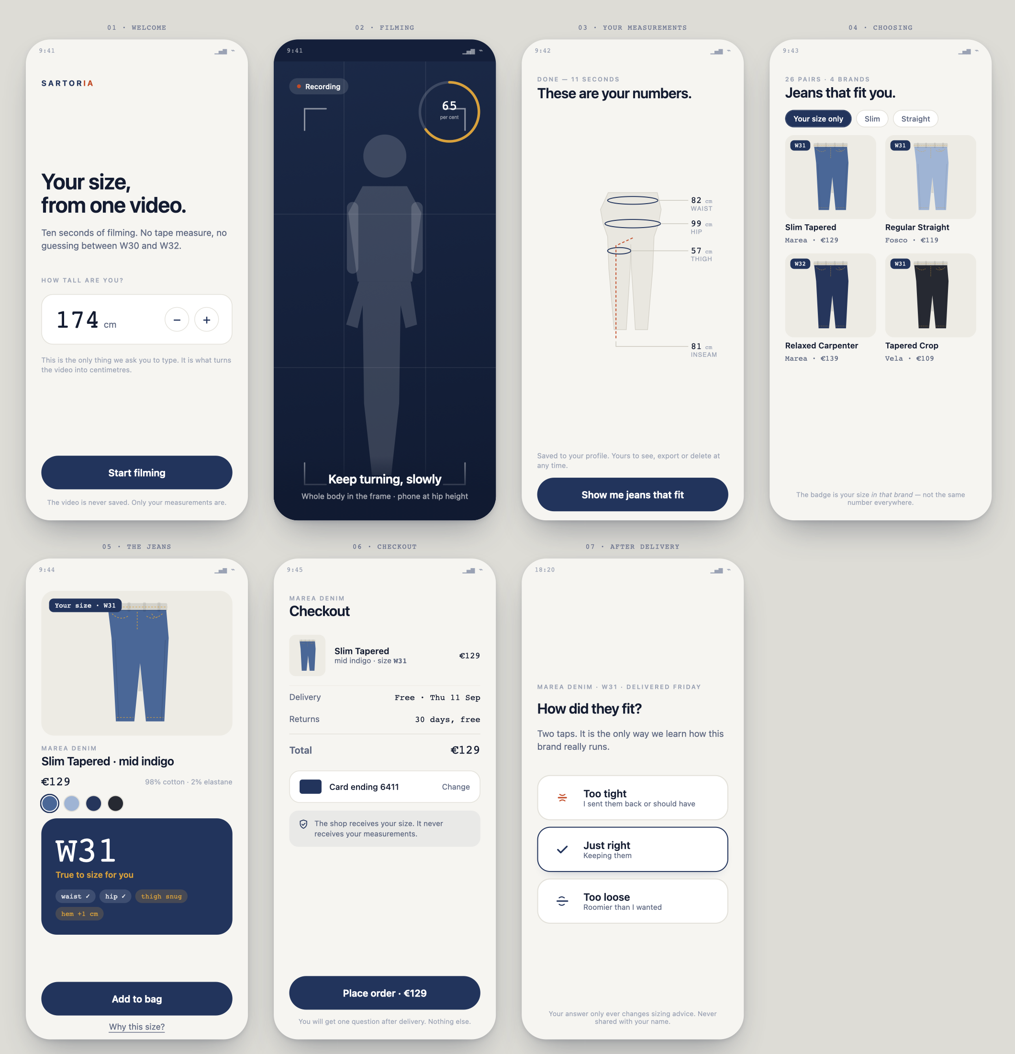
THE CUSTOMER APP · PROPOSAL
Seven screens, start to finish
design direction, not final art
Film · measure · choose · pay · one question
One thing to do per screen, and exactly one number to type: your height
The size badge follows you through the catalogue, so the shop is already filtered to what fits
Checkout says what the shop receives — your size, never your measurements
One question after delivery, and nothing else ever
What is deliberately missing
No confidence scores, no agent names, no charts, no jargon. Everything the back office shows is hidden here on purpose. Colours come from denim itself: indigo dye, raw cotton, one selvedge-red accent.
Notes:
Walk the seven screens once, left to right, top row then bottom. Then say what is missing: none of the machinery from the back office appears here, and that is the point.

Slide 7
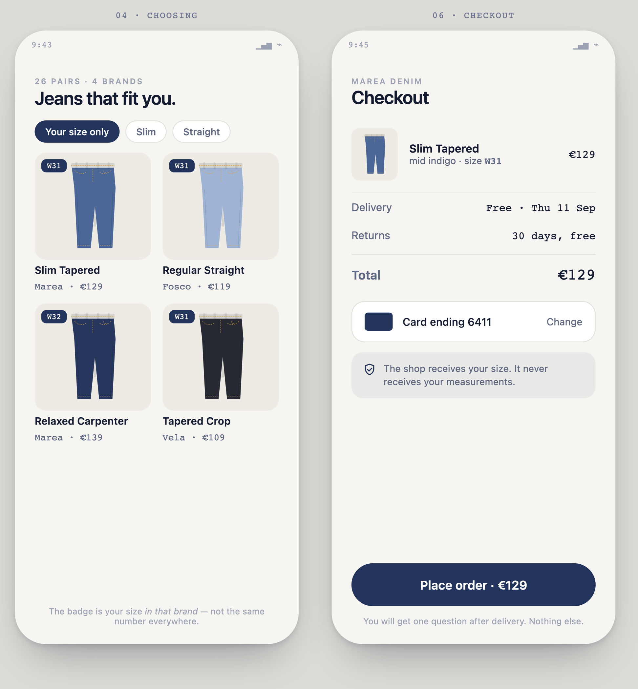
THE CUSTOMER APP · CHOOSING AND PAYING
The size badge is the product
W31 here, W32 there
The same person is not the same size in two brands. The badge on every product is their size in that brand — which is the whole thing we are selling, expressed as one small label.
A shop filtered to fit
“Your size only” turns a catalogue of 26 pairs into the ones that will actually work. Nothing else in the flow needs explaining after that.
The promise, at the moment it matters
The shop receives a size. It never receives the measurements. Saying that on the payment screen is worth more than saying it in a privacy policy.
Decided: the order is placed with us. We take the payment and pay the brand out — which is also what makes the fit outcome our own first-party data.
Notes:
The badge is the slide to linger on: a customer who learns they are a W31 at one brand and a W32 at another has understood the product without any explanation from us.

Slide 8
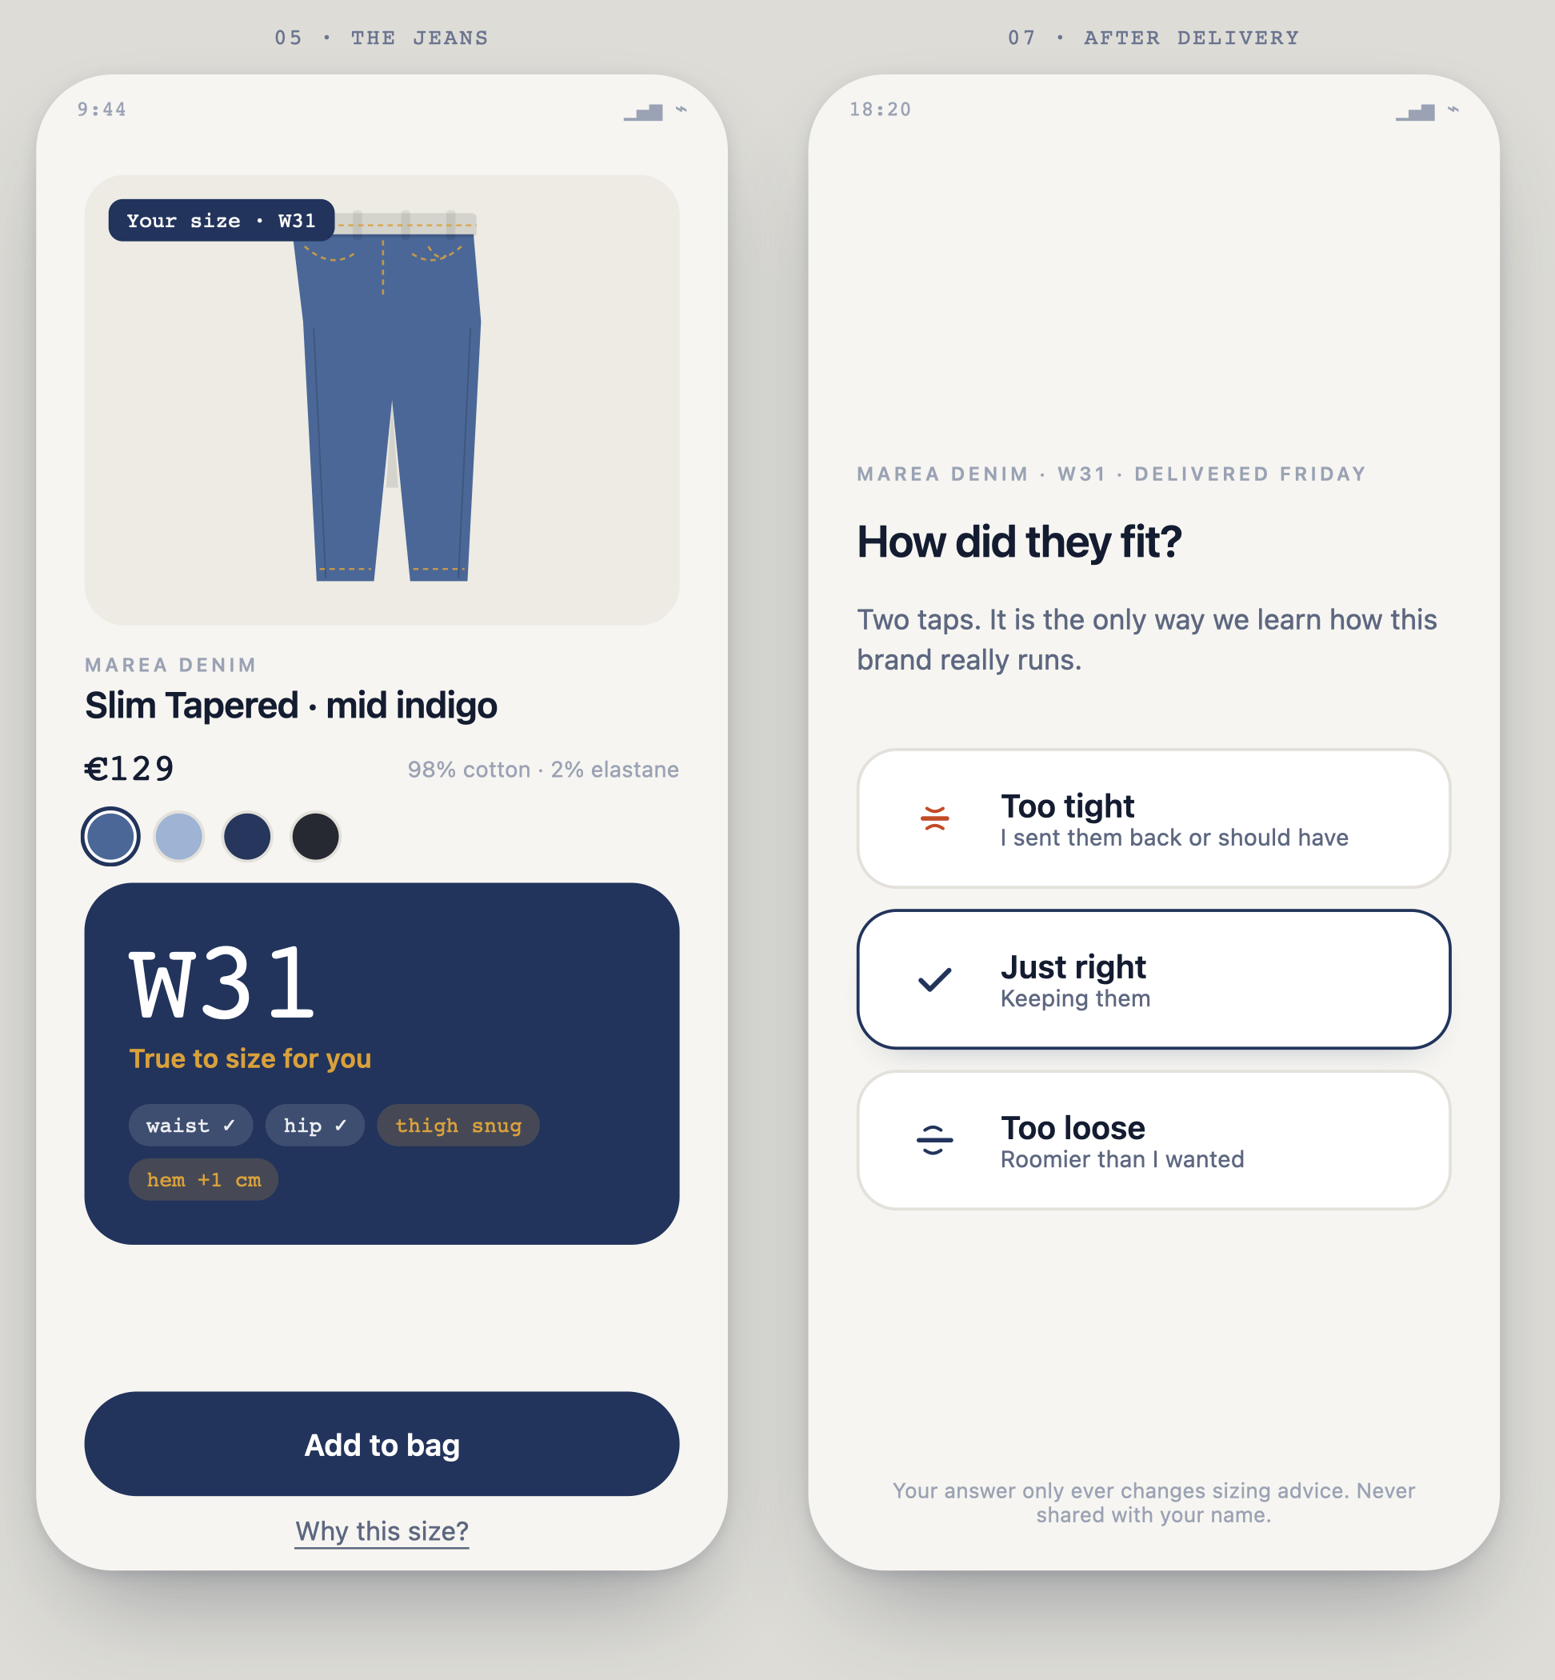
THE CUSTOMER APP · THE TWO THAT MATTER
One screen sells. One screen teaches.
The size screen
A size, a verdict in four words, and four small tags saying where it will be snug. The long explanation is one tap away for the people who want it, and invisible to those who do not.
The question after delivery
Three taps, no typing, no login. It is the only place the system ever finds out whether it was right.
Why it is the asset
No brand's size chart says “we run tight in the waist”. Only the answers to this question do. Every answer improves the next person's recommendation.
Notes:
Spend the most time on the third box. The post-delivery question is cheap to build and is the only source of the data that makes the whole thing defensible.

Slide 9
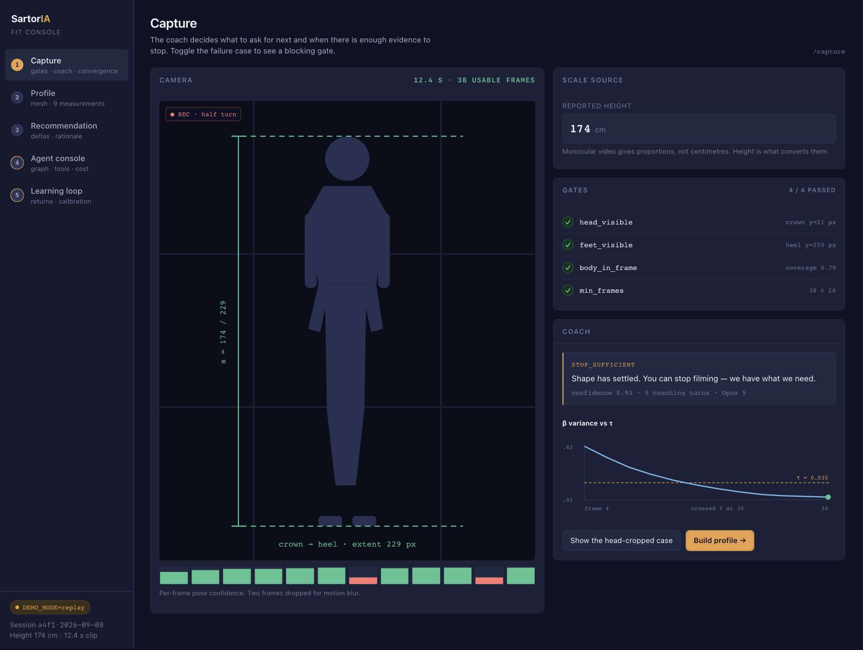
THE BACK OFFICE · BUILT, WORKING
Every filming session, and why it passed or failed
Each check with the value it actually measured, not a spinner
The exact message the customer was shown, and why
The chart on the right shows the estimate settling — we stop when it stops moving
Toggling the failure case reproduces a rejected session exactly
Why it looks like this
When a customer writes in saying the app rejected their video, this is the screen that answers them in ten seconds. Dense on purpose.
Notes:
Say plainly that this is already built and working as a mockup, and that it is the tool the support and data people will live in.

Slide 10
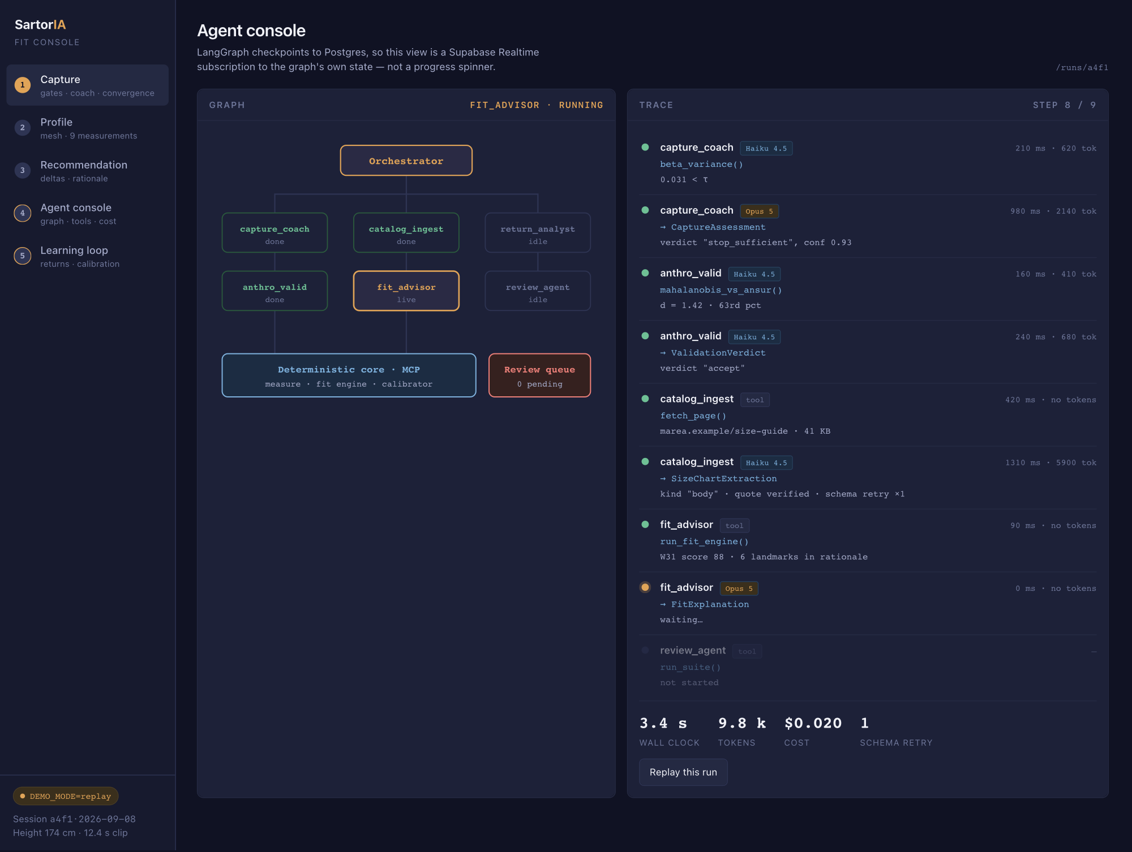
THE BACK OFFICE · BUILT, WORKING
What the six agents did, and what it cost
Who is finished, who is working, who is idle
Every step: what it did, what came back, how long, what it cost
A small cheap model does the repetitive reading; a large one reasons
Retries are shown, not hidden — the AI sometimes answers in the wrong format
Why this matters commercially
AI costs money per use. This screen is how we know what one recommendation costs, and where to spend a cheaper model instead.
Notes:
Three more back-office screens exist beyond these two: the measurements of a session, the reasoning behind a recommendation, and the learning from returns.

Slide 11
customer actions in blue · what we show in amber · internal steps plain · decisions as diamonds
DELIVERABLE 2 · SERVICE BLUEPRINT
Six stages, five layers
Stages copied from our experience map. One change: stage 05 now happens in the app, not on the retailer's site — the map needs updating to match.
01 Build Digital
Profile
02 Set Preferences
& Search
03 Match Fit
04 Review
& Decide
05 Purchase
06 Learn
& Improve
Physical
evidence
Phone camera, the 3D leg profile
Cut filters on screen
A size badge on every product
Product page, the size card
Order confirmation, the delivery box
One notification, return label if needed
Customer
actions
Registers, types height, films ten seconds
Picks preferred cut, searches across brands
Sees only the jeans that fit
Reads the size and why, accepts or rejects
Pays in the app
Taps one of three answers
Front stage
(visible)
Welcome, live coaching, then the measurements
Cut filters, brand list, saved preferences
Catalogue with your size on each item
Size, verdict, four sub-scores, “why this size”
Checkout, confirmation, dispatch notices
One push, one question
Back stage
(internal)
Consent logged · 3D fit · nine measurements · sanity check
Preferences stored, catalogue query built
Size charts read per brand · calculator scores every product · brand calibration applied
Advisor explains the calculation; every claim checked against it
Order created, payment captured, brand notified, fulfilment tracked
Answer becomes a structured finding; calibration updated
Support
processes
Auth, consent ledger, GPU worker, reference body data
Brand and product database
Size-chart database with a data-quality tier, similar-body search
Anthropic API, faithfulness check
Marketplace payment provider, brand order API, invoicing, carrier
Learning pipeline, brand analytics
DECISIONS
Video usable? · Accept the size? · Kept or returned?
Failure and loop paths: unusable video → re-record, then type the measurements by hand · reject the size → back to Set Preferences · returned → refund, and the reason is captured
Notes:
Read it as a promise being kept: the top row is what the customer touches, the bottom row is what has to exist for that to be possible. It also answers six of the how-might-we questions from the experience map: on-device processing, manual entry as an equal option, honesty when a brand's data is thin, sub-scores instead of one number, the verified size passed straight into checkout, and asking whether they kept them rather than assuming accepting means keeping.

Slide 12
DELIVERABLE 3 · TECHNICAL ARCHITECTURE
Front end, back end, and what supports them
EU-hosted · the order and the payment are ours
FRONT END
Customer app
Brand dashboard
Internal console
phone · Next.js on Vercel
return-rate, catalogue
sessions, agents, cost
requests
Vercel · routes, session, order orchestration
BACK END
live updates,
agent state
Supabase · eu-central-1
Identity
Measurements + outcomes
Postgres · Auth · private Storage · Realtime · similar-body search
email, device, orders
pseudonymised, no faces
the two are joined only by a pseudonym — deleting it anonymises the rest
Modal · Python worker, scales to zero
Anthropic API
3D body fit · measurement extractor · the calculator · calibration · the six agents
Haiku 4.5 · Opus 5
SUPPORT
Payments
Brand systems
Logistics
our page, our branding · payment triggered by API · money to the brand
order API · size-chart feed or scrape
carrier API · returns labels
Everything that holds personal data sits in the EU. Video frames are never stored — only the height, nine measurements and how sure we are.
The checkout is ours — our page, our branding, our confirmation — but the card fields are the provider's and the money goes straight to the brand. The order is still our own event, without us ever holding funds.
Notes:
Three questions get asked here. Why not all on Vercel: the 3D fitting libraries exceed a serverless function and need minutes of CPU. Why Supabase is split in two: so deleting a person is one row, and the anonymous training data stays lawful. Why we take the payment: the outcome becomes an event we own.

Slide 13
PLAN
Fourteen weeks: hardest part first, screens last
1–2
From video to a measurement, once
Measurement points checked on computer-made bodies. Deliverable: one error figure.
3
Combining frames, and centimetres
How the error falls as frames are added; first check against real people.
GATE
Decision point
Worse than about 3 cm on the leg? Switch to a simpler method. Same agents either way.
4–5
Coach, sanity check, calculator
Agents 1 and 2, the set of bad clips, the tolerance ranges, three brands loaded by hand.
6–7
Toolbox, size charts, returns
The calculator wired up as tools. Label the 50 size charts — the dullest week; do not let it slip.
8–9
Wiring it together, and testing
All six agents connected, every run traced, all three test sets running.
10
The experiments that answer questions
The comparison experiments, the cost curves, the learning study.
11–13
The screens
The five screens, live updates, the 3D leg, and replay mode.
14
Write-up and buffer
Figures from committed CSVs. Something in weeks 6–9 will overrun.
Decide at week 3, not at week 9 — that is the difference between a project delivered and a project rescued.
Notes:
The gate row is the project-management point: the computer-vision risk is concentrated in the first three weeks and has a pre-agreed fallback that leaves the agentic layer — the graded part — untouched.

Slide 14
IMPACT AND SUCCESS METRICS
How we will know it worked
No real numbers exist yet. These are the targets to validate, and the order in which we can actually measure them.
THE ONE THAT MATTERS
−8 pp
Return rate on recommended purchases, against a 10% randomised holdout
A before-and-after comparison gets demolished at the first meeting: seasonality, product mix, promotions. A holdout — some eligible sessions get no recommendation — is the only version a retailer's finance team will accept.
target, once 1 000 orders
have been measured
Scans completed
Replies after delivery
Size accepted
≥ 70%
≥ 35%
≥ 75%
started → usable profile
the only input to learning
kept without switching size
If people will not film, nothing downstream matters
Below 20% the loop starves and calibration never moves
Measures whether the recommendation is believed
Outcomes per brand
We say “not sure”
AI cost per answer
1 000
> 0%
< €0.05
per brand and category
and falling over time
tokens plus compute
Calibration means nothing before this counter fills
A system that never abstains is lying about its confidence
Decides whether this is a business or an experiment
The first two can be measured before a single return is counted — so they are the first two we instrument.
Notes:
The point of the holdout is credibility, not rigour for its own sake: without it the return-rate number is an opinion. And the last two tiles are the ones people forget — a system that never says it is unsure, and a cost per answer nobody has checked, are both ways of quietly failing.

Slide 15
WHAT WE NEED TO DECIDE
Five questions, then we build
Priority
If weeks 11–13 run short, which screen gets cut? My answer is 2, because measurements can live inside screen 3.
1
Audience
How much machinery stays visible in a shipped product — all of it behind a flag, or a simple view by default?
2
Language
Italian in the interface with English in the code and thesis, or English throughout? This decides which language agent 5's labelled set is built in.
3
Vocabulary
You know denim better than the mockup does. Any measurement name, tolerance or phrase that reads wrong to you?
4
Fit score
A number out of 100, words, or both?
5
Colours, spacing and copy are cheap to change once the app exists. Layout and scope are not — those are what this meeting is for.
Notes:
Close by naming the next step: with these five answers, the scaffold is a Next.js repo on Vercel, the Supabase schema with RLS and Realtime, and the Modal app with stub endpoints and a compiling LangGraph graph.

Slide 16
APPENDIX
The operational detail: the checks on a filming session, why we ask for your height, the nine measurement points, how we test it, and where the data comes from.
Notes:
Skip the appendix unless someone asks. It exists so that the answer is in the room when they do.

Slide 17
GATES AND SIGNALS
Four checks that stop everything, five that just give a hint
Check | Type | What happens
head_visible | BLOCKING | No way to get centimetres. Session discarded, and the person is told why.
feet_visible | BLOCKING | The same problem at the other end of the body.
body_in_frame | BLOCKING | The 3D fit is unreliable when part of the body is missing.
min_frames | BLOCKING | Too few usable frames to combine.
rotation_coverage | coaching | Keep filming; ask for a wider turn.
blur_variance | coaching | Throw away the blurry frames, lower the confidence.
lighting_estimate | coaching | Ask the user to turn towards the light.
clothing_looseness | confidence | Flagged — baggy clothes are the biggest source of error.
beta_variance | stop rule | Estimate has settled: stop. Still moving: keep filming.
“Scan failed, please try again” teaches the user nothing and guarantees a second failure. Every blocking message names the cause and the one physical action that fixes it.
Notes:
Point out the asymmetry: blocking checks end the session, coaching signals only change what the agent says next. Mixing the two is how capture flows become frustrating.

Slide 18
THE ONE RULE WE CANNOT BEND
No head in frame, no centimetres
One camera gets your proportions right, but not your size. The centimetres have to come from somewhere else.
your height in cm ÷ head-to-heel in the picture = the scale
Head in frame
Crown outside frame
we can see head to heel
the scale works out
measurements come out in centimetres
the top of the head is missing
there is no way to work out the scale
every measurement is just a ratio
PROCEED
HARD FAILURE
Blocking gates return a cause, never a generic failure.
“We can’t see the top of your head. We need your full body, head to feet, to turn the scan into centimetres — move the phone further away and record again.”
Notes:
The key point: this is a precondition, not a quality metric. No amount of extra footage repairs it, because the scale factor has no other source. Message quality is scored in Suite C, not left to taste — a clip with the head cropped must produce a re-capture verdict that names the head.

Slide 19
THE SECOND WAY IN
The pair already in the wardrobe
Nobody knows their waist in centimetres. Everybody knows which jeans they reach for first.
“Which pair that you already own fits you best?”
brand · model · the size on the label — three taps, no camera, no tape measure
When the capture fails
When we have both
What measuring misses
the crown is out of frame
the gate blocks, as it must
we ask one question instead
the video says W32
the favourite pair is a W34
the disagreement is information
two identical pairs of legs
two different favourite jeans
the body is not the taste
STILL AN ANSWER
NOT NOISE
ASKED EVERY TIME
Still open
When the two disagree, which one wins — the measurement or the wardrobe? We do not know yet, and the honest answer probably changes once there are real outcomes to calibrate against.
It is also the demo's insurance: with the vision pipeline down, the app still returns a size.
Notes:
This route came from a teammate's alternative proposal — map a known good fit in one brand onto another brand — which we absorbed rather than adopted whole. It earns its place three times over: it is the graceful degradation for a blocked capture, it is a cross-check when both signals exist, and it is the only input that carries fit preference rather than body geometry. The disagreement case is deliberately left unanswered here.

Slide 20
MEASUREMENT ON FIXED TOPOLOGY
Nine measurement points, defined once, used for every body
The 3D body model always has the same structure, so we say once where each measurement is taken and it holds for everyone.
Waist
Hip / seat
Thigh
slice around the body
slice around the body
slice around the leg
narrowest point between ribs and hip
widest point across the seat
just below the crotch
Knee
Calf
Ankle
slice around the leg
slice around the leg
slice around the leg
at the kneecap
widest point below the knee
narrowest point above the foot
Inseam
Outseam
Rise
along the body
along the body
height difference
crotch to inner ankle
waist to outer ankle
waist down to the crotch
Expect to land within 1.5–3 cm, when one size step is about 4 cm. The crotch is the hardest point to place, and baggy clothes are the biggest source of error.
Notes:
Be honest about accuracy here rather than in the questions. Measurement error consuming a quarter to a half of a size step is exactly why the outcome-learning loop matters — the two halves of the project support each other.

Slide 21
EVALUATION
Three test sets, one results file, nothing hand-waved
A
The measurements
B
Reading size charts
C
How the agents behave
Average error per measurement on real people, and how often we land within 1 cm and 2 cm
Best case on computer-made bodies: how much error is ours even with a perfect 3D fit
The key experiment: how the error falls as more frames are combined
What happens if the person mistypes their height by 1, 2 or 3 cm
50 hand-labelled charts, ~10 brands across 5 categories
How many values we read correctly, and how often we botch inches into centimetres
Body chart or garment laid flat — the one field that matters most
Rows the AI invented that are not on the page: must be zero, or explained
A page rigged to give the AI instructions, to prove it ignores them
A set of deliberately bad clips: does it reach the right verdict every time
Message quality: does it name the cause and one action?
Is the explanation true to the calculation, is it useful, and does our AI grader agree with people
Did it pick the right tools, how often did it retry, what did it cost, how long did it take
One big prompt, then a simple chain, then all six agents — to prove the complexity earns its place
Which model does which job is itself a result: a small fast one for the repetitive reading (agents 3 and 5), a large one for the reasoning and grading (1, 4 and 6) — with the cost of each reported.
Notes:
Evaluation is the weakest part of most agentic projects, so it is the place to be strongest. Note that the judge is itself validated: agreement with human ratings reported as Cohen's kappa on a held-out slice.

Slide 22
DATA STRATEGY
We invent data only where we can be certain it is true
The trap: make up the answers with a rule, train a model to find that rule again, then report how accurate it is. That only measures the model against your own invention. It proves nothing.
Source | Role | Why this is honest
SURREAL — computer-made bodies | Build and tune the measuring step | Generated from known shapes, so their true measurements are known exactly
AMASS | Realistic movement | Real motion capture, so the generated videos move like a person
BodyM | Checking against real people | Real photos of real people, measured with a tape. This is where the reported numbers come from
ANSUR II | Sanity check | A public database of real body measurements, so we know which combinations actually occur
RentTheRunway · ModCloth | Real feedback on real purchases | Customers said whether it ran small, true to size or large — plus what they wrote
Brands' size charts | Input and test set for agent 3 | Public, no personal data, small volumes. EU copyright law allows this for research
Limitation to state, not to discover in the viva:
these datasets say whether an item fitted, not whether it was kept or sent back. We stand in for the real outcome with what the customer said.
Notes:
The rule in one line: made-up data may generate the inputs, never the answer you then report as a result. SURREAL passes because the measurements come from the geometry itself, not from a model we are trying to learn.

