Slide 1
Mockup review · v1 · 8 September 2026
SartorIA Console
Five screens for the master's MVP. Nothing is built yet — this is a mockup, and the point of this deck is to collect what you would change before we write the Next.js app.
5
6
3
0
screens
agents behind them
weeks to build
lines written
What I need from you
Each screen slide carries one question in the amber box. Answer those and ignore the pixels — colours and spacing are cheap to change later, layout and what we choose to show are not.
Notes:
Open by saying what is real and what is not: the layout and the content are the proposal, the data is seeded, and no screen talks to a server yet.

Slide 2
THE ONE IDEA
The interface exposes the machinery
instead of hiding it.
This is a master's project in AI, so the system is the subject. A pretty wizard that hides six agents behind a spinner would show nothing to the examiners — and would also be a worse product, because a size recommendation nobody can interrogate is a size recommendation nobody trusts.
What most demos do
What these screens do
A chat box
A spinner while something happens
One answer, no reasoning
The machinery is a black box
Gates and their evidence, live
Tool calls with latency and cost
The reasoning as a chart, next to the text
Every claim checkable against the engine
Screens 4 and 5 are the ones that carry this. If we cut anything, it should not be those.
Notes:
If a colleague pushes back that this is over-engineered for a consumer, agree — and say the exam version and the shipped version can differ by a feature flag. That is slide 8's question.

Slide 3
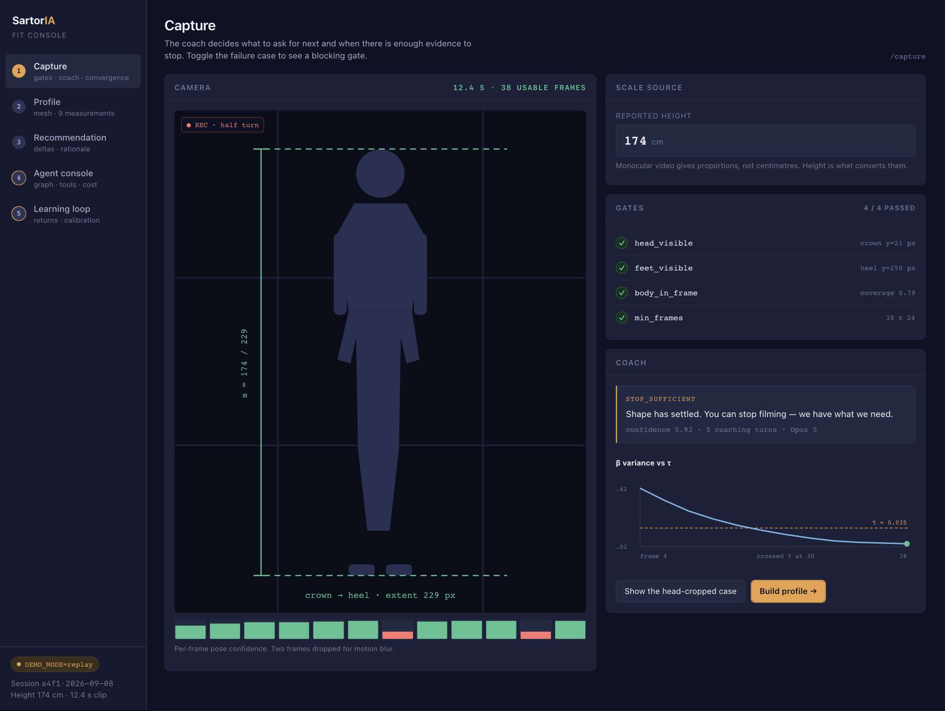
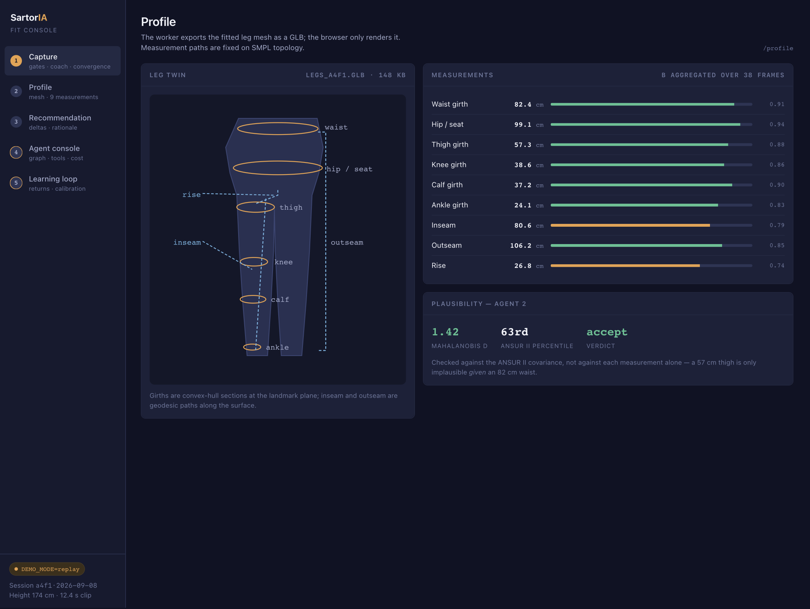
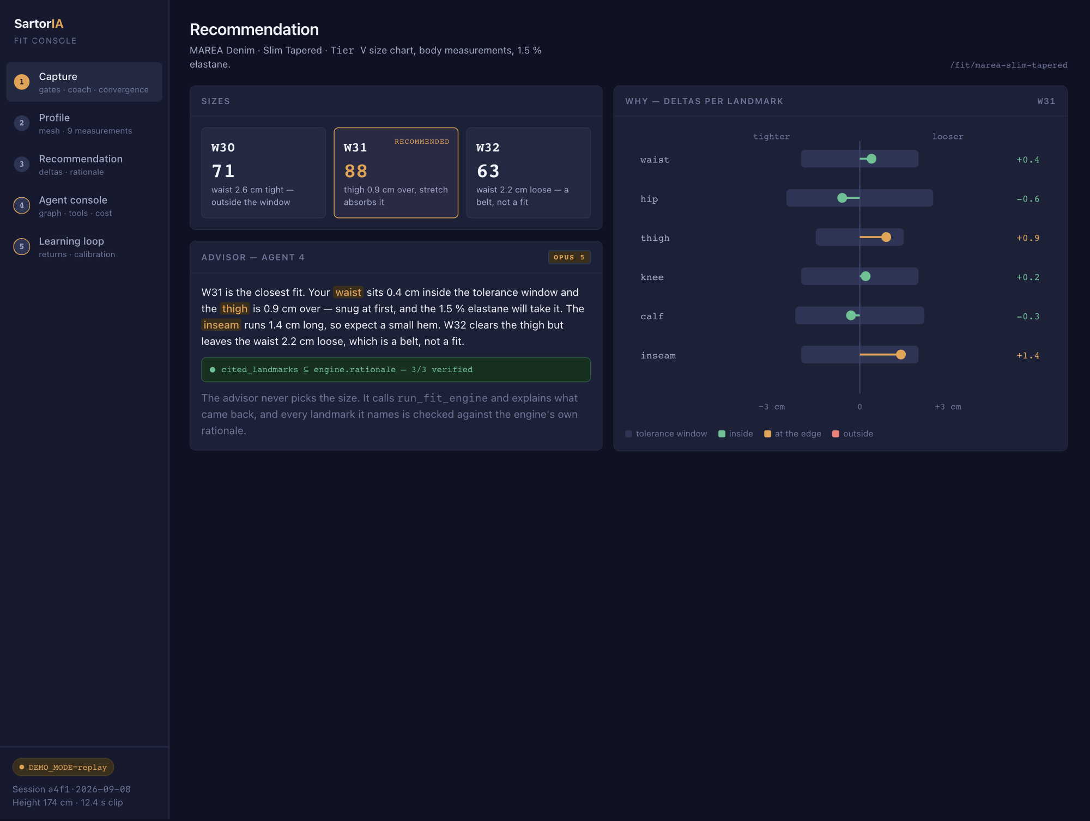
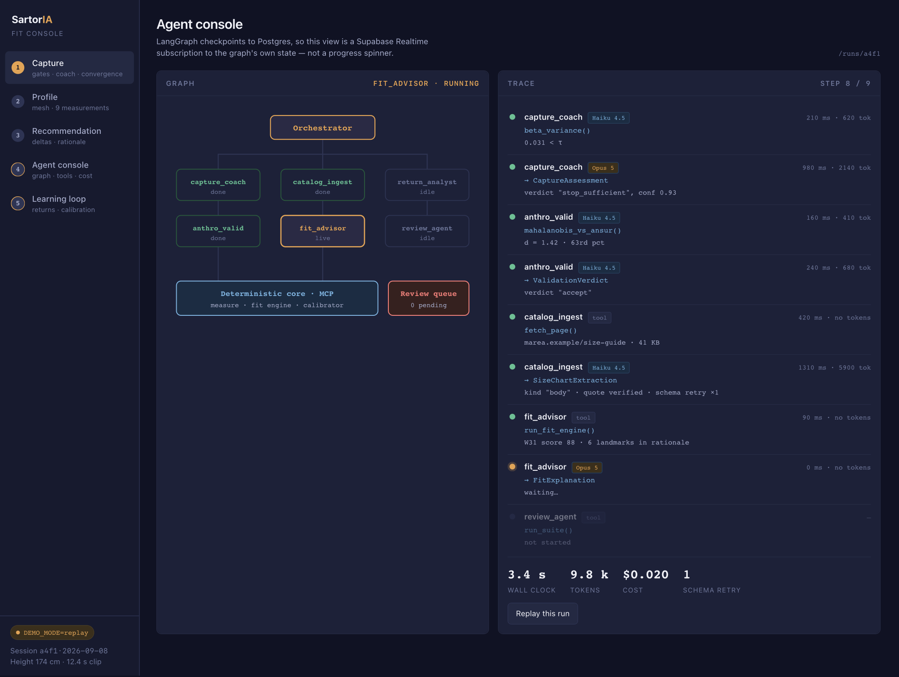
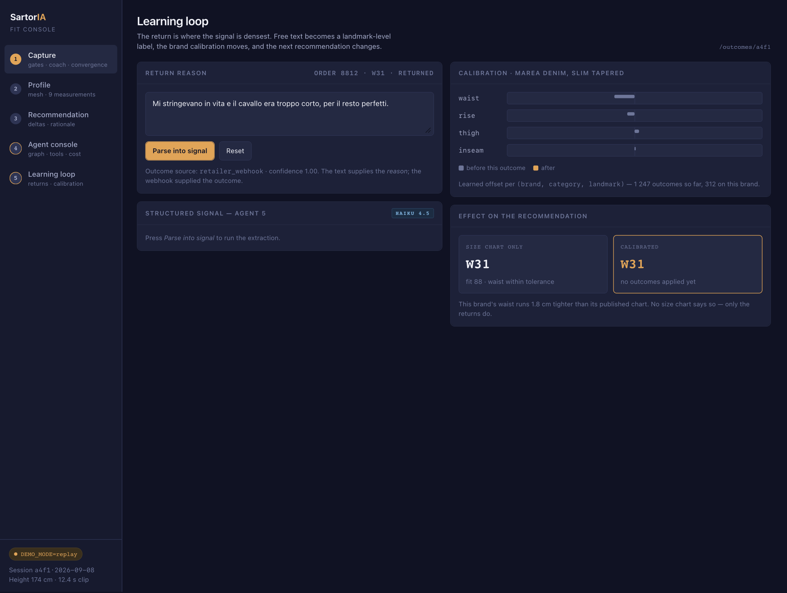
OVERVIEW
Five screens, one session
The same user, the same 12-second clip, followed from capture to a return that changes the next recommendation.
1
Capture
2
Profile
3
Recommendation
4
Agent console
5
Learning loop
gates · coach · convergence
mesh · 9 measurements
deltas · rationale
graph · tools · cost
returns · calibration
Honest about the mockup:
all figures are seeded in JavaScript and no screen calls a server; the 3D leg twin is an SVG illustration, not the react-three-fiber render it will be; the denim brand is invented so we are not putting made-up sizing on a real one.
Screens 4 and 5 in amber — the two that would not exist in an ordinary shopping app.
Notes:
Use this slide to set the walking order, then go screen by screen. Do not linger — the detail is on the next five slides.

Slide 4
SCREEN 1 OF 5
Capture
/capture
The coach decides what to ask for next, and when there is enough evidence to stop.
WHAT TO LOOK AT
Four blocking gates, each showing the evidence it actually measured — not a spinner
The coach message names the cause and one physical action
β-variance sparkline crossing τ at frame 30: the stop rule is a statistic, not a timer
Filmstrip with two frames dropped for motion blur
QUESTION FOR YOU
Is the split right — camera left, gates and coach right? And should the height field come first, as its own step, since without it there are no centimetres at all?
Notes:
Screen 1 — Capture. Ask the amber question out loud and write the answer on the slide; that is the output of this meeting.

Slide 5
SCREEN 2 OF 5
Profile
/profile
Nine landmarks measured on a fitted mesh, with a plausibility check before anything is stored.
WHAT TO LOOK AT
Six girth planes and three length paths, drawn where they are actually taken
Per-measurement confidence, not one global score
Rise and inseam have the lowest confidence — the crotch landmark is the ambiguous one
Mahalanobis distance against ANSUR II, not a per-measurement sanity check
QUESTION FOR YOU
How much of this does a customer see? The confidence bars and the Mahalanobis number are an asset at the exam and possibly noise in a shop. Split it into a simple view and a technical one?
Notes:
Screen 2 — Profile. Ask the amber question out loud and write the answer on the slide; that is the output of this meeting.

Slide 6
SCREEN 3 OF 5
Recommendation
/fit/…
The engine picks the size. The advisor only explains what came back, and every landmark it names is verified.
WHAT TO LOOK AT
Delta chart: tolerance window as a band, the wearer's offset as a dot, colour by how close to the edge
The advisor's highlighted landmarks correspond one-to-one with the chart rows
The green badge is a real check: cited_landmarks ⊆ engine.rationale, 3 of 3
W32 is rejected in words a person can argue with — “a belt, not a fit”
QUESTION FOR YOU
Does the delta chart read without being explained? And is a score of 88 useful to a buyer, or should it be words — “snug”, “true to size”, “roomy”?
Notes:
Screen 3 — Recommendation. Ask the amber question out loud and write the answer on the slide; that is the output of this meeting.

Slide 7
SCREEN 4 OF 5
Agent console
/runs/…
LangGraph checkpoints to Postgres, so this is a live subscription to the graph's own state.
WHAT TO LOOK AT
Node states — done, live, idle — straight from the checkpoint table
Every step shows the tool, the result, latency, tokens and which model ran it
Haiku for extraction and classification, Opus for reasoning: the cost split is visible
One schema retry is recorded rather than hidden — malformed output is normal and handled
QUESTION FOR YOU
This screen is built for the examiners. Does it stay in the product behind a flag, become an internal-only tool, or get cut once the exam is over?
Notes:
Screen 4 — Agent console. Ask the amber question out loud and write the answer on the slide; that is the output of this meeting.

Slide 8
SCREEN 5 OF 5
Learning loop
/outcomes/…
The return is where the signal is densest: free text becomes a landmark-level label.
WHAT TO LOOK AT
Italian free text parsed into two signals, each carrying the phrase that supports it
The waist offset for this brand moves from −1.4 to −1.8 cm
The recommendation flips from W31 to W32 — the loop closing, visibly
No size chart says this brand runs tight in the waist. Only the returns do
QUESTION FOR YOU
Is watching the recommendation change convincing, or does it read as an unstable system? Would you rather see it as “what we learned this week” than as an instant flip?
Notes:
Screen 5 — Learning loop. Ask the amber question out loud and write the answer on the slide; that is the output of this meeting.

Slide 9
WHAT WE NEED TO DECIDE
Five questions, then we build
Priority
If weeks 11–13 run short, which screen gets cut? My answer is 2, because measurements can live inside screen 3.
1
Audience
How much machinery stays visible in a shipped product — all of it behind a flag, or a simple view by default?
2
Language
Italian in the interface with English in the code and thesis, or English throughout? This decides which language agent 5's labelled set is built in.
3
Vocabulary
You know denim better than the mockup does. Any measurement name, tolerance or phrase that reads wrong to you?
4
Fit score
A number out of 100, words, or both?
5
Colours, spacing and copy are cheap to change once the app exists. Layout and scope are not — those are what this meeting is for.
Notes:
Close by naming the next step: with these five answers, the scaffold is a Next.js repo on Vercel, the Supabase schema with RLS and Realtime, and the Modal app with stub endpoints and a compiling LangGraph graph.

