Slide 1
Master's MVP · system, plan and interface · v0.1
SartorIA
Six AI agents that turn a phone video into leg measurements, tidy up brands' size charts,
recommend a trouser size, and learn from what people send back — plus the five screens that show it working.
13–14
6
5
9
weeks part-time
agents
screens
measurements
Part one is the system and the plan. Part two is the interface, and it carries the questions I need answered.
Notes:
Frame the deck in one sentence: the graded contribution is not a size recommender and not a body scanner, it is the division of labour between agents and deterministic code. Everything that follows defends that split.

Slide 2
THE CLAIM
The AI handles the messy parts.
The maths stays ordinary code.
Where the AI works
Where ordinary code works
Messy input: video, web pages, PDFs, sentences people type
Writing in plain language, and answering follow-up questions
Deciding how many steps to take, when to stop, when to give up
Knowing when it is not sure
Taking measurements off the 3D body model
Comparing each measurement with what the size allows
Correcting each brand once we know how its clothes really fit
Same answer every time, testable, free to run
Picking the size is arithmetic. Letting the AI do the arithmetic would be a bug, not a feature.
Notes:
This is the slide to land hard. The division of labour is the thesis. If the committee remembers one thing, it should be that the project can say why each agent is an agent, and why the scorer is not.

Slide 3
GLOSSARY
Five words, defined once
These five come up on every slide from here on. Nothing else in the deck needs a definition.
A piece of AI that decides its own next step and can use tools, instead of answering once and stopping. This project has six.
1
Agent
Something an agent is allowed to call: fetch a web page, convert inches to centimetres, run the size calculator.
2
Tool
The calculator
Ordinary code that actually picks the size. Same input, same answer, every time. The AI never does this arithmetic.
3
in the code: fit engine
A check
A test that has to pass, or the session stops and the person is told exactly what went wrong.
4
in the code: gate
Measurement point
A place on the body we measure — waist, thigh, knee, ankle. Nine of them for trousers.
5
in the code: landmark
Everything else on the slides is either a brand name, a dataset name, or a number.
Notes:
Spend a minute here. Once the room has these five words, no later slide needs explaining twice — and the two on the right, the calculator and the check, are the ones that carry the argument.

Slide 4
THE TEST WE APPLY TO EVERY STEP
Which steps actually need AI?
1
Is the input messy,
and different every time?
2
Does it have to judge
how sure it is?
3
Is it unknown in advance
how many steps it takes?
At least one yes, or it is ordinary code.
Task | AI? | Why
Tidy up a brand's size chart | Yes | Messy input, and it has to admit when it is unsure
Read why someone sent an item back | Yes | People write it however they like; we need it on a fixed list
Guide the person filming | Yes | We cannot know how many hints it will take
Explain the recommendation | Yes | Writing, and answering follow-up questions
Work out the fit score | No | No to all three. It must give the same answer every time
Choose the size | No | No to all three. It must be checkable and testable
Notes:
Expect this question in the viva and answer it before it is asked. The two 'No' rows are the credibility rows: a project that uses an LLM for everything has not thought about it.

Slide 5
SYSTEM TOPOLOGY
Three ways in, one router, six agents, one calculator
New user · video + height
New brand · size chart URL
Return · free text
Router — decides who works next
1
Capture Coach
3
Catalog Ingestor
5
Return Analyst
checks the clip, gives hints
reads brands' size charts
reads why items came back
2
Anthro Validator
4
Fit Advisor
6
Review Agent
sanity-checks the numbers
explains · never decides
tests everything, blocks bad changes
The calculator — one shared toolbox for all six
Human review queue
takes measurements · picks the size · learns per brand · database
fed by agents 1 · 2 · 3
Agents 1, 2 and 3 hand anything they are unsure about to a person — the red path. Nothing uncertain is stored as if it were fact.
Notes:
Walk the three entry points, then point at the core: every agent reaches it through tools, never by reimplementing it. Then point at the red path and say that escalation is a designed output, not an error handler.

Slide 6
AGENT REGISTER
Filming, checking, reading size charts
1
Capture Coach
TOOLS
We cannot know in advance how many hints a person will need, the clues come from pictures and numbers at once, and the signal that says “enough” only appears as more frames arrive.
head_visible · feet_visible · bbox_coverage · blur_variance
pose_confidence · beta_variance · lighting · clothing_looseness
OUTPUT
CaptureAssessment
2
Anthropometric Validator
TOOLS
Numbers come out wrong for several different reasons — a mistyped height, baggy clothes, a bad 3D fit — and each one needs a different fix.
mahalanobis_vs_ansur · marginal_percentile
ratio_checks · recompute_with_scale
OUTPUT
ValidationVerdict
3
Catalog Ingestor
TOOLS
The clearest case for AI. Every brand publishes its sizes differently, in web pages, PDFs and pictures — and one question decides everything: is the chart the body, or the garment laid flat?
fetch_page · html_to_text · ocr_image · convert_units
lookup_existing_chart · validate_schema · write_garment_size
OUTPUT
SizeChartExtraction
Notes:
Agent 3 is the one to dwell on: the body-versus-flat classification is a single field that silently inverts every recommendation if it is wrong, which is why the schema forces a verbatim quote as evidence.

Slide 7
AGENT REGISTER
Advising, labelling, testing
4
Fit Advisor
TOOLS
Writing and answering follow-ups is language work. Choosing the size is not, so it asks the calculator and explains the answer it gets back.
run_fit_engine · get_body_profile
retrieve_brand_notes · simulate_alternative
OUTPUT
FitExplanation
5
Return Analyst
TOOLS
What people write when they send something back is exactly what the system needs to learn from. Turning it into a specific measurement point takes judgement.
landmark_taxonomy · write_return_signal
trained on real customer reviews, labelled by hand
OUTPUT
ReturnSignal
6
Review Agent
TOOLS
Runs every test, grades the answers that have no single right answer, and blocks any change that makes things worse. This is what makes it a system rather than an experiment.
run_suite · judge_explanation
compare_to_baseline · promote_version
OUTPUT
Scorecard + gate
Notes:
Agent 6 is the differentiator against typical student projects: prompt versioning with a regression gate. Mention that the judge itself is validated against human ratings and the agreement is reported as Cohen's kappa.

Slide 8
CAPTURE PIPELINE
Twelve seconds of video, plus one number
The video is not a 3D scan. It helps because your body shape stays the same while you turn, so every extra frame narrows the estimate.
Video
Each frame
Checks
Combine frames
Settled?
10–15 s, half turn
fitted to a 3D body
head · feet · fully in frame
one body, many angles
estimate stopped moving
yes
no — the coach asks for a wider turn, better light, or a steadier hand
Sanity check — agent 2
Leg measurements
Turn into centimetres
against real body data
nine points, in centimetres
using the height you typed
gate failed
Re-capture, with the reason named
implausible after one retry
Manual entry — fallback
Notes:
Two exits, both explicit and both carrying a reason. This closes the dead-end scan-fail loop found in the original process diagram, which returned only to the capture step and offered no manual fallback.

Slide 9
THE ONE RULE WE CANNOT BEND
No head in frame, no centimetres
One camera gets your proportions right, but not your size. The centimetres have to come from somewhere else.
your height in cm ÷ head-to-heel in the picture = the scale
Head in frame
Crown outside frame
we can see head to heel
the scale works out
measurements come out in centimetres
the top of the head is missing
there is no way to work out the scale
every measurement is just a ratio
PROCEED
HARD FAILURE
Blocking gates return a cause, never a generic failure.
“We can’t see the top of your head. We need your full body, head to feet, to turn the scan into centimetres — move the phone further away and record again.”
Notes:
The key point: this is a precondition, not a quality metric. No amount of extra footage repairs it, because the scale factor has no other source. Message quality is scored in Suite C, not left to taste — a clip with the head cropped must produce a re-capture verdict that names the head.

Slide 10
GATES AND SIGNALS
Four checks that stop everything, five that just give a hint
Check | Type | What happens
head_visible | BLOCKING | No way to get centimetres. Session discarded, and the person is told why.
feet_visible | BLOCKING | The same problem at the other end of the body.
body_in_frame | BLOCKING | The 3D fit is unreliable when part of the body is missing.
min_frames | BLOCKING | Too few usable frames to combine.
rotation_coverage | coaching | Keep filming; ask for a wider turn.
blur_variance | coaching | Throw away the blurry frames, lower the confidence.
lighting_estimate | coaching | Ask the user to turn towards the light.
clothing_looseness | confidence | Flagged — baggy clothes are the biggest source of error.
beta_variance | stop rule | Estimate has settled: stop. Still moving: keep filming.
“Scan failed, please try again” teaches the user nothing and guarantees a second failure. Every blocking message names the cause and the one physical action that fixes it.
Notes:
Point out the asymmetry: blocking checks end the session, coaching signals only change what the agent says next. Mixing the two is how capture flows become frustrating.

Slide 11
MEASUREMENT ON FIXED TOPOLOGY
Nine measurement points, defined once, used for every body
The 3D body model always has the same structure, so we say once where each measurement is taken and it holds for everyone.
Waist
Hip / seat
Thigh
slice around the body
slice around the body
slice around the leg
narrowest point between ribs and hip
widest point across the seat
just below the crotch
Knee
Calf
Ankle
slice around the leg
slice around the leg
slice around the leg
at the kneecap
widest point below the knee
narrowest point above the foot
Inseam
Outseam
Rise
along the body
along the body
height difference
crotch to inner ankle
waist to outer ankle
waist down to the crotch
Expect to land within 1.5–3 cm, when one size step is about 4 cm. The crotch is the hardest point to place, and baggy clothes are the biggest source of error.
Notes:
Be honest about accuracy here rather than in the questions. Measurement error consuming a quarter to a half of a size step is exactly why the outcome-learning loop matters — the two halves of the project support each other.

Slide 12
DATA STRATEGY
We invent data only where we can be certain it is true
The trap: make up the answers with a rule, train a model to find that rule again, then report how accurate it is. That only measures the model against your own invention. It proves nothing.
Source | Role | Why this is honest
SURREAL — computer-made bodies | Build and tune the measuring step | Generated from known shapes, so their true measurements are known exactly
AMASS | Realistic movement | Real motion capture, so the generated videos move like a person
BodyM | Checking against real people | Real photos of real people, measured with a tape. This is where the reported numbers come from
ANSUR II | Sanity check | A public database of real body measurements, so we know which combinations actually occur
RentTheRunway · ModCloth | Real feedback on real purchases | Customers said whether it ran small, true to size or large — plus what they wrote
Brands' size charts | Input and test set for agent 3 | Public, no personal data, small volumes. EU copyright law allows this for research
Limitation to state, not to discover in the viva:
these datasets say whether an item fitted, not whether it was kept or sent back. We stand in for the real outcome with what the customer said.
Notes:
The rule in one line: made-up data may generate the inputs, never the answer you then report as a result. SURREAL passes because the measurements come from the geometry itself, not from a model we are trying to learn.

Slide 13
EVALUATION
Three test sets, one results file, nothing hand-waved
A
The measurements
B
Reading size charts
C
How the agents behave
Average error per measurement on real people, and how often we land within 1 cm and 2 cm
Best case on computer-made bodies: how much error is ours even with a perfect 3D fit
The key experiment: how the error falls as more frames are combined
What happens if the person mistypes their height by 1, 2 or 3 cm
50 hand-labelled charts, ~10 brands across 5 categories
How many values we read correctly, and how often we botch inches into centimetres
Body chart or garment laid flat — the one field that matters most
Rows the AI invented that are not on the page: must be zero, or explained
A page rigged to give the AI instructions, to prove it ignores them
A set of deliberately bad clips: does it reach the right verdict every time
Message quality: does it name the cause and one action?
Is the explanation true to the calculation, is it useful, and does our AI grader agree with people
Did it pick the right tools, how often did it retry, what did it cost, how long did it take
One big prompt, then a simple chain, then all six agents — to prove the complexity earns its place
Which model does which job is itself a result: a small fast one for the repetitive reading (agents 3 and 5), a large one for the reasoning and grading (1, 4 and 6) — with the cost of each reported.
Notes:
Evaluation is the weakest part of most agentic projects, so it is the place to be strongest. Note that the judge is itself validated: agreement with human ratings reported as Cohen's kappa on a held-out slice.

Slide 14
HOW WE CATCH THE AI MAKING THINGS UP
Two checks a computer can run for us
1
The explanation is verifiable
The advisor is explaining a calculation we already have. If the calculator says the waist is 2 cm tight and the text says it is loose, that is a mistake we can catch automatically — not a matter of opinion. Checked on every run, no exceptions.
cited_landmarks ⊆ engine.rationale.landmarks
2
Every claim has a source
When reading a size chart, the agent must quote the exact words on the page that justify its answer. If the quote is not really there, the answer is rejected — so the field that matters most cannot be claimed without proof.
kind_evidence ∈ source_page_text
Both turn “does this look right?” into a test a computer runs. That is the practical payoff of keeping the maths in ordinary code.
Notes:
If there is time for only one technical slide beyond the topology, make it this one. Verifiable hallucination detection is unusual in a student project and it follows directly from the architectural choice.

Slide 15
DEPLOYMENT
What runs where
Vercel and Supabase carry the product. One layer cannot live on either of them.
Browser · Next.js on Vercel
the screens · sign-in · starts the work
live updates
starts the work
Supabase · eu-central-1
database · sign-in · private file storage · live updates · finds similar bodies
saves progress
Modal · the heavy lifting, running only when needed
3D body fit · measurements · the size calculator · the six agents
agents call the Anthropic API — Haiku 4.5 at volume, Opus 5 for reasoning and judging
Why the worker is not on Vercel
The 3D fitting libraries alone are bigger than a Vercel function is allowed to be, and working through hundreds of frames takes minutes. Not something to optimise — the wrong kind of machine.
Notes:
The loop on the right is the point: because LangGraph checkpoints to Supabase Postgres, the browser can subscribe to the graph's own state over Realtime. That is what makes a live agent console possible instead of a progress spinner.

Slide 16
THE ONE IDEA
The interface exposes the machinery
instead of hiding it.
This is a master's project in AI, so the system is the subject. A pretty wizard that hides six agents behind a spinner would show nothing to the examiners — and would also be a worse product, because a size recommendation nobody can interrogate is a size recommendation nobody trusts.
What most demos do
What these screens do
A chat box
A spinner while something happens
One answer, and no way to question it
The workings are hidden
Each check, and what it actually measured
What every step did, how long it took, what it cost
The reasoning as a chart, next to the words
Every claim checkable against the calculation
Screens 4 and 5 are the ones that carry this. If we cut anything, it should not be those.
Notes:
If a colleague pushes back that this is over-engineered for a consumer, agree — and say the exam version and the shipped version can differ by a feature flag. That is slide 8's question.

Slide 17
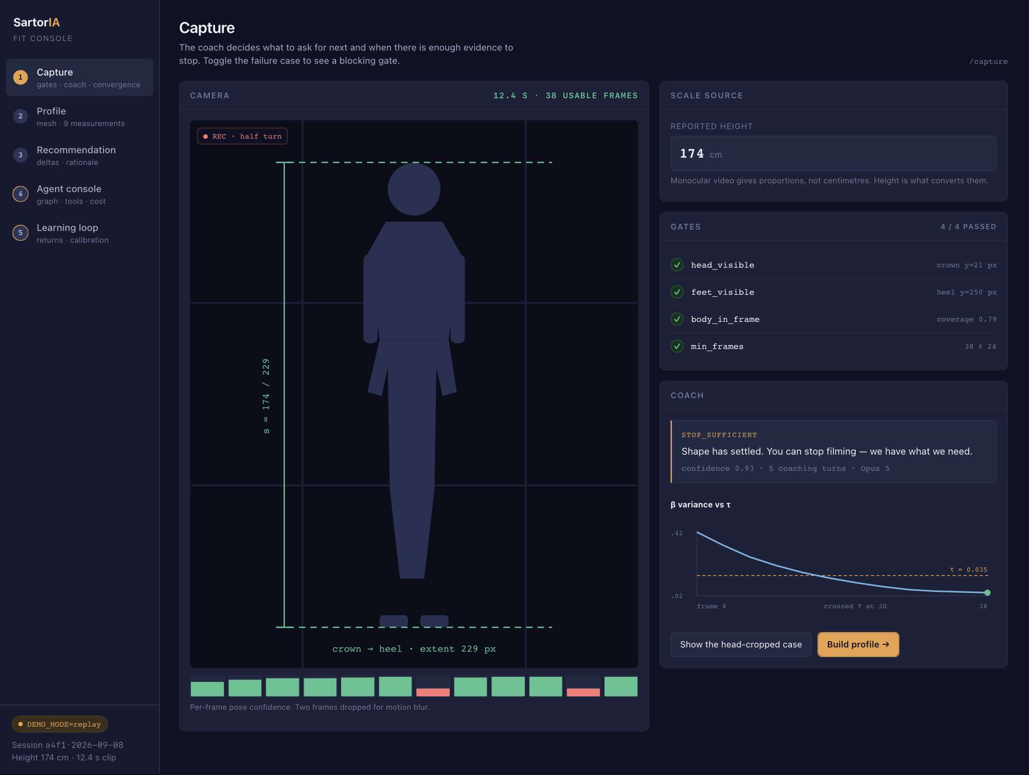
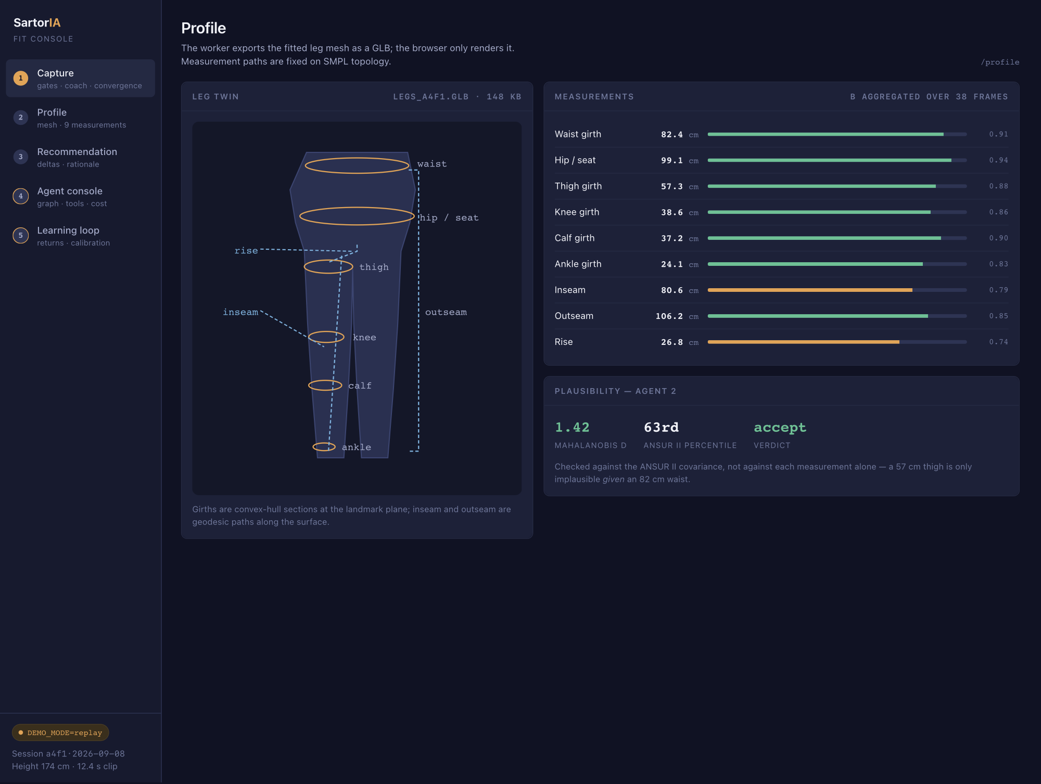
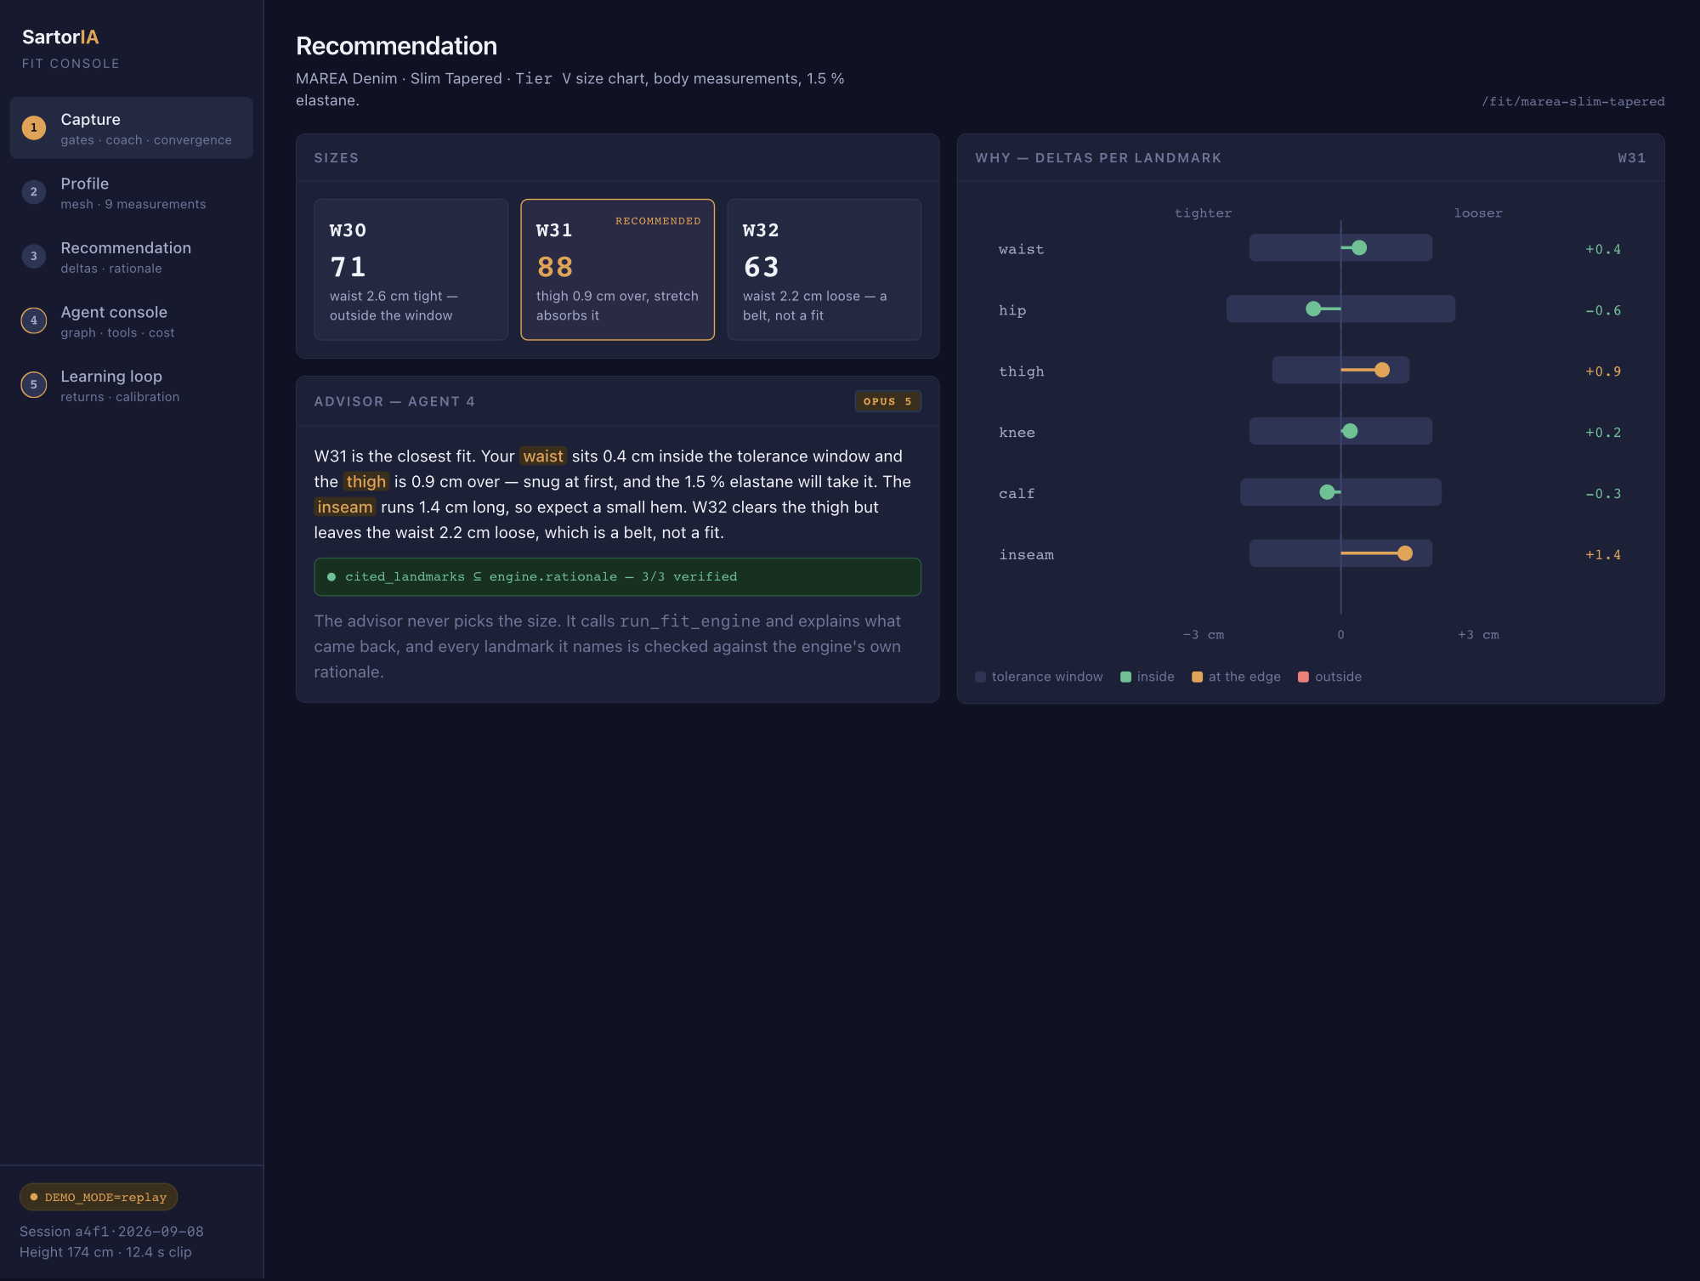
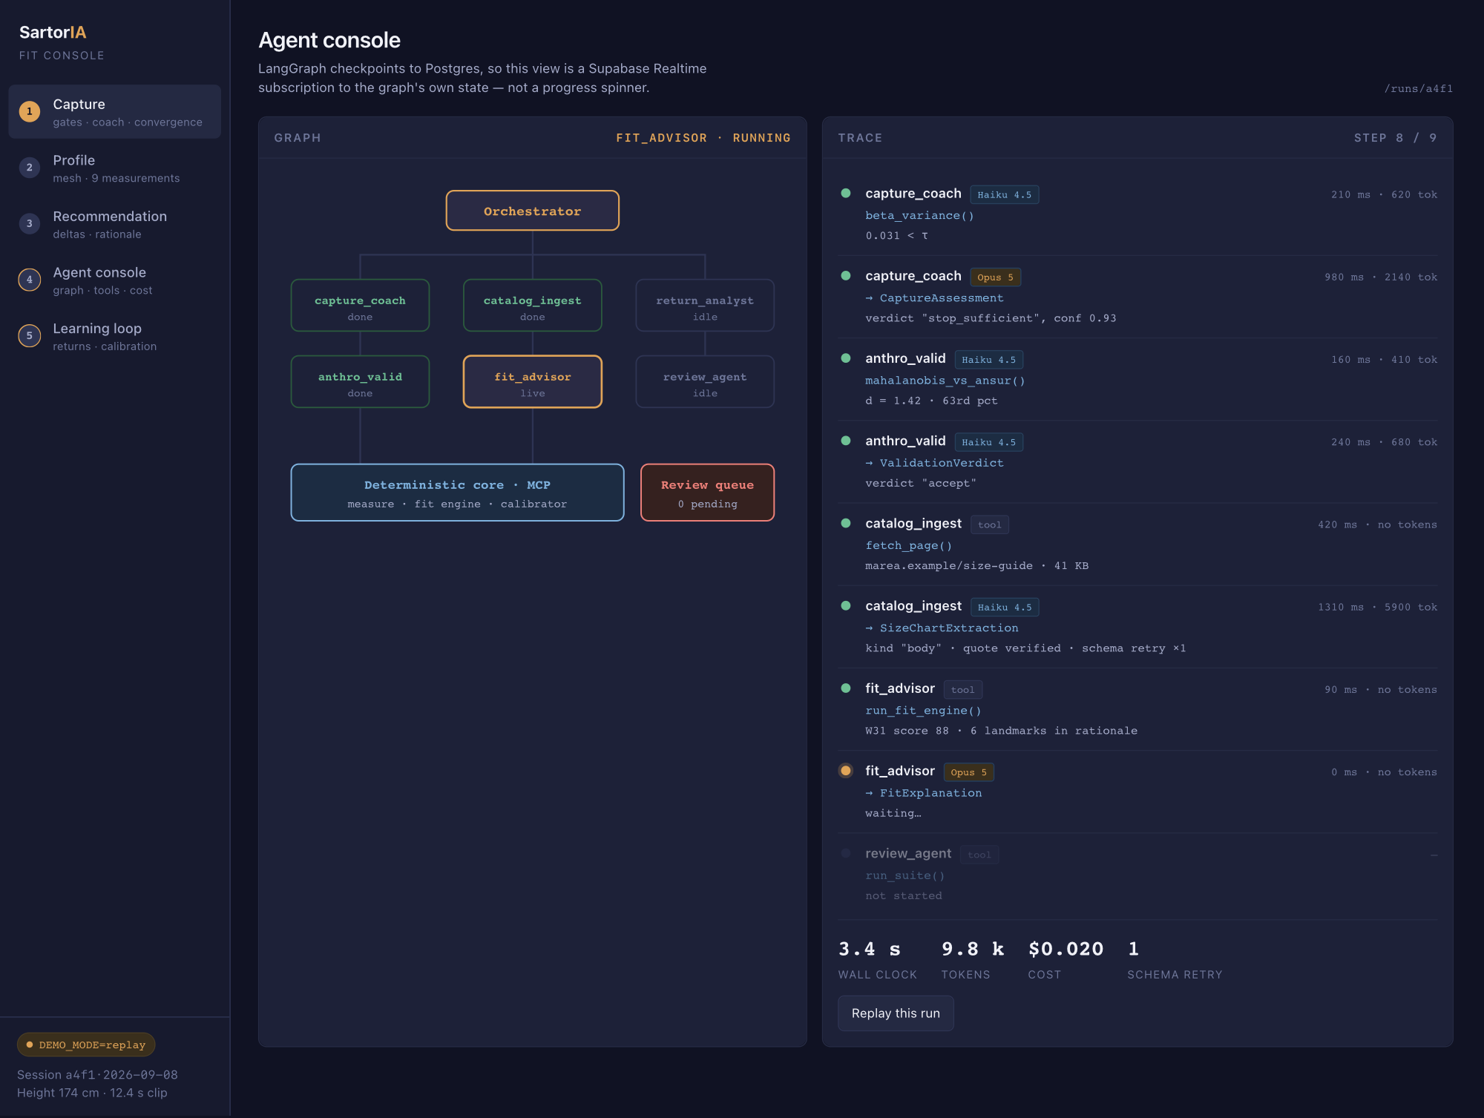
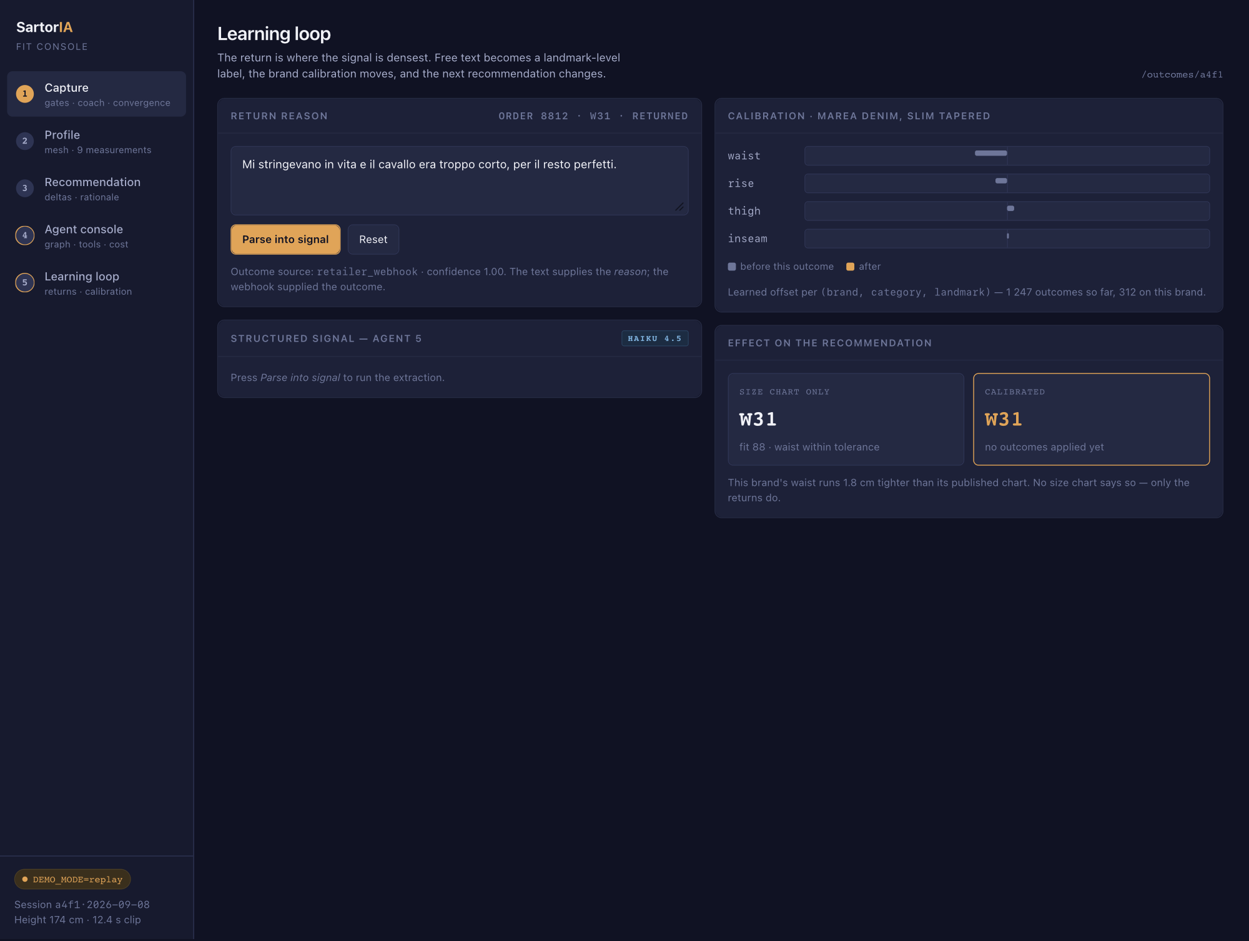
OVERVIEW
Five screens, one session
The same user, the same 12-second clip, followed from capture to a return that changes the next recommendation.
1
Capture
2
Profile
3
Recommendation
4
Agent console
5
Learning loop
checks · hints · when to stop
3D leg · nine measurements
differences · why
who did what · cost
returns · learning
Honest about the mockup:
every figure is hard-coded and no screen talks to a server yet; the 3D leg is a drawing, not the real 3D viewer it will become; the denim brand is invented, so we are not putting made-up sizing on a real one.
Screens 4 and 5 in amber — the two that would not exist in an ordinary shopping app.
Notes:
Use this slide to set the walking order, then go screen by screen. Do not linger — the detail is on the next five slides.

Slide 18
SCREEN 1 OF 5
Capture
/capture
The coach decides what to ask for next, and when there is enough evidence to stop.
WHAT TO LOOK AT
Four checks that can stop the session, each showing what it actually measured
The coach message names the cause and one physical action
The little chart shows the estimate settling: we stop when it stops moving, not after a fixed time
Filmstrip with two frames dropped for motion blur
QUESTION FOR YOU
Is the split right — camera left, gates and coach right? And should the height field come first, as its own step, since without it there are no centimetres at all?
Notes:
Screen 1 — Capture. Ask the amber question out loud and write the answer on the slide; that is the output of this meeting.

Slide 19
SCREEN 2 OF 5
Profile
/profile
Nine measurements taken off the 3D body, sanity-checked before anything is stored.
WHAT TO LOOK AT
Six measurements around the leg and three along it, drawn where they are actually taken
Per-measurement confidence, not one global score
Rise and inseam are the least certain — the crotch is the hardest point to place
Checked against a database of real bodies as a whole, not one measurement at a time
QUESTION FOR YOU
How much of this does a customer see? The certainty bars and the sanity-check score help at the exam and may be noise in a shop. Do we split it into a simple view and a detailed one?
Notes:
Screen 2 — Profile. Ask the amber question out loud and write the answer on the slide; that is the output of this meeting.

Slide 20
SCREEN 3 OF 5
Recommendation
/fit/…
The calculator picks the size. The advisor only explains it, and every measurement it names is verified.
WHAT TO LOOK AT
The chart: the grey band is what the size allows, the dot is where the person actually is
Each highlighted word in the text matches a row in the chart
The green badge is a real check: every measurement the text mentions was actually flagged by the calculator
W32 is rejected in words a person can argue with — “a belt, not a fit”
QUESTION FOR YOU
Does the delta chart read without being explained? And is a score of 88 useful to a buyer, or should it be words — “snug”, “true to size”, “roomy”?
Notes:
Screen 3 — Recommendation. Ask the amber question out loud and write the answer on the slide; that is the output of this meeting.

Slide 21
SCREEN 4 OF 5
Agent console
/runs/…
The system saves its own progress to the database, so this screen can follow along live.
WHAT TO LOOK AT
Who is finished, who is working, who is idle — read straight from the database
Every step shows what it did, what came back, how long it took and what it cost
Small model for the repetitive reading, large one for the reasoning — the cost of each is visible
One retry is shown rather than hidden: the AI sometimes answers in the wrong format, and that is handled
QUESTION FOR YOU
This screen is built for the examiners. Does it stay in the product behind a flag, become an internal-only tool, or get cut once the exam is over?
Notes:
Screen 4 — Agent console. Ask the amber question out loud and write the answer on the slide; that is the output of this meeting.

Slide 22
SCREEN 5 OF 5
Learning loop
/outcomes/…
A return is where the information is richest: a sentence becomes a specific, usable finding.
WHAT TO LOOK AT
A sentence in Italian becomes two specific findings, each quoting the words it came from
The waist offset for this brand moves from −1.4 to −1.8 cm
The recommendation flips from W31 to W32 — the loop closing, visibly
No size chart says this brand runs tight in the waist. Only the returns do
QUESTION FOR YOU
Is watching the recommendation change convincing, or does it read as an unstable system? Would you rather see it as “what we learned this week” than as an instant flip?
Notes:
Screen 5 — Learning loop. Ask the amber question out loud and write the answer on the slide; that is the output of this meeting.

Slide 23
PLAN
Fourteen weeks: hardest part first, screens last
1–2
From video to a measurement, once
Measurement points checked on computer-made bodies. Deliverable: one error figure.
3
Combining frames, and centimetres
How the error falls as frames are added; first check against real people.
GATE
Decision point
Worse than about 3 cm on the leg? Switch to a simpler method. Same agents either way.
4–5
Coach, sanity check, calculator
Agents 1 and 2, the set of bad clips, the tolerance ranges, three brands loaded by hand.
6–7
Toolbox, size charts, returns
The calculator wired up as tools. Label the 50 size charts — the dullest week; do not let it slip.
8–9
Wiring it together, and testing
All six agents connected, every run traced, all three test sets running.
10
The experiments that answer questions
The comparison experiments, the cost curves, the learning study.
11–13
The screens
The five screens, live updates, the 3D leg, and replay mode.
14
Write-up and buffer
Figures from committed CSVs. Something in weeks 6–9 will overrun.
Decide at week 3, not at week 9 — that is the difference between a project delivered and a project rescued.
Notes:
The gate row is the project-management point: the computer-vision risk is concentrated in the first three weeks and has a pre-agreed fallback that leaves the agentic layer — the graded part — untouched.

Slide 24
SCOPE DISCIPLINE
What this project does not build
✕
Train our own 3D body model
✕
A full 3D scan of the person
We use an existing one as it comes. Training one is a PhD, not an MVP.
Needs many steady views, and the result is hard to measure reliably.
✕
Simulating the fabric
✕
Plugging into a shop's systems
The 3D leg exists to measure, not to dress.
We have no access to real orders yet, so the feedback comes from public data.
✕
Payments and checkout
✕
Two genders of size chart
Faked, and openly labelled as faked.
Doubles the golden-set week and adds no new science.
Privacy comes from what we keep, not from what we film: the video frames are never saved. We keep the height, the nine measurements, the body-shape numbers and how sure we are.
Notes:
The head gate means the whole body, face included, passes through the pipeline — so say plainly that the privacy claim is a retention claim, which is verifiable in the schema rather than asserted. Top-of-head detection needs no facial features, so face masking at ingest is compatible with the gate.

Slide 25
WHAT WE NEED TO DECIDE
Five questions, then we build
Priority
If weeks 11–13 run short, which screen gets cut? My answer is 2, because measurements can live inside screen 3.
1
Audience
How much machinery stays visible in a shipped product — all of it behind a flag, or a simple view by default?
2
Language
Italian in the interface with English in the code and thesis, or English throughout? This decides which language agent 5's labelled set is built in.
3
Vocabulary
You know denim better than the mockup does. Any measurement name, tolerance or phrase that reads wrong to you?
4
Fit score
A number out of 100, words, or both?
5
Colours, spacing and copy are cheap to change once the app exists. Layout and scope are not — those are what this meeting is for.
Notes:
Close by naming the next step: with these five answers, the scaffold is a Next.js repo on Vercel, the Supabase schema with RLS and Realtime, and the Modal app with stub endpoints and a compiling LangGraph graph.

Slide 26
CLOSING
The three-minute story
1
Enter height, record twelve seconds of video
The loop closes
in front of the room
2
The coach gates the clip and names any problem
3
Pick a brand never seen before — agent 3 reads its size chart live
Six agents, one calculator, and a claim we can measure:
AI on the messy edges, ordinary code at the centre — with the numbers to back it.
4
The recommendation arrives, explained measurement by measurement
5
Type a return reason in plain Italian
6
Calibration shifts, and the recommendation changes
Companion documents: Architettura SartorIA · SartorIA MVP Blueprint
Notes:
Close on the demo rather than on a summary slide. Rehearse it until it runs in three minutes without narration — the moment the recommendation shifts after a typed return reason is when the whole architecture becomes obvious.

