Slide 1

Comp 3120/8110 Software Development Management
Week 1 Lecture 2
Tuesday 26th February 2019
Log into Socrative!
http://www.socrative.com
CALDWELL8573

Slide 2

Workshops
Workshops will be held during the following weeks of semester:
Week 2
Week 3
Week 5
Week 6
Break
Week 8
Week 9
Week 10
Week 11
Week 12
There should be enough space for everyone now in the workshops.
Very important!
Let me know if you have any workshop issues ASAP

Slide 3
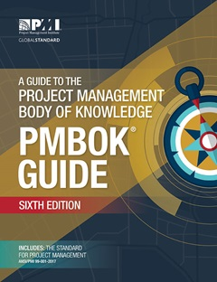
Today, we will cover:
Course Details
Course outline on Wattle, especially assessment
Course schedule
Introduction to Project Management
the basic definition of a project
an introduction to project management fundamentals
a preview of a range of project management approaches and lifecycles
the Project Management Body of Knowledge (PMBoK)
why organisations manage projects
Book image from https://www.pmi.org/pmbok-guide-standards

Slide 4
Course details - assignments
Assignment 1 - Research Report Review (10%)
groups will review and provide feedback on a research paper provided to you.
Assignment 2 - Research Report (15%)
groups will research an assigned topic and produce a short research paper on their assigned topic.
Assignment 3 - Briefing Paper & Presentation (20%)
students will produce a short briefing paper for a scenario provided to you and used in workshop exercises. In addition to the briefing paper, students are required to present the key points, including recommendation, during Week 12. The briefing paper, including recommendations, will require students to draw upon and apply the knowledge gained from their research conducted for Assignments 1 & 2.
Due: 5pm Friday, 29 March
Due: 5pm Friday, 26 April
Briefing paper due: 5pm Friday, 24 May
Presentation slides due: 9am Tuesday, 28 May

Slide 5
Course details - assignments
Notice all the reports in the assignments?
We’ll be helping you with that …
Workshop 1 Next week
Academic Skills and Learning Centre

Slide 6

Course details - assignments
GROUP submission – i.e. a single copy per group – via the appropriate Wattle assignment submission activity
Wattle
INDIVIDUAL submission – i.e. each student must submit a peer assessment at https://users.cecs.anu.edu.au/webpax/login.php
Due: 9am Monday morning following each Assignment due date

Slide 7
Course details
Wattle
Course outline
Course schedule
Weekly reading

Slide 8


What do you think a project is?
Socrative
CALDWELL8573
Notes:
.

Slide 9
What is a ‘project’ anyway?
Goal driven?
Solution to a business problem?
Lifecycle?
Fixed End Point?
Change?
Adds value?
Unique?
Notes:
.

Slide 10

Generally accepted definition of a project
A project is a sequence of unique, complex and connected activities that have one goal or purpose and that must be completed by a specific time, within budget, and according to specification. (Robert Wysocki, Effective Project Management)

Slide 11
Generally accepted definition of a project
A project is a sequence of unique, complex and connected activities that have one goal or purpose and that must be completed by a specific time, within budget, and according to specification. (R. Wysocki)

Slide 12
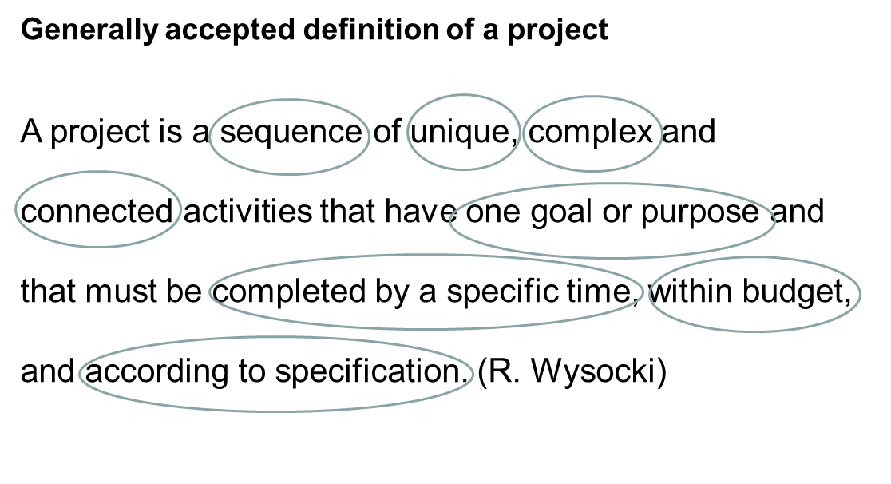
A better definition of a project?
A project is a sequence of finite dependent activities whose successful completion results in the delivery of the expected business value that validated doing the project. (Robert Wysocki)

Slide 13
What distinguishes a project from business as usual?
Socrative
CALDWELL8573

Slide 14
Project – Program - Portfolio
Project
A project is a sequence of finite dependent activities whose successful completion results in the delivery of the expected business value that validated doing the project. (Wysocki)
Program
A collection of related projects, which may need to be completed in a specific order for the program to be complete. Programs may have more than one goal.
Portfolio
A collection of projects that share a common link to one another.

Slide 15
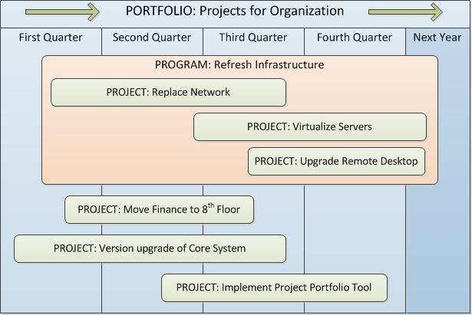
Project – Program - Portfolio
http://pmfiles.com/2011/570/
Notes:
What does the second definition have that the first one doesn’t? In what ways is it better?

Slide 16
Project management fundamentals
Definition from the Project Management Institute
Project management is the application of knowledge, skills, tools and techniques to project activities to meet the project requirements.
In other words … Project management is organised common sense

Slide 17
What goes on in the mind of a project manager …
What does the business need to do?
What business situation is being addressed by this project?
What will you do?
Project
Management
How will you do it?
How well did you do?
How will you know you did it?

Slide 18
Project management fundamentals
Definition
Project management is an organised common-sense approach that utilizes the appropriate client involved in order to meet sponsor needs and deliver expected incremental business value.. (R. Wysocki)
Project management is the application of knowledge, skills, tools and techniques to project activities to meet the project requirements. (PMI)
In other words … Project management is organised common sense

Slide 19
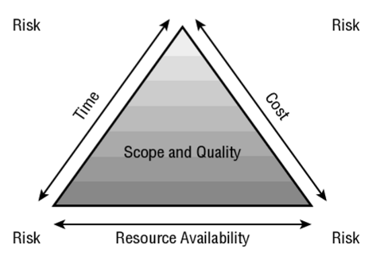
The iron triangle

Slide 20
Classifying projects
Risk – (high, medium, low)
Business value (high, medium, low)
Length (3-6 months, 6-12 months, etc.)
Complexity (high, medium, low)
Technology used (well-established, used occasionally, rarely used)
Number of departments affected (all, most, several, few)
Cost

Slide 21
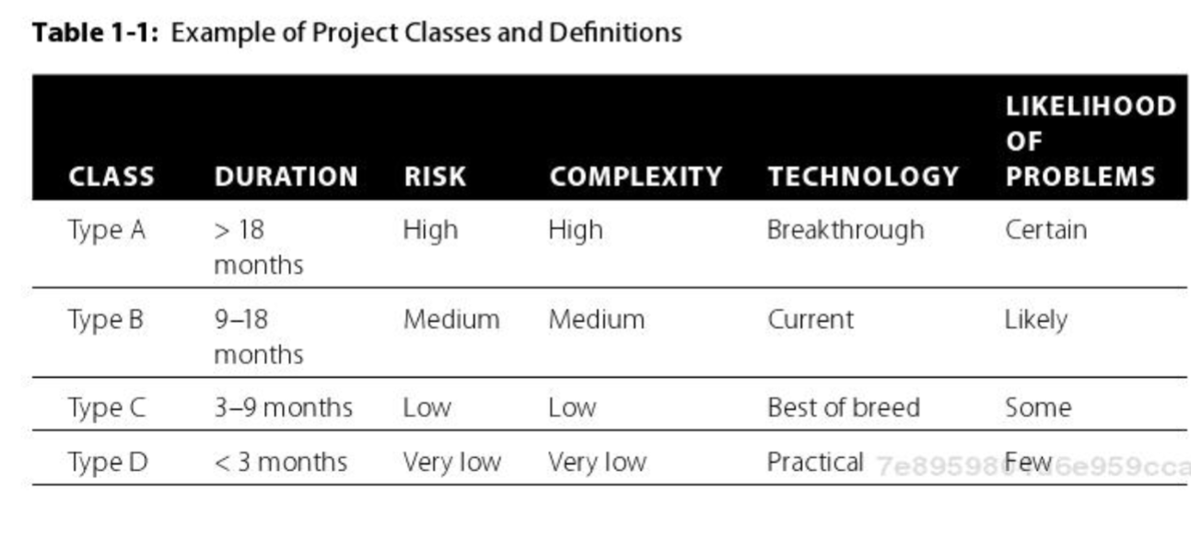
Classifying projects
Type A projects – high business value, high complexity
Type B projects – shorter but still significant business value
Type C projects – most common: short, using established technology
Type D projects – barely meets definition of a project

Slide 22
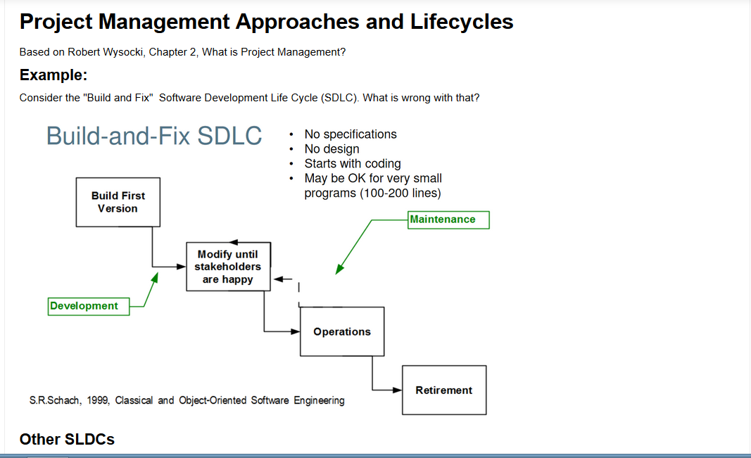
Project management approaches and lifecycles

Slide 23
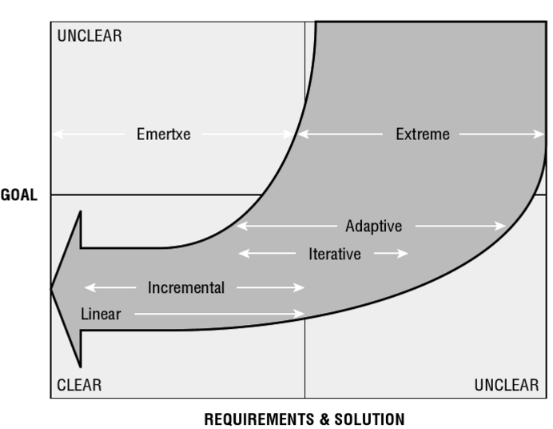
To determine an appropriate approach, the project manager must understand the certainty of the solution -- a continuum ranging from:
high certainty -- both the goal and the solution are clearly defined OR
some uncertainty -- the goal is clearly defined but the solution isn't
major uncertainty -- neither goal nor solution are clearly defined.

Slide 24
Software development models
The waterfall model – This takes the fundamental process activities of specification, development, validation, and evolution and represents them as separate process phases such as requirements specification, software design, implementation, and testing.
Incremental development This approach interleaves the activities of specification, development and validation. The system is developed as a series of versions (increments), with each version adding functionality to the previous version.
Integration and configuration This approach relies on the availability of reusable components or systems. The system development process focuses on configuring these components for use in a new setting and integrating them into a system.
Sommerville, Ian. (2016) Software Engineering. p. 45-46

Slide 25
Is the project management lifecycle different from the software development lifecycle?
Socrative
CALDWELL8573
Notes:
.

Slide 26
Why have different approaches to project management developed?
Socrative
CALDWELL8573

Slide 27


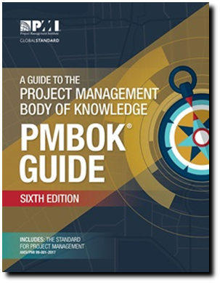
Project Management Body of Knowledge
Five Process Groups
Initiating (or scoping) process group
Planning process group
Executing (or launching) process group
Monitoring and controlling process group
Closing process group
Ten Knowledge Areas
Project Integration Management
Project Scope Management
Project Time Management
Project Cost Management
Project Quality Management
Project Human Resource Management
Project Communications Management
Project Risk Management
Project Procurement Managment
Project Stakeholder Management

Slide 28
What is the PMBoK and where does it fit within the daily management of software development?
Fact or fiction: the PMBoK and agile approaches to project management are incompatible?
Socrative
CALDWELL8573

Slide 29
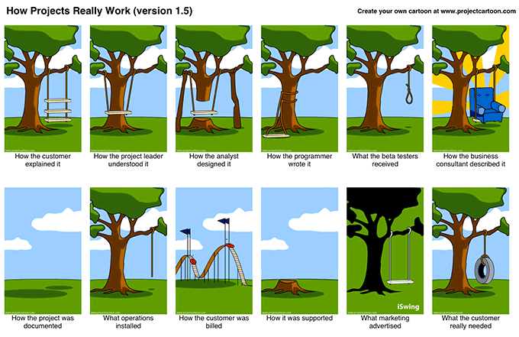
8
Why do organisations manage projects?
Remember this from Monday’s lecture?

Slide 30


Why do projects fail? – Technical reasons
Software 1 computes thrust force needed in units of pounds
Software 2 accepts number from Software 1 in units of newtons
1 newton of force = .2249 pounds of force
(metric) (English)
1999 NASA’s Mars Climate Orbiter
$125 Million cost
10 month journey
Entered Mars atmosphere too low and fast and disintegrated

Slide 31
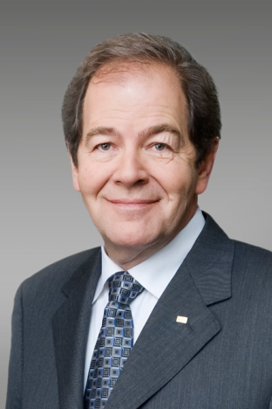

Why do projects fail? Management reasons
CGI Federal
Paid $88M
Website < 1% successful
Serge Godin
Founder, Billionaire
‘ObamaCare’
US$1.5 Billion Government Project
What went wrong? “sloppy software foundation possibly due to the haste with which code was written.” and “with so many contractors, everyone could technically fulfill the requirements in their statement of work, and the thing can still not work in the end.” Washington Post, 2013¹
1 https://www.washingtonpost.com/news/wonk/wp/2013/10/16/meet-cgi-federal-the-company-behind-the-botched-launch-of-healthcare-gov/?utm_term=.c938b4e4adf3

Slide 32
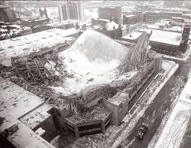
Why do projects fail? Not understanding requirements
Hartford Coliseum
1978
Roof fell in only hours after thousands of basketball spectators left the coliseum
What went wrong? Many things, including the use of computer science to work out the minimum required materials for the expected load, and a computer analysis that left out the torsional stress requirements.

Slide 33

Why we manage projects
Software development is different. It is
complex
abstract
usually requirements are incomplete
technology changes rapidly
technology is a vast domain
technology experience is incomplete
software development is akin to research
software construction is really design
change appears easy
change is inevitable
Managing software development projects is difficult!

Slide 34
What are the key attributes of a good project manager and why are they important?
Socrative
CALDWELL8573

Slide 35
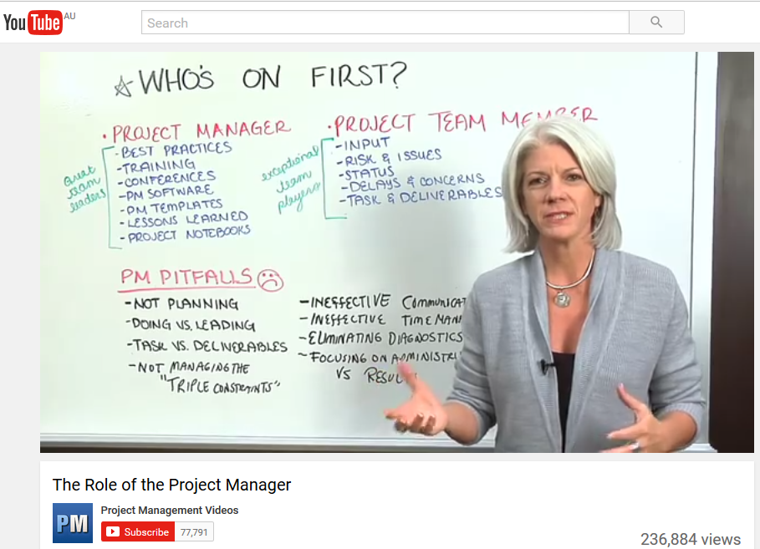
What are the key attributes of a good project manager and why are they important?
Best practices
Training
Conferences
PM software
PM templates
Lessons learned
Project notebooks

Slide 36
Project management vs Project leadership

Slide 37
Understanding teamwork
Team formation
Developing your people skills
Personality and its impact
Emotional intelligence and performance

Slide 38
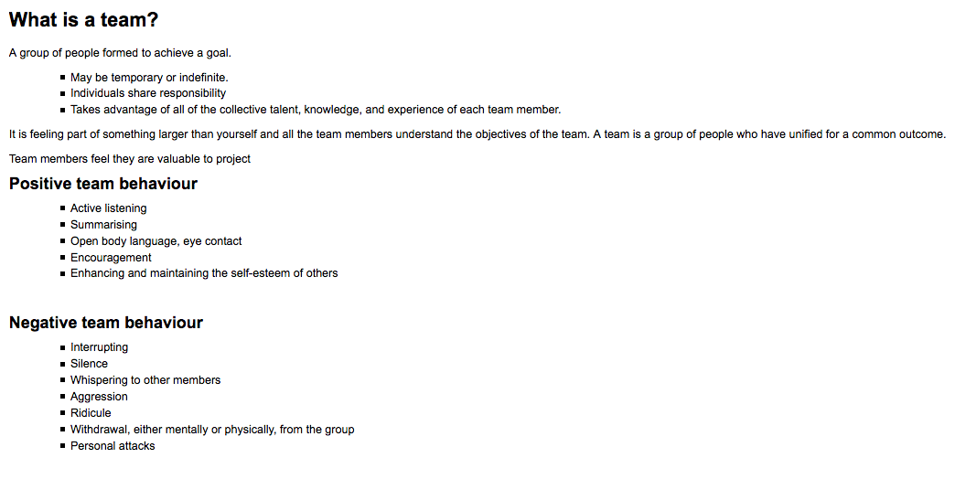
Understanding teamwork

Slide 39
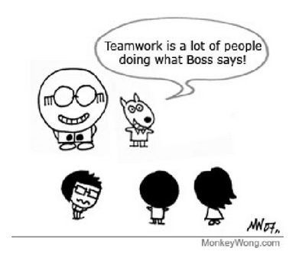
Understanding teamwork
, not!

Slide 40
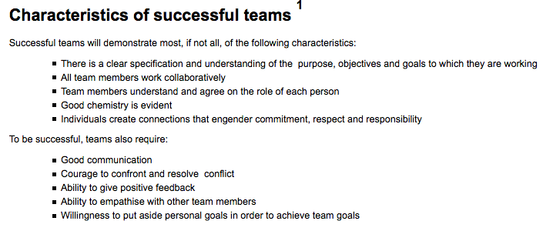
Understanding teamwork

Slide 41
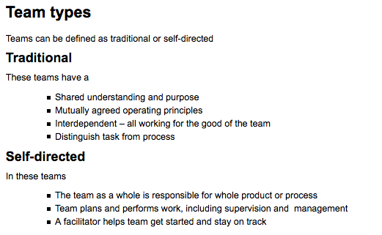
Understanding teamwork

Slide 42
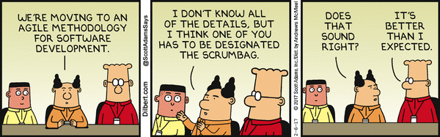
10
What is Agile project management (APM)?
Socrative
CALDWELL8573

