Slide 1
Do most people have tech support with their services and what is the minimum, maximum, and average income of a person with services?
Jessenia Lorenzo
D205 - Performance Assessment - Postgre SQL

Slide 2
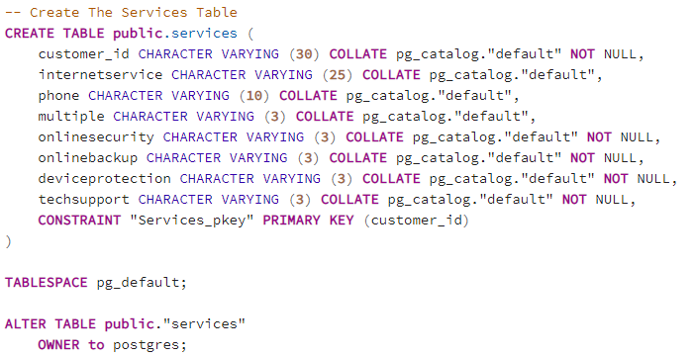
-- Create the Services Table

Slide 3
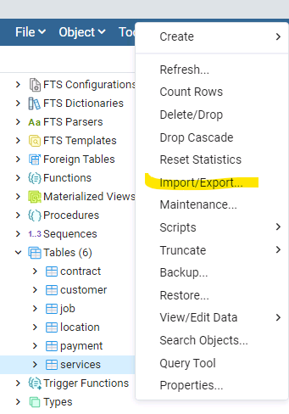
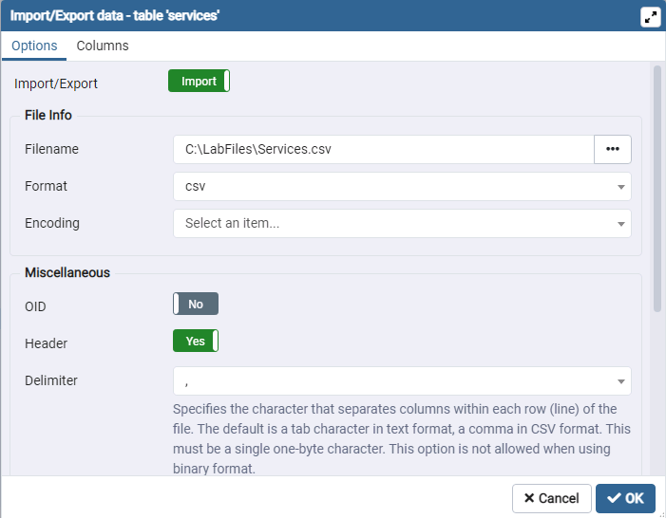
-- Importing the Services Table
I imported the Services table on the left using the import function.

Slide 4
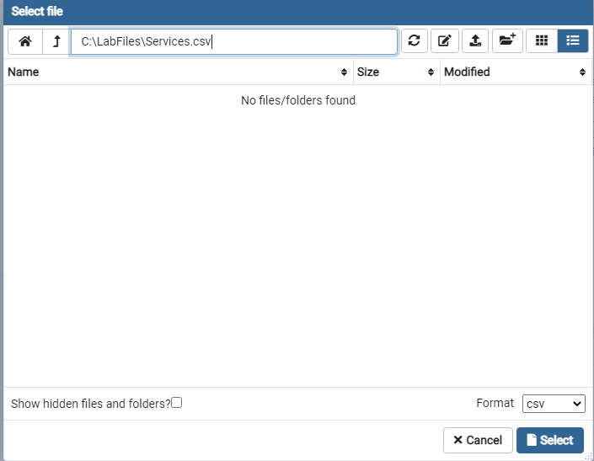
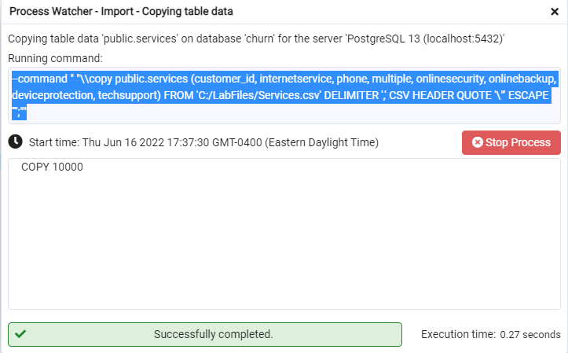
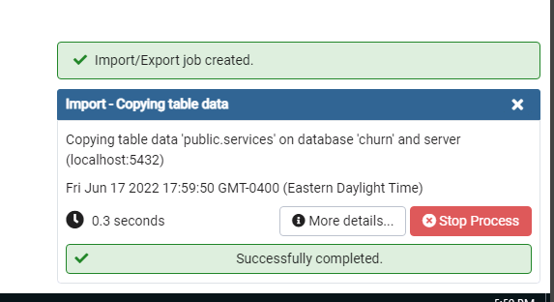
-- Importing the Services Table (continued)

Slide 5
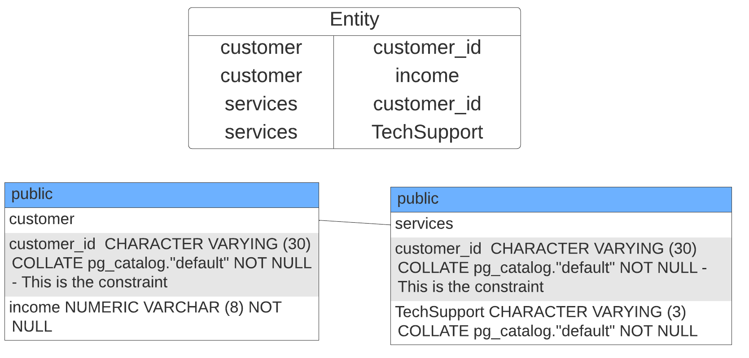
-- This is my Entity Relationship Diagram (ERD)

Slide 6
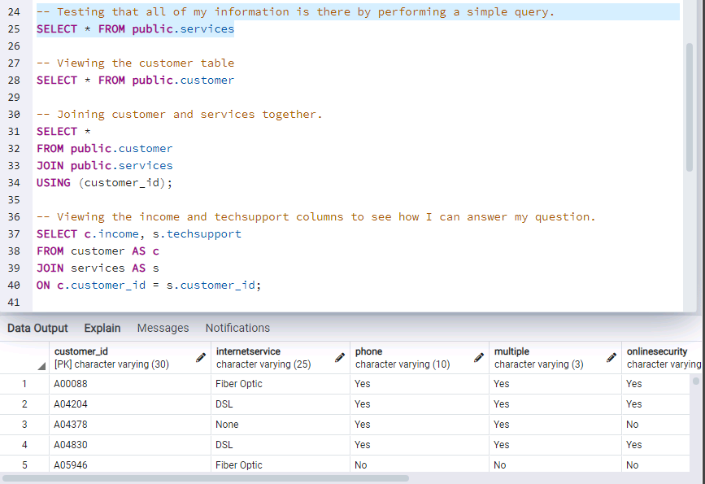
-- With the relationship formed in the previous slide…

Slide 7
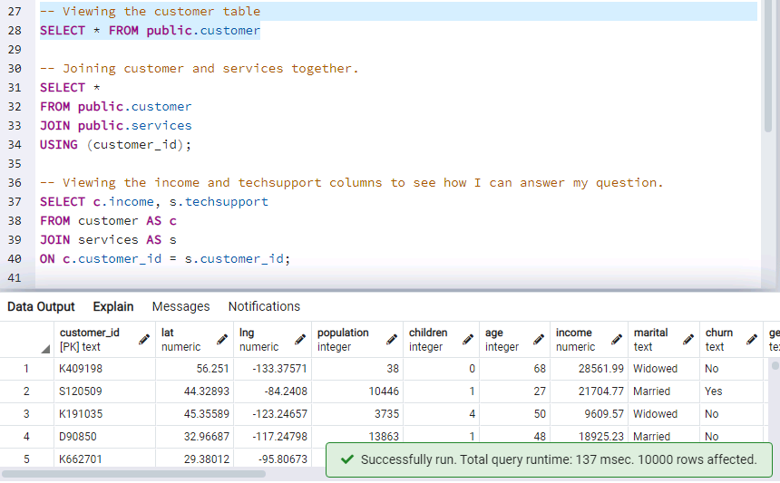
View the customer table to examine my variables.

Slide 8
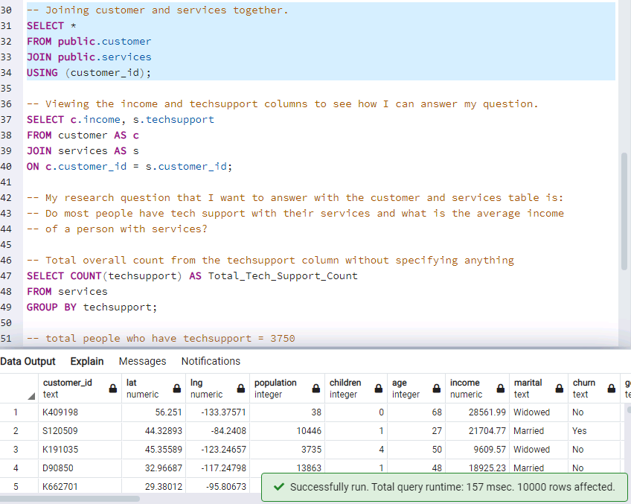
Join both customer and services table

Slide 9
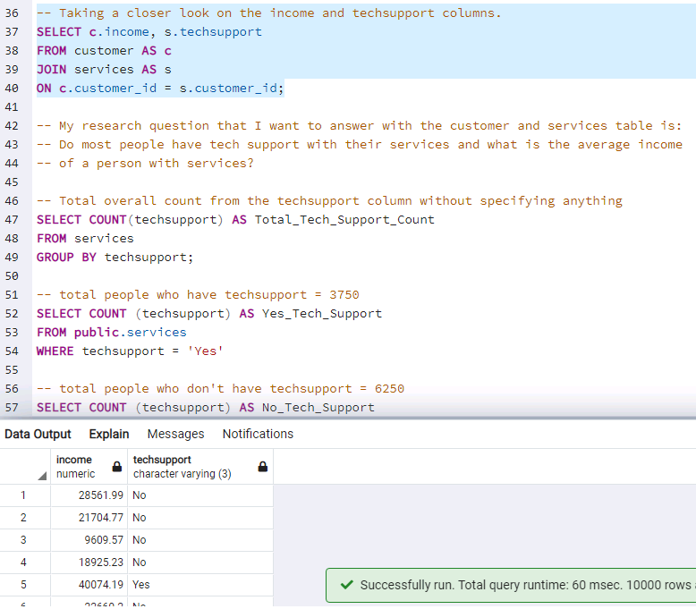
Examine a little closer income and techsupport

Slide 10
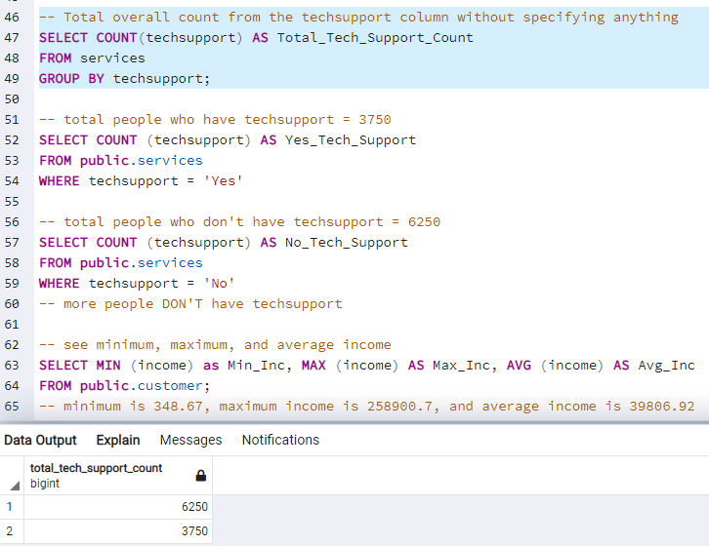
Taking a general look at techsupport by group

Slide 11
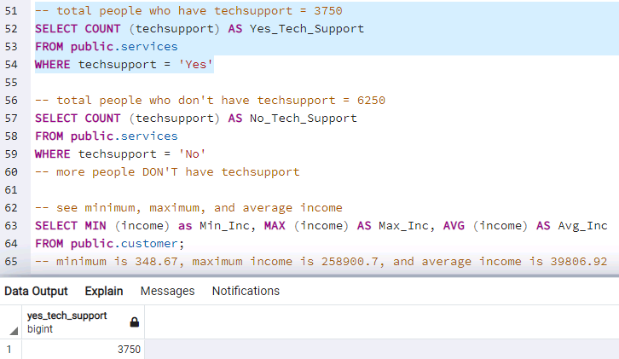
Total people who have techsupport - 3750

Slide 12
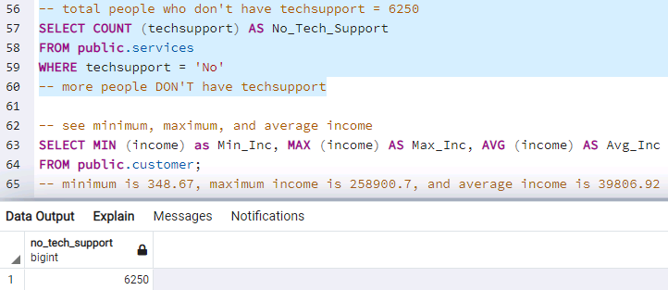
Total people who don’t have techsupport - 6250
More than double the amount of people DON’T have tech support.

Slide 13
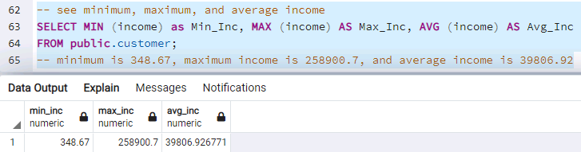
Taking a look of what the minimum, maximum, and average income in the table is

Slide 14
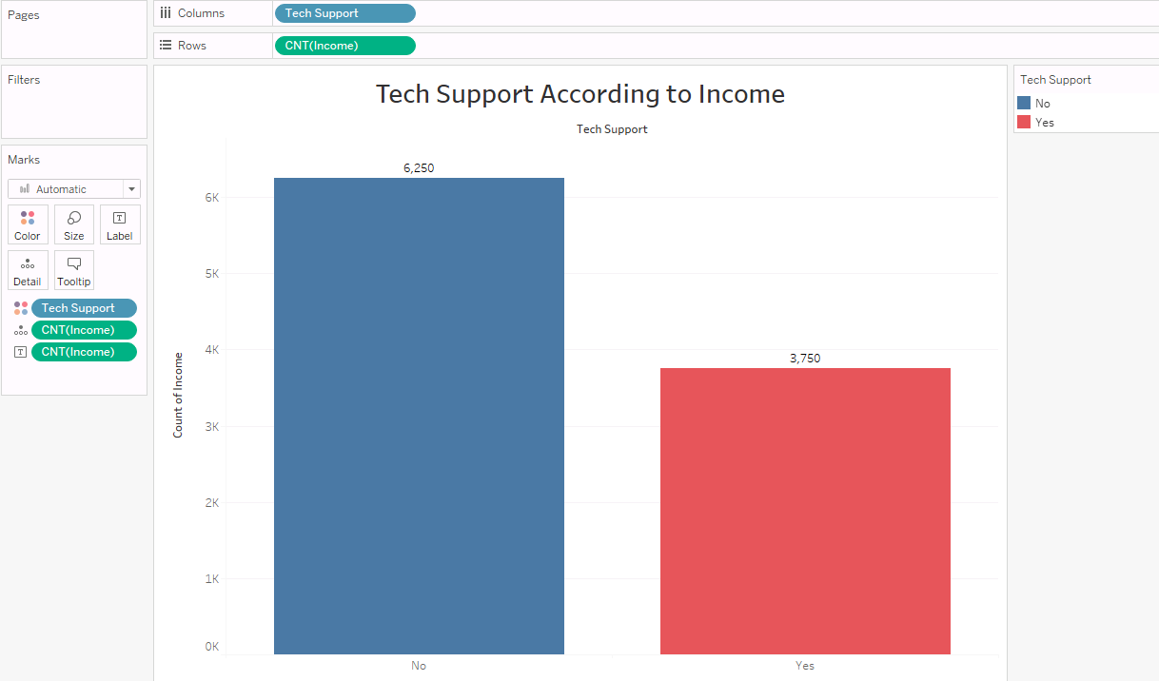
To export my data to import both customer and services into Tableau, I used the following query:
COPY income TO 'c:/LabUser/income_customer.csv' DELIMITER ',' CSV HEADER;

Slide 15
Thank you!

