Slide 1
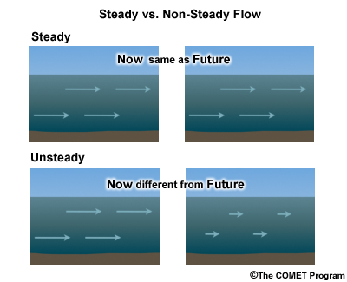
Overview of Unsteady Flow Modeling
Giulia Sofia, PhD

Slide 2
Overview
1. What is Unsteady Flow?
2. How is it different than Steady Flow?
3. Why would you use it?

Slide 3
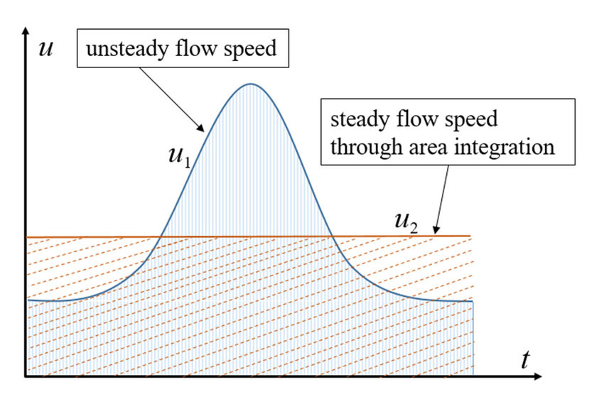
What is Unsteady flow?
Unsteady flow
Flow changes with time
Steady flow
changes gradually
Flow does not change with time

Slide 4
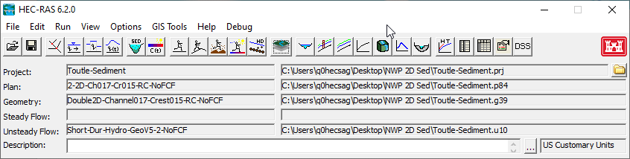
What is Unsteady flow?
Steady flow
Unsteady flow

Slide 5
How is it different than Steady flow?
How is it different than Steady Flow?
  Boundary Conditions
  Calibration

Slide 6

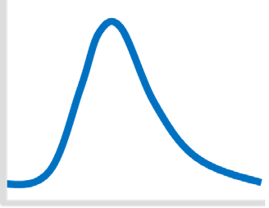
How is it different than Steady flow?
  Boundary Conditions
  Hydrologic routing
  Hydraulic routing

Slide 7
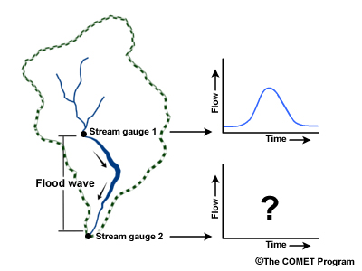
How is it different than Steady flow?
Hydrologic-routing methods employ essentially the equation of continuity, according to which the difference between the inflow and outflow rate is equal to the rate of change of storage.
The continuity equation preserves the water volume in the channel
The relationship between storage and outflows are usually empirical in nature, and stage–discharge relationships may be used.

Slide 8
How is it different than Steady flow?
Hydraulic-routing methods uses the continuity equation and adds an energy budget approach, represented by the momentum equation.
In this way, hydraulic routing accounts for the actual physics of water movement in the channel.

Slide 9
How is it different than Steady flow?
Steady: Discharge (Q) at each cross section and stage/ discharge relationship at D/S
Unsteady: Inflow hydrograph(s) at boundaries and interior locations, which are routed by the model, and stage at D/S.

Slide 10
How is it different than Steady flow?
Algorithms used in HEC-RAS:
Steady: Iterative solution of the energy equation section-by- section for each flow.
Unsteady: Matrix solution of the continuity and momentum equations, for flow and stage, simultaneously at all sections each time step.

Slide 11
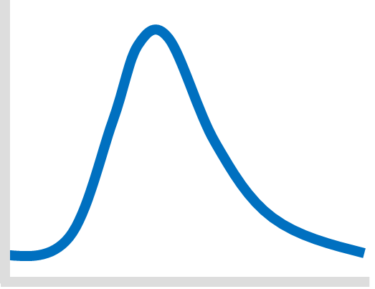
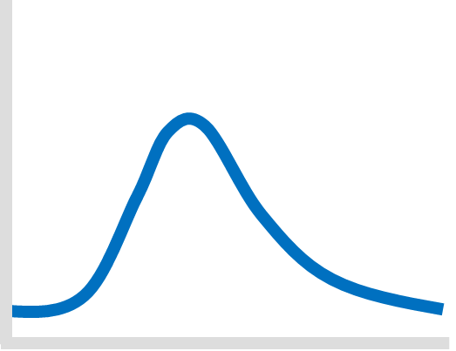

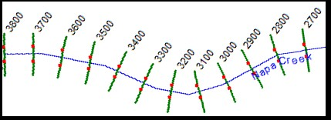
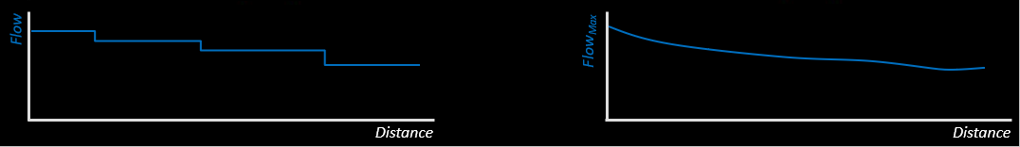
How is it different than Steady flow?
Hydrologic-routing
Hydraulic-routing

Slide 12
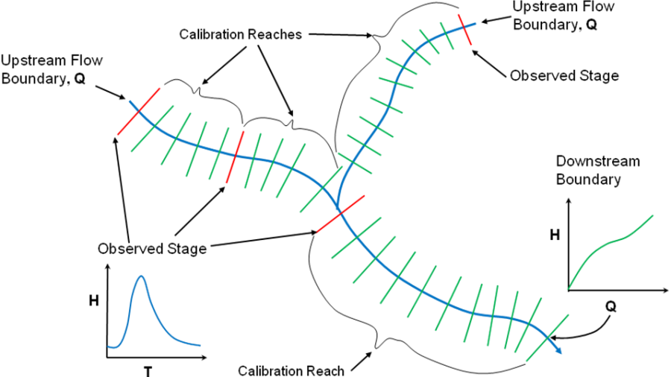
How is it different than Steady flow?
Calibration
Steady flow

Slide 13
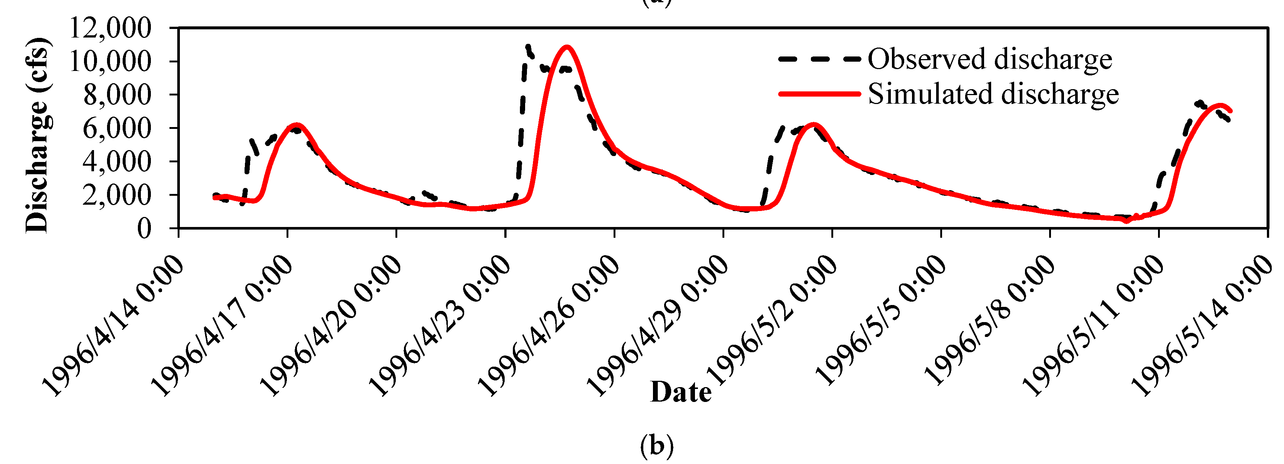
How is it different than Steady flow?
Calibration
Unsteady flow

Slide 14
Applications
Unsteady flow
The events being modeled are very dynamic with respect to time (i.e., flood waves; flash floods; river systems in which the peak flow comes up very quickly, stays high for a very short time, and then recedes quickly).
Complex flow networks.
Extremely flat river systems, where gravity, hydrostatic pressure, and friction are not necessarily the only significant force acting on the flow (i.e. local and convective acceleration forces).
Systems with structures

Slide 15
Unsteady Flow Routing (1D or 2D) vs
Hydrologic Routing/Steady Flow Hydraulics?
Considerations:
  Physical description of the river channels, floodplain areas, bridges/ culvert, levees, road, hydraulic structures
  Size (area/length) and complexity of the system?
    (1, 10, 50, 100, 500, or 1000’s of sq. km)
  Model Objective: planning or real time
  Events will be analyzed?
    (2yr-500 yr)
  Typical duration of a flood event?
    (1/2 day, 1-3 days, week, month, or 6 months)

Slide 16
Unsteady Flow Routing (1D or 2D) vs
Hydrologic Routing/Steady Flow Hydraulics?
Unique aspects of the system that affect the choice :
Availability and accuracy of the terrain data and hydraulic structure information?
Accuracy of the hydrology used to drive the models?
Model objectives – results?
  Water surface elevations, water depths, arrival times, average velocities, detailed velocities at specific locations, etc…
Required accuracy of the results?

Slide 17
1D vs. 2D Hydraulic Modeling
Some areas in which 2D models often outperform 1D models:
  When modeling an area behind a leveed system, and the levee will be overtopped and/or breached, and the water can go in many directions.
  Bays and Estuaries in which 2D velocities are needed
  Alluvial Fans
  Flow around abrupt bends in which a significant amount of super elevation will occur during the event.
  Very wide and flat flood plains, such that when the flows goes out into the overbank area, the water will take multiple flow paths and have varying water surface elevations
  Applications where it is very important to obtain detailed velocities for the hydraulics of flow in a channel, floodplain, or around an object, such as a bridge abutment or bridge piers, etc…
14

Slide 18
1D vs. 2D Hydraulic Modeling
Some applications where 1D results will be similar to 2D results:
  Rivers and floodplains in which the dominant flow directions and forces follow the general river flow path.
  Steep streams that are highly gravity driven and have small overbank areas.
  River systems that contain a lot of bridges/culvert, weirs, dams, gated structures, levees, pump stations, etc….
  Medium to large river systems (50 or more miles), and it is necessary to run longer time periods (2 week to 6 months).
  Areas in which the basic data does not support the potential gain of using a 2D model.
16

Slide 19
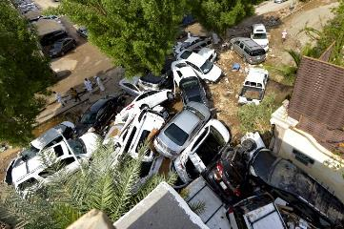
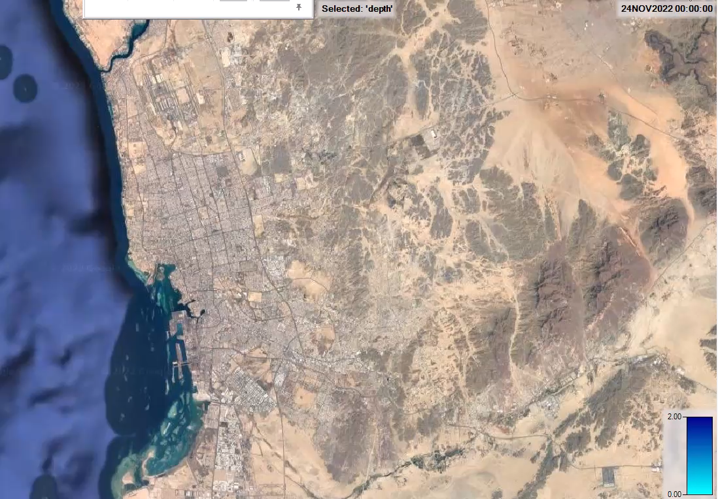
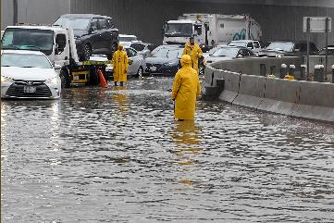
1D vs. 2D Hydraulic Modeling

Slide 20
Application Strategy
1. Prepare hydrographs (boundary conditions)
Upstream flows
Downstream Boundary conditions

Slide 21
Application Strategy
2. Calibration
Manning’s n affects both stage and timing.
Storage areas/ineffective flow areas can be very important.
Fine tuning of flood wave attenuation via conveyance
adjustment.
Structures such as bridges, diversions and pumps can be useful sources of data.

Slide 22
Questions?
33

