Slide 1
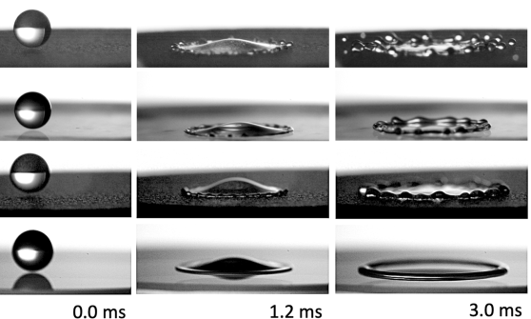
HEC-RAS.
Land Cover Layer and Manning’s n Values
Giulia Sofia, PhD
Modified from
https://doi.org/10.1038/s41598-019-51490-5

Slide 2
Overview
1. Why do we need it?
2. Land Cover Data Sources
3. Importing Land Cover Data
4. Associating Manning’s n Values
5. What if I don’t have any?

Slide 3
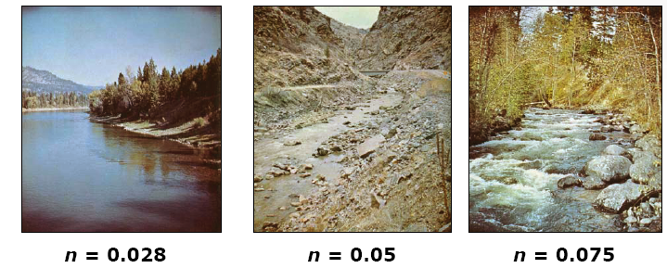
Application
During floods, part of the discharge of a river is carried by the simple main channel and the rest are carried by the floodplains located to its sides.
Depth and Velocity of flow adjust themselves is response to input flow rate, energy gradient, and channel/floodplain properties that cause resistance—all expressed in Manning’s coefficient

Slide 4
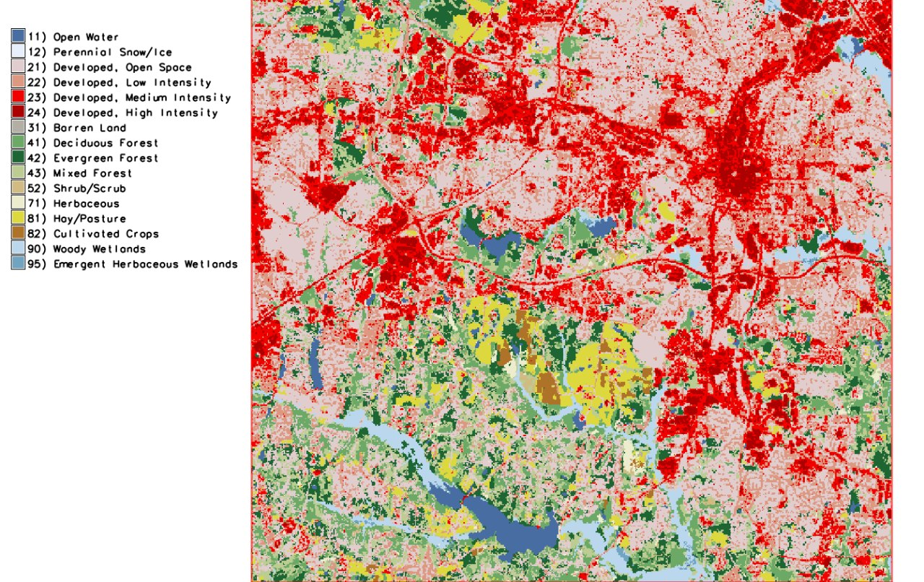
Application
From an analytical standpoint, Mannings’ n value is a coefficient that needs to be chosen to calculate or model flow
From a practical standpoint, we can estimate this coefficient based on land-cover

Slide 5
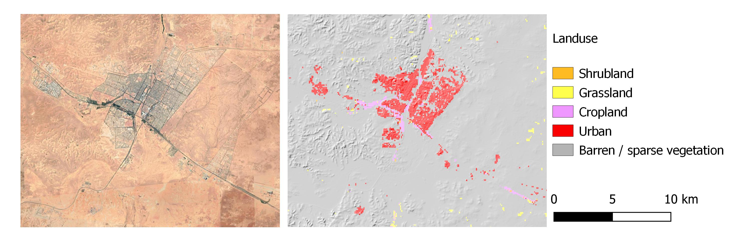
Data sources
European Space Agency (ESA) WorldCover 100 m >>10m 2020

Slide 6
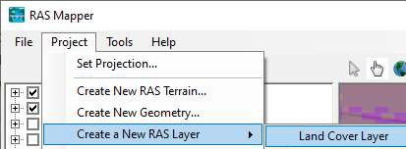
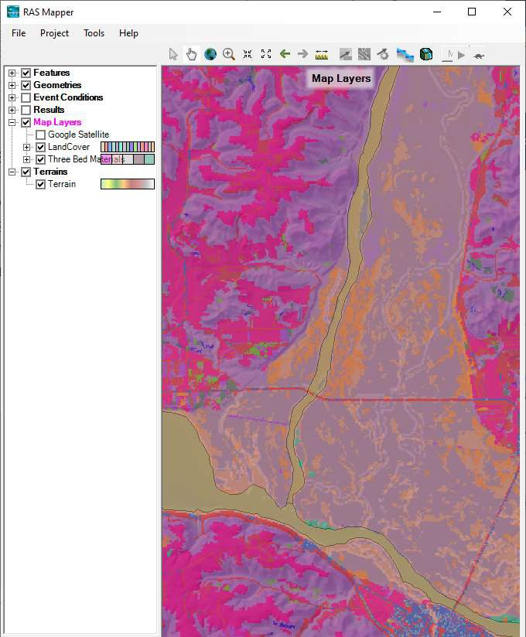
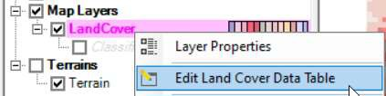


Importing data
Create Land Cover
Import Land Cover Data
Define Base
n Values
Associate Land Cover with Geometry

Slide 7
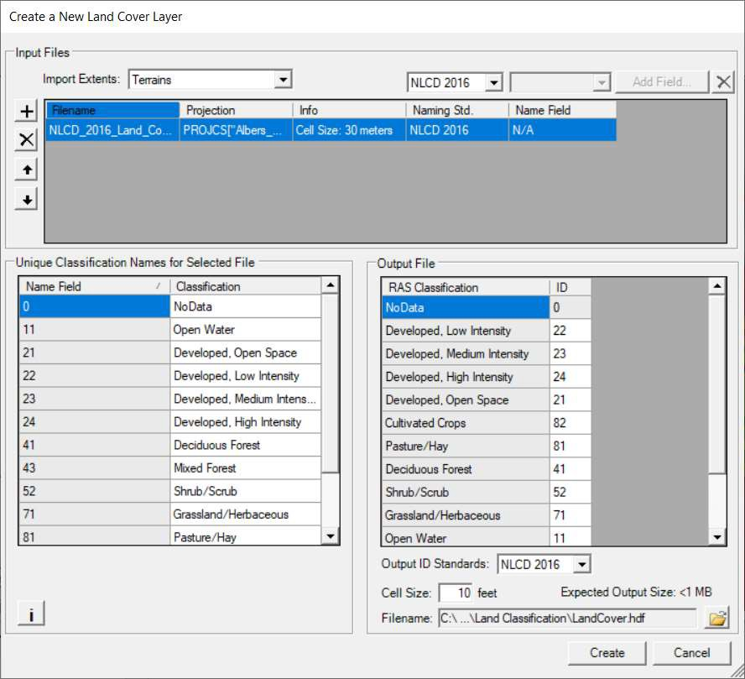

Importing data
Create Land Cover
We should have knowledge of ‘standard’ landuse classes to be attributed to the actual values, in order to have consistent results
New Raster is created (LandCover.tif and LandCover.hdf)
Reprojected into coordinate system
As for the previous terrain files, these files are technically not used by the linux system. But the information loaded in hecras is stored at the cell center for each mesh area, and embedded in the .hdf file under the umbrella ‘geometry’

Slide 8
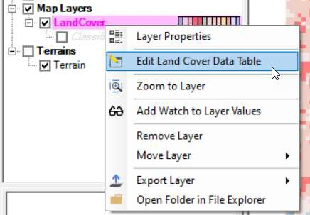
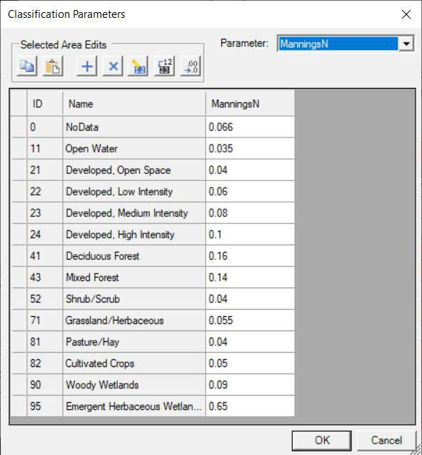
Associating Mannings’ values
Create Land Cover

Slide 9
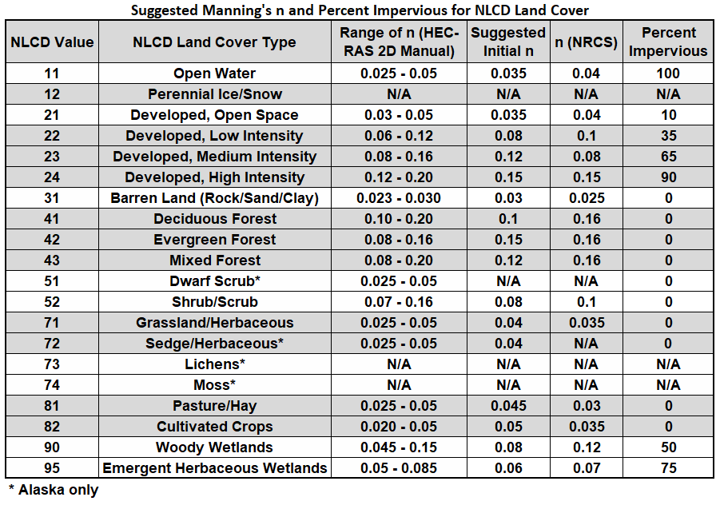
Associating Mannings’ values
Create Land Cover
Surface Roughness and Manning’s ‘n’ Table as suggested for HECRas, based on NLCD land cover types

Slide 10

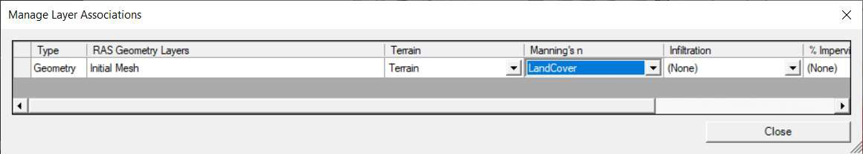
Associating Mannings’ values
Create Land Cover
This is a commonly overlooked step for new users.

Slide 11
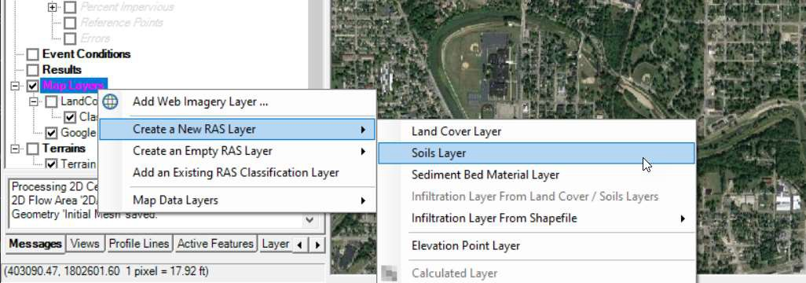
What if I don’t have any?
If you don’t have land cover data, you can create an Empty land cover dataset.
Create Classification Polygons for each area using the RAS Mapper Editing Tools and Web Imagery
Create Land Cover

Slide 12
Questions?
33

