Slide 1
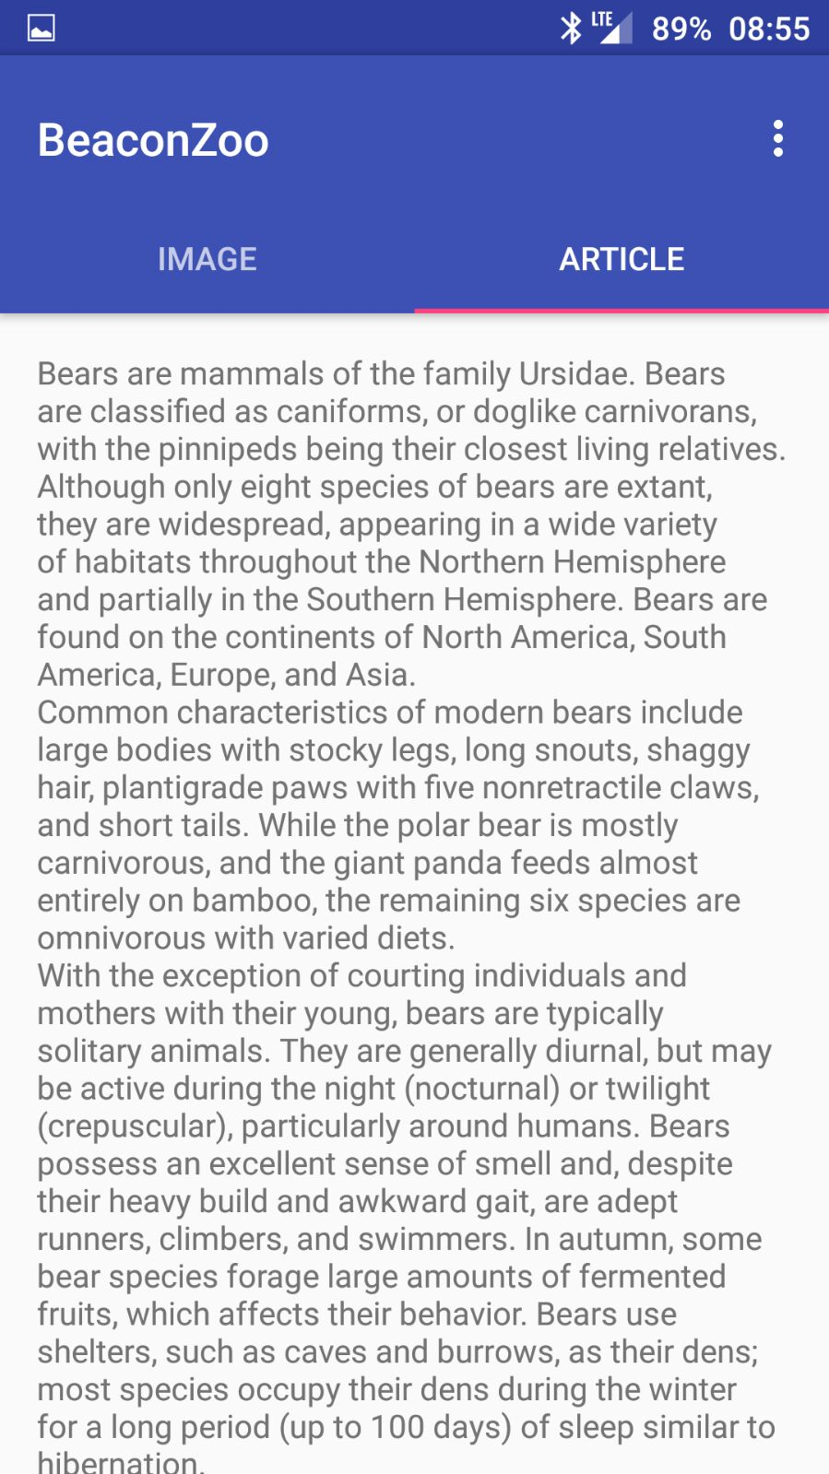

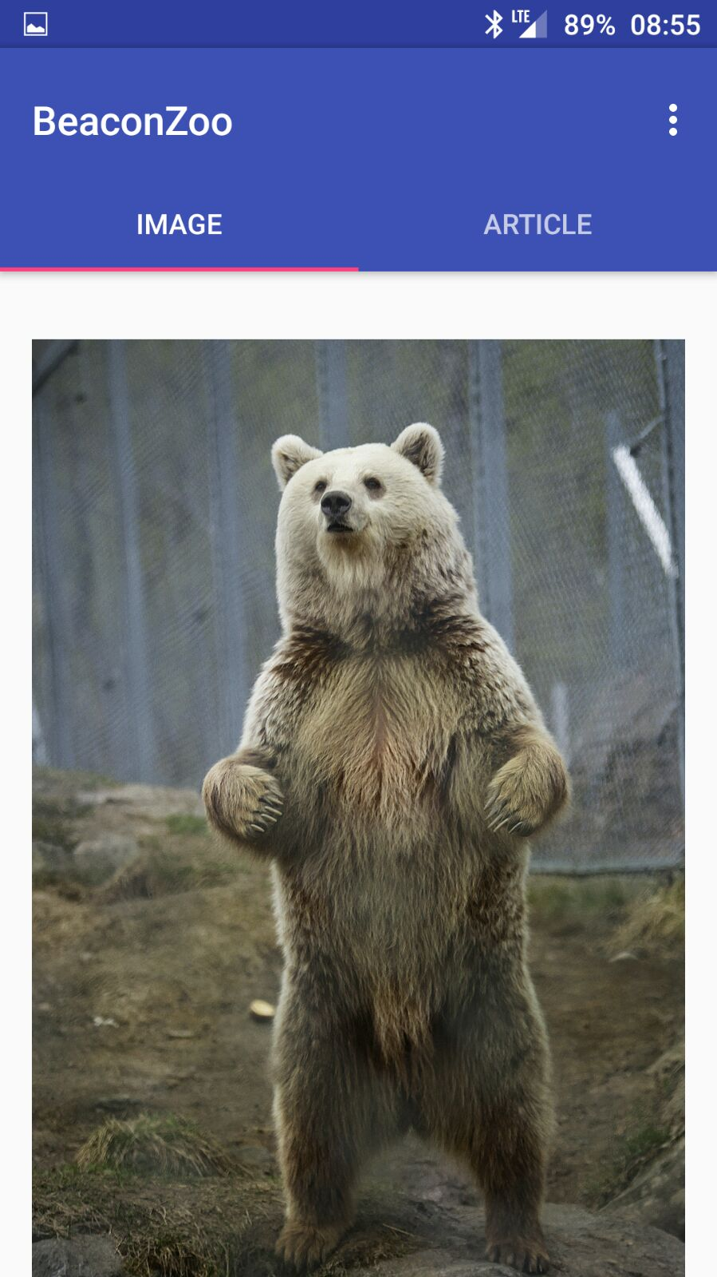
Designing and developing BeaconZoo
Hannes, Oula, Saku and Tuure
School of Engineering, Software Engineering
Introduction
The subject of this thesis was to design and develop 3D –video game for PC. Development we used Unity which is a cross-platform game engine developed by Unity Technologies. Our goal was to develop a racing video game.
FIGURE 1. Basic design of the solution
The Gunther – racing video game
A 3D –racing video game called Gunther racing is a PC –video game for people who want to compete against their friends in online game. The purpose of the game is to collect points while driving. The winner is a player who gathers more points before death. There is enemies on the road who shoot you to death if you are too slow!
Methods
The Gunther 3D – racing video game for PC is developed with Unity, a cross-platform game engine. All scripts we created for controlling Unity GameObjects are written in C#. Almost all GameObjects of this game are controlled from scripts. For developing we used Github, Unity 5.5.0 and Trello.
FIGURE 2. View of image page
Results
We learned that Unity game engine is very good tool to develop video games for PC. Especially people like us who want to begin development of 3D –games Unity game engine is a good way to start. There is countless numbers of tutorials for beginners.
FIGURE 3. View of article page
Conclusions
Working with the Unity game engine is really nice. For us it became clear that the unity has an unlimited number of possibilities. We reached our main goal, which was to create working 3D –video game. There were no major problems.
Thesis
Date of publication: 2016, Summer
Supervisor Pertti Heikkilä

