Slide 1
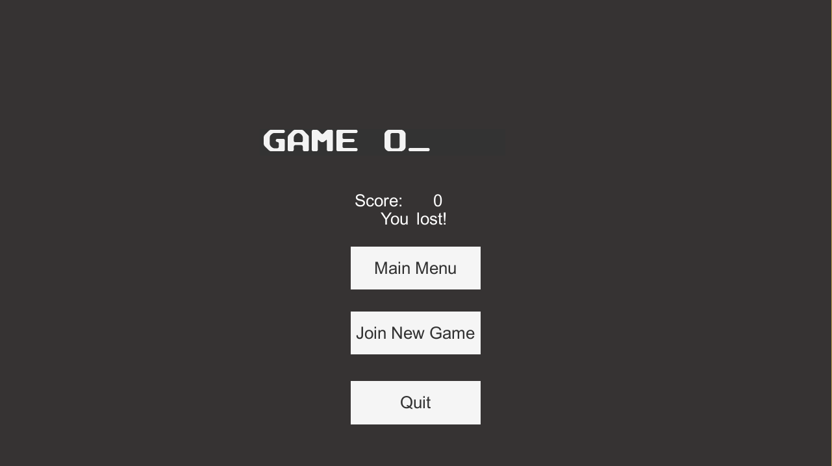
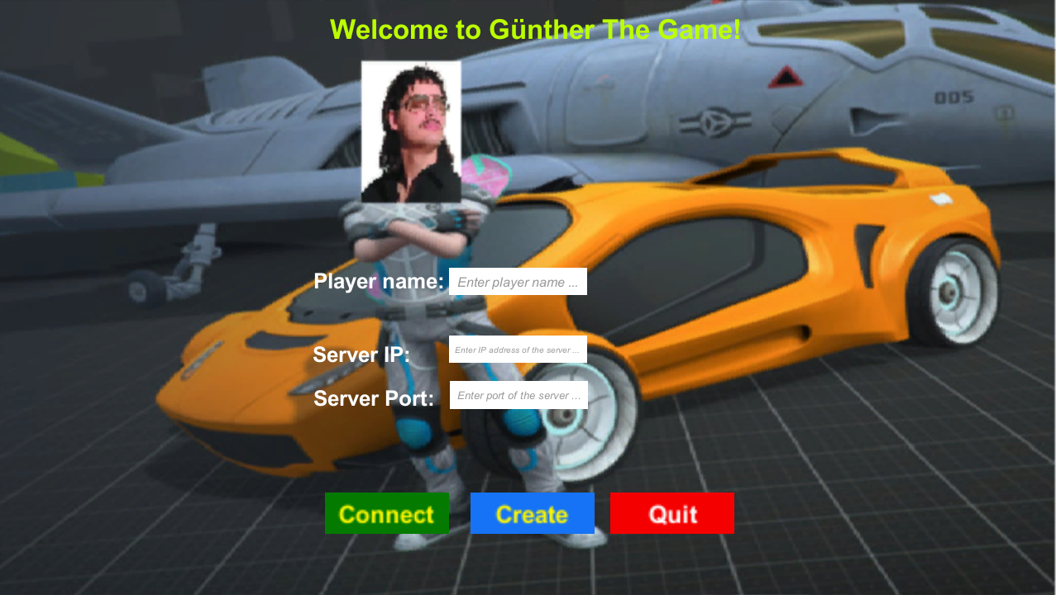
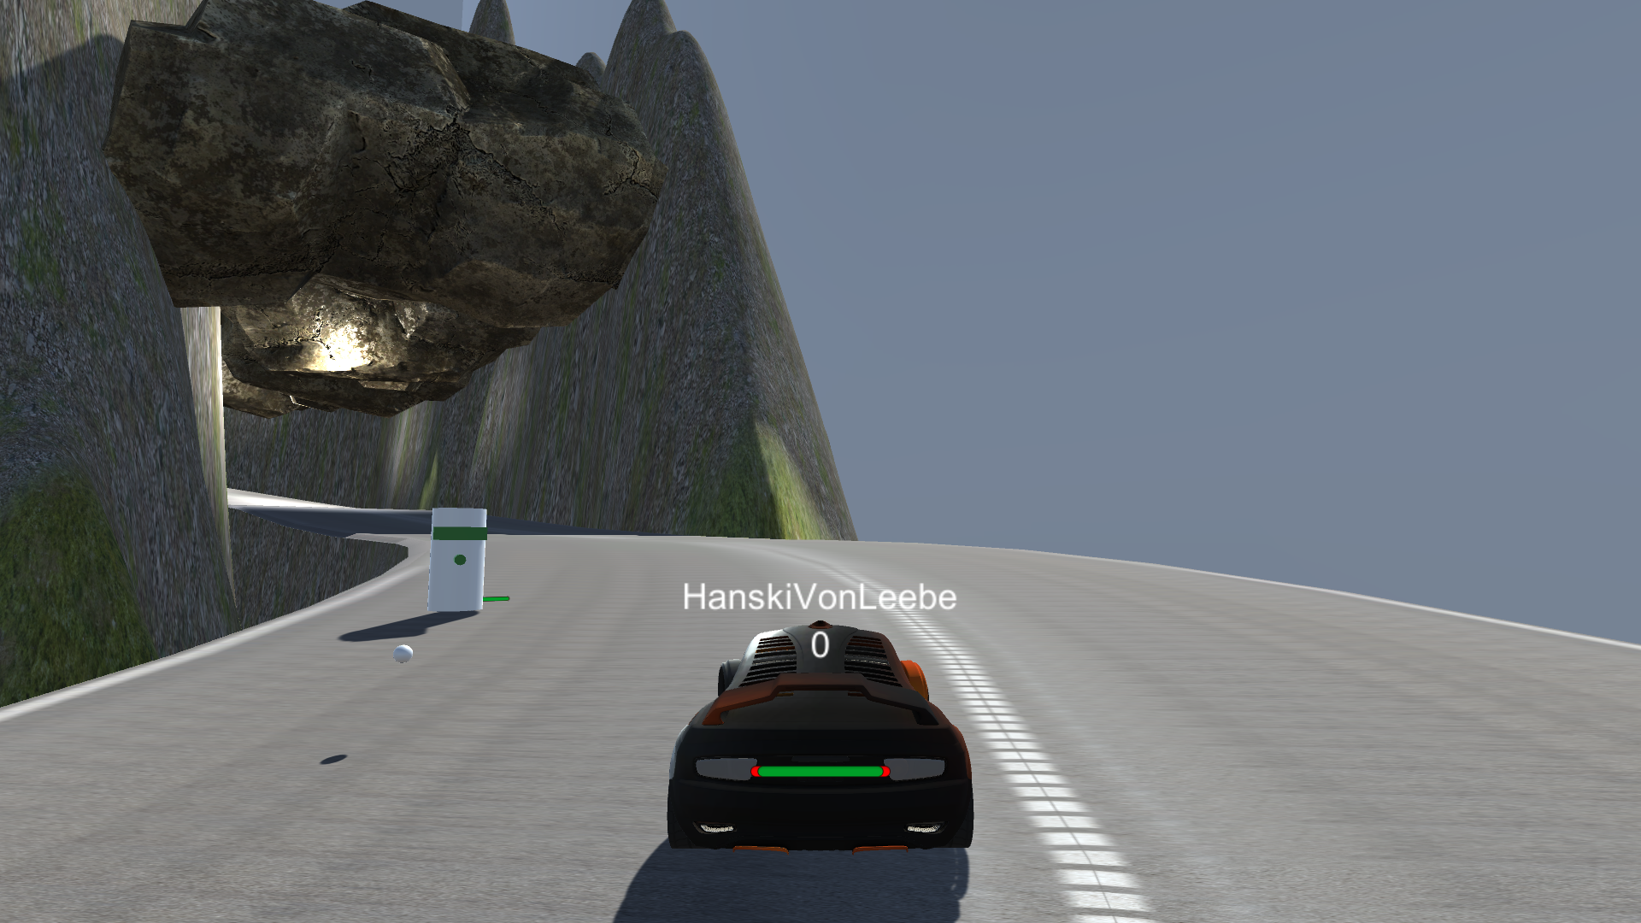
Designing and developing Gunther the Game
Hannes, Oula, Saku and Tuure
School of Engineering, Software Engineering
Introduction
The subject of this thesis was to design and develop a 3D video game for PC. In the development we used the Unity game engine which is a cross-platform game engine developed by Unity Technologies. Our goal was to develop a racing video game.
FIGURE 1. View of starting screen
Gunther the Game
A 3D racing video game called Gunther the Game is a PC-video game for people who want to compete against their friends in an online game. The purpose of the game is to collect points while driving laps through the circuit. The winner is a player who finishes 5 laps before the others. There are enemies on the road who shoot you to death if you are too slow!
Methods
Gunther the Game – a 3D racing video game for PC developed with Unity, a cross-platform game engine. All scripts which we created for controlling Unity GameObjects are written in C#. Almost all GameObjects of this game are controlled from scripts. For developing we used Github, Unity 5.5.0 and Trello.
FIGURE 2. View of Gunther the Game
Results
We learned that the Unity game engine is a very good tool to develop video games for PC. Especially for people like us, who want to begin development of 3D games. For that, the Unity game engine is a good way to start. There are countless numbers of tutorials for beginners.
FIGURE 3. View of eding screen
Conclusions
Working with the Unity game engine was really nice. For us it became clear that the Unity has an unlimited number of possibilities. We reached our main goal, which was to create working 3D video game. There were no major problems.
Coursework
20.12.2016, Winter
Supervisor Pertti Heikkilä

