Slide 1

WELCOME TO THIS UGLY POWER POINT
Mista Gudtayste
January 2001

Slide 2
WELCOME TO THIS UGLY POWER POINT
The title is to small on this slide. And these colors are not a good choice.
Mista Gudtayste
January 2001
You think people are going to remember your name ? It should be on its own slide.
Everybody knows the date. But thanks anyway. (Seriously don’t put the date nobody cares)
If you really want to show your logo, make it have its own slide. Here, it takes place for nothing, breaks with the feeling of the slide, and is ugly. But in general, don’t put headers or footers in slides, that is a waste of space.

Slide 3
Summary
1 – Something boring
2 – Something more boring
3 – Something even more boring
4 – Come on you’re spoiling it

Slide 4
Summary
Have you ever heard someone from the audience tell “Well I’m glad to see this summary, now I am physically and psychologically prepared.”
No. People don’t need to be prepared, you know why ?
Because they are here to listen, not to read. They don’t care what are the different parts because YOU will introduce them by speaking and making your way through your presentation. You can use hundreds other things to separate the parts of your speech (colors, fonts, transitions, even a little sentence) that are ten times better than making an old-school/non-surpising summary.
1 – Something boring
2 – Something more boring
3 – Something even more boring
4 – Come on you’re spoiling it
Don’t use numbers. Numbers are associated with lists, And guess what, lists are boring. You are not making a list, you are making an AWESOME presentation. You don’t need a list.
I insist, NO Summary

Slide 5
1 – That is a title
Pain suffering agony ache dolor hurting
Pain suffering agony ache dolor hurting
Pain suffering agony ache dolor hurting
Pain suffering agony ache dolor hurting
Pain suffering agony ache dolor hurting
Pain suffering agony ache dolor hurting
Pain suffering agony ache dolor hurting

Slide 6
1 – That is a title
As we already said, no numbers. If you need something to precise the part of the presentation or specify what you are talking about, it means that your presentation is not good enough.
Pain suffering agony ache dolor hurting
Pain suffering agony ache dolor hurting
Pain suffering agony ache dolor hurting
Pain suffering agony ache dolor hurting
Pain suffering agony ache dolor hurting
Pain suffering agony ache dolor hurting
Pain suffering agony ache dolor hurting
Hem hem…People are here to listen. Reading is boring, and it makes people forget the speaker. Develop the habit of not putting more than three words on your slides. It can make your presentation go from average to GREAT.

Slide 7
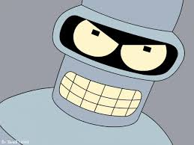

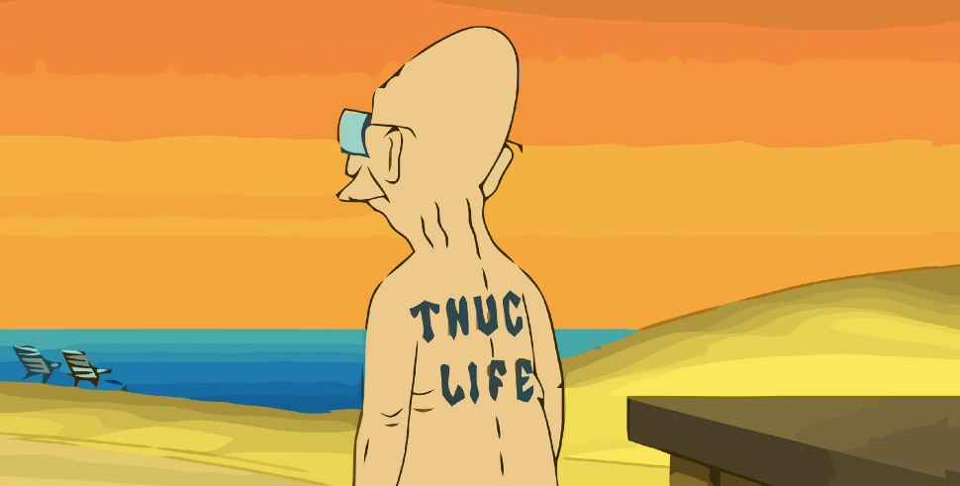
Some images (can’t hurt)
I need a hero,
I’m holding out for a hero ‘till the end of the night

Slide 8
Some images (can’t hurt)
Take only HD pictures
You put either text or images, but not both on the same level.
I need a hero,
I’m holding out for a hero ‘till the end of the night
In most case, you should only put one image per slide.

Slide 9
Fonts
Say Goodbye to Times New Roman, Calibri, and Comic Sans MS,

Slide 10
Fonts
Say Goodbye to Times New Roman, Calibri, and Comic Sans MS,
In order to make your text beautiful and create a unique feeling, you will need to look for the right font, which means : force yourself to seek out new fonts, and try them on your presentations.

