Slide 1
Virtual Memory Explorer
Pitch Deck
20xx
</
} /> [
/>
Group#666 Kaiyu Liu 1195058
Notes:
Good [morning/afternoon/evening], everyone. Today, we're going to take a voyage through the architecture of the Virtual Memory Explorer.

Slide 2
</ Table of contents
{01}
{04}
Overview
OS Implementation
{02}
{05}
Design Philosophy
GUI design
{03}
{06}
Memory & Frame
Demonstration
Notes:
Our presentation consist of six parts, the first two, overview and design philosophy is to give you a general understanding of our program, The following section 3, 4 and 5 will look into the implementation detail and lastly we well show an example

Slide 3
01
Overview
Pitch Deck
20xx
</>
} /> [

Slide 4
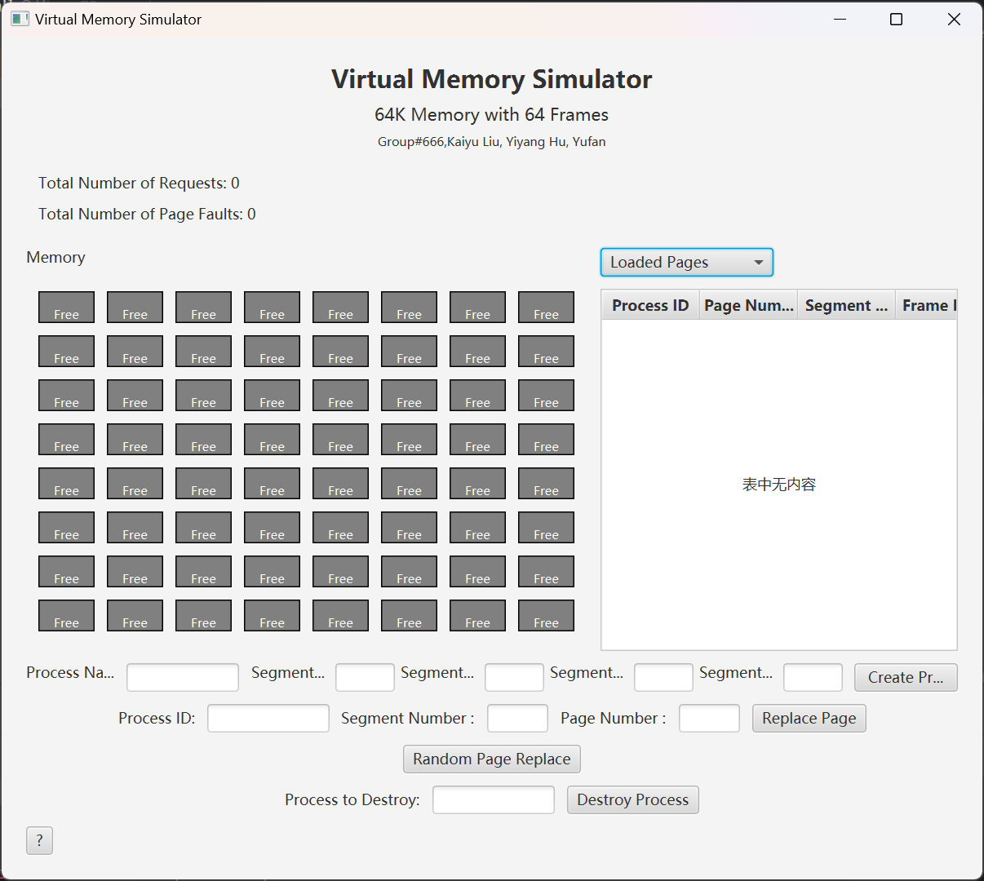
</ Introduction to Virtual Memory Explorer
Virtual Memory Explorer is an interactive learning tool designed to simplify complex concepts in memory management and operating systems.
This application provides a hands-on experience in exploring the workings of virtual memory, allowing students and educators to visualize and understand its dynamics.
Through simulation, we demonstrate key processes like paging and memory allocation, making it accessible for both beginners and advanced IT professionals.
JavaFX>
Notes:
Virtual Memory Explorer serves as a bridge between theory and practice. It's an interactive platform where complex concepts of memory management and operating system fundamentals are broken down into visual simulations. This hands-on application lets users—students and educators alike—delve into the workings of virtual memory, offering a dynamic way to visualize and understand its operation.

Slide 5
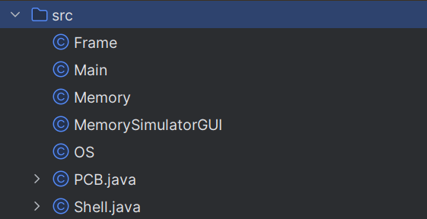
</ Introduction
/> **
} /> [
Real Hardware
Our Code
Start Button
Physical Memory (RAM)
Computer Monitor
Operating System's Memory Management
Process Management in CPU
Memory Frame in RAM
Command Line Interface (CLI)
Main.java
Memory.java
MemorySimulatorGUI.java
OS.java
PCB.java (Process Control Block)
Frame.java
Shell.java:
Notes:
Main.java：This file serves as the entry point for the application, analogous to how a user starts interacting with a computer system.
Memory.java：Manages the allocation and management of memory frames, similar to how physical memory is utilized in a computer system.
MemorySimulatorGUI.java：Provides a graphical user interface, similar to how a monitor displays information and allows user interaction in a computer system.
OS.java：Represents the functionalities of an operating system, particularly in managing memory, akin to the Memory Management Unit (MMU) in a computer.
PCB.java (Process Control Block)：Manages process-specific information such as state and memory requirements, paralleling how a CPU tracks and manages processes.
Frame.java：represents a single memory frame within physical memory
Shell.java:Provides a text-based interface for user commands, similar to a CLI terminal in a computer system, where users input commands related to memory and process management.

Slide 6
02
Design Philosophy
Pitch Deck
20xx
</>
} /> [

Slide 7
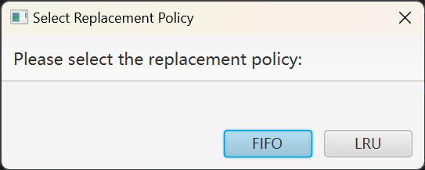
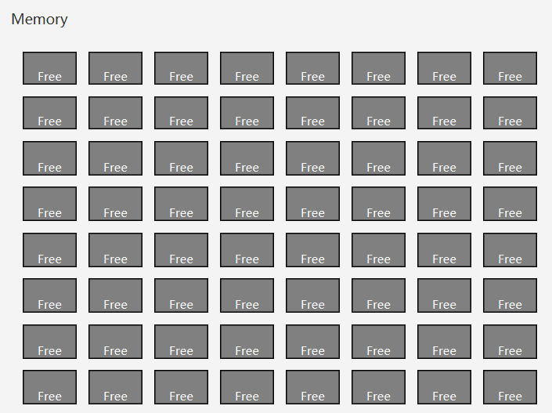


</ Features
Policy Selection and Initialization
Memory Grid Visualization
Choose between FIFO and LRU policies at the start for tailored memory management simulation
8x8 grid displaying real-time memory frame status, illustrating allocation and utilization.
Process Management
Create and destroy processes to see dynamic memory allocation in action.
</>

Slide 8

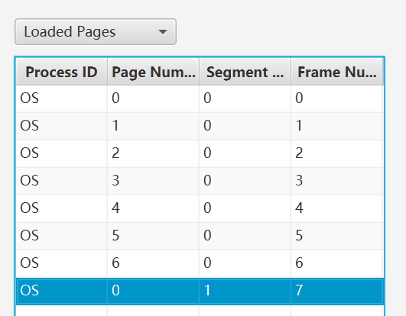
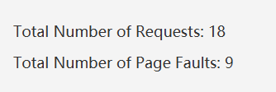


</ Features
Page Replacement Simulation
Page Tables and Statistics Display
Simulate page replacement to understand the impact of different policies
Monitor page movements and view key statistics like total requests and page faults..
Random Page Replacement Feature
Experiment with the unpredictability of random page replacement
</>

Slide 9
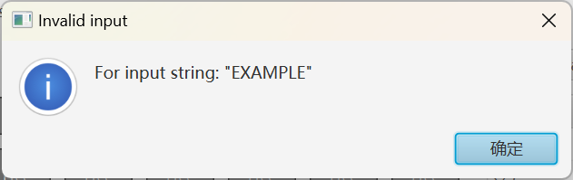
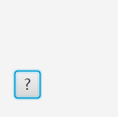
</ Features
Instruction and Alert System:
Guidelines and alerts to enhance user interaction and understanding
</>

Slide 10
03
Memory & Frame
Pitch Deck
20xx
</>
Group#666 Yu Fan
} /> [

Slide 11
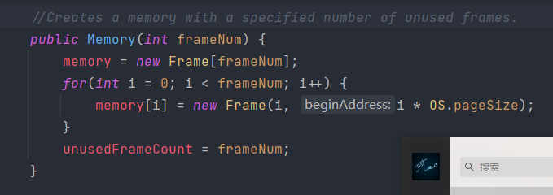
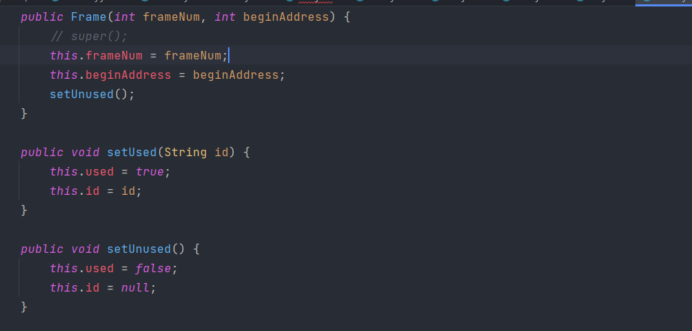
</ Memory
Initialization
Frame
Four basic properties of the frame
Define the frame to be used
memory is an array of frames
Set memory:
Unused frame to create memory
Records unused frames

Slide 12
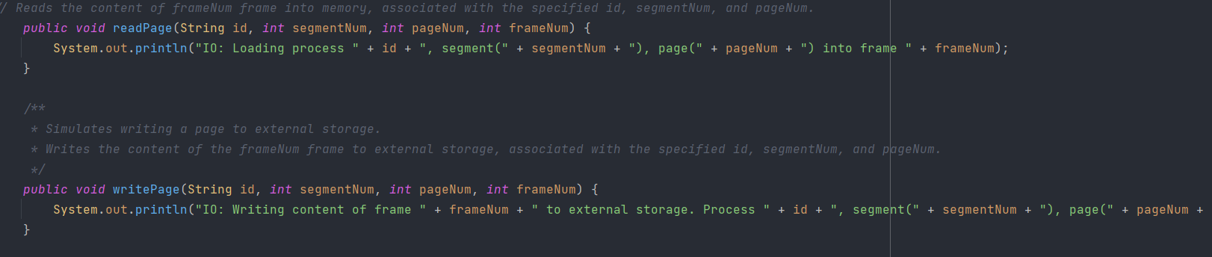
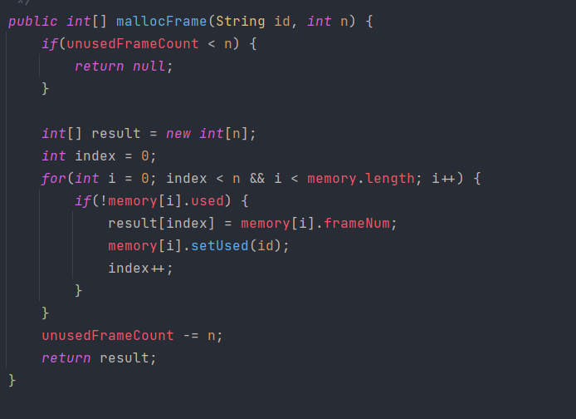
</ destroy process
Handling of page
Memory usage
Read the address of the page
Write the address of the page
Check whether the memory is used
The unused memory was updated

Slide 13
04
OS Implementation
Pitch Deck
20xx
</>
Group#666 Lei Xia
} /> [

Slide 14
</ Content
1.Initialization
2.Create process and destroy process
3.Convert logical address to the memory address
4.Page replacement
5.Show memory , process

Slide 15
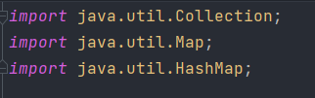
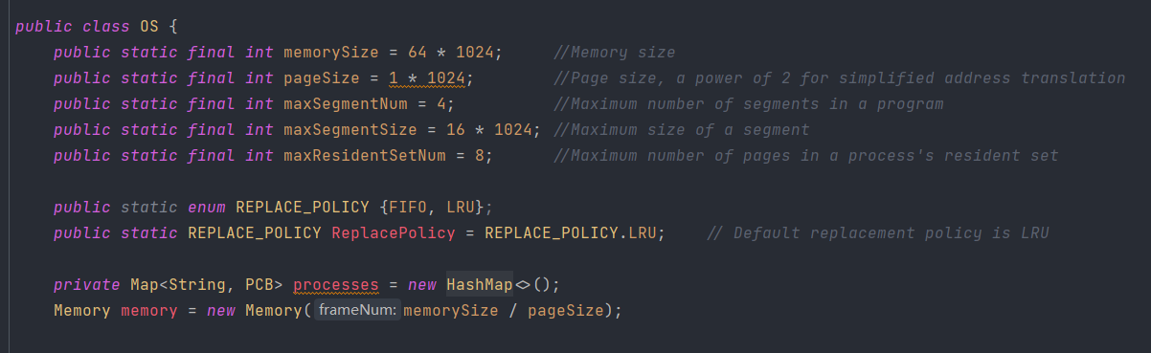
We totally use three java interface in the OS
1. Initialization

Slide 16
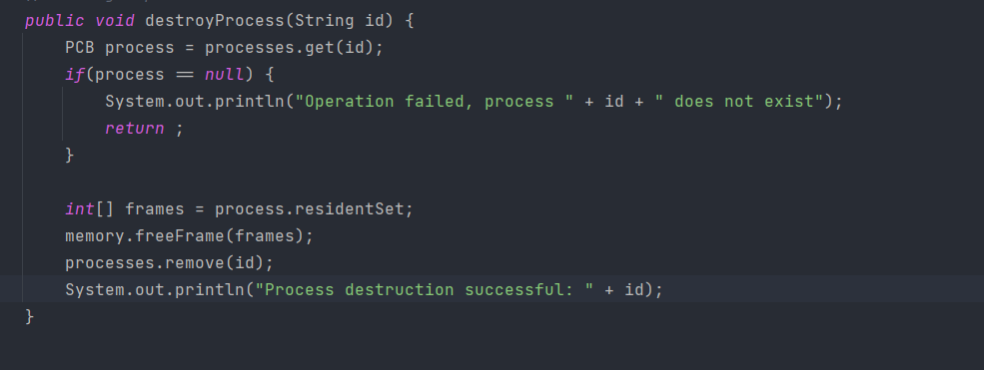
2.Destroy process

Slide 17
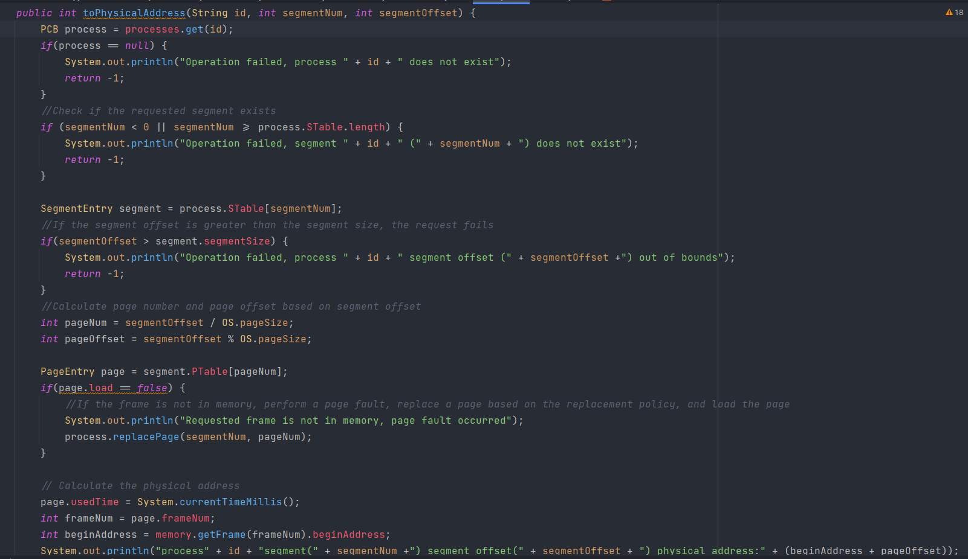
3.Convert logical address to the memory address

Slide 18
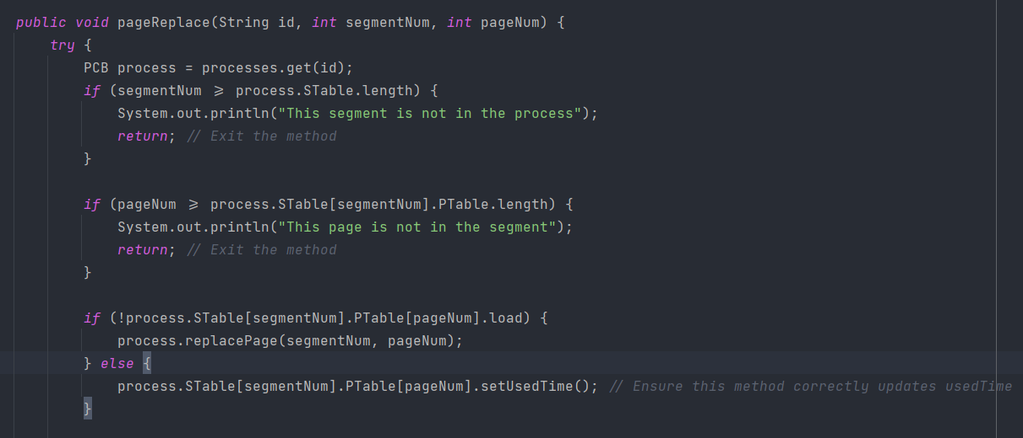
4. Page Replacement

Slide 19
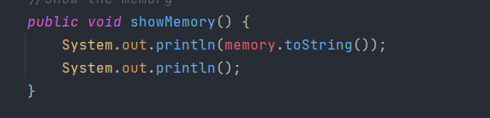
5. Show memory

Slide 20
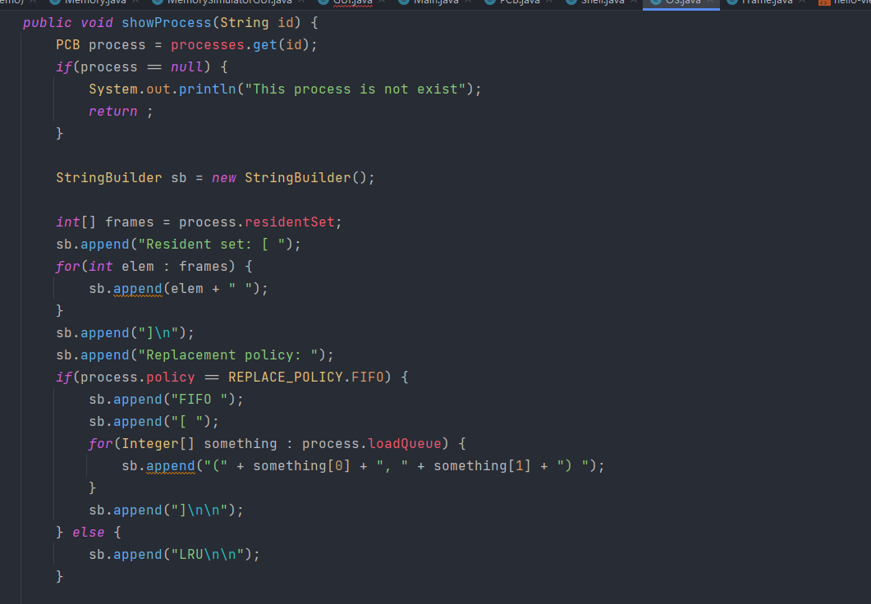
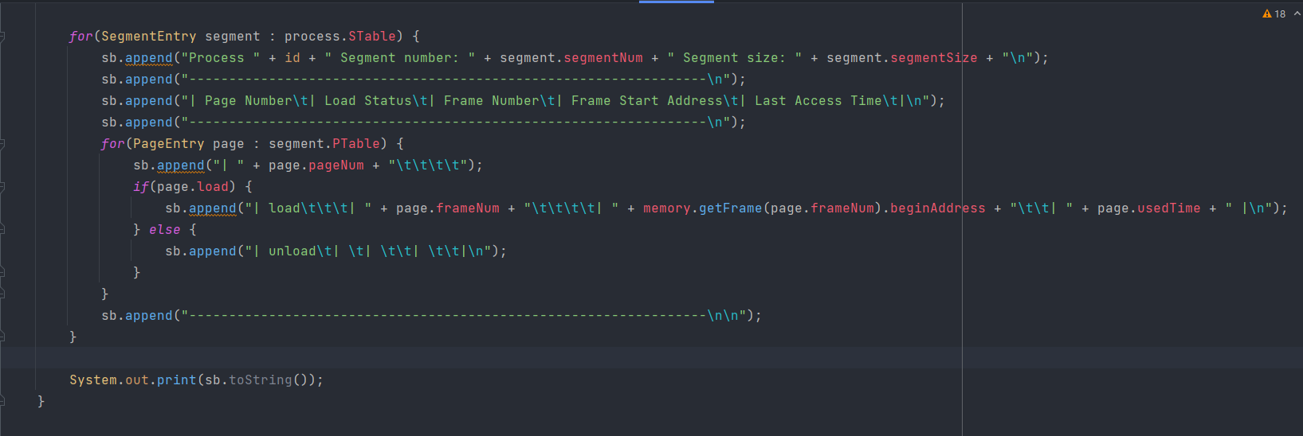
6.Show process

Slide 21
05
GUI Design
Pitch Deck
20xx
</>
Group#666 Yiyang Hu
} /> [

Slide 22
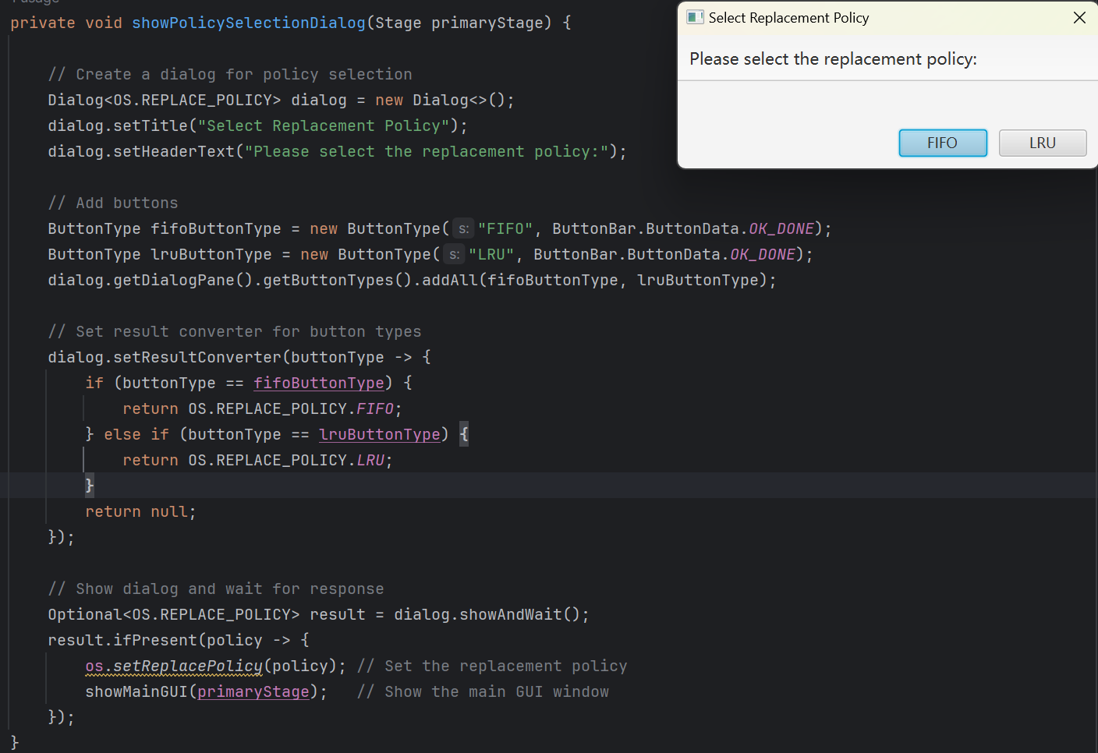
Show Process Selection Dialog

Slide 23
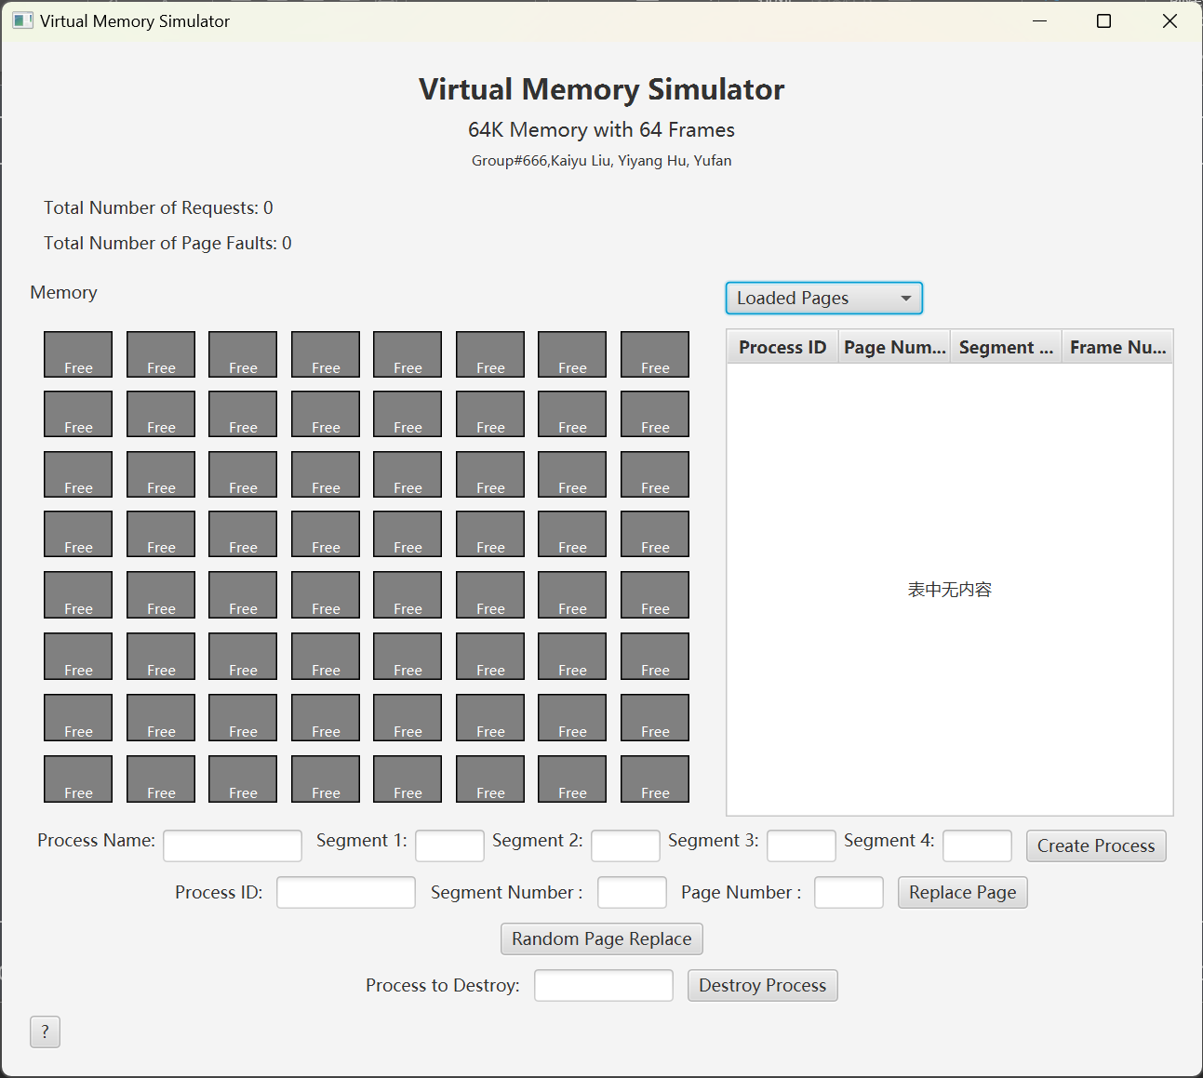
public void showMainGUI(Stage primaryStage) {
Main Layout
VBox header = createHeader();
//….. Call create() methods
// Layout configuration for memory grid and page table HBox mainLayout = new HBox(10); mainLayout.getChildren().addAll(memoryGrid, pageTableBox); mainLayout.setAlignment(Pos.CENTER);
//….. Call create() methods
VBox root = new VBox(10); root.getChildren().addAll(header, statsPanel, mainLayout, controlPanel, pageReplacementPanel, randomReplaceButton, destroyPanel, bottomBox); root.setAlignment(Pos.TOP_CENTER); root.setPadding(new Insets(20)); bottomBox.setAlignment(Pos.BOTTOM_LEFT);

Slide 24
Handler
private void handlePageReplacement(String processId, String segmentNum, String pageNum){ //Does not exist the Process PCB process = os.getProcesses().get(processId); //Process existed try {
//code to see if the input is valid } catch (IllegalArgumentException e) { showAlert("Invalid input", e.getMessage()); return; } //Valid Input, execute replacePage() os.pageReplace(processId, Integer.parseInt(segmentNum), Integer.parseInt(pageNum)); showAlert("Success", "page replacement successful: " + "page(" + pageNum + ")" + " in " + "segment(" + segmentNum + ")" +" is loaded."); updatePageTable(); // method to update the loaded pages table loadedPageTableView.refresh(); // Refresh the correct TableView updateUnloadedPageTable(); updateStats(); unloadedPageTableView.refresh(); // Refresh the unloaded page table updateMemoryGrid(); }

Slide 25
private void randomPageReplace() { Random random = new Random(); try { Collection<PCB> allPcbs = os.getAllActivePCBs(); PCB[] pcbArray = allPcbs.toArray(new PCB[0]);
PCB selectedPCB = pcbArray[random.nextInt(pcbArray.length)]; SegmentEntry selectedSegment = selectedPCB.STable[random.nextInt(selectedPCB.STable.length)]; int pageNum = random.nextInt(selectedSegment.PTable.length); if (some conditions) {
// in case of error return; } os.pageReplace(selectedPCB.id, selectedSegment.segmentNum, pageNum); updatePageTable(); // A method to update the loaded pages table loadedPageTableView.refresh(); // Refresh the correct TableView updateUnloadedPageTable(); updateStats(); unloadedPageTableView.refresh(); // Refresh the unloaded page table updateMemoryGrid(); } catch (Exception e) { showAlert("Error", "An error occurred during random page replacement: " + e.getMessage()); e.printStackTrace(); } }
Handler

Slide 26
Handler
private void handlePageReplacement(String processId, String segmentNum, String pageNum){ //Does not exist the Process PCB process = os.getProcesses().get(processId); //Process existed try {
// codes to check if the input is valid
} catch (IllegalArgumentException e) { showAlert("Invalid input", e.getMessage()); return; } //Valid Input, execute replacePage() os.pageReplace(processId, Integer.parseInt(segmentNum), Integer.parseInt(pageNum)); showAlert("Success", "page replacement successful: " + "page(" + pageNum + ")" + " in " + "segment(" + segmentNum + ")" +" is loaded."); updatePageTable(); // method to update the loaded pages table loadedPageTableView.refresh(); // Refresh the correct TableView updateUnloadedPageTable(); updateStats(); unloadedPageTableView.refresh(); // Refresh the unloaded page table updateMemoryGrid(); }

Slide 27
Updater
private void updateMemoryGrid() { for (int i = 0; i < GRID_SIZE; i++) { for (int j = 0; j < GRID_SIZE; j++) { int frameIndex = i * GRID_SIZE + j; Frame frame = memory.getFrame(frameIndex); StackPane frameVisual = (StackPane) getNodeFromGridPane(memoryGrid, j, i); String label = frame != null && frame.isUsed() ? frame.getId() : "Free"; Label frameLabel = (Label) frameVisual.getChildren().get(0); frameLabel.setText(label); } } }
private void updateStats() { totalRequestsLabel.setText("Total Number of Requests: " + os.getTotalRequest()); totalPageFaultsLabel.setText("Total Number of Page Faults: " + os.getPageFault()); }

Slide 28
Updater
private void updatePageTable() { ObservableList<PageTableEntry> data = FXCollections.observableArrayList(); // a way to get all active PCB instances, e.g., a list or map in your OS class Collection<PCB> allPcbs = os.getAllActivePCBs(); // This method needs to be implemented in your OS class for (PCB pcb : allPcbs) { for (int frameNum : pcb.residentSet) { Frame frame = memory.getFrame(frameNum); if (frame != null && frame.isUsed()) { for (SegmentEntry segment : pcb.STable) { for (PageEntry page : segment.PTable) { if (page.frameNum == frameNum && page.load) { data.add(new PageTableEntry(pcb.id, page.pageNum, segment.segmentNum, frameNum)); } } } } } } loadedPageTableView.setItems(data); // Update the TableView's items }

Slide 29
06
Demonstration
Pitch Deck
20xx
</>
} /> [

Slide 31
Thanks!
Pitch Deck
20xx
</
} /> [
Do you have any questions?
liukai@kean.edu
/>

