Slide 1
Battle of Neighborhood
Explore German Cities

Slide 2
Problem and Background
Moving is never easy. Nearby venues play an important role when choosing cities.
Top 80 German cities with the most populations are explored.
Venue types: cafe, restaurants, hotels, durgstores...

Slide 3
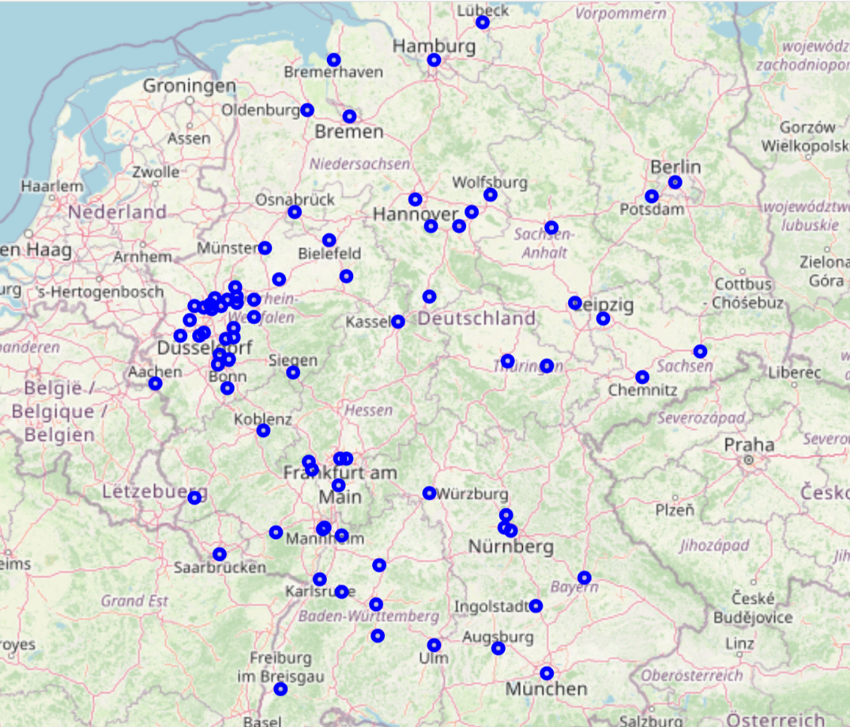
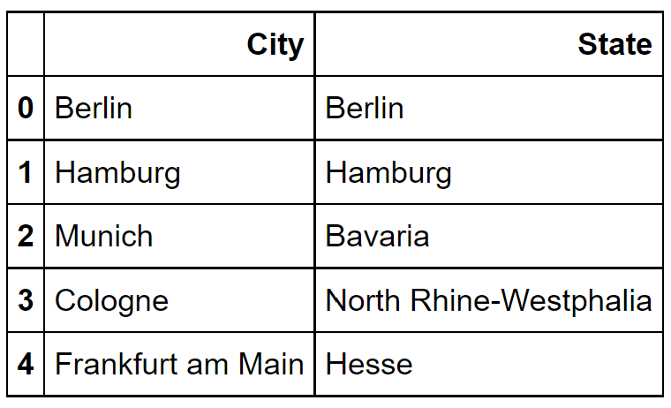
German Cities
...

Slide 4
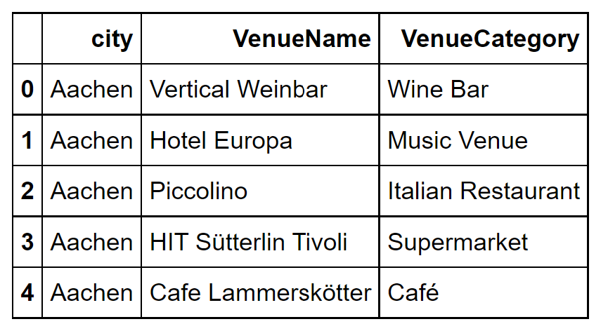
Explore Venues using FourSquare API
FourSquare API can be used to explore each city, providing the geographical coordinates of each city.

Slide 5
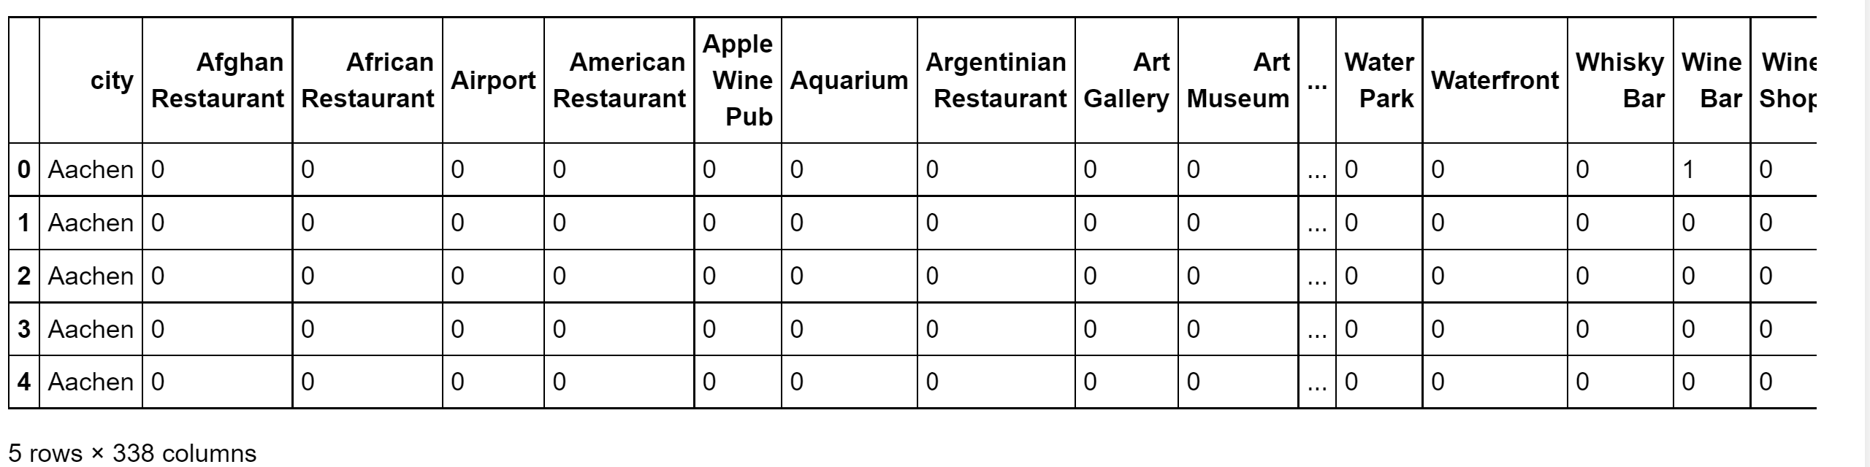
Methology
Summarize the venue types for each city
338 venue Categories

Slide 6
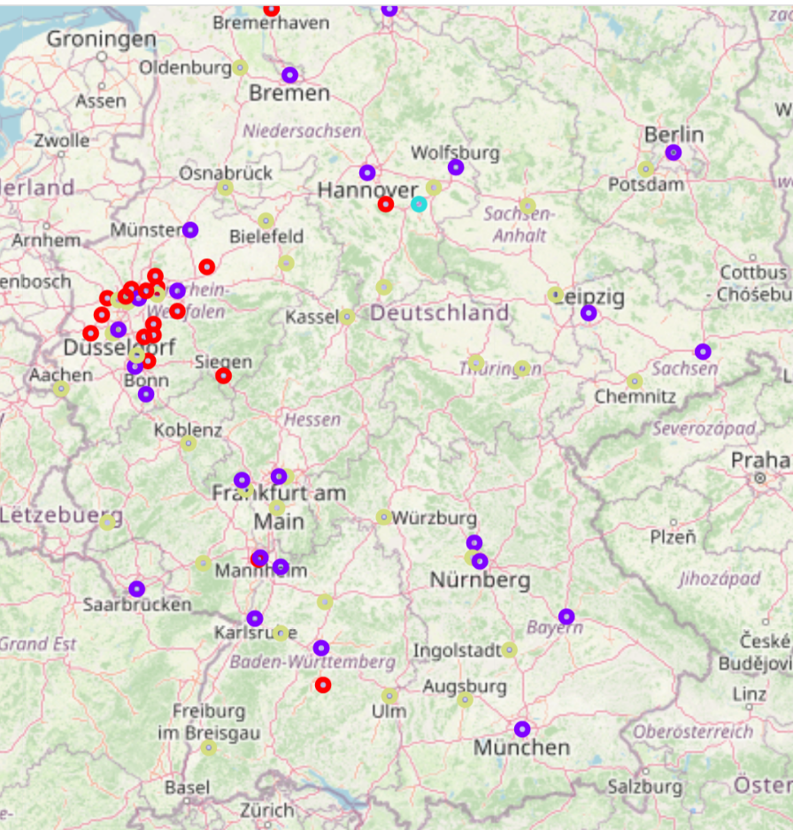
Methology
Cluster Analyse: K Means Cluster with n = 4
Visualization in maps

Slide 7
Result
Cluster 0: cafe, hotel and German/Italian restaurant are very frequent in this cluster
Cluster 1: gyms are much more than other venues (explanation will be followed)
Cluster 2: supermarkets, cafes and drugstores are a lot, and the differecnce of their frequencies are slight
Cluster 3: supermarkets are dominant in this cluster (about twice more than the second venue type), which is follwed by drugstore, cafe, fast food restaurant and clothing store

Slide 8
Conclusion
Most cities in cluster 0 are popular German cities, which are frequently visited by tourists. This explains why there are so many restaurants and hotels in these vities. If someone like bustling cities, the cities in cluster 0 could be his choices.
The most frequent venues types from cluster 2 and cluster 3 are very similar. As discussed above, in cluster 3, the supermarkets are dominant, while hotels are not that frequent compared to other clusters. If someone enjoys a quiet life (for example, when someone buys groceries and cooks by himself more often than going to restaurants, or when someone does not like many tourists near his home), he can consider the cities in cluster 3.
Cluster 2 can be almost seen as the mixture of the other two clusters. There are many restaurants and hotels, meanwhile there are also lots of drugstores and supermarkets for the needs of the natives. Therefore cluster 2 are choices between cluster 0 and cluster 3.

