Slide 1
Algorithm Analysis & Design Introduction to Algorithm
T&R Team of Algorithm Design
College of Computer Science and Engineering, CQU
Notes:
本人是国际视觉电生理学会(ISCEV)的会员。

Slide 2
Dynamic PROGRAMMING
15
Overlapped sub-problems

Slide 3
Those who cannot remember the past are doomed to repeat it.
-----George Santayana,
The life of Reason,
Book I: Introduction and
Reason in Common
Sense (1905)

Slide 4

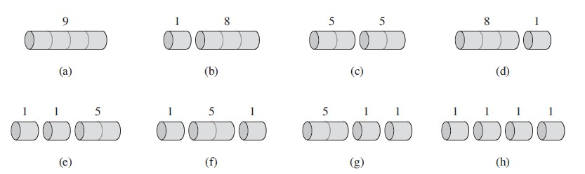
Rod cutting
Given a rod of length n inches and a table of prices p_{i} for i = 1,2,3,…,n, determine the maximum revenue r(n) obtainable by cutting up the rod and selling the pieces.
For n = 4, which one is best ?
How many different ways of cutting rod with length n ?

Slide 5
Optimal substructure – Rod cutting
In the best solution, we cut i inch from rod at the first time,
r(n)= p_{i} + r(n-i)
r (n-i) is totally the same problem with just smaller size.
&
The n-i part of best solution must be the best solution for problem n-i;
Why r(n-i)must be the best solution for problem n-i ?

Slide 6

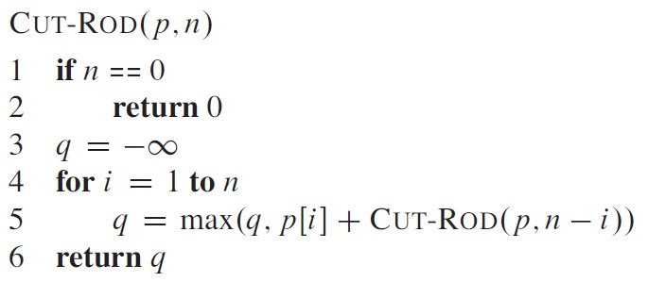
Recursive top-down implementation
The length of first piece have n possibilities: 1,2,….n inches long

Slide 7
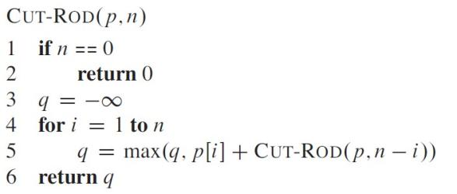
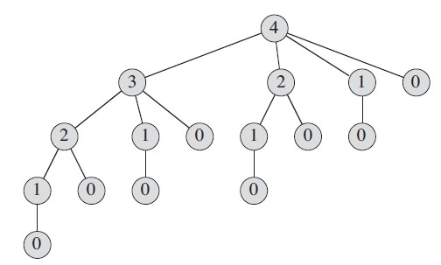
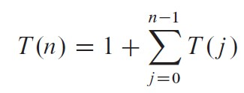

Recursive top-down implementation – good ?
求解n规模需要所有小于n规模的解支撑

Slide 8
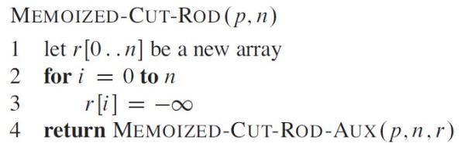
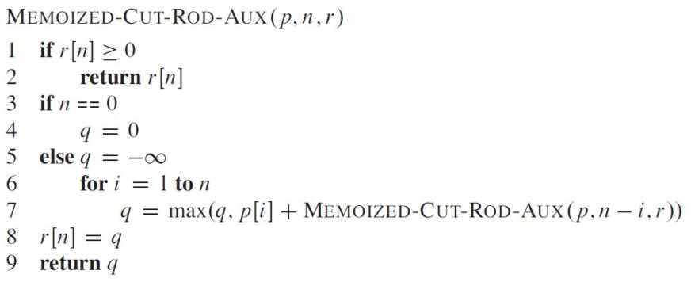
Dynamic Programming – top down memoization
Avoid resolving same sub-problem
记录过的子问题则直接返回

Slide 9
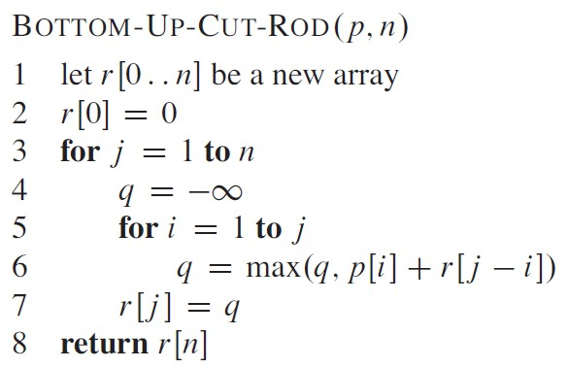
Dynamic Programming – Bottom up
Avoid resolving same sub-problem
问题从小解到大
求过

Slide 10
Dynamic Programming – Bottom up
In class exercise:
compute r[1] – r[10]with bottom up method.

Slide 11
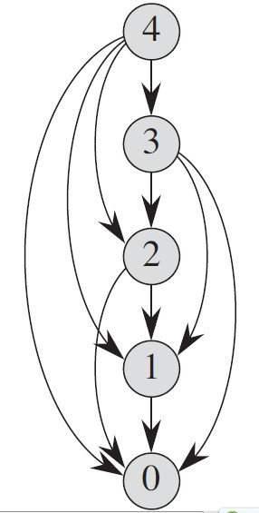

Dynamic Programming – Efficiency
Avoid resolving same sub-problem

Slide 12
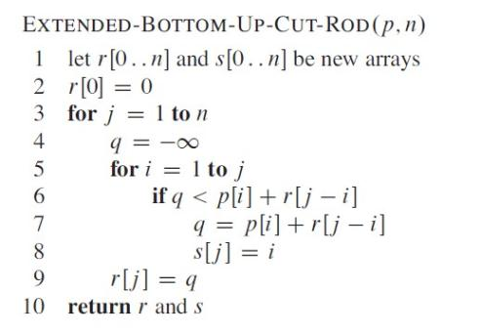
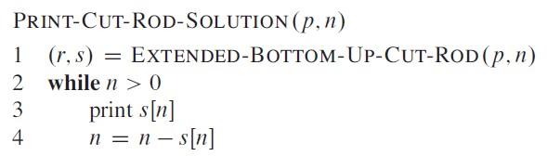
Reconstructing the solution
记录最后一次选择的切割

Slide 13
Homework
CLRS 15.1-3
CLRS 15.1-5

Slide 14
Knapsack Problem

Slide 15
The Knapsack Problem
The famous knapsack problem:
A thief breaks into a museum. Fabulous paintings, sculptures, and jewels are everywhere. The thief has a good eye for the value of these objects, and knows that each will fetch hundreds or thousands of dollars on the clandestine art collector’s market. But, the thief has only brought a single knapsack to the scene of the robbery, and can take away only what he can carry. What items should the thief take to maximize the haul?

Slide 16
0-1 Knapsack problem
Given a knapsack with maximum capacity W, and a set S consisting of n items
Each item i has some weight w_{i} and benefit value b_{i} (all w_{i} , b_{i} and W are integer values)
Problem: How to pack the knapsack to achieve maximum total value of packed items?

Slide 17
0-1 Knapsack problem: a picture
Weight
Benefit value
w_{i}
b_{i}
Items
3
2
This is a knapsack
Max weight: W = 20
3
4
4
5
5
8
W = 20
9
10

Slide 18
The Knapsack Problem
More formally, the 0-1 knapsack problem:
The thief must choose among n items, where the ith item worth v_{i} dollars and weighs w_{i} pounds
Carrying at most W pounds, maximize value
Note: assume v_{i}, w_{i}, and W are all integers
“0-1” each item must be taken or left in entirety
Generalization, the unbounded knapsack problem:
No bound on the number of each item
Think about the thief ran into a bank…

Slide 19
0-1 Knapsack – Formulation
The problem is called a “0-1” problem, because each item must be entirely accepted or rejected.

Slide 20
Unbounded Knapsack – Formulation
The problem is called a unbounded problem, because each item has no bound on its number that can be accepted.

Slide 21
0-1 Knapsack problem: brute-force approach
Let’s first solve this problem with a straightforward algorithm
Since there are n items, there are 2^{n} possible combinations of items.
We go through all combinations and find the one with the most total value and with total weight less or equal to W
Running time will be O(2^{n})

Slide 22
0-1 Knapsack problem: brute-force approach
Can we do better?
Yes, with an algorithm based on dynamic programming
We need to carefully identify the subproblems
Let’s try this:
If items are labeled 1..n, then a subproblem
would be to find an optimal solution for
OPT(k) = {items labeled 1, 2, .. k}前k个可选

Slide 23
Defining a Subproblem
If items are labeled 1..n, then a subproblem would be to find an optimal solution for OPT(k)= {items labeled 1, 2, .. k}
This is a valid subproblem definition.
The question is: can we describe the final solution OPT(n) in terms of subproblems OPT(1),OPT(2),…,OPT(n-1)?
Unfortunately, we can’t do that. Explanation follows….

Slide 24
Defining a Subproblem
w₁ =2
b₁ =3
w₂ =4
b₂ =5
w₃ =5
b₃ =8
w₄ =3
b₄ =4
Weight
Benefit
Item
#
w_{i}
b_{i}
?
1
2
3
Max weight: W = 20
For S₄:
Total weight: 14;
total benefit: 20
OPT(4)
2
3
4
OPT(5)
3
4
5
4
5
8
5
9
10
w₁ =2
b₁ =3
w₃ =4
b₃ =5
w₄=5
b₄ =8
w₅ =9
b₅ =10
OPT(4) is not part of the solution for OPT(5)!!!
For S₅:
Total weight: 20
total benefit: 26

Slide 25
Defining a Subproblem (continued)
As we have seen, the solution for OPT(4) is not part of the solution for OPT(5)
So our definition of a subproblem is flawed and we need another one!
Let’s add another parameter: w, which will represent the exact weight limit for each subset of items
The subproblem then will be to compute OPT[i,w]

Slide 26
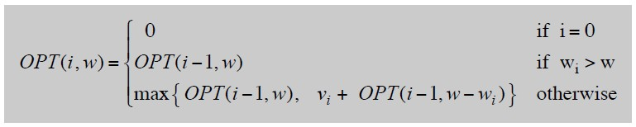
Dynamic Programming – Adding a New Variable
Def. OPT(i, w) = max profit subset of items 1, …, i with weight limit w.
Case 1: OPT does not select item i.
–OPT selects best of { 1, 2, …, i-1 } using weight limit w
Case 2: OPT selects item i.
–new weight limit = w – wi
–OPT selects best of { 1, 2, …, i–1 } using this new weight limit
第i个物品重量超过整体载重限制

Slide 27
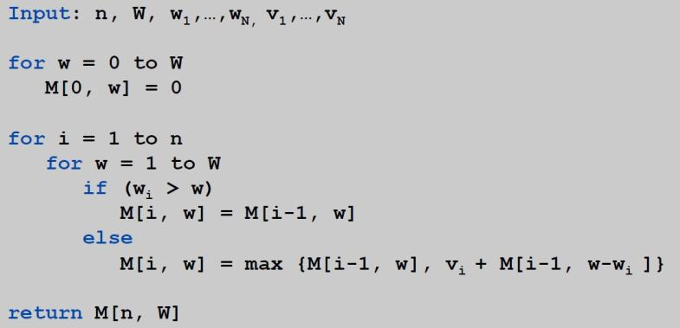
Knapsack – Bottom-Up
Knapsack. Fill up an n-by-W array.
i货物单重都超全载重，肯定不放

Slide 28
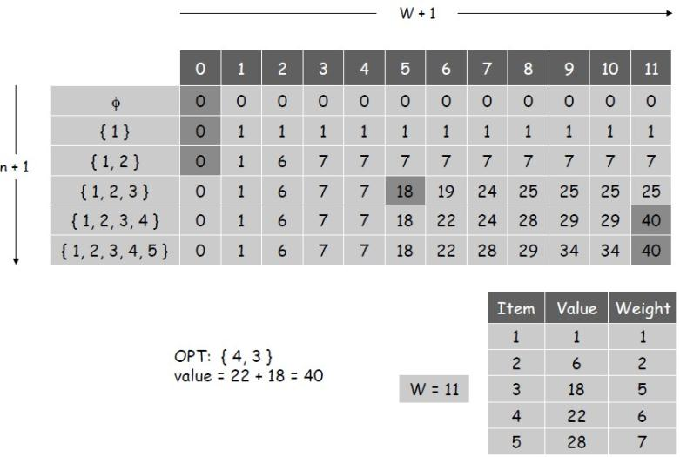
Knapsack Algorithm

Slide 29
Exercise in Class: 0-1 Knapsack Problem
Compute OPT(5,12)

Slide 30
Q: Unbounded Knapsack – Formulation
The problem is called a unbounded problem, because each item has no bound on its number that can be accepted.

Slide 31
例: 有一辆最大货运量为10吨的卡车，用以装载3种货物．每种货物的单位重量及相应单位价值如表所示。应如何装载可使总价值最大?
货物编号I | 1 | 2 | 3
单位重量（t） | 3 | 4 | 5
单位价值c_{i} | 4 | 5 | 6
设第i种货物装载的件数为x_{i}(i＝1，2，3)，则问题可表为

Slide 32
建立动态规划模型，用列表法求解
s₂ | 0 | 1 | 2 | 3 | 4 | 5 | 6 | 7 | 8 | 9 | 10
f₁(s₂) | 0 | 0 | 0 | 4 | 4 | 4 | 8 | 8 | 8 | 12 | 12
x₁* | 0 | 0 | 0 | 1 | 1 | 1 | 2 | 2 | 2 | 3 | 3
s
f₁(s)
x₁*

Slide 33
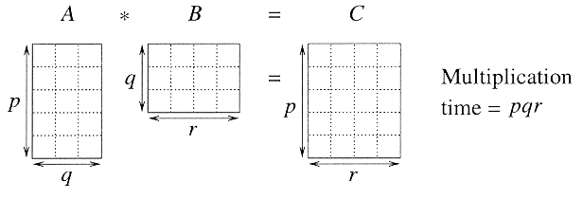
Matrix chain multiplication
In particular for 1 ≤ i ≤ p and 1 ≤ j ≤ r,
C[i, j] = ∑_{k = 1 to q} A[i, k] B[k, j]
Observe that there are pr total entries in C and each takes O(q) time to compute, thus the total time to multiply 2 matrices is pqr.

Slide 34
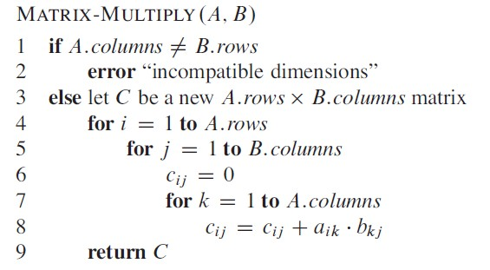
Matrix chain multiplication
If A is a p x q matrix and B is a q x r matrix, the resulting matrix C is a p x r matrix;
Total times of multiplication is p x q x r;

Slide 35
Matrix chain multiplication
Given a sequence of matrices A₁ A₂…A_{n} , and dimensions p₀ p₁…p_{n} where A_{i} is of dimension p_{i-1} x p_{i} , determine multiplication sequence that minimizes the number of operations.
This algorithm does not perform the multiplication, it just figures out the best order in which to perform the multiplication.

Slide 36
Matrix chain multiplication
Matrix multiplication is associative, and so all parenthesizations yield the same product.
16000, 10500, 36000, 87500, 34500

Slide 37
Counting the number of parenthesizations
If we have just 1 item, then there is only one way to parenthesize. If we have n items, then there are n-1 places where you could break the list with the outermost pair of parentheses, namely just after the first item, just after the 2nd item, etc. and just after the (n-1)th item.
When we split just after the kth item, we create two sub-lists to be parenthesized, one with k items and the other with n-k items. Then we consider all ways of parenthesizing these. If there are L ways to parenthesize the left sub-list, R ways to parenthesize the right sub-list, then the total possibilities is L∗R.

Slide 38
Counting the number of parenthesizations
Catalan number

Slide 39
DP Solution(I)
Let A_{i…j} be the product of matrices i through j. A_{i…j} is a p_{i-1} x p_{j} matrix. At the highest level, we are multiplying two matrices together. That is, for any k, 1 ≤ k ≤ n-1,
A_{1…n} = (A_{1…k})(A_{k+1…n})
The problem of determining the optimal sequence of multiplication is broken up into 2 parts:
: How do we decide where to split the chain (what k)?
A : Consider all possible values of k.
: How do we parenthesize the subchains A_{1…k} & A_{k+1…n}?
A : Solve by recursively applying the same scheme.
NOTE: this problem satisfies the “principle of optimality”.
Next, we store the solutions to the sub-problems in a table and build the table in a bottom-up manner.

Slide 40
DP Solution(II)
For 1 ≤ i ≤ j ≤ n, let m[i, j] denote the minimum number of multiplications needed to compute A_{i…j} .
Example: Minimum number of multiplies for A_{3…7}
In terms of p_{i} , the product A_{3…7} has dimensions ____.

Slide 41
DP Solution(III)
The optimal cost can be described be as follows:
i = j ⇒ the sequence contains only 1 matrix, so m[i, j] = 0.
i < j ⇒ This can be split by considering each k, i ≤ k < j,
as A_{i…k} (p_{i-1} x p_{k} ) times A_{k+1…j} (p_{k} x p_{j}).
This suggests the following recursive rule for computing m[i, j]:
m[i, i] = 0
m[i, j] = min_{i ≤ k < j} (m[i, k] + m[k+1, j] + p_{i-1}p_{k}p_{j} ) for i < j

Slide 42
Computing m[i,j]
For a specific k, (A_{i} …A_{k})( A_{k+1} … A_{j}) =
m[i, j] = min_{i ≤ k < j} (m[i, k] + m[k+1, j] + p_{i-1}p_{k}p_{j} )

Slide 43
Computing m[i,j]
For a specific k, (A_{i} …A_{k})( A_{k+1} … A_{j}) = A_{i…k}( A_{k+1} … A_{j}) (m[i, k] mults)
m[i, j] = min_{i ≤ k < j} (m[i, k] + m[k+1, j] + p_{i-1}p_{k}p_{j} )

Slide 44
Computing m[i,j]
For a specific k, (A_{i} …A_{k})( A_{k+1} … A_{j}) = A_{i…k}( A_{k+1} … A_{j}) (m[i, k] mults) = A_{i…k} A_{k+1…j} (m[k+1, j] mults)
m[i, j] = min_{i ≤ k < j} (m[i, k] + m[k+1, j] + p_{i-1}p_{k}p_{j} )

Slide 45
Computing m[i,j]
For a specific k, (A_{i} …A_{k})( A_{k+1} … A_{j}) = A_{i…k}( A_{k+1} … A_{j}) (m[i, k] mults) = A_{i…k} A_{k+1…j} (m[k+1, j] mults) = A_{i…j} (p_{i-1} p_{k} p_{j} mults)
m[i, j] = min_{i ≤ k < j} (m[i, k] + m[k+1, j] + p_{i-1}p_{k}p_{j} )

Slide 46
Computing m[i,j]
For a specific k, (A_{i} …A_{k})( A_{k+1} … A_{j}) = A_{i…k}( A_{k+1} … A_{j}) (m[i, k] mults) = A_{i…k} A_{k+1…j} (m[k+1, j] mults) = A_{i…j} (p_{i-1} p_{k} p_{j} mults)
For solution, evaluate for all k and take minimum.
m[i, j] = min_{i ≤ k < j} (m[i, k] + m[k+1, j] + p_{i-1}p_{k}p_{j} )

Slide 47
Applying dynamic programming

Slide 48
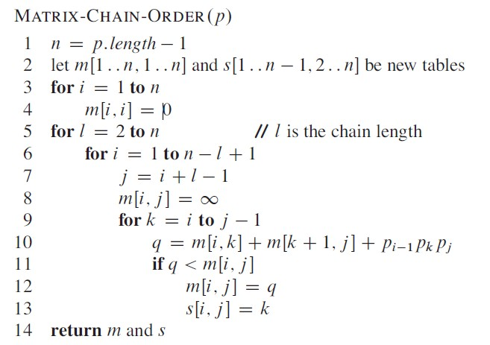
Implementation
记录拆分处

Slide 49
A₁ A₂ A₃ A₄ A₅ A₆ A₇ A₈
l=2
l=3
l=4
l=5
l=6
l=7
l=8

Slide 50

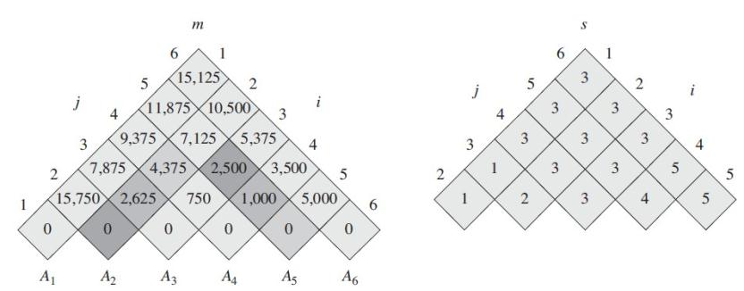
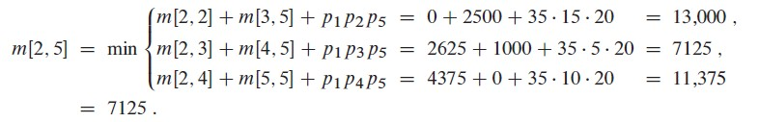
Applying dynamic programming
s[2,5] = 3

Slide 51
Analysis
The array s[i, j] is used to extract the actual sequence (see next).
There are 3 nested loops and each can iterate at most n times, so the total running time is Θ(n³).

Slide 52
Extracting Optimum Sequence
Leave a split marker indicating where the best split is (i.e. the value of k leading to minimum values of m[i, j]). We maintain a parallel array s[i, j] in which we store the value of k providing the optimal split.
If s[i, j] = k, the best way to multiply the sub-chain A_{i…j} is to first multiply the sub-chain A_{i…k} and then the sub-chain A_{k+1…j} , and finally multiply them together. Intuitively s[i, j] tells us what multiplication to perform last. We only need to store s[i, j] if we have at least 2 matrices & j > i.

Slide 53
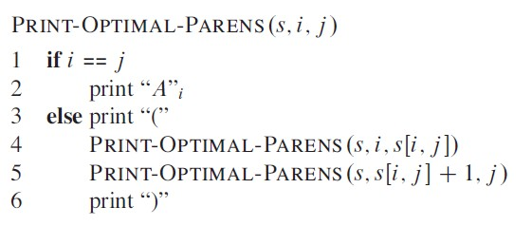
Constructing optimal solution

Slide 54
Mult (A, i, j)
1. if (j > i)
2. then k = s[i, j] 用记录的最优分割点直接计算最少次数
3. X = Mult(A, i, k) // X = A[i]...A[k]
4. Y = Mult(A, k+1, j) // Y = A[k+1]...A[j]
5. return X*Y // Multiply X*Y
6. else return A[i] // Return ith matrix

Slide 55
Exercise in Class
20 X 30 30 x 35 35 x 10 10 x 20 20 x 15 15 x 25

Slide 56
Finding a Recursive Solution
Figure out the “top-level” choice you have to make (e.g., where to split the list of matrices)
List the options for that decision
Each option should require smaller sub-problems to be solved
Recursive function is the minimum (or max) over all the options
m[i, j] = min_{i ≤ k < j} (m[i, k] + m[k+1, j] + p_{i-1}p_{k}p_{j} )

Slide 57
Steps in DP: Step 1
Think what decision is the “last piece in the puzzle”
Where to place the outermost parentheses in a matrix chain multiplication
(A₁) (A₂ A₃ A₄)
(A₁ A₂) (A₃ A₄)
(A₁ A₂ A₃) (A₄)

Slide 58
DP Step 2
Ask what subproblem(s) would have to be solved to figure out how good your choice is
How to multiply the two groups of matrices, e.g., this one (A₁) (trivial) and this one (A₂ A₃ A₄)

Slide 59
DP Step 3
Write down a formula for the “goodness” of the best choice
m[i, j] = min_{i ≤ k < j} (m[i, k] + m[k+1, j] + p_{i-1}p_{k}p_{j} )

Slide 60
DP Step 4
Arrange subproblems in order from small to large and solve each one, keeping track of the solutions for use when needed
Need 2 tables
One tells you value of the solution to each subproblem
Other tells you last option you chose for the solution to each subproblem

Slide 61
Matrix-Chain-Order(p)
1. n ← length[p] - 1
2. for i ← 1 to n // initialization: O(n) time
3. do m[i, i] ← 0
4. for L ← 2 to n // L = length of sub-chain
5. do for i ← 1 to n - L+1
6. do j ← i + L - 1
7. m[i, j] ← ∞
8. for k ← i to j - 1
9. do q ← m[i, k] + m[k+1, j] + p_{i-1} p_{k} p_{j}
10. if q < m[i, j]
11. then m[i, j] ← q
12. s[i, j] ← k
13. return m and s

Slide 62
Homework
CLRS 15.2-1

Slide 63
Elements of Dynamic Programming
Optimal substructure原问题的最优解投影在子问题空间上，可得到子问题的最优解
Overlapping subproblems

Slide 64
Optimal Substructure
Show that a solution to a problem consists of making a choice, which leaves one or more subproblems to solve.
Suppose that you are given this last choice that leads to an optimal solution.
Given this choice, determine which subproblems arise and how to characterize the resulting space of subproblems.
Show that the solutions to the subproblems used within the optimal solution must themselves be optimal. Usually use cut-and-paste.
Need to ensure that a wide enough range of choices and subproblems are considered.

Slide 65
Optimal Substructure
Optimal substructure varies across problem domains:
1. How many subproblems are used in an optimal solution.
2. How many choices in determining which subproblem(s) to use.
Informally, running time depends on (# of subproblems overall) × (# of choices).
How many subproblems and choices do the examples considered contain?
Dynamic programming uses optimal substructure bottom up. (Personally, up-bottom with memorization also OK)
First find optimal solutions to subproblems.
Then choose which to use in optimal solution to the problem.

Slide 66
Optimal Substucture
Does optimal substructure apply to all optimization problems? No.
Applies to determining the shortest path but NOT the longest simple path of an unweighted directed graph.
Why?
Shortest path has independent subproblems.
Solution to one subproblem does not affect solution to another subproblem of the same problem.
Subproblems are not independent in longest simple path.
Solution to one subproblem affects the solutions to other subproblems.

Slide 67
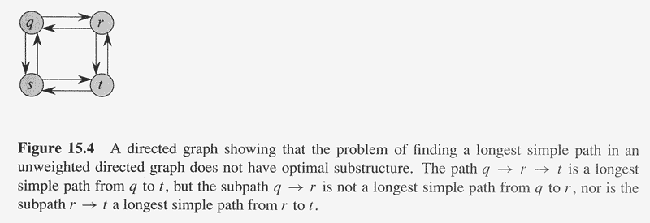

Slide 68
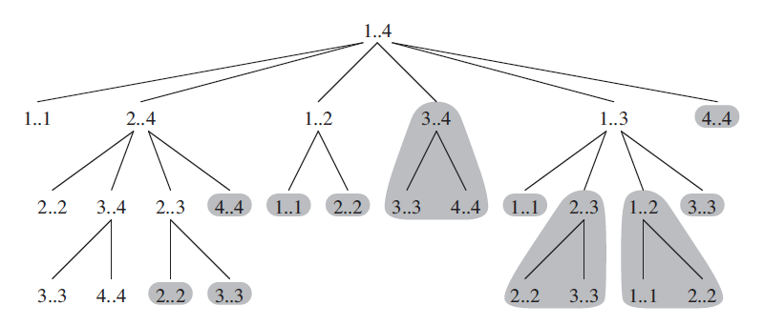
Overlapping Subproblems
The space of subproblems must be “small”.
The total number of distinct subproblems is a polynomial in the input size.
A recursive algorithm is exponential because it solves the same problems repeatedly (Memorization works!).
If divide-and-conquer is applicable, then each problem solved will be brand new.

Slide 69
Dynamic Programming
Similar to divide-and-conquer, it breaks problems down into smaller problems that are solved recursively.
In contrast, DP is applicable when the sub-problems are not independent, i.e. when sub-problems share sub-sub-problems. It solves every sub-sub-problem just once and save the results in a table to avoid duplicated computation.

Slide 70
Elements of DP Algorithms
Sub-structure: decompose problem into smaller sub-problems. Express the solution of the original problem in terms of solutions for smaller problems.
Table-structure: Store the answers to the sub-problem in a table, because sub-problem solutions may be used many times.
Bottom-up computation: combine solutions on smaller sub-problems to solve larger sub-problems, and eventually arrive at a solution to the complete problem.

Slide 71
Applicability to Optimization Problems
Optimal sub-structure (principle of optimality): for the global problem to be solved optimally, each sub-problem should be solved optimally. This is often violated due to sub-problem overlaps. Often by being “less optimal” on one problem, we may make a big savings on another sub-problem.
Small number of sub-problems: Many NP-hard problems can be formulated as DP problems, but these formulations are not efficient, because the number of sub-problems is exponentially large. Ideally, the number of sub-problems should be at most a polynomial number.

Slide 72
Homework
CLRS 15.3-2
CLRS 15.3-3

Slide 73
Longest Common Subsequence
Problem: Given 2 sequences, X = ⟨x₁,...,x_{m}⟩ and Y = ⟨y₁,...,y_{n}⟩, find a common subsequence whose length is maximum.
springtime ncaa tournament basketball
printing north carolina snoeyink
Subsequence need not be consecutive, but must be in order.

Slide 74
Naïve Algorithm
For every subsequence of X, check whether it’s a subsequence of Y .
Time: Θ(n2^{m}).
2^{m} subsequences of X to check.
Each subsequence takes Θ(n) time to check: scan Y for first letter, for second, and so on.

Slide 75
Optimal Substructure
Theorem
Let Z = ⟨z₁, . . . , z_{k}⟩ be any LCS of X and Y .
1. If x_{m} = y_{n}, then z_{k} = x_{m} = y_{n} and Z_{k-1} is an LCS of X_{m-1} and Y_{n-1}.
2. If x_{m} ≠ y_{n}, then either z_{k} ≠ x_{m} and Z is an LCS of X_{m-1} and Y .
3. or z_{k} ≠ y_{n} and Z is an LCS of X and Y_{n-1}.
Notation:
prefix X_{i} = ⟨x₁,...,x_{i}⟩ is the first i letters of X.
This says what any longest common subsequence must look like; do you believe it?

Slide 76
Optimal Substructure
Theorem
Let Z = ⟨z₁, . . . , z_{k}⟩ be any LCS of X and Y .
1. If x_{m} = y_{n}, then z_{k} = x_{m} = y_{n} and Z_{k-1} is an LCS of X_{m-1} and Y_{n-1}.
2. If x_{m} ≠ y_{n}, then either z_{k} ≠ x_{m} and Z is an LCS of X_{m-1} and Y .
3. or z_{k} ≠ y_{n} and Z is an LCS of X and Y_{n-1}.
Proof: (case 1: x_{m} = y_{n})
Any sequence Z’ that does not end in x_{m} = y_{n} can be made longer by adding x_{m} = y_{n} to the end. Therefore,
longest common subsequence (LCS) Z must end in x_{m} = y_{n}.
Z_{k-1} is a common subsequence of X_{m-1} and Y_{n-1}, and
there is no longer CS of X_{m-1} and Y_{n-1}, or Z would not be an LCS.

Slide 77
Optimal Substructure
Theorem
Let Z = ⟨z₁, . . . , z_{k}⟩ be any LCS of X and Y .
1. If x_{m} = y_{n}, then z_{k} = x_{m} = y_{n} and Z_{k-1} is an LCS of X_{m-1} and Y_{n-1}.
2. If x_{m} ≠ y_{n}, then either z_{k} ≠ x_{m} and Z is an LCS of X_{m-1} and Y .
3. or z_{k} ≠ y_{n} and Z is an LCS of X and Y_{n-1}.
Proof: (case 2: x_{m} ≠ y_{n}, and z_{k} ≠ x_{m})
Since Z does not end in x_{m},
Z is a common subsequence of X_{m-1} and Y, and
there is no longer CS of X_{m-1} and Y, or Z would not be an LCS.

Slide 78
Recursive Solution
Define c[i, j] = length of LCS of X_{i} and Y_{j} .
We want c[m,n].
This gives a recursive algorithm and solves the problem. But does it solve it well?

Slide 79
Recursive Solution
c[springtime, printing]
c[springtim, printing] c[springtime, printin]
[springti, printing] [springtim, printin] [springtim, printin] [springtime, printi]
[springt, printing] [springti, printin] [springtim, printi] [springtime, print]

Slide 80
Recursive Solution
 |  | p | r | i | n | t | i | n | g
s
p
r
i
n
g
t
i
m
e
Keep track of c[α,β] in a table of nm entries:
top/down
bottom/up

Slide 81
Computing the length of an LCS
LCS-LENGTH (X, Y)
m ← length[X]
n ← length[Y]
for i ← 1 to m
do c[i, 0] ← 0
for j ← 0 to n
do c[0, j ] ← 0
for i ← 1 to m
do for j ← 1 to n
do if x_{i} = y_{j}
then c[i, j ] ← c[i−1, j−1] + 1
b[i, j ] ← “ ”
else if c[i−1, j ] ≥ c[i, j−1]
then c[i, j ] ← c[i− 1, j ]
b[i, j ] ← “↑”
else c[i, j ] ← c[i, j−1]
b[i, j ] ← “←”
return c and b
b[i, j ] points to table entry whose subproblem we used in solving LCS of X_{i} and Y_{j}.
c[m,n] contains the length of an LCS of X and Y.
Time: O(mn)

Slide 82
Constructing an LCS
PRINT-LCS (b, X, i, j)
if i = 0 or j = 0
then return
if b[i, j ] = “ ”
then PRINT-LCS(b, X, i−1, j−1)
print x_{i}
elseif b[i, j ] = “↑”
then PRINT-LCS(b, X, i−1, j)
else PRINT-LCS(b, X, i, j−1)
Initial call is PRINT-LCS (b, X,m, n).
When b[i, j ] = , we have extended LCS by one character. So LCS = entries with in them.
Time: O(m+n)

Slide 83
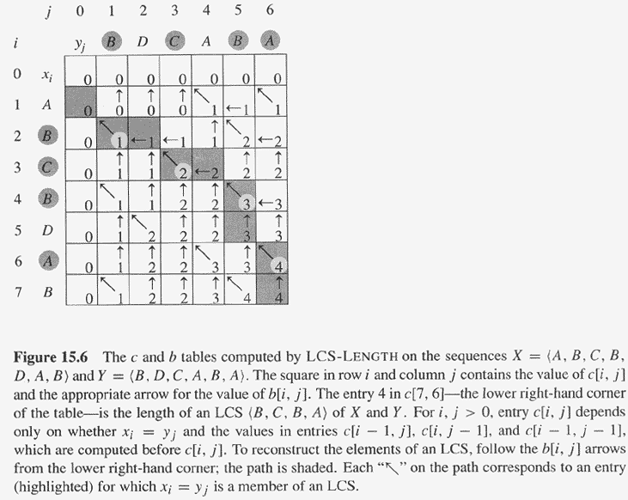
Copyright © The McGraw-Hill Companies, Inc. Permission required for reproduction or display.

Slide 84
Homework
CLRS 15.4-1
CLRS 15.4-3

Slide 85
最大子段和
问题：给定n 个整数（可以为负数）的序列
(a₁, a₂, … , a_{n})
求
实例： (-2, 11, -4, 13, -5, -2)
解：最大子段和 a₂+a₃+a₄= 20
算法1---顺序求和+比较
算法2---分治策略
算法3---动态规划

Slide 86
算法1 顺序求和+比较
1. sum←0 // sum为最终输出
2. for i←1 to n do
3. for j←i to n do
4. thissum ←0 // thissum为a[i]到a[j]之和
5. for k←i to j do
6. thissum ← thissum+a[k]
7. if thissum > sum
8. then sum ← thissum
9. besti ←i // 记录最大和的首位置
10． bestj ←j // 记录最大和的末位置
复杂性：O(n³)

Slide 87
算法2 分治策略
将序列分成左右两半，中间分点center
递归计算左段最大子段和 leftsum
递归计算右段最大子段和 rightsum
a_{center}→a₁的最大和s1, a_{center+1}→a_{n}的最大和s2
max { leftsum, rightsum, s1+s2} 重复计算？
s1+s2
leftsum
rightsum
a₁ a₂ … a_{k} a_{k+1} … a_{n}
left center center+1 right

Slide 88
算法2 MaxSubSum
算法 MaxSubSum (A, left, right）
1．If |A|=1，则输出元素值（当值为负时输出0）
2．center ←(left+right)/2;
3．leftsum ←MaxSubSum(A,left,center) //左和
4．righsum ←MaxSubSum(A,center+1,right) //右和
5．s1 ←A1[center] //求从center向左的最大和O(n)
6．s2 ←A2[center+1] //求从center+1向右的最大和O(n)
7．sum ←s1+s2
8．if leftsum > sum then sum ←leftsum
9．if rightsum >sum then sum ←rightsum
时间：T(n)=2T(n/2)+O(n), T(c)=O(1)
T(n)=O(nlogn)

Slide 89
算法3：动态规划
令
多步判断：
b[j] 表示最后一项为 a[j] 的序列构成的最大的子段和
最优解为 b[1], b[2], ..., b[n]中的最大值
a[1] a[2] a[3] … a[j-1] a[j] … a[n]
最大子段和 b[j-1]
最大子段和 b[j]
b[j]可能不包含a[j]前的元素因为前面最大子段和为负而a[j]为正；也可能包含
递推方程为
b[j]= max{b[j-1]+a[j],a[j]} j=1,2，…,n

Slide 90
算法3：MaxSum
MaxSum(A,n)
1. sum ←0; b ←0
2. for i ←1 to n do b为末元素为a[i]的最大和子段
3. if b>0 then b ←b+a[i]
4. else b ←a[i]
5. if b>sum then
6. sum ←b
7. c ← i //记录最大和的末项标号
8. return sum
若结尾为a[i-1]的最大子段的sum为负，则a[i]为结尾的最大子段定只含有a[i]自己，否则则是结尾为a[i-1]的最大子段拼接上a[i]
时间复杂度：O(n), 空间复杂度：O(n).

Slide 91

凸多边形的三角划分
问题：给定凸n边形P，用在内部互不相交的n−3条对角线
(弦) 将P分割成三角形。设P={v₀,v₁,…,v_{n-1}}, 权函数W (例如对每个三角形赋权为三边长度之和), 求具有最小权和
(对角线总长度最短) 的分割方案.
5 边形的划分实例

Slide 92
递推方程
k
定义
t [i,j]为凸多边形
{v_{i-1}, v_{i}, …, v_{j}}
的最优分割对应
的最小权值
k+1
i
t[i,k]
t[k+1,j]
i-1
笨办法：穷举
j
1
n

Slide 93
算法分析
矩阵乘法
求解算法参照算法 MatrixChain,
时间为O(n³)，空间为O(n²).

Slide 94
Optimal Binary Search Trees
Problem
Given sequence K = k₁ < k₂ <··· < k_{n} of n sorted keys, with a search probability p_{i} for each key k_{i}.
Want to build a binary search tree (BST) with minimum expected search cost.
Actual cost = # of items examined.
For key k_{i}, cost = depth_{T}(k_{i})+1, where depth_{T}(k_{i}) = depth of k_{i} in BST T .

Slide 95
Expected Search Cost
Sum of probabilities is 1.
(1)

Slide 96
Example
Consider 5 keys with these search probabilities: p₁ = 0.25, p₂ = 0.2, p₃ = 0.05, p₄ = 0.2, p₅ = 0.3.
k₂
i depth_{T}(k_{i}) depth_{T}(k_{i})·p_{i}
1 1 0.25
2 0 0
3 2 0.1
4 1 0.2
5 2 0.6
1.15
k₁
k₄
k₃
k₅
Therefore, E[search cost] = 2.15.

Slide 97
Example
p₁ = 0.25, p₂ = 0.2, p₃ = 0.05, p₄ = 0.2, p₅ = 0.3.
k₂
i depth_{T}(k_{i}) depth_{T}(k_{i})·p_{i}
1 1 0.25
2 0 0
3 3 0.15
4 2 0.4
5 1 0.3
1.10
k₁
k₅
k₄
Therefore, E[search cost] = 2.10.
k₃
This tree turns out to be optimal for this set of keys.
并非越平衡越好

Slide 98
Example
Observations:
Optimal BST may not have smallest height.
Optimal BST may not have highest-probability key at root.
Build by exhaustive checking?
Construct each n-node BST.
For each, assign keys and compute expected search cost.
But there are Ω(4^{n}/n^{3/2}) different BSTs with n nodes.

Slide 99
Optimal Substructure
Any subtree of a BST contains keys in a contiguous range k_{i}, ..., k_{j} for some 1 ≤ i ≤ j ≤ n.
If T is an optimal BST and T contains subtree T′ with keys k_{i}, ... ,k_{j} , then T′ must be an optimal BST for keys k_{i}, ..., k_{j}.
Proof: Cut and paste.
T
T′

Slide 100
Optimal Substructure
One of the keys in k_{i}, …,k_{j}, say k_{r}, where i ≤ r ≤ j, must be the root of an optimal subtree for these keys.
Left subtree of k_{r} contains k_{i},...,k_{r−1}.
Right subtree of k_{r} contains k_{r}+1, ...,k_{j}.
To find an optimal BST:
Examine all candidate roots k_{r} , for i ≤ r ≤ j
Determine all optimal BSTs containing k_{i},...,k_{r−1} and containing k_{r+1},...,k_{j}
k_{r}
k_{i}
k_{r-1}
k_{r+1}
k_{j}

Slide 101
Recursive Solution
Find optimal BST for k_{i},...,k_{j}, where i ≥ 1, j ≤ n, j ≥ i−1. When j = i−1, the tree is empty.
Define e[i, j ] = expected search cost of optimal BST for k_{i},...,k_{j}.
If j = i−1, then e[i, j ] = 0.
If j ≥ i,
Select a root k_{r}, for some i ≤ r ≤ j .
Recursively make an optimal BSTs
for k_{i},..,k_{r−1} as the left subtree, and
for k_{r+1},..,k_{j} as the right subtree.

Slide 102
Recursive Solution
When the OPT subtree becomes a subtree of a node:
Depth of every node in OPT subtree goes up by 1.
Expected search cost increases by
If k_{r} is the root of an optimal BST for k_{i},..,k_{j} :
e[i, j ] = p_{r} + (e[i, r−1] + w(i, r−1))+(e[r+1, j] + w(r+1, j))
= e[i, r−1] + e[r+1, j] + w(i, j).
But, we don’t know k_{r}. Hence,
from Eq. 1
(because w(i, j)=w(i,r−1) + p_{r} + w(r + 1, j))

Slide 103
Computing an Optimal Solution
For each subproblem (i,j), store:
expected search cost in a table e[1 ..n+1 , 0 ..n]
Will use only entries e[i, j ], where j ≥ i−1.
root[i, j ] = root of subtree with keys k_{i},..,k_{j}, for 1 ≤ i ≤ j ≤ n.
w[1..n+1, 0..n] = sum of probabilities
w[i, i−1] = 0 for 1 ≤ i ≤ n.
w[i, j ] = w[i, j-1] + p_{j} for 1 ≤ i ≤ j ≤ n.

Slide 104
Pseudo-code
OPTIMAL-BST(p, q, n)
for i ← 1 to n + 1
do e[i, i− 1] ← 0
w[i, i− 1] ← 0
for l ← 1 to n
do for i ← 1 to n−l + 1
do j ←i + l−1
e[i, j ]←∞
w[i, j ] ← w[i, j−1] + p_{j}
for r ←i to j
do t ← e[i, r−1] + e[r + 1, j ] + w[i, j ]
if t < e[i, j ]
then e[i, j ] ← t
root[i, j ] ←r
return e and root
Consider all trees with l keys.
Fix the first key.
Fix the last key
Determine the root
of the optimal
(sub)tree
Time: O(n³)

Slide 105
Homework
CLRS 15.5-2

Slide 106
例1 求从始点到终点的最短路径
d,15
d,11
S₁
6
d,9
3
B₁
9
u,2
2
T₁
A₁
u,5
3
C₁
5
u,13
4
4
S₂
u,8
B₂
d,3
T₂
7
3
6
4
A₂
2
u,7
4
C₂
d,10
5
3
S₃
d,6
3
B₃
u,7
T₃
4
2
7
A₃
d,5
C₃
d,11
9
1
1
7
S₄
B₄
T₄
4
u,7
2
4
u,1
1
A₄
u,4
3
C₄
u,10
3
5
6
S₅
B₅
T₅

Slide 107
基本思想
解：判断序列
任何最短路径的子路径都是相对于子路径的始点和终点的最短路径
为找一条最短路径只需从T_{j}开始进行多步判断

Slide 108
一个最优决策序列的任何子序列本身一定是相对于
子序列的初始和结束状态的最优的决策序列(对照前页的图)
例2 求总长模10的最小路径
2
2
u,4
2
u,2
2
d,1
u,6
S
T
5
5
5
5
最优解：下、下、下、下
动态规划求解：下、上、上、上
不满足优化原则，不能使用动态规划设计技术

Slide 109
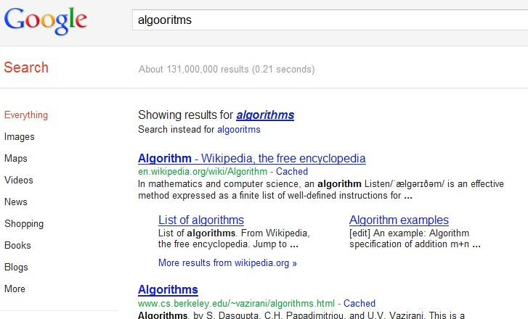
Sequence Alignment
TYPO

Slide 110
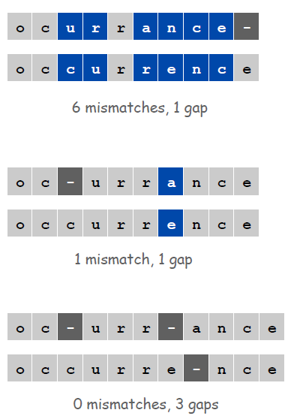
Sequence Alignment
How similar are two strings ?
ocurrance
occurrence

Slide 111
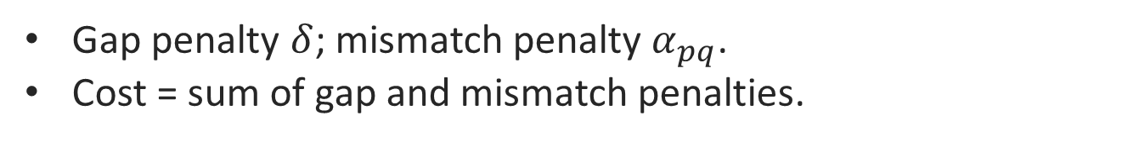
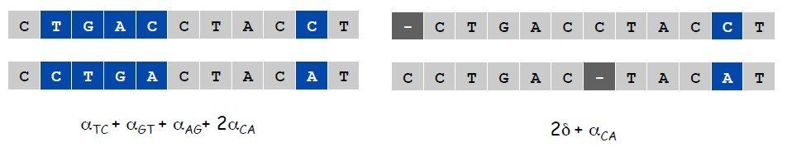
Edit Distance
Applications.
Basis for Unix diff.
Speech recognition.
Computational biology.c
Edit Distance. [Levenshtein 1966, Needleman-Wunsch 1970]

Slide 112
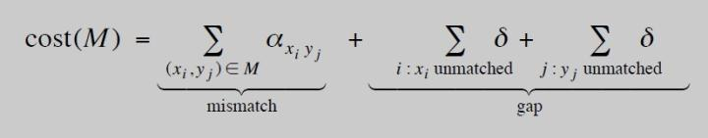
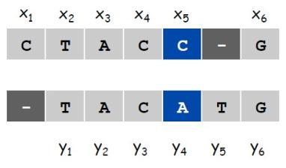

Sequence Alignment
Goal: Given two strings X = x1 x2 . . . xm and Y = y1 y2 . . . yn find
alignment of minimum cost.
Def. An alignment M is a set of ordered pairs xi-yj such that each item occurs in at most one pair and no crossings.
Def. The pair xi-yj and xi'-yj' cross if i < i', but j > j'.

Slide 113
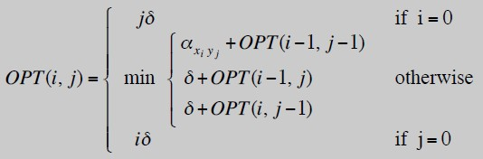
Sequence Alignment: Problem Structure
Def. OPT(i, j) = min cost of aligning strings x1 x2 . . . xi and y1 y2 . . . yj.
Case 1: OPT matches xi-yj.
–pay mismatch for xi-yj + min cost of aligning two strings 若XIYJ相同则同跳过
x1 x2 . . . xi-1 and y1 y2 . . . yj-1
Case 2a: OPT leaves xi unmatched.
–pay gap for xi and min cost of aligning
x1 x2 . . . xi-1 and y1 y2 . . . Yj
Case 2b: Case 2b: OPT leaves yj unmatched.
–pay gap for yj and min cost of aligning
x1 x2 . . . xi and y1 y2 . . . yj-1

Slide 114
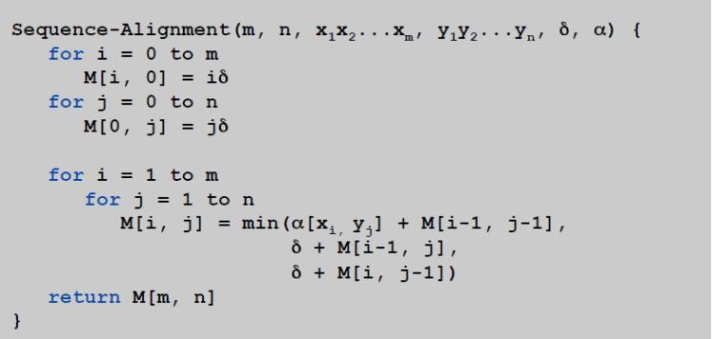
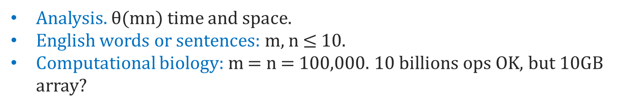
Sequence Alignment: Algorithm
Sequence-Alignment. Fill up an m-by-n array.

Slide 115
图像压缩
像素点灰度值 0∼255，表示为8位二进制数
像素点灰度值序列 { p₁, p₂,…, p_{n}}，p_{i}为第i个像素点的灰度值
变位压缩存储格式 将{ p₁, p₂,…, p_{n}}分割成 m 段S₁, S₂, … ,S_{m}.
第i 段有l[i]个像素，每个像素有b[i]位
约束条件：限定每段像素个数 l[i] 不超过256
表示段S_{i} 的总位数=表示每个像素位数 b[i]的二进制数(3 位，最大8位，对应255亮度值)
+ 表示本段像素个数 l[i] 的二进制数(8位，最大可255)
+ 本段每个像素的位数×本段像素个数
问题
给定像素序列{ p₁, p₂, …, p_{n}}，确定空间最小的分段方式

Slide 116
实例
灰度值序列 P={10,12,15,255,1,2,1,1,2,2,1,1}
分法1 S₁={10,12,15}，S₂={255}, S₃={1,2,1,1,2,2,1,1}
分法2 S₁={10,12,15,255,1,2,1,1,2,2,1,1}
分法3 分成12组，每组一个数
存储空间
分法1：11×3组+4位×3个+8位×1个+2位×8个=69
分法2：11×1组+8位×12个=107
分法3：11×12组+4×3+8×1+1×5+2×3=163

Slide 117
算法设计
递推方程
设s[i]是像素序列{p₁, p₂, … , p_{i}}的最优分段所需存储位数
P₁ P₂ … P_{i-k} P_{i-k+1} … P_{i}
S[i-k]位 k 个灰度
k∗bmax(i-k+1,i)

Slide 118
算法
Compress (P,n) //计算最小位数S[n]
1. Lmax←256; header←11; S[0]←0 //header每个段附加存贮
2. for i←1 to n do
3. b[i]←length(P[i]) //表示第i个像素灰度的二进制位数
4. bmax←b[i] //3-6行分法的最后一段只有p[i]自己
5. S[i]←S[i−1]+bmax
6. l[i]←1
7. 常时间 for j←2 to min{i,Lmax} do//最后段j个像素,j=2,.i或256
8. if bmax<b[i−j+1] //统一段内表示像素的二进制位数
9. then bmax←b[i−j+1]
10. if S[i]>S[i− j]+j*bmax
11. then S[i]←S[i− j]+j*bmax
12. l[i]←j
13. S[i]←S[i]+header
计算复杂性 T(n)=O(n)

Slide 119
（问题）有m排n列的柱桩，每一排的柱桩从左向右标号为1,2,…,n，且在每个柱桩上预先放好价值不一样的宝石。现在有位杂技演员从第一排的第1号柱桩开始跳跃，每次都必须跳到下一排的柱桩上，且每次跳跃最多只能向左或向右移动一个桩子。也就是说如果现在杂技演员站在第j号桩上，那么他可跳到下一排的第j号桩上，也可跳到下一排的第j-1 (if j>1)或者 j+1 (if j<n) 号桩上，并得到桩上的宝石。计算出一条最佳的跳跃顺序，使杂技演员获得的宝石的总价值最大。 （输入） 4 4 （4排4列的柱桩，空格隔开） 1,1, 1, 1 （放在第1排各桩上的宝石价值，逗号隔开） 1, 5, 1, 1 。 2 ,1, 10, 1 。 20 ,1, 1, 1 （放在第4排各桩上的宝石价值） （输出） 28 （最大价值） 1 (开始位置，固定) 2 (在第二排的位置) 1 (在第三排的位置) 1 (在第四排的位置)
Project

Slide 120
要求： a.单人独立完成； b.提交名为 学号_姓名_SA.rar 的压缩文件，含如下内容：1). 完整的源码 2).不依赖于IDE环境的可执行文件及测试数据 3).电子版本项目报告，报告中至少包括对算法思想、递推方程式及该问题的最优子结构性质、程序结构的描述以及计算复杂度分析, 以及测试结果 c. 第15周交（每班统一U盘拷贝) 说明： 1. 不依赖于IDE环境的可执行文件指exe及其支持dll，测试数据均在同一目录中，在任意一台Win XP机器上直接双击exe即可运行。 2. 测试数据不少于20排20列，按照前述的格式放在test.txt文件里，执行结果存入output.txt文件里 参考资料： Algorithm Design, Jon Kleiberg. Eva Tardos, Cornell University
Project

