Slide 1
Algorithm Analysis & Design Introduction to Algorithm
T&R Team of Algorithm Design
College of Computer Science and Engineering, CQU
Notes:
本人是国际视觉电生理学会(ISCEV)的会员。

Slide 2
GREEDY ALGORITHM
16
Locally optimal choice

Slide 3
Overview
Like dynamic programming, used to solve optimization problems.
Dynamic programming can be overkill; greedy algorithms tend to be easier to code
Problems exhibit optimal substructure (like DP).
Problems also exhibit the greedy-choice property.
When we have a choice to make, make the one that looks best right now.
Make a locally optimal choice in hope of getting a globally optimal solution.

Slide 4
Greedy Strategy
The choice that seems best at the moment is the one we go with.
Prove that when there is a choice to make, one of the optimal choices is the greedy choice. Therefore, it’s always safe to make the greedy choice.
Show that all but one of the subproblems resulting from the greedy choice are empty.

Slide 5
Activity-selection Problem
Input: Set S of n activities, a₁, a₂, …, a_{n}.
s_{i} = start time of activity i.
f_{i} = finish time of activity i.
Output: Subset A of maximum number of compatible activities.
Two activities are compatible, if their intervals don’t overlap.
Example:
Activities in each line
are compatible.
2
5
3
6
1
4
7

Slide 6
Optimal Substructure
Assume activities are sorted by finishing times.
f₁ ≤ f₂ ≤ … ≤ f_{n}.
Suppose an optimal solution includes activity a_{k}.
This generates two subproblems.
Selecting from a₁, …, a_{k-1}, activities compatible with one another, and that finish before a_{k} starts (compatible with a_{k}).
Selecting from a_{k+1}, …, a_{n}, activities compatible with one another, and that start after a_{k} finishes.
The solutions to the two subproblems must be optimal.
Prove using the cut-and-paste approach.

Slide 7
Activity Selection: Repeated Subproblems
Consider a recursive algorithm that tries all possible compatible subsets to find a maximal set, and notice repeated subproblems:
S 1∈A?
yes
no
S’ 2∈A?
S-{1} 2∈A?
yes
no
yes
no
S’’
S’-{2}
S’’
S-{1,2}

Slide 8
Recursive Solution
Let S_{ij} = subset of activities in S that start after a_{i} finishes and finish before a_{j} starts.
Subproblems: Selecting maximum number of mutually compatible activities from S_{ij}.
Let c[i, j] = size of maximum-size subset of mutually compatible activities in S_{ij}.
Recursive
Solution:

Slide 9
Greedy Choice Property
Dynamic programming? Memoize? Yes, but…
Activity selection problem also exhibits the greedy choice property:
Locally optimal choice ⇒ globally optimal sol’n
Them 16.1: if S is an activity selection problem sorted by finish time, then ∃ optimal solution A ⊆ S such that {1} ∈ A
Sketch of proof: if ∃ optimal solution B that does not contain {1}, can always replace first activity in B with {1} (Why?). Same number of activities, thus optimal.

Slide 10
Greedy-choice Property
The problem also exhibits the greedy-choice property.
There is an optimal solution to the subproblem S_{ij}, that includes the activity with the smallest finish time in set S_{ij}.
Can be proved easily.
Hence, there is an optimal solution to S that includes a₁.
Therefore, make this greedy choice without solving subproblems first and evaluating them.
Solve the subproblem that ensues as a result of making this greedy choice.
Combine the greedy choice and the solution to the subproblem.

Slide 11
Recursive Algorithm
Recursive-Activity-Selector (s, f, i, j)
m ← i+1
while m < j and s_{m} < f_{i}
do m ← m+1 找到i后第一个不冲突的活动
if m < j
then return {a_{m}} ∪ 第一个（m+1）一定入选
Recursive-Activity-Selector(s, f, m, j)
else return φ
Initial Call: Recursive-Activity-Selector (s, f, 0, n+1)
Complexity: Θ(n)
Straightforward to convert the algorithm to an iterative one.

Slide 12
Typical Steps
Cast the optimization problem as one in which we make a choice and are left with one subproblem to solve.
Prove that there’s always an optimal solution that makes the greedy choice, so that the greedy choice is always safe.
Show that greedy choice and optimal solution to subproblem ⇒ optimal solution to the problem.
Make the greedy choice and solve top-down.
May have to preprocess input to put it into greedy order.
Example: Sorting activities by finish time.

Slide 13
Activity Selection: A Greedy Algorithm
So actual algorithm is simple:
Sort the activities by finish time
Schedule the first activity
Then schedule the next activity in sorted list which starts after previous activity finishes
Repeat until no more activities
Intuition is even more simple:
Always pick the shortest ride available at the time

Slide 14
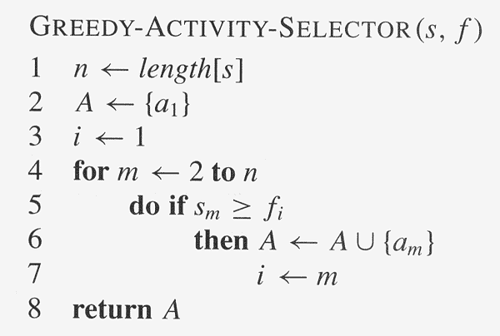
Copyright © The McGraw-Hill Companies, Inc. Permission required for reproduction or display.
i记录当前选中的最后一个任务s

Slide 15
Elements of Greedy Algorithms
Greedy-choice Property.
A globally optimal solution can be arrived at by making a locally optimal (greedy) choice.
Optimal Substructure.

Slide 16
Knapsack Problem

Slide 17
The Knapsack Problem
The famous knapsack problem:
A thief breaks into a museum. Fabulous paintings, sculptures, and jewels are everywhere. The thief has a good eye for the value of these objects, and knows that each will fetch hundreds or thousands of dollars on the clandestine art collector’s market. But, the thief has only brought a single knapsack to the scene of the robbery, and can take away only what he can carry. What items should the thief take to maximize the haul?

Slide 18
0-1 Knapsack problem
Given a knapsack with maximum capacity W, and a set S consisting of n items
Each item i has some weight w_{i} and benefit value b_{i} (all w_{i} , b_{i} and W are integer values)
Problem: How to pack the knapsack to achieve maximum total value of packed items?

Slide 19
0-1 Knapsack problem: a picture
Weight
Benefit value
w_{i}
b_{i}
Items
3
2
This is a knapsack
Max weight: W = 20
3
4
4
5
5
8
W = 20
9
10

Slide 20
The Knapsack Problem
More formally, the 0-1 knapsack problem:
The thief must choose among n items, where the ith item worth v_{i} dollars and weighs w_{i} pounds
Carrying at most W pounds, maximize value
Note: assume v_{i}, w_{i}, and W are all integers
“0-1” b/c each item must be taken or left in entirety
A variation, the fractional knapsack problem:
Thief can take fractions of items
Think of items in 0-1 problem as gold ingots, in fractional problem as buckets of gold dust

Slide 21
0-1 Knapsack problem
Problem, in other words, is to find
The problem is called a “0-1” problem, because each item must be entirely accepted or rejected.
Just another version of this problem is the “Fractional Knapsack Problem”, where we can take fractions of items.

Slide 22
0-1 Knapsack problem: brute-force approach
Let’s first solve this problem with a straightforward algorithm
Since there are n items, there are 2^{n} possible combinations of items.
We go through all combinations and find the one with the most total value and with total weight less or equal to W
Running time will be O(2^{n})

Slide 23
0-1 Knapsack problem: brute-force approach
Can we do better?
Yes, with an algorithm based on dynamic programming
We need to carefully identify the subproblems
Let’s try this:
If items are labeled 1..n, then a subproblem
would be to find an optimal solution for
S_{k} = {items labeled 1, 2, .. k}

Slide 24
Defining a Subproblem
If items are labeled 1..n, then a subproblem would be to find an optimal solution for S_{k} = {items labeled 1, 2, .. k}
This is a valid subproblem definition.
The question is: can we describe the final solution (S_{n} ) in terms of subproblems (S_{k})?
Unfortunately, we can’t do that. Explanation follows….

Slide 25
Defining a Subproblem
w₁ =2
b₁ =3
w₂ =4
b₂ =5
w₃ =5
b₃ =8
w₄ =3
b₄ =4
Weight
Benefit
Item
#
w_{i}
b_{i}
?
1
2
3
Max weight: W = 20
For S₄:
Total weight: 14;
total benefit: 20
S₄
2
3
4
S₅
3
4
5
4
5
8
5
9
10
w₁ =2
b₁ =3
w₂ =4
b₂ =5
w₃ =5
b₃ =8
w₅ =9
b₅ =10
Solution for S₄ is not part of the solution for S₅!!!
For S₅:
Total weight: 20
total benefit: 26

Slide 26
Defining a Subproblem (continued)
As we have seen, the solution for S₄ is not part of the solution for S₅
So our definition of a subproblem is flawed and we need another one!
Let’s add another parameter: w, which will represent the exact weight for each subset of items
The subproblem then will be to compute B[k,w]

Slide 27
Recursive Formula for subproblems
Recursive formula for subproblems:
It means, that the best subset of S_{k} that has total weight w is one of the two:
1) the best subset of S_{k-1} that has total weight w, or
2) the best subset of S_{k-1} that has total weight w-w_{k} plus the item k

Slide 28
Recursive Formula
The best subset of S_{k} that has the total weight w, either contains item k or not.
First case: w_{k}>w. Item k can’t be part of the solution, since if it was, the total weight would be > w, which is unacceptable
Second case: w_{k} <=w. Then the item k can be in the solution, and we choose the case with greater value

Slide 29
The Knapsack Problem And Optimal Substructure
Both variations exhibit optimal substructure
To show this for the 0-1 problem, consider the most valuable load weighing at most W pounds
If we remove item j from the load, what do we know about the remaining load?
A: remainder must be the most valuable load weighing at most W - w_{j} that thief could take from museum, excluding item j

Slide 30
Solving The Knapsack Problem
The optimal solution to the fractional knapsack problem can be found with a greedy algorithm
How?
The optimal solution to the 0-1 problem cannot be found with the same greedy strategy
Greedy strategy: take in order of dollars/pound
Example: 3 items weighing 10, 20, and 30 pounds, knapsack can hold 50 pounds
Suppose item 2 is worth $100. Assign values to the other items so that the greedy strategy will fail

Slide 31
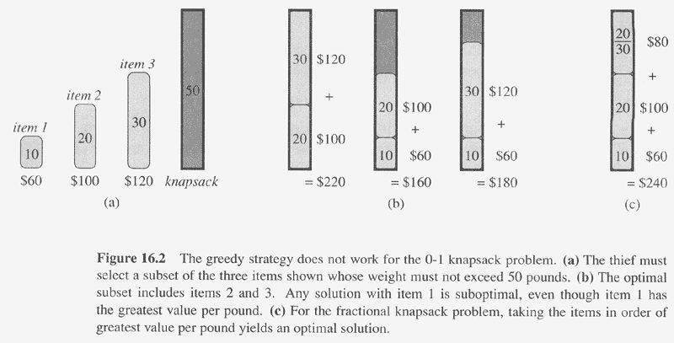
Copyright © The McGraw-Hill Companies, Inc. Permission required for reproduction or display.
贪心策略解01背包结果
贪心性质证明：反证，如果最优解不是尽力放最值钱的a，而是放a之后的某个x才能形成最优解S，且x一共放了y公斤，则用xy/a公斤的a替换x可保证相同的价值，且使放剩余物品的载重增加，可形成更优解，矛盾

Slide 32
The Knapsack Problem: Greedy Vs. Dynamic
The fractional problem can be solved greedily
The 0-1 problem cannot be solved with a greedy approach
As you have seen, however, it can be solved with dynamic programming

Slide 33
0-1 Knapsack Algorithm
for w = 0 to W
B[0,w] = 0
for i = 0 to n
B[i,0] = 0
for w = 0 to W
if w_{i} <= w // item i can be part of the solution
if b_{i} + B[i-1,w-w_{i}] > B[i-1,w]
B[i,w] = b_{i} + B[i-1,w- w_{i}]
else
B[i,w] = B[i-1,w]
else B[i,w] = B[i-1,w] // w_{i} > w

Slide 34
Running time
for w = 0 to W
B[0,w] = 0
for i = 0 to n
B[i,0] = 0
for w = 0 to W
< the rest of the code >
O(W)
Repeat n times
O(W)
What is the running time of this algorithm?
O(n*W)
Remember that the brute-force algorithm
takes O(2^{n})

Slide 35
Example
Let’s run our algorithm on the
following data:
n = 4 (# of elements)
W = 5 (max weight)
Elements (weight, benefit):
(2,3), (3,4), (4,5), (5,6)

Slide 36
Example (2)
i
0
1
2
3
4
W
0
0
1
0
2
0
3
0
4
0
5
0
for w = 0 to W
B[0,w] = 0

Slide 37
Example (3)
i
0
1
2
3
4
W
0
0
0
0
0
0
1
0
2
0
3
0
4
0
5
0
for i = 0 to n
B[i,0] = 0

Slide 38
Example (4)
Items:
1: (2,3)
2: (3,4)
3: (4,5)
4: (5,6)
i
0
1
2
3
4
W
0
0
0
0
0
0
i=1
b_{i}=3
w_{i}=2
w=1
w-w_{i} =-1
1
0
0
2
0
3
0
4
0
5
0
if w_{i} <= w // item i can be part of the solution
if b_{i} + B[i-1,w-w_{i}] > B[i-1,w]
B[i,w] = b_{i} + B[i-1,w- w_{i}]
else
B[i,w] = B[i-1,w]
else B[i,w] = B[i-1,w] // w_{i} > w

Slide 39
Example (5)
Items:
1: (2,3)
2: (3,4)
3: (4,5)
4: (5,6)
i
0
1
2
3
4
W
0
0
0
0
0
0
i=1
b_{i}=3
w_{i}=2
w=2
w-w_{i} =0
1
0
0
2
0
3
3
0
4
0
5
0
if w_{i} <= w // item i can be part of the solution
if b_{i} + B[i-1,w-w_{i}] > B[i-1,w]
B[i,w] = b_{i} + B[i-1,w- w_{i}]
else
B[i,w] = B[i-1,w]
else B[i,w] = B[i-1,w] // w_{i} > w

Slide 40
Example (6)
Items:
1: (2,3)
2: (3,4)
3: (4,5)
4: (5,6)
i
0
1
2
3
4
W
0
0
0
0
0
0
i=1
b_{i}=3
w_{i}=2
w=3
w-w_{i}=1
1
0
0
2
0
3
3
0
3
4
0
5
0
if w_{i} <= w // item i can be part of the solution
if b_{i} + B[i-1,w-w_{i}] > B[i-1,w]
B[i,w] = b_{i} + B[i-1,w- w_{i}]
else
B[i,w] = B[i-1,w]
else B[i,w] = B[i-1,w] // w_{i} > w

Slide 41
Example (7)
Items:
1: (2,3)
2: (3,4)
3: (4,5)
4: (5,6)
i
0
1
2
3
4
W
0
0
0
0
0
0
i=1
b_{i}=3
w_{i}=2
w=4
w-w_{i}=2
1
0
0
2
0
3
3
0
3
4
0
3
5
0
if w_{i} <= w // item i can be part of the solution
if b_{i} + B[i-1,w-w_{i}] > B[i-1,w]
B[i,w] = b_{i} + B[i-1,w- w_{i}]
else
B[i,w] = B[i-1,w]
else B[i,w] = B[i-1,w] // w_{i} > w

Slide 42
Example (8)
Items:
1: (2,3)
2: (3,4)
3: (4,5)
4: (5,6)
i
0
1
2
3
4
W
0
0
0
0
0
0
i=1
b_{i}=3
w_{i}=2
w=5
w-w_{i}=2
1
0
0
2
0
3
3
0
3
4
0
3
5
0
3
if w_{i} <= w // item i can be part of the solution
if b_{i} + B[i-1,w-w_{i}] > B[i-1,w]
B[i,w] = b_{i} + B[i-1,w- w_{i}]
else
B[i,w] = B[i-1,w]
else B[i,w] = B[i-1,w] // w_{i} > w

Slide 43
Example (9)
Items:
1: (2,3)
2: (3,4)
3: (4,5)
4: (5,6)
i
0
1
2
3
4
W
0
0
0
0
0
0
i=2
b_{i}=4
w_{i}=3
w=1
w-w_{i}=-2
1
0
0
0
2
0
3
3
0
3
4
0
3
5
0
3
if w_{i} <= w // item i can be part of the solution
if b_{i} + B[i-1,w-w_{i}] > B[i-1,w]
B[i,w] = b_{i} + B[i-1,w- w_{i}]
else
B[i,w] = B[i-1,w]
else B[i,w] = B[i-1,w] // w_{i} > w

Slide 44
Example (10)
Items:
1: (2,3)
2: (3,4)
3: (4,5)
4: (5,6)
i
0
1
2
3
4
W
0
0
0
0
0
0
i=2
b_{i}=4
w_{i}=3
w=2
w-w_{i}=-1
1
0
0
0
2
0
3
3
3
0
3
4
0
3
5
0
3
if w_{i} <= w // item i can be part of the solution
if b_{i} + B[i-1,w-w_{i}] > B[i-1,w]
B[i,w] = b_{i} + B[i-1,w- w_{i}]
else
B[i,w] = B[i-1,w]
else B[i,w] = B[i-1,w] // w_{i} > w

Slide 45
Example (11)
Items:
1: (2,3)
2: (3,4)
3: (4,5)
4: (5,6)
i
0
1
2
3
4
W
0
0
0
0
0
0
i=2
b_{i}=4
w_{i}=3
w=3
w-w_{i}=0
1
0
0
0
2
0
3
3
3
0
3
4
4
0
3
5
0
3
if w_{i} <= w // item i can be part of the solution
if b_{i} + B[i-1,w-w_{i}] > B[i-1,w]
B[i,w] = b_{i} + B[i-1,w- w_{i}]
else
B[i,w] = B[i-1,w]
else B[i,w] = B[i-1,w] // w_{i} > w

Slide 46
Example (12)
Items:
1: (2,3)
2: (3,4)
3: (4,5)
4: (5,6)
i
0
1
2
3
4
W
0
0
0
0
0
0
i=2
b_{i}=4
w_{i}=3
w=4
w-w_{i}=1
1
0
0
0
2
0
3
3
3
0
3
4
4
0
3
4
5
0
3
if w_{i} <= w // item i can be part of the solution
if b_{i} + B[i-1,w-w_{i}] > B[i-1,w]
B[i,w] = b_{i} + B[i-1,w- w_{i}]
else
B[i,w] = B[i-1,w]
else B[i,w] = B[i-1,w] // w_{i} > w

Slide 47
Example (13)
Items:
1: (2,3)
2: (3,4)
3: (4,5)
4: (5,6)
i
0
1
2
3
4
W
0
0
0
0
0
0
i=2
b_{i}=4
w_{i}=3
w=5
w-w_{i}=2
1
0
0
0
2
0
3
3
3
0
3
4
4
0
3
4
5
0
3
7
if w_{i} <= w // item i can be part of the solution
if b_{i} + B[i-1,w-w_{i}] > B[i-1,w]
B[i,w] = b_{i} + B[i-1,w- w_{i}]
else
B[i,w] = B[i-1,w]
else B[i,w] = B[i-1,w] // w_{i} > w

Slide 48
Example (14)
Items:
1: (2,3)
2: (3,4)
3: (4,5)
4: (5,6)
i
0
1
2
3
4
W
0
0
0
0
0
0
i=3
b_{i}=5
w_{i}=4
w=1..3
1
0
0
0
0
0
2
0
3
3
3
3
0
3
4
4
4
0
3
4
5
0
3
7
if w_{i} <= w // item i can be part of the solution
if b_{i} + B[i-1,w-w_{i}] > B[i-1,w]
B[i,w] = b_{i} + B[i-1,w- w_{i}]
else
B[i,w] = B[i-1,w]
else B[i,w] = B[i-1,w] // w_{i} > w

Slide 49
Example (15)
Items:
1: (2,3)
2: (3,4)
3: (4,5)
4: (5,6)
i
0
1
2
3
4
W
0
0
0
0
0
0
i=3
b_{i}=5
w_{i}=4
w=4
w- w_{i}=0
1
0
0
0
0
0
2
0
3
3
3
3
0
3
4
4
4
0
3
4
5
5
0
3
7
if w_{i} <= w // item i can be part of the solution
if b_{i} + B[i-1,w-w_{i}] > B[i-1,w]
B[i,w] = b_{i} + B[i-1,w- w_{i}]
else
B[i,w] = B[i-1,w]
else B[i,w] = B[i-1,w] // w_{i} > w

Slide 50
Example (15)
Items:
1: (2,3)
2: (3,4)
3: (4,5)
4: (5,6)
i
0
1
2
3
4
W
0
0
0
0
0
0
i=3
b_{i}=5
w_{i}=4
w=5
w- w_{i}=1
1
0
0
0
0
0
2
0
3
3
3
3
0
3
4
4
4
0
3
4
5
5
0
3
7
7
if w_{i} <= w // item i can be part of the solution
if b_{i} + B[i-1,w-w_{i}] > B[i-1,w]
B[i,w] = b_{i} + B[i-1,w- w_{i}]
else
B[i,w] = B[i-1,w]
else B[i,w] = B[i-1,w] // w_{i} > w

Slide 51
Example (16)
Items:
1: (2,3)
2: (3,4)
3: (4,5)
4: (5,6)
i
0
1
2
3
4
W
0
0
0
0
0
0
i=3
b_{i}=5
w_{i}=4
w=1..4
1
0
0
0
0
0
0
2
0
3
3
3
3
3
0
3
4
4
4
4
0
3
4
5
5
5
0
3
7
7
if w_{i} <= w // item i can be part of the solution
if b_{i} + B[i-1,w-w_{i}] > B[i-1,w]
B[i,w] = b_{i} + B[i-1,w- w_{i}]
else
B[i,w] = B[i-1,w]
else B[i,w] = B[i-1,w] // w_{i} > w

Slide 52
Example (17)
Items:
1: (2,3)
2: (3,4)
3: (4,5)
4: (5,6)
i
0
1
2
3
4
W
0
0
0
0
0
0
i=3
b_{i}=5
w_{i}=4
w=5
1
0
0
0
0
0
0
2
0
3
3
3
3
3
0
3
4
4
4
4
0
3
4
5
5
5
0
3
7
7
7
if w_{i} <= w // item i can be part of the solution
if b_{i} + B[i-1,w-w_{i}] > B[i-1,w]
B[i,w] = b_{i} + B[i-1,w- w_{i}]
else
B[i,w] = B[i-1,w]
else B[i,w] = B[i-1,w] // w_{i} > w

Slide 53
Comments
This algorithm only finds the max possible value that can be carried in the knapsack
To know the items that make this maximum value, an addition to this algorithm is necessary
Please see LCS algorithm from the previous lecture for the example how to extract this data from the table we built

Slide 54
Change-Making Problem

Slide 55
Change-Making Problem
Finding the number of ways of making changes
for a particular amount of cents, n, using a given
set of denominations C={c1…cd} (e.g, the US
coin system: {1, 5, 10, 25, 50, 100})
– An example: n = 4,C = {1,2,3}, solutions: {1,1,1,1},
{1,1,2},{2,2},{1,3}.
▪ Minimizing the number of coins returned for a
particular quantity of change (available coins
{1, 5, 10, 25})
– 30 Cents (solution: 25 + 2, two coins)
– 67 Cents ?
▪ 17 cents given denominations = {1, 2, 3, 4}?

Slide 56
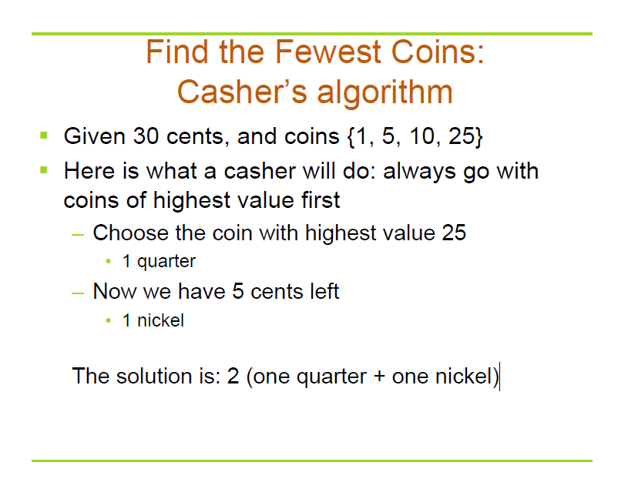

Slide 57
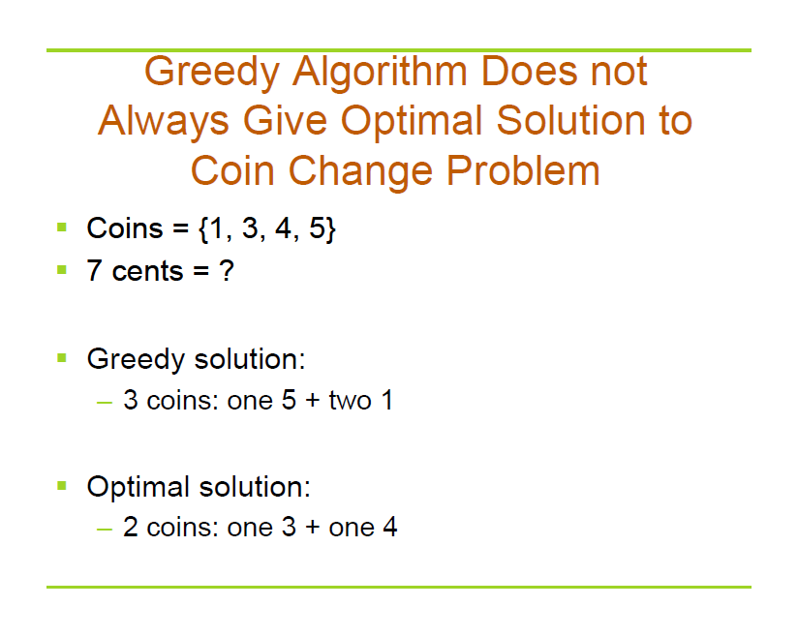

Slide 58
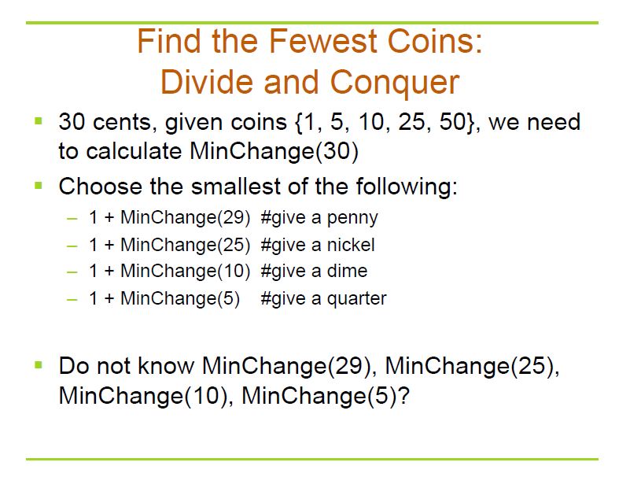
尝试性的选择1,5,10,25为首次选择，递归求解剩余规模问题

Slide 59
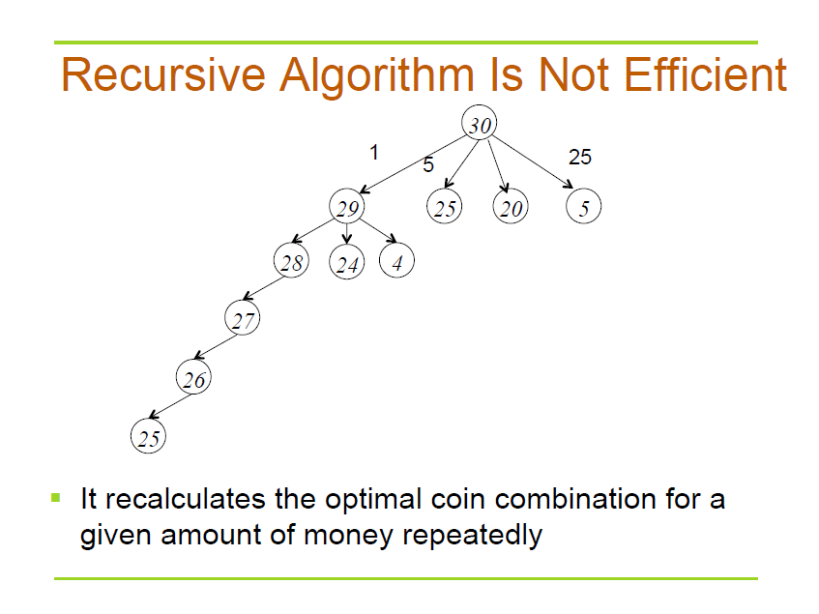

Slide 60
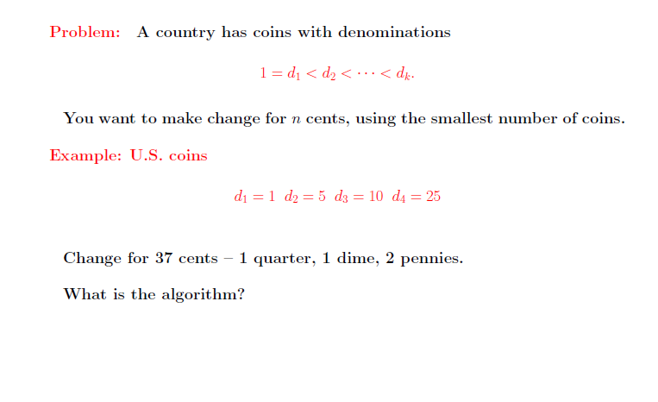
Dynamic Programming

Slide 61
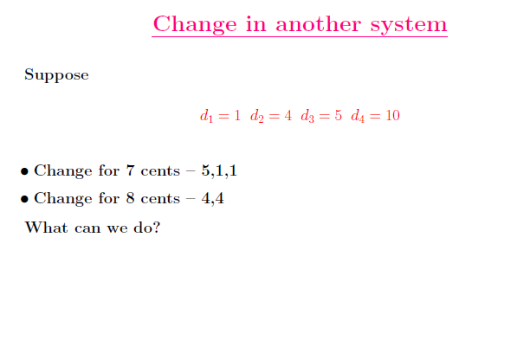
Dynamic Programming

Slide 62
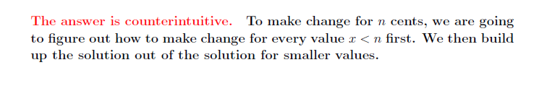
Dynamic Programming

Slide 63
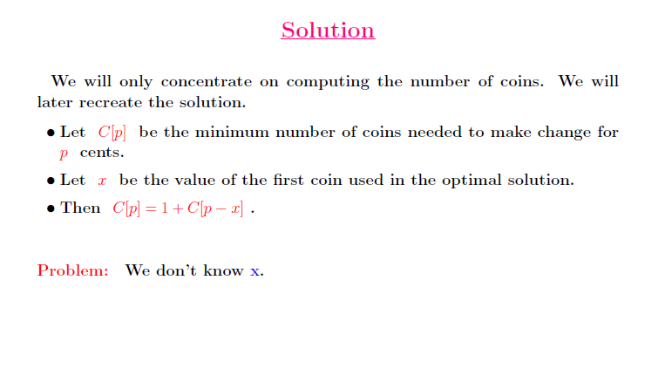
Dynamic Programming

Slide 64
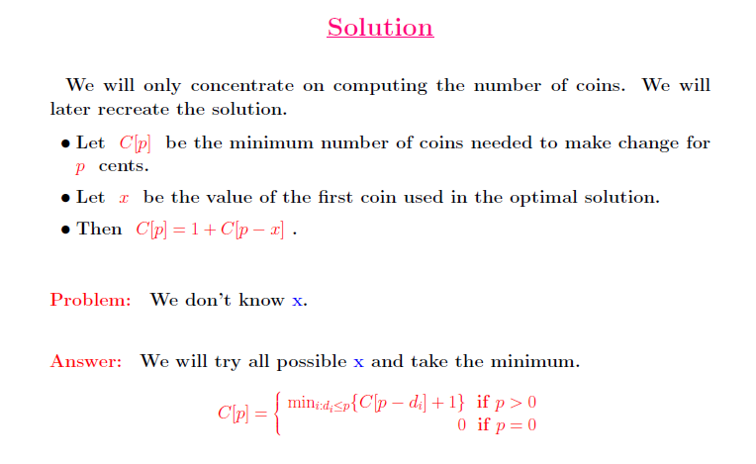
Dynamic Programming

Slide 65
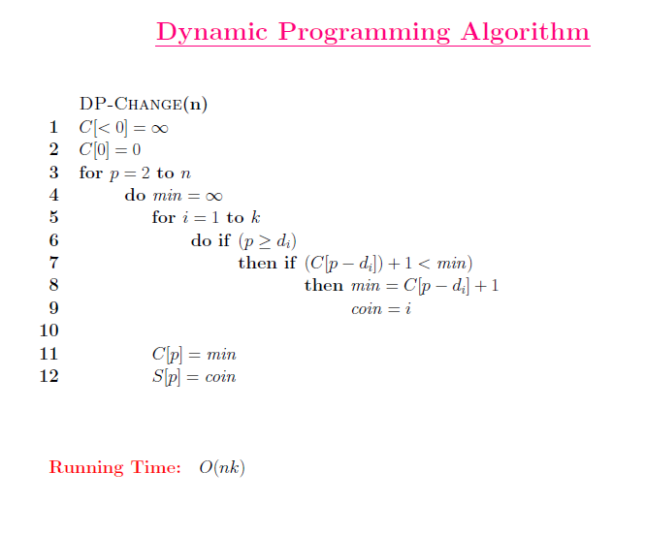

Slide 66
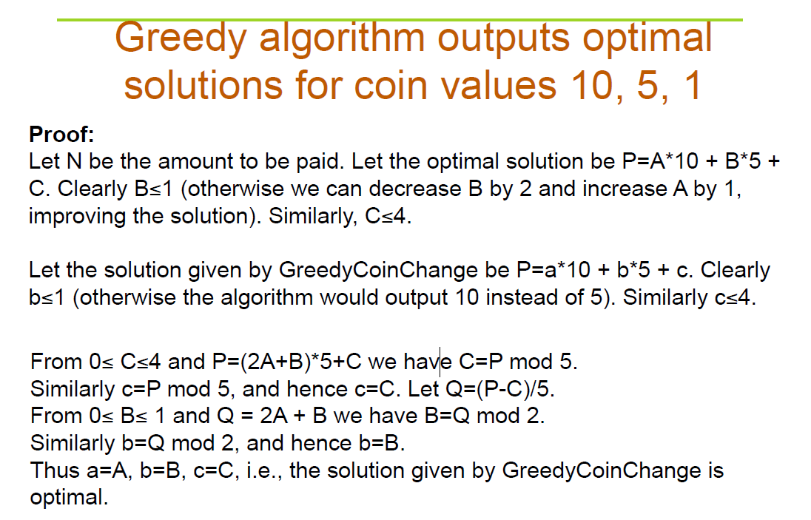
尽量先用大面值匹配
另一种证明思路：首先，最大面值匹配法一定能找到可行解，因为最小硬币面值1；反证，若存在一个最优解可用10分却不用10分优先匹配，则用5分至少要2个，这两个5分可用1个10分替换形成更优，矛盾；类似的5分与1分

Slide 67
Homework
CLRS 16.1-2
CLRS 16.1-5
CLRS 16.2-7

Slide 68
Exercise in Class
Prove that Greedy algorithm outputs optimal solution for coin values 18,6,3,1 （实际上，如果面值系统是倍数关系，则一定可以用贪心策略获得最优解）

Slide 69
Huffman Codes

Slide 70
Data Compression
Q. Given a text that uses 32 symbols (26 different letters, space, and
some punctuation characters), how can we encode this text in bits?
Q. Some symbols (e, t, a, o, i, n) are used far more often than others.
How can we use this to reduce our encoding?
Q. How do we know when the next symbol begins?
Ex. c(a) = 01 What is 0101?
c(b) = 010
c(e) = 1

Slide 71
Data Compression
Q. Given a text that uses 32 symbols (26 different letters, space, and some punctuation characters), how can we encode this text in bits?
A. We can encode 25 different symbols using a fixed length of 5 bits per symbol. This is called fixed length encoding.
Q. Some symbols (e, t, a, o, i, n) are used far more often than others.
How can we use this to reduce our encoding?
A. Encode these characters with fewer bits, and the others with more bits.
Q. How do we know when the next symbol begins?
A. Use a separation symbol (like the pause in Morse), or make sure thatthere is no ambiguity by ensuring that no code is a prefix of another one.
Ex. c(a) = 01 What is 0101?
c(b) = 010
c(e) = 1

Slide 72
Prefix Codes
Definition. A prefix code for a set S is a function c that maps each x∈S to 1s and 0s in such a way that for x,y∈S, x≠y, c(x) is not a prefix of c(y).
Ex. c(a) = 11
c(e) = 01
c(k) = 001
c(l) = 10
c(u) = 000
Q. What is the meaning of 1001000001 ?
A. “leuk”
Suppose frequencies are known in a text of 1G:
fa=0.4, fe=0.2, fk=0.2, fl=0.1, fu=0.1
Q. What is the size of the encoded text?
A. 2*fa + 2*fe + 3*fk + 2*fl + 4*fu = 2.4G

Slide 73
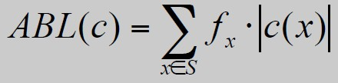
Optimal Prefix Codes
Definition. The average bits per letter of a prefix code c is the sum
over all symbols of its frequency times the number of bits of its
encoding:
We would like to find a prefix code that is has the lowest possible
average bits per letter.
Suppose we model a code in a binary tree…

Slide 74
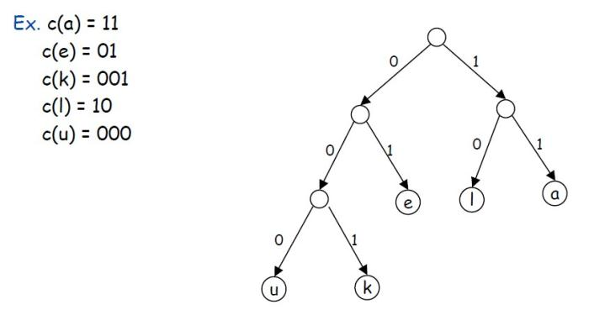
Representing Prefix Codes using Binary Trees
Q. How does the tree of a prefix code look?
A. Only the leaves have a label.
Pf. An encoding of x is a prefix of an encoding of y if and only if the
path of x is a prefix of the path of y.不会处于同一路径上

Slide 75
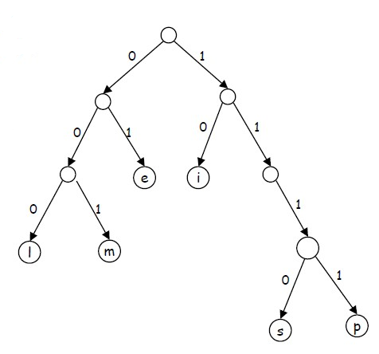

Representing Prefix Codes using Binary Trees
Q. What is the meaning of
111010001111101000 ?
A. “simpel”
Q. How can this prefix code be made more efficient?
A. Change encoding of p and s to a shorter one.
This tree is now full.

Slide 76
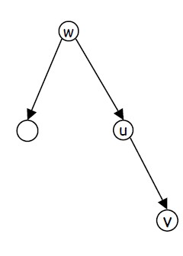
Representing Prefix Codes using Binary Trees
Definition. A tree is full if every node that is not a leaf has two
children.
Claim. The binary tree corresponding to the optimal prefix code is full.
Pf. (by contradiction)
Suppose T is binary tree of optimal prefix code and is not full.
This means there is a node u with only one child v.
Case 1: u is the root; delete u and use v as the root
Case 2: u is not the root
– let w be the parent of u
– delete u and make v be a child of w in place of u
In both cases the number of bits needed to encode any leaf in the
subtree of v is decreased. The rest of the tree is not affected.
Clearly this new tree T’ has a smaller ABL than T. Contradiction.

Slide 77
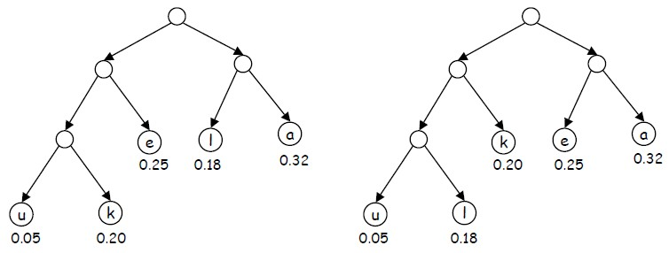
Optimal Prefix Codes: False Start
Q. Where in the tree of an optimal prefix code should letters be placed
with a high frequency?
A. Near the top.
Greedy template. Create tree top-down, split S into two sets S1 and S2
with (almost) equal frequencies. Recursively build tree for S1 and S2.
[Shannon-Fano, 1949] f_{a}=0.32, f_{e}=0.25, f_{k}=0.20, f_{l}=0.18, f_{u}=0.05

Slide 78
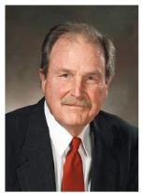
Optimal Prefix Codes: Huffman Encoding
Observation. Lowest frequency items should be at the lowest level in
tree of optimal prefix code.
Observation. For n > 1, the lowest level always contains at least two
leaves.
Observation. The order in which items appear in a level does not
matter.
Claim. There is an optimal prefix code with tree T* where the two
lowest-frequency letters are assigned to leaves that are siblings in T*.
Greedy template. [Huffman, 1952] Create tree bottom-up.
Make two leaves for two lowest-frequency letters y and z.
Recursively build tree for the rest using a meta-letter for yz.

Slide 79
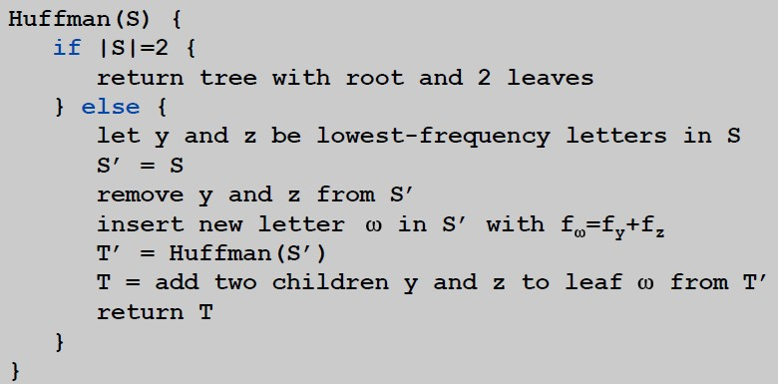
Optimal Prefix Codes: Huffman Encoding
Q. What is the time complexity?
A. T(n) = T(n-1) + O(n)找最小 so O(n²)每次都要重新找最小，存在重复计算
Q. How to implement finding lowest-frequency letters efficiently?一次性构造最小堆，以后在堆上找最小
A. Use priority queue for S: T(n) = T(n-1) + O(log n) so O(n log n)

Slide 80
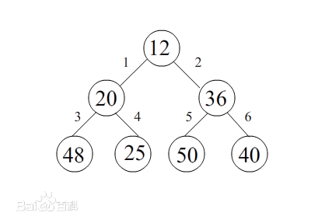
Optimal Prefix Codes: Huffman Encoding
优先级队列（Priority Queue）（最小堆）。什么是优先级队列？优先级队列是指一种维护一组元素的数据结构，它的常用操作是从这些元素中抽取最小的元素，和插入新元素。即他维护了一个动态的元素集合，同时要求插入和抽取尽可能的快。实现优先级队列使用的是数据结构中的堆（Heap）（注意：和内存管理中的堆的概念区别）。最小堆是一个数据结构，在存储方式上使用的是一维线性表（一维数组）存储元素，这些元素在逻辑上组成一个二叉树。
最小堆要求满足以下特征：对任何节点：左（右）子节点 >= 本节点。(显然，集合中的最小元素是二叉树的根节点。) （请注意上述特征和二叉查找树相区别，二叉查找树的特征是：左子节点 <= 本节点 <= 右子结点，其中序遍历输出就是排序结果。）每次找到最小O(1)时间，重构堆O(logn)时间（从第二层开始，把小者提到第一层做根。然后向下，将第三层的小者放到刚刚第二层被移走的地方。如此下去直到最底层。N个节点的深度是logN，几叉树决定log的底数。）

Slide 81
实例
100
例如 a:45, b:13; c:12;
d:16; e:9; f:5
55
a
45
30
25
编码：
f--0000, e--0001,
d--001, c--010,
b—011, a--1
14
d
c
b
16
12
13
f
e
平均位数：
4*(0.05+0.09)
+3*(0.16+0.12+0.13)+1*0.45= 2.24
5
9

Slide 82
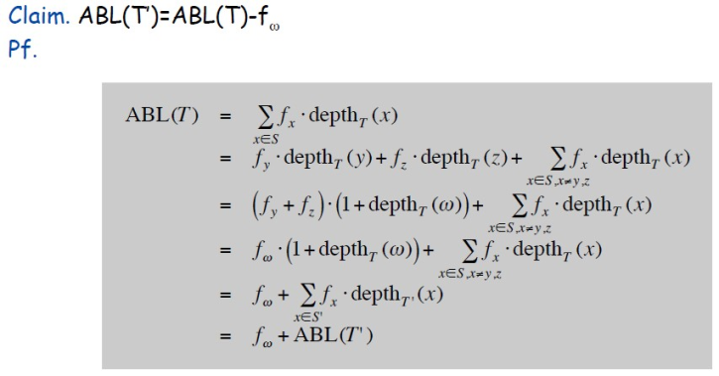
Huffman Encoding: Greedy Analysis
Claim. Huffman code for S achieves the minimum ABL of any prefix code.
Pf. by induction, based on optimality of T’ (y and z removed, ω added)

Slide 83
Huffman Encoding: Greedy Analysis
Claim. Huffman code for S achieves the minimum ABL of any prefix
code.
Pf. (by induction)
Base: For n=2 there is no shorter code than root and two leaves.
Hypothesis: Suppose Huffman tree T’ for S’ of size n-1 with ω instead of y and z is optimal. (IH)
Step: (by contradiction)
Idea of proof:
– Suppose other tree Z of size n is better.
– Delete lowest frequency items y and z from Z creating Z’
– Z’ cannot be better than T’ by IH.

Slide 84
Huffman Encoding: Greedy Analysis
Claim. Huffman code for S achieves the minimum ABL of any prefix
code.
Pf. (by induction)
Base: For n=2 there is no shorter code than root and two leaves.
Hypothesis: Suppose Huffman tree T’ for S’ with ω instead of y and z is optimal. (IH)
Step: (by contradiction)
Suppose Huffman tree T for S is not optimal.
So there is some tree Z such that ABL(Z) < ABL(T).
Then there is also a tree Z for which leaves y and z exist that are
siblings and have the lowest frequency (see observation).
Let Z’ be Z with y and z deleted, and their former parent labeled ω.
Similar T’ is derived from S’ in our algorithm.
We know that ABL(Z’)=ABL(Z)-fω, as well as ABL(T’)=ABL(T)-fω.
But also ABL(Z) < ABL(T), so ABL(Z’) < ABL(T’).
Contradiction with IH.

Slide 85
文件归并
问题：给定一组不同长度的排好序文件构成的集合
S = { f₁, … , f_{n}}.
其中 f_{i} 表示第 i 个文件含有的项数.
使用二分归并将这些文件归并成一个有序的文件. 找到一个比较次数最少的归并次序.
172
归并过程对应于二叉树
实例： 26,10,63,19,33,21
118
36
82
54
26
10
63
19
33
21

Slide 86
归并的代价
归并树叶 f_{i} 和 f_{j} , 代价是 |f_{i}| + |f_{j}|.
C(T) 是树的内结点的权之和
实例：
C(T)=36+82+54+118+172
=(26+10+63+19)×3+(33+21)×2
=462
172
118
54
36
82
26
10
63
19
33
21

Slide 87
更好的归并方法
Huffman树的算法
时间O(nlogn)
172
109
63
62
47
29
33
21
26
10
19
(10+19)×4+(33+21+26)×3+63
=116+240+63=419

Slide 88
应用：最小生成树Prim算法
无向连通带权图G=(V,E,W)
使得W(T)最小的生成树T
算法 Prim(G,E,W)
1．S←{1}
2．while V−S ≠ ∅ do
3． 从V−S中选择 j 使得 j 到 S 中顶点的边权最小
4． S←S∪{j}

Slide 89
实例
1
1
1
5
6
1
2
5
3
5
4
2
3
2
3
4
4
6
4
3
2
5
6
5
6
5
6
6

Slide 90
Prim算法的正确性证明
对步数归纳
命题：对于任意 k < n, 存在一棵最小生成树包含算法前 k 步选择的边
归纳基础：k=1, 存在一棵最小生成树 T 包含边e={1,i}, 其中{1,i}是所有关联 1 的边中权最小的.
设T 为一棵最小生成树，假设T 不包含{1,i}, 则T∪{{1,i}}含有一条回路，回路中关
联1的另一条边为{1,j}，
令 T ’=(T-{{1,j}})∪{{1,i}}，
则T’也是生成树，
且W(T ’)≤W(T).
1
1
i
j
i
j
T
T’

Slide 91
Prim算法的正确性证明
归纳步骤：
假设算法进行了k−1步，生成树的边为e₁,e₂,…,e_{k−1}, 这些边的 k 个端点构成集合S. 由归纳假设存在G 的一棵最小生成树T 包含这些边.
算法第k 步选择了顶点 i_{k+1}, 则 i_{k+1}到S中顶点的边权最小, 设这条边为 e_{k}={i_{k+1},i_{l}}. 假设T不含有e_{k}，则将 e_{k} 加到T 中形成一条回路. 这条回路有另外一条连接S与V−S中顶点的边e, 令T *=(T−{e})∪{e_{k}}，
则T*是G 的一棵生成树，包
含e₁,e₂, …, e_{k}, W(T*) ≤ W(T).
时间T(n)=O(n²)
S
i_{l}
e
e_{k}
V-S
i_{k+1}

Slide 92
应用：Kruskal算法
算法 Kruskal（V,E,W）
1．按照权从小到大顺序排序 E 中的边
{e₁, e₂, …, e_{m}}
2. for i←1 to m do
3． 如果 e_{i} 的两个端点不在同一个连通分
支，则将 e_{i} 加到T 中.
时间：T(m)=O(mlogm)

Slide 93
实例
1
1
1
5
5
6
6
1
1
2
5
3
5
4
2
5
3
5
4
2
3
4
6
4
6
4
3
2
3
2
5
6
5
6
5
6
6
6

Slide 94
Kruskal算法的正确性证明
命题：对于任意 n, 该算法对 n 阶图得到一棵最小生成树.
证明 n=2, 只有一条边，命题显然为真.
假设对于n个顶点的图算法正确，考虑n+1个顶点的图G, G中最小权边 e = {i, j}，从G 中短接 i 和 j，得到图G’. 根据归纳假设，由算法存在G’ 的最小生成树T’.令T=T ’∪{e}, 则T 是关于G 的最小生成树. 换句话说：n个节点形成的最小生成树，选择其中一节点分裂成具有最短边的两点，则这个n+1节点的图必然顺势选择这个短边形成新的生成树，否则退而选择其他边构造生成树只可能总体边长合更大
否则存在G 的含边e 的最小生成树T*，W(T*)<W(T). (如果 e ∉T*, 在T*中加边e，形成回路. 去掉回路中任意别的边所得生成树的权仍旧最小). 在T*中短接 e 得到G’ 的生成树T*−{e}, 且
W(T*−{e})=W(T *)−w(e)<W(T)−w(e )=W(T’)，
与T’ 的最优性矛盾.

Slide 95
应用：单源最短路径
给定带权图G=(V,E),每条边的权为道路长度（非负实数）.
源 s∈V，求从 s 出发到达其它结点的最短路径.
Dijkstra算法：
x∈S ⇔ x∈V 且从 s 到 x 的最短路径长度已知
初始：S={s} ，S=V 时算法结束
从 s 到 u 相对于S 的最短路径：从 s 到 u且仅经过S 中顶点的最短路径
dist[u]：从 s 到 u 的相对于S 的最短路径的长度
short[u]：从 s 到 u 的最短路径的长
dist[u] ≥ short[u]

Slide 96
Dijkstra算法
Dijkstra（G,E,W）
1. S={s}; dist[s]←0
2. for i∈V−{s} do
3. dist[i]←w(s,i) // 如果s 到 i 没有边, w(s,i)=∞
4. while V−S≠∅ do
5. 从V−S中取出相对S具有最短路径的顶点 j
6. S←S∪{j};
7. for i∈V−S do
8. dist[i]←min{ dist[i], dist[j]+w(j,i) }

Slide 97
实例
S={1},
从 1 到 2 相对 S 的最短路径：
1-2，dist[2]=10
从 1 到 3 相对 S 的最短路径无dist[3]=∞
从 1 到 4 相对 S 的最短路径：
1-4，dist[4]=30
从 1 到 5 相对于 S 的最短路径：
1-5，dist[5]=100
S={1,2},
修改从 1 到 3 相对 S 的最短路径(245不改)：
1-2-3，dist[3]=60
1
100
10
2
30
5
50
10
60
3
4
20
1
100
10
2
30
5
50
10
60
3
4
20

Slide 98
实例
1
100
S={1,2,4},
修改 1 到 3 相对 S 的最短路径：
1-4-3，dist[3]=50
修改 1 到 5 相对 S 的最短路径：
1-4-5，dist[5]=90
S={1,2,4,3}
修改 1 到 5 的相对 S 的最短路径：
1-4-3-5，dist[5]=60
10
2
30
5
50
10
60
3
4
20
1
100
10
2
30
5
50
10
60
3
4
20

Slide 99
Dijkstra算法正确性证明
命题：当算法进行到第 k 步时，对于S 中每个结点 i，
dist[i] = short[i]
归纳基础 k=1, S={s}, dist[s]=short[s]=0, 命题为真.
归纳步骤 假设命题对于k 为真. 考虑 k+1步, 选择顶点v (边
{u,v}). 假若存在另一条 s-v 路径 L (绿色)，最后一次出S 的
顶点为 x, 在这次从S 中出来后
经过V−S 的第一个顶点为 y.
S
x
L
dist[v] ≤ dist[y] //v先被选
≤ dist[y]+d(y,v) ≤ L
y
dist[v]=short[v]
s
u
T(n)=O(n²)
v

Slide 100
Dijkstra算法正确性证明
解释：第K+1步选V，说明DIST(V)一定小于其他任意一个Y的DIST(Y)。若不信任V，则存在另一条不经过u而经过xy的到v最短路径，但DIST(Y)肯定大于DIST(V)，而且还要加上yv之间的距离，形成矛盾
S
x
L
y
s
u
v

Slide 101
贪心法小结
适用于满足优化原则的组合优化问题：问题表成多步判断
确定优化测度：贪心选择的依据
确定是否满足贪心选择性质：每步贪心选择都导致最优解
证明方法：归纳法、交换论证
自顶向下计算
贪心法得不到最优解的处理办法
讨论对于哪些输入贪心选择能够得到最优解
讨论贪心法的解最坏情况下与最优解的误差
贪心法的时间复杂度和空间复杂度低

Slide 102
求解优化问题：设计技术比较
技术 | 动态规划 | 分支估界 | 贪心法
使用条件 | 优化原则 多步判断 | 多米诺性质 多步判断 | 贪心选择+优化原则 多步判断
选择依据 | 子问题结果 | 约束条件和界 | 局部最优性质
计算过程 | 看子问题结果选择 自底向上 | 选择后生成子问题 自顶向下 | 选择后生成子问题 自顶向下
数据结构 | 二维表 | 树、队列 | 线性表
解 | 一个最优解 | 一个和多个最优解 | 一个最优或近似解
关键问题 | 递推方程 空间复杂性高 | 设定代价函数 时间复杂性高 | 贪心选择性质证明 近似解的误差估计

